Slide 1










Distributed LSTM and Multivariable regression
Stock market price forecasting during the covid-19 pandemic and recessions

Slide 2
How to leverage Big Data processing for financial predictions?
What data sources are relevant?
Are fundamentals from companies already priced in the market?
How do recession psychology differ from normal times?
How to coalesce massive data set to create a informational competitive advantage?
How can we use Machine Learning to this job effectively?

Slide 3
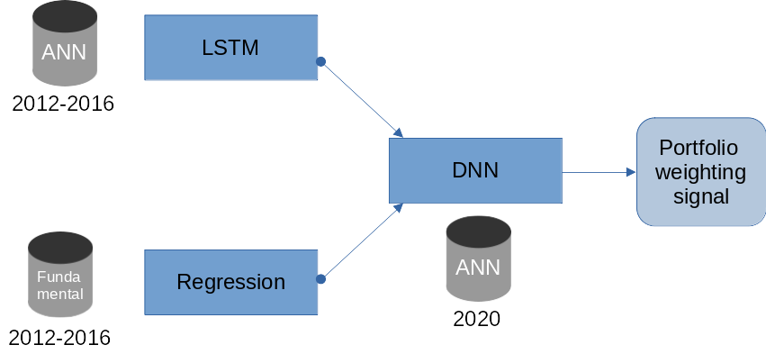
Approach
1. LSTM: Brownian Motion
2. Factor modeling:
Include alternative sources of information in an interpretable manner and eventually scale up
3. DNN for the combination

Slide 4
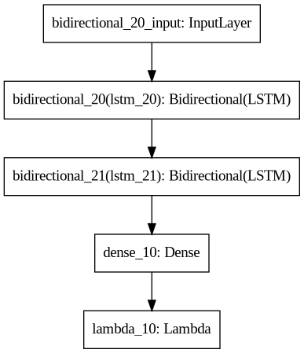
Implementation
1. Preprocessing
2. TensorFlow / Keras neural network
3. TensorFlowOnSpark conversion
1. MLlib multivariable regression
2. DNN combination of models

Slide 5
Evaluation: HPC computation
 | Single node | Distributed 3 nodes
Preprocessing time (s) | 390.2 | 75.1
Training time (s) | 660.5 | 2160.9
Epochs | 100 | 500
Accuracy | 0.00301 | 0.00348
890 Inferences (s) | 26.2 | N/A
Optuna (50 * 150 epochs) | 10 hours | N/A
HPC: 2 worker nodes + 1 master node
Different optimization requirements
4x / 33% speed-up
Discussion: effectiveness of distrubtion

Slide 6
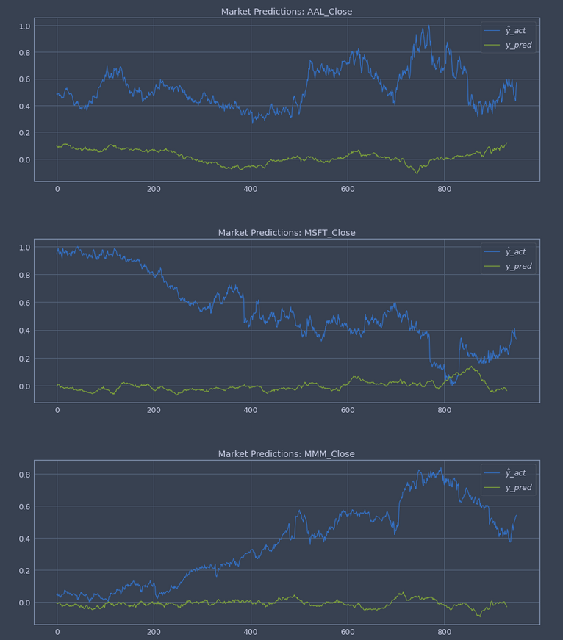
Evaluation: Qualitative assessment of LSTM
LSTM predictions
Better than Brownian motion?
Reflect the low accuracy
Deeper layers
Need of more data
Better tuning

Slide 7
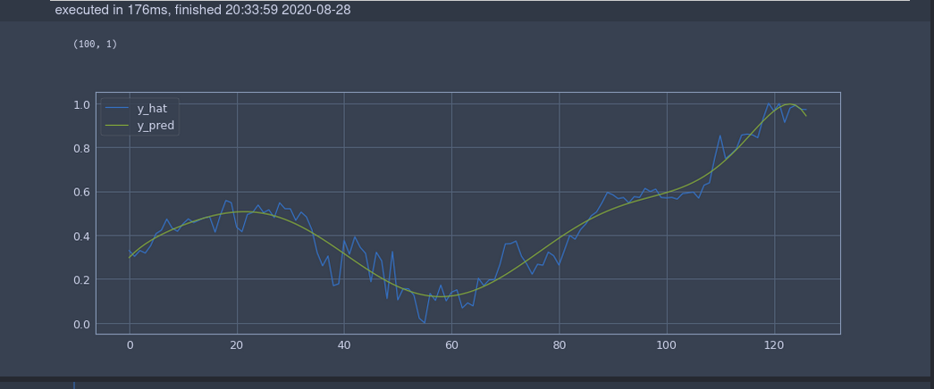
Evaluation: Polynomial interpolation
Objective:
Create a mapping
Fundamentals → Parameters → Polynomial approximation

Slide 8
Conclusions & Lessons Learned
What was achieved:
LSTM & Factor modeling
Shortcomings:
The problem of latent space modeling
Amdahl’s law for small Machine Learning application (serial bottleneck)
Interesting avenues for improvements:
Better modelization of correlation, correction with Kalman features and leverage Neural Ordinary Differential Equations to build on Black Scholes framework

