Slide 1
GeoComputing (Year 3)
Geo+Database

Slide 2
Prelude
Introduction to DB
Geographically enabled DB
Some F&OSS GeoDBs
  SQLITE
  PostGIS
Uses

Slide 3
Online Resources Used
Resources used in this lecture:
http://www.ucl.ac.uk/archaeology/cisp/database/manual/node1.html
http://devpinoy.org/blogs/cruizer/archive/2009/04/22/introduction-to-object-databases-using-db4o.aspx
http://hollywoodbollywood.co.in/hoadmin/relation-diagram
http://www.gnu.org/software/sqltutor/manual/sqltutor.html
http://www.pythoncentral.io/introduction-to-sqlite-in-python/
http://workshops.boundlessgeo.com/suiteintro/postgis/introduction.html
http://blog.thematicmapping.org/2012/10/mapping-population-density-of-new.html
http://www.gistutor.com/quantum-gis/20-intermediate-quantum-gis-tutorials/34-working-with-your-postgis-layers-using-quantum-gis-qgis.html
http://live.osgeo.org/en/quickstart/postgis_quickstart.html

Slide 4
Introduction to DB
DB = structured collection of data
Addresses, NIC # : organized as DB
Software: DB Management System (DMS)
Many organization models of DB
Common: Relational DBMS

Slide 5
Tables everywhere !
DMS uses one or more tables
Store data in tables
Table column title = Field Name
Each Row = Entity
Each Column = Attribute of Entity

Slide 6
Generic Vs Specific DBs
Intention when creating DB
Specific, limited to most needed
  Project/study
  Sensor network
  Web Processing Service
Generic
  Resources survey
  Broad uses/Institutional memory

Slide 7
Relational DBMS
Common/Powerful
Saves disk space
Avoids data redundancy (Quality Control !)
Many tables connected together
Faster Query
Updates/corrections applied once only

Slide 8
Primary Vs Foreign Keys
PK: Unique Identifier
  If many same name villages, add district to it
FK: Link to other table
Very unique IDs:
  Computer generated
  Absolute uniqueness in DB

Slide 9

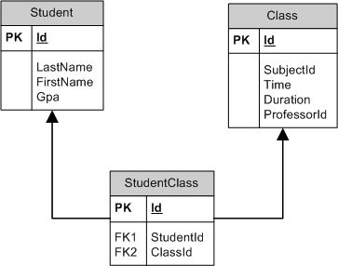
RDBMS style

Slide 10
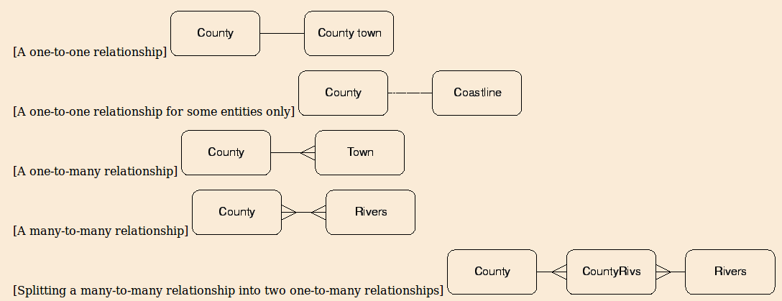
Relationships

Slide 11
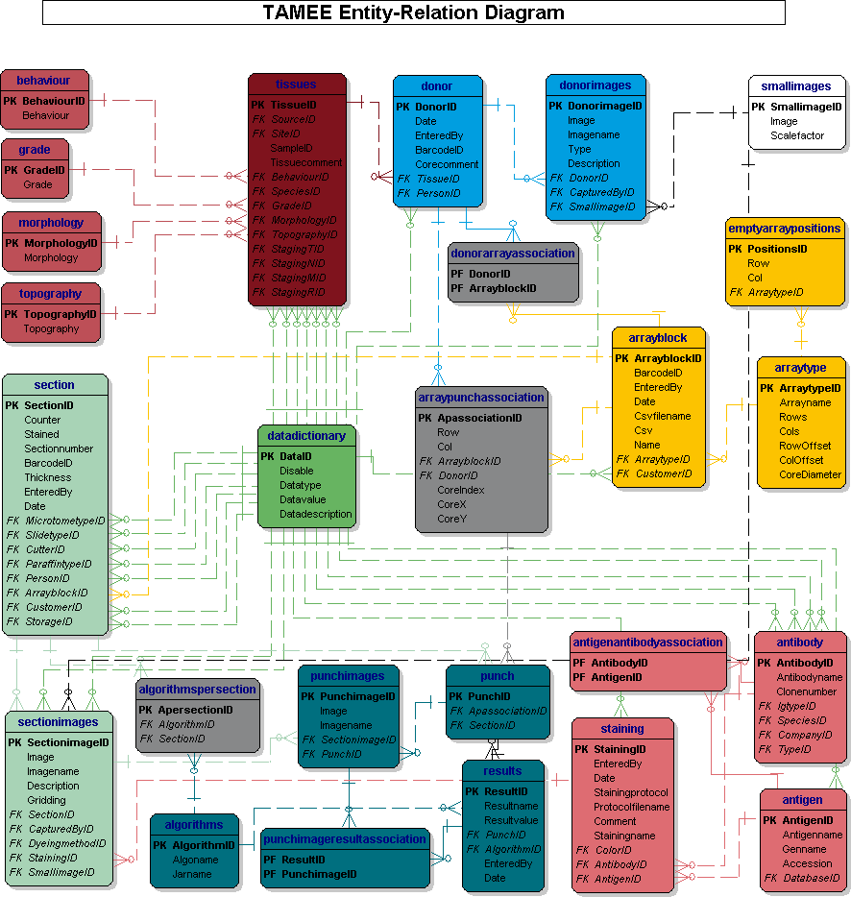
Example
RDBMS

Slide 12
Geo-Database
Geographically enabled DB has:
  Spatial data types (point, lines, polygons)
  Spatial functions (SQL calls Geoprocessing)
  Spatial indexes (Fast Geoprocessing)

Slide 13
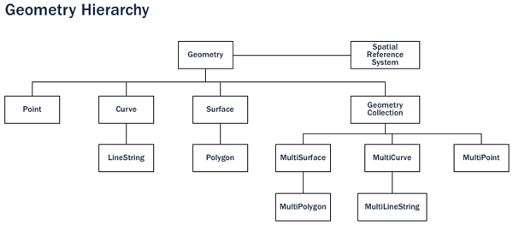

Spatial data types hierarchy

Slide 14
Spatial Operations
PostGIS has ~800 Operations
  Management
  Retrieval
  Conversion
  Generation
  Comparison

Slide 15
Sequencing Operations
Management
  Make me a new geometry column in a table (AddGeometryColumn)
  Update all of the existing geometry columns (Populate_Geometry_Columns)
Conversion
  Show the text representation of this point (ST_AsText)
  Convert this text string into a valid PostGIS geometry (ST_GeomFromText)

Slide 16
Sequencing Operations
Retrieval
  How long is Unawatuna artifical sea dyke? (ST_Length)
  What is the perimeter of Sri Lanka? (ST_Perimeter)

Slide 17
Sequencing Operations
Comparison
  Is Sri Lanka next to India? (ST_Touches)
  Is Colombo in Thailand? (ST_Contains)
Generation
  Calculate a 1000m exclusion limit around Parliament! (ST_Buffer)
  Consolidate Western and Central Provinces! (ST_Union)

Slide 18
Spatial index
Like sorting names from a list
..but..
… for spatial objects in tables !
Bounding boxes as first approximations
Second pass looks closer at geometries

Slide 19
Practicals Software
SQLITE
  Serverless
  Small
PostGIS
  Server-client architecture
  Distributed postgreSQL background
  Industry level software

Slide 20
SQLITE Python Primer
import sqlite3
# Create a database in RAM
db = sqlite3.connect(':memory:')
# Create/open file mydb with SQLite3 DB
db = sqlite3.connect('data/mydb')
# Close the DB
db.close()

Slide 21
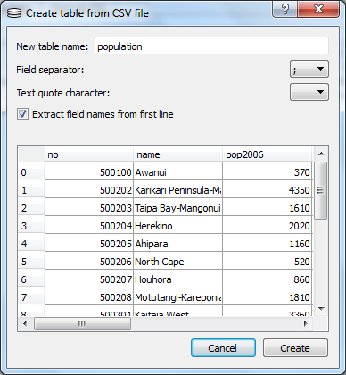
SQLITE and QGIS
Strong integration
Save vector to SQLITE
Create table from CSV
http://blog.thematicmapping.org/2012/10/mapping-population-density-of-new.html

Slide 22
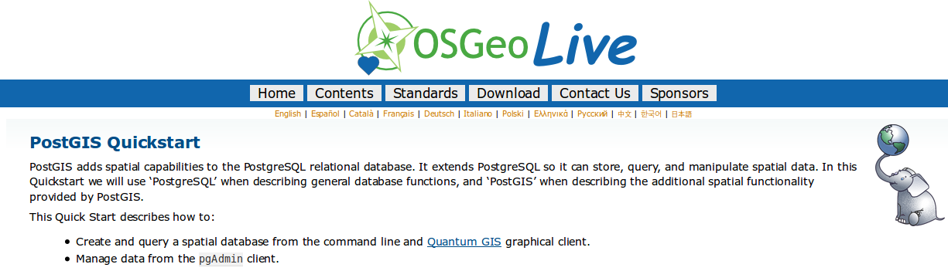
PostGIS in OsgeoLive DVD
http://live.osgeo.org/en/quickstart/postgis_quickstart.html

Slide 23


PostGIS in QGIS
SPIT
  Shapefile to PostGIS Import Tool
Display PostGIS layers
Edit vectors
Save to PostGIS

Slide 24
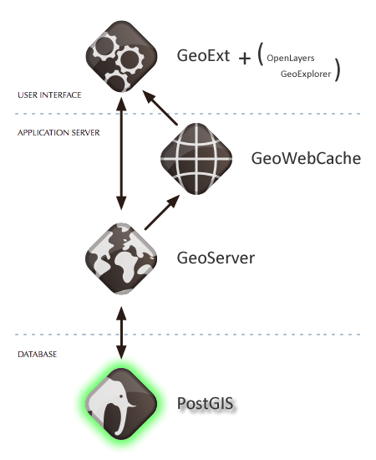
PostGIS
PostGIS in WebGIS

Slide 25
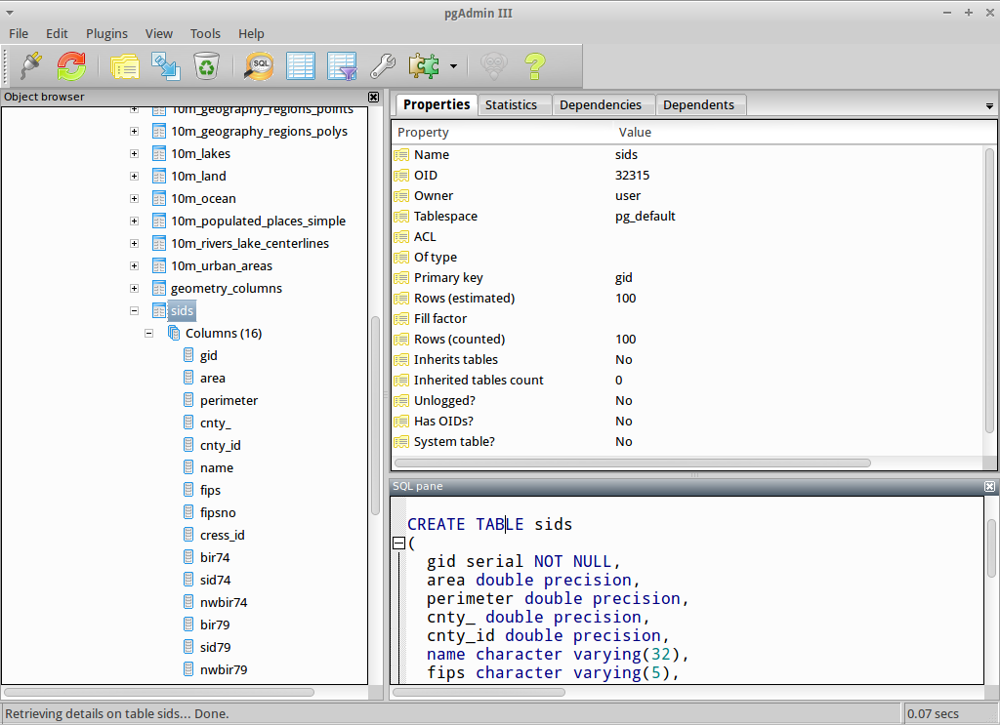
PgAdminIII
http://live.osgeo.org/en/quickstart/postgis_quickstart.html
http://www.pgadmin.org/visualtour12.php
http://www.guia-ubuntu.com/index.php?title=Imagen:PgAdmin_III.jpg

Slide 26


