Slide 1
GeoComputing (Year 3)
Python
Fundamentals for raster processing

Slide 2

Python
programming language
  General-purpose
  High-level
design philosophy:
  Code readability
  Clear
  Expressive

Slide 3



History
Guido van Rossum
  Dutch man
  BDFL for Python
  Benevolent Dictator For Life
  Works at Google (2003-now)
Monty Python Flying Circus
  TV series
  Movies

Slide 4
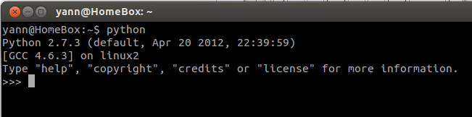
Opening a Python Session
Open a Terminal
  Ctrl+Shift+t in Linux
  Run “cmd” in MSWindows
Type “python” or “path/adjusted/python”

Slide 5
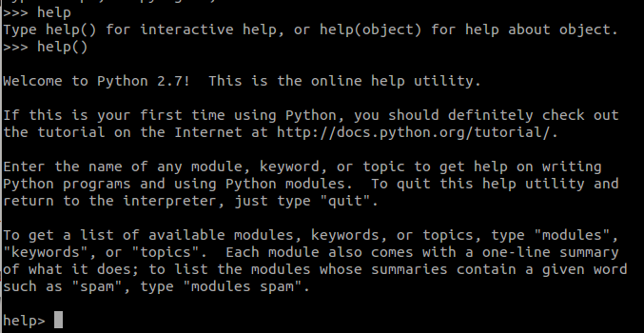
Get help !
Type “help”
Type “help()” for interactive help (q = exit)
Type “help(object)” for a specific help

Slide 6
Hello World !
Type:
  print “Hello World!”
Press Enter Key
>>> print "Hello World!"
Hello World!

Slide 7
Variable 101
Give the value 12 to a variable “a”
>>> a = 12
>>> a
12
“a = “ is an assignment
of a value (12) into the
variable named “a”

Slide 8
Simple math 101
A=12 b=11, add them
>>> a = 12
>>> b = 11
>>> a+b
23

Slide 9
Return a+b into c
c=a+b
>>>c = a + b
>>>c
23

Slide 10
More complex math
Import math library
>>> from math import *
Log(a+b) into c
>>> c = log( a + b )
>>> c
3.1354942159291497
Import all functions
from math library
log() is a function
applied to “a+b”

Slide 11
Lists
A list of objects (words, numbers, etc...)
>>> lst = [ ]
>>> lst.append( "create" )
>>> lst.append( "a" )
>>> lst.append( "list" )
>>> lst
['create', 'a', 'list']
Declare that “lst” is a list

Slide 12
Arrays
'i' signed integer 2
'f' floating point 4
'd' floating point 8
Import arrays
>>> from array import *
Create an integer array “a”
>>> a = array( 'i', [0,2,4,16,128] )
Import all functions
from “array” library
Array “a” has 5 slots
Slot#: 0 1 2 3 4
Values#: 0 2 4 16 128

Slide 13
Add to array
Function append for a single value
>>> a.append( 16384 )
>>> a[ 5 ]
16384

Slide 14
Add an Array to an Array
Function extend for an array “b”
>>> b = array( 'i', [0,1,2] )
>>> a.extend( b )
>>> a
array('i', [0, 2, 4, 16, 128, 16384, 0, 1, 2])

Slide 15
Iterative processes (loops)
>>> for i in range( 0, 8, 1 ):
... print a[ i ]
...
0
2
4
16
128
...
Range function:
From 0
To 8
Count every 1
Result: 0 1 2 3 4 5 6 7
Access values
by slot index
a[0]=0
a[1]=2
a[2]=4
...

Slide 16
First raster algorithm
Define input / output float arrays
>>> red = array( 'f', [25, 34, 32, 12, 79] )
>>> nir = array( 'f', [26, 35, 200, 56, 85] )
>>> output = array( 'f', [0,0,0,0,0] )

Slide 17
First raster algorithm
Define the algorithm function
>>> def ndvi( red, nir ):
... return (nir-red)/(nir+red)
...

Slide 18
Apply the algorithm to pixels
For loop to apply function to each pixel
>>> for i in range( len( red ) ):
... output[i] = ndvi( red[i], nir[i] )
...
Length of array “red”
Your algorithm !

Slide 19
Output
Print the output array on screen
>>> output
array('f', [
0.019607843831181526,
0.014492753893136978,
0.7241379022598267,
0.6470588445663452,
0.03658536449074745 ])

Slide 20
Display output
Import pylab library
>>> import pylab as p
Plot array “output”and show the plot
>>> p.plot( output )
[<matplotlib.lines.Line2D object at 0x3cb6750>]
>>> p.show()

Slide 21
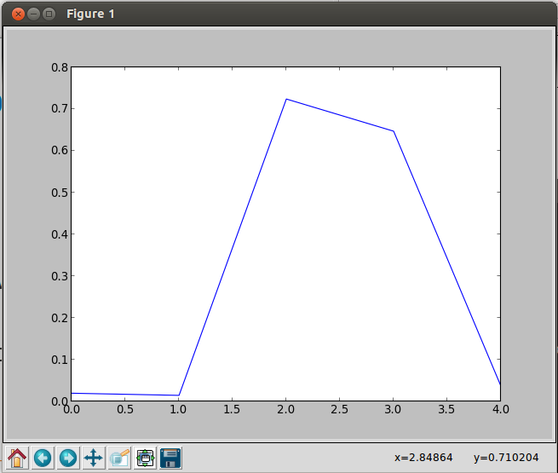
Output displayed

Slide 22
More layout & save png to disk
>>> p.plot( output )
[<matplotlib.lines.Line2D object at 0x3cb6750>]
>>> p.xlabel( 'pixel number' )
<matplotlib.text.Text object at 0x4f7f310>
>>> p.ylabel( 'NDVI' )
<matplotlib.text.Text object at 0x3c9e3d0>
>>> p.title( 'NDVI for few pixels of Landsat DN' )
<matplotlib.text.Text object at 0x3c96f10>
>>> p.grid( True )
>>> p.savefig( 'first_algorithm' )
>>> p.show()

Slide 23
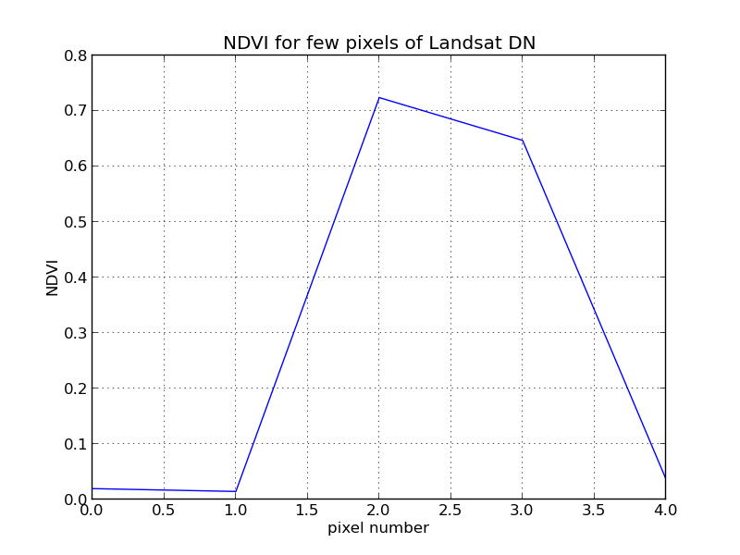
PNG output with Layout

Slide 24
Final version with bar chart
import pylab as p
p.bar(left=[0.8,1.8,2.8,3.8,4.8],height=output,width=0.4,bottom=0,color=["red","green","blue","orange","magenta"],linewidth=0)
p.xlabel( 'pixel number' )
p.ylabel( 'NDVI' )
p.title( 'NDVI for few pixels of Landsat DN' )
p.grid( True )
p.savefig( 'first_algorithm' )
p.show()

Slide 25
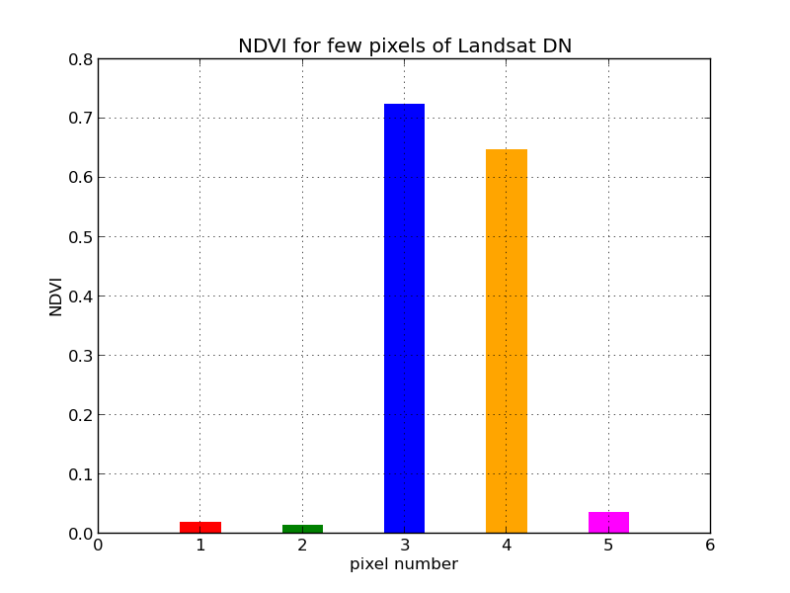
Display PNG of the script

Slide 26
Complete script
from array import *
red = array( 'f', [25, 34, 32, 12, 79] )
nir = array( 'f', [26, 35, 200, 56, 85] )
output = array( 'f', [0,0,0,0,0] )
def ndvi( red, nir ):
return (nir-red)/(nir+red)
for i in range( len( red ) ):
output[i] = ndvi( red[i], nir[i] )
import pylab as p
leftLst=[0.8,1.8,2.8,3.8,4.8]
colLst=["red","green","blue","orange","magenta"]
p.bar(left=leftLst,height=output,width=0.4,bottom=0,color=colLst,linewidth=0)
p.xlabel( 'pixel number' )
p.ylabel( 'NDVI' )
p.title( 'NDVI for few pixels of Landsat DN' )
p.grid( True )
p.savefig( 'first_algorithm' )
p.show()

Slide 27


