Slide 1
GeoComputing (Year 3)
Python-GDAL scripting

Slide 2

Python
programming language
  General-purpose
  High-level
design philosophy:
  Code readability
  Clear
  Expressive

Slide 3
GDAL
Geospatial Data Abstraction Library
  Library reading / writing
  Raster geospatial data formats
  OGR for vector
Extensive capabilities of data exchange
~200 raster/vector data formats

Slide 4
The Problem
I have an algorithm
I have some raster data
I want to run the algorithm on the data

Slide 5
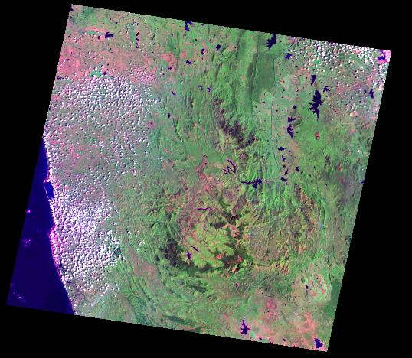
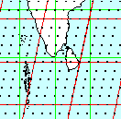
The Data
0
Satellite imagery
  Landsat 7
  P141
  R055
r050
r060
p155
p135

Slide 6
The modules
GDAL
Python Script

Slide 7
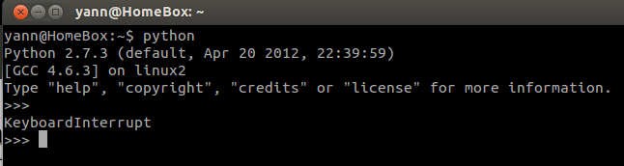
Start Python
yann@HomeBox:~$ python
Python 2.7.3 (default, Apr 20 2012, 22:39:59)
[GCC 4.6.3] on linux2
Type "help", "copyright", "credits" or "license" for more information.
>>>

Slide 8
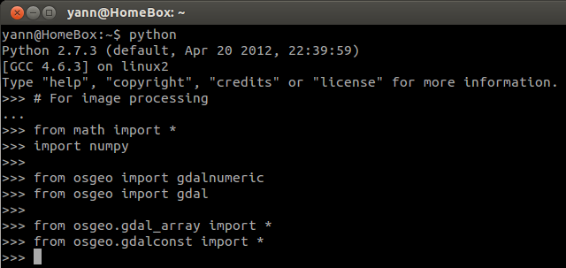
Import GDAL Libraries
# For image processing
from math import *
import numpy
from osgeo import gdalnumeric
from osgeo import gdal
from osgeo.gdal_array import *
from osgeo.gdalconst import *

Slide 9
Create raster file names list
Because it is a short hand way to work
F = [ ]
F.append('/home/user/Desktop/img/b3.tif')
F.append('/home/user/Desktop/My\ img/b4.tif')
_____

Slide 10
Set output format & projection
# Output raster format to be used
driver = gdal.GetDriverByName( 'ENVI' )
# Output projection to be used
tmp = gdal.Open( F[0] )
geoT = tmp.GetGeoTransform()
proJ = tmp.GetProjection()
del tmp

Slide 11
Load two bands
Explicit loading:
b3 = LoadFile( F[2] )
b4 = LoadFile( F[3] )
You can also automatically load the 6 visible bands:
b = [ 0, 0, 0, 0, 0 ]
for i in range ( 0, 5 ):
b[ i ] = LoadFile( F[ i - 1 ] )

Slide 12
Compute something ...
With explicit loading of bands:
vi = ( b4 – b3 ) / ( b4 + b3 )
With auto loading of bands:
vi = ( b[3] – b[2] ) / ( b[3] + b[2] )

Slide 13
Make an output raster file
# Open vi array
out = OpenArray( vi )
#Set projection and transform
out.SetGeoTransform( geoT )
out.SetProjection( proJ )
#Copy raster format style and add data
driver.CreateCopy( '/home/user/Desktop/img/ndvi', out)
#Clean memory
del out, vi

Slide 14


Slide 15
Landsat DN->Rad->TOARef
Landsat VNIR data requires conversion
  DN to radiance (TOA)
  Radiance (TOA) to Reflectance (TOA)
  Reflectance TOA to Reflectance Surface
DN to Rad to Ref (TOA) are few equations
TOA Ref to SURF Ref
  Atmospheric correction (not today)

Slide 16
DN to rad to TOARef
#Depending on your Landsat (here Landsat 7)
LMax = [ 191.6, 196.5, 152.9, 241.1, 31.060, 10.8 ]
Lmin = [ -6.2, -6.4, -5.0, -5.1, -1.0, -0.35 ]
Kexo = [ 1970.0, 1843.0, 1555.0, 1047.0, 227.1, 80.53 ]
#From the .MTL or .MET companion file
sun_elevation = 47.0
doy = 41

Slide 17
Create a temporary value
#Cos(sunZenithAngle) / (pi*(Sun2EarthDistance)^2)
c1 = (cos(90-sun_elevation)*pi/180)
c2 = (pi*(1+0.01672*sin(2*pi*(doy-93.5)/365))**2)
constant = c1/c2

Slide 18
Recompute bands
#Affine transform
aT3 = b3 * (Lmax[2]-Lmin[2])/255.0 + Lmin[2]
aT4 = b4 * (Lmax[3]-Lmin[3])/255.0 + Lmin[3]
#TOA Reflectance
toar3 = aT3 / (constant * Kexo[2])
toar4 = aT4 / (constant * Kexo[3])

Slide 19
Recompute bands
#Affine transform
aT = (Lmax[i]-Lmin[i])/255.0 + Lmin[i]
#TOA Reflectance
toar[i] = b[i] * aT / (constant * Kexo[i])
#Clean the mess
del aT, constant, Lmin, Lmax, Kexo, b

Slide 20
Recompute vi
With auto loading of bands:
vi = ( toar[3] – toar[2] ) / ( toar[3] + toar[2] )
#Clean the mess
del toar

Slide 21
Write new raster to disk
# Open vi array
out = OpenArray( vi )
#Set projection and transform
out.SetGeoTransform( geoT )
out.SetProjection( proJ )
#Copy raster format style and add data
driver.CreateCopy( 'ndvi_toar.tif', out)
#Clean memory
del out, vi

Slide 22


Slide 23
HDF files
Hierarchical Data Format
  MODIS
  Aster
  NASA datasets in general (atmospheric,etc)
Files inside a file
  Need to query first the structure
  Then access SubDataSets (SDS)

Slide 24
Dealing with HDF files
# For image processing
from math import *
import numpy
from osgeo import gdalnumeric
from osgeo import gdal
from osgeo.gdal_array import *
from osgeo.gdalconst import *
filename='/home/user/Desktop/MOD04_L2.A2012264.0510.051.2012264144106.hdf'
ds = gdal.Open(filename)
sds_mtd = ds.GetMetadata( 'SUBDATASETS' )
print( 'keys' )
for i in sds_mtd.iterkeys():
print( i,sds_md[i] )

Slide 25
Dealing with HDF files
datakeys = {} #This is a Python Dictionary
Datasets = [ 'SUBDATASET_64' ]
Datanames = [ 'Deep_Blue_Single_Scattering_Albedo_Land' ]
for (j,i) in enumerate(datasets):
this = {}
this['name'] = sds_mtd[i + '_NAME']
this['description'] = sds_mtd[i + '_DESC']
this['data']=gdalnumeric.LoadFile( this['name'] )
datakeys[datanames[j]] = this.copy()
print( datakeys[datanames[j]] )
de=datakeys['Deep_Blue_Single_Scattering_Albedo_Land']['data']/10000
print( de )

Slide 26
HDF all together
from math import *
import numpy
from osgeo import gdalnumeric
from osgeo import gdal
from osgeo.gdal_array import *
from osgeo.gdalconst import *
filepath='/home/yann/Python_HDF_MOD04/MOD04_L2.A2012264.0510.051.2012264144106.hdf'
ds = gdal.Open(filepath)
sds_md = ds.GetMetadata('SUBDATASETS')
print 'keys'
for i in sds_md.iterkeys():
print i,sds_md[i]
datakeys = {} #This is a Dictionary
datasets = ['SUBDATASET_64']
datanames = ['Deep_Blue_Single_Scattering_Albedo_Land']
for (j,i) in enumerate(datasets):
this = {}
this['name'] = sds_md[i + '_NAME']
this['description'] = sds_md[i + '_DESC']
this['data'] = gdalnumeric.LoadFile(this['name'])
datakeys[datanames[j]] = this.copy()
#print datakeys[datanames[j]]
de=datakeys['Deep_Blue_Single_Scattering_Albedo_Land']['data']/10000
print de

