Slide 1
GeoComputing (Year 3)
Python-GDAL/OGR scripting

Slide 2

Python
programming language
  General-purpose
  High-level
design philosophy:
  Code readability
  Clear
  Expressive

Slide 3
GDAL/OGR
GDAL -> OGR Simple Feature Lib
  Library reading & (some ) writing
  Vector geospatial data formats
Extensive capabilities of data exchange
~70 vector data formats

Slide 4
The Problem
I have an GPS coordinates of a building
I have a vector data file
I want to insert the GPS data:
  In the vector file
  As a polygon (building boundary)
  Different projection systems

Slide 5
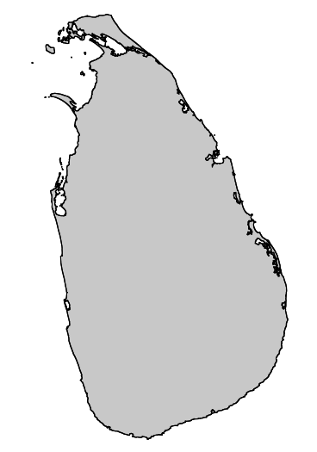
The Data
GADM
  Shapefile
  Admin boundary
  Level 0
GPS coordinates
  Google
  Openlayers

Slide 6
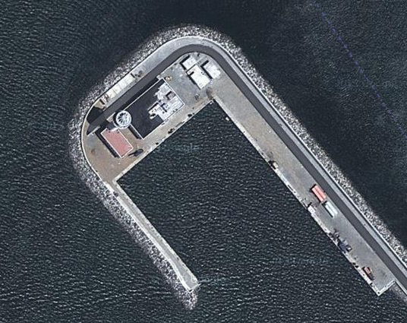
The GPS Data
Define Feature corners (Projection: EPSG:900913)
  #North
    tuple0=[8887703.1,776744.3]
  #East
    tuple1=[8887718.1,776725.5]
  #South
    tuple2=[8887688.5,776697.6]
  #West
    tuple3=[8887673.0,776718.6]

Slide 7
The modules
OGR
OSR
Python Script

Slide 8
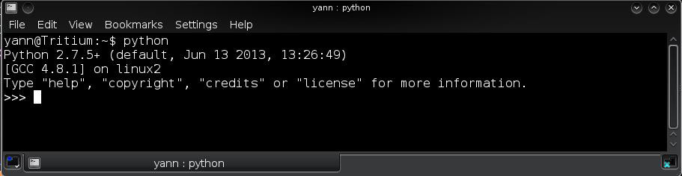
Start Python
yann@HomeBox:~$ python
Python 2.7.5+ (default, Jun 13 2013, 13:26:49)
[GCC 4.8.1] on linux2
Type "help", "copyright", "credits" or "license" for more information.
>>>

Slide 9
Import OGR/OSR Libraries
# For vector processing
from osgeo import osr
from osgeo import ogr

Slide 10
Projections transforms
# Define Google projection
  ggl = osr.SpatialReference( )
  ggl.ImportFromEPSG( 900913 )
# Define WGS84 projection
  wgs = osr.SpatialReference( )
  wgs.ImportFromEPSG( 4326 )

Slide 11
Transform Matrix
# Transform definition
    conversion from Google Mercator
    to Geographical Lat-Long
t = osr.CoordinateTransformation( ggl, wgs )

Slide 12
Reproject tuples
# Reprojection using defined transform
point0 = t.TransformPoint( tuple0[0],tuple0[1] )
point1 = t.TransformPoint( tuple1[0],tuple1[1] )
point2 = t.TransformPoint( tuple2[0],tuple2[1] )
point3 = t.TransformPoint( tuple3[0],tuple3[1] )

Slide 13
Geometry Creation
# Define a ring entity
ring0 = ogr.Geometry( ogr.wkbLinearRing )
# Fill in the 4 points to the ring
ring0.AddPoint( point0[0],point0[1] )
ring0.AddPoint( point1[0],point1[1] )
ring0.AddPoint( point2[0],point2[1] )
ring0.AddPoint( point3[0],point3[1] )

Slide 14
Polygon Geometry
# Make the polygon0
  polygon0 = ogr.Geometry( ogr.wkbPolygon )
  polygon0.AddGeometry( ring0 )

Slide 15
Download GADM LK
Global Administrative maps
  http://gadm.org
  Level 0: Country
  Level 1: Provinces
  Level 2: Districts
  Level 3: Sub-districts

Slide 16
Define Driver
Shapefile: ESRI standard
# Import Shapefile Driver definitions
driver =
  ogr.GetDriverByName( 'ESRI Shapefile' )

Slide 17
Load country vector into Python
# Open the country shapefile
shapef =
  driver.Open( 'LKA_adm0.shp', True )

Slide 18
Access the first vector layer
# Set the index of the layer
index = 0
# Query the first Layer (#0)
layer0 =
  shapef.GetLayerByIndex( index )

Slide 19
How many features in layer?
# Query the Feature count from Layer 0
no_of_features =
  layer0.GetFeatureCount( )
print
  "Number of features in original layer 0 is:\t", no_of_features

Slide 20
Get Feature desc/def
# Get the Layer0 definition
FeatureDefinition =
  layer0.GetLayerDefn( )
# Create feature definition
feature0 = ogr.Feature( featureDefinition )

Slide 21
Insert Polygon & Attributes
# Set the polygon0 geometry
  feature0.SetGeometry( polygon0 )
# Set Attribute Fields
  feature0.SetField( 'ID_0','111' )
  feature0.SetField( 'ISO','CMB' )
  feature0.SetField( 'NAME_ENGLI','CMB Port Authority' )
  feature0.SetField( 'NAME_ISO','CMBPA' )

Slide 22
Add new Feature to shapefile
# Add the feature to the shapefile
  layer0.CreateFeature( feature0 )
#Query the Feature count from Layer 0
  no_of_features = layer0.GetFeatureCount( )
  print "Number of features in new layer 0 is:\t\t", no_of_features

Slide 23
Clean up the mess
# Clean up the mess
  ring0.Destroy( )
  polygon0.Destroy( )
  feature0.Destroy( )

Slide 24


Slide 25


