Slide 1
GeoComputing (Year 3)
Python database scripting

Slide 2

Python
programming language
  General-purpose
  High-level
design philosophy:
  Code readability
  Clear
  Expressive

Slide 3
dbm & sqlite
DBM (was anydbm in Python 2.x)
  Standard Python library
  Unified access to gdbm & dbm
SQLITE (transactional SQL database engine)
  Library self-contained, serverless, zero-configuration
  Most widely deployed SQL database engine in the world
  Public Domain source code

Slide 4
The Problem
I have an GPS coordinates of a building
I need a long term company storage
I want to insert the GPS data:
  In a database
  With different projection systems of clients

Slide 5
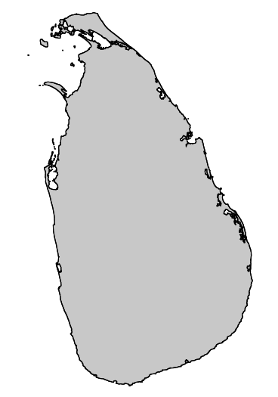
The Data
GPS coordinates
  Google
  Openlayers
  In Sri Lanka

Slide 6

The GPS Data
Define Feature corners (Projection: EPSG:900913)
  #North
    tuple0=[8887703.1,776744.3]
  #East
    tuple1=[8887718.1,776725.5]
  #South
    tuple2=[8887688.5,776697.6]
  #West
    tuple3=[8887673.0,776718.6]

Slide 7
The modules
dbm (anydbm if Python < 3)
sqlite3
OSR
Python Script

Slide 8
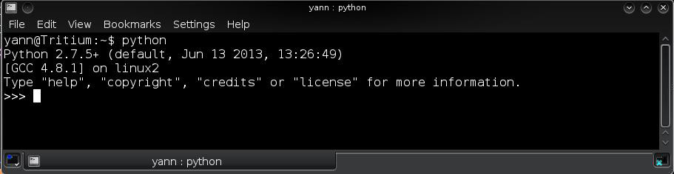
Start Python
yann@HomeBox:~$ python
Python 2.7.5+ (default, Jun 13 2013, 13:26:49)
[GCC 4.8.1] on linux2
Type "help", "copyright", "credits" or "license" for more information.
>>>

Slide 9
Import Libraries
# For vector DB processing
from osgeo import osr
import anydbm # Python < 3
import dbm # Python >= 3
import sqlite3

Slide 10
Projections transforms
# Define Google projection
  ggl = osr.SpatialReference( )
  ggl.ImportFromEPSG( 900913 )
# Define WGS84 projection
  wgs = osr.SpatialReference( )
  wgs.ImportFromEPSG( 4326 )

Slide 11
Transform Matrices
# Transform definition
    conversion from Google Mercator
    to Geographical Lat-Long (t) and back (inv_t)
t = osr.CoordinateTransformation( ggl, wgs )
inv_t = osr.CoordinateTransformation( wgs, ggl )

Slide 12
Insert tuples in a list
# Reprojection using defined transform
point = [ ]
point.append( t.TransformPoint( tuple0[0],tuple0[1] ) )
point.append( t.TransformPoint( tuple1[0],tuple1[1] ) )
point.append( t.TransformPoint( tuple2[0],tuple2[1] ) )
point.append( t.TransformPoint( tuple3[0],tuple3[1] ) )

Slide 13
Database Creation
#Create a 'n'ew set of coordinates databases
  coordXDB = anydbm.open( "coordx.dbm", 'n' )
  coordYDB = anydbm.open( "coordy.dbm", 'n' )
  If Python > 3 use: dbm.open( )

Slide 14
Load the data
pointNames = ["A","B","C","D"]
i = 0
for name in pointNames:
  coordXDB[name] = str( point[ i ][ 0 ] )
  coordYDB[name] = str( point[ i ][ 1 ] )
  i += 1

Slide 15
List the database content
print coordXDB.items( )
print coordYDB.items( )
#close the database files
coordXDB.close( )
coordYDB.close( )

Slide 16
Coordinates retrieval & use
coordXDB = anydbm.open( "coordx.dbm", 'r' )
coordYDB = anydbm.open( "coordy.dbm", 'r' )
points = coordXDB.keys( ) #Get db Keys
#Reconstruct the points coordinates pairs
for point in points:
  print (
    "Building Corner \"%s\" = ( %.5fE, %.5fN )" %
    ( point, float( coordXDB[point] ), float( coordYDB[point] ) )
    )

Slide 17
Reproject on retrieval
print( "\nTransform on the fly to EPSG:900913\n" )
for point in points:
xy = t.TransformPoint(
  float( coordXDB[ point ] ), float( coordYDB[ point ] )
    )
print (
    "Building Corner \"%s\" = ( %.2fE, %.2fN )" % ( point, xy[0], xy[1] )
    )

Slide 18
Coordinates update in DB
coordXDB = anydbm.open( "coordx.dbm", 'w' )
coordYDB = anydbm.open( "coordy.dbm", 'w' )
points = coordXDB.keys( ) #Get db Keys
print ( “Shift all points East 1km (project,shift,reproject back)\n” )
for point in points:
  xy = t.TransformPoint( float( coordXDB[ point ] ), float( coordYDB[ point ] ) )
  new_x = xy[0] + 1000
  new_xy = inv_t.TransformPoint( new_x, xy[1] )
  coordXDB[point] = str( new_xy[0] )
  coordYDB[point] = str( new_xy[1] ) #explain why needed
  print ( "Building Corner \"%s\" = ( %.5fE, %.5fN )" %
  ( point, float( coordXDB[ point ] ), float( coordYDB[ point ] ) ) )

Slide 19
SQLITE
import sqlite3
names = ["A","B","C","D"]
points = [ ]
points.append( t.TransformPoint( tuple0[0],tuple0[1] ) )
points.append( t.TransformPoint( tuple1[0],tuple1[1] ) )
points.append( t.TransformPoint( tuple2[0],tuple2[1] ) )
points.append( t.TransformPoint( tuple3[0],tuple3[1] ) )

Slide 20
Connect to a new DB
# Connect to a sqlite small database
# It will create it if the file is not there
  conn = sqlite3.connect( "coordinates.db" )
#get access (handle on a cursor)
  c = conn.cursor( )

Slide 21
SQL create table in DB
c.execute( 'create table Points (id int, name text, x float, y float)' )
#hint: to delete that table use: c.execute( 'drop table Points' )
#Check the new 'Points' table appears in the list
  c.execute( "SELECT name FROM sqlite_master WHERE type='table';" )
  print( c.fetchall( ) )
#Check that columns were created successfully
  c.execute( "PRAGMA table_info(Points)" ) # not using SQL !
  print( c.fetchall( ) )

Slide 22
SQL insert data into DB
i = 0
for point in points:
  sql_command = ' insert into Points VALUES ('
  + str( i ) + ',\" ' + names[ i ] + ' \", '
  + str( points[ i ][ 0 ] ) + ', '
  + str( points[ i ][ 1 ] ) + ') '
  print( sql_command )
  #Send the command to database
  c.execute( sql_command )
  #increment index
  i += 1

Slide 23
Write to DB & disconnect
#Commit changes to database (write on disk)
conn.commit( )
#Close the connection to the database
conn.close( )

Slide 24
Connect back & use DB
conn = sqlite3.connect( 'coordinates.db' )
c = conn.cursor( ) #Get the handle
#Query available data in table “Points”
x = c.execute( "select * from Points" )
#Display the bounty
print( x.fetchall( ) )

Slide 25


Slide 26


