Slide 1
GeoComputing (Year 3)
Python for PostGIS

Slide 2

Python
programming language
  General-purpose
  High-level
design philosophy:
  Code readability
  Clear
  Expressive

Slide 3
PostgreSQL DBMS
Entreprise level, open source, freely available, object-relational database system
Architecture that has earned a strong reputation for reliability, data integrity, and correctness
Store large binary objects (pictures, sounds, video)
It has native programming interfaces for C/C++, Java, .Net, Perl, Python, Ruby, Tcl, ODBC, etc

Slide 4
PostgreSQL specs
Limit | Value
Maximum Database Size | Unlimited
Maximum Table Size | 32 TB
Maximum Row Size | 1.6 TB
Maximum Field Size | 1 GB
Maximum Rows per Table | Unlimited
Maximum Columns per Table | 250-1600 depends on column type
Maximum Indexes per Table | Unlimited

Slide 5
PostGIS
Open source, freely available, and fairly OGC compliant spatial database extender for the PostgreSQL Database Management System.
Spatial functions:
  distance, area, union, intersection, and
  specialty geometry data types to the database.
Similar functionality to SQL Server 2008 Spatial support, ESRI ArcSDE, Oracle Spatial, and DB2 spatial extender.

Slide 6
Installation
Ubuntu:
  apt-get install postgresql-...-postgis
  apt-get install pgadmin.
Others:
  www.postgis.org

Slide 7
Setup of the DB
THIS IS DIRECT SHELL INPUT
THIS IS NOT IN PYTHON
user@pc:~$ sudo su postgres
postgres@pc:/home/user# createdb -E UNICODE gis
postgres@pc:/home/user# createlang plpgsql gis
Create actual database files by typing this:
psql -d gis -f /usr/share/postgresql-9.1-postgis/firstgis.sql
psql -d gis -f /usr/share/postgresql-9.1-postgis/spatial_ref_sys.sql

Slide 8
Manage PostgreSQL databases
Create a regular database and set its owner.
createdb -U postgres -O SET-USERNAME-HERE SET-DATABASE-HERE
Create a spatial database and set its owner (PostGIS template).
createdb -U postgres -T template_postgis -O SET-USERNAME-HERE SET-DATABASE-HERE
Reset a spatial database (PostGIS template).
dropdb -U postgres SET-DATABASE-HERE
createdb -U postgres -T template_postgis -O SET-USERNAME-HERE SET-DATABASE-HERE

Slide 9
shp2pgsql & pgsql2shp
Located in the bin/ folder of the PostgreSQL install directory.
pgsql2shp dumps a postgis database table, view or sql query to ESRI shape
USAGE:
pgsql2shp [OPTIONS] database [schema.]table
pgsql2shp [OPTIONS] database query
shp2pgsql generates an SQL script from ESRI shape and DBF files suitable for loading into a PostGIS enabled database.
USAGE:
shp2pgsql [OPTIONS] shapefile [schema.]table

Slide 10
Create our own Python utility
import os
# Insert shapefile into postGIS
def s2p( shp, table, db ):
os.system( "shp2pgsql -D "+shp+" "+table+" "+db+" | psql "+db+"" )
# From postGIS export as shapefile
def p2s( shp, dbpaswd, db, table ):
os.system( "pgsql2shp -f "+shp+"-P '"+dbpaswd+"' "+db+" "+table+"" )

Slide 11
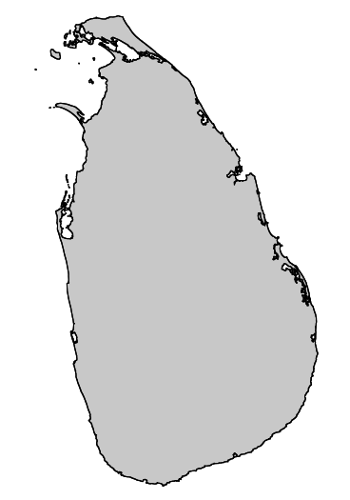
The Data
GADM
  Shapefile
  Admin boundary
  Level 0
GPS coordinates
  Google
  Openlayers

Slide 12
Download GADM LK
Global Administrative maps
  http://gadm.org
  Level 0: Country
  Level 1: Provinces
  Level 2: Districts
  Level 3: Sub-districts

Slide 13

The GPS Data
Define Feature corners (Projection: EPSG:900913)
  #North
    tuple0=[8887703.1,776744.3]
  #East
    tuple1=[8887718.1,776725.5]
  #South
    tuple2=[8887688.5,776697.6]
  #West
    tuple3=[8887673.0,776718.6]

Slide 14
The modules
psycopg2
Python Script

Slide 15
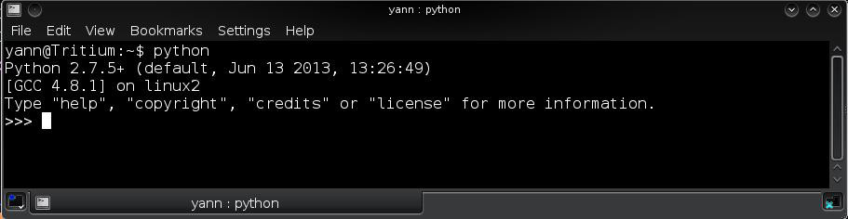
Start Python
yann@HomeBox:~$ python
Python 2.7.5+ (default, Jun 13 2013, 13:26:49)
[GCC 4.8.1] on linux2
Type "help", "copyright", "credits" or "license" for more information.
>>>

Slide 16

Import the shapefile in DB
import os
shp = 'LKA_adm0.shp'
table = 'LKA_adm0'
db = 'gis'
# Insert shapefile into postGIS
s2p( shp, table, db )
Easy !

Slide 17
What if your shp has no .prj?
Import into DB with ogr2ogr (direct shell, not Python)
ogr2ogr -f "PostgreSQL" -s_srs EPSG:4326 "PG:dbname=mydbname" LKA_adm0.shp -nln coastline
-f “PostgreSQL” destination “file type” is a PostgreSQL database
-s_srs the source spatial reference system for the shapefile, if without .prj file, can be set by EPSG or WKT
“PG:dbname=mydbname” a PostGIS server destination
-nln a new layer name, the table name in the database

Slide 18

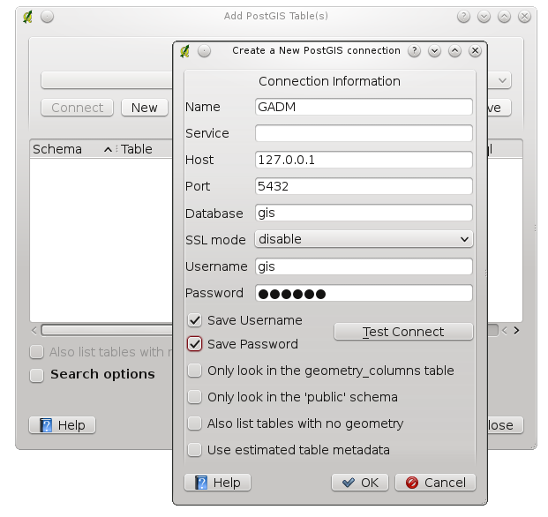
Launch QGIS
Open
PostGIS
Connection

Slide 19
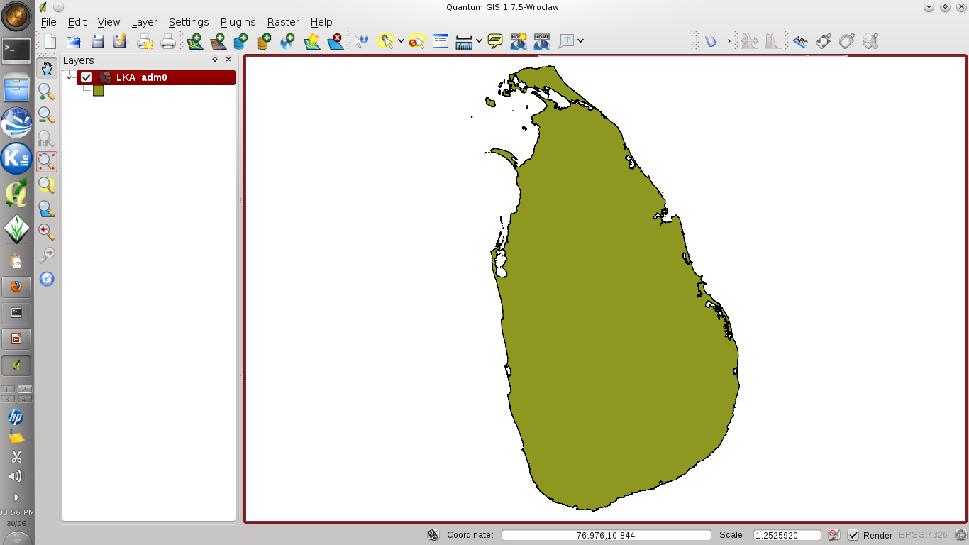
GADM vector from DB

Slide 20
Test connection to DB
from psycopg2 import connect
db = 'gis'
usr = 'gis'
host = '127.0.0.1'
paswd = 'passwd'
try:
c = connect( "dbname="+db+" user="+usr+" host="+host+" password="+paswd+"\"" )
except:
print( "I am unable to connect to the database" )

Slide 21
Check DB version
import psycopg2, sys
db = 'gis'
c = psycopg2.connect( database = db, user = 'gis' )
cur = c.cursor( )
cur.execute( 'SELECT version( )' )
print( cur.fetchone( ) )

Slide 22
Set GPS points
names = ["A","B","C","D"]
points = [ ]
points.append( t.TransformPoint( tuple0[0],tuple0[1] ) )
points.append( t.TransformPoint( tuple1[0],tuple1[1] ) )
points.append( t.TransformPoint( tuple2[0],tuple2[1] ) )
points.append( t.TransformPoint( tuple3[0],tuple3[1] ) )

Slide 23
SQL insert data into DB
I = 0 #(PROBLEM HERE, DID NOT CREATE TABLE/RING)
for point in points:
  sql_command = ' insert into Points VALUES ('
  + str( i ) + ',\" ' + names[ i ] + ' \", '
  + str( points[ i ][ 0 ] ) + ', '
  + str( points[ i ][ 1 ] ) + ') '
  print( sql_command )
  #Send the command to database
  c.execute( sql_command )
  #increment index
  i += 1

Slide 24
Write to DB & disconnect
#Commit changes to database (write on disk)
conn.commit( )
#Close the connection to the database
conn.close( )

Slide 25
Connect back & use DB
conn = sqlite3.connect( 'coordinates.db' )
c = conn.cursor( ) #Get the handle
#Query available data in table “Points”
x = c.execute( "select * from Points" )
#Display the bounty
print( x.fetchall( ) )

Slide 26
Select with distance
import psycopg2
con = psycopg2.connect( database='gis', user='gis' )
c = con.cursor( )
# Find the distance within 1 km of point-of-interest
poi = ( -124.3, 53.2 ) # longitude, latitude
# Table 'Points' has a geography column 'geog'
c.execute( """\
SELECT gid, ST_AsGeoJSON(geog), ST_Distance(geog, poi)
FROM Points, (SELECT ST_MakePoint(%s, %s)::geography AS poi) AS f
WHERE ST_DWithin(geog, poi, 1000);""", poi)
for row in curs.fetchall( ):
print( row )

Slide 27


Slide 28


