Slide 1
Remote Sensing Introduction
Image Object Segmentation
Tutorial

Slide 2
Image Segmentation
Tutorial to experience
  High resolution satellite imagery
  Urban RS
  GRASS GIS
  Object-based classification

Slide 3
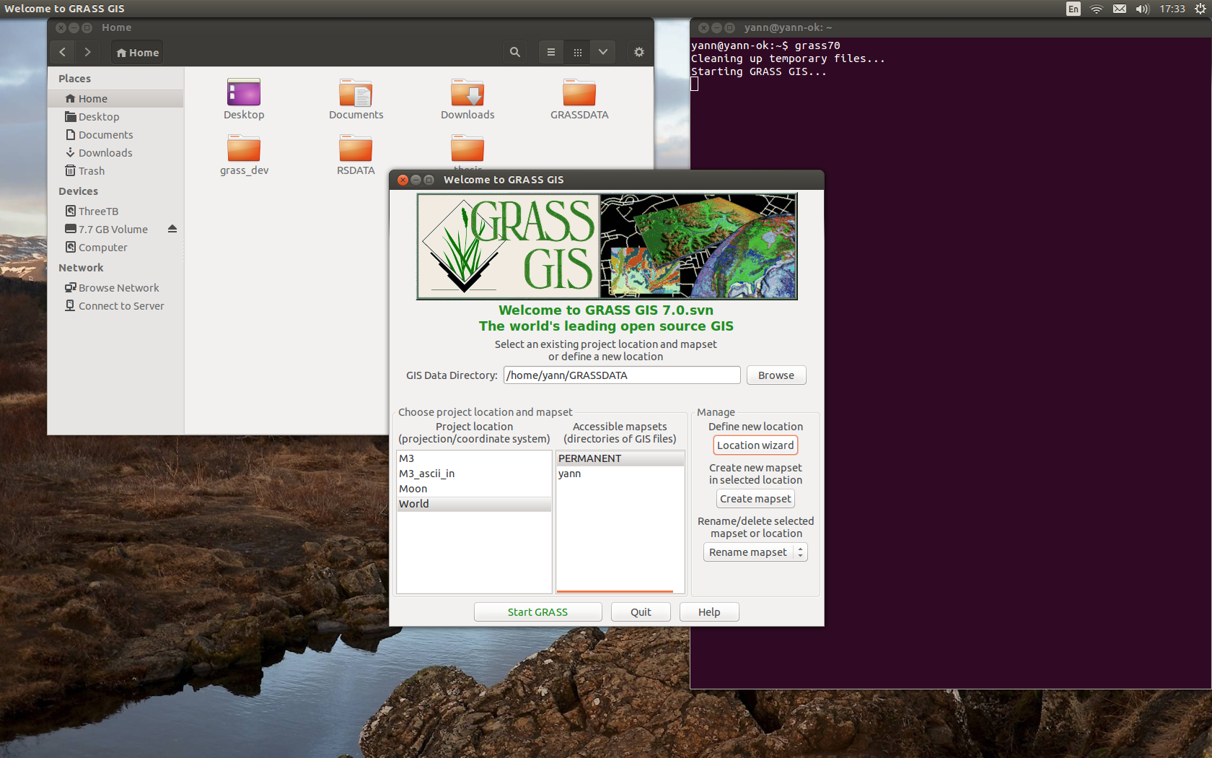
Start GRASS GIS
Define New Location

Slide 4
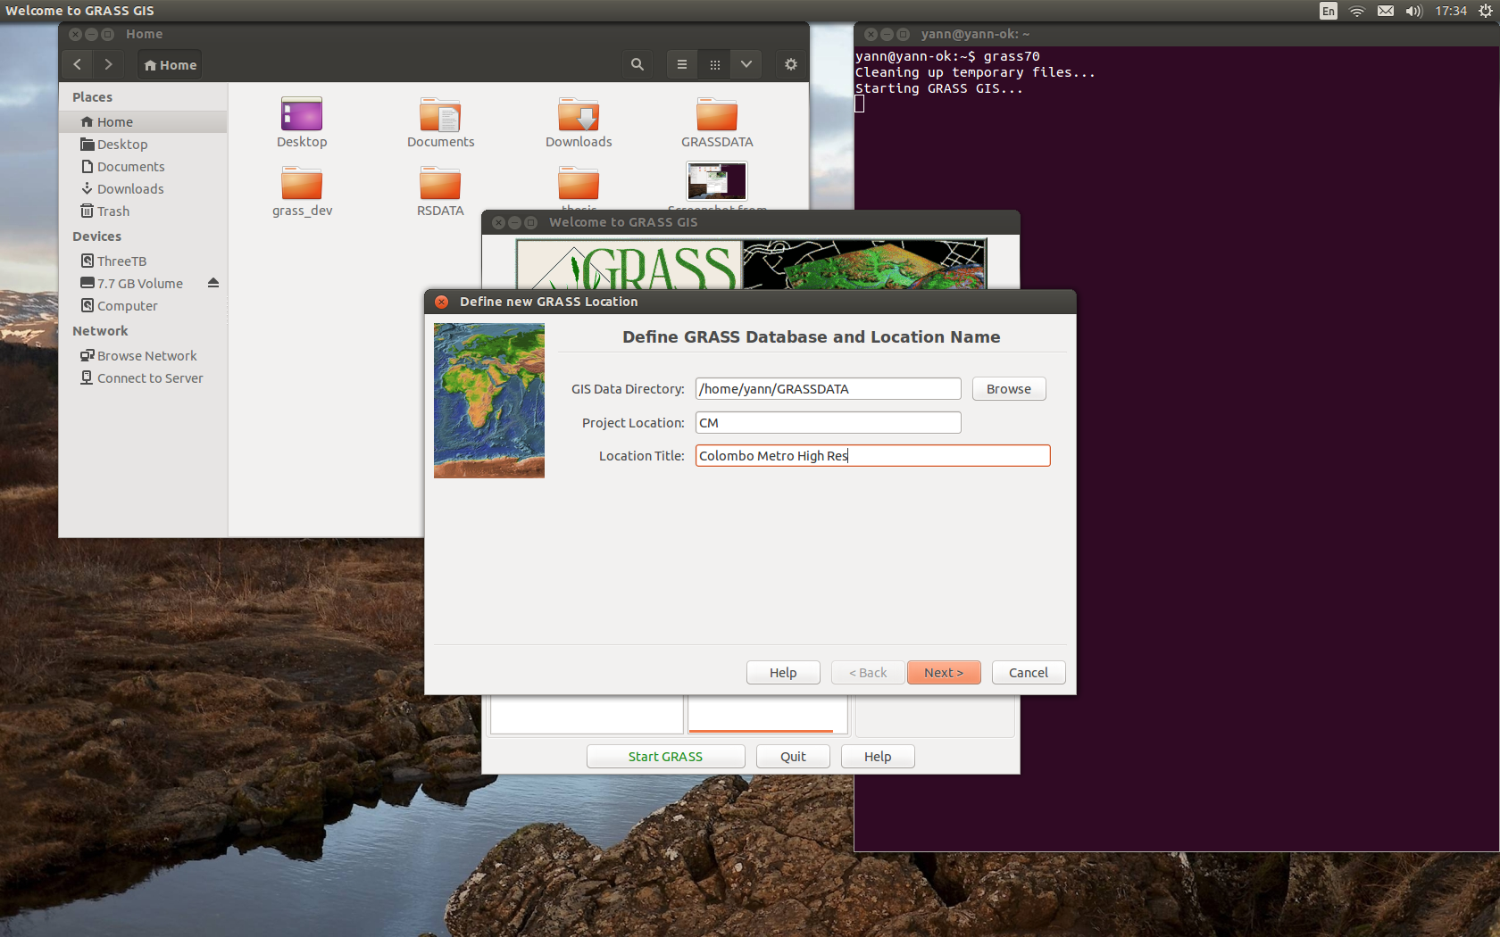
Give a name and description

Slide 5
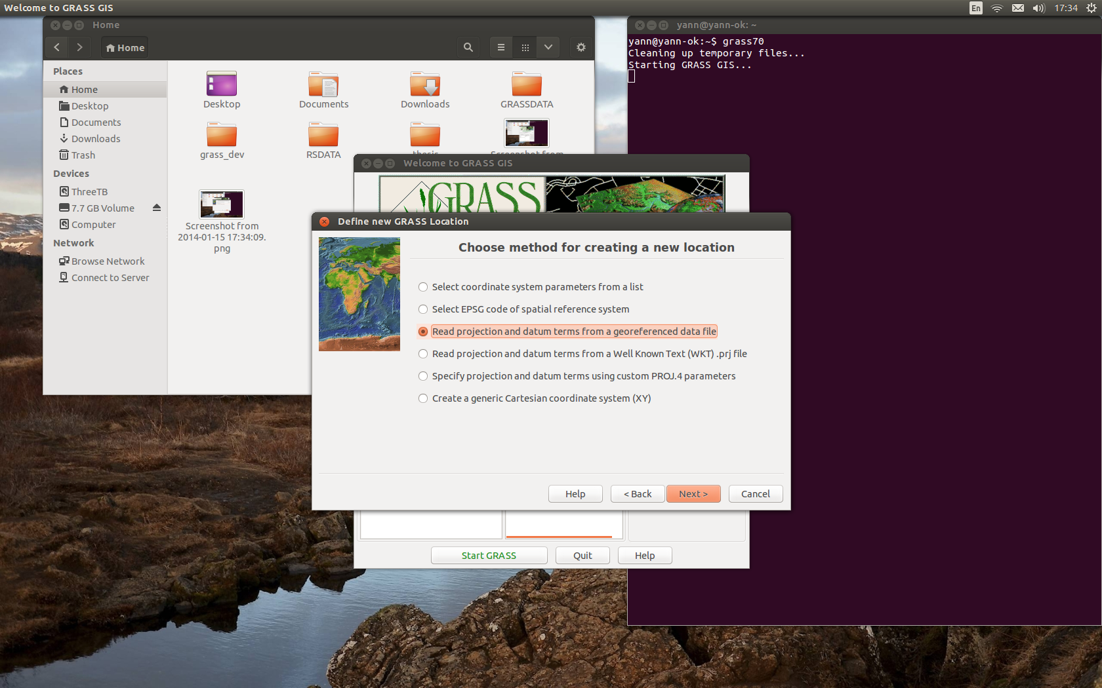
Creation Method: data file

Slide 6
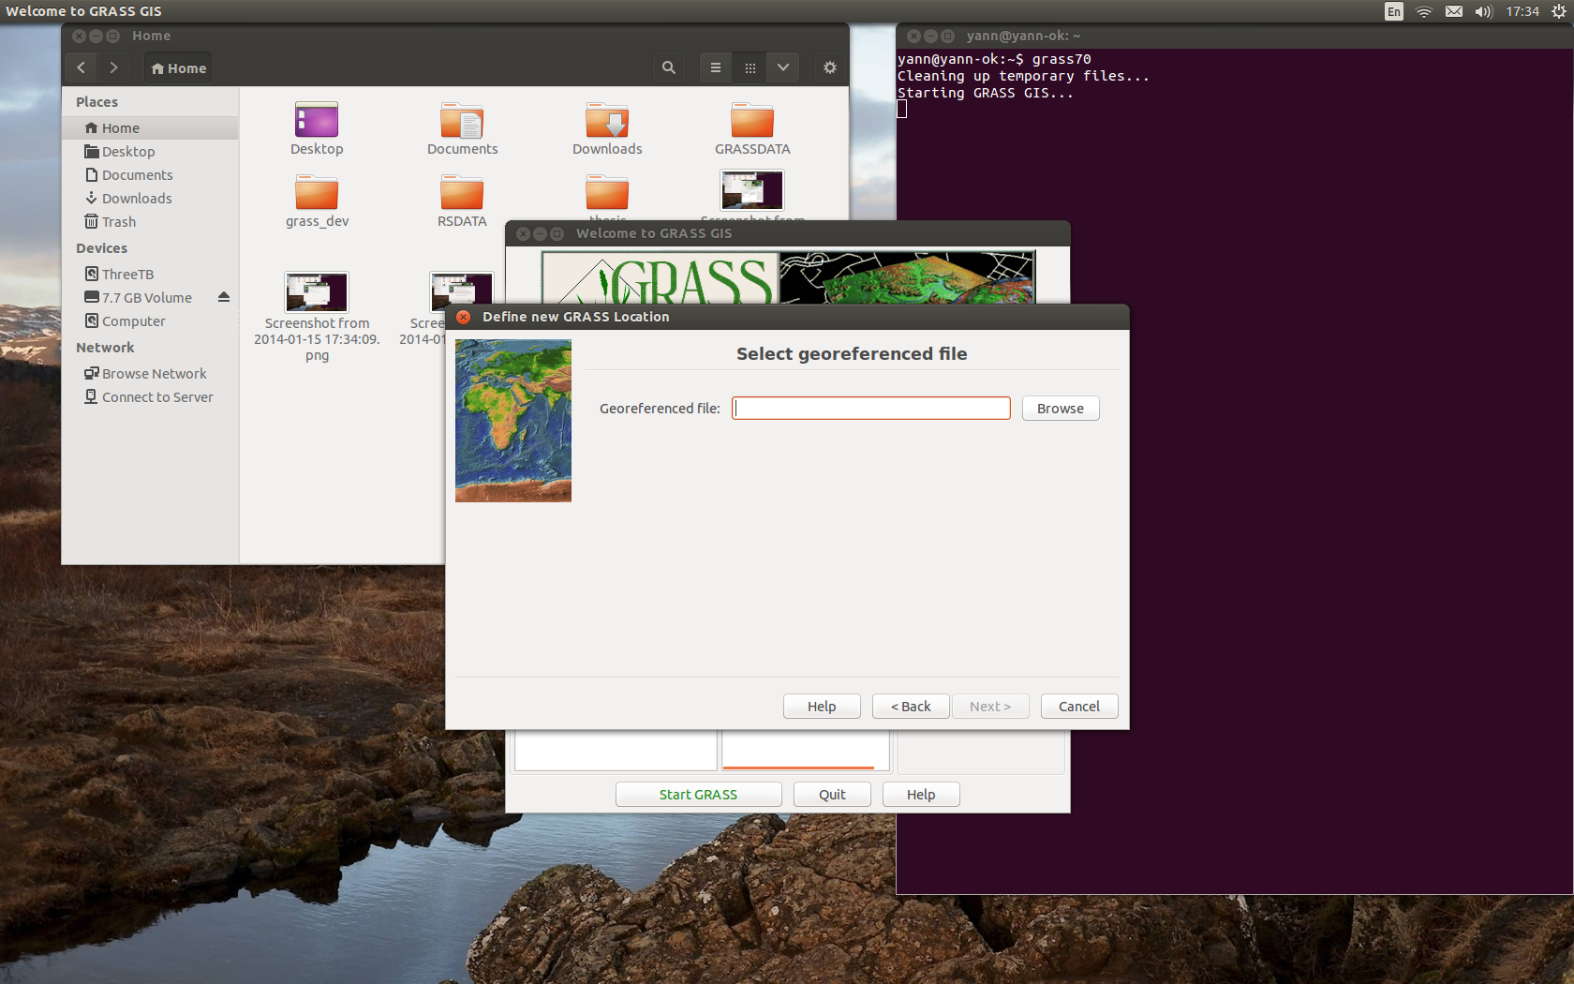
Select the file

Slide 7
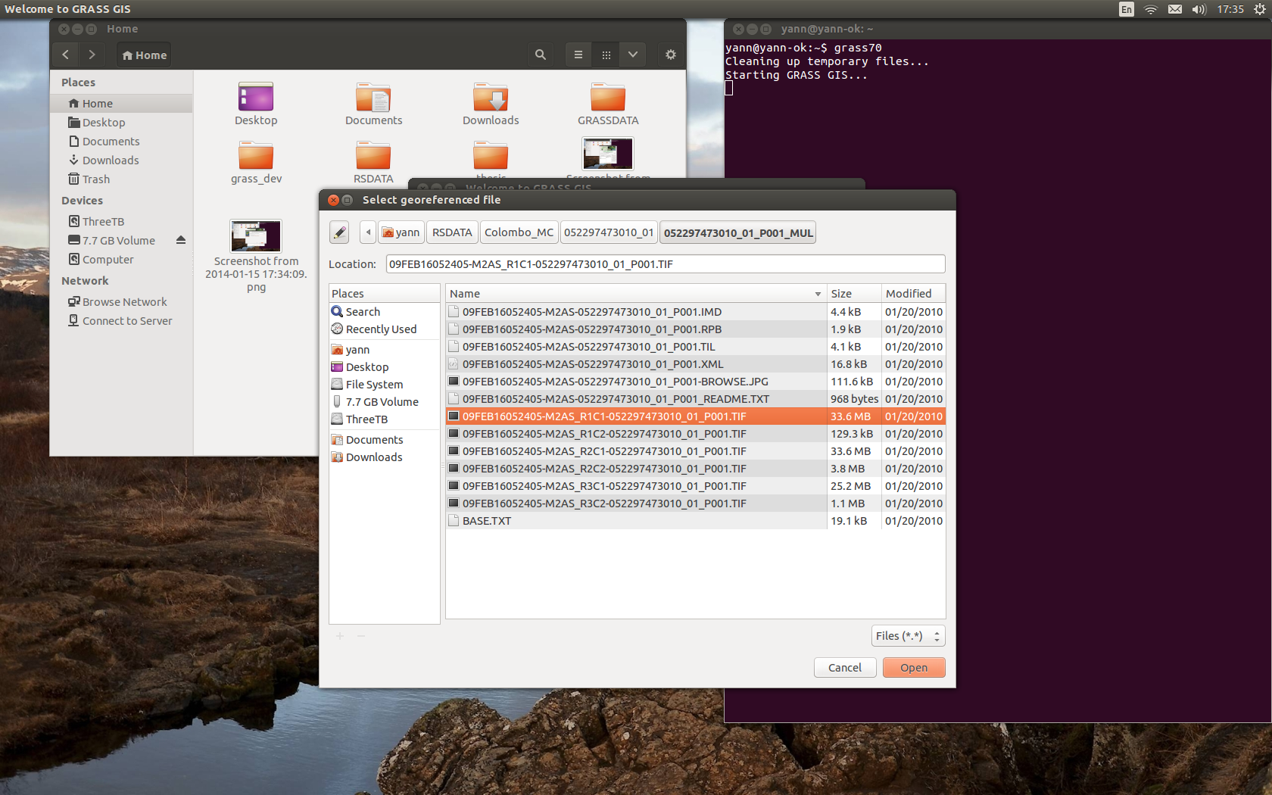
Colombo Metro file given

Slide 8
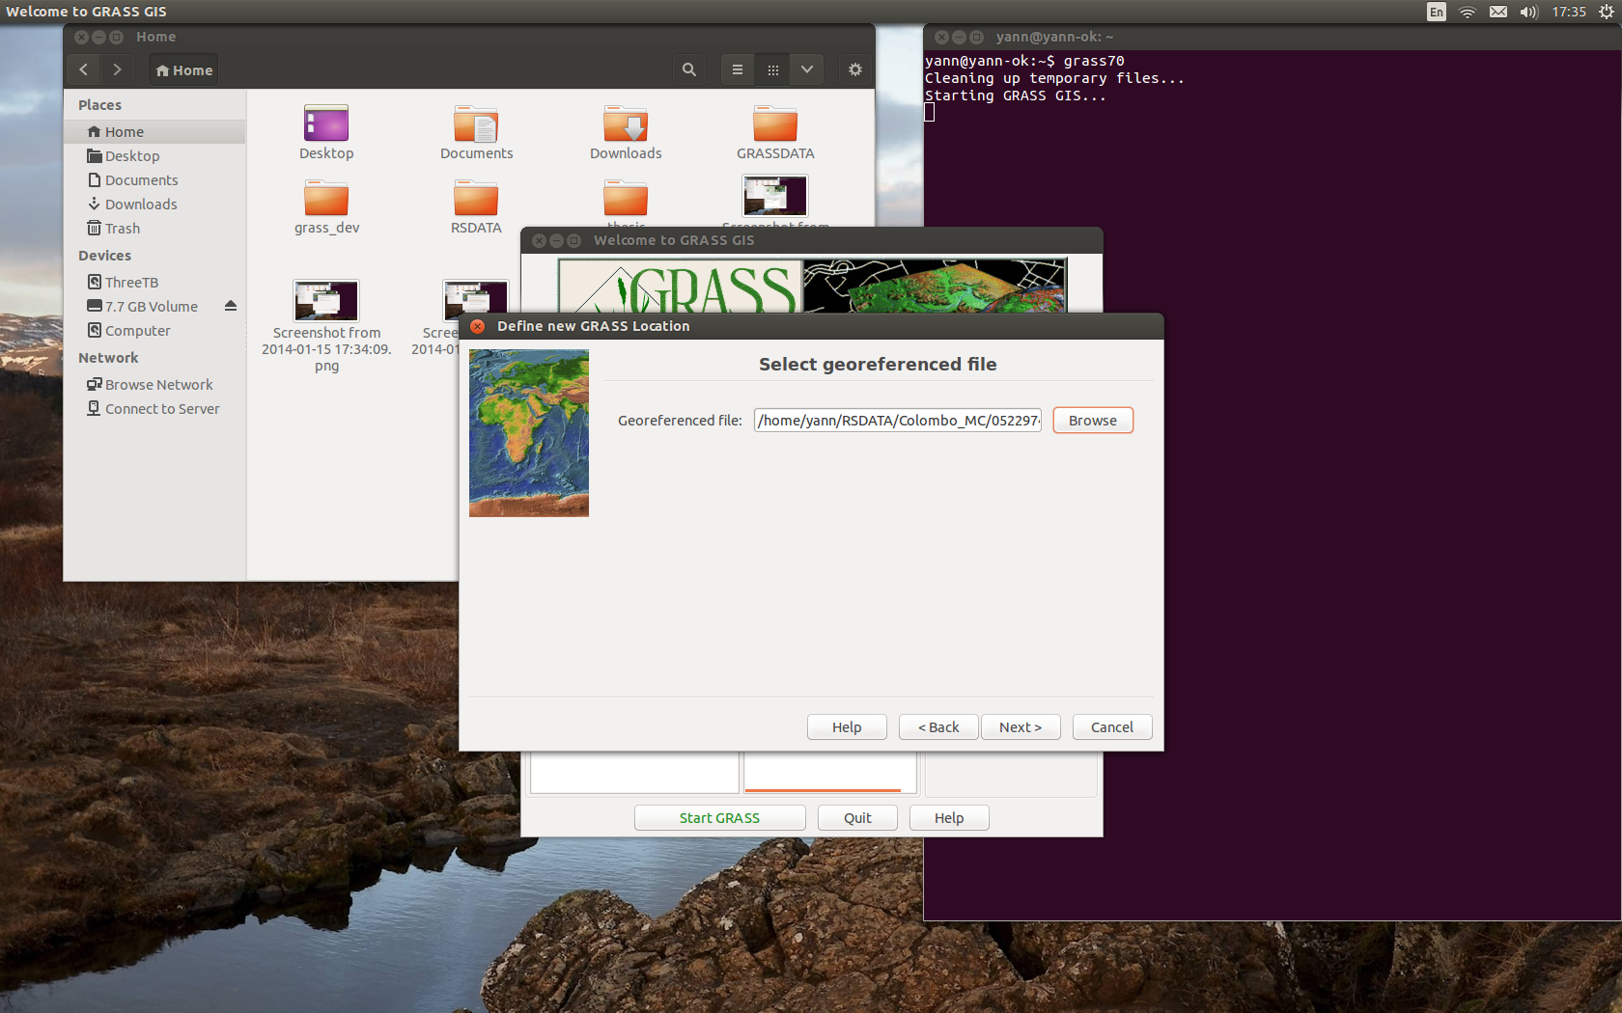
Data File is set

Slide 9
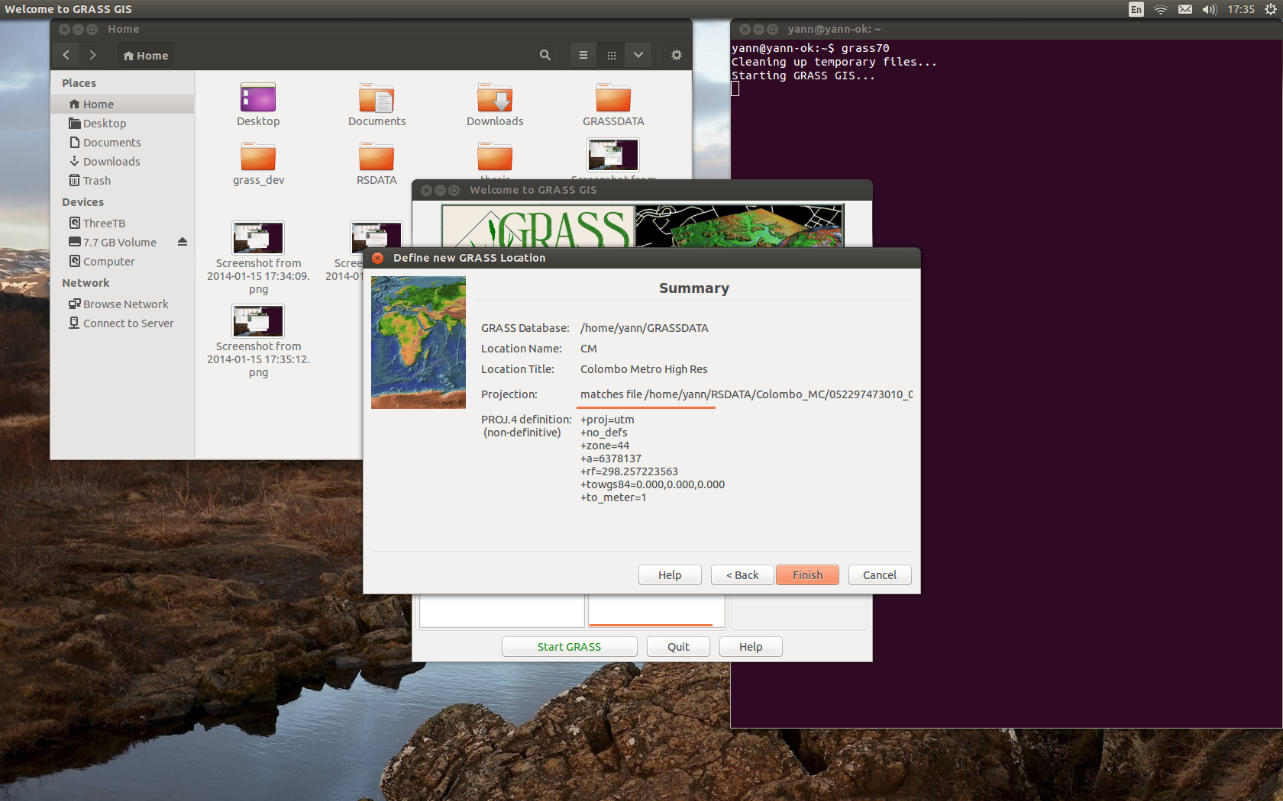
Confirm projection & resolution

Slide 10
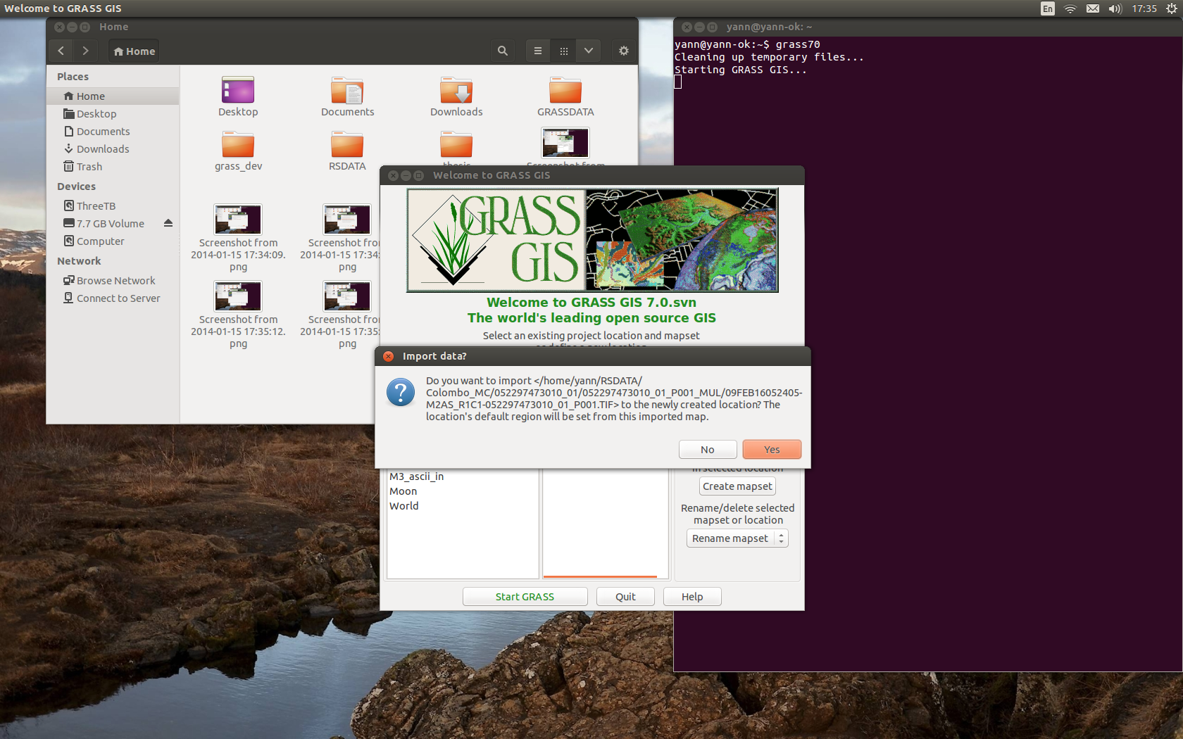
Import the data file used

Slide 11

All good with import of data file

Slide 12
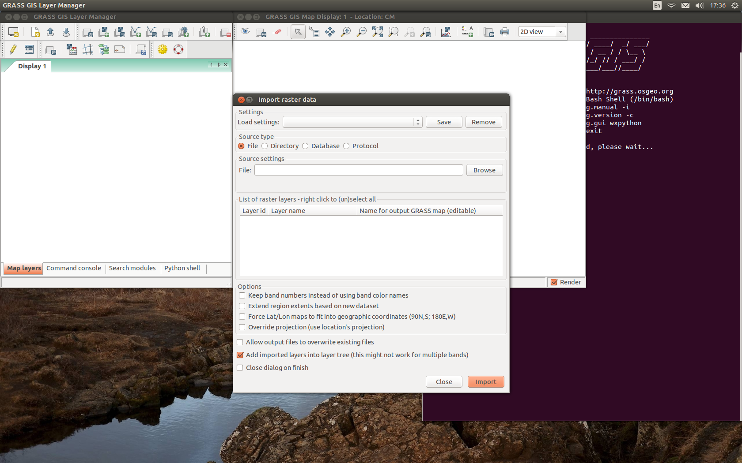
File->import->Raster (common)
Import all the raster data files

Slide 13
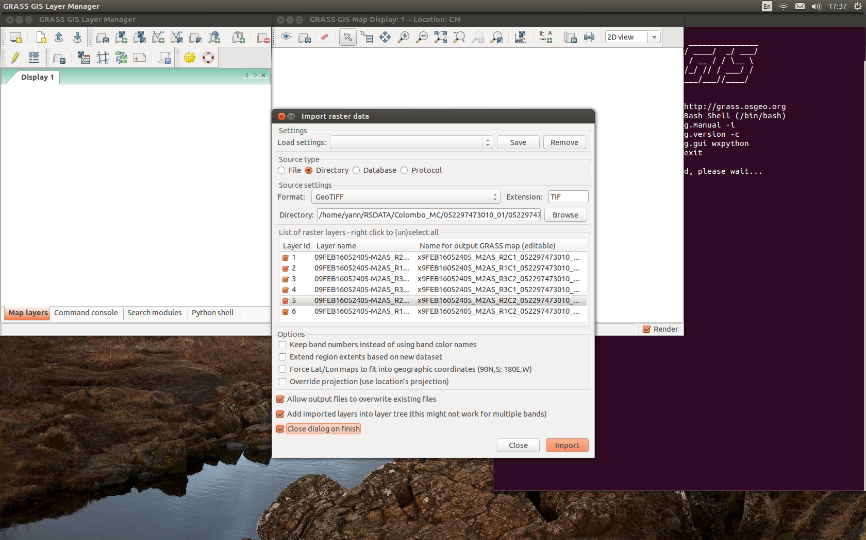
Select Directory import mode

Slide 14
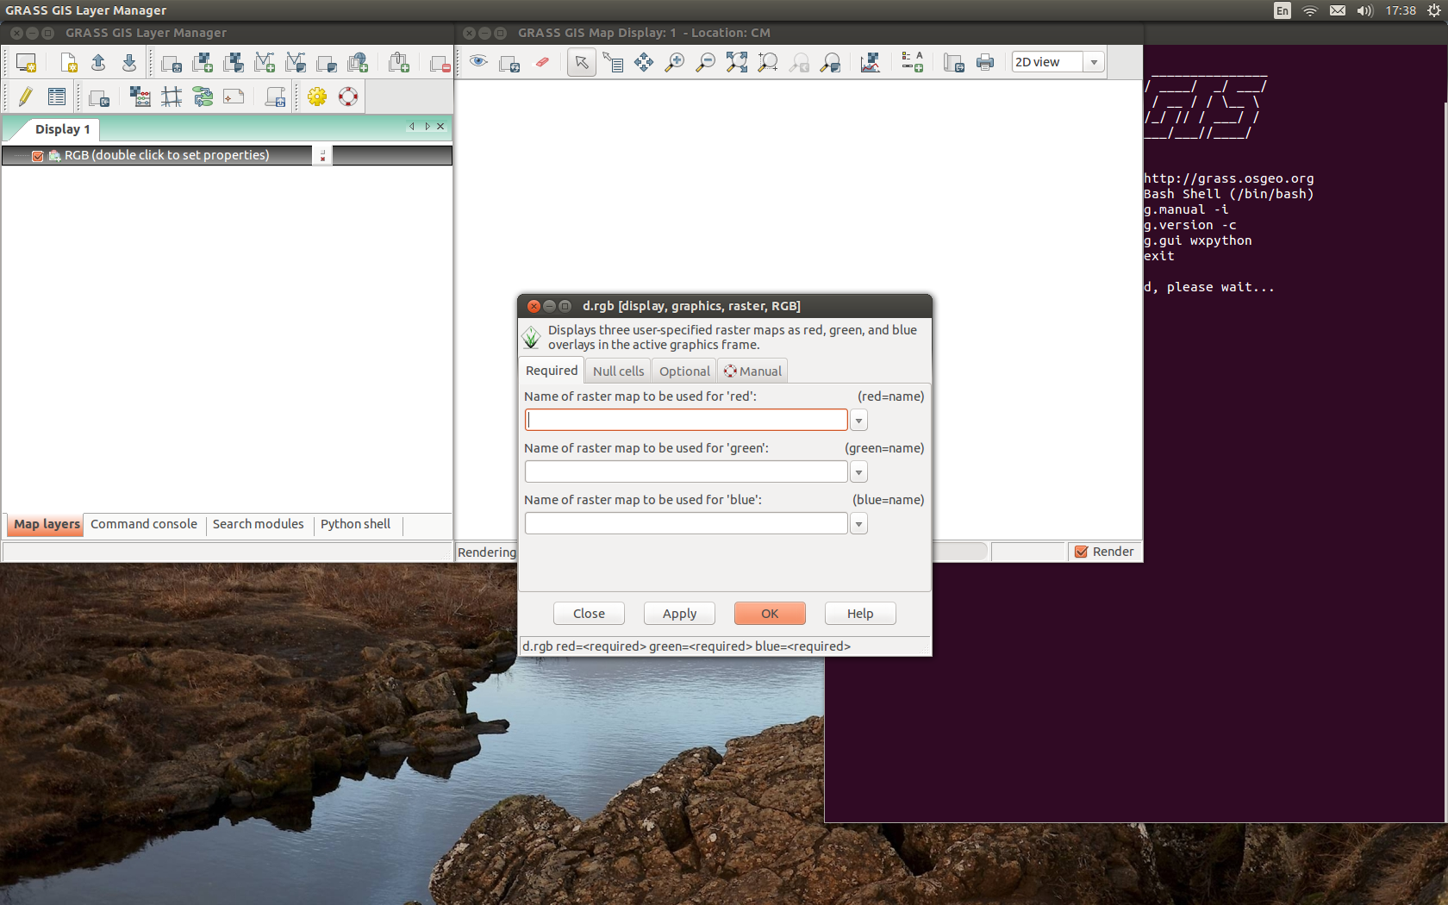
Display a RGB composite

Slide 15
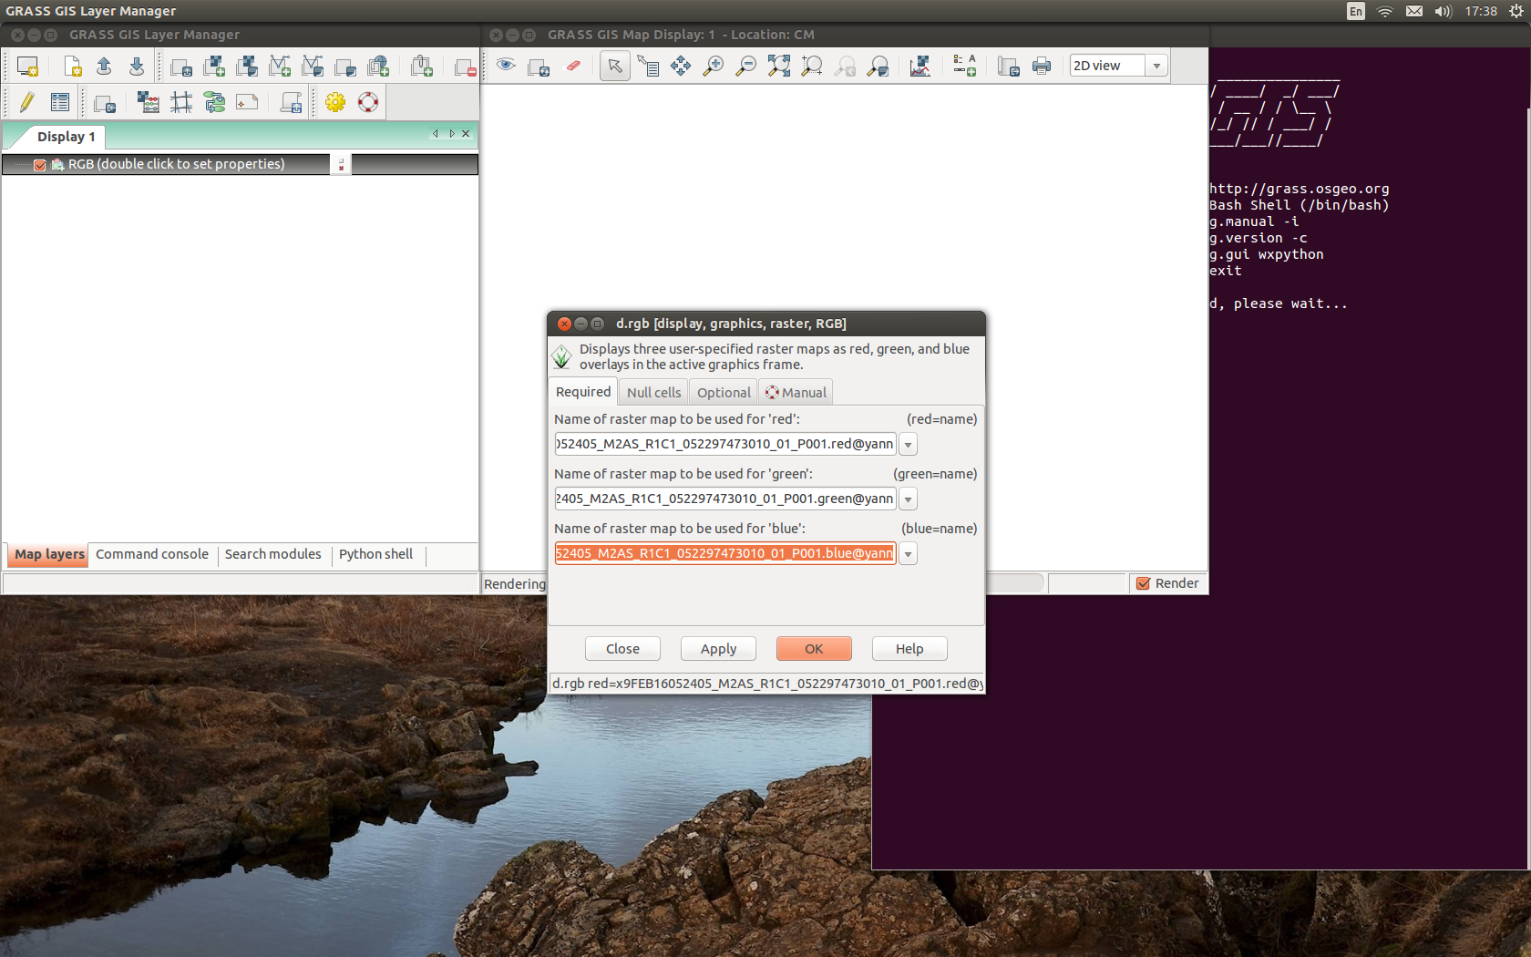
Add the R, G & B bands

Slide 16
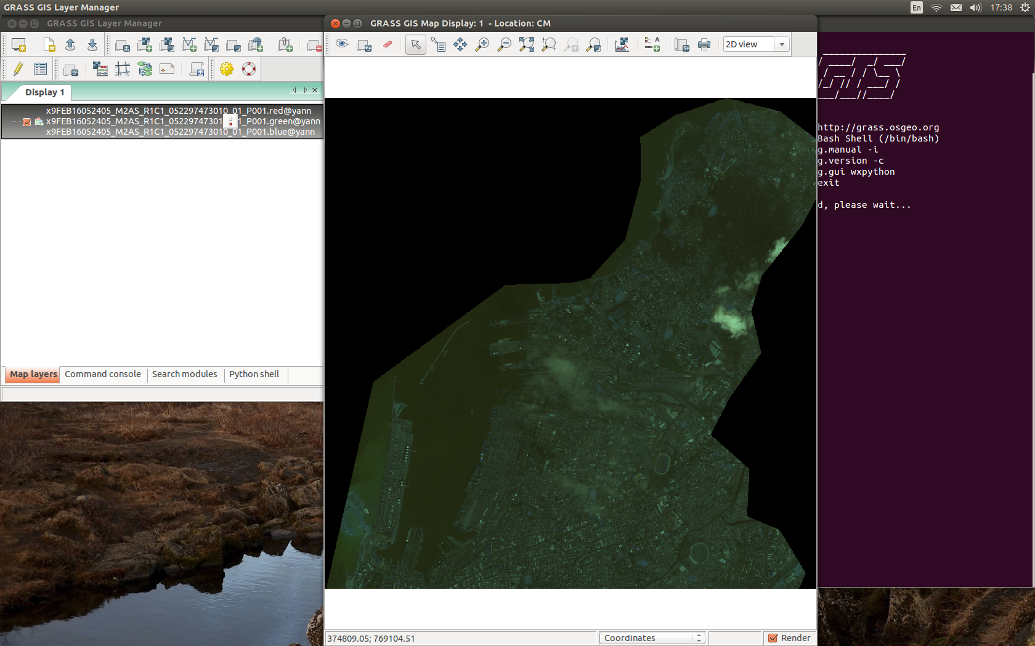
One RGB composite

Slide 17
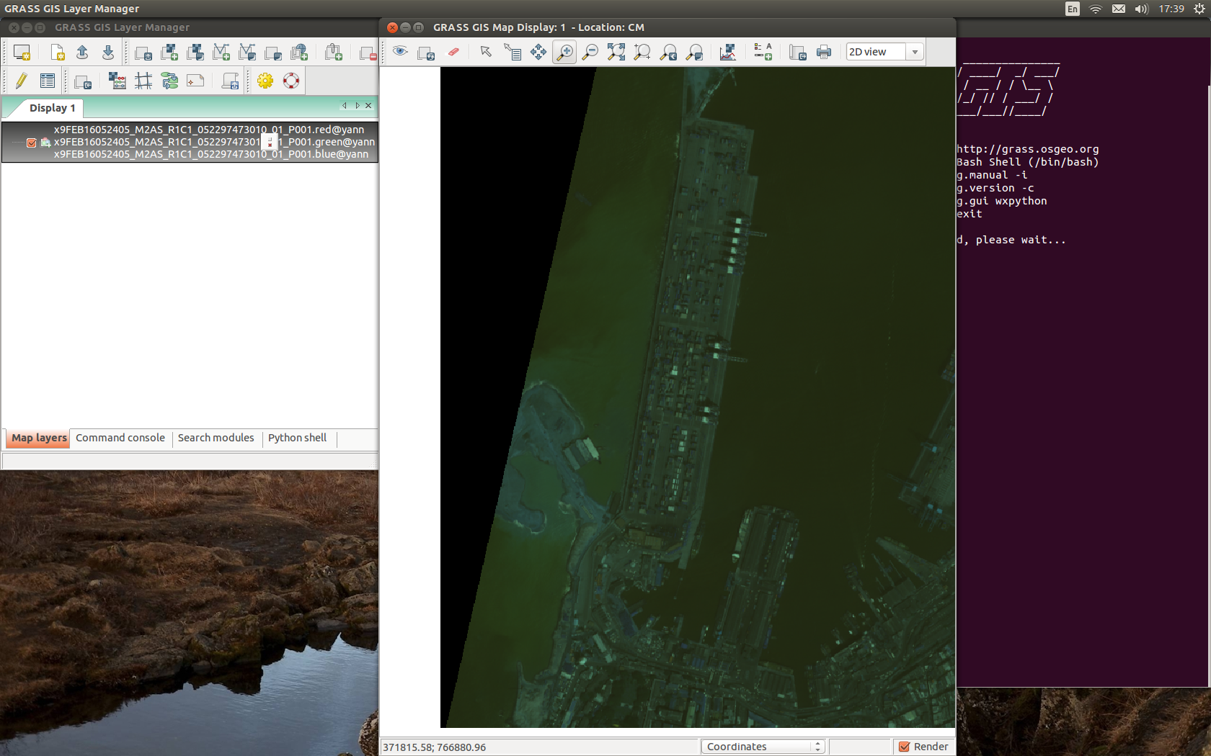
Zoom in

Slide 18
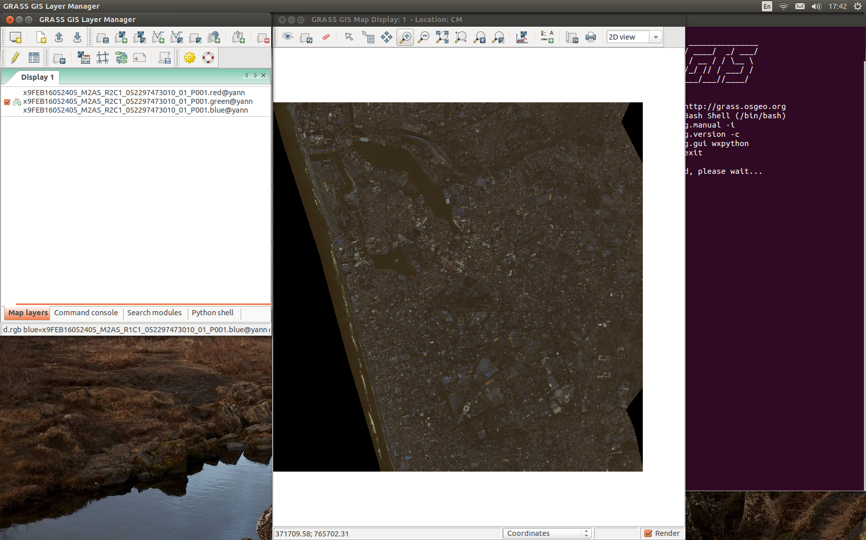
Find this image, display RGB

Slide 19
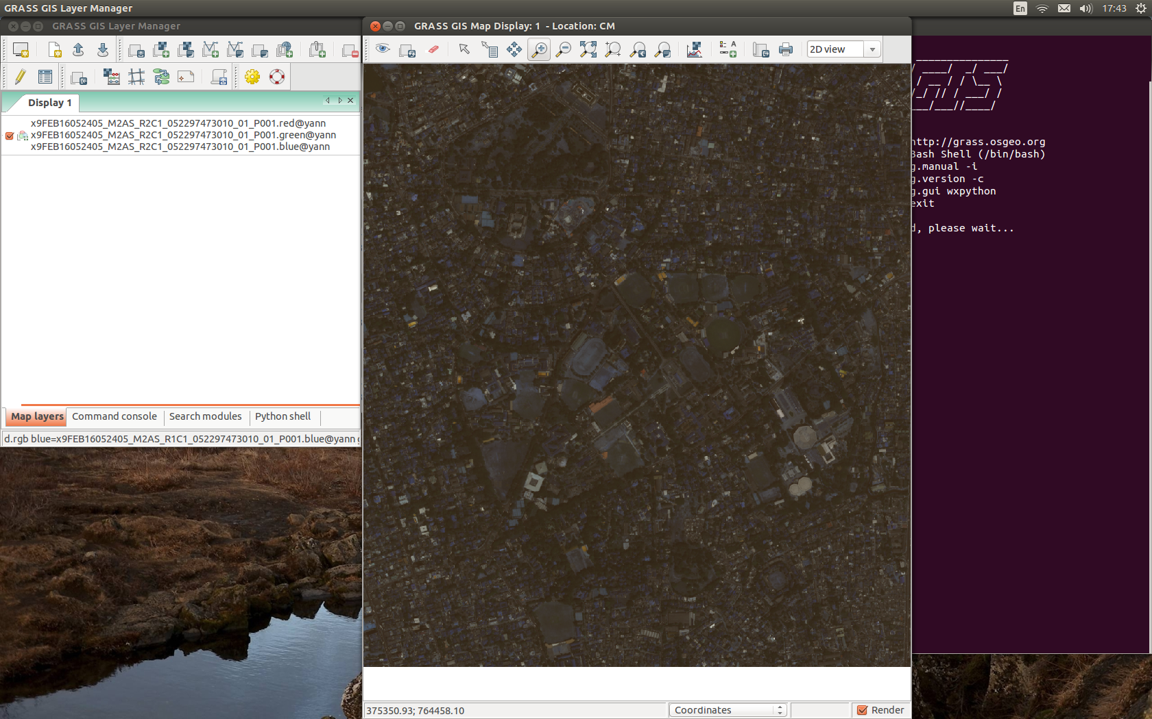
Zoom in

Slide 20
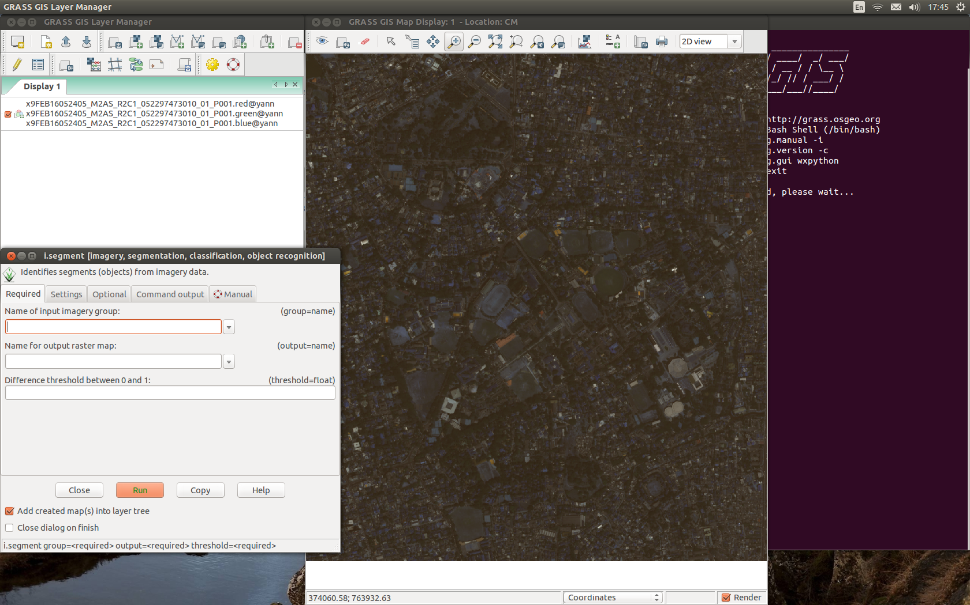
imagery->classify->segmentation

Slide 21
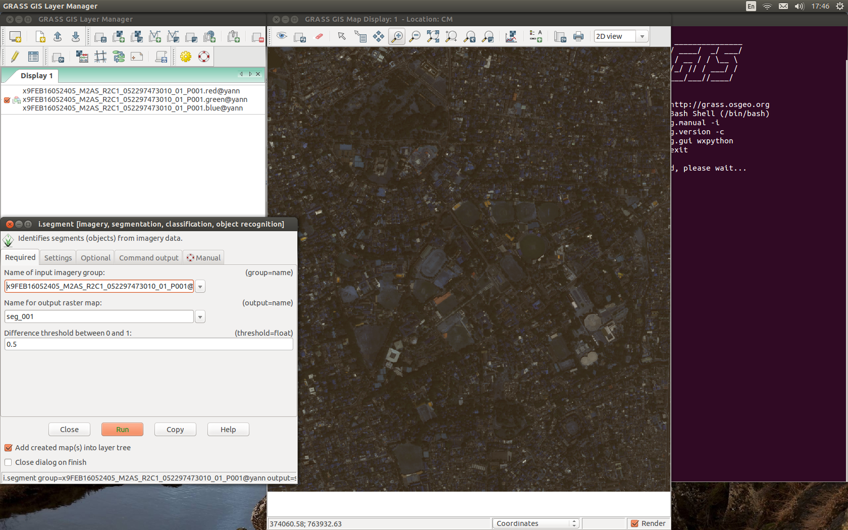
Set image in/out, threshold (0.5)

Slide 22
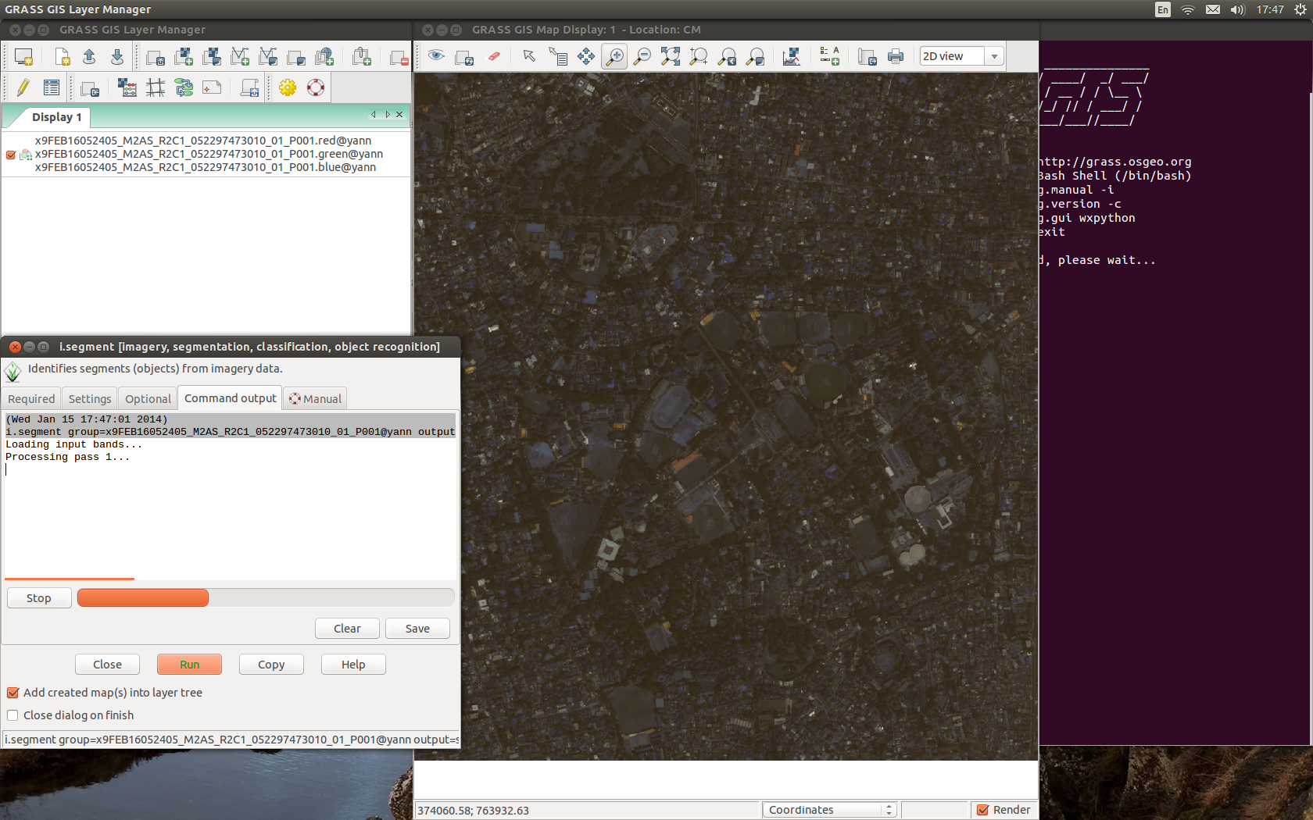
Running Pass 1

Slide 23

Running Pass 2 … etc.

Slide 24
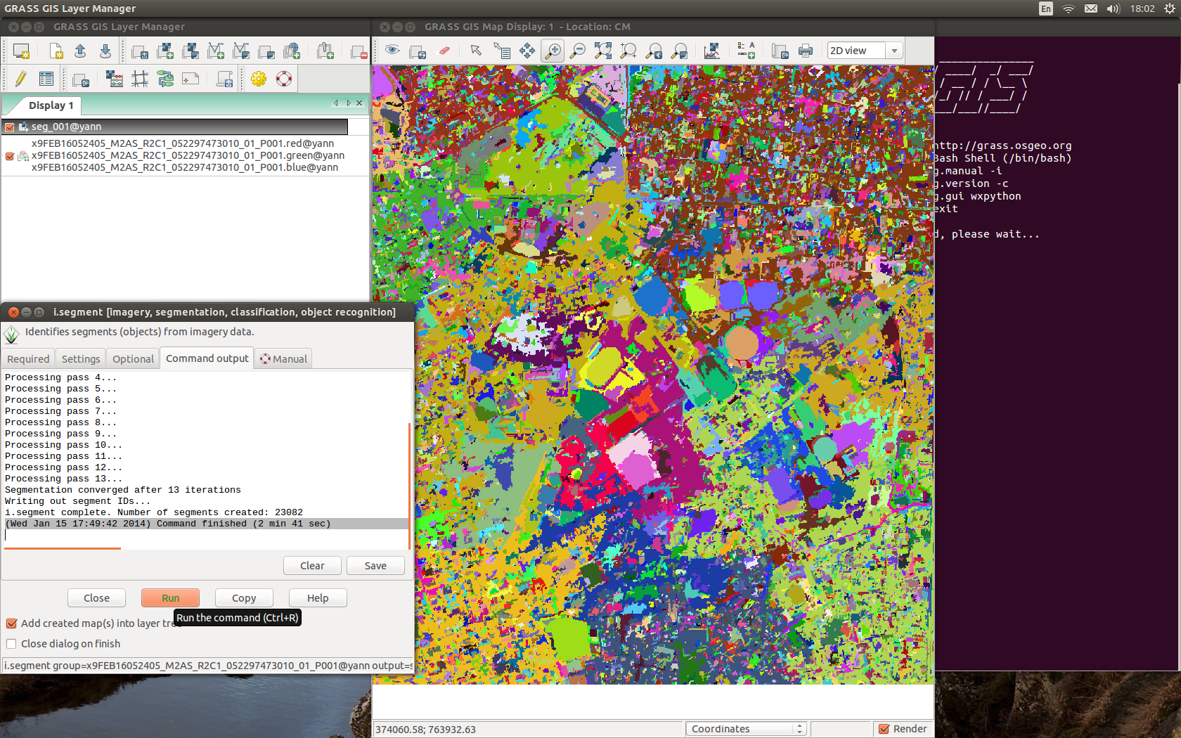
First output: seg_001 map

Slide 25
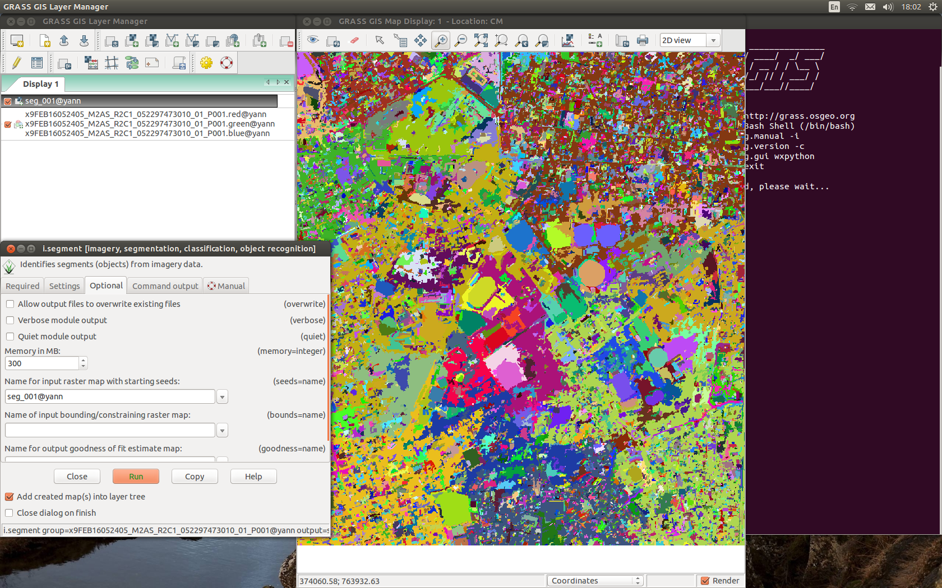
Add seg_001 as optional input

Slide 26
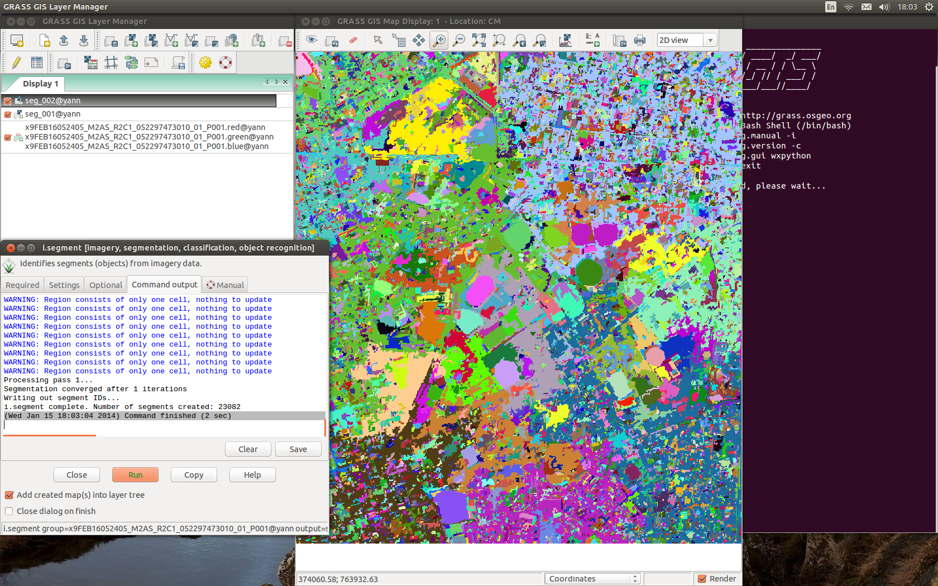
New run: seg_002

Slide 27
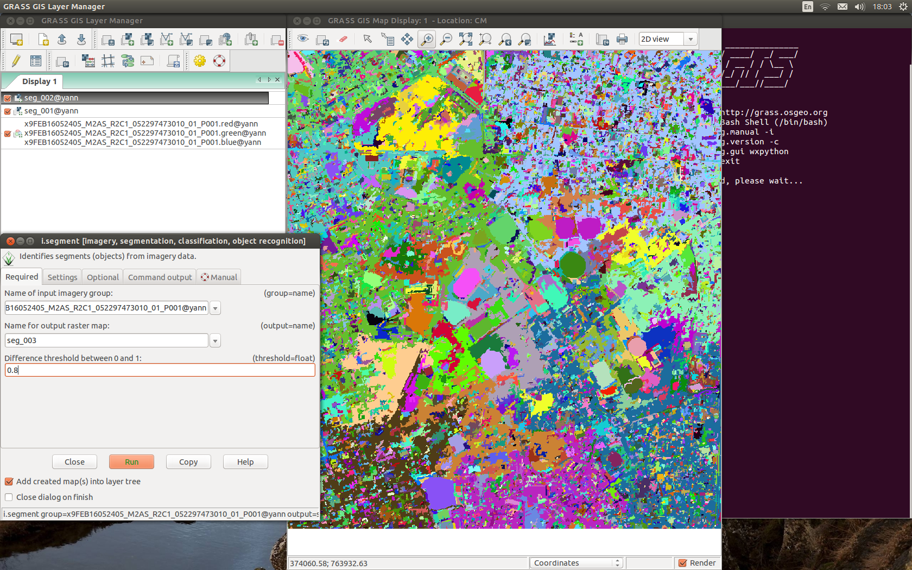
Change threshold, use seg_002

Slide 28
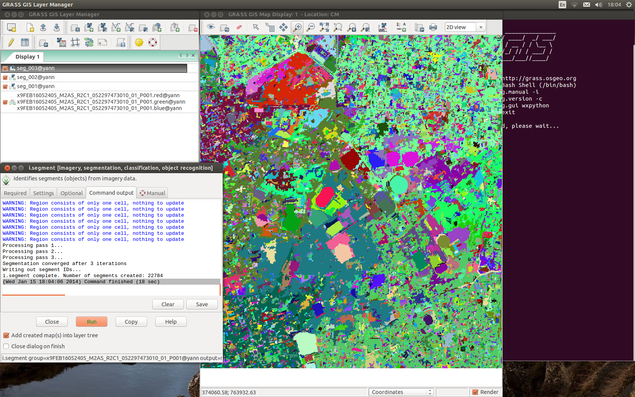
seg_003

Slide 29
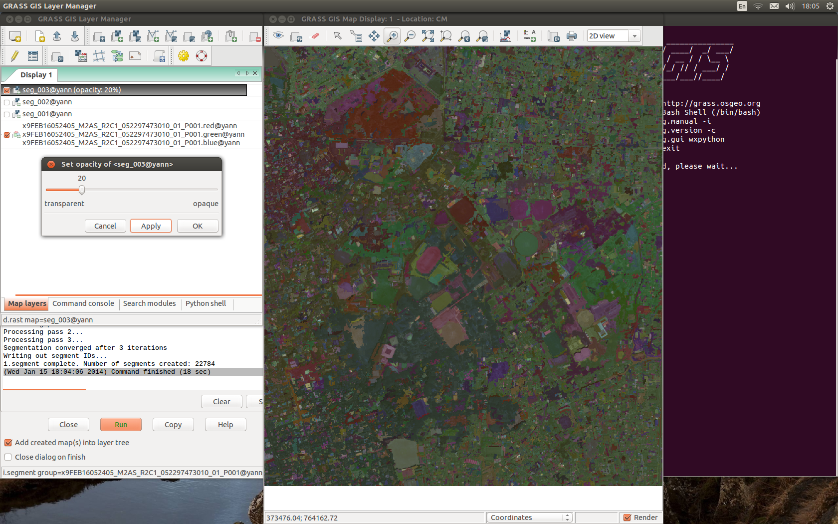
Seg_003 change transparency
Right-click here

Slide 30
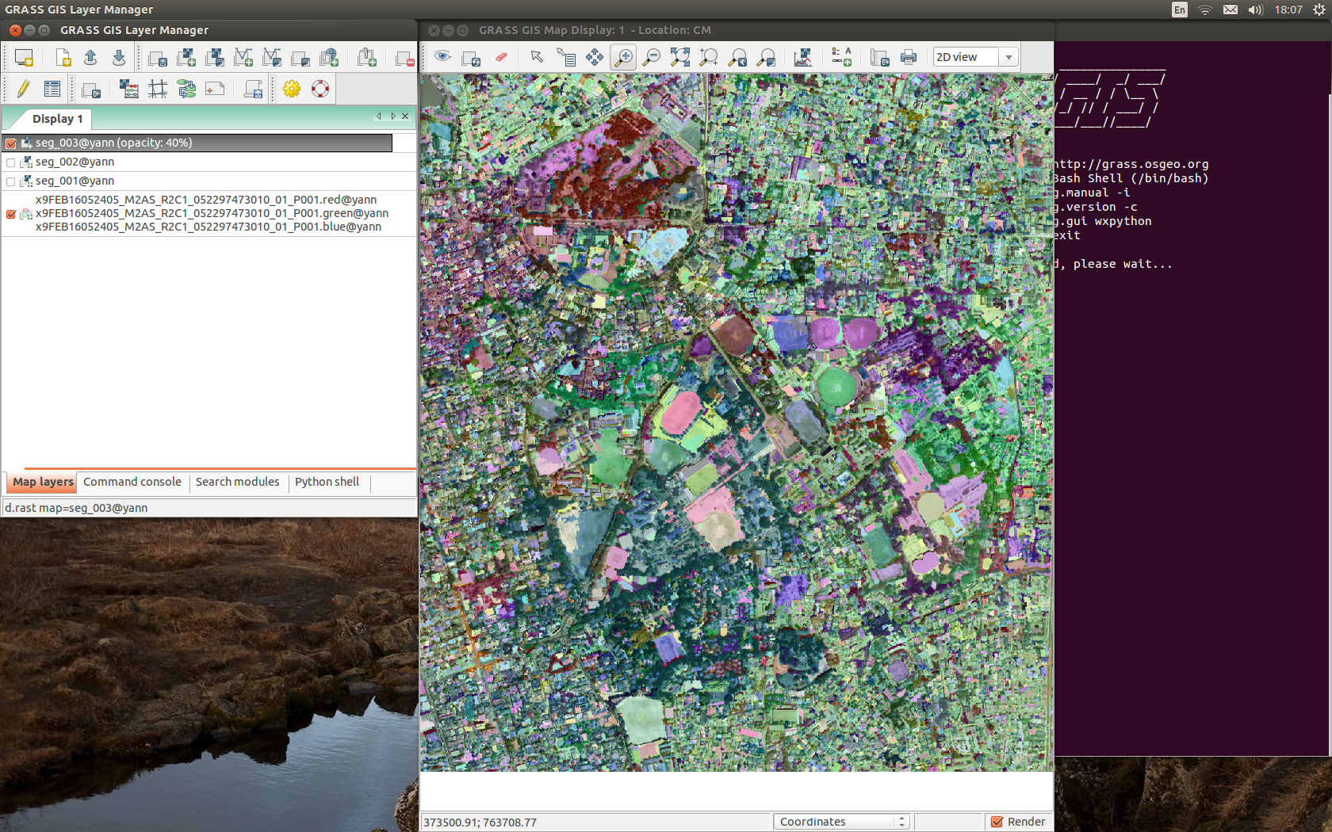
Raster->develop->colors
Set each data file of the RGB to grey
with equalized area option

Slide 31
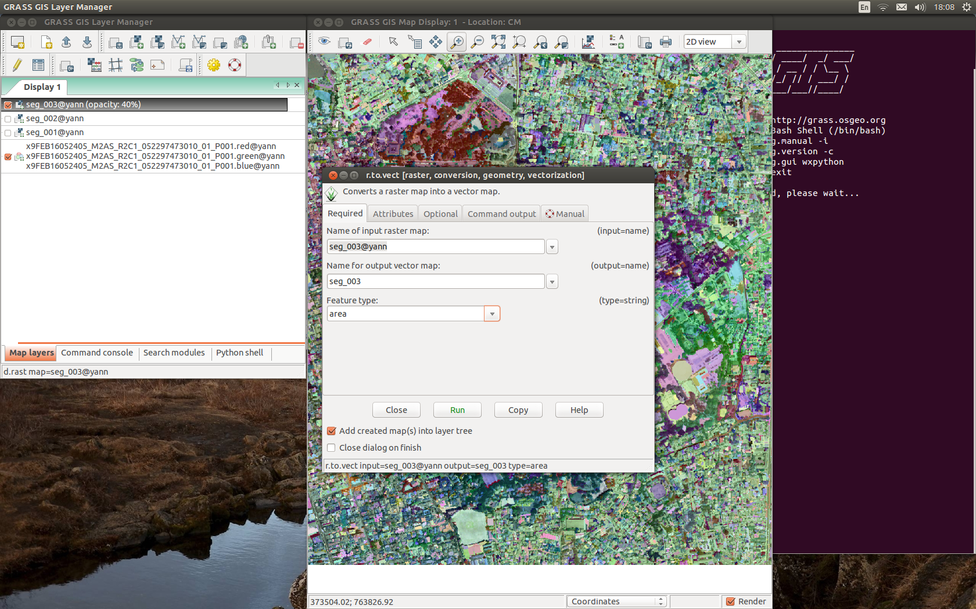
File->convert->raster to vector

Slide 32
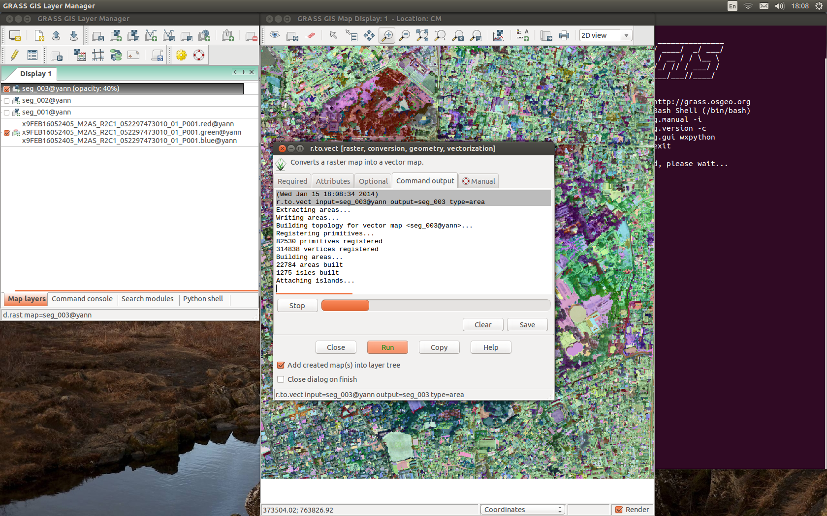
Converting....

Slide 33
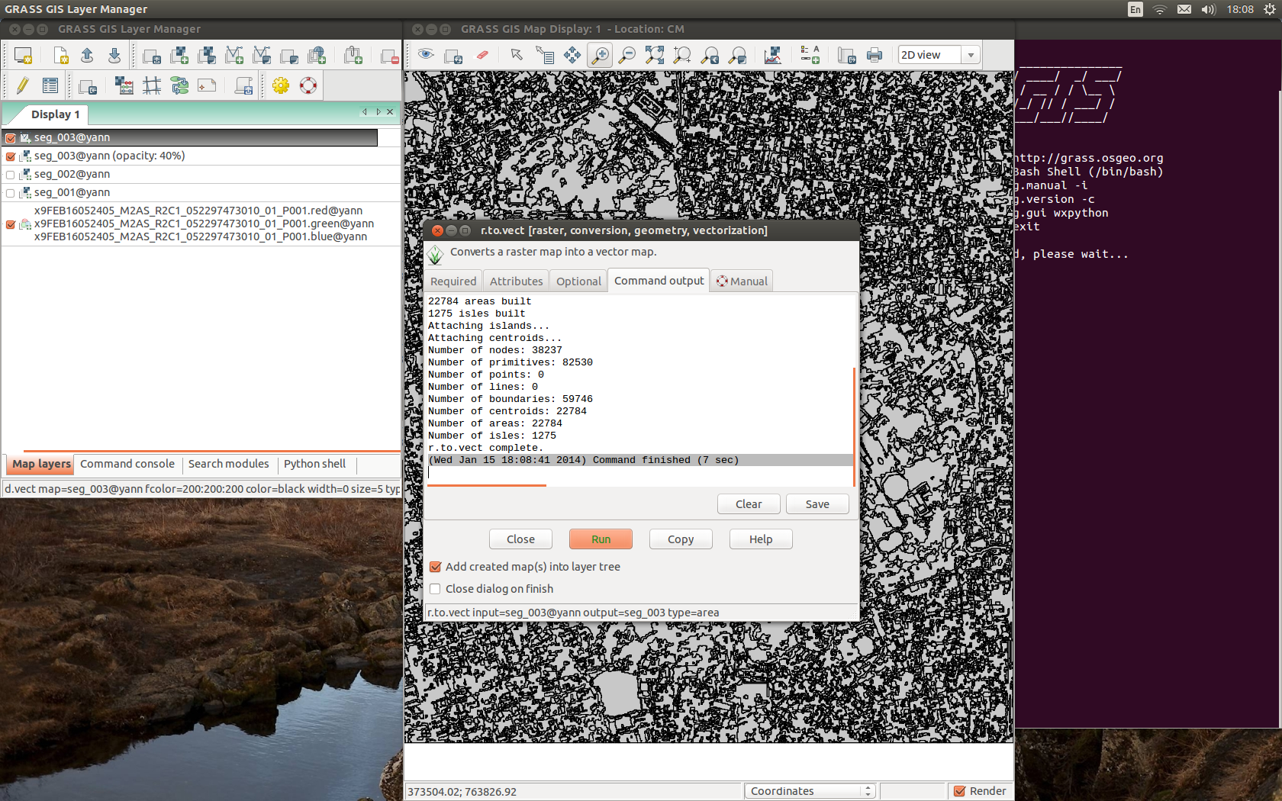
Conversion done

Slide 34
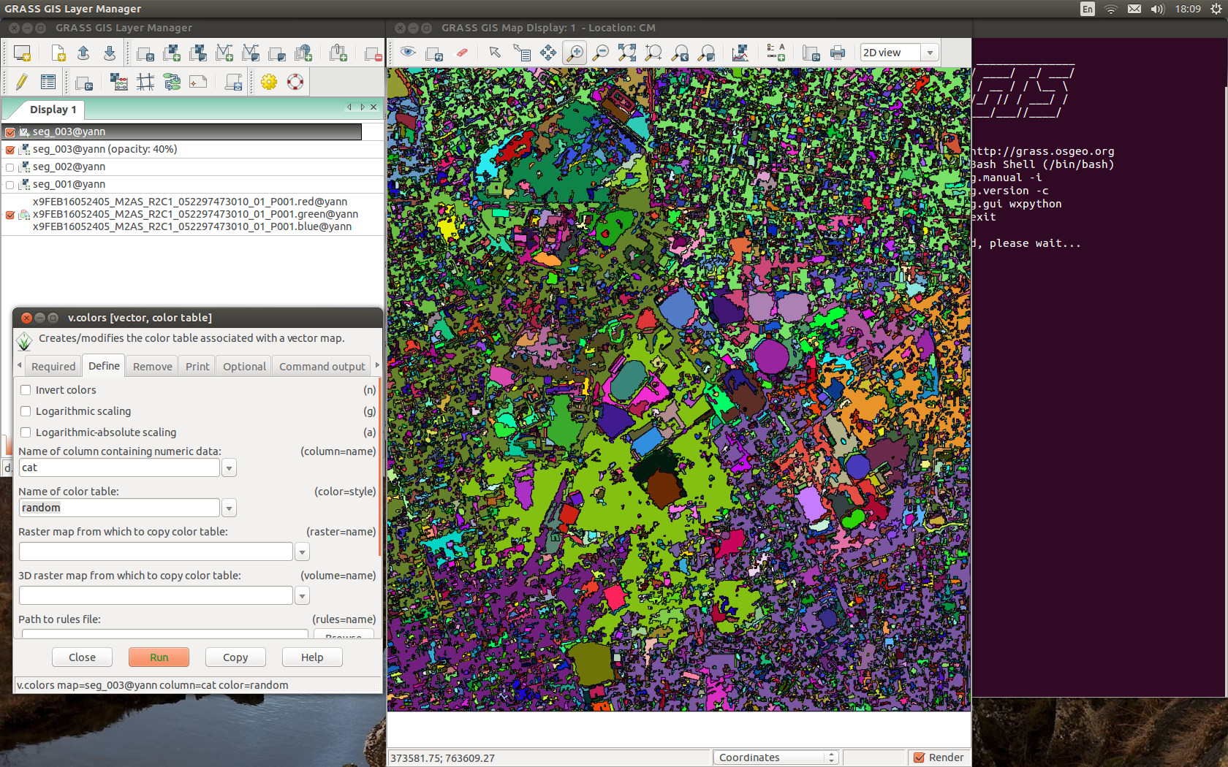
Set color table to random

Slide 35
Discuss your perspectives
Building Vs landscape classification
Shapes identification
Linearity?
What do you understand from this:
  Process
  Map
  Information extraction

Slide 36
End

