Slide 1
GPS
NMEA Protocol

Slide 2
NMEA standard for GPS
NMEA
  National Marine Electronics Association
GPS sentences standard
  Self-reliant sentence
  Independent from other sentences
  Starts with ‘$’ sign, has ~80 characters
  Ends with checksum + carriage return
http://www.engineersgarage.com/tutorials/gps-receivers-nmea-standards

Slide 3
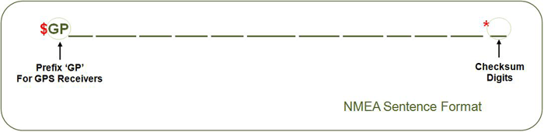
More details on sentences
ASCII text
Varies in precision
Checksum starts with '*'+2 hexadecimals
  8 bit exclusive OR of all the characters between $ and *
  Not including, the $ and *
http://www.engineersgarage.com/tutorials/gps-receivers-nmea-standards

Slide 4
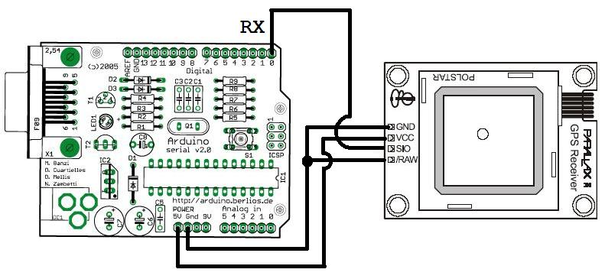
Connecting a GPS to Arduino
http://playground.arduino.cc/Tutorials/GPS
A GPS connects with Null-Modem: - 4800 bps, 8 bits, 1 stop bit
- no parity, no handshake

Slide 5
Sentences types
$GPGGA:
  Global Positioning System Fix Data
$GPGSV:
  GPS satellites in view
$GPGSA:
  GPS DOP and active satellites
$GPRMC:
  Recommended minimum specific GPS/Transit data
http://playground.arduino.cc/Tutorials/GPS

Slide 6
Detailing GPRMC sentence
$GPRMC,225446,A,4916.45,N,12311.12,W,000.5,054.7,191194,020.3,E*68
  225446 Time of fix 22:54:46 UTC
  A Navigation receiver warning A = Valid position, V = Warning
  4916.45,N Latitude 49 deg. 16.45 min. North
  12311.12,W Longitude 123 deg. 11.12 min. West
  000.5 Speed over ground, Knots
  054.7 Course Made Good, degrees true
  191194 UTC Date of fix, 19 November 1994
  020.3,E Magnetic variation, 20.3 deg. East
  *68 mandatory checksum
http://playground.arduino.cc/Tutorials/GPS

Slide 7
Parsing NMEA stream
$GPGGA,154654,4428.2011,N,00440.5161,W,0,00,,-00044.7,M,051.6,M,,*6B
$GPGSA,A,1,,,,,,,,,,,,,,,*1E
$GPGSV,3,1,10,02,50,290,00
$GPGGA,154655,4328.1874,N,00340.5185,W,1,03,08.5,-00044.7,M,051.6,M,,*79
$GPGSA,A,2,13,23,25,,,,,,,,,,08.5,08.5,00.9*0E
$GPGSV,3,1,10,02,50,290,26,04,60,210,26,08,33,173,29,10,21,296,00*7E
$GPGSV,3,2,10,13,58,044,34,16,03,035,00,20,02,109,00,23,26,057,34*7B
$GPGSV,3,3,10,25,24,045,35,27,56,145,27,,,,,,,,*7D
$GPRMC,154655,A,4428.1874,N,00440.5185,W,000.7,000.0,050407,,,A*6C
Not working yet
Time in UTC (HhMmSs): 154655
Status (A=OK,V=KO): A
Latitude: 4428.1874
Direction (N/S): N
Longitude: 00440.5185
Direction (E/W): W
Speed in Knots: 000.7
Heading in degrees: 000.0
Date in UTC (DdMmAa): 050407
Magnetic variation:
Variation (E/W):
Mode: A

Slide 8
Where is this GPS?
http://quaxio.com/arduino_gps/
$GPGGA,004235.776,3746.2757,N,12223.3240,W,1,07,1.1,27.3,M,-25.3,M,,0000*54
$GPGSA,A,3,02,04,24,28,09,17,15,,,,,,2.0,1.1,1.6*36
$GPGSV,3,1,12,04,57,134,35,24,56,287,36,05,55,318,,17,41,046,32*7C
$GPGSV,3,2,12,02,39,177,24,12,31,305,26,28,17,099,36,30,14,297,*74
$GPGSV,3,3,12,09,10,157,31,15,10,234,36,20,,044,,48,44,197,37*73
$GPRMC,004235.776,A,3746.2757,N,12223.3240,W,0.22,173.75,170613,,,A*7B
$GPGGA,004236.776,3746.2770,N,12223.3217,W,1,07,1.1,39.9,M,-25.3,M,,0000*55
$GPGSA,A,3,02,04,24,28,09,17,15,,,,,,2.0,1.1,1.6*36
$GPRMC,004236.776,A,3746.2770,N,12223.3217,W,0.13,211.41,170613,,,A*7D
$GPGGA,004237.776,3746.2779,N,12223.3198,W,1,07,1.2,50.6,M,-25.3,M,,0000*5A
$GPGSA,A,3,02,04,24,28,09,17,15,,,,,,2.0,1.2,1.6*35
$GPRMC,004237.776,A,3746.2779,N,12223.3198,W,0.16,173.46,170613,,,A*74
Use Google Maps/Earth to display the result
Was it later or earlier than the previous NMEA stream?

Slide 9
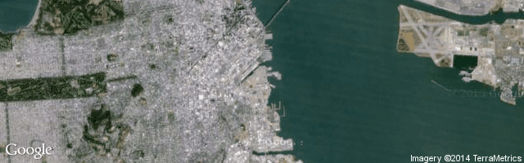
Answer 1
3746.2779,N,12223.3198,W
  Lat: 37+(46.2779/60) = 37.7713
  Lon: -1*(122+(23.3198/60)) = -122.3887
http://quaxio.com/arduino_gps/

Slide 10
Answer 2
...

Slide 11
End

