Slide 1
Exploring Wavelets
and
Rainfall Reconstruction
IWMI Techies
25-29 April 2011

Slide 2
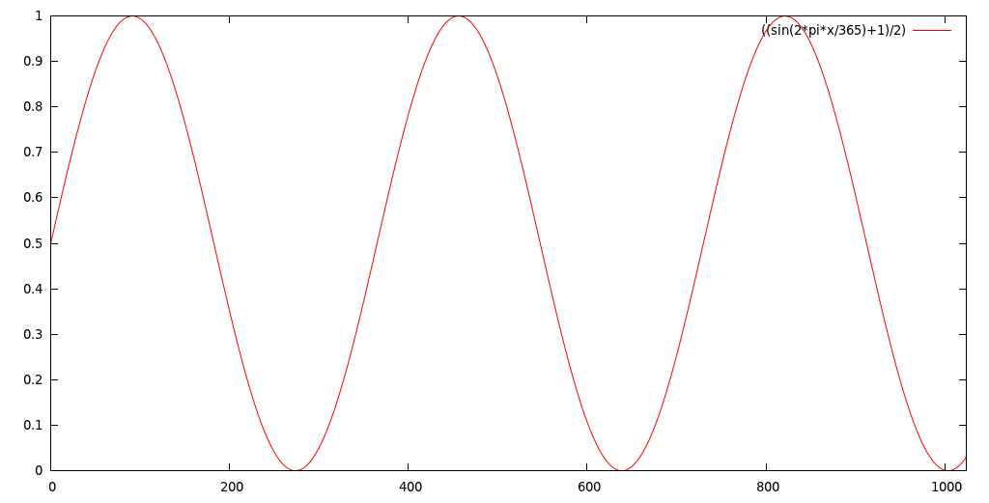
Signals and Methods
Stationary Signal
  Gauss/Fourier Analysis (F.A.)
S. Sig. with singularities → Window G/F.A.
Non Stationary Signal → Wavelet Analysis
Wavelets:
  remedial to lack of time dimension in FT
Notes:
Heideman, M.T., Johnson, D.H., Burrus, C.S. 1984.
Gauss and the History of the Fourier Transform.
IEEE ASSP Magazine

Slide 3
Wavelet Transform
Wavelet transform does not need wavelets (!)
Sub-band coding scheme
Use a constant-Q filter bank
(Mallat, 1989)
Also called Multi-Resolution Analysis
Notes:
Mallat, S.G. 1989 Atheory for multiresolution signal decomposition: the wavelet representation
IEEE Transactions on pattern analysis and machine intelligence. 11(7):674-693

Slide 4
Properties
Basis Functions
  Psi – Wavelet (Band-Pass Filter) aka Mother
  Phi – Scaling (Low-Pass Filter) aka Father
Orthogonality
  f = Σ_{x} < f, x > x
  Perseval's theorem ||f||²=Σ_{x}|<f,x>|²
  f(t) = Σ_{J,k} < f(t), Psi(2^{J}t-k) > Psi(2^{J}t-k)
  f(t) = b₀ Phi(t)+ Σ_{J,k} b_{2^J+k} . Psi(2^{J}t-k)
Notes:
Mother Wavelet is dilated/translated to create a “Band-Pass Filter”

Slide 5
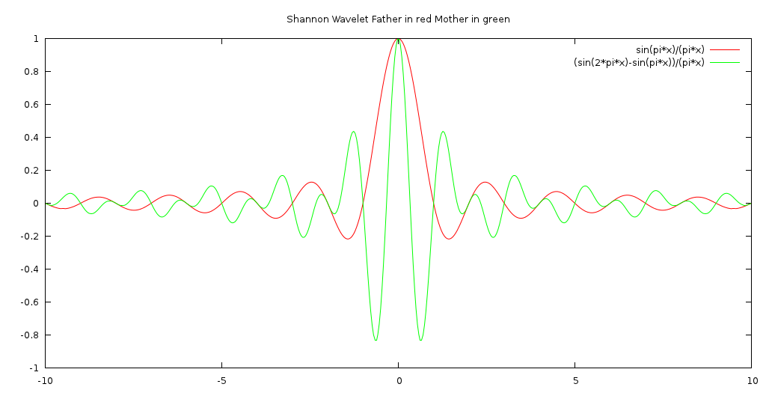
Shannon Wavelet
Notes:
GNUPLOT:
Set sample 500
set title "Shannon Wavelet Father in red Mother in green"
plot [-10:10] sin(pi*x)/(pi*x),(sin(2*pi*x)-sin(pi*x))/(pi*x)
Remark: Father Function is Normalized sinc function
sinc(x) = sin(PIx)/PIx since integral over all x is 1.
The Fourier Transform of the normalized sinc function is the rectangle function with no scaling

Slide 6
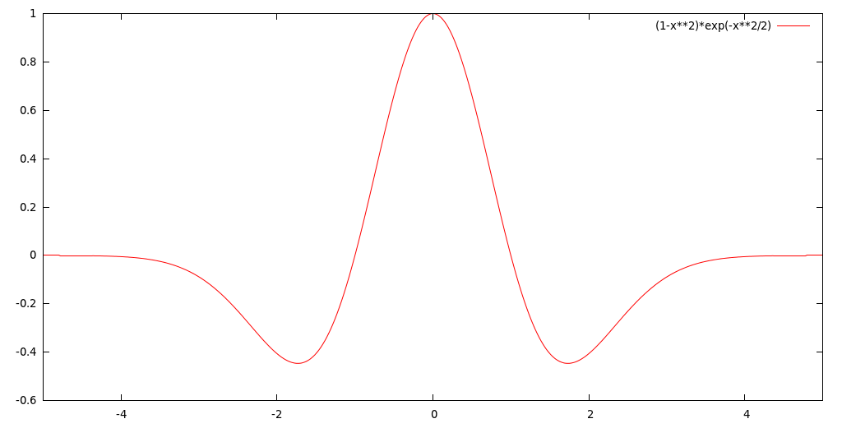
Mexican Hat (DOG n=2)
Notes:
Second derivative of a Gaussian
Psi(t)=(1-t^2)*exp(-t^2/2)

Slide 7
Self-similarity of a signal
Wavelet coefficients values Vs Scale = 2D
2D graph shows patterns
Investigation reveals fractal nature of signals
We will start with the Mexican Hat
and synthetic signals
Then explore some real signal from rainfall
and NDVI

Slide 8
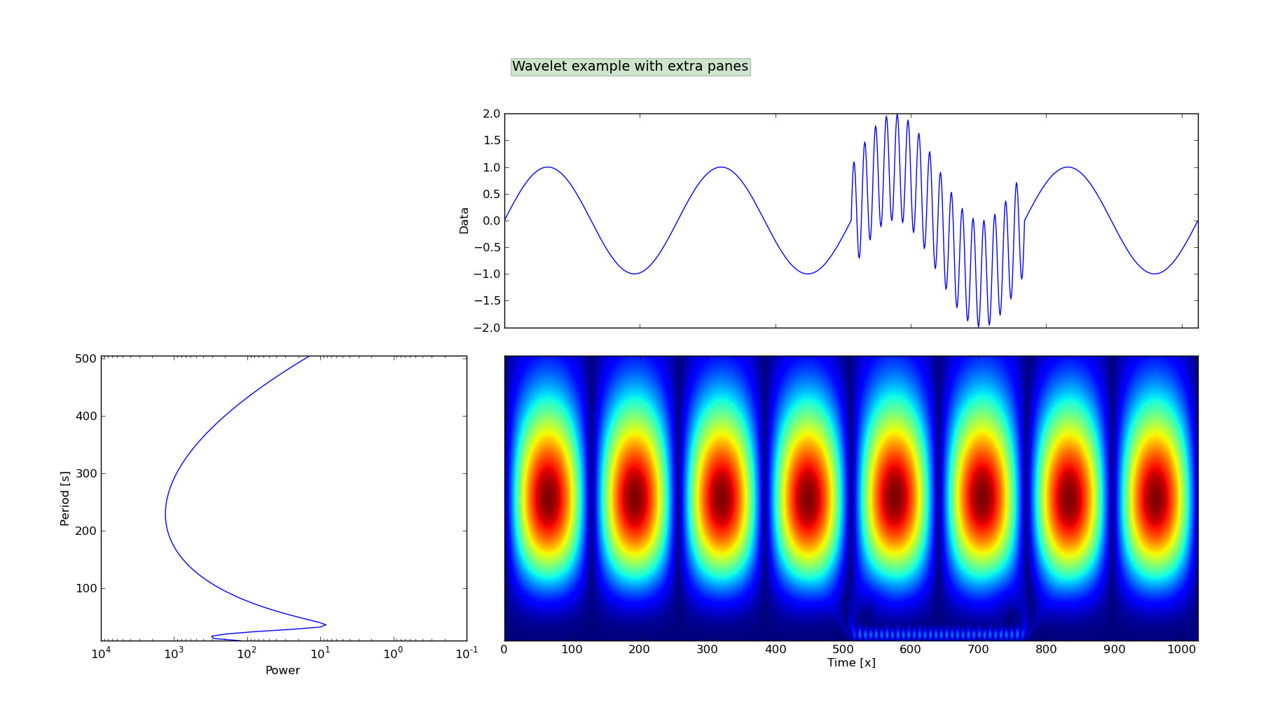
Mexican Hat 16 256
Regular event every 256 days
Sudden event:
Start = 512
End = 768
Has 16 days return period

Slide 9
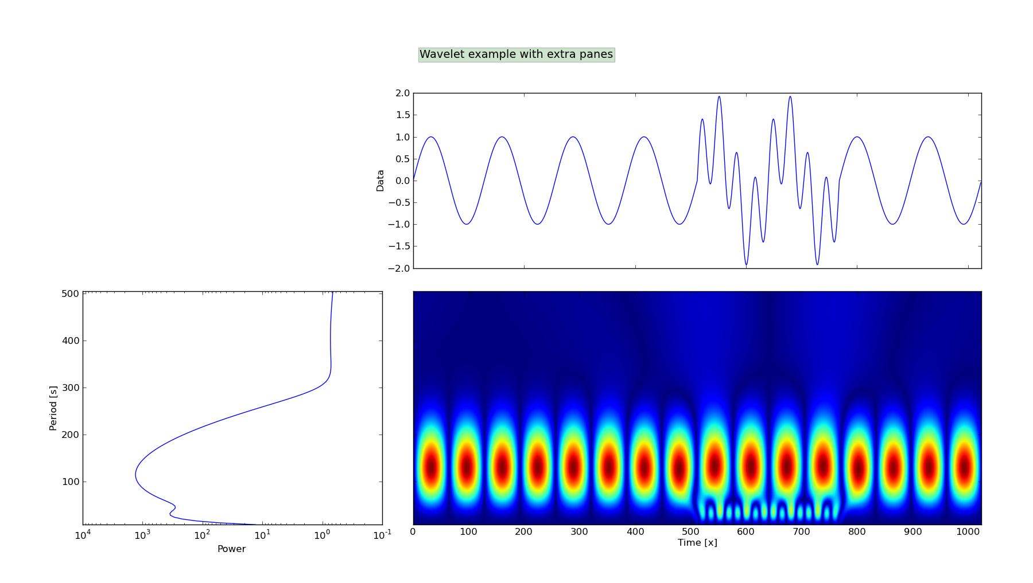
Mexican Hat 32 128
Regular event every 128 days
Sudden event:
Start = 512
End = 768
Has 32 days return period

Slide 10
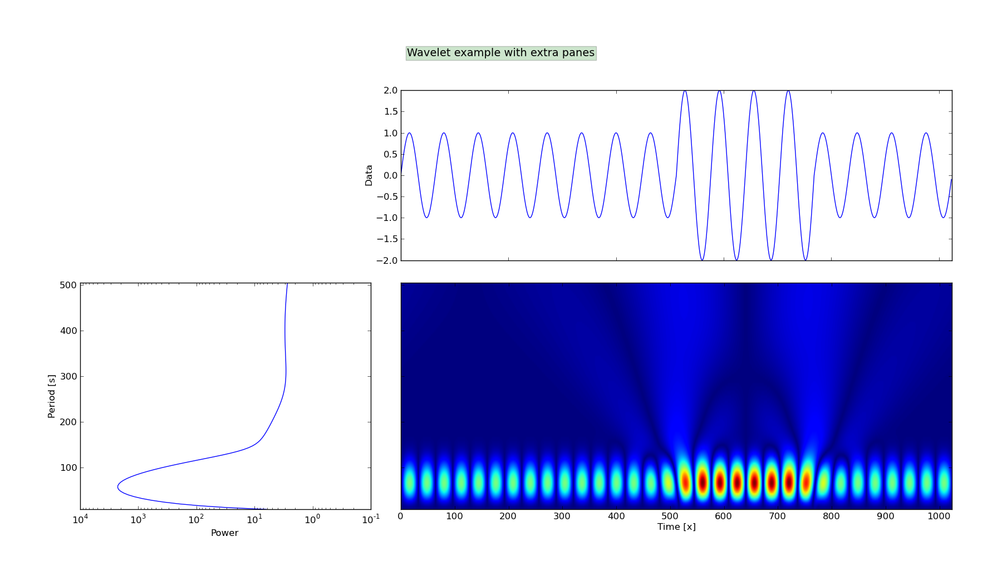
Mexican Hat 64 64
Regular event every 64 days
Sudden event:
Start = 512
End = 768
Has 64 days return period

Slide 11
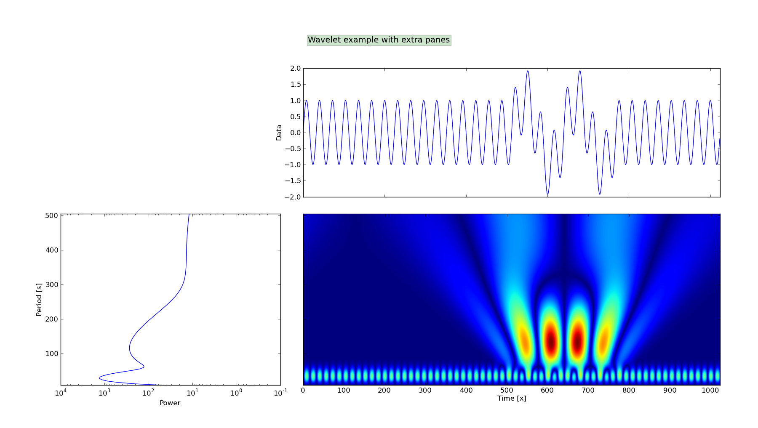
Mexican Hat 128 32
Regular event every 32 days
Sudden event:
Start = 512
End = 768
Has 128 days return period

Slide 12
Karkheh Rainfall (Iran)

Slide 13
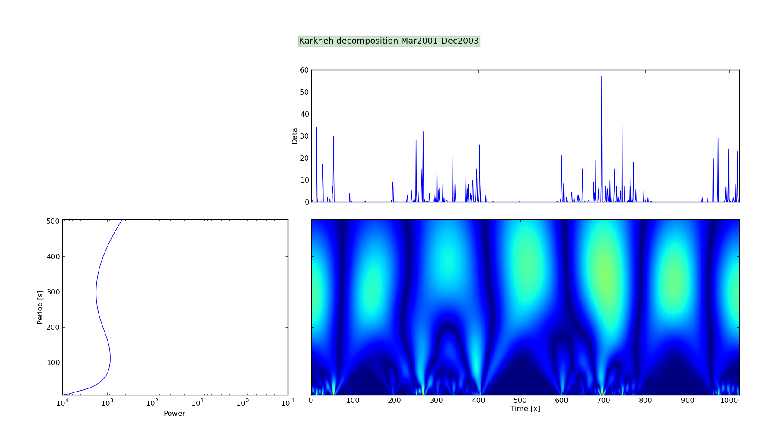
Karkheh Rainfall Decomposition
Regular event every ~300 days
Sudden events:
Start = ?
End = ?
Have 1-? days return period
Notes:
12th March 2001
31st December 2003
1024 days (2^n required for better decomposition)
Location: Navahand Meteorological Station
Eleveation: 1680.9m
Longitude: 48.417
Latitude: 34.15

Slide 14
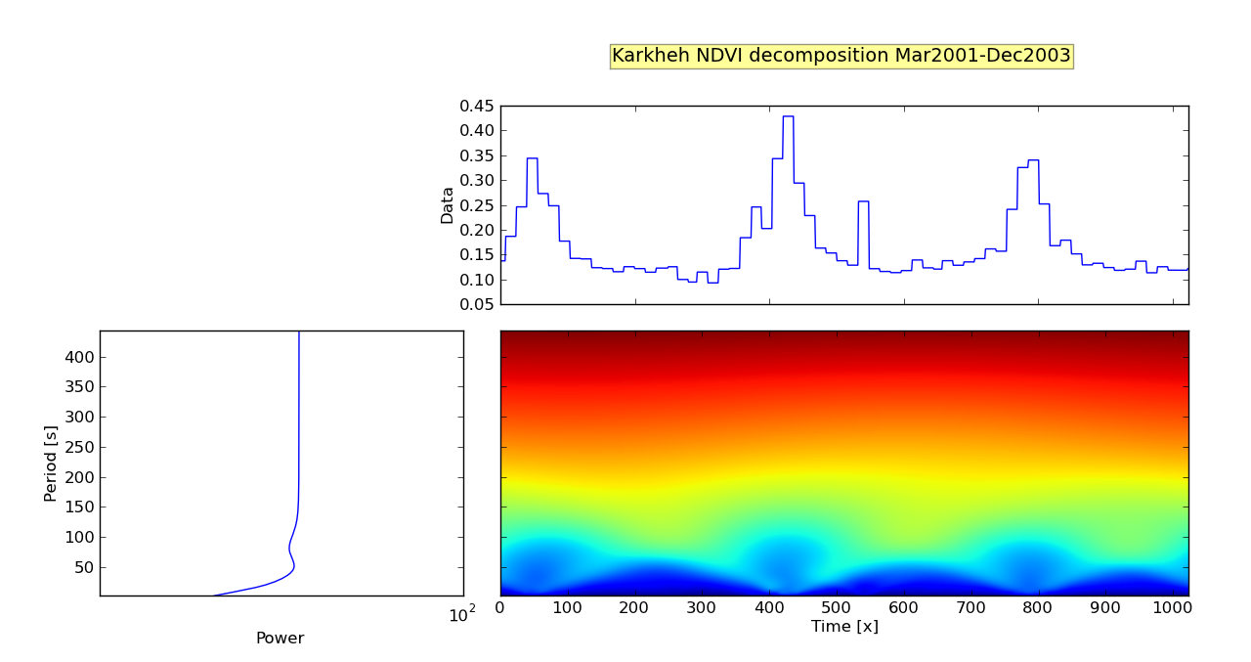
Karkheh NDVI Decomposition
Regular event every ~ 1 y (!)
Sudden events:
Start = ?
End = ?
Have ? days return period

Slide 15
Mixed Recomposition by CIP
WATER software
Downloadable on CIP software page
FFT smooth NDVI and Rainfall
Lag phase correction
  MODIS data ~45-60 days
Wavelet decomposition NDVI / Rainfall
Rec Rainfall

Slide 16
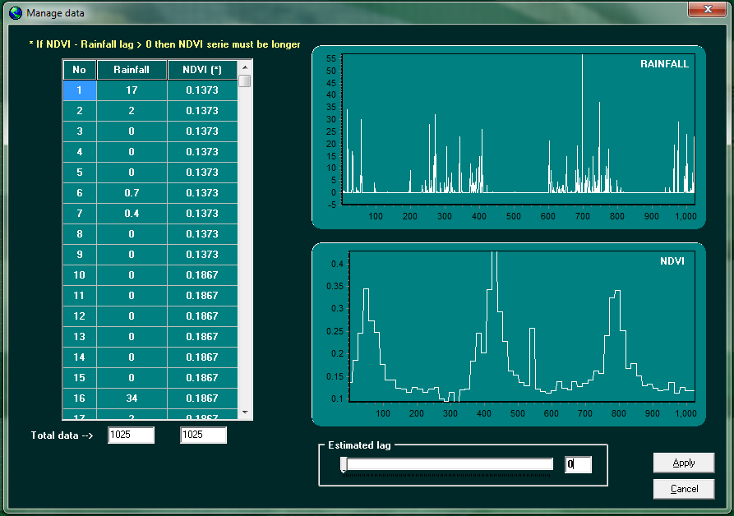

Slide 17
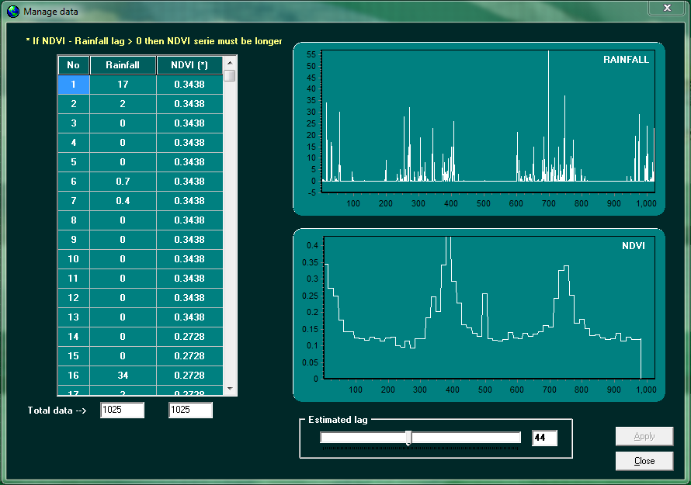

Slide 18
Reconstruction Idea
R@0
R@1
HP1 RAIN
LP2 NDVI
HP2 RAIN

Slide 19
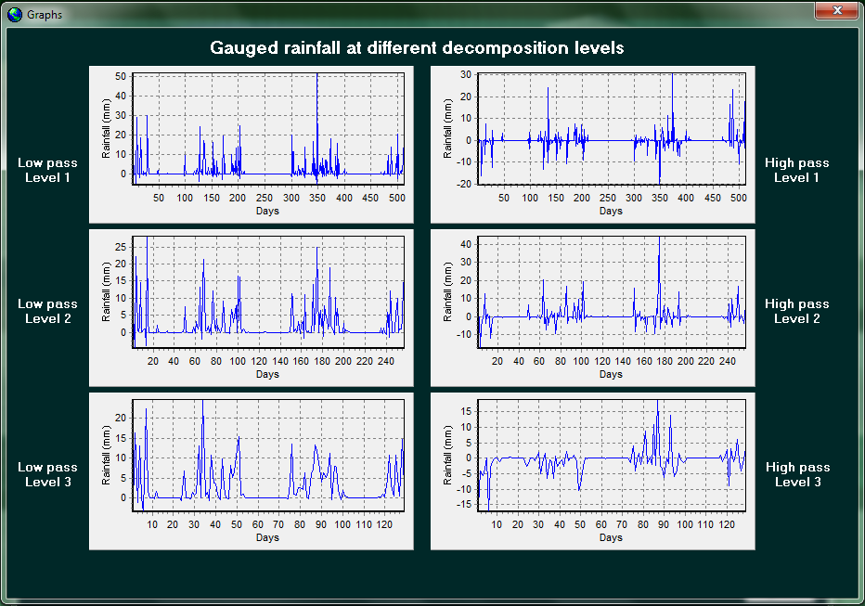
HP1
HP2

Slide 20
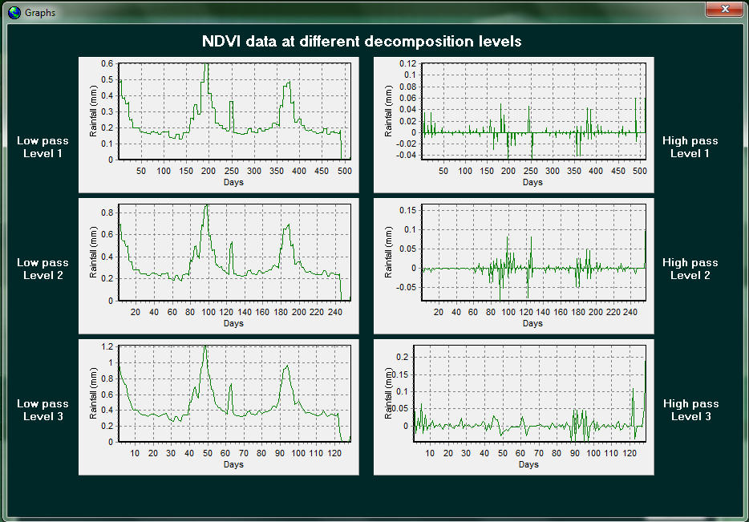
LP2

Slide 21
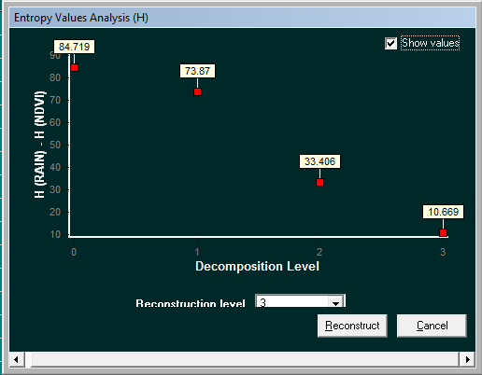
Entropy Check before
Reconstruction
Notes:
Entropy
1. A thermodynamic quantity representing the unavailability of a system's thermal energy for conversion into mechanical work, often interpreted as the degree of disorder or randomness in the system.
2. Lack of order or predictability; gradual decline into disorder
<theory> A measure of the disorder of a system. Systems tend to go from a state of order (low entropy) to a state of maximum disorder (high entropy).
The entropy of a system is related to the amount of information it contains. A highly ordered system can be described using fewer bits of information than a disordered one. For example, a string containing one million "0"s can be described using run-length encoding as [("0", 1000000)] whereas a string of random symbols (e.g. bits, or characters) will be much harder, if not impossible, to compress in this way.
Shannon's formula gives the entropy H(M) of a message M in bits:
H(M) = -log2 p(M)
Where p(M) is the probability of message M.

Slide 22
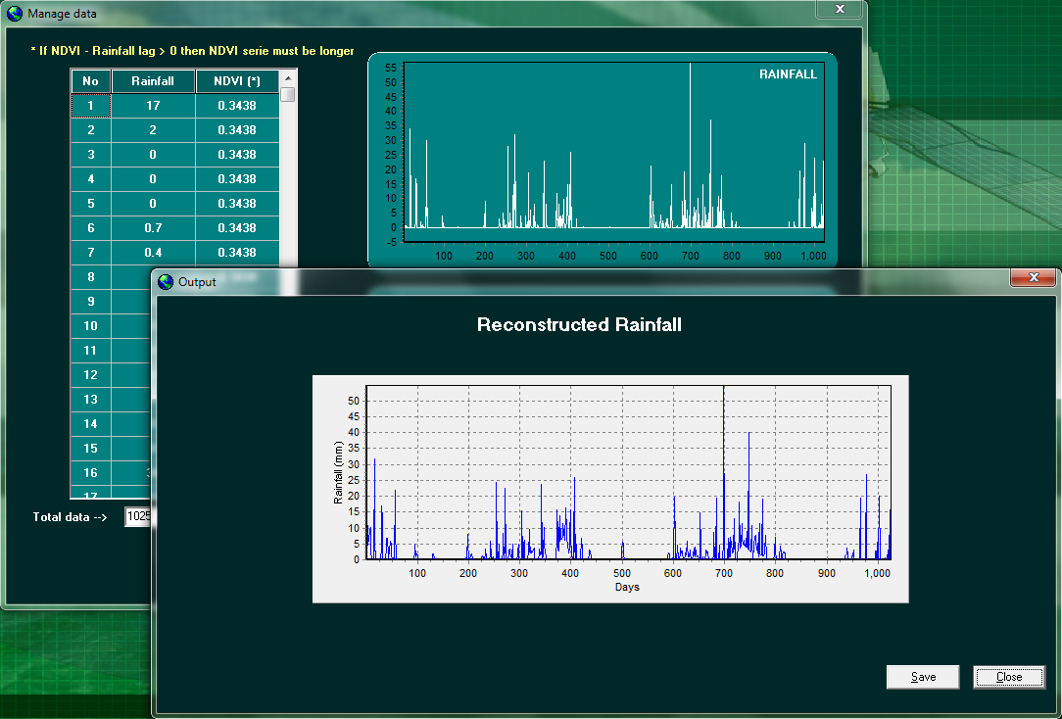

Slide 23
Thank you

Slide 24
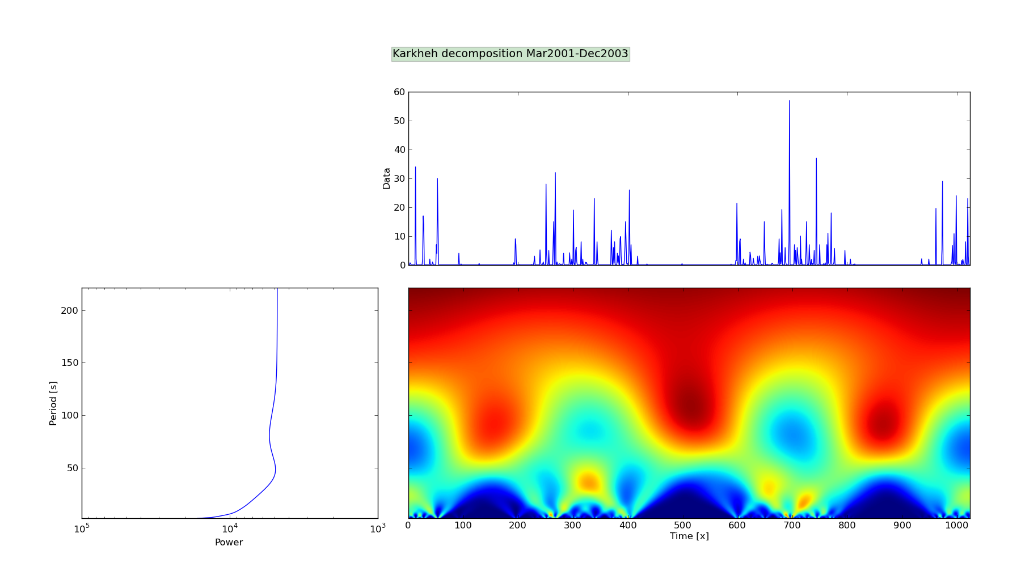
Mexican Hat (Matlab) Karkheh

Slide 25
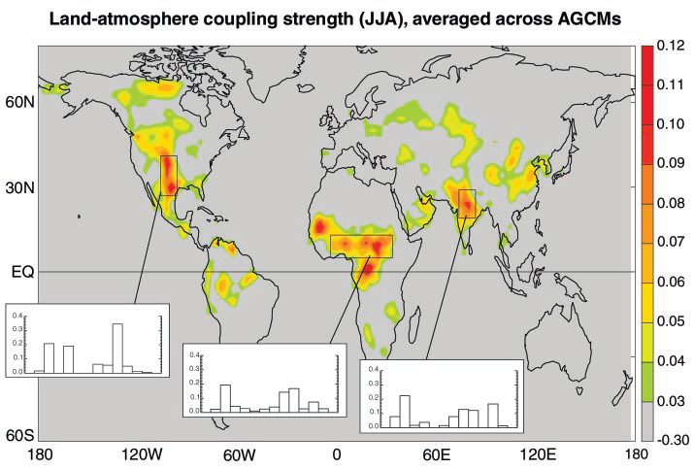
S.M. feed-back to precipitation

Slide 26
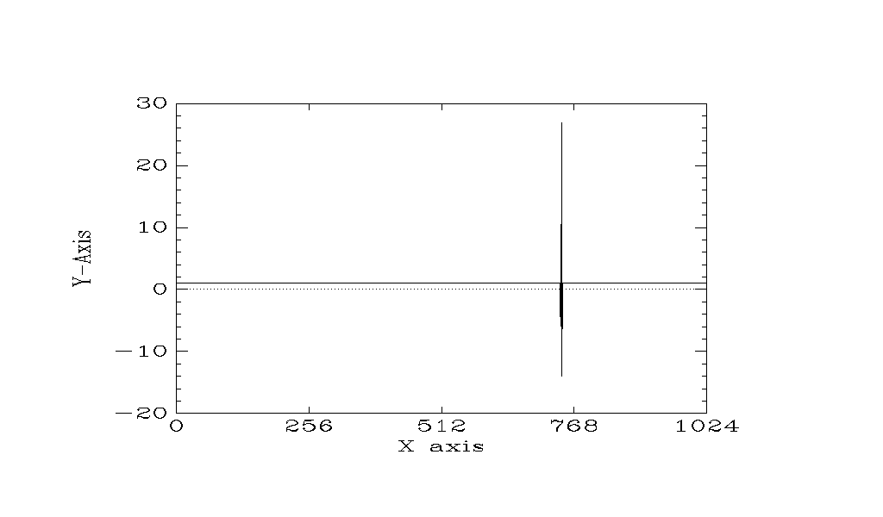
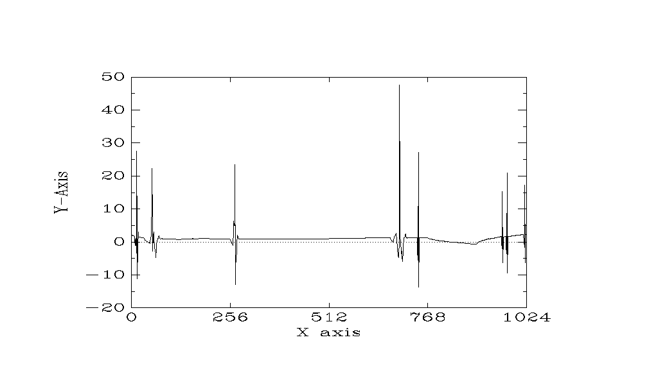
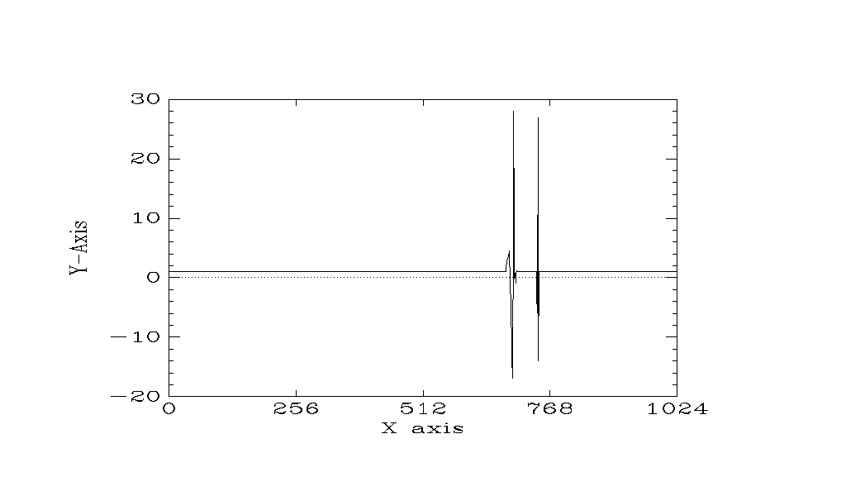
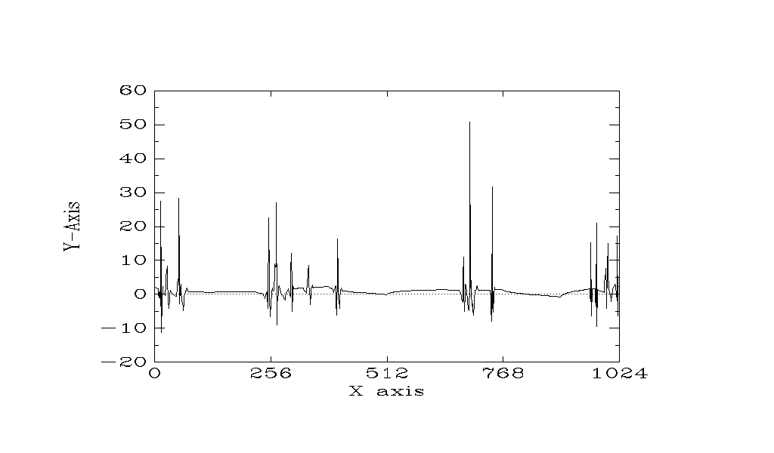
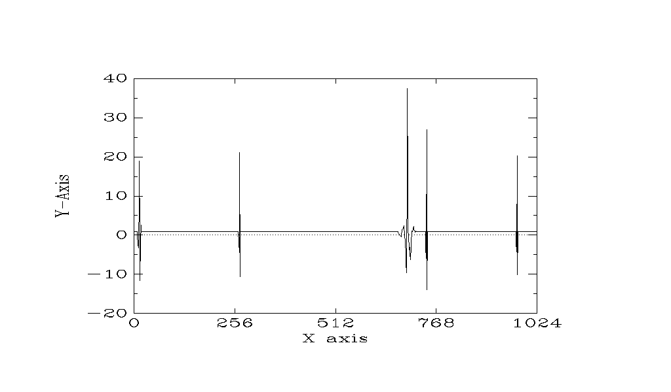
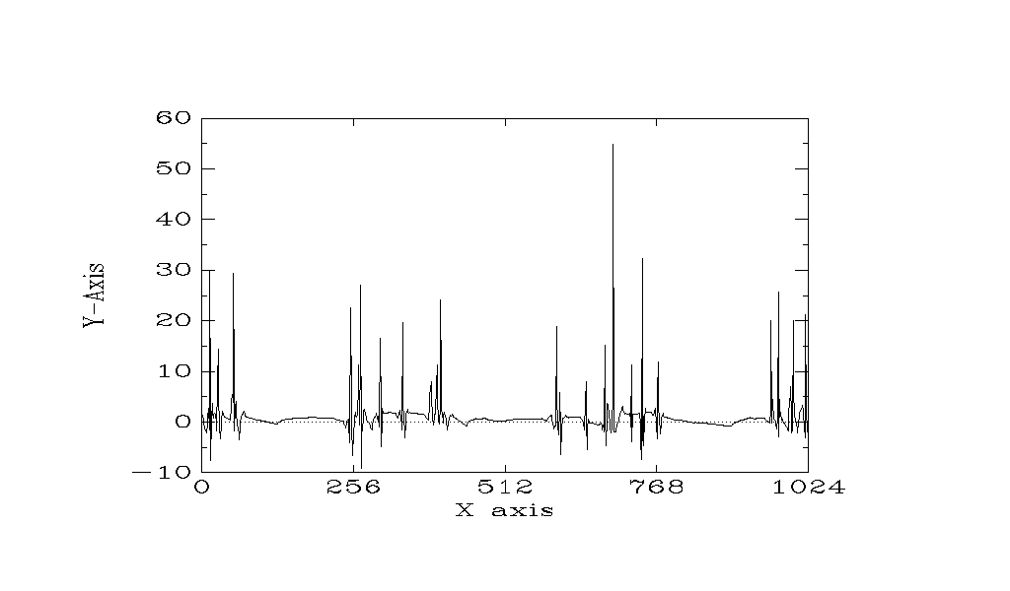

Slide 27


