Slide 1
Wavelet-based spatio-temporal fusion of observed rainfall with NDVI in Sri Lanka
ACRS 2012 – Pattaya, Thailand

Slide 2
Contents
Why do we need that
Methodology
Implementation
Hinkuregoda Exp
Conclusions

Slide 3
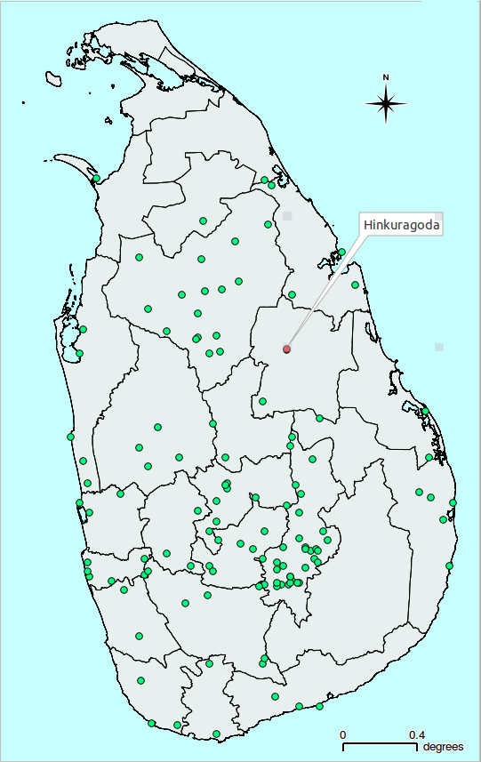

Why do you need that?
Few Meteorological stations
Daily Rainfall points
From point to GRID
With Time-Series
Use vegetation as driver

Slide 4
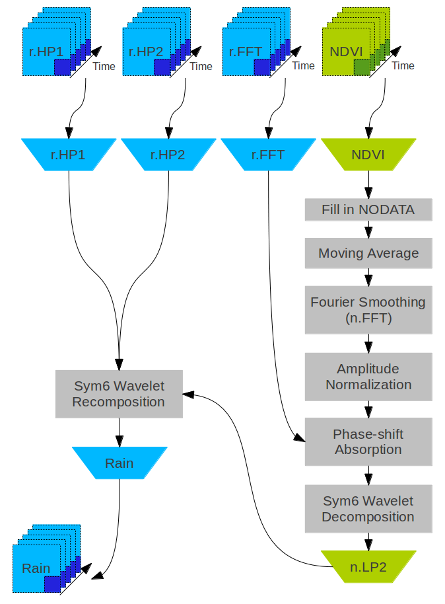
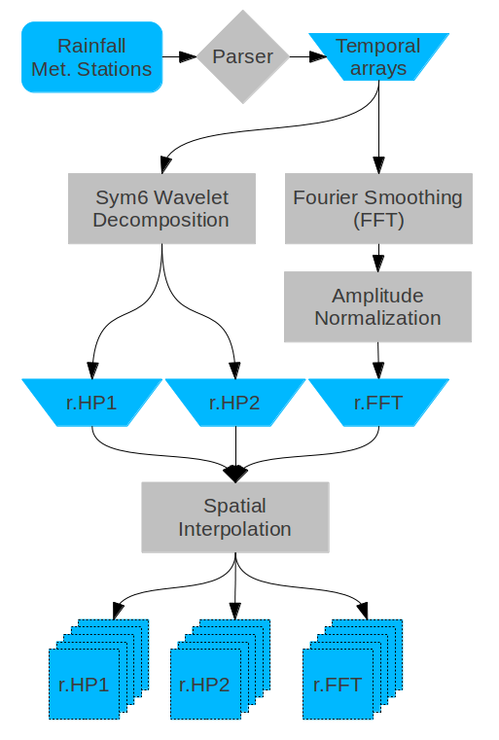
Methodology

Slide 5
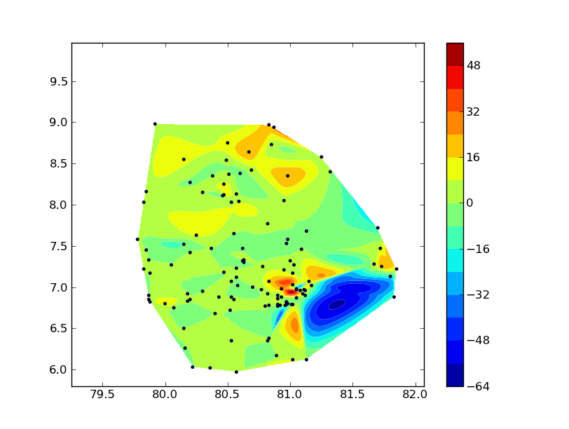
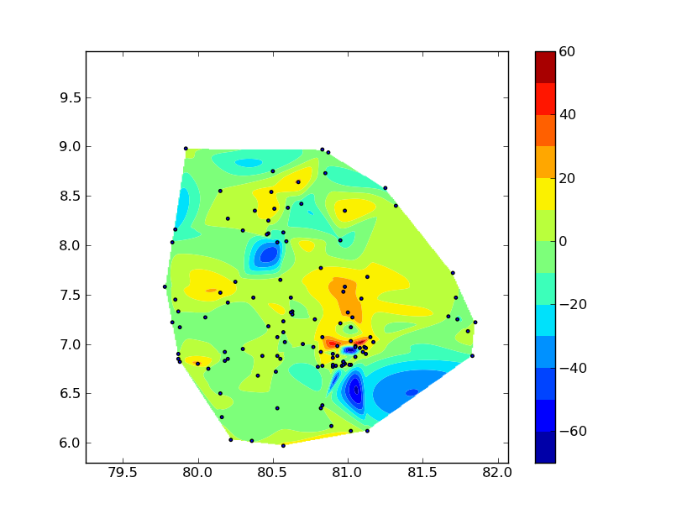
Spatial Interpolation r.HP1&2 @ frequency slice

Slide 6
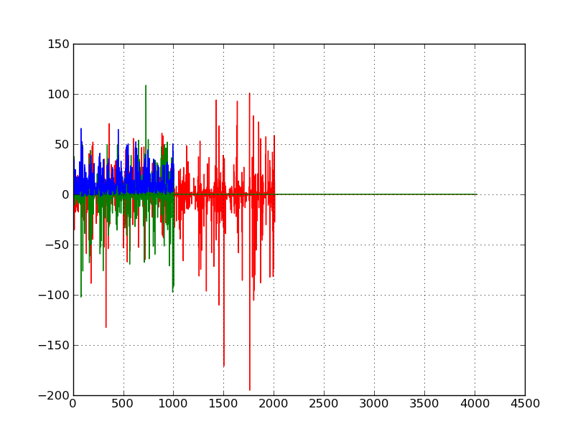
Frequency

Slide 7
Test Rainfall Reconstruction
Is the algorithm working?
Assess the spatial output
Assess the time-series output
Is the procedure loosing data?
Cumulative rainfall consistency check

Slide 8
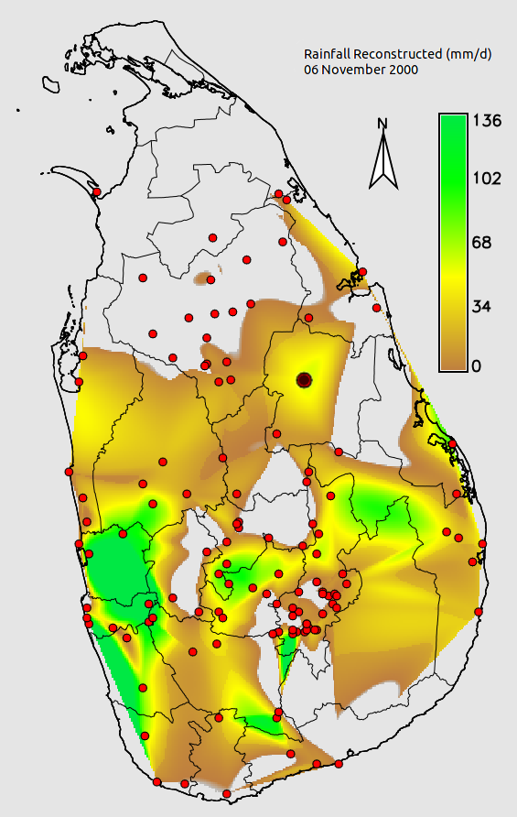
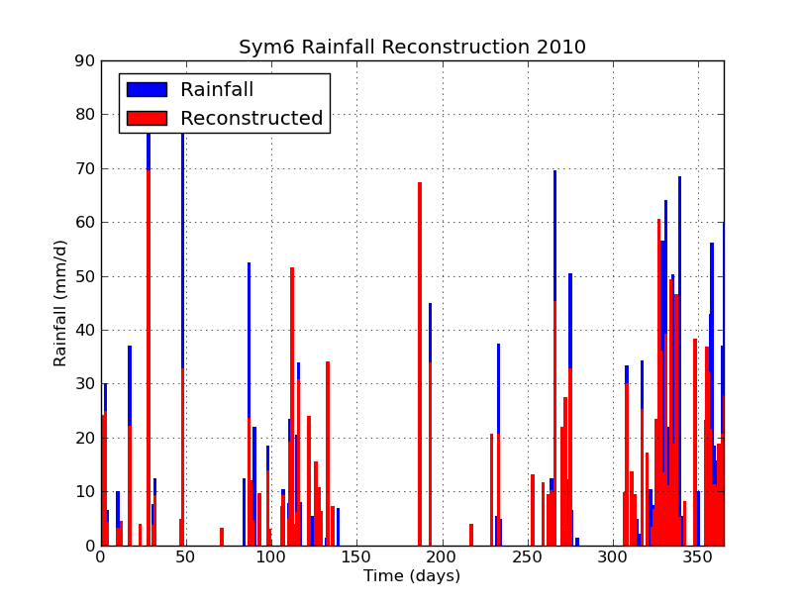
Spatial & Temporal RR

Slide 9
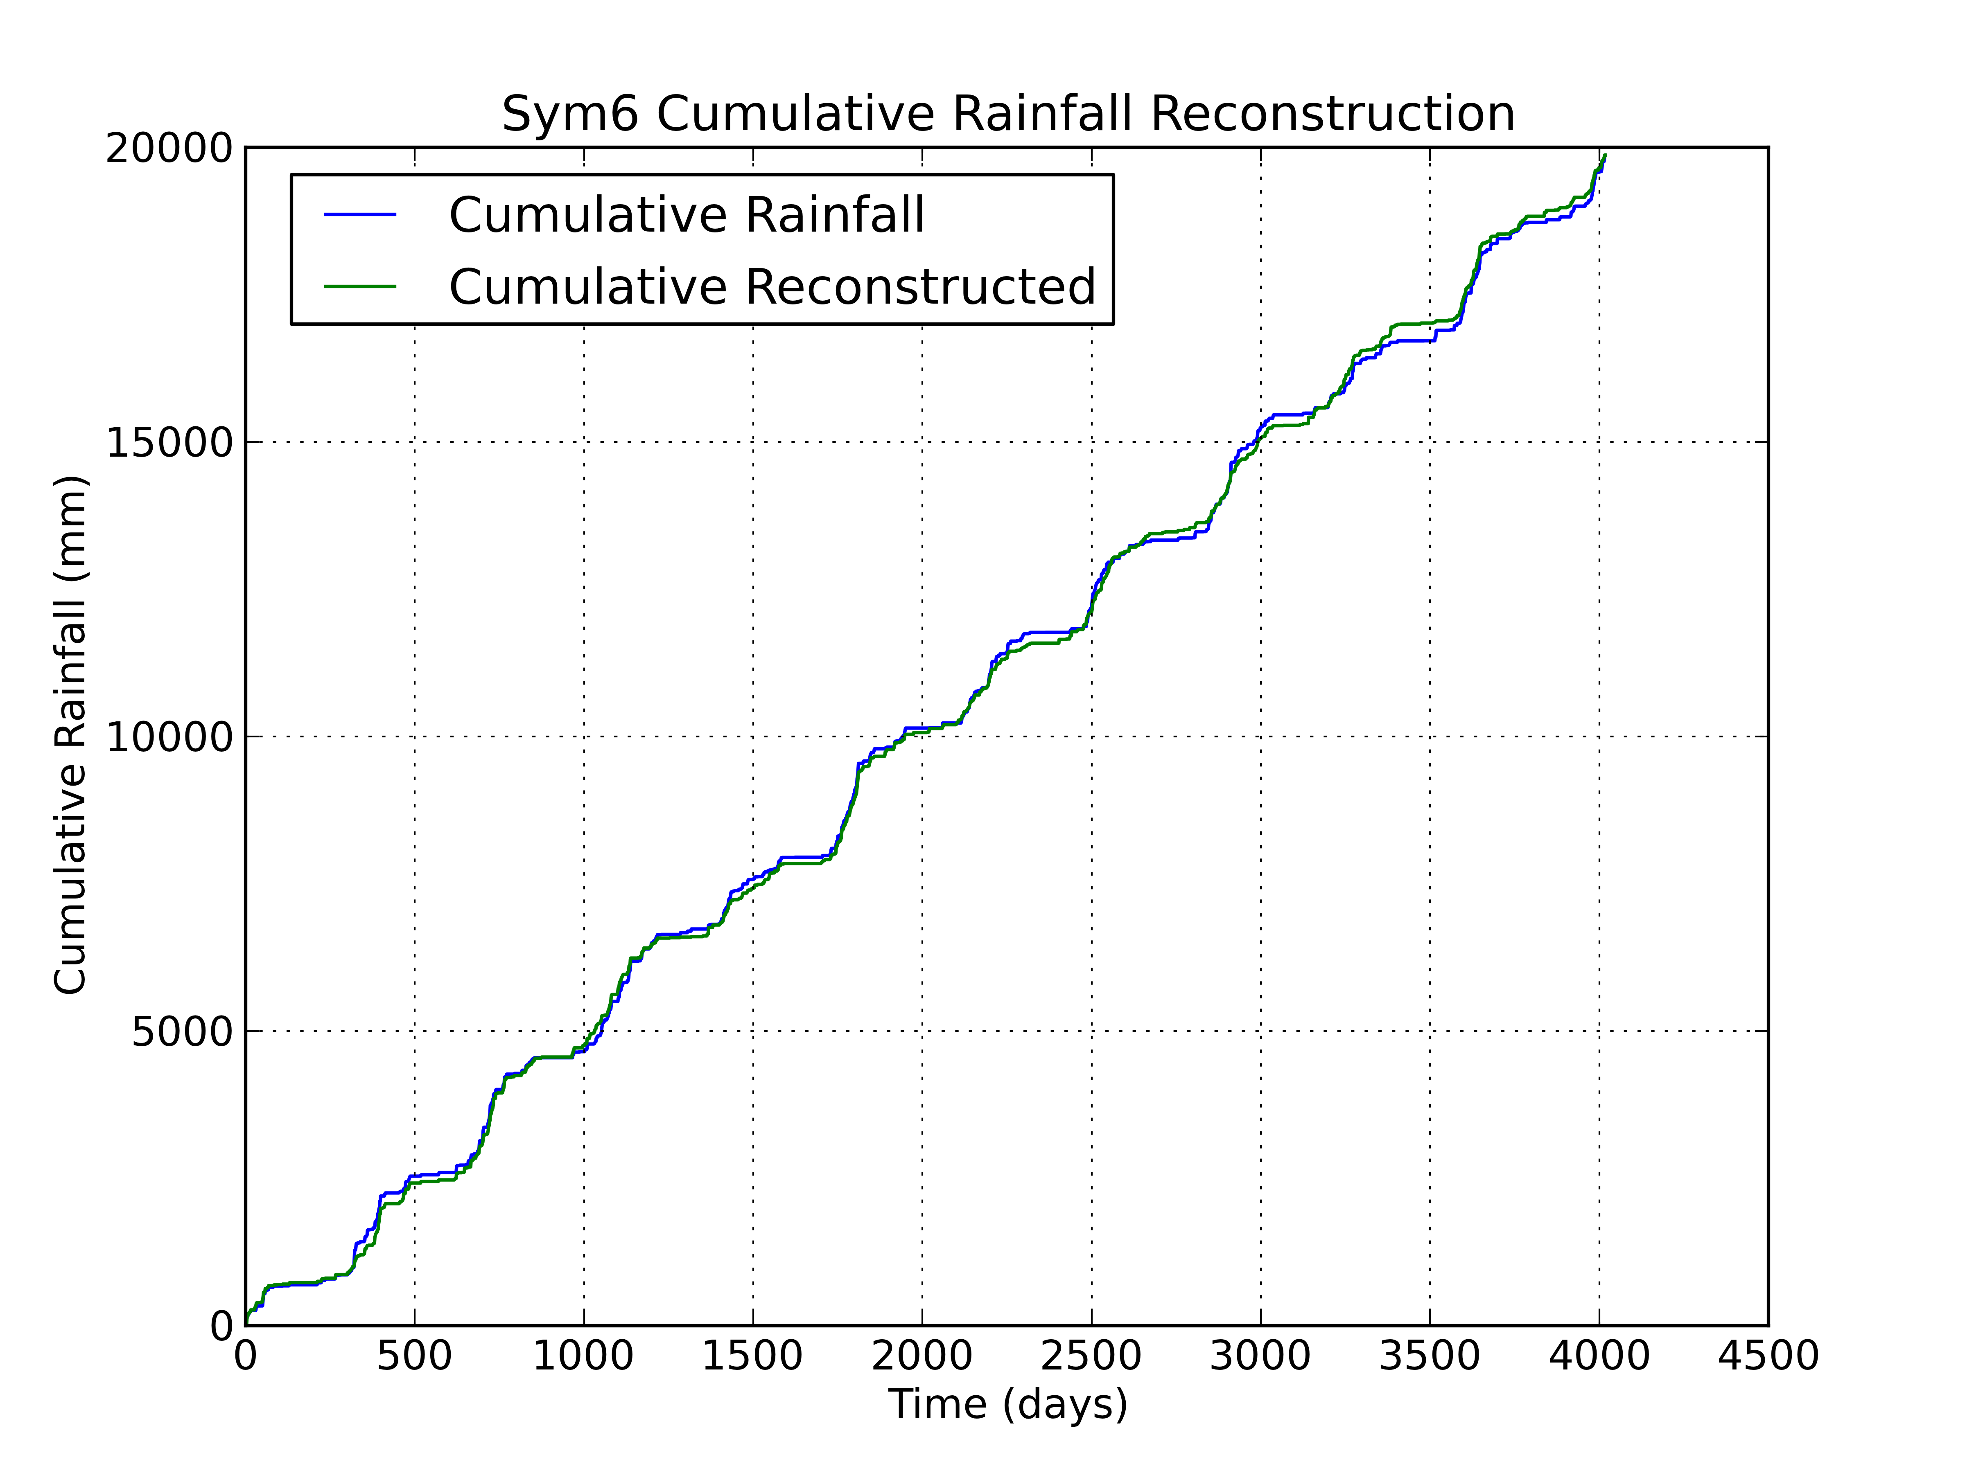
Cumulative RR (11 years)

Slide 10
Hinkuragoda Experiment
Remove Hinkuragoda dataset
Rerun processing
Assess impact on reconstruction
Assess histogram statistics changes

Slide 11
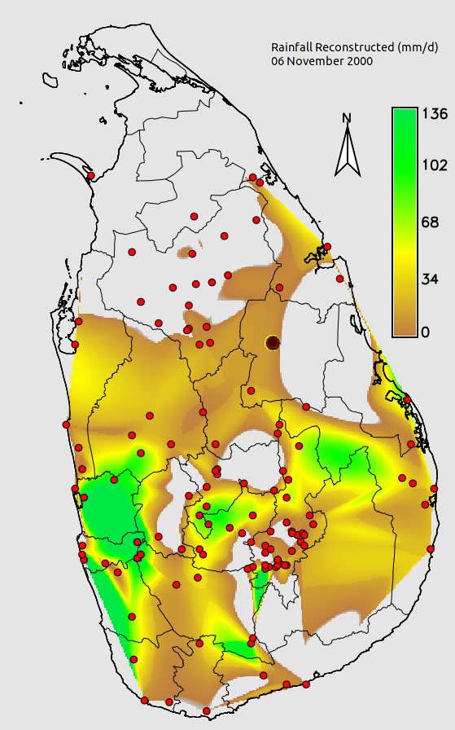
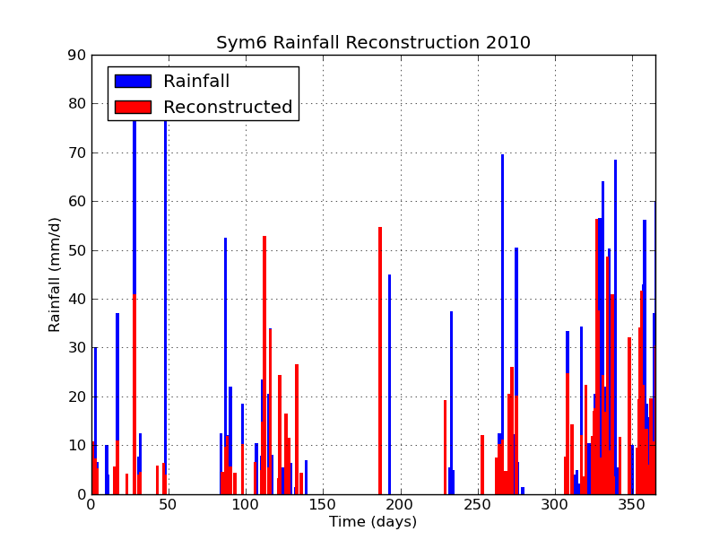
Hinkuragoda Experiment

Slide 12
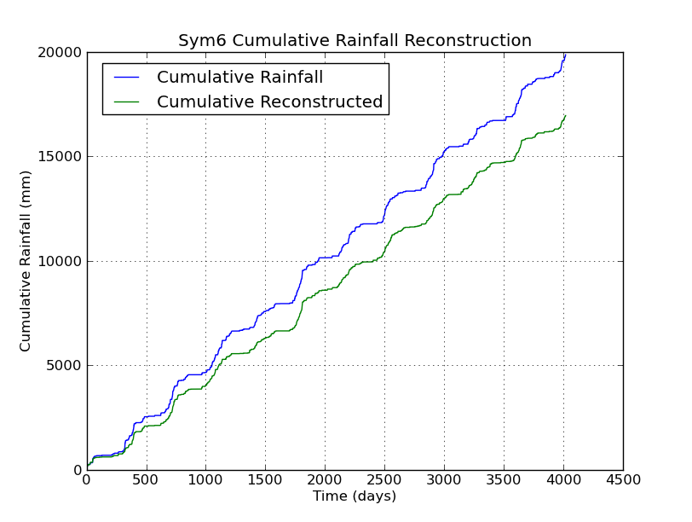
Hinkuragoda Experiment
Experiment Envt
Source rain gauges:
30-50 Km radius
Experiment Results
Cumulative Rainfall:
85% accuracy
Reconstruction:
Linear difference

Slide 13
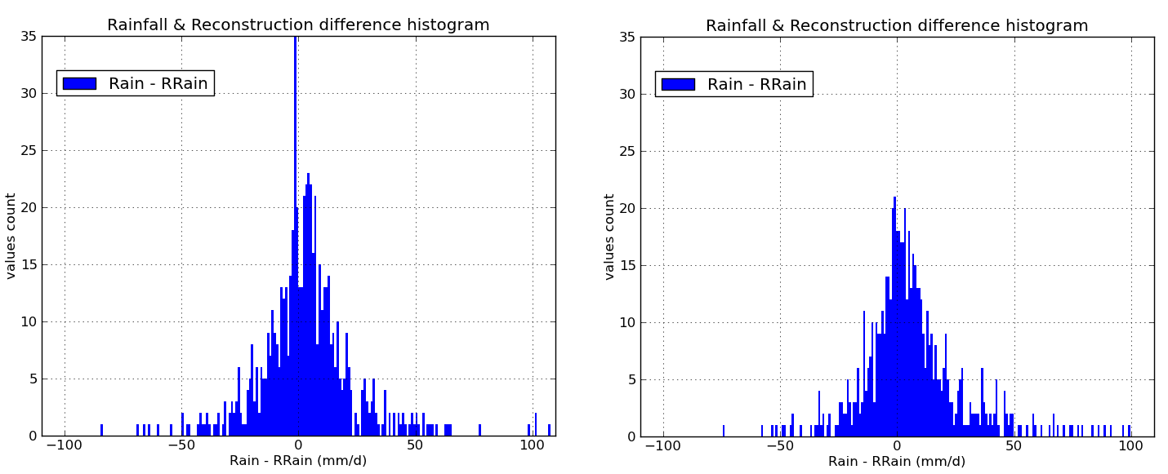
Difference Histograms

Slide 14
Statistical tests
 | Exp1* | Exp2* | Exp1 | Exp2
Sample size | 627 | 618 | 4018 | 4018
Minimum |  |  | -106 | -112
Maximum |  |  | 108 | 110
Arithmetic mean | 3.1 | 6.1 | 0.0 | 0.7
Unbiased variance |  |  | 121 | 132
Biased skewness | 0.6 | 0.9 | 0.6 | 1.6
Biased kurtosis | 4.4 | 3.1 | 21 | 21
* Removed diff=0
Histogram shapes
No changes

Slide 15
On-Going Thoughts
Working well with representative met.Stations
Distance to Met Stations induces errors
Errors for cumulative rainfall: linear only
Climate zoning Vs Heterogeneity

Slide 16
RR Applications
Ungauged basins
    Improve sampling rate of hydrological modeling
Regional climate modeling
    RegCM (Solomon is using it):
      Precip Evap. overestimation in Version 3
      Precip forcing: EnKF assimilate Cevap to obs. Precip & Ev
Food Security forecasting models
    Markov chains, EnKF etc to store momentum of variations
    Higher S-T res than actual for FS forecasting models
Agricultural insurance

Slide 17
Thank you

