Slide 1
Remote Sensing of
Soil Moisture

Slide 2
Soil Moisture
Appears in:
  Climate forecasting
  Thermal buffering (seasons, urban heat islands)
  Plants transpire water from < 1 meter soil column
  Crop yields
Microwave satellites
  AMSR-E
  SMOS
  And more ...
Moisture content down to a few centimeters
Repeated measurements within a day helps extrapolation

Slide 3
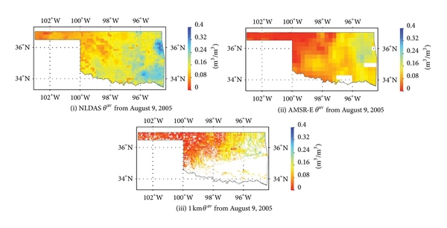
Microwave RS
Relating
  dielectric permittivity of soils
  with soil profile water content
Simulated (left)
AMSR-E (right)
Soil Moisture (below)
http://www.hindawi.com/isrn/soil.science/2013/424178/

Slide 4
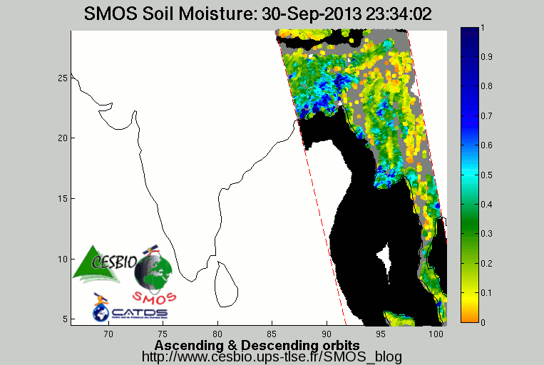

Slide 6
Thermal satellites
Thermal satellites
  AVHRR
  MODIS
  Landsat (not daily !)
Possible to use
  Thermal temporal difference
  2 succeeding days
Limited accuracy still...

Slide 7
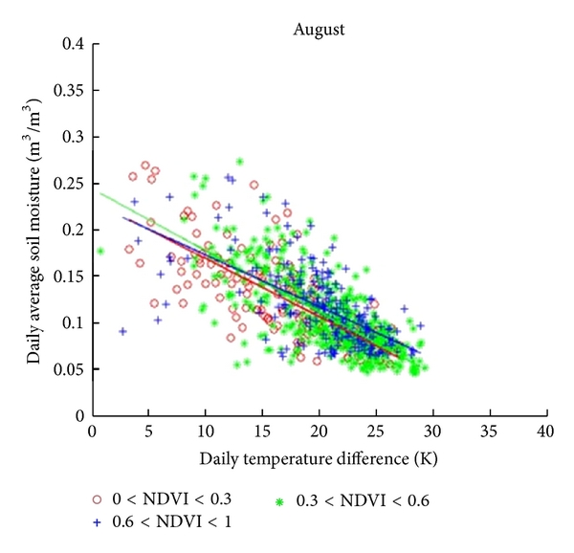
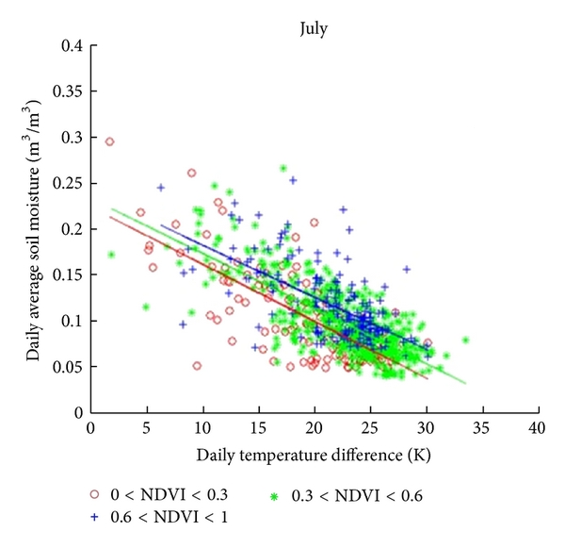
Daily temperature difference
http://www.hindawi.com/isrn/soil.science/2013/424178/fig18/
Daily temperature difference versus daily average soil moisture corresponding to latitude: 101.875°W~102°W; longitude: 35.125°N~35.625°N and different NDVI values for June and July (Satellite used was MODIS @ 1Km resolution)

Slide 8
Conclusion
Remote Sensing of soil moisture
  Still a challenge
  Has been in research since 1980s
  Microwave imaging
  Thermal imaging
  Limited successes in spatial resolution

Slide 9
Thank you

