Slide 1
Determining spatial and temporal patterns of submergence in rice
Yann Chemin¹, Surajit Phuphak², Sonia Asilo³, Robert Hijmans⁴
¹International Water Management Institute, Sri Lanka
²Ubon-Rachathani University, Thailand
³International Rice Research Institute, The Philippines
⁴University of California at Davis, USA

Slide 2
Submergence of rice
Water level rises above rice crop canopy
Rice plant response → elongate shoots above the rising water level
Costs energy → Reduce yield
Sub1 Rice gene, nearly stops the natural elongation process
MABX Introgression into local rice variety
Sustain submerged about 2 weeks
Notes:
Submergence is the condition by which the water level rises above the rice crop canopy. General rice plant response to submergence is to elongate its shoots above the rising water level. This costs in energy and eventually has a direct impact in terms of reducing yields. A specific gene, called Sub1, when introgressed into popular rice varieties by Marker Assisted Back-crossing, nearly stops the natural elongation process and permits that local rice variety to sustain submerged conditions for a generally recognized period of about 2 weeks.

Slide 3
Location of submergence
Plant breeders now look for well-identified and location-accurate submergence areas
High temporal RS surface water maps
Percentage of occurrence: surface water
Rice maps + crop calendars
Two study areas:
  Northeastern Thailand
  Nueva Ecija in North Central Philippines.
Notes:
Plant breeders now look for well-identified and location-accurate submergence areas in order to disseminate such improved local rice varieties. Remote sensing is proposed to provide surface water maps at high temporal resolution, determining a percentage of occurrences of surface water for a given pixel. Rice area maps and knowledge of crop calendars are proposed to add to the assessment of submergence prone areas in two study areas, the Northeastern Thailand and Nueva Ecija in North Central Philippines.

Slide 4
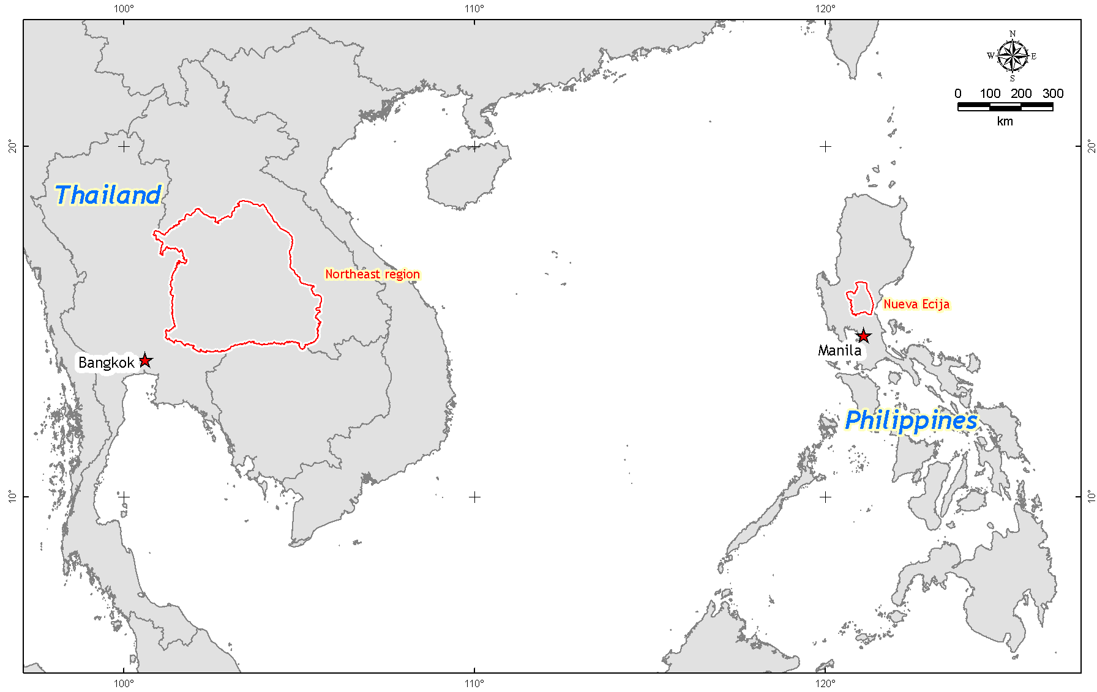

Slide 5
Rice area losses from flood

Slide 6
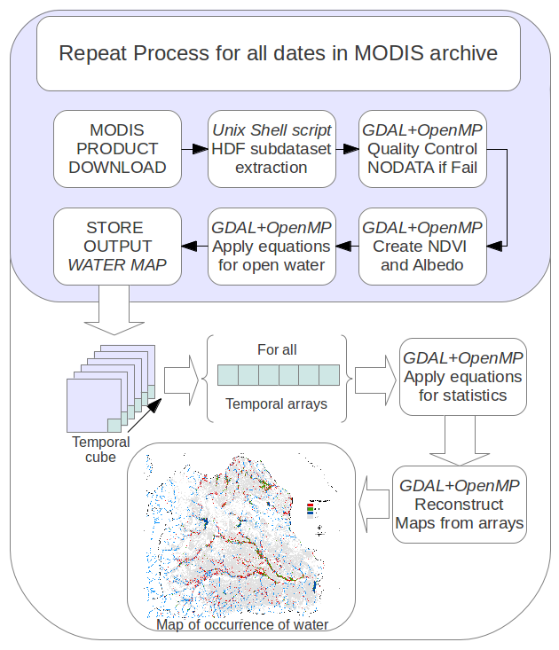
Methodology

Slide 7
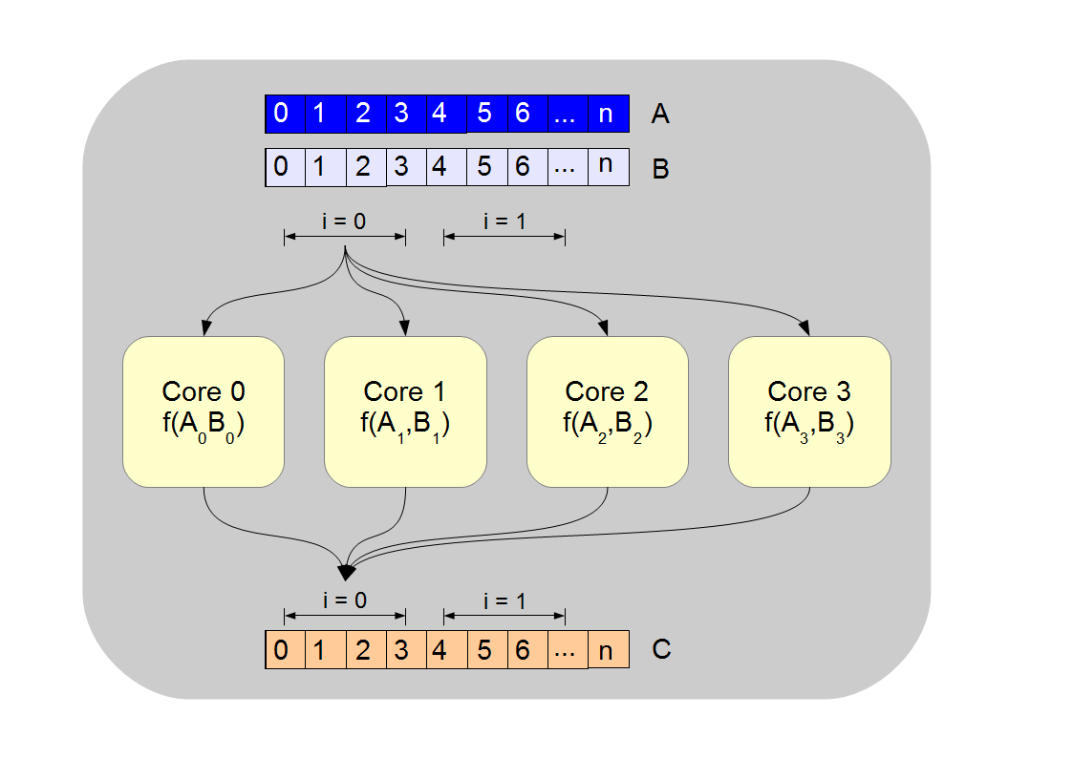
Methodology (HPC)

Slide 8
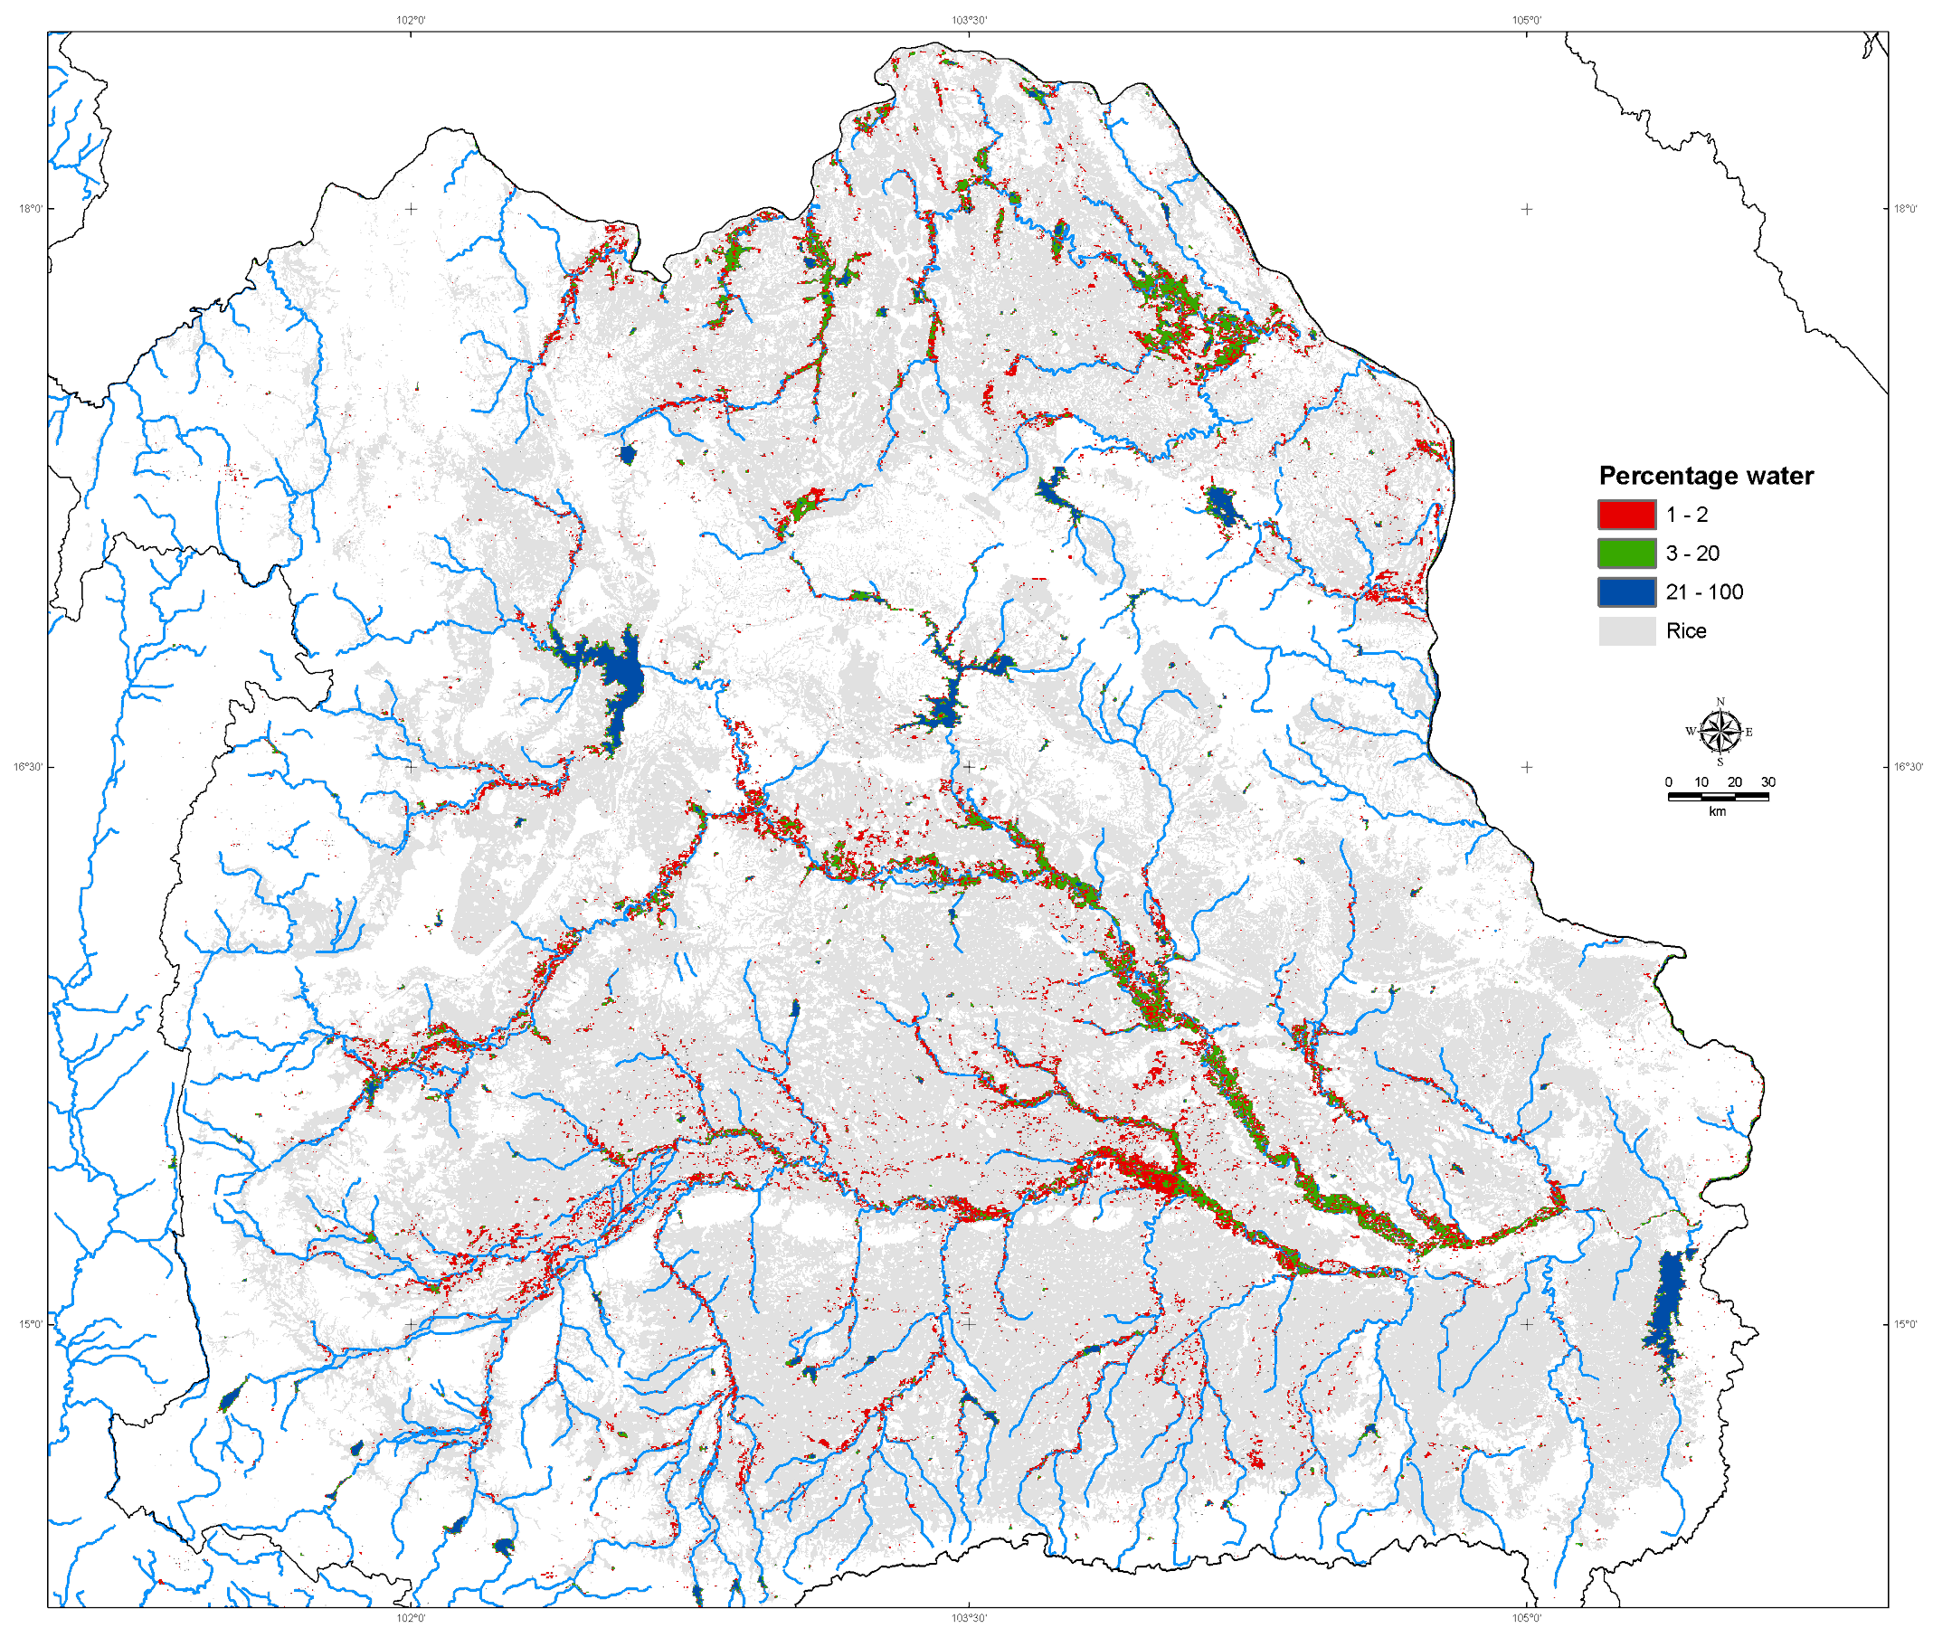
Occurrence (10 years)
Thailand (NE)
Notes:
Percentage flood occurrence 2000-2008
The red color in figure 4 above is a surface water occurrence of 1-10% for all images analyzed. In Northeastern Thailand, if only the 3 months rainfall peak is taken (August-October, not shown) the occurrence on the same areas expands to a range of about 5-30%. This can be stronger (figure 5 right side, below) on a single month period of September occurrences ranging 10-75%.

Slide 9
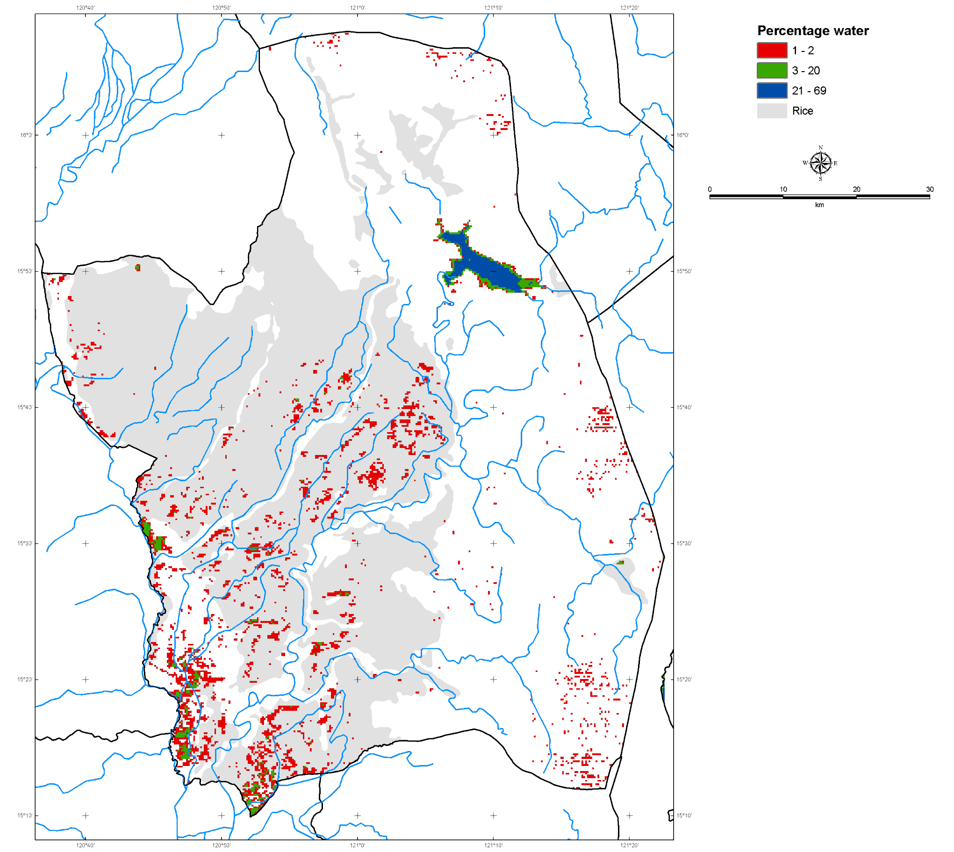
Occurrence (10 years)
The Philippines
(Nueva Ecija)
Notes:
Percentage flood occurrence 2000-2008

Slide 10
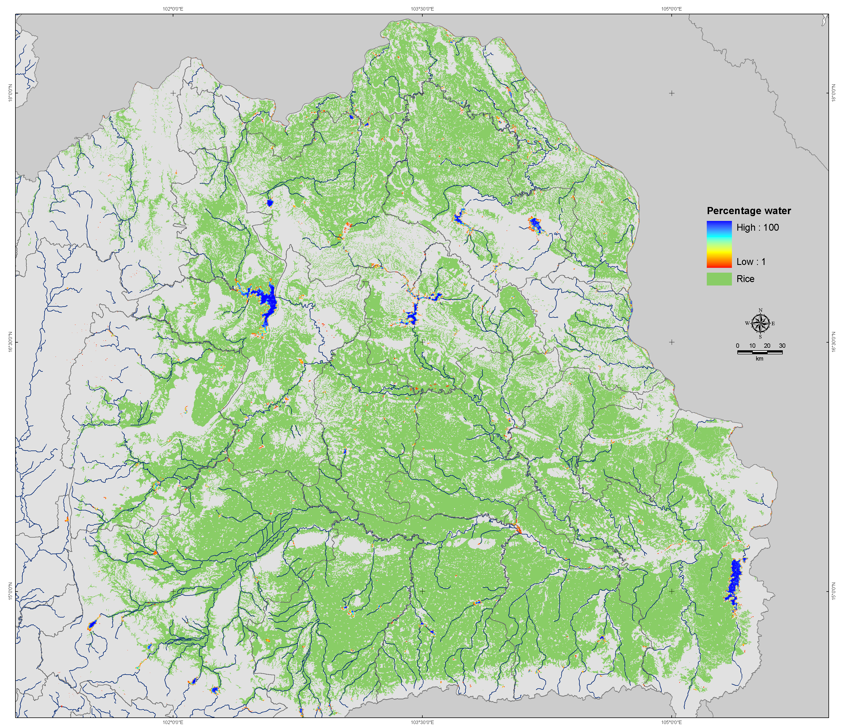
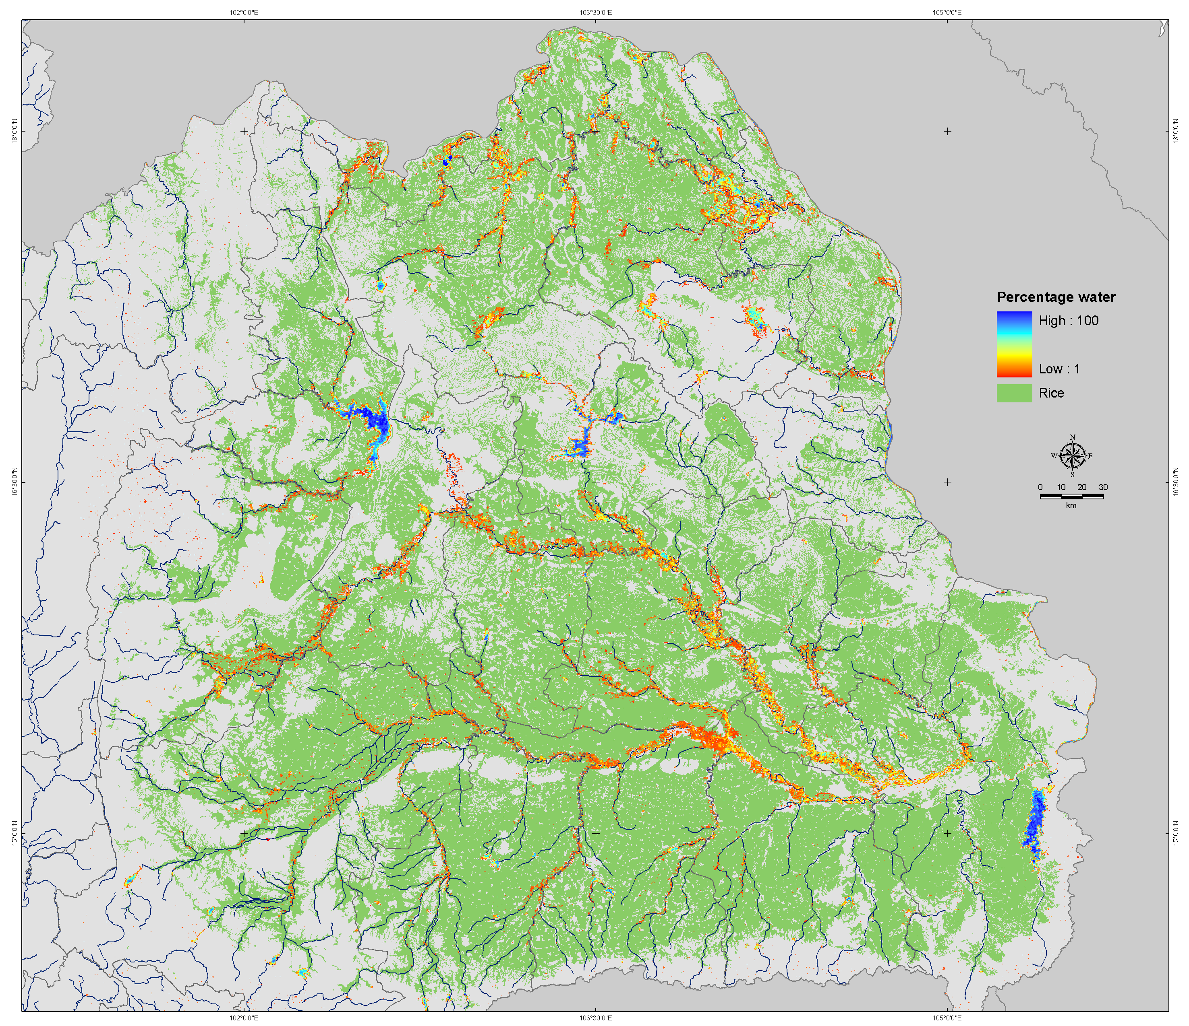
TH: January & September

Slide 12
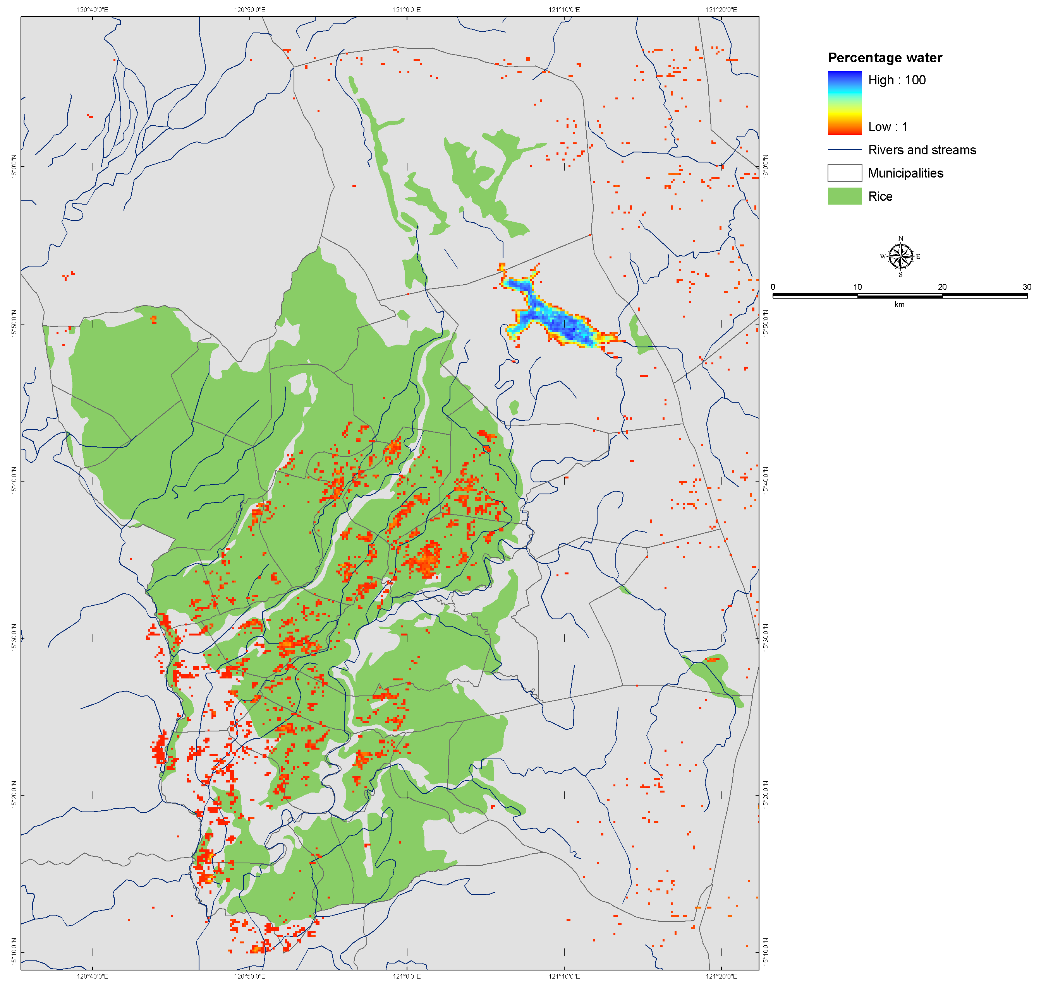
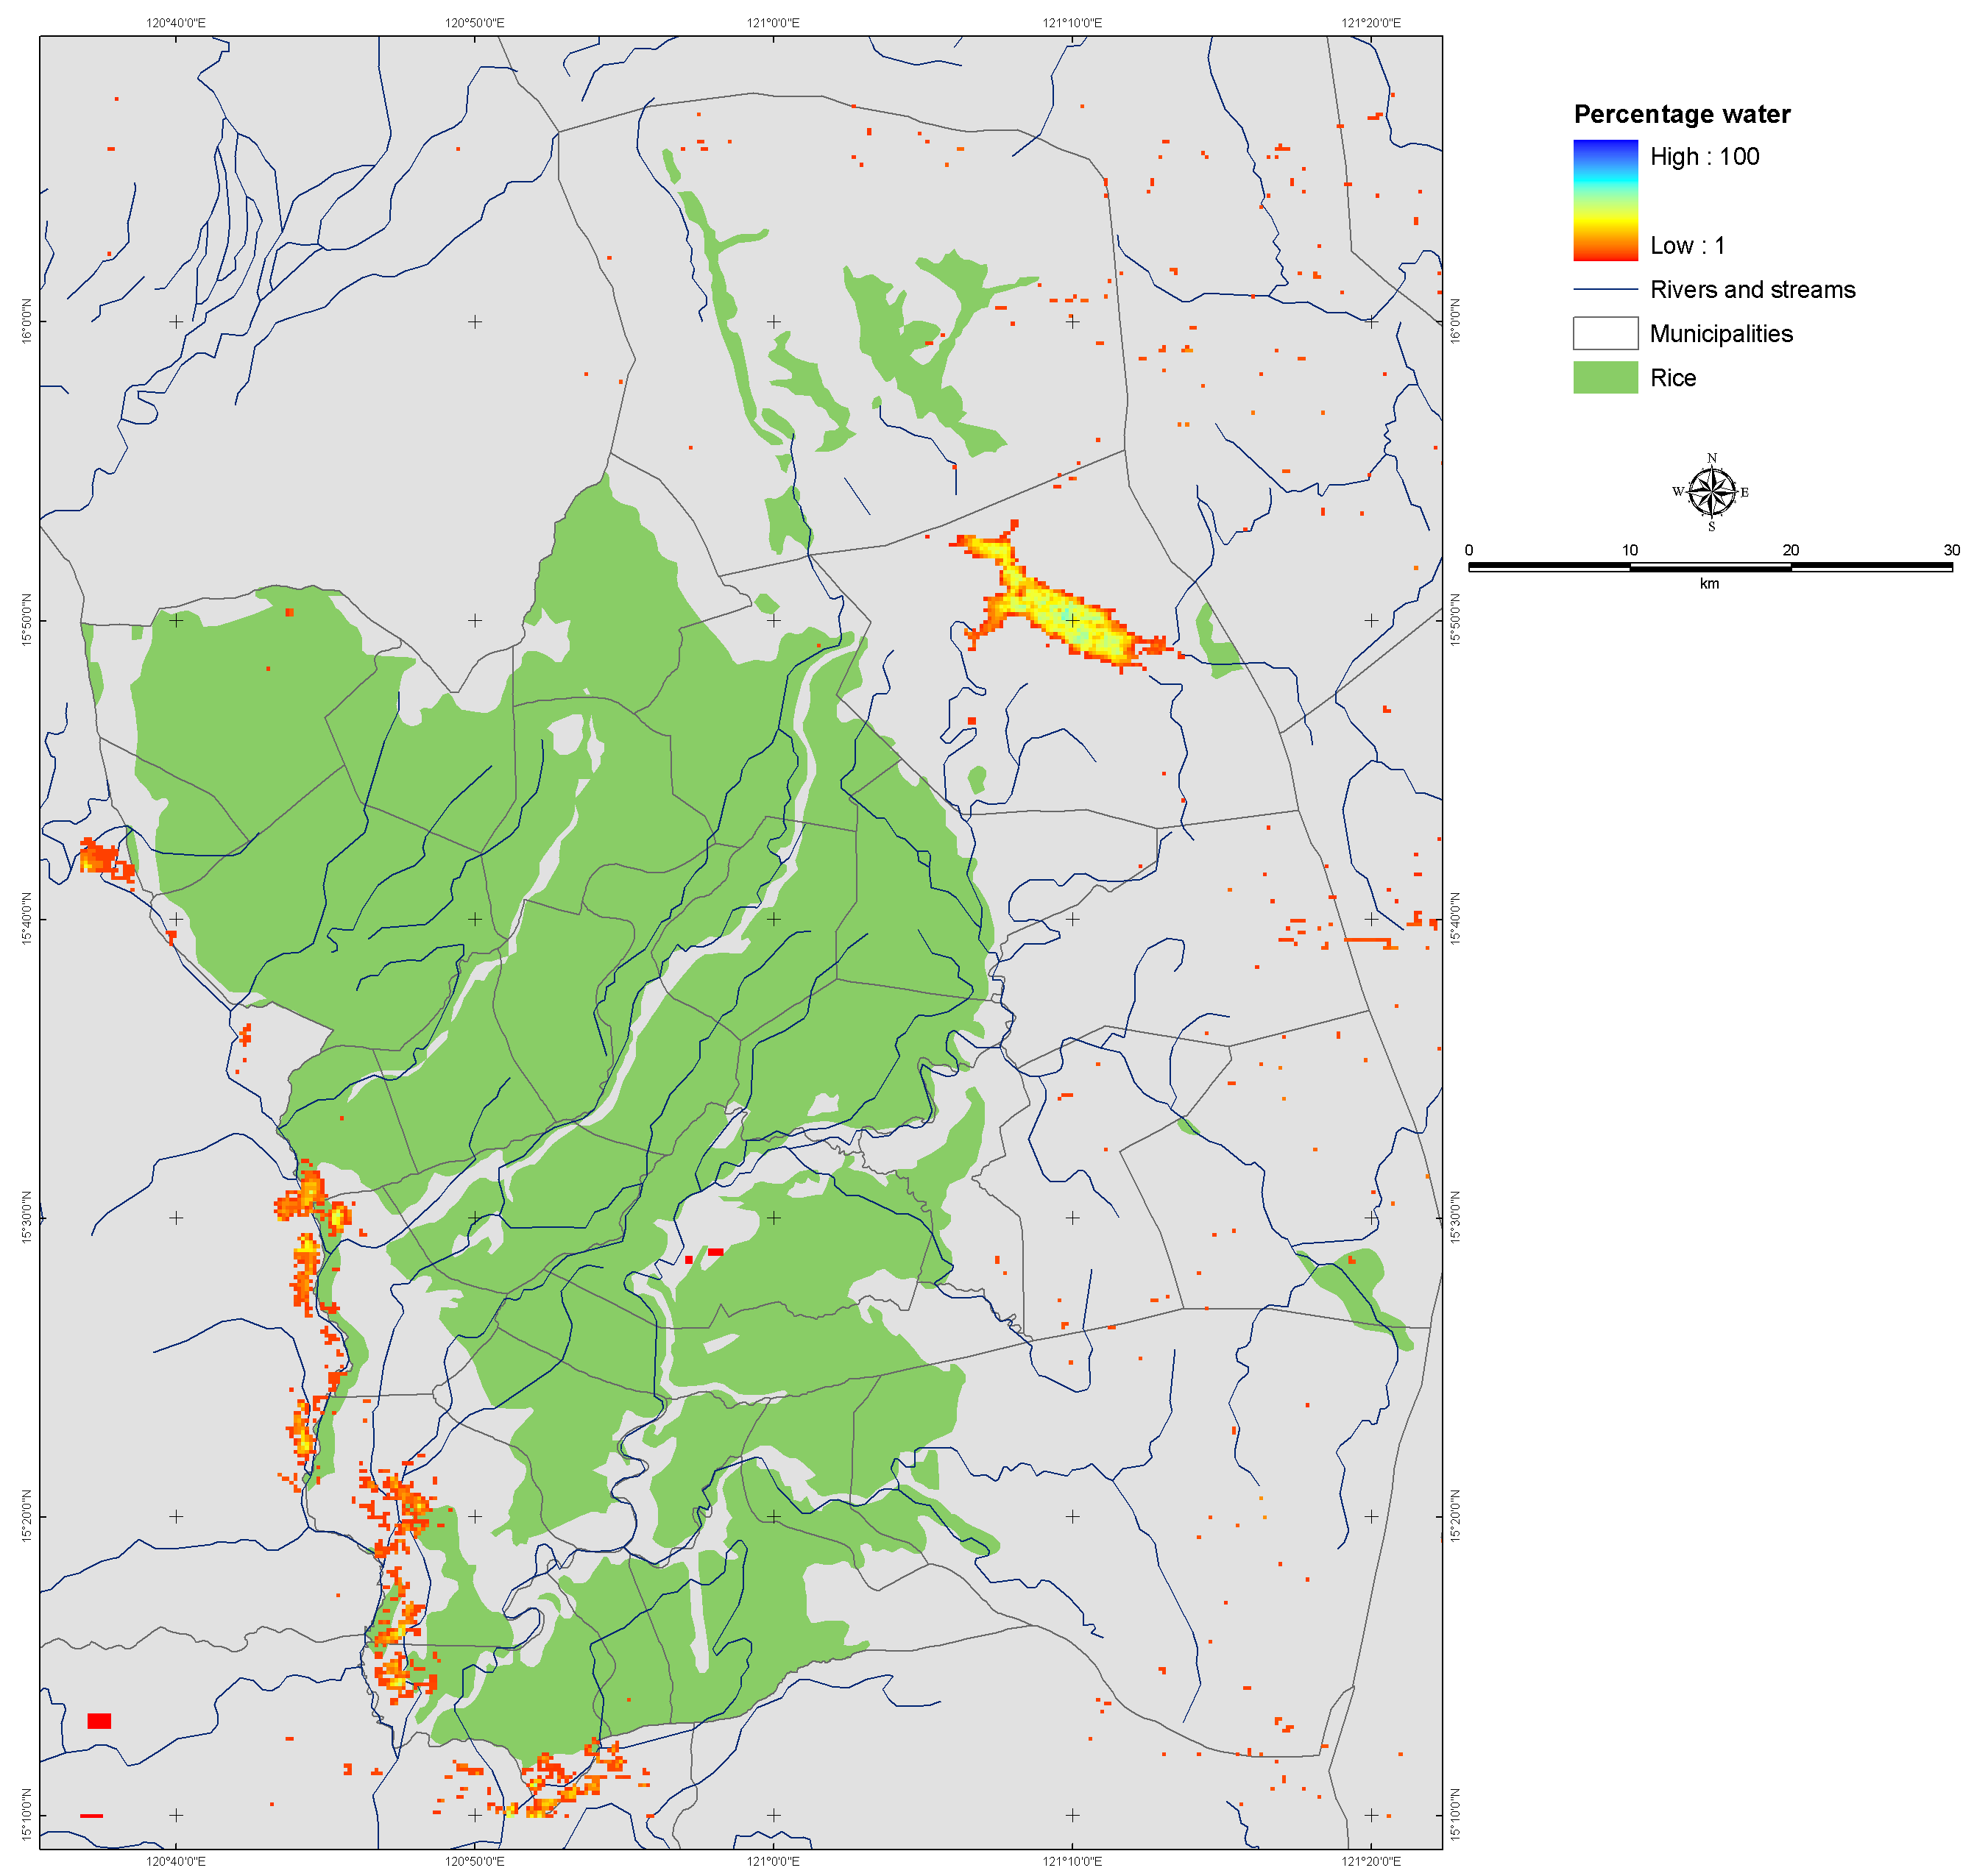
PH: January & September
Notes:
In Nueva Ecija (Figure 6), the monthly occurrence maps for January and September shows a different pattern altogether. January bringing widespread low occurrence of surface water is attributed to controlled flooding of rice paddies for the dry season cropping. September mostly around the Western side of the area could be due to late controlled flooding for the wet season cropping or early season controlled flooding for the dry season rice crop. January is the time of flooding/transplanting and September is the time of reproductive-maturity stage for rice crop in Nueva Ecija. PhilRice (personal communication) mentions that the southwestern part of the system area is prone to submergence and that it has standing water almost all throughout the rice wet cropping season.

Slide 13
Notes:
September mostly around the Western side of the area was detected to have standing water. This southwestern portion of Nueva Ecija has been reported to be submerged/flooded during the rainy season due to impeded drainage and absence of natural drainage outlets. It is also found to be lying on a low elevation area.

Slide 14
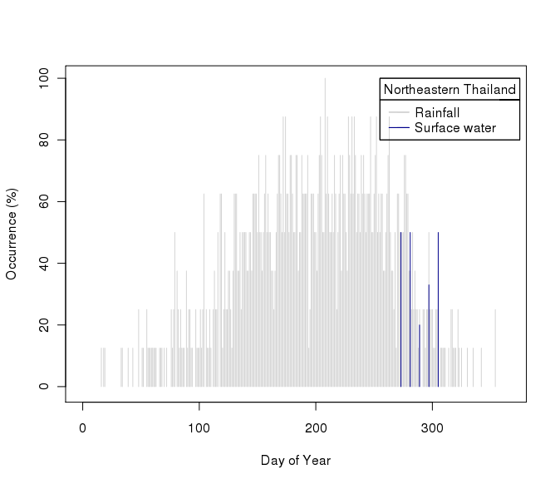
TH: 8-Daily Occurrence RandPix
Notes:
Above graphs (Figure 7) expand a given pixel temporal occurrence of surface water every 8-days composite period of MODIS. As can be seen in this figure's right side, the central location of Nueva Ecija, at DOY=169 is having a 50% occurrence of surface water and DOY=345 a 17% occurrence. The two negative values at DOY=145 and DOY=209 are failed Quality Flags on all available days. In the case of Northeastern Thailand, one main season is found in the range of DOY=[273,281,289,297,305] with a range of 20-50%, averaging at 40.6% occurrence of surface water over a period of 5*8=40 representative days. For this pixel, Failed quality flags were found at all 8-days composites for all years at DOY=[121,161,177,201,209,217,225], the latest range of DOY=[201-225] being a contiguous period.

Slide 15
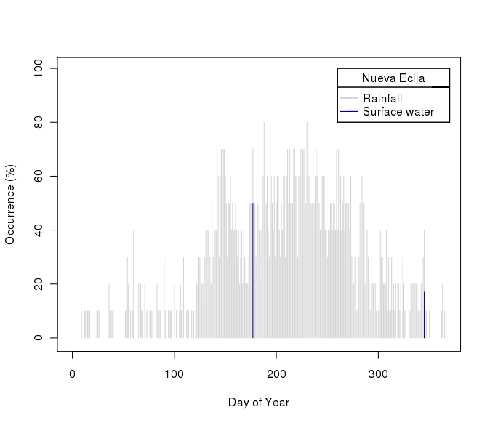
PH: 8-Daily Occurrence RandPix
Notes:
Above graphs (Figure 7) expand a given pixel temporal occurrence of surface water every 8-days composite period of MODIS. As can be seen in this figure's right side, the central location of Nueva Ecija, at DOY=169 is having a 50% occurrence of surface water and DOY=345 a 17% occurrence. The two negative values at DOY=145 and DOY=209 are failed Quality Flags on all available days. In the case of Northeastern Thailand, one main season is found in the range of DOY=[273,281,289,297,305] with a range of 20-50%, averaging at 40.6% occurrence of surface water over a period of 5*8=40 representative days. For this pixel, Failed quality flags were found at all 8-days composites for all years at DOY=[121,161,177,201,209,217,225], the latest range of DOY=[201-225] being a contiguous period.

Slide 16
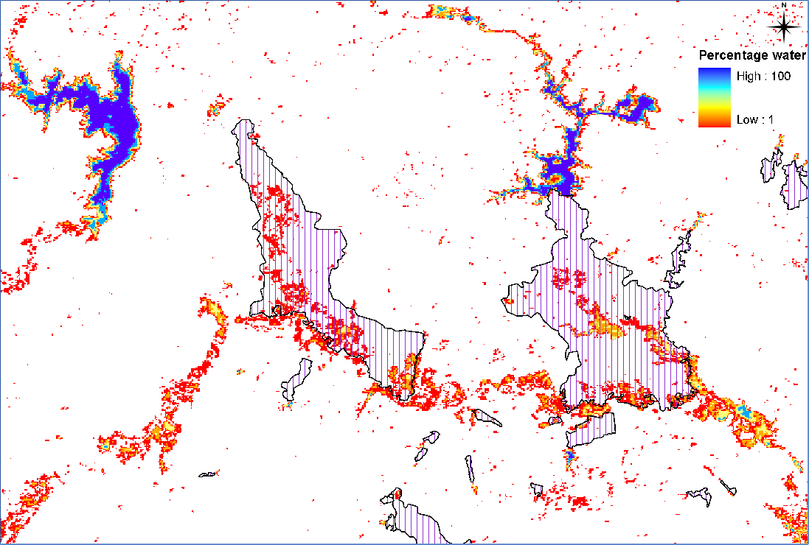
TH: Irrigated areas
Thailand
Sensitive Irrigated areas
Notes:
Dealing with irrigated areas of Northeastern Thailand, majoring in sugar cane and rice, one can see in figure 8 (above) that some areas are indeed under threat of submergence (left-side), and others are not (right-side). The right hand side map does not have surface water occurrence, because the irrigated area is located in a relatively high and undulated topography, taking water from the Sirindorn Dam (down right side of the map). On the other hand, the Left-side map of figure 8 is showing Ubon Rat Dam (top left) and Lam Pao Dam (top right), which are having downstream command areas under various threat (10-50% occurrence of surface water in August-October period).

Slide 17
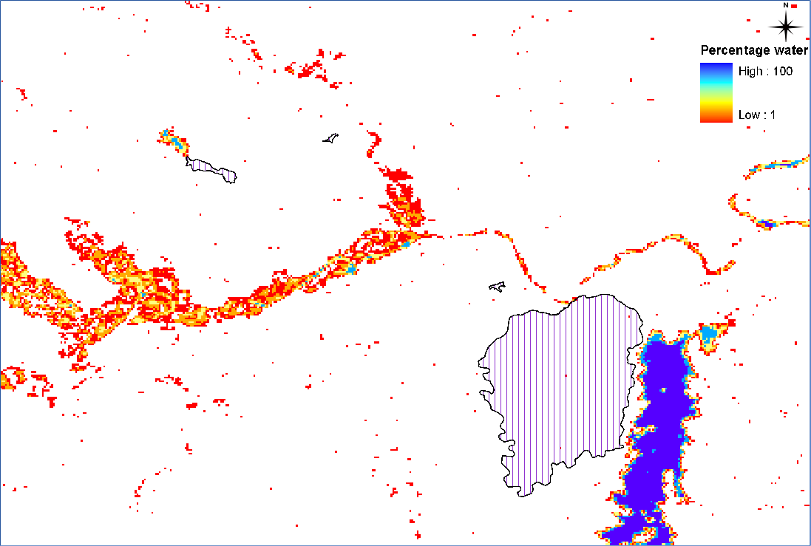
Thailand
Non-sensitive Irrigated area
Notes:
Dealing with irrigated areas of Northeastern Thailand, majoring in sugar cane and rice, one can see in figure 8 (above) that some areas are indeed under threat of submergence (left-side), and others are not (right-side). The right hand side map does not have surface water occurrence, because the irrigated area is located in a relatively high and undulated topography, taking water from the Sirindorn Dam (down right side of the map). On the other hand, the Left-side map of figure 8 is showing Ubon Rat Dam (top left) and Lam Pao Dam (top right), which are having downstream command areas under various threat (10-50% occurrence of surface water in August-October period).

Slide 18
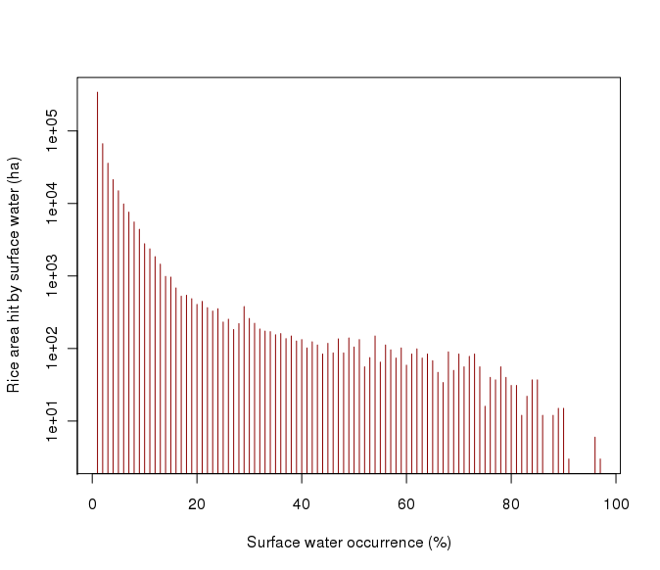
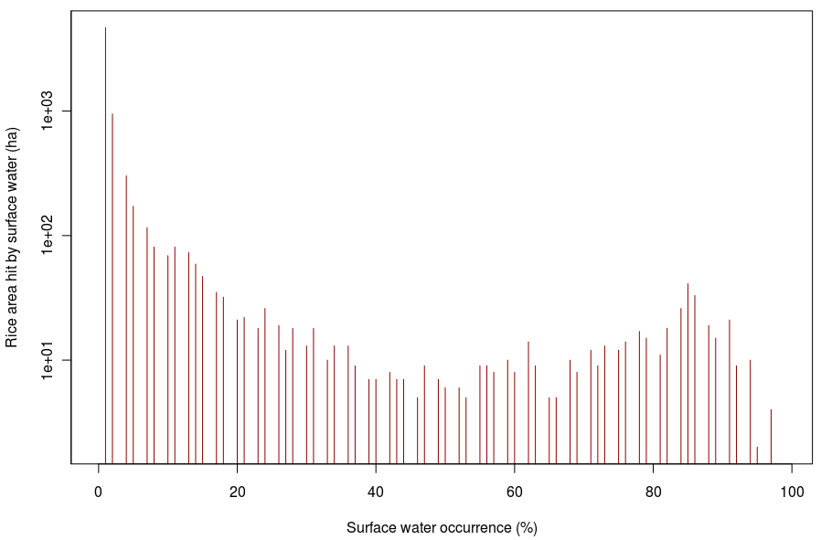
Distribution Occurrence on Rice
TH stats avg
2005-2011 = 315,000 ha
This method (TH)
2000-2008 = 530,005 ha
PHL stats
Median = 10.2% of area
Avg = 19.5% of area
This method (PHL)
2000-2008 = 13.75% of area
Notes:
Figure 9 shows that most of the surface water in rice land is having an occurrence less than 10-20% of the time. Over the last 8 years of this study, that means 300-400 days estimated of surface water. While this is useful for the sensitivity of the rice land system in North East Thailand, this does provide with only a spatial sensitivity area of rice.

Slide 19
Conclusions
High temporal point of view
Relate rice areas to potential submergence
Timing and the duration of surface water
  uncertain due to RS data in frequency
  Improvement needed

Slide 20
Thank you

