Slide 1
Remote Sensing
of
Rainfall

Slide 2

TRMM
http://trmm.gsfc.nasa.gov/
Latest Asia 3-hourly animation visible here:
http://trmm.gsfc.nasa.gov/trmm_rain/asia/asia_3hrly.mpg
Latest Asia weekly animation visible here:
http://trmm.gsfc.nasa.gov/trmm_rain/asia/asia_accumulation.mpg

Slide 3
TRMM Spacecraft
On-board the TRMM platform:
13.8 GHz Precipitation Radar (PR)
TRMM Microwave Imager (TMI)
Visible and Infrared Radiometer (VIRS)
Clouds & Earth's Radiant Energy Sensor (CERES)
Lightning Imaging Sensor (LIS)

Slide 4
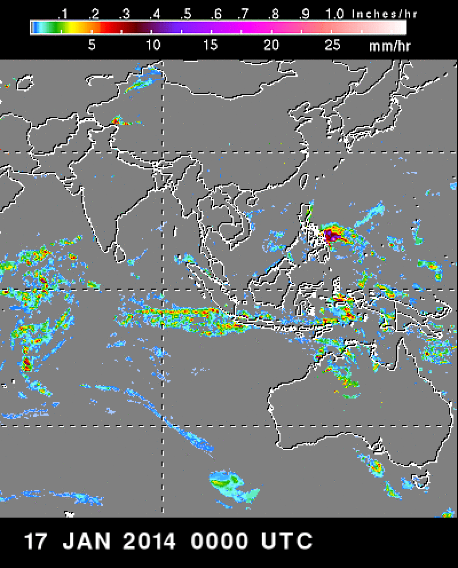
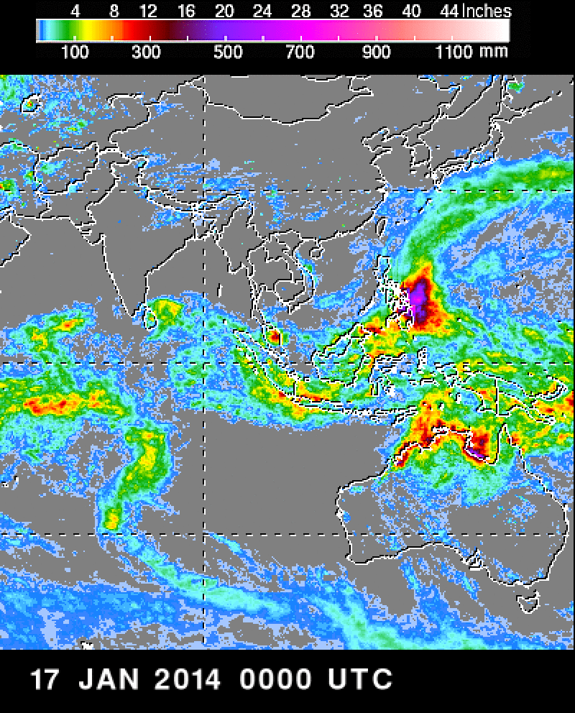
3hour & Weekly accumulation

Slide 5
TRMM Climate Rainfall data
http://rain.atmos.colostate.edu/CRDC/datasets/trmm.html
Level 3 products: Mapped into a uniform space and time grid
  3A25: A monthly climate product of accumulated values from the 2A23 and 2A25 PR retrievals. It contains monthly mean values of the surface rainfall rate, vertical rain profile, stratiform/convective fraction, and numerous other related parameters. Gridded monthly averages are provided at both 5x5 degree and 0.5x0.5 degree resolutions globally between 40N and 40S latitude.
  3A11: A TMI emission-based retrieval producing only monthly estimates (there is no corresponding level 2 product) at a 5x5 spatial resolution only over tropical oceans (no estimates over land regions) between 40N and 40S latitude.
  3A12: Monthly averaged values from the 2A12 TMI retrieval including 14-level profile and surface rain estimates. Although there is no official 3A12 product, the monthly accumulated 2A12 values are contained within the 3B31 dataset. The monthly values are stored at a spatial resolution of 5x5 degrees between 40N and 40S.
  3B31: This dataset contains monthly mean values from the combined PR/TMI 2B31 algorithm. Monthly values from the 2A12 algorithm are also included with this dataset.
  3B42: A monthly 1x1 degree dataset of densely sampled GPI rainfall estimates from geosynchronous infrared data, which have been calibrated or adjusted using coincident TRMM retrievals
  3B43: A monthly 1x1 degree dataset containing the "best" rainfall estimate from TRMM, geosynchronous IR, and rain gauge data.

Slide 6
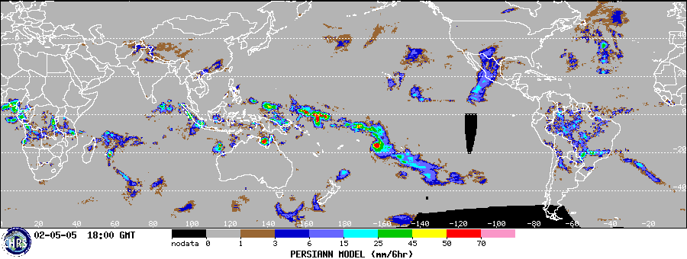
PERSIANN Model
http://chrs.web.uci.edu/persiann/

Slide 7
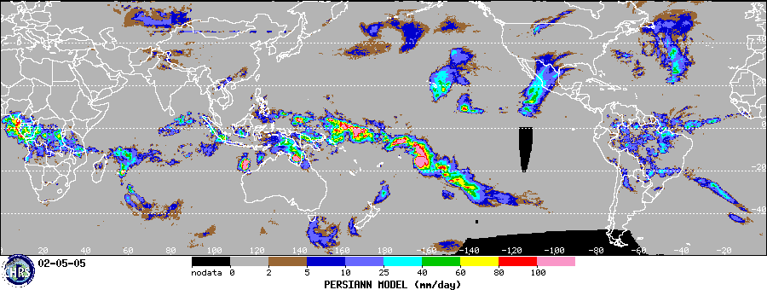
Daily PERSIANN

Slide 8
PERSIANN
Precipitation Estimation from Remote Sensing Information using Artificial Neural Network
Precipitation from IR images is based on statistical relationship between cloud top temperature and precipitation rates

Slide 9
PERSIANN Calibration
IR-based precipitation estimates
Calibrated by microwave data
From low Earth orbit satellites:
  Tropical Rainfall Measuring Mission Microwave Imager (TRMM)
  Special Sensor Microwave Imager (SSMI)
  Advanced Microwave Scanning Radiometer‐Earth observing system (AMSR-E)

Slide 10
Other Models....
Asian Precipitation-Highly Resolved Observational Data Integration Towards Evaluation of Water Resources (APHRODITE)
Global Satellite Mapping of Precipitation (GSMaP)
Climate Prediction Center Morphing technique (CMORPH)
And more...
Krakauer NY, Pradhanang SM, Lakhankar T, Jha AK. Evaluating Satellite Products for Precipitation Estimation in Mountain Regions: A Case Study for Nepal. Remote Sensing. 2013; 5(8):4107-4123.
http://www.mdpi.com/2072-4292/5/8/4107/pdf

Slide 11
Thank you

