Slide 1
Remote Sensing of
Water Storage Volumes
Chemin, Y., Rabbani, U. Monitoring On-Farm Water Storage use: From LIDAR to multi-source remote sensing. International Journal of GeoInformatics. 7(3):1-6, 2011.

Slide 2
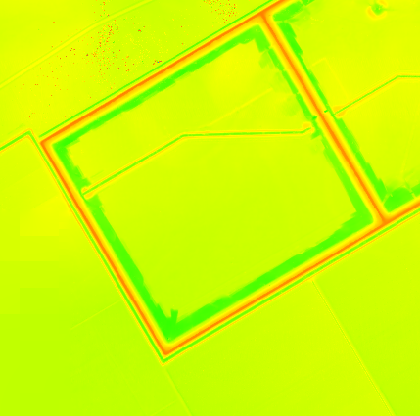
Lidar Data Interpolated
Water Storage
Lidar point cloud
Spline interpolation

Slide 3

Boundary delineation
Watershed extraction
Common in GIS

Slide 4
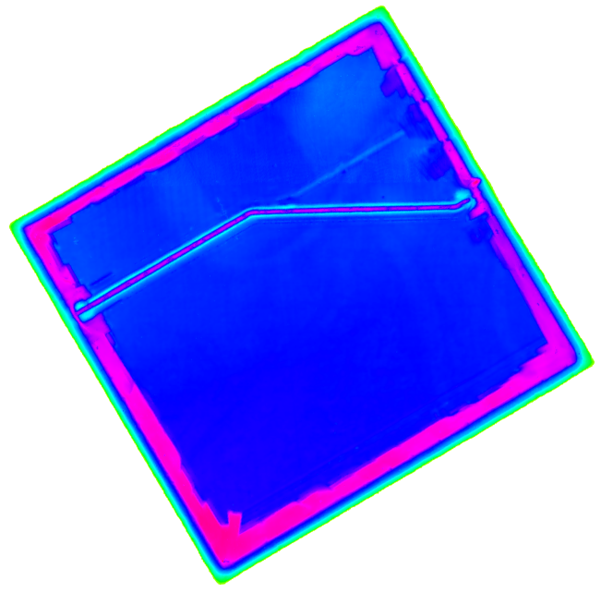
Elevation data within tank
Drain channel
Abrupt change at boundary (walls)

Slide 5
Depth to Volume from Lidar

Slide 6
Area to Volume from Lidar

Slide 7
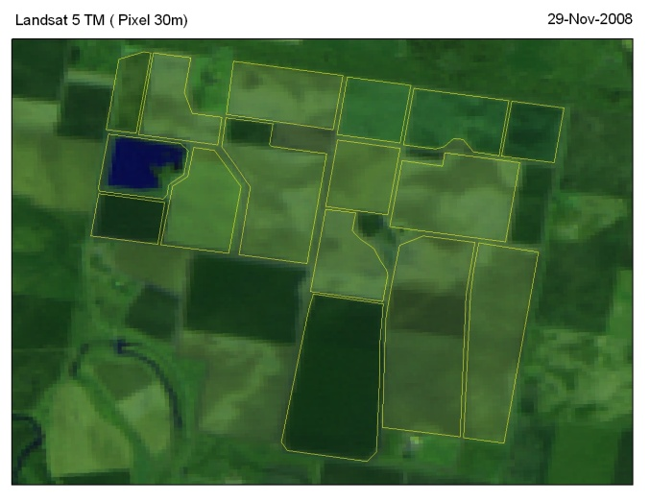
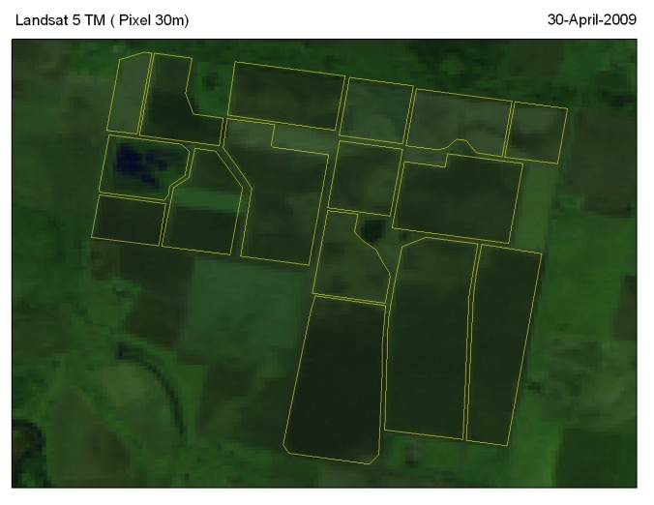
Remote Sensing Area update

Slide 8
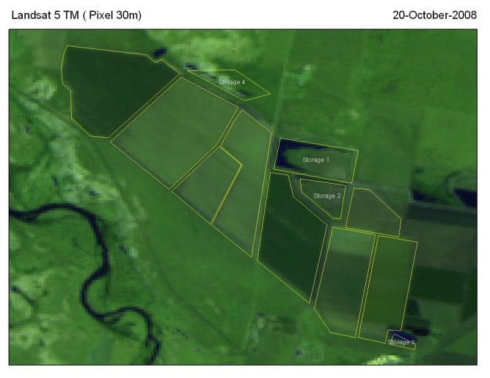
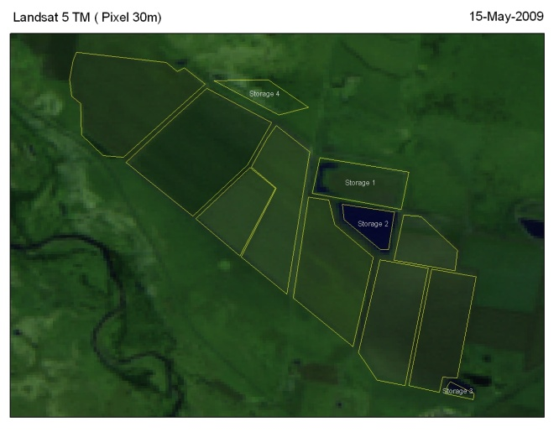
Remote Sensing Area update

Slide 9
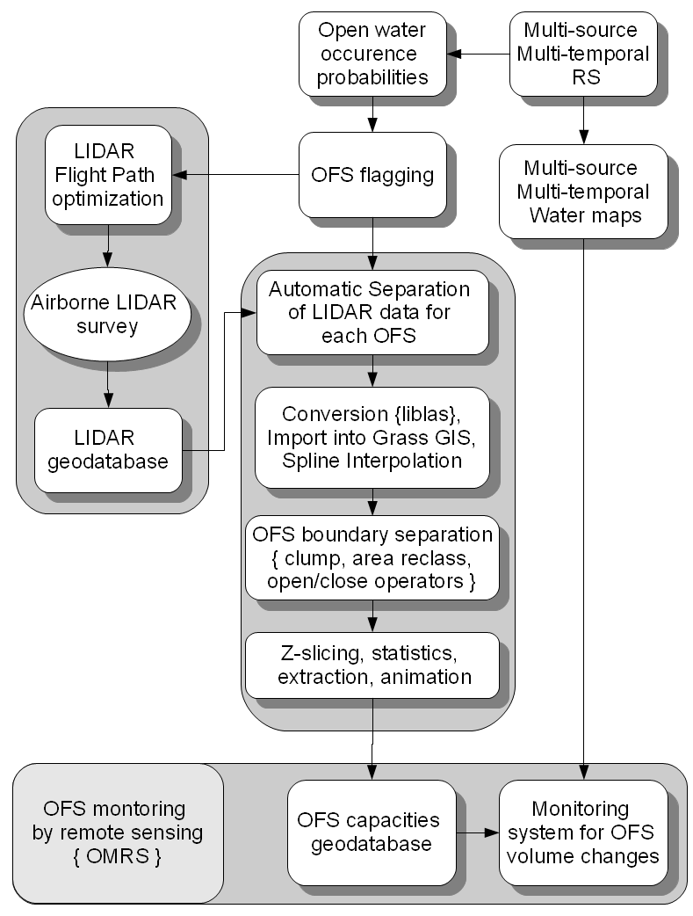
Monitoring Methodology
of water storages
Can be applied to Sri Lanka
Note:
OFS => On-Farm Storage
A water tank in Australia

Slide 10
Conclusion
It is possible to monitor water tank
A Lidar survey is required for best results
Or standard bathy survey (! Time + LKR)
Then remote sensing images
  Extract water within boundaries
  Convert Area to Volume
  Report to Water management

Slide 11
Thank you

