Slide 1
Ferghana Valley
Crop & Water Analysis
With
Public Domain RS data

Slide 2
Historical context
Empirical Models
Bio-Physical Models
Energy Balance + Interpolation from observation
After Menenti (2000)

Slide 3
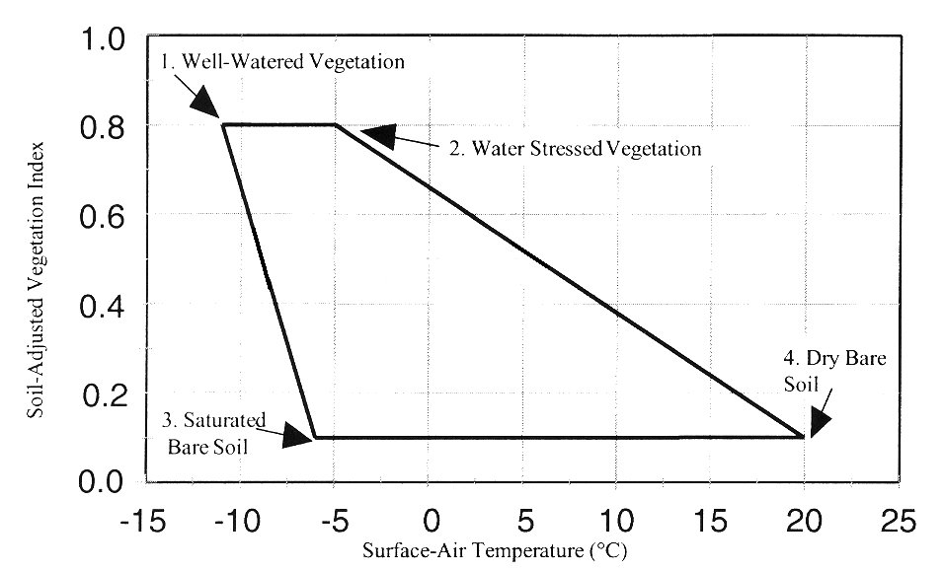
VI Temperature Trapezoid
High ETa
Low ETa
(after Moran et al., 1994)

Slide 4
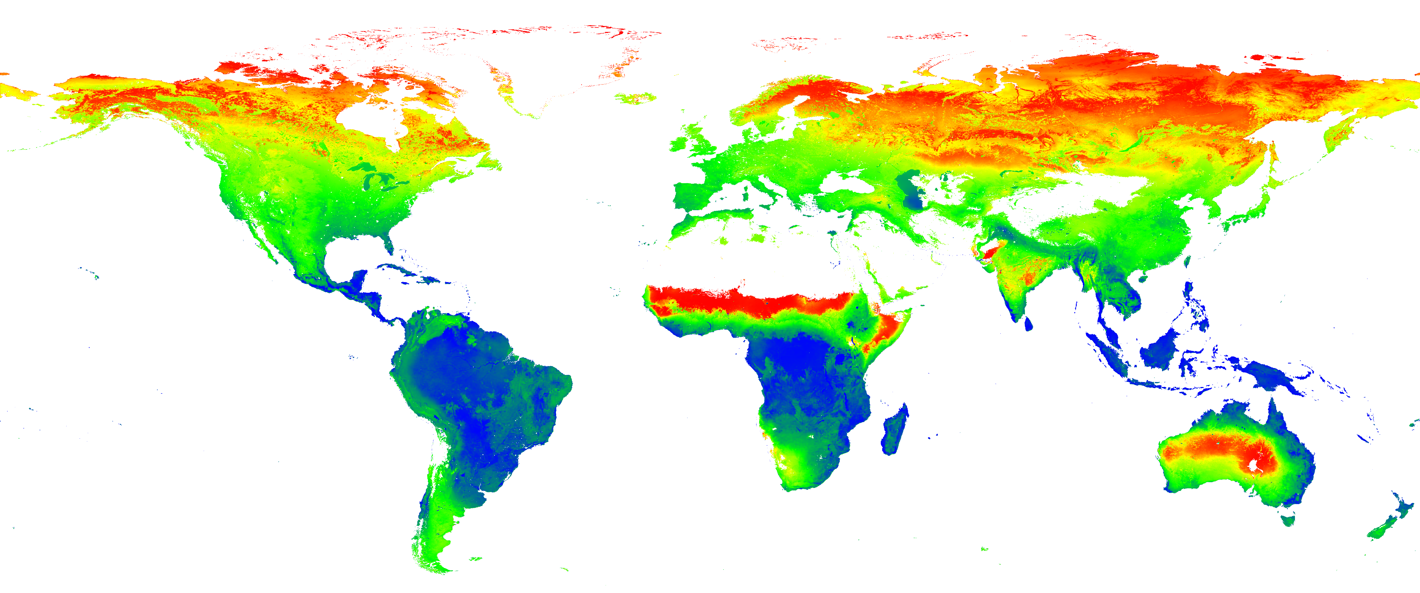
Public Domain TIR Satellites
ETa requires TIR band(s)!!!
High resolution (<100m pixel size):
Landsat 5TM
Landsat 7ETM+
Terra-Aster
Medium-low resolution (100m<pixsize<1km):
NOAA AVHRR (11,14,15,17)
Terra-Modis
Aqua-Modis
Very Low Resolution ( pixel size > 1km )
Meteosat
IOC ( Indian Ocean Coverage )

Slide 5
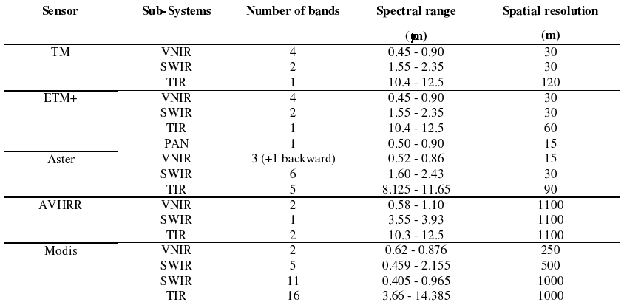
Specs of example satellites

Slide 6
Common Satellite Products
NDVI (Normalized Diff. Veg.Index)
Surface Albedo (broadband 0.3-3microm)
Temperature (skin, aero, canopy, etc...)
Emissivity (black to greybody radiation Conv.)
Not only satellite-based, but useful for ETa
  Incoming solar radiation ( ground )
  Net incoming solar radiation ( balance )

Slide 7
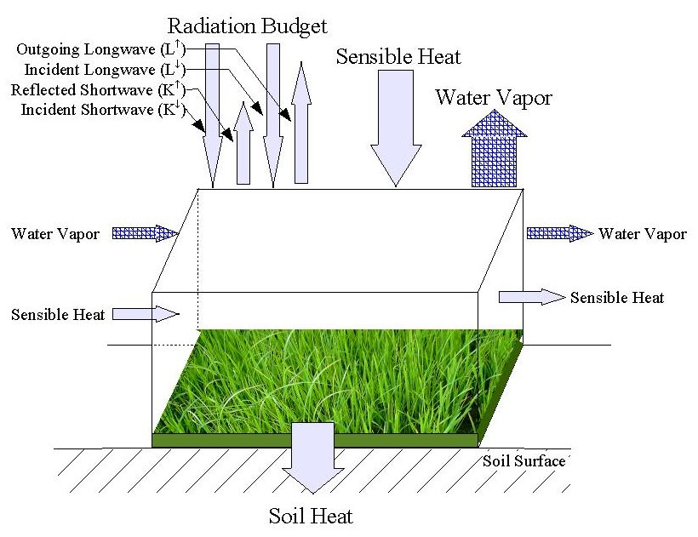
Evapotranspiration by RS

Slide 8
Energy balance for ET actual
It is an Instantaneous Process
R_Net = G0 + H + LE
  Rn is the net radiation emitted from the Earth surface (W/m2)
  G0 is the soil heat flux (W/m2) => conduction
  H is the sensible heat flux (W/m2) => convection
  LE is the latent heat flux, being the energy necessary to vaporize water (W/m2) => vaporization
When converting vaporization to evaporation, the energy needed to vaporize depends on the temperature essentially.

Slide 9
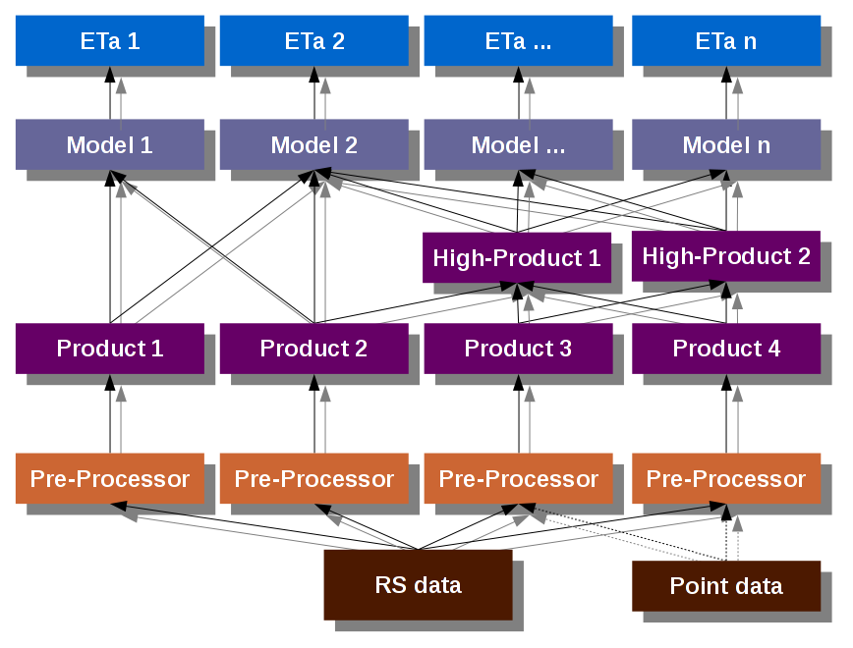
Generic ETa Modeling

Slide 10
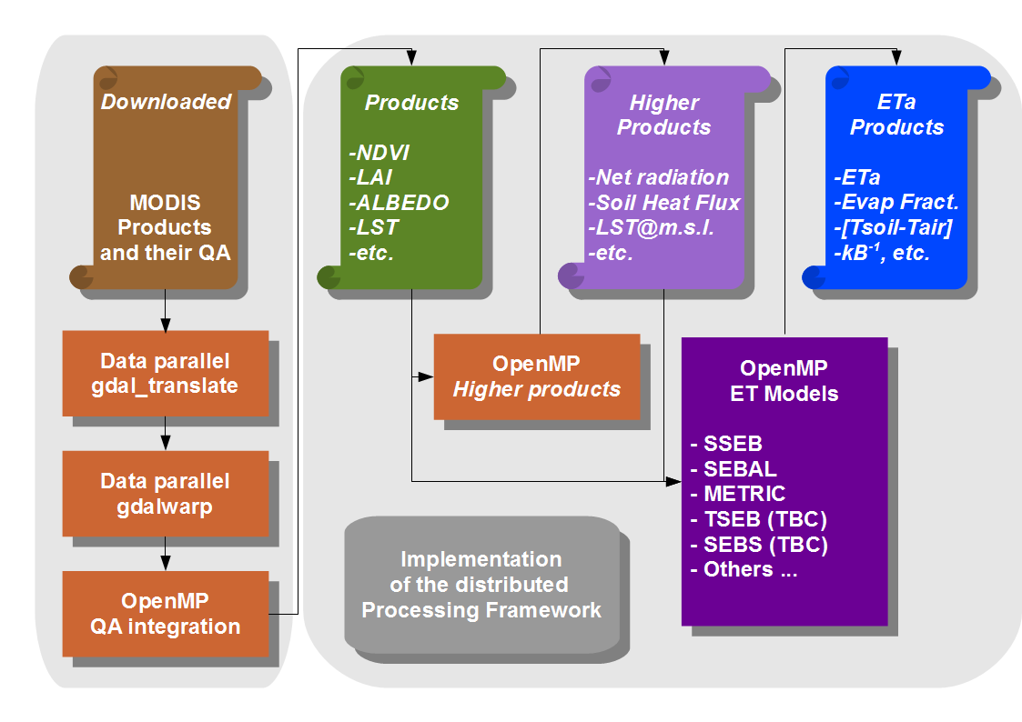
Implementation of Generic ETa

Slide 11
Parameterization of ETa models
SEBAL (Bastiaanssen, 1995/8)
  Iteration system to estimate Sensible Heat Flux
  Simultaneous convergence of H, rah, roh_air and (Tair-Tsoil)
TSEB (Kustas and Norman, 1999/2001), Two-sources fractional mixing.
SEBS (Su, 2002), simplification of convergence, additional relationships to boundary layer
SSEB (Senay, 2007), most simple model.
Other energy balance models (~30)
rah: Aero-dynamic resistance momentum heat s/m (15-40)
roh_air: Air density kg/m3 (1.15 )
Cp: Air specific heat at constant pressure J/kg/K: 1004
H = roh_air.Cp.(Tair-Tsoil)/rah
Tair ( at 2m height ), Tsoil
in rah especially psychrometric parameter (Psi_h)

Slide 12
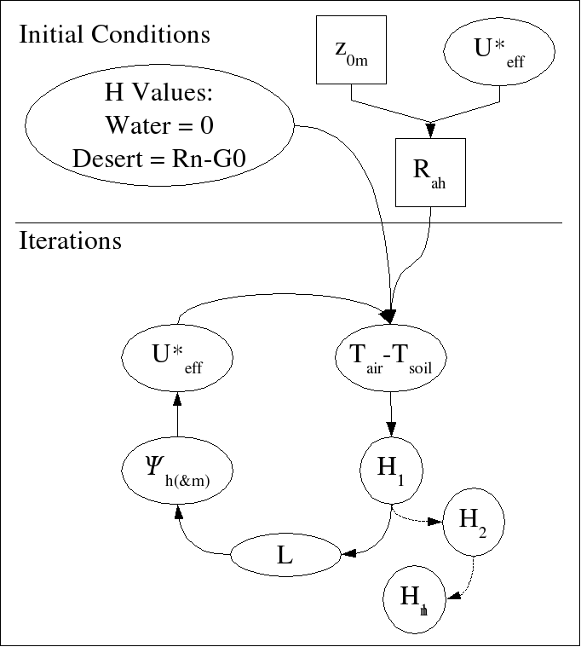
Parameterizations
SEBAL
Convergence H
Geo End-members
MOST calibration
Diabatic phase exchange coefs

Slide 13
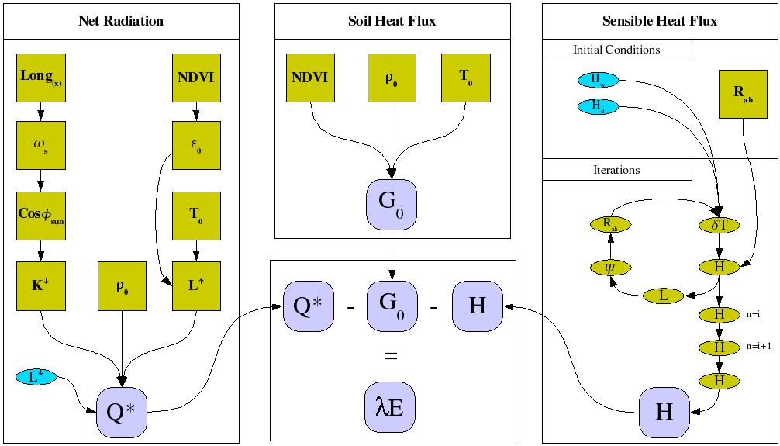
SEBAL/METRIC Models

Slide 14
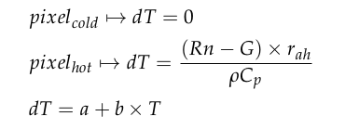
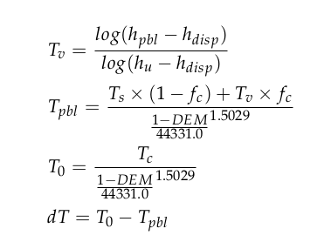
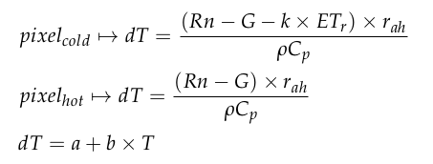
Parameterization of (Tsoil-Tair)
SEBAL
SEBS
METRIC

Slide 15
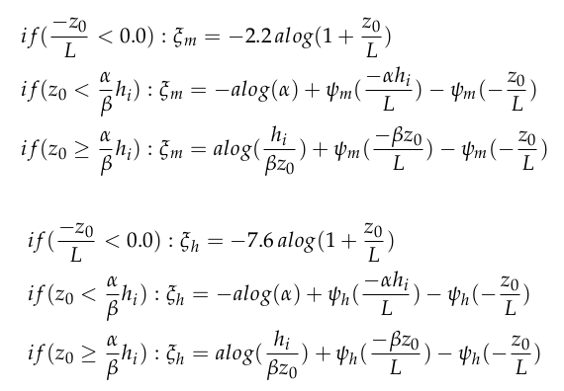
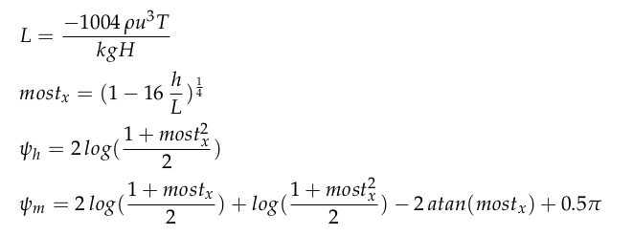
Monin-Obukhov Similarity
SEBS Bulk Atm Bound L Sim.
SEBAL & METRIC: MOST

Slide 16
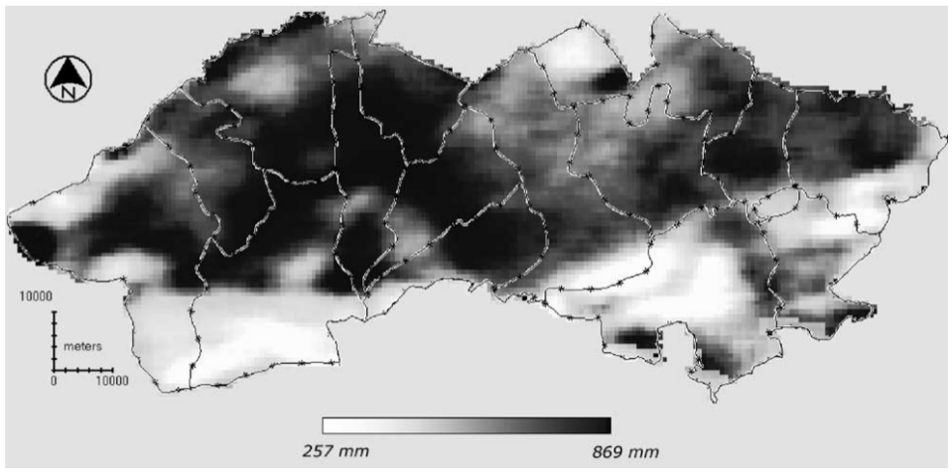
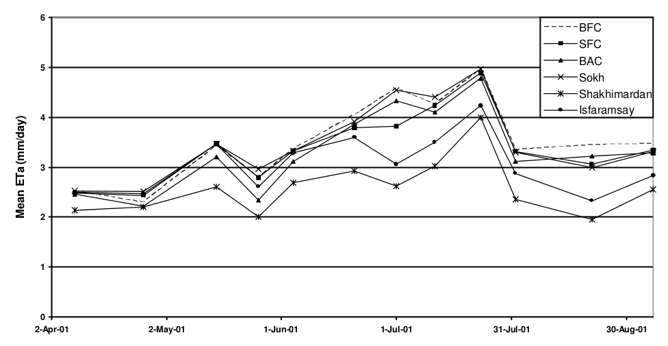
2001 (2004-5): WP UZB
Public domain RS
ETa analysis
Cotton Summer
Ferghana Valley
Spatio-temporal
Water Mgt

Slide 17

Applications: Cotton water consumption
UZBEKISTAN
Ferghana Valley
Irrigation zones
Vs
Administrative zones
Agriculture on Uzbekistan’s Emblem,
a grammar school’s entry wall, near Namangan

Slide 18
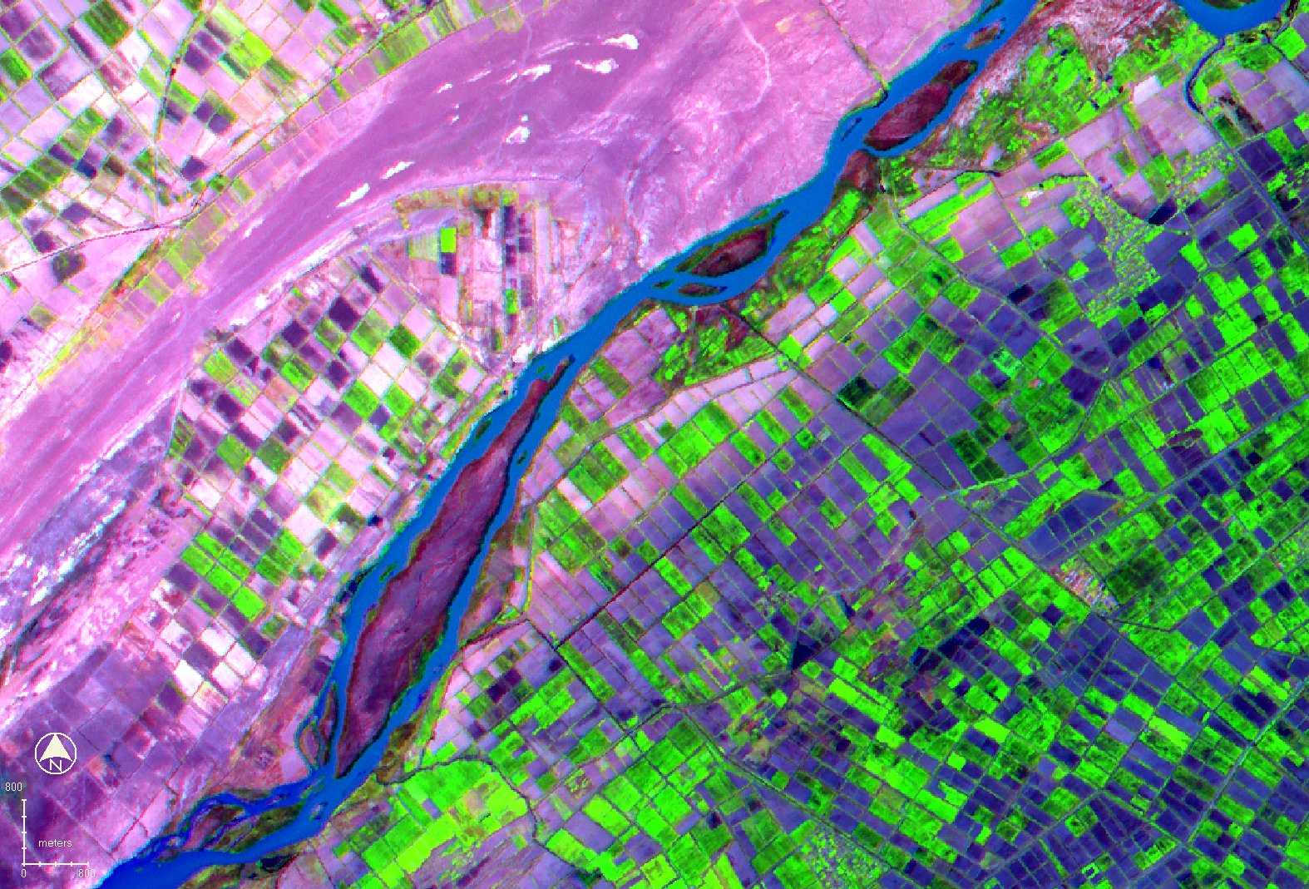
Water Savings in Transition
Better Cropping with less Water:
“Best Practices Project”
Analysis of local AND temporal crop water scarcity
Low-tech, low finances

Slide 19
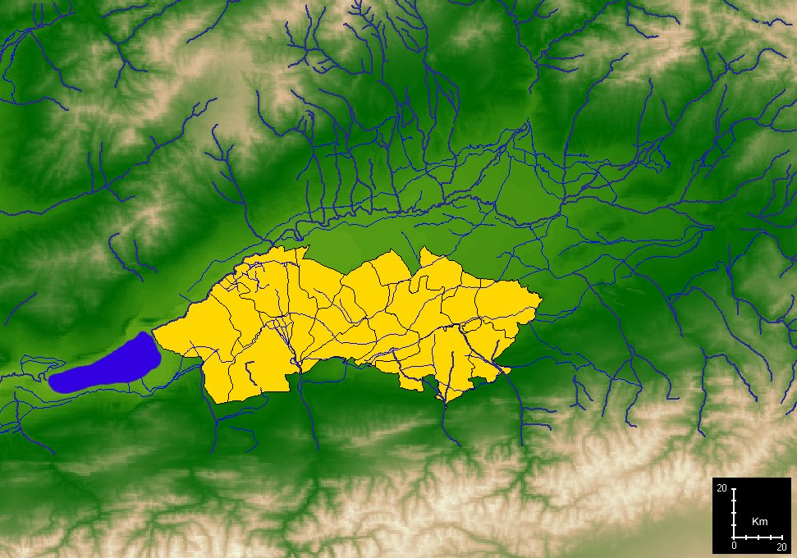
Ferghana Province

Slide 20
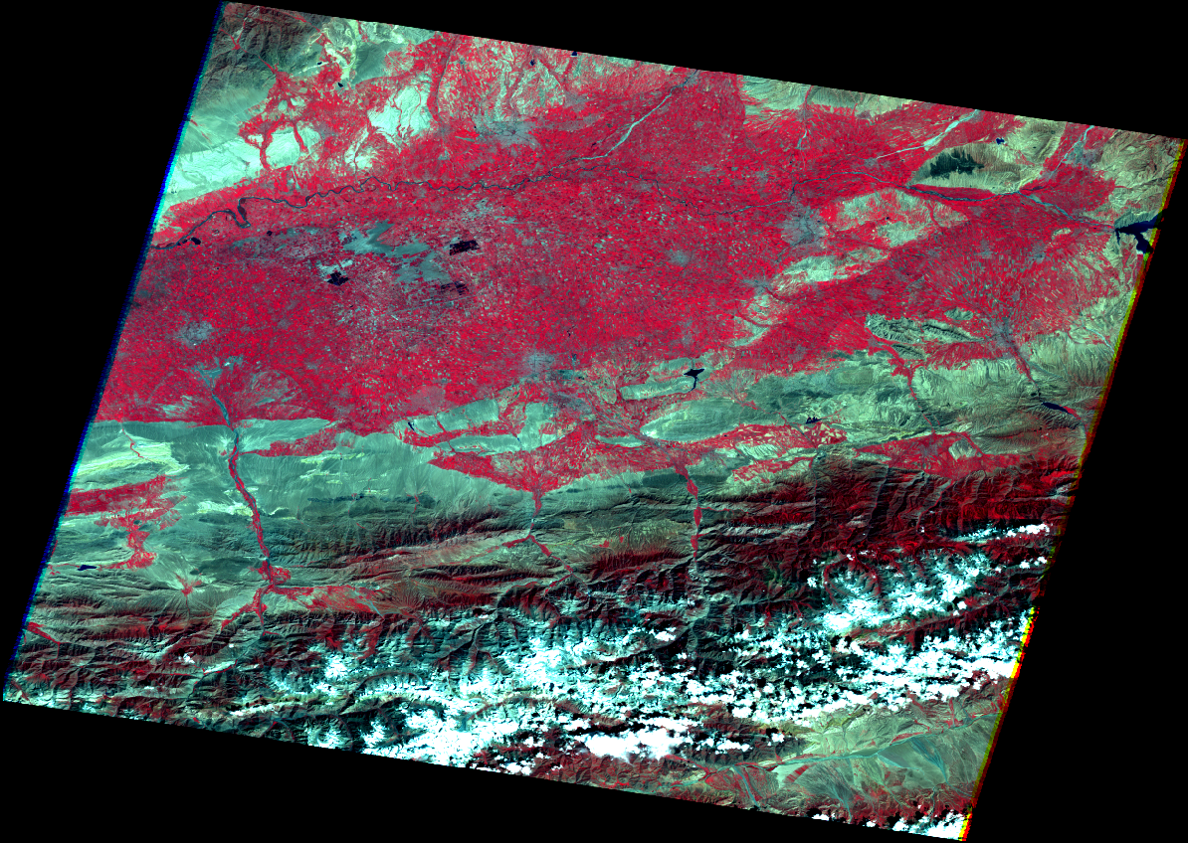
Landsat 7 ETM+

Slide 21
UZB: Irrigation Vs Admin. zones
Regional issue of water:
5 countries, 2 main river basins
Conscious denial of how sensitive water is.
Outflow to Aral Sea (Pakpathan area) ~= 0
Local issue around water:
Water management at administrative level
Transition economy (setting up of WUA: Water Users Association:Private))
Upstream/Downstream of basin are political boundaries

Slide 22
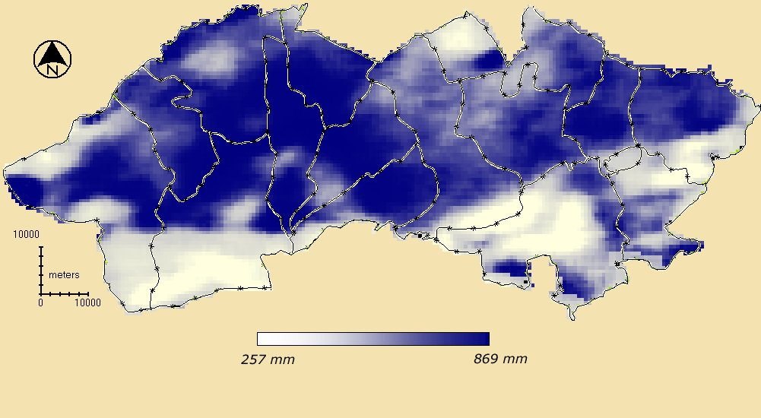
UZB: Cotton cropping season
NOAA AVHRR 2001 March-October

Slide 23
UZB: Water consumption curves
(Administrative Unit )

Slide 24
UZB: Water consumption curves
( Irrigation Unit )

Slide 25
UZB: Administrative Units

Slide 26
ETa variations by Districts

Slide 27
District map of Ferghana Province

Slide 32
ETa variations by Irrig. Zones

Slide 33
Irrigation map of Ferghana Province

Slide 35
Irrigation map of Ferghana Province

Slide 37
Irrigation map of Ferghana Province

Slide 38
Temporal Analysis
Management Unit irrigation calendar can be estimated
Contextual Water Scarcity can be spotted in time
Additional dimension to:
“How the system works?”

Slide 39
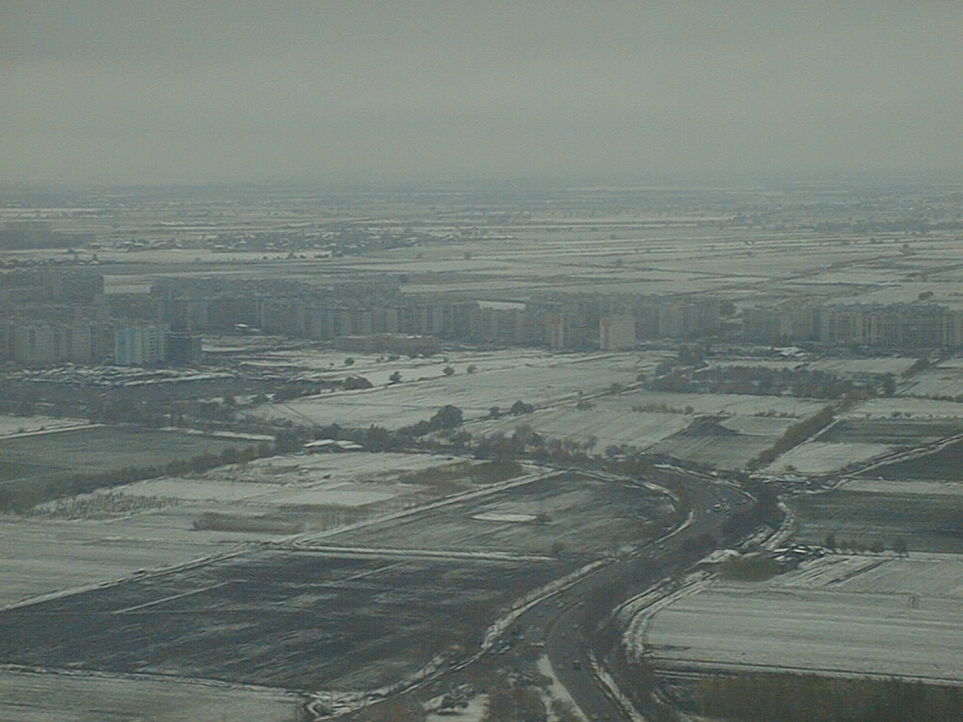
From District to Farms/Fields
November 1999 near Tashkent

Slide 40
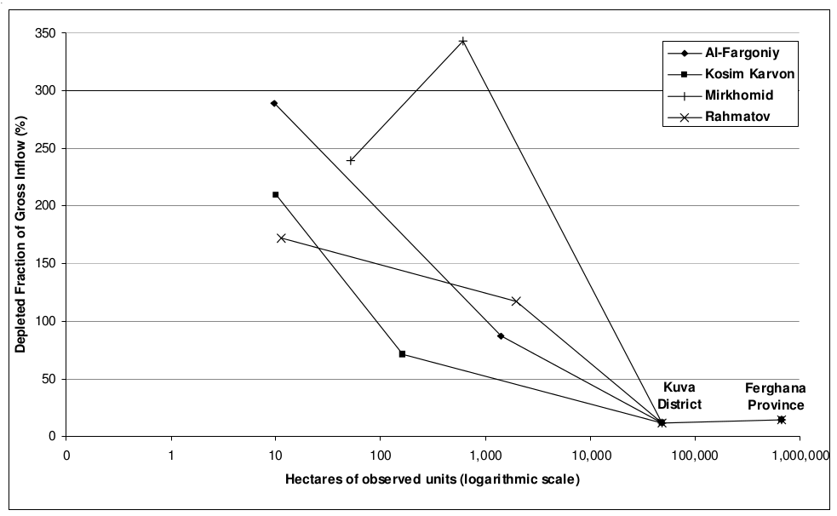
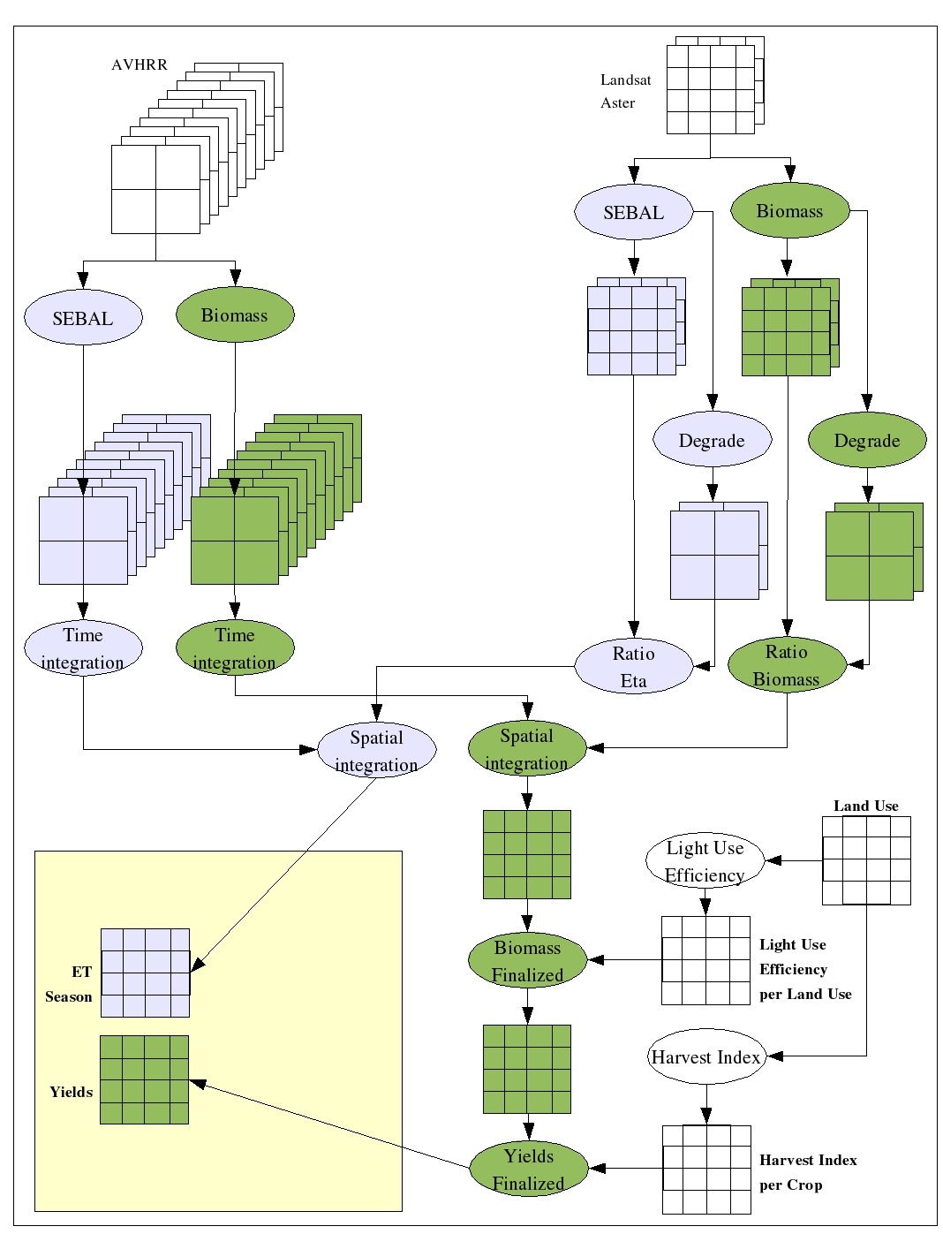
2001 (2005): WP UZB Farms
Scale effects
Cotton water Cons.
Cotton crop Yield

Slide 41
Kuva District & Mikhomid Farm

Slide 42
Yield and ETa Methodology
Resolving spatio-temporal
scales

Slide 43
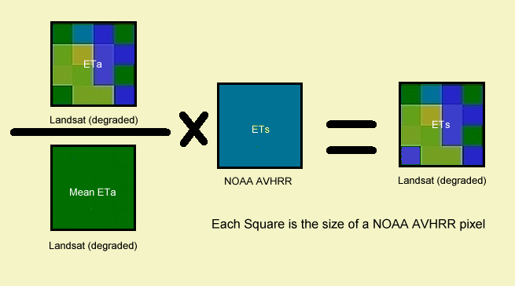
Resolution Enhancement

Slide 44


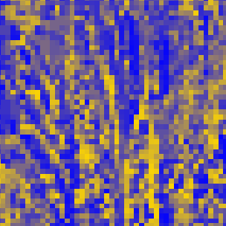
Resolution Enhancement
458 mm
495 mm
405 mm
549 mm
347 mm
574 mm
Results (zoom)
10 Km
10 Km
10 Km

Slide 45
Cotton Biomass from space

Slide 46
Farm Level Yields
Indicators | Al – Fargoniy | Kosim Karvon | Mirkhomid | Rahmatov | Total
Ref. Yield | 4.1 | 4.36 | 3.37 | 3.47
RS Yield | 3.3 | 3.74 | 3.5 | 3.43
No. of Pixels | 9,363 | 1,670 | 10,212 | 17,655 | 38,900
Diff. (% of Ref) | -19.59% | -14.12% | +3.74% | -1.08% | -4.83%
Maximum is 15%
Only one farm did not make it

Slide 47
Field Level Yields
Indicators | Al – Fargoniy | Kosim Karvon | Mirkhomid | Rahmatov | Total
Ref. Yield | 4.3 | 4.36 | 3.2 | 3.47
RS Yield | 3.38 | 4.05 | 3.29 | 3.77
No. of Pixels | 261 | 291 | 1418 | 301 | 2271
Diff. (% of Ref) | -21.35% | -8.02% | +2.70% | -7.94% | +0.49%
Inaccuracy was found to be from a small trigonal field near a railway
Other fields checked OK

Slide 48
ET validation
(Karakkum Reservoir)

Slide 49
ET validation
6 different ET models used to validate RS
Wetland
Kairakkum Reservoir (Valley's outlet)
SEBAL | E-Pan | ETo-Evapot | ETo-PM | ETo-HG | ETo-MH | ETo-Iv
937.2mm | 911.8mm | 880.1mm | 848.8mm | 898.4mm | 1004.0mm | 933.8mm
- | 103% | 106% | 110% | 104% | 93% | 100%
Notes: E-Pan = Pan evaporated water from Ferghana Meteorological station ; Evapot = simulated ETo with Evapot software (after Cholponkulov, 2002) ; PM = ETo Penman-Monteith (standard) ; HG = ETo Hargreaves (standard) ; MH = modified Hargreaves ; Iv = Eto Ivanov (standard).

Slide 50
Districts/Irrigation Zones ETa

Slide 51
Water Productivity Indicators
Water-Accounting Indicator | Definition
Depleted Fraction per unit of Gross Inflow (-) | The fraction of gross inflow that is depleted by process and non-process uses.
Process Fraction (cotton) per unit of Gross Inflow (-) | The amount of cotton evapotranspiration over gross inflow
Water Productivity (cotton) per unit of Irrigation (kg/m³) | The physical mass of cotton production measured against irrigation inflow
Depleted Fraction per unit of Available Water (-) | The fraction of net amount of water available that is depleted by process and non-process uses.
Process Fraction (cotton) per unit of Available Water (-) | The amount of cotton evapotranspiration over the net amount of water available
Water Productivity (cotton) per unit of Available Water (kg/m³) | The physical mass of cotton production measured against the net amount of water available
Water Productivity (cotton) per unit of ET (kg/m³) | The physical mass of cotton production measured against cotton evapotranspiration

Slide 52
Equations Used
Equation used*
Depleted Fraction per unit of Gross Inflow (-)
Process Fraction (cotton) per unit of Gross Inflow (-)
Water Productivity (cotton) per unit of Irrigation (kg/m³)
Depleted Fraction per unit of Available Water (-)
Process Fraction (cotton) per unit of Available Water (-)
Water Productivity (cotton) per unit of Available Water (kg/m³)
Water Productivity (cotton) per unit of ET (kg/m³)

Slide 53
Valley/Districts: DF Gross Inflow

Slide 54
Irrig. Sys.: DF Gross Inflow

Slide 55
Depleted Fraction of Gross Inflow

Slide 56
Productivity of Irrigated Water

Slide 57
Productivity of ET water

Slide 58
DF of Gross Inflow in Scale

Slide 59
Farm level analysis
Indicators | Al – Fargoniy | Kosim Karvon | Mirkhomid | Rahmatov
ETs* (m3) ETscotton* (m3) Production* (kg) Q (m3) D (m3) P (m3) | 9,347,388 2,629,130 1,234,744 10,719,688 12,134 751,500 | 966,841 445,783 250,111 1,370,000 28 87,586 | 3,839,331 2,727,339 1,428,001 1,120,000 925 327,642 | 12,609,132 4,735,848 2,424,088 10,790,000 75,487 1,057,686
Dfgross* (%) | 87 | 71 | 343 | 117
Pfgross* (%) | 25 | 33 | 244 | 44
Dfavail* (%) | 82 | 66 | 265 | 107
Pfavail* (%) | 23 | 31 | 189 | 40
Wpirr.* (kg/m3) | 0.12 | 0.18 | 1.28 | 0.22
Wpavail.* (kg/m3) | 0.11 | 0.17 | 0.99 | 0.21
Wpet* (kg/m3) | 0.47 | 0.56 | 0.52 | 0.51
*RS data included

Slide 60
Field Level analysis
Indicators | Al – Fargoniy | Kosim Karvon | Mirkhomid | Rahmatov
ETscotton* (m3/ha) Yield* (t/ha) Q (m3/ha) D (m3/ha) P (m3/ha) | 7154.8 3.38 2478 195 538 | 6102 4.05 2922 5 538 | 6878.3 3.29 2879 49 538 | 6558.4 3.77 3825 726 538
Dfgross* / Pfgross* (%) | 289 | 209 | 239 | 171
Dfavail* / Pfavail* (%) | 254 | 177 | 204 | 180
Wpirr.* (kg/m3) | 1.36 | 1.39 | 1.14 | 0.99
Wpavail.* (kg/m3) | 1.20 | 1.17 | 0.98 | 1.04
Wpet* (kg/m3) | 0.47 | 0.66 | 0.48 | 0.57
*RS data included

Slide 61
Conclusions
Agricultural water consumption
Agricultural yields
Can be monitored by remote sensing
Planning and management can be done

Slide 62
Thank you

