Slide 1
Remote Sensing of
Urban Heat Island
Chemin, Y., Rabbani, U. Monitoring On-Farm Water Storage use: From LIDAR to multi-source remote sensing. International Journal of GeoInformatics. 7(3):1-6, 2011.

Slide 2
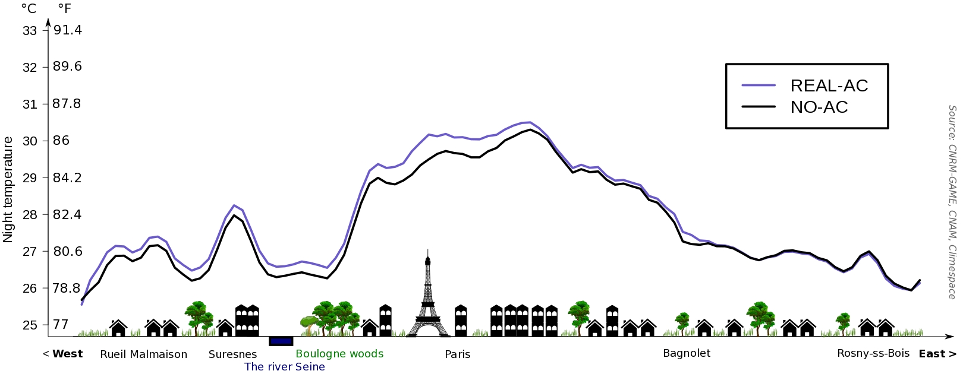
UHI
Air conditioning systems release waste heat into the atmosphere such that their widespread use can inadvertently elevate city air temperatures.
This graph shows the result of a model that calculated the likely magnitude of the effect during the 2003 heat wave in Paris.
Credit: Météo France/Cécile de Munck
http://www.nasa.gov/topics/earth/features/heat-island-sprawl.html

Slide 3
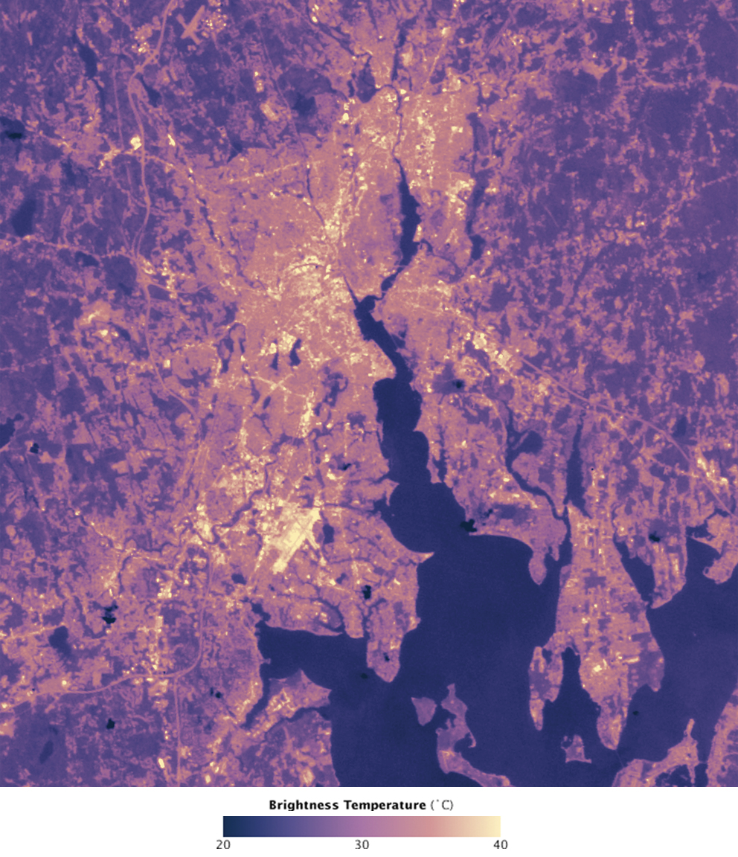
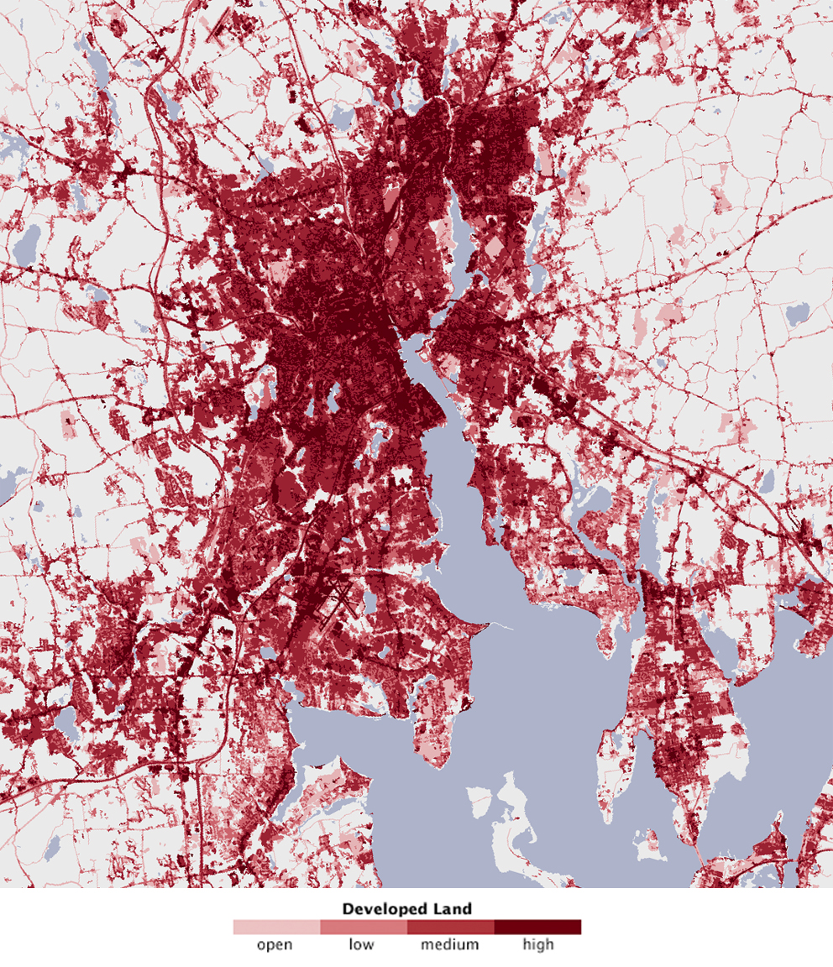
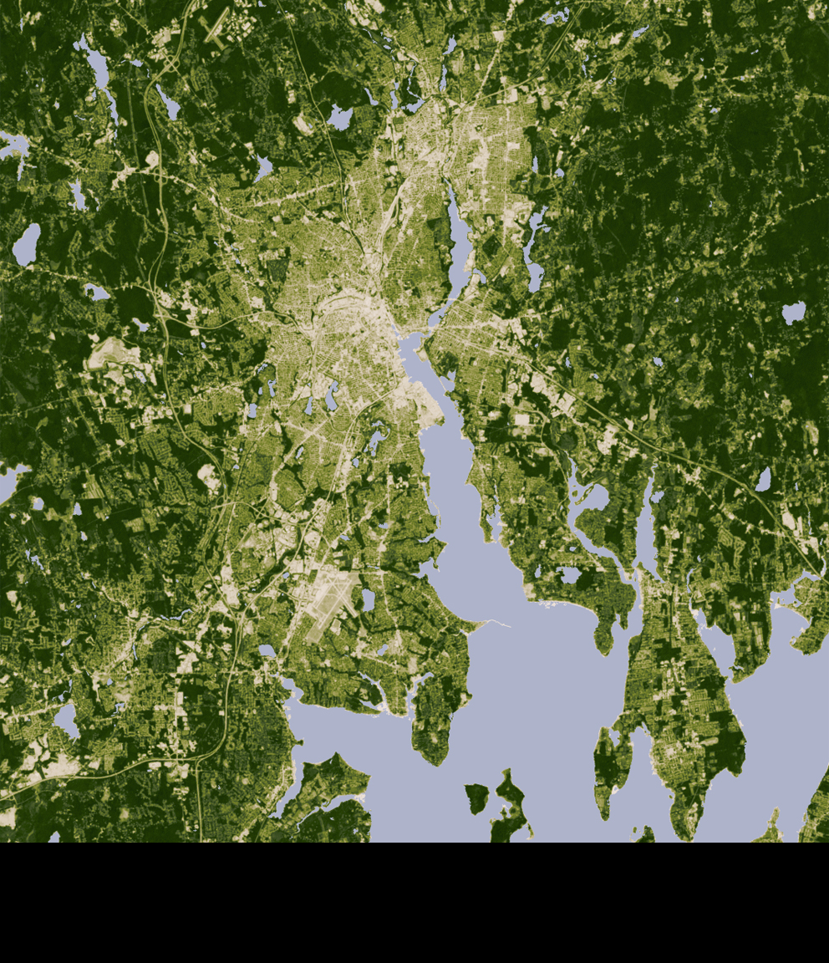
UHI
Heat Island Mapping
Built-up
Vegetation
http://www.nasa.gov/topics/earth/features/heat-island-sprawl.html

Slide 4
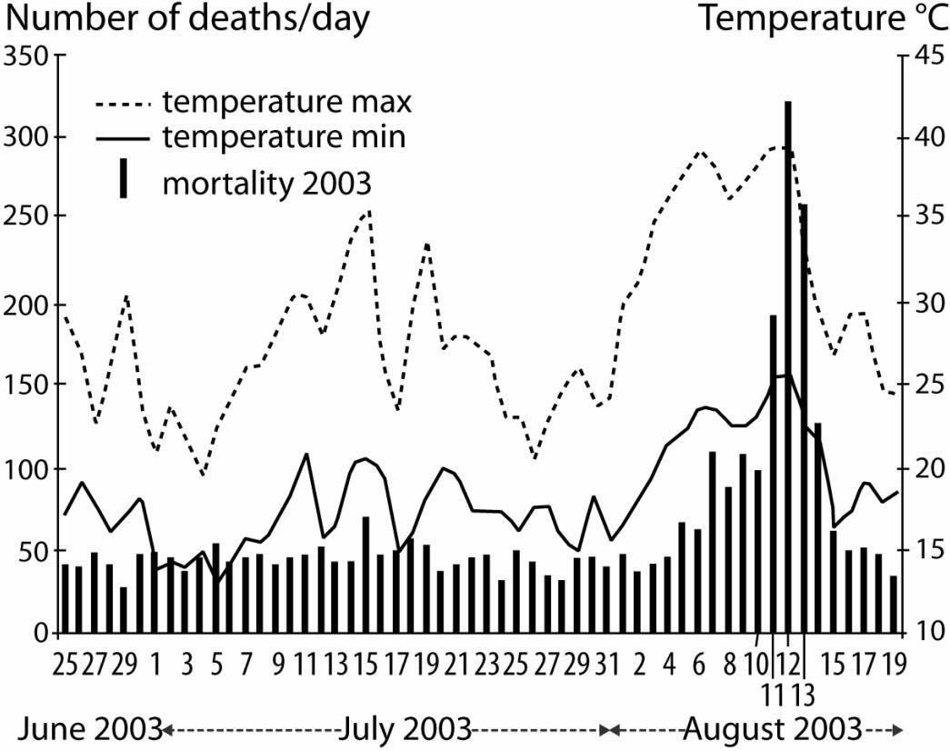
Mortality, Paris 2003 Heat Wave
http://www.nasa.gov/topics/earth/features/heat-island-sprawl.html

Slide 5
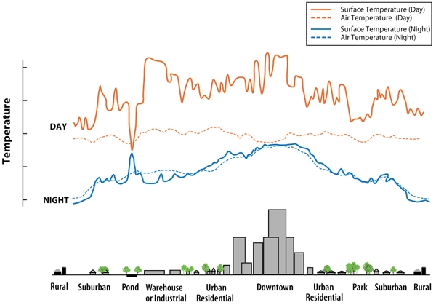
Surface Vs Air Temperature

Slide 6
Research questions
How to design our cities against heat islands?
Air conditioning exacerbate heat islands
Trees and parks ?
Painting the surfaces of roads/buildings white ?
Creating “green” roofs ?
Complex phenomenon
Variable with each city

Slide 7
Conclusions
Building/roads are dark/dry
  Retain heat
Vegetation/water cool themselves
Air conditioning heats the city
Smog creates a city greenhouse cap
Research on planning better cities
http://www.urbanheatislands.com/

Slide 8
Thank you

