Slide 1
Remote Sensing of
Atmospheric Pollution
Chemin, Y., Rabbani, U. Monitoring On-Farm Water Storage use: From LIDAR to multi-source remote sensing. International Journal of GeoInformatics. 7(3):1-6, 2011.

Slide 2
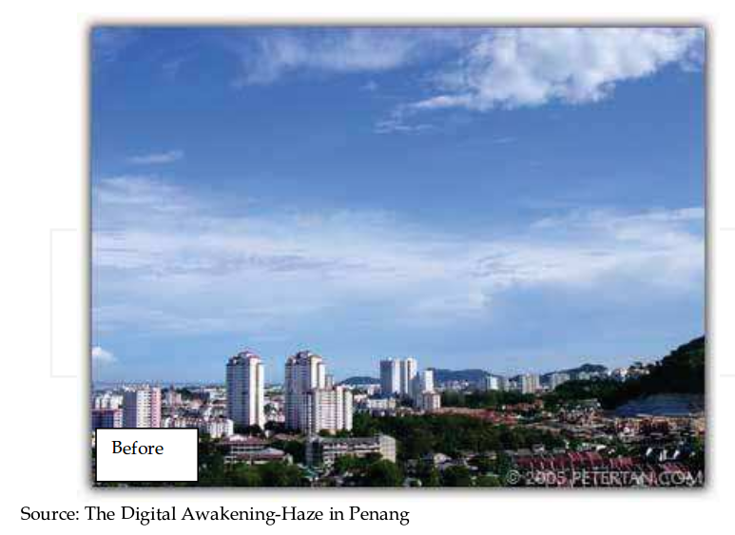
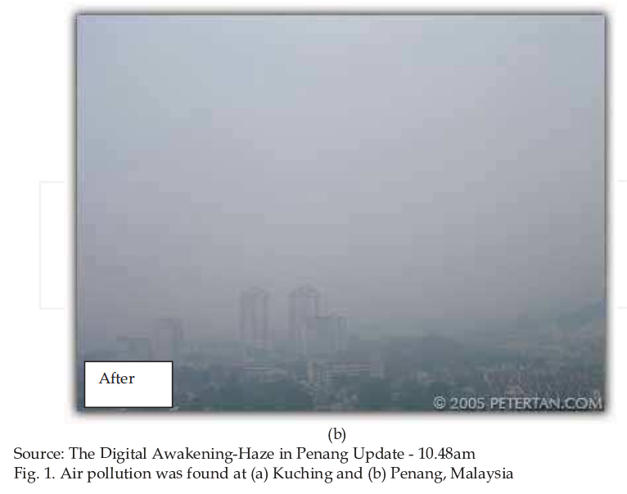
Penang, Malaysia
http://www.intechopen.com/books/advances-in-geoscience-and-remote-sensing/air-pollution-determination-using-remote-sensing-technique

Slide 3
Atmospheric information?
Reflectance values at Top of Atmosphere
=
Surface Reflectance
+
Atmospheric Reflectance

Slide 4
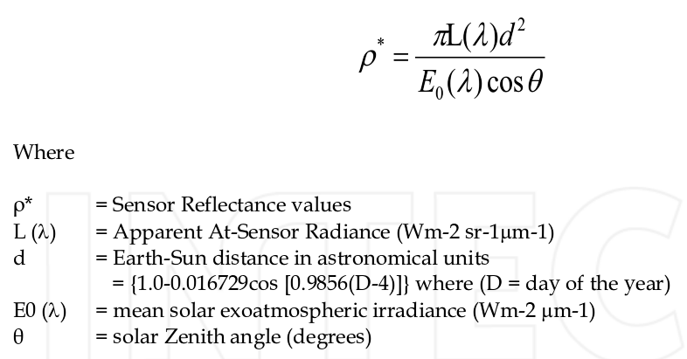
Landsat TOA Reflectance

Slide 5
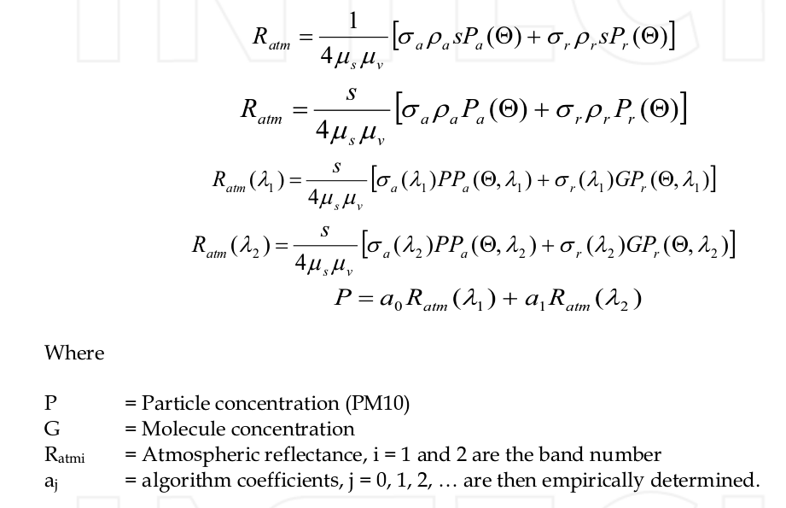
Atmospheric Reflectance
http://www.intechopen.com/download/get/type/pdfs/id/9534

Slide 6
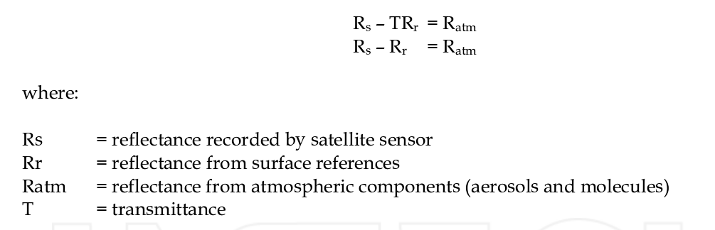
All together...

Slide 7
Conclusions
Reflectance at sensor
Reflectance of atmosphere
Reflectance measured on ground
All together: Air Pollution model
Using standard Landsat imagery

Slide 8
Thank you

