Slide 1
MWS data extraction

Slide 2
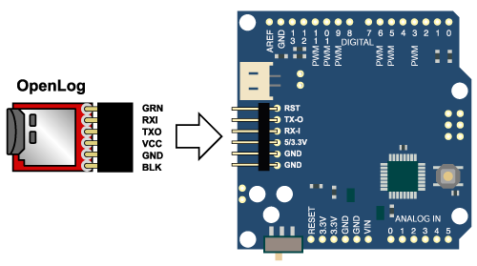
Extract microSD card
OpenLog
microSD

Slide 3
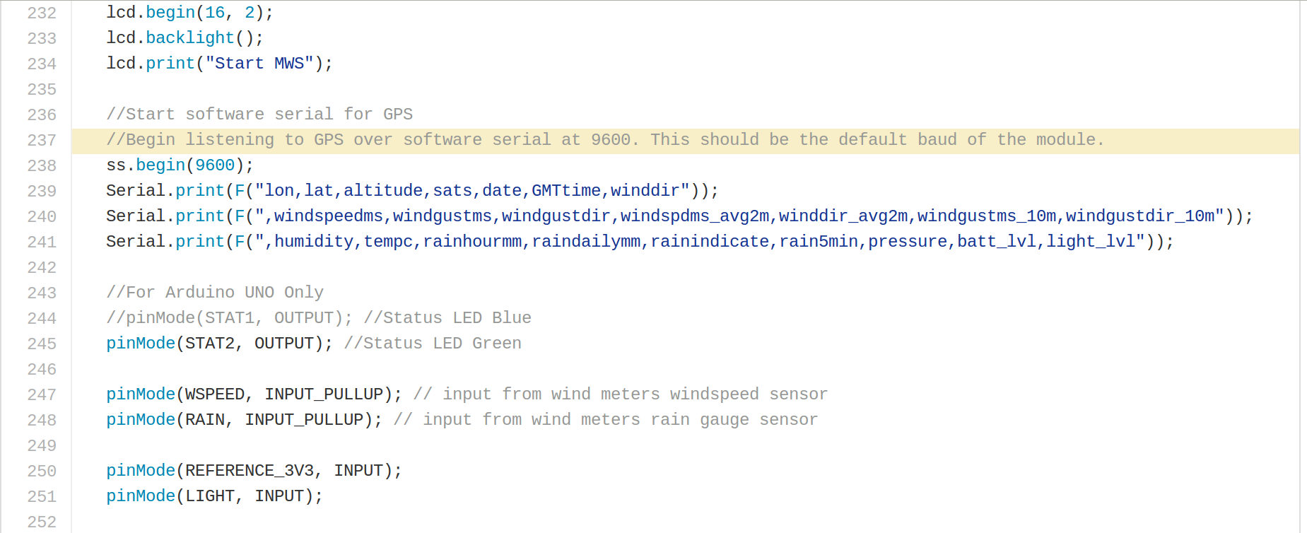
Read SD card
CSV format
Max file size 2Gb
New file .TXT

Slide 4
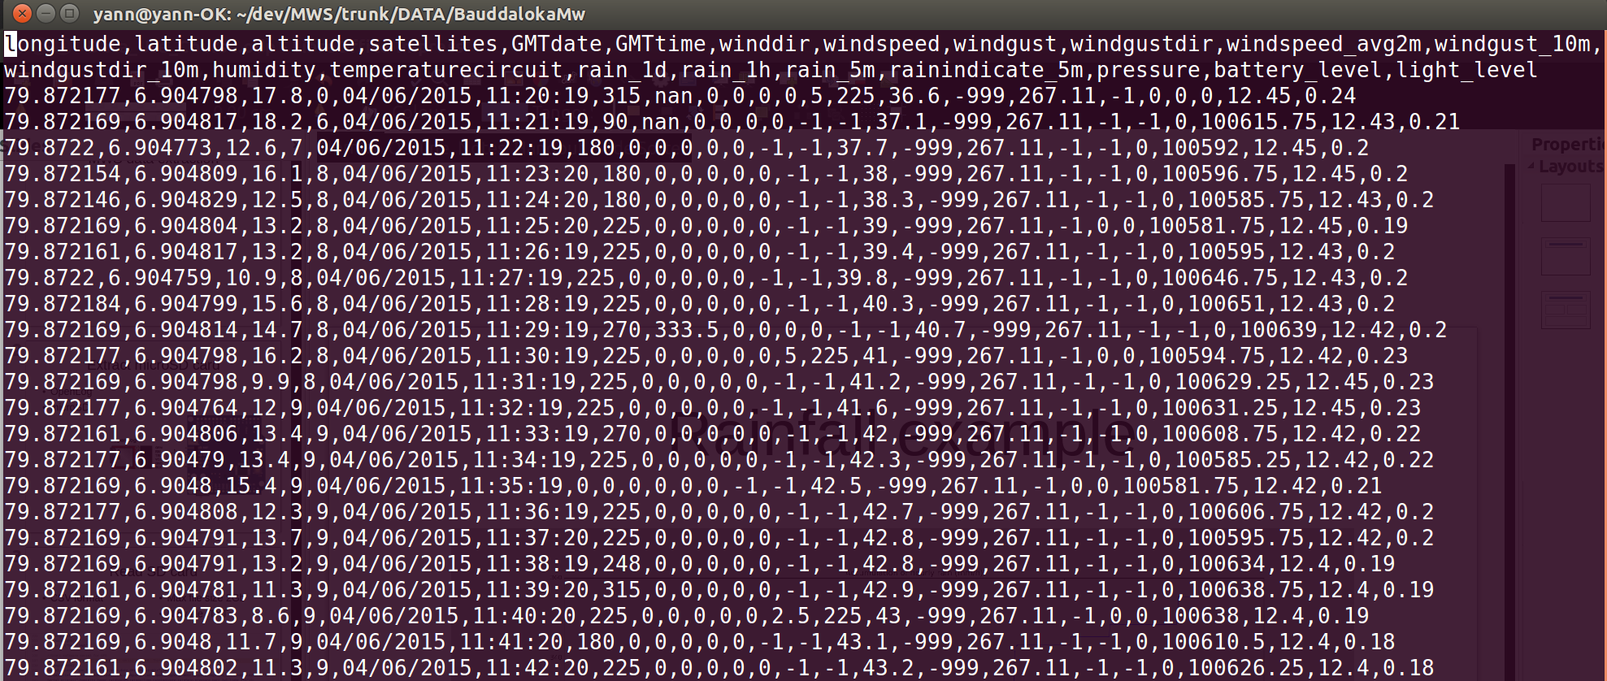
Data sample

Slide 5
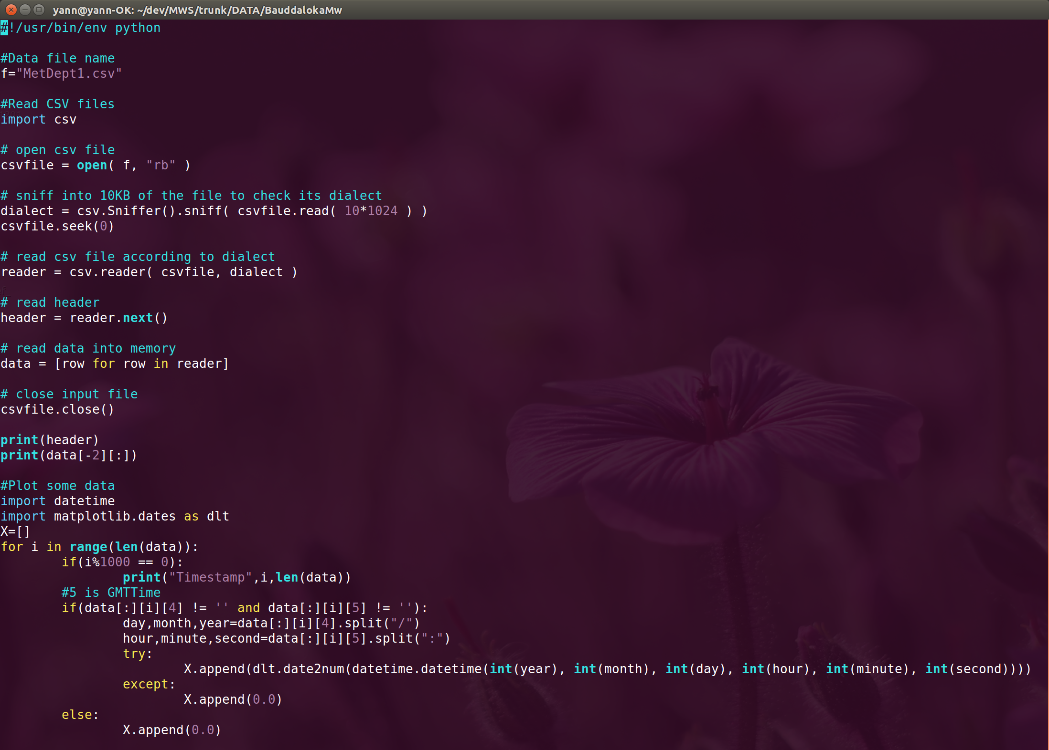
Python extraction

Slide 6
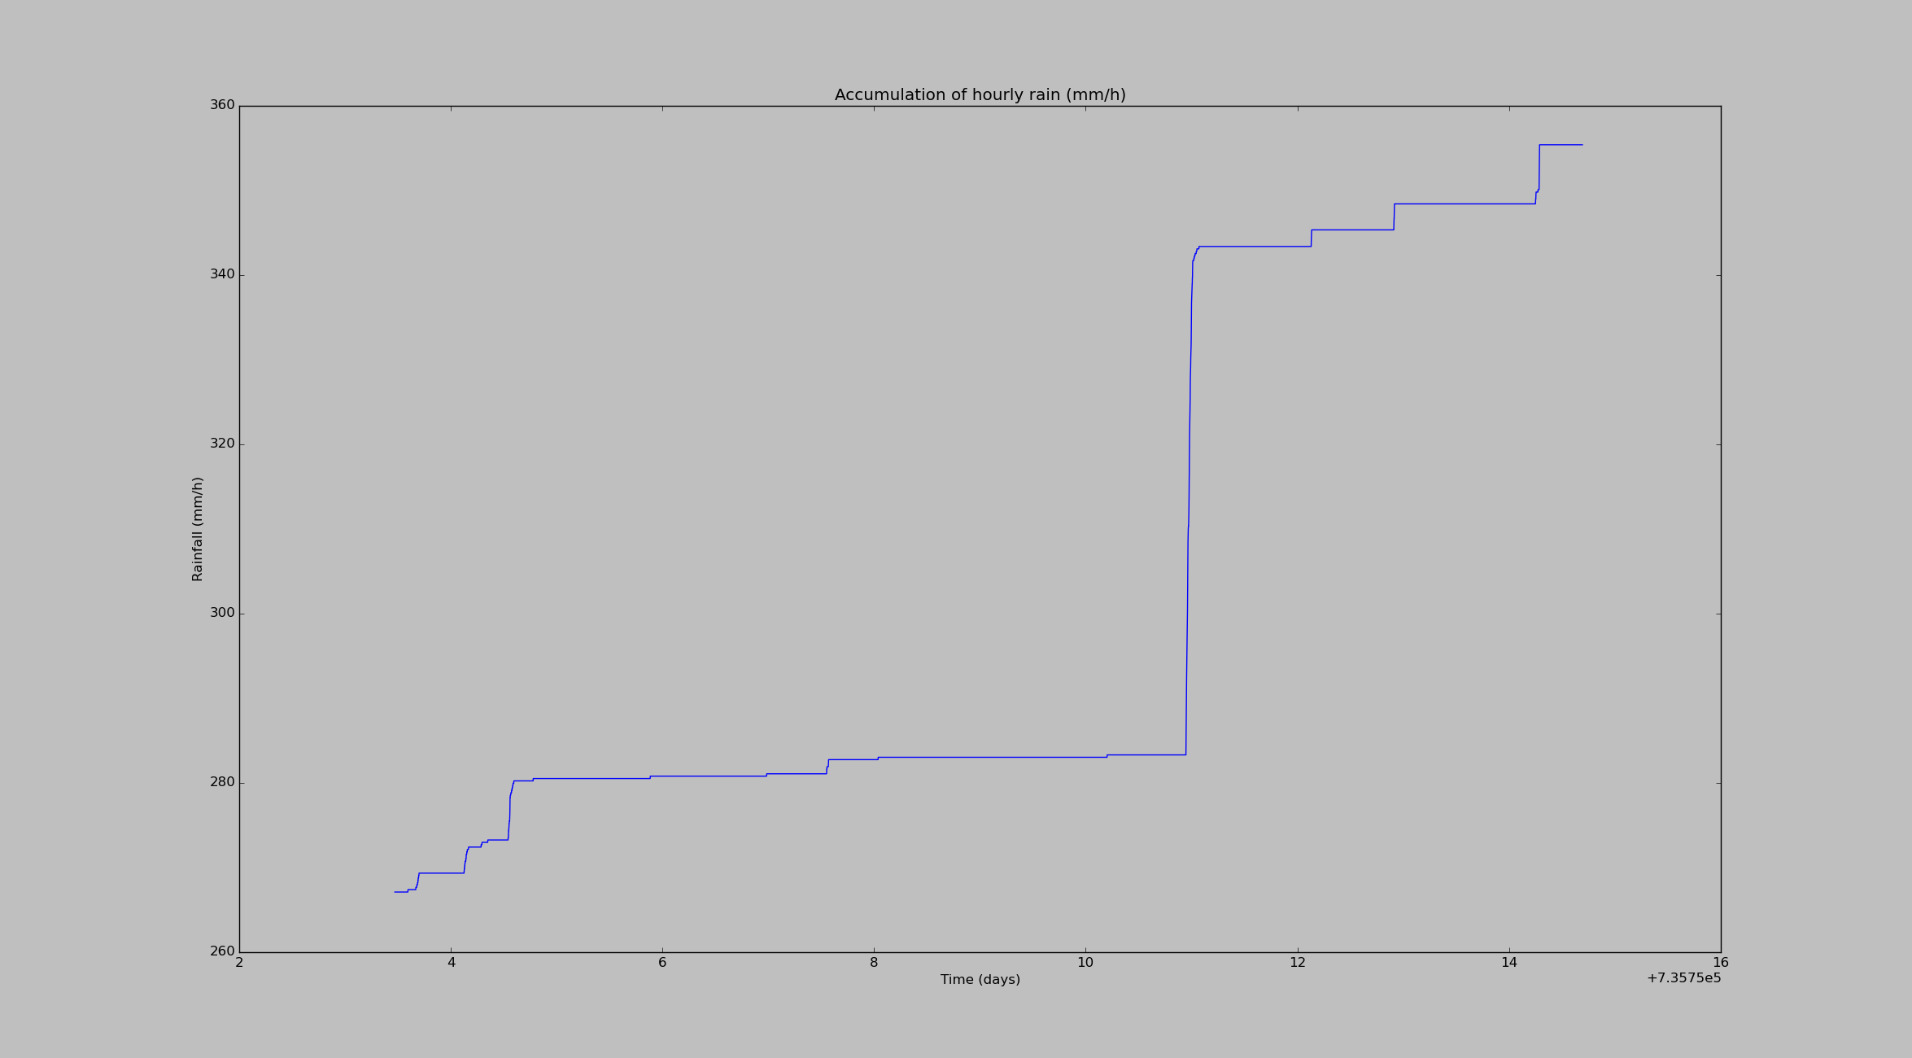
Rainfall example

