Slide 1
CgET: a CGIAR initiave
For
A Global Mapping of Evapotranspiration
Daily from 2000-onwards

Slide 2
CRP5 SRP information
  Surveillance is the ongoing, systematic collection, analysis and interpretation of data essential to the planning, implementation and evaluation of land and water management policy and practice
  Data collected are rarely comparable across ecological zones because of inconsistencies in methods or in the spatial scale at which observations are made
  > Remote Sensing monitoring
  > Advances in RS for measuring components of the water balance

Slide 3
CGIAR & IPG
We contribute to:
  Public Domain Research
  International Public Goods
IWMI center has a history of World Datasets:
  Water/Climate Atlas
  Wetlands
  Irrigation

Slide 4
IWMI and ET uses
Irrigation Systems Performance (~1997)
Crop Water Productivity (~1999)
Water Accounting (~1999)
Wetlands-Agriculture interface (2000)
Basin water uses (2001)

Slide 5
Chronology of events
2001: Initial thoughts
  SEBAL should be automatic (did not want to manually process/solve it all the time)
  Work started on automatic SEBAL in 2001
2003-2005: Programming knowledge acquisition
  C knowledge acquired 2003
  HPC programming 2003-5 (OpenMP, MPI)
  HPC raster processing framework coded 2005
  Book published in 2009 (1st ed.) & 2011 (2nd ed.) giving all coding required to replicate it
2004-2005: Automatic processing SEBAL
2005-2011: Additional models
  ETo PM, ETo Hargreaves (2005-6)
  ETa SSEB (Senay) (2007)
  ETa TSEB (Kustas et al.) (2009-now, prototype ready needs proofing of output)
  Ongoing ETa SEBS (Su)... (2009-now, prototype mostly done)
  Future: ETLook (Cheema, 2012)
2012: Pilot for ET models benchmarking (ETb) published
  Chemin, Y., 2012. A distributed benchmarking framework for Actual ET models. In "Evapotranspiration - Remote Sensing and Modeling", January 2012, Chapter 19, 421-436pp
  Got downloaded 1200 times in 3 months of publication (2600+ in 1 year).
  International contacts request me to assess accuracy of MOD16with this method, after reading this article

Slide 6
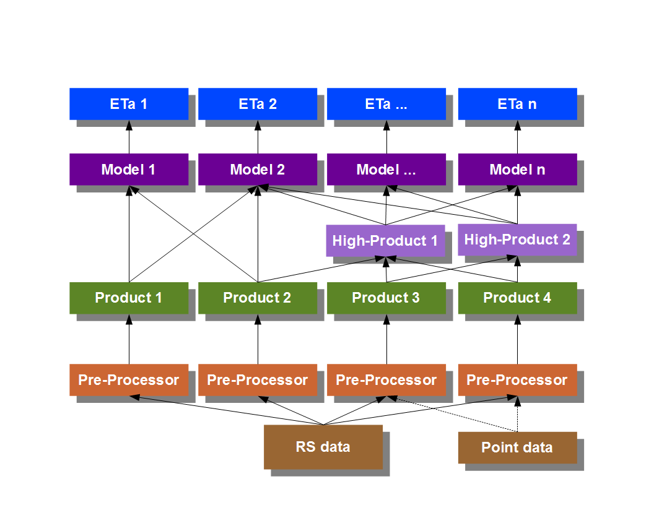
Methodology

Slide 7
ET models available
ETo PM (Penman-Monteith, 1972)
ET Pot (Astronomical computations)
ETa SEBAL (Bastiaanssen, 1995/8)
ETa METRIC (Allen, 2001)
ETa SSEB (Senay, 2007)
ETa TSEB (Kustas, Norman, etc 2001) => “Prototype”
ETa SEBS (Su, 2002) => “Incomplete”
ETo Hargreaves (+Modified and Samani versions) => “Test”
ETLook (Cheema, 2012)
Others as they come

Slide 8
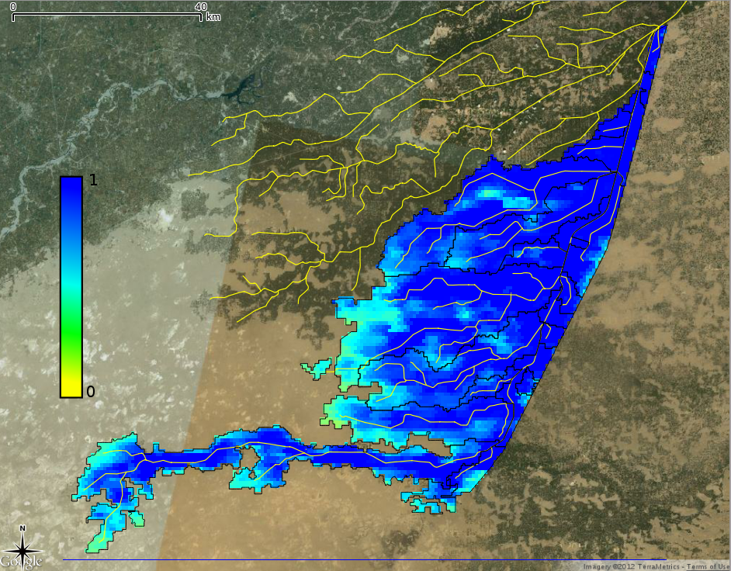
An irrigation system in Pakistan
Hakra Branch
Evaporative Fraction
Water Availability
2012-10-04

Slide 9
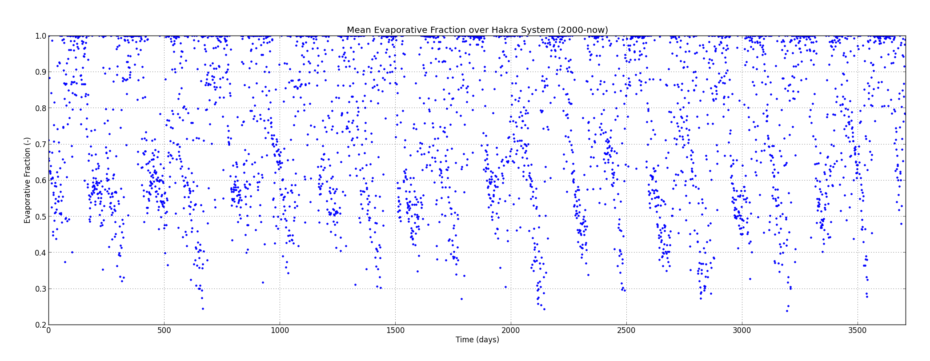
An irrigation system in Pakistan
2000-2012 daily average of evaporative fraction on Hakra system

Slide 10
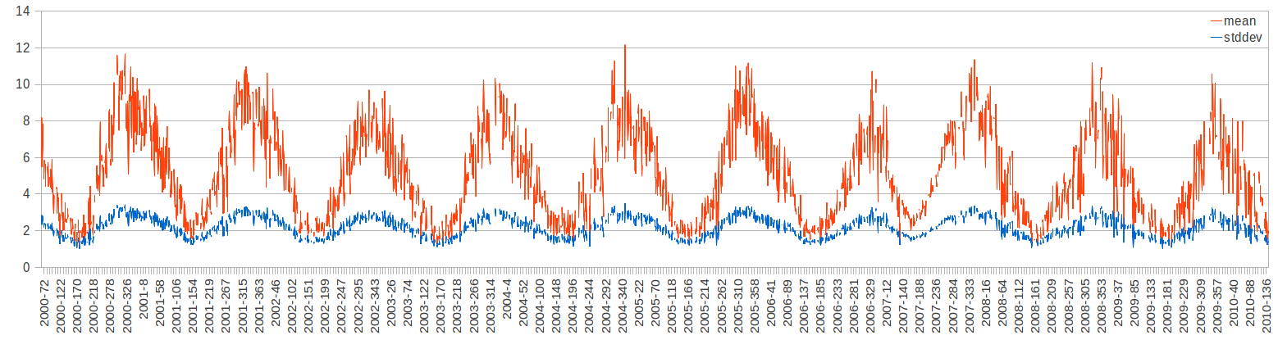
An irrigation system in Australia
Mean and stddev of ETa
Irrigation system ~70,000 ha in NSW
~4000+ images processed

Slide 11
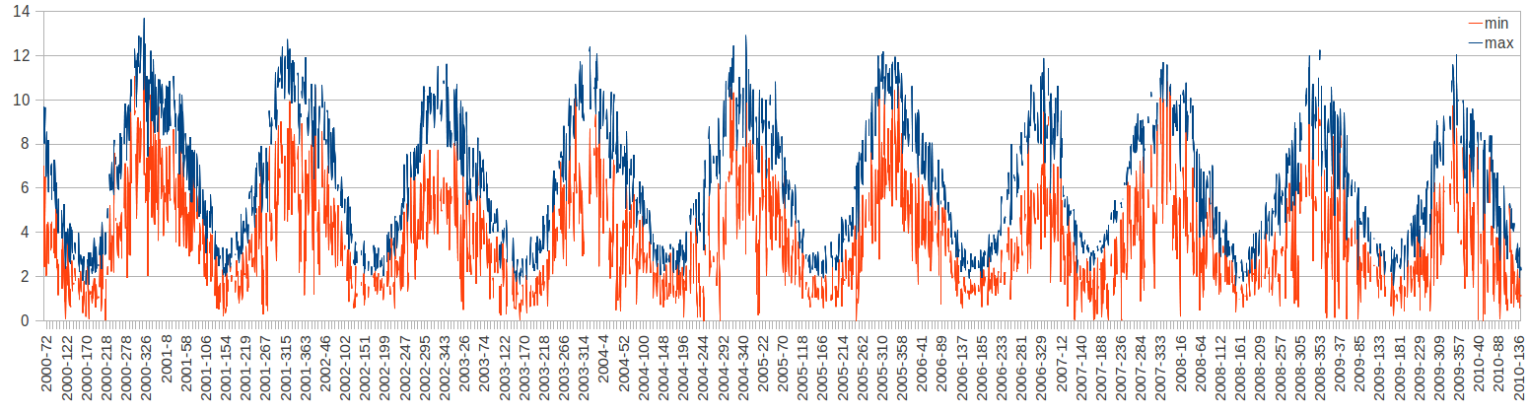
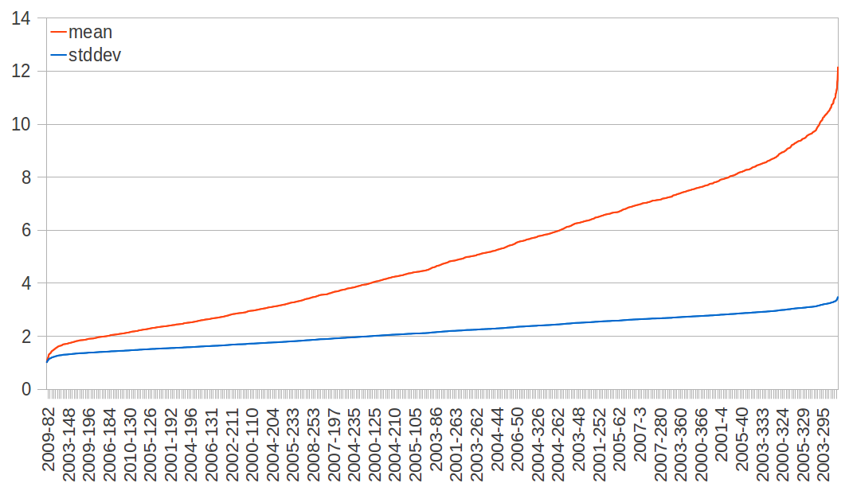
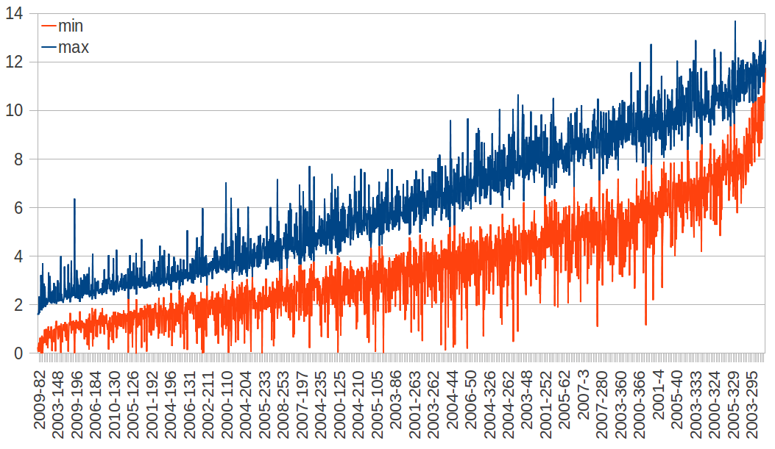
Min, Max, Sorting

Slide 12
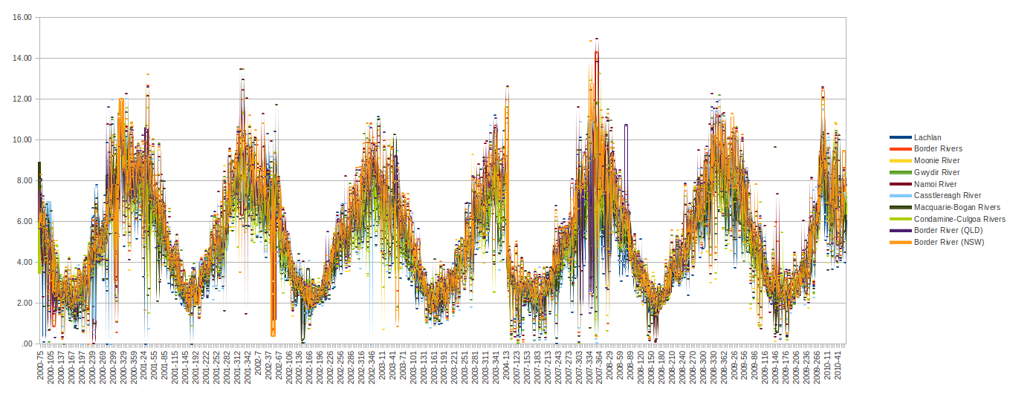
ETa Murray Darling Sub-Basins
2000-2004
2007-2010

Slide 13
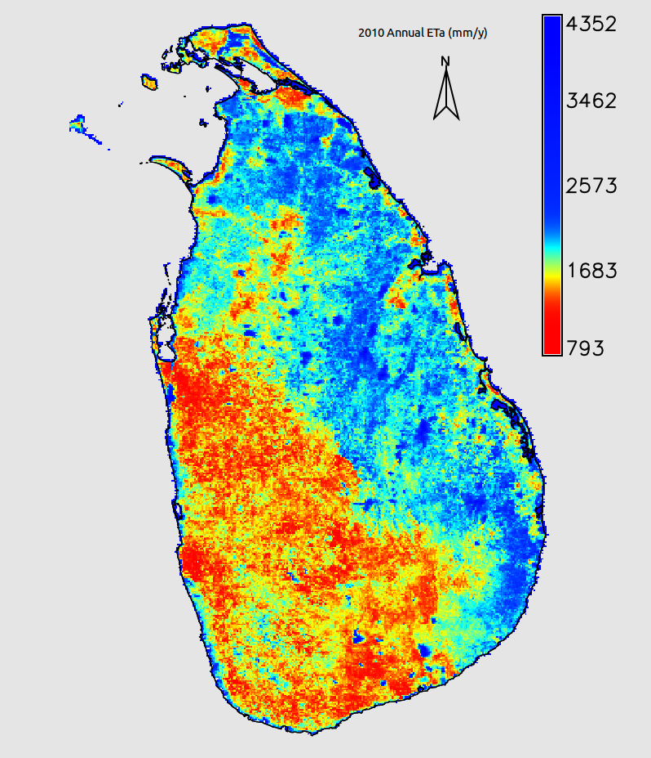
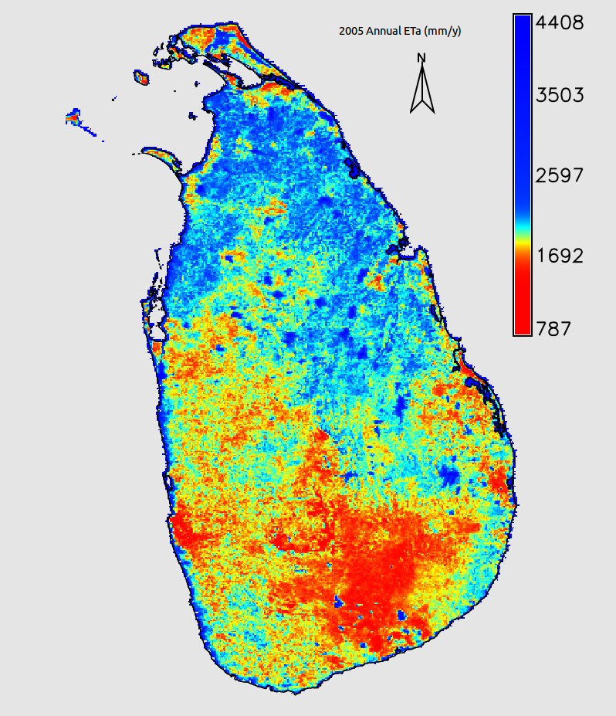
Sri Lanka Annual ET

Slide 14
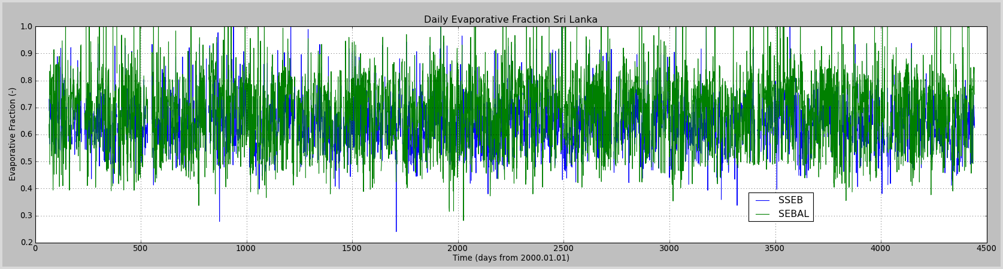
EF Sri Lanka
Two ETa models
LK Average Evaporative Fraction
No meaning, just a proof it processes

Slide 15
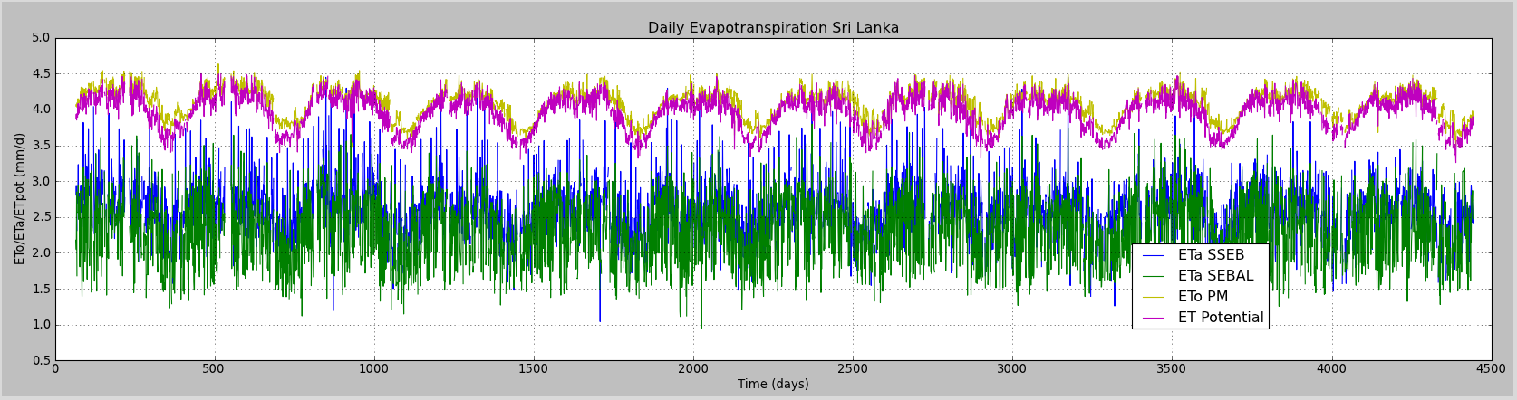
ET Sri Lanka
Actual state of research
4500 days processed for LK
4 ET models (ETo PM, ET Pot, SSEB, SEBAL)

Slide 16
RS Products Generated
Models output:
  Energy fluxes
  Resistances
  Evaporative Fraction
  ET (ref,pot,actual)
  Biomass growth ( I can provide you vegetation height at 90 m resolution)
  (yield, if crop map)
QA checked:
  NDVI
  Albedo
  LST
  Emissivity
  LAI
  etc.

Slide 17
Some ET Applications
Impact of 10 years of WUAs in Central Asia
Crop Yield & Crop Water Productivity
Performance of Irrig. Systems
Basin water monitoring/management
Wetland health
Countries with less/no hydro data (Afgh, CAC, PRC)
Models (SWAT, HBV, RegClim):
  RS direct input
  Calibration/Parameterization by RS forcing

Slide 18
Some Corollary Applications
Land Use / Land Cover
Irrigated Area Mapping
HRU generation for hydro-models
Disaggregating SMOS from 50 to 1Km
Flood mapping
Biomass Growth
etc...

Slide 19
Project Definition
People: Yann (Ph. D) , Lal (Ph. D) (IWMI-HQ), Alexander (IWMI-Tashkent), MCS x1, MSc x1, PhD x1
Year 1:
  Crowdsourcing Level 0: Scientific groups
  Alpha open source release of Global ET with pixel-based uncertainty:
    cal/val in Sri Lanka + Central Asian Countries + previous IWMI study sites
    Continent-based trainings of scientists interested in publishing local cal/val
  Initial publications
Year 2:
  Crowdsourcing Level 1: Anybody interested to use
    Multi-lateral cal/val (each continent has one collaborating group)
    Alpha release: 50% of continents are cal/val OK, 50% of submitted publication
    Final release: 90% cal/val OK, 50% of publications accepted
    Continent-based trainings and engagement of users (anybody can register to trainings)
Year 3:
  Crowdsourcing Level 2: Anybody interested to teach trainers
    Community of users self-parameterization
    Continent-based trainings of trainers
  Stable release: Casual activity to iron out missing elements

Slide 20
Project Logistics
Core needs:
  Hardware to be discussed (large access to Internet for RS download)
  No Software cost (F&OSS only)
  No RS data cost (Terra/Aqua - MODIS)
  LK: Problem in RS data download (time) & storage (size)
  Country with large Internet pipe: No data download problem, less storage problem
To be arranged from CGIAR existing possibilities/Internet:
  Climate data input (Internet, CG countries)
  FluxNet data input (Internet, Public Domain)
  Primary cal/val sites (LK, CAC, ZID, ?)
  Secondary cal/val sites (Previously published since 2000)
    Previous studies of CGIAR
    Kharkheh (Lal), Ferghana (Yann), Zhanghe (Yann), Pak?, Nile?
    Americas (CIAT/Andy)? Europe(Markus/Thomas)? Africa(Yann)? Australia (Yann)?

Slide 21
Project Software output
Distributed processing framework (Public domain)
  MODIS satellite data
  C with OpenMP
  Can do in GPU, Cluster (not really needed unless World)
Grass GIS modules (GPL)
  Landsat/Aster and MODIS (… maybe more)
  Casual users, specific needs (high.res)
  Already many modules in GRASS7

Slide 22
Scientific community
First year
  Alpha release for researchers,
  1 training for coding/parameterization of ET models
  2 face to face / group meetings for calibration/validation/writing articles
Second year
  50% of researchers have submitted articles
  1 training for anybody interested (we can even consider large groups) in using this.
  2 face to face / group research meetings
Third year
  100% of researchers have submitted articles, about 50% are published.
  Final training session for training trainers.
  2 face to face group meetings for researchers (a session in a conference?)
Requirements:
  Collect required costs for organizing 1 week and 2 weeks trainings/workshops in each of the interested Universities to include in budget.

Slide 23
Thank you

Slide 24
Validation site location in the US
Suggested additional calibration sites in US:
Barrow Alaska (Representative site location for Arctic Research Community- Surface Energy Balance)
Jemez Mountain (Representative site location for climate change and associated drought impact on vegetation stress)

Slide 25
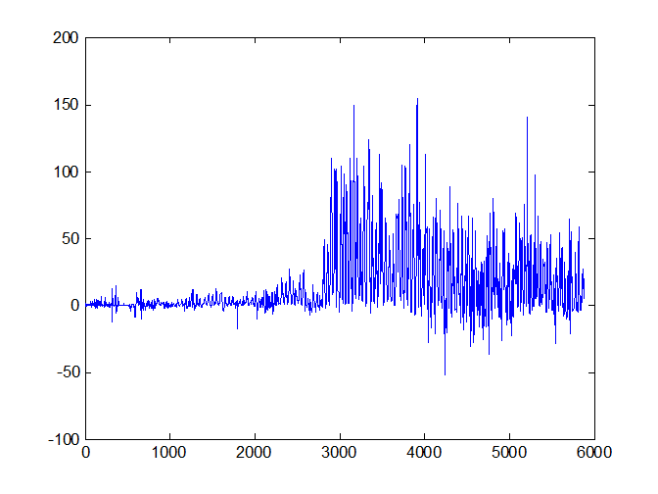
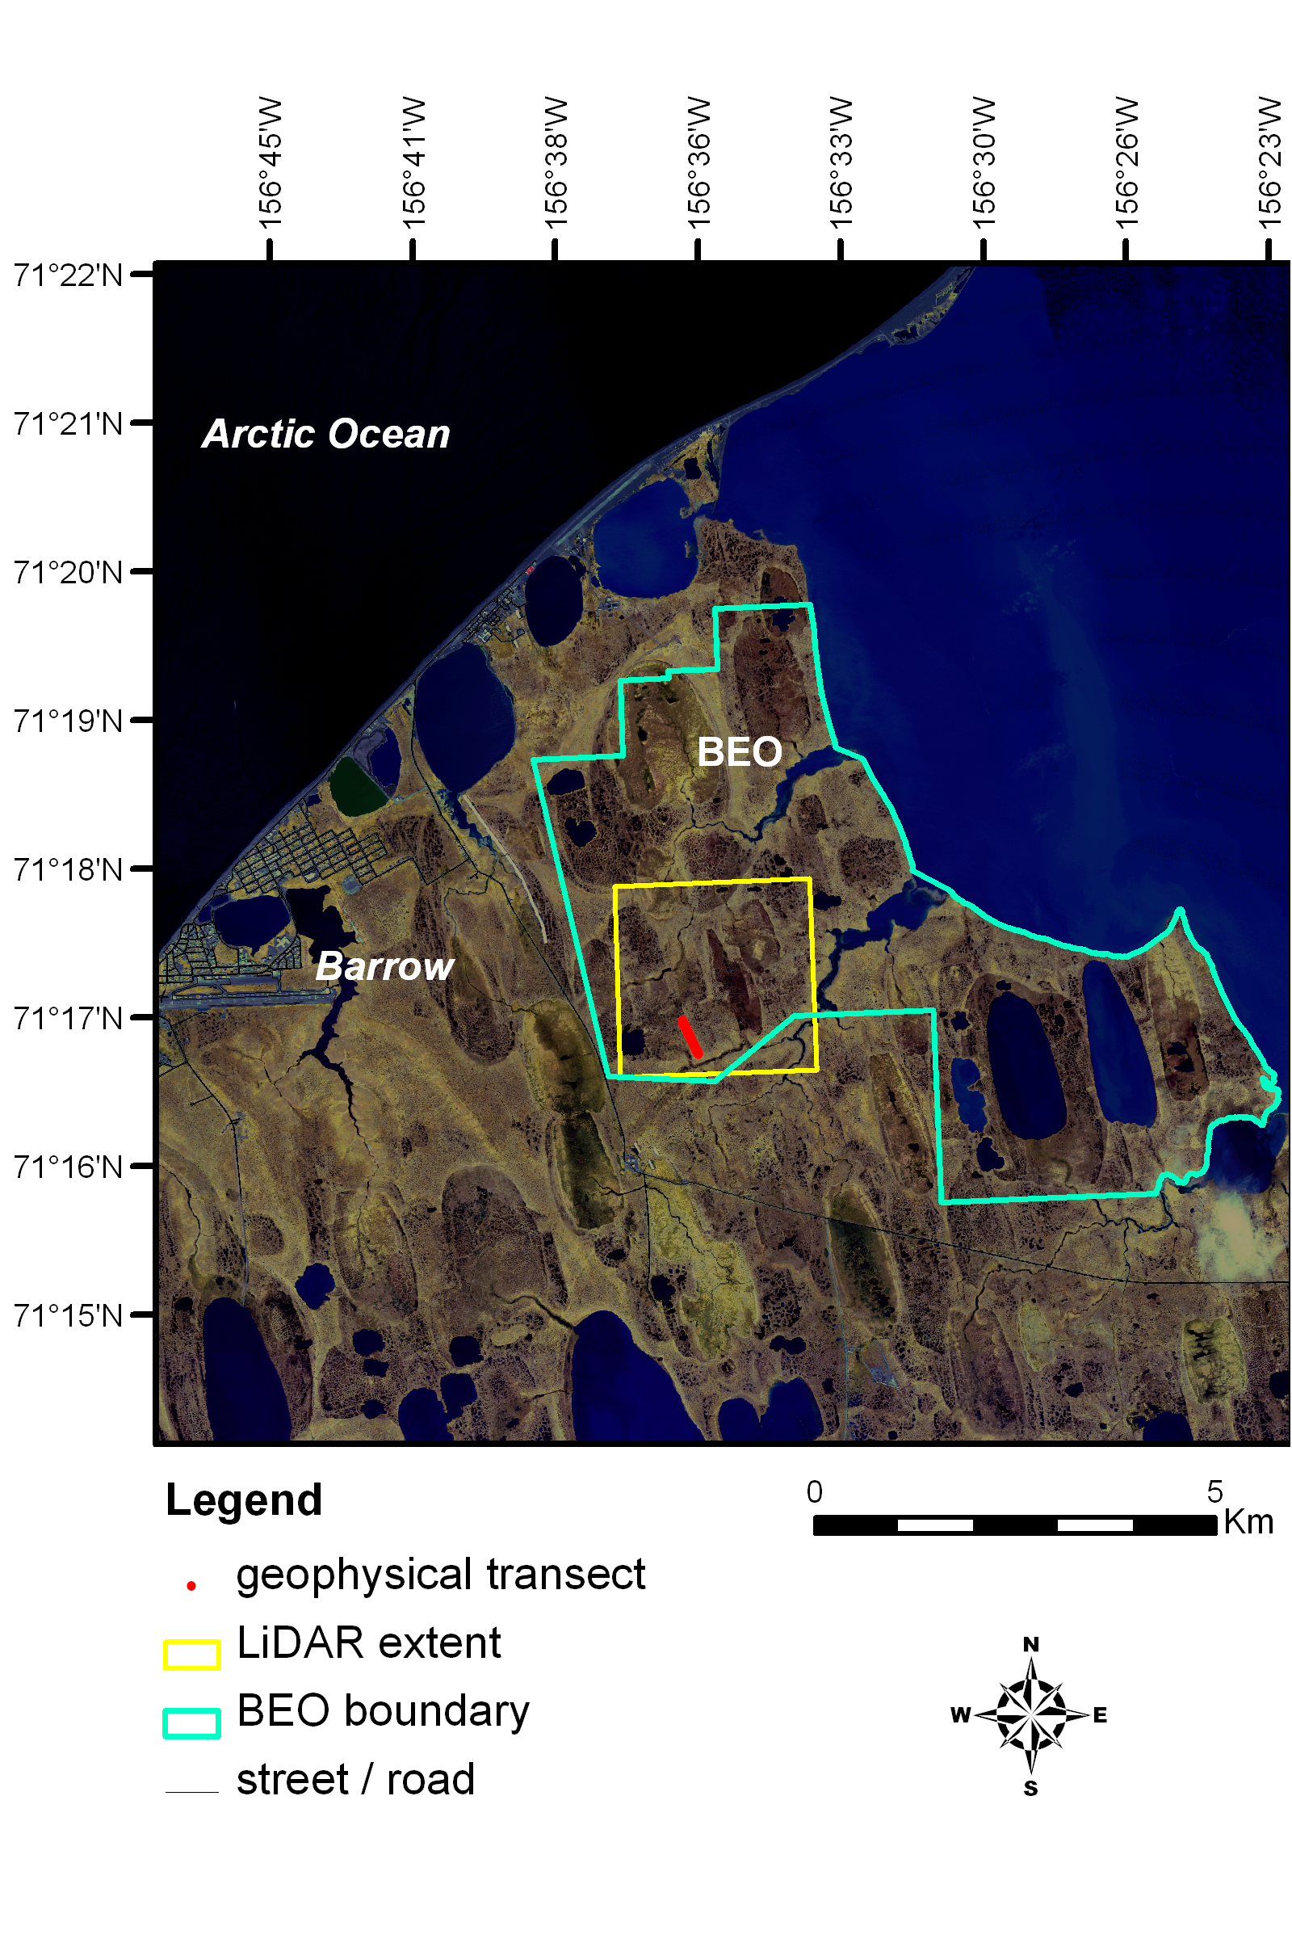
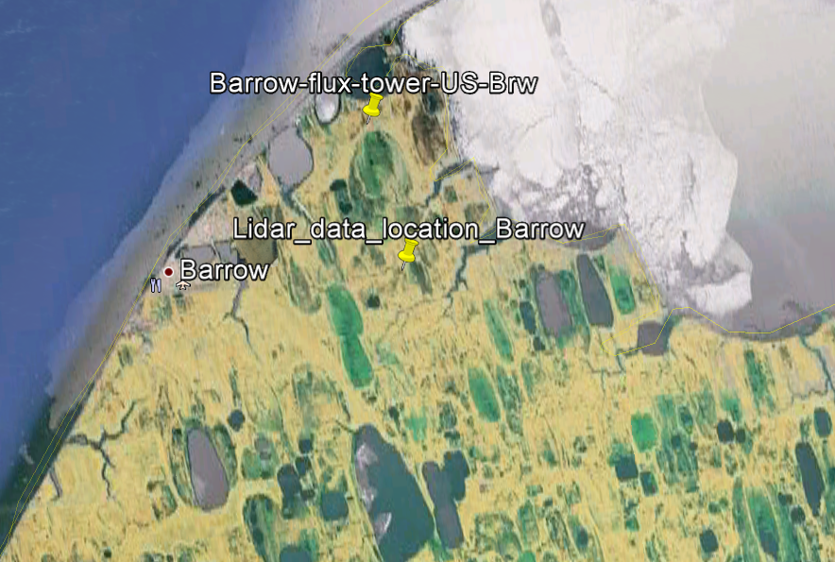
Data availability for these validation site locations: Barrow Alaska (71.323218 N (Lat), -156.612771 E (Long))
Growing
season
H (W/m²)

Slide 26
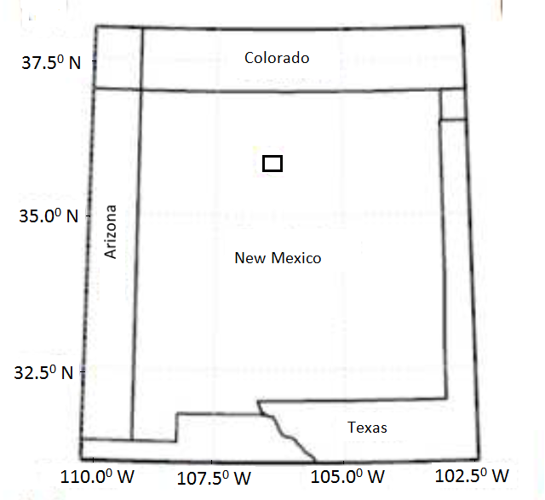
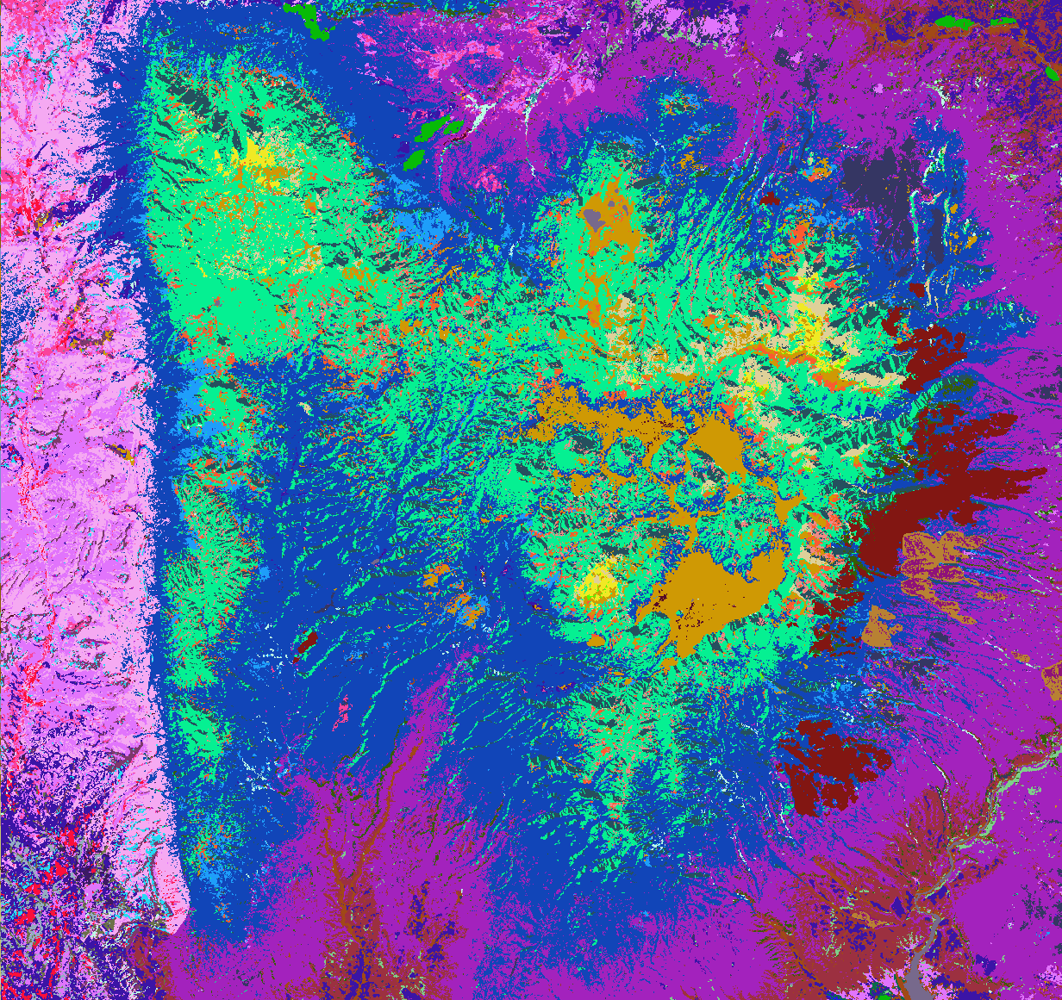
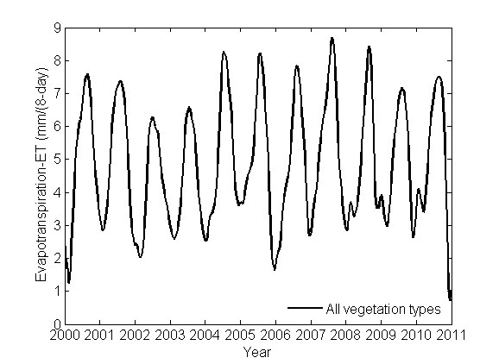
Data availability for these validation site locations: Jemez Mountain- South West United state (35.817459° N (Lat), - 106.513276° E (Long))

