Slide 1
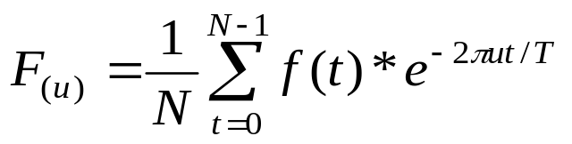
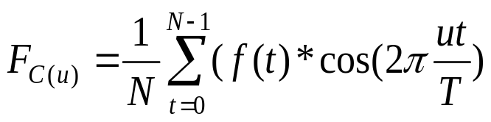
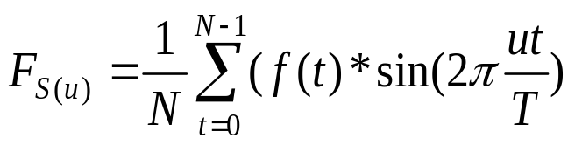
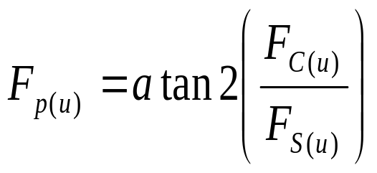
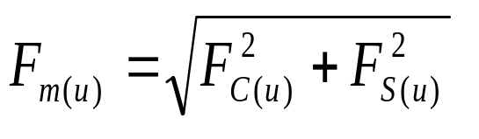
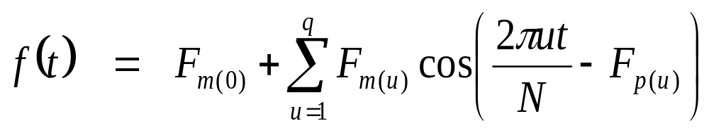
Discrete Fourier Smoothing
Forward Fourier Transform
Where
N
is the Number of temporal components (i.e., Bands)
q
is number of harmonics to be used in the inverse transform
f(t)
is the input MTCI value at each band (i.e., t)
T
is total length of time (i.e., number of bands)
u
is harmonic number
Fourier Cosine Component
Fourier Sine Component
Fourier Magnitude
Fourier Phase
Inverse Fourier Transform

