Slide 1



  In-House Simulator

Slide 2



In-House Simulator
  Models
Two-Fluid Four-Equation One Pressure Model
$$\frac{∂}{∂t}\left(α_{k}ρ_{k}\right)+\frac{∂}{∂x}\left(α_{k}ρ_{k}u_{k}\right)=0$$
$$\frac{∂}{∂t}\left(α_{k}ρ_{k}u_{k}\right)+\frac{∂}{∂x}\left(α_{k}ρ_{k}u_{k}^{2}\right)=−α_{k}\frac{∂p_{k}}{∂x}−\left(p−p^{i}\right)\frac{∂α_{k}}{∂x}+α_{k}ρ_{k}g\sin{θ}+\frac{τ_{i,k}S_{i}}{A_{k}}+\frac{{4τ}_{w,k}}{Dα_{k}}$$
Two-Fluid Five-Equation One Pressure Model
$$\frac{∂\left(α_{1}ρ_{1}\left(h_{1}+\frac{v_{1}^{2}}{2}\right){+α}_{2}ρ_{2}\left(h_{2}+\frac{v_{2}^{2}}{2}\right)\right)}{∂t}+ \frac{∂{(α}_{1}ρ_{1}v_{1}\left(h_{1}+\frac{v_{1}^{2}}{2}\right)+α_{2}ρ_{2}v_{2}\left(h_{2}+\frac{v_{2}^{2}}{2}\right) }{∂x}=\frac{∂p_{k}}{∂t}+{(α}_{1}ρ_{1}v_{1})gsinθ+{(α}_{2}ρ_{2}v_{2})gsinθ+\frac{q_{W,m}^{"}S}{A}$$
Additional:
$k$ = 1 or 2
$α_{k}$ = volume fraction of $k$-phase
$p$ = pressure
$θ$ = pipe slope

Slide 3
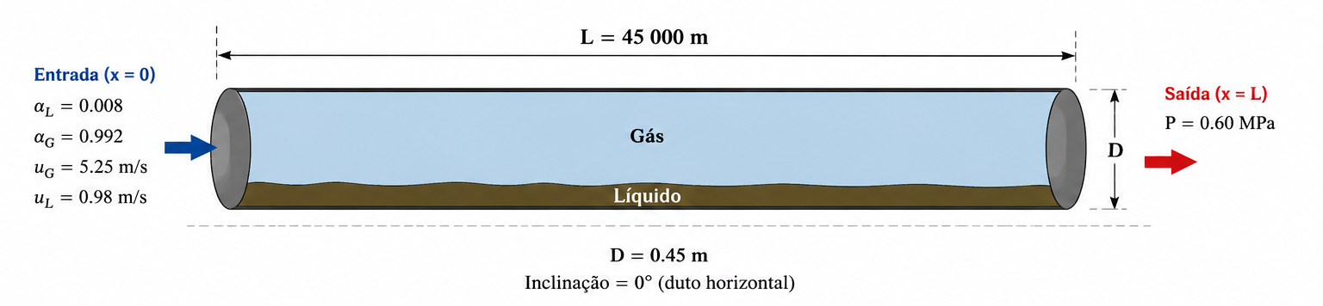
In-House Simulator
  Stratified Case – LH-LP (Low Holdup / Low Pressure)
1-D;
Óleo e gás;
Sem transferência de massa;
Viscoso;
Compressível;
L = 45 km;
D = 0,45 m;
FIGUEIREDO, Aline Barbosa; BAPTISTA, Renan Martins; RACHID, Felipe Bastos de Freitas; BODSTEIN, Gustavo Cesar Rachid. Numerical simulation of stratified-pattern two-phase flow in gas pipelines using a two-fluid model. International Journal of Multiphase Flow, v. 88, p. 30–49, 2017. DOI: 10.1016/j.ijmultiphaseflow.2016.09.006

Slide 4
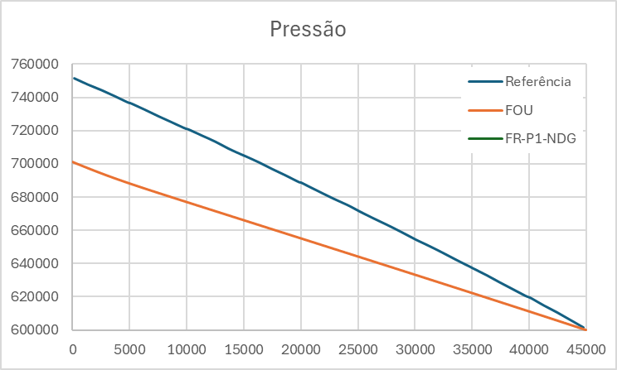
In-House Simulator
  Stratified Case – LH-LP (Low Holdup / Low Pressure)
Results:
FIGUEIREDO, Aline Barbosa; BAPTISTA, Renan Martins; RACHID, Felipe Bastos de Freitas; BODSTEIN, Gustavo Cesar Rachid. Numerical simulation of stratified-pattern two-phase flow in gas pipelines using a two-fluid model. International Journal of Multiphase Flow, v. 88, p. 30–49, 2017. DOI: 10.1016/j.ijmultiphaseflow.2016.09.006

