Slide 1

Digital Fundamentals
Tenth Edition
Floyd
Chapter 5
组合逻辑分析
© 2008 Pearson Education

Slide 2

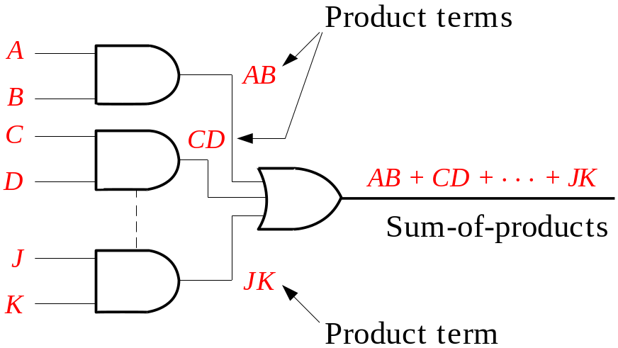
Summary
Combinational Logic Circuits 组合逻辑电路
In Sum-of-Products (SOP) form, basic combinational circuits can be directly implemented with AND-OR combinations if the necessary complement terms are available.
Notes:
在不考虑非门的情况下，积之和的表达形式可以由基本的 与门-或门的组合完成。

Slide 3
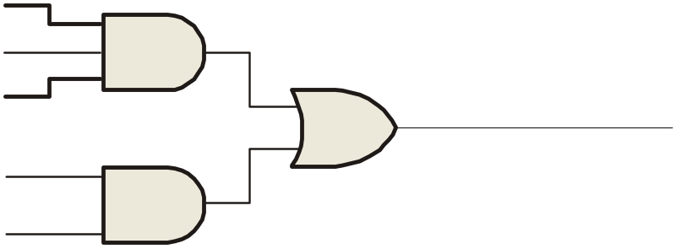
Summary
Combinational Logic Circuits
An example of an SOP implementation is shown. The SOP expression is an AND-OR combination of the input variables and the appropriate complements.
A
B
ABC
C
X = ABC
+ DE
SOP
D
E
DE

Slide 4
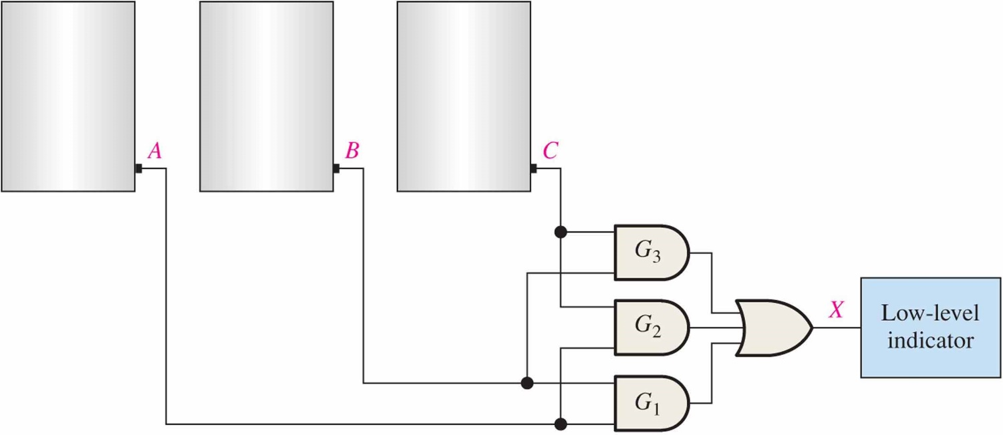
Figure 5.2
EXAMPLE 5–1 In a certain chemical-processing plant, a liquid chemical is used in a manufacturing process. The chemical is stored in three different tanks. A level sensor in each tank produces a HIGH voltage when the level of chemical in the tank drops below a specified point.
Design a circuit that monitors the chemical level in each tank and indicates when the level in any two of the tanks drops below the specified point.
Related Problem*
Write the Boolean SOP expression for the AND-OR logic in Figure 5–2.
Notes:
Solution
The AND-OR circuit in Figure 5–2 has inputs from the sensors on tanks A, B, and C as shown. The AND gate G1 checks the levels in tanks A and B, gate G2 checks tanks A and C, and gate G3 checks tanks B and C. When the chemical level in any two of the tanks gets too low, one of the AND gates will have HIGHs on both of its inputs, causing its output to be HIGH; and so the final output X from the OR gate is HIGH. This HIGH input is then used to activate an indicator such as a lamp or audible alarm, as shown in the figure.

Slide 5
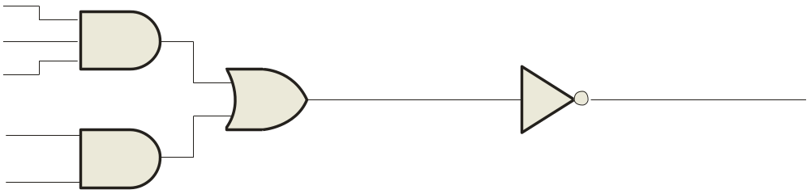
Summary
5.1.2 Combinational Logic Circuits
When the output of a SOP form is inverted, the circuit is called an AND-OR-Invert circuit. The AOI configuration lends itself to product-of-sums (POS) implementation.
An example of an AOI implementation is shown. The output expression can be changed to a POS expression by applying DeMorgan’s theorem twice.
A
B
ABC
C
X = ABC
+ DE
X = ABC
+ DE
AOI
D
X = (ABC)(DE)
DeMorgan
E
DE
X = (A + B + C)(D + E)
POS
Notes:
“积之和”与“和之积”形式之间的关系？

Slide 6
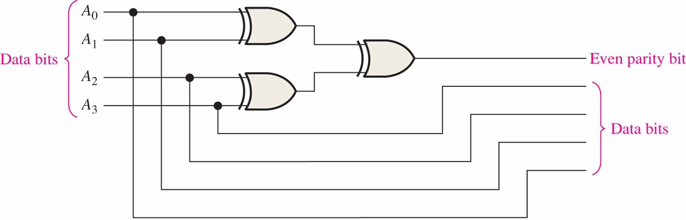
Figure 5.7 Even-parity generator.
EXAMPLE 5–3 Use exclusive-OR gates to implement an even-parity code generator for an original 4-bit code.
Related Problem*
How would you verify that a correct even-parity bit is generated for each combination of the four data bits?
Determine the even-parity output for all 16 input combinations. Each combination should have an even number of 1s including the parity bit.
Notes:
Solution
Recall from Chapter 2 that a parity bit is added to a binary code in order to provide error detection. For even parity, a parity bit is added to the original code to make the total number of 1s in the code even. The circuit in Figure 5–7 produces a 1 output when there is an odd number of 1s on the inputs in order to make the total number of 1s in the output code even. A 0 output is produced when there is an even number of 1s on the inputs.

Slide 7
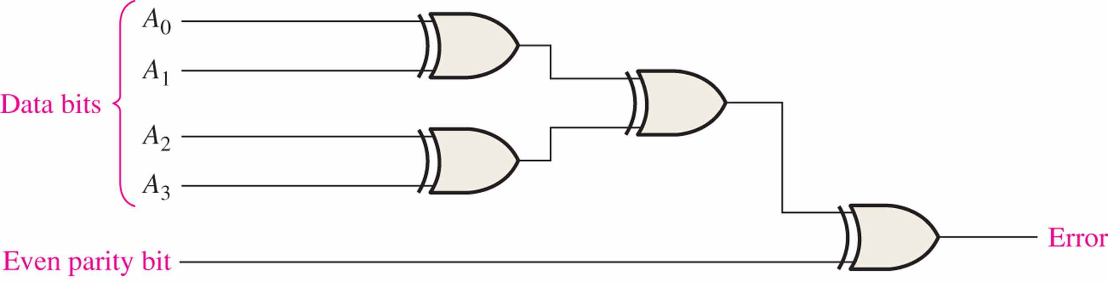
Figure 5.7 Even-parity checker.
EXAMPLE 5-4 Use exlusive-OR gates to implement an even-parity checker for the 5-bit code generated by the circuit in Example 5-3.
Related Problem*
How would you verify that an error is indicated when the input code is incorrect?
Apply codes with odd number of 1s and verify output is 1.
Notes:
Solution
The circuit in Figure 5–8 produces a 1 output when there is an error in the five-bit code and a 0 when there is no error.

Slide 8
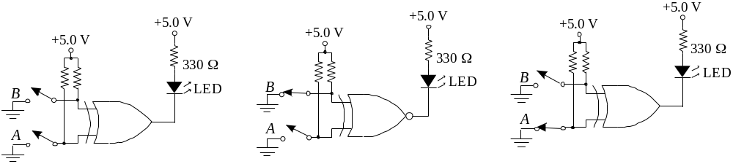


Summary
Example
For each circuit, determine if the LED should be on or off.
(a) (b) (c)
Solution
Circuit (a): XOR, inputs agree, output is LOW, LED is ON.
Circuit (b): XNOR, inputs disagree, output is LOW, LED is ON.
Circuit (c): XOR, inputs disagree, output is HIGH, LED is OFF.

Slide 9
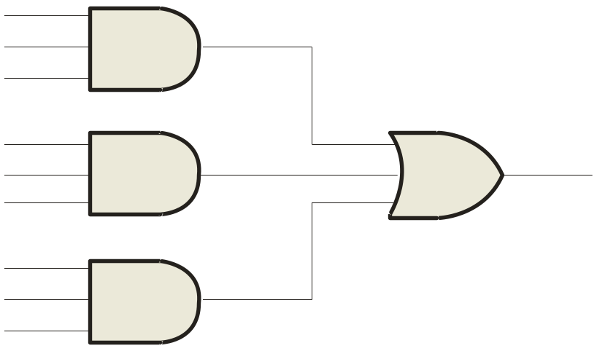
Summary
5.2 Implementing Combinational Logic
Implementing a SOP expression is done by first forming the AND terms; then the terms are ORed together.
Example
Show the circuit that will implement the Boolean expression X = ABC + ABD + BDE. (Assume that the variables and their complements are available.)
Solution
Start by forming the terms using three 3-input AND gates.
Then combine the three terms using a 3-input OR gate.
A
B
C
A
X = ABC + ABD + BDE
B
D
B
D
E

Slide 10
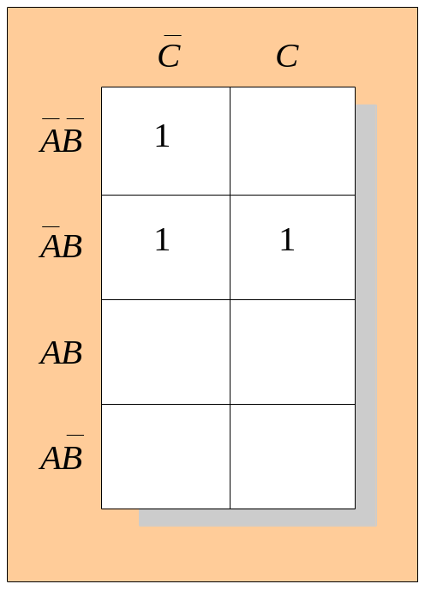
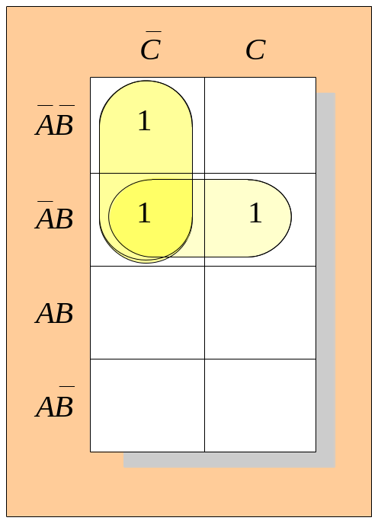
Summary
Karnaugh Map Implementation
For basic combinational logic circuits, the Karnaugh map can be read and the circuit drawn as a minimum SOP.
Example
A Karnaugh map is drawn from a truth table. Read the minimum SOP expression and draw the circuit.
Solution
1. Group the 1’s into two overlapping groups as indicated.
Read each group by eliminating any variable that changes across a boundary.
B changes across this boundary
The vertical group is read A C.
C changes across this boundary
The horizontal group is read AB.
The circuit is on the next slide:

Slide 11
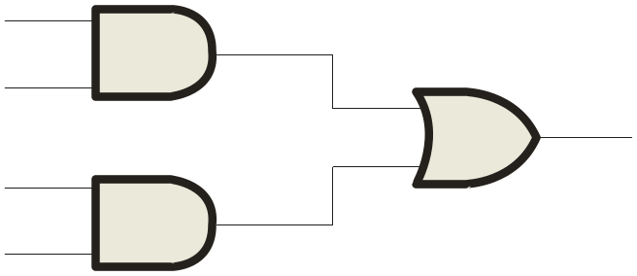
Summary
Solution
continued…
Circuit:
A
C
X =
A
C
+
A
B
A
B
The result is shown as a sum of products.
It is a simple matter to implement this form using only NAND gates as shown in the text and following example.
这个例子可以完全用与非门实现。
思考：为什么全部用与非门会更好？

Slide 12
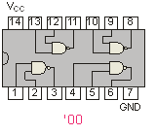

Summary
NAND Logic
Example
Convert the circuit in the previous example to one that uses only NAND gates.
Solution
Recall from Boolean algebra that double inversion cancels. By adding inverting bubbles to above circuit, it is easily converted to NAND gates:
Fixed Function Logic
A
C
X =
C
+
A
B
A
A
B

Slide 13
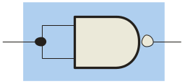
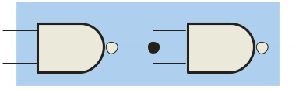
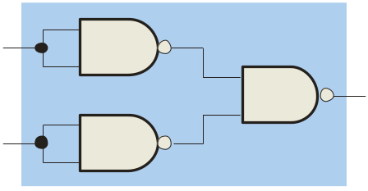
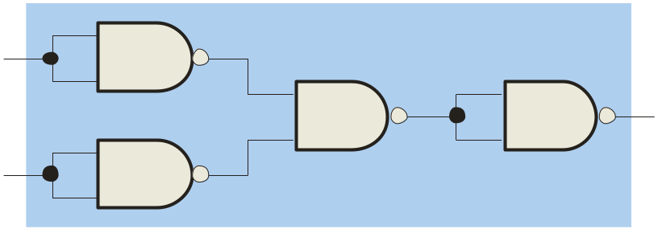
Summary
5.3 Universal Gates 通用逻辑门
NAND gates are sometimes called universal gates because they can be used to produce the other basic Boolean functions.
A
A
A
AB
B
Inverter
AND gate
A
A
A + B
A + B
B
B
OR gate
NOR gate

Slide 14
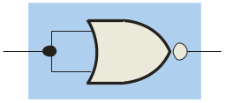
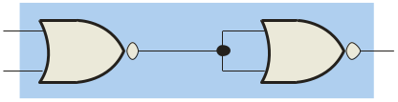
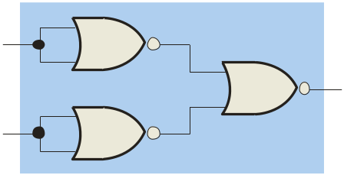
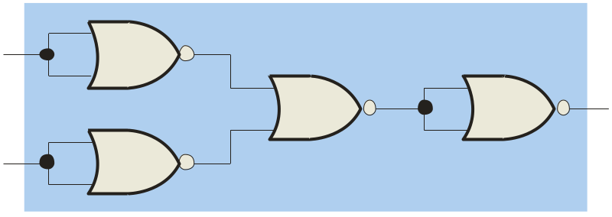
Summary
Universal Gates
NOR gates are also universal gates and can form all of the basic gates.
A
A
A
A + B
B
Inverter
OR gate
A
A
AB
AB
B
B
AND gate
NAND gate

Slide 15
Summary
NAND Logic
Recall from DeMorgan’s theorem that AB = A + B. By using equivalent symbols, it is simpler to read the logic of SOP forms. The earlier example shows the idea:
A
C
X =
A
C
+
A
B
A
与非门的等价形式
B
The logic is easy to read if you (mentally) cancel the two connected bubbles on a line.
Notes:
Bubble logic，泡泡逻辑，详见参考教材。

Slide 16
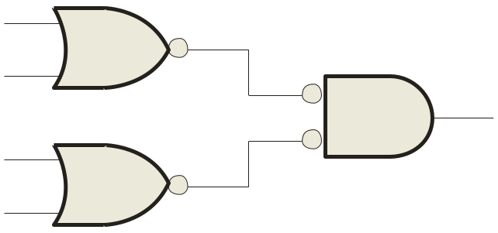
Summary
NOR Logic
Alternatively, DeMorgan’s theorem can be written as A + B = A B. By using equivalent symbols, it is simpler to read the logic of POS forms. For example,
A
B
X =
(A + B)(A + C)
A
或非门的等价形式
C
Again, the logic is easy to read if you cancel the two connected bubbles on a line.

Slide 17

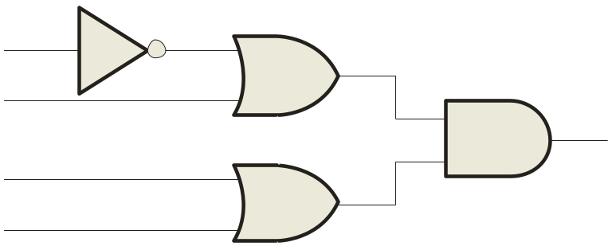
Summary
5.5 Pulsed Waveforms
For combinational circuits with pulsed inputs, the output can be predicted by developing intermediate outputs and combining the result. For example, the circuit shown can be analyzed at the outputs of the OR gates:
A
A
G₁
B
B
G₃
C
C
D
G₂
D
G₁
G₂
G₃

Slide 18
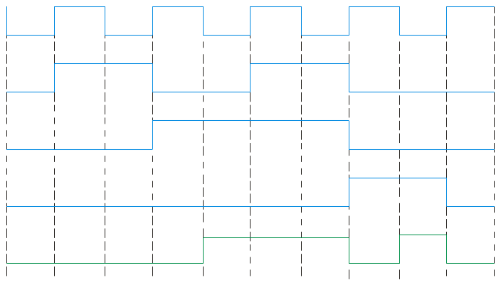
Summary
5.5 Pulsed Waveforms
Inputs
Output
Alternatively, you can develop the truth table for the circuit and enter 0’s and 1’s on the waveforms. Then read the output from the table.
A B C D
X
0 0 0 0
0
0 0 0 1
1
A
0 0 1 0
1
G₁
0 0 1 1
1
B
0 1 0 0
0
G₃
C
0 1 0 1
1
G₂
0 1 1 0
1
D
0 1 1 1
1
1 0 0 0
0
A
0 1 0 1 0 1 0 1 0 1
1 0 0 1
0
0 1 1 0 0 1 1 0 0 0
1 0 1 0
0
B
1 0 1 1
0
C
0 0 0 1 1 1 1 0 0 0
1 1 0 0
0
1 1 0 1
1
D
0 0 0 0 0 0 0 1 1 0
1 1 1 0
1
G₃
0 0 0 0 1 1 1 0 1 0
1 1 1 1
1

Slide 19
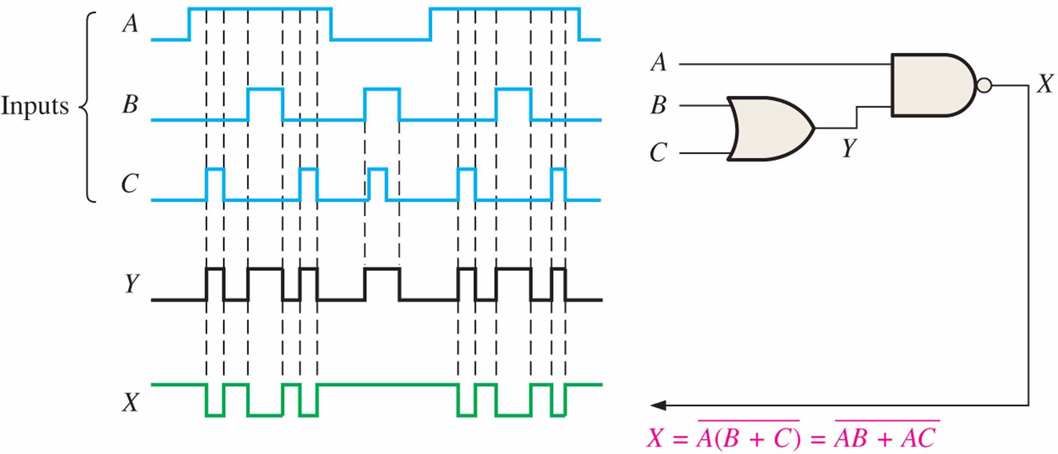
Figure 5.31
EXAMPLE 5-12 Determine the final output waveform X for the circuit in Figure 5–31, with input waveforms A, B, and C as shown.
The output expression, (AB + AC)’, indicates that the output X is LOW when both A and B are HIGH or when both A and C are HIGH or when all inputs are HIGH.
Notes:
Solution

Slide 20
Selected Key Terms
Universal gate
Negative-OR
（非-或）
Negative-AND（非-与）
Either a NAND or a NOR gate. The term universal refers to a property of a gate that permits any logic function to be implemented by that gate or by a combination of gates of that kind.
The dual operation of a NAND gate when the inputs are active-LOW.
The dual operation of a NOR gate when the inputs are active-LOW.

Slide 21

Quiz
1. Assume an AOI expression is AB + CD. The equivalent POS expression is
a. (A + B)(C + D)
b. (A + B)(C + D)
c. (A + B)(C + D)
d. none of the above
© 2008 Pearson Education

Slide 22
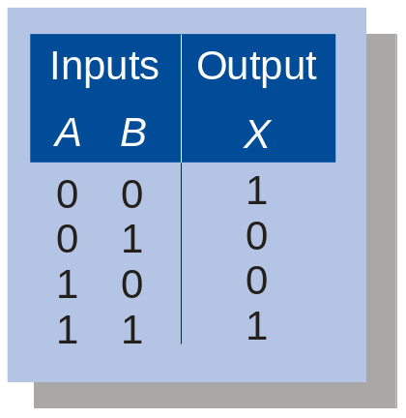
Quiz
2. The truth table shown is for
a. a NAND gate
b. a NOR gate
c. an exclusive-OR gate
d. an exclusive-NOR gate
© 2008 Pearson Education

Slide 23
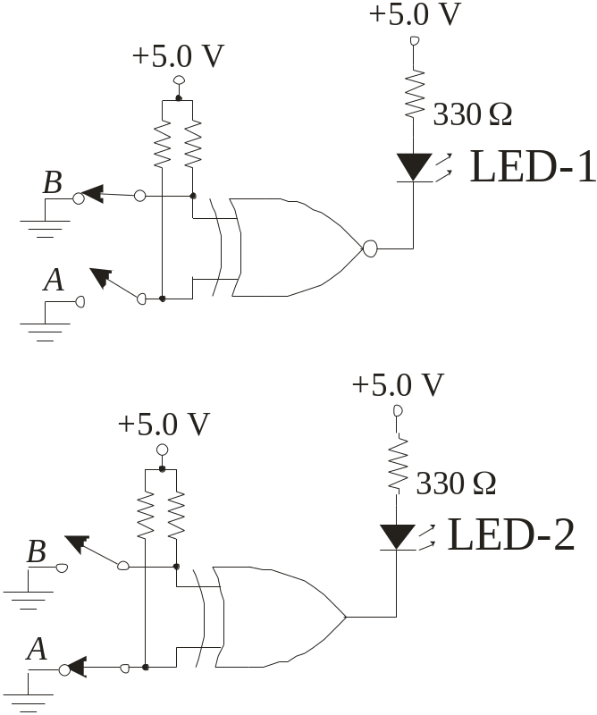
Quiz
3. An LED that should be ON is
a. LED-1
b. LED-2
c. neither
d. both
© 2008 Pearson Education

Slide 24
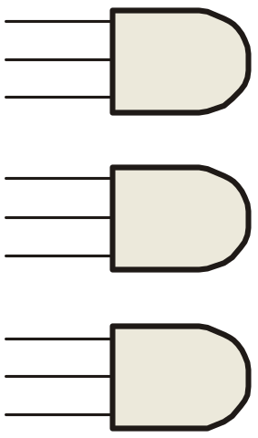
Quiz
4. To implement the SOP expression , the type of gate that is needed is a
a. 3-input AND gate
b. 3-input NAND gate
c. 3-input OR gate
d. 3-input NOR gate
X = ABC + ABD + BDE
A
B
C
A
B
D
B
D
E
© 2008 Pearson Education

Slide 25
Quiz
5. Reading the Karnaugh map, the logic expression is
a. A C + A B
b. A B + A C
c. A B + B C
d. A B + A C
© 2008 Pearson Education

Slide 26
Quiz
6. The circuit shown will have identical logic out if all gates are changed to
a. AND gates
b. OR gates
c. NAND gates
d. NOR gates
A
B
C
D
© 2008 Pearson Education

Slide 27
Quiz
7. The two types of gates which are called universal gates are
a. AND/OR
b. NAND/NOR
c. AND/NAND
d. OR/NOR
© 2008 Pearson Education

Slide 28
Quiz
8. The circuit shown is equivalent to an
a. AND gate
b. XOR gate
c. OR gate
d. none of the above
A
B
© 2008 Pearson Education

Slide 29
Quiz
9. The circuit shown is equivalent to
a. an AND gate
b. an XOR gate
c. an OR gate
d. none of the above
A
B
© 2008 Pearson Education

Slide 30
Quiz
Answers:
1. b
2. d
3. a
4. c
5. d
6. c
7. b
8. d
9. d

Slide 31
Homework
判断题、自测题：(自愿完成)
5.1-5.2节：2、8、10-(g,h)、 11-(d,f)
5.3-5.4节：20、24-(f,g)
5.5节：29

