Slide 1

Digital Fundamentals
Tenth Edition
Floyd
Chapter 7
© 2008 Pearson Education

Slide 2
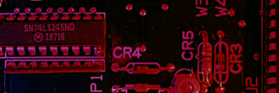
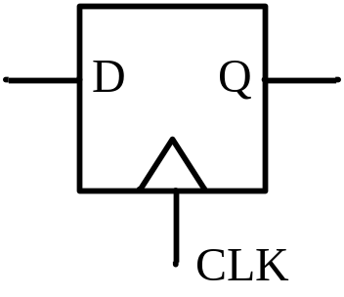
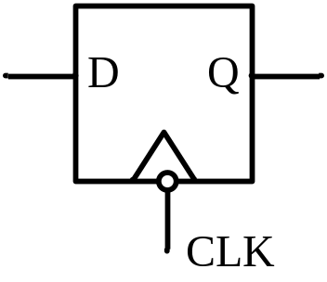
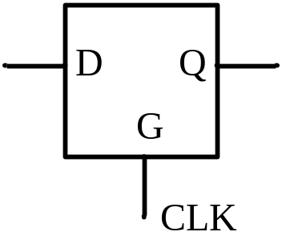
Summary
FlipFlop / Latch(触发器/锁存器)
A flipflop/latch is a temporary storage device that has two stable states (bistable). It is a basic form of memory.
Type of FF
SR
D
JK
T
positive
edge-triggered
flip-flop
negative
edge-triggered
flip-flop
transparent
(level-sensitive)
latch
Type of triggering:
Untriggered (asynchronous) 非触发（异步）
Level-triggered (C=1) 水平触发
Edge-triggered (rising or falling edge of C) 边沿触发
Notes:
触发器/锁存器，基本存储单元，具有存储二进制信息的能力。也即当输入信息消失时，所置成的状态能够保持不变。
有两个稳定的状态：0状态和1状态。
触发器(flip-flop)和锁存器(latch)有时名称可混用，它们的本质区别在于有无触发方式。
有些锁存器受“使能”信号控制。
从左到右依次为：
1.上升沿触发的触发器
2.下降沿触发的触发器
3.锁存器(电平敏感)

Slide 3
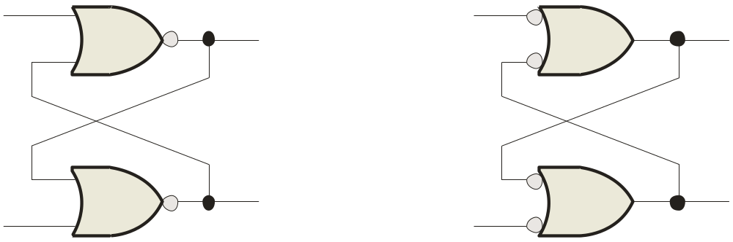
Summary
S-R Latch(S-R锁存器)
The S-R (Set-Reset) latch is the most basic type. It can be constructed from NOR gates or NAND gates. With NOR gates, the latch responds to active-HIGH inputs; with NAND gates, it responds to active-LOW inputs.
R
S
Q
Q
Q
Q
S
R
NOR Active-HIGH Latch NAND Active-LOW Latch
Notes:
基本SR锁存器。有两种配置形式
与非配置/或非配置
或非配置，高有效输入。
与非配置，低有效输入

Slide 4
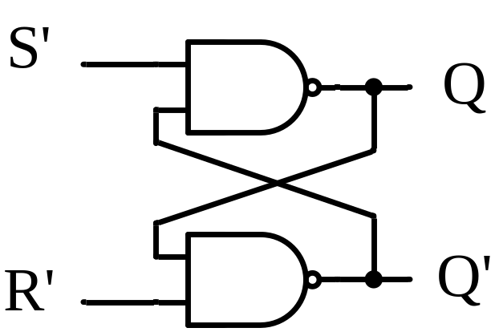
S’-R’ Latch(S’R’锁存器)
0
0
1
S’ | R’ | Q | Q’
0 | 0 | 1 | 1
0
1
The outputs of a latch are always complements of each others.
Q=Q’ is invalid when LOWs are applied to both S’ and R’.
0
1
1
0
1
Notes:
此处用S’R’命名，表示该锁存器的输入是低电平有效
Q=Q’是非法状态
因此在S’R’锁存器中，同时输入0,0不允许

Slide 5
S’-R’ Latch(S’R’锁存器)
0
0
1
S’ | R’ | Q | Q’
0 | 0 | 1 | 1
0 | 1 | 1 | 0
1
0
0
1
1
1
0

Slide 6
S’-R’ Latch(S’R’锁存器)
1
0
0
S’ | R’ | Q | Q’
0 | 0 | 1 | 1
0 | 1 | 1 | 0
1 | 0 | 0 | 1
0
1
1
1
0
0
1

Slide 7
S’-R’ Latch(S’R’锁存器)
1
0
0
S’ | R’ | Q | Q’
0 | 0 | 1 | 1
0 | 1 | 1 | 0
1 | 0 | 0 | 1
1 | 1 | NC | NC
1
1
1
1
1
NC: No Change
1
0

Slide 8
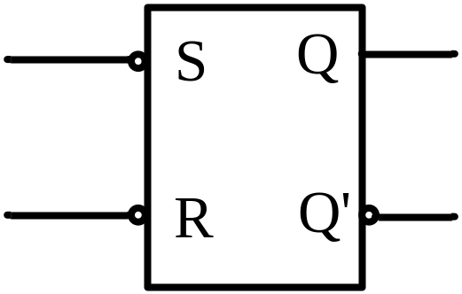
S’-R’ Latch(S’R’锁存器)
00
01
11
10
R’S’
Q^{n}
0
R’ | S’ | Q^{n} | Q^{n+1} | Comments
0 | 0 | 0 | Invalid
 |  | 1
0 | 1 | 0 | 0 | Reset (置0)
 |  | 1
1 | 0 | 0 | 1 | Set (置1)
 |  | 1
1 | 1 | 0 | 0 | Remain (保持)
 |  | 1 | 1
d
0
0
1
1
d
0
1
1
Q^{n+1}=S+R’Q^{n}
S’+R’=1 (约束)
Notes:
简单概念：
现态Q^{n}：输入信号发生变化前锁存器的状态
次态Q^{n+1}: 输入信号发生变化后锁存器的状态

Slide 9
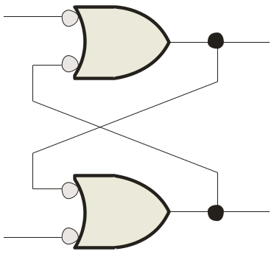
Summary
S’-R’ Latch(S’R’锁存器)
The active-LOW S-R latch is in a stable (latched) condition when both inputs are HIGH.
Assume the latch is initially RESET (Q = 0) and the inputs are at their inactive level (1). To SET the latch (Q = 1), a momentary LOW signal is applied to the S input while the R remains HIGH.
1
S
1
0
Q
Latch initially RESET
0
1
Q
1
R
To RESET the latch a momentary LOW is applied to the R input while S is HIGH.
1
S
0
1
Q
Latch initially SET
Never apply an active set and reset at the same time (invalid).
1
0
1
Q
R

Slide 10
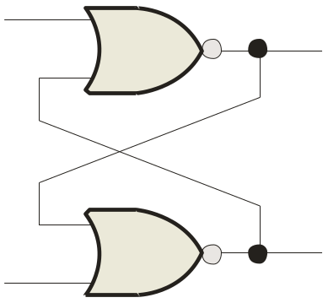
Summary
S-R Latch(SR锁存器)
The active-HIGH S-R latch is in a stable (latched) condition when both inputs are LOW.
0
R
1
Assume the latch is initially RESET (Q = 0) and the inputs are at their inactive level (0). To SET the latch (Q = 1), a momentary HIGH signal is applied to the S input while the R remains LOW.
0
Q
Latch initially RESET
0
1
Q
0
S
0
R
0
To RESET the latch (Q = 0), a momentary HIGH signal is applied to the R input while the S remains LOW.
1
Q
Latch initially SET
1
0
Q
0
S

Slide 11
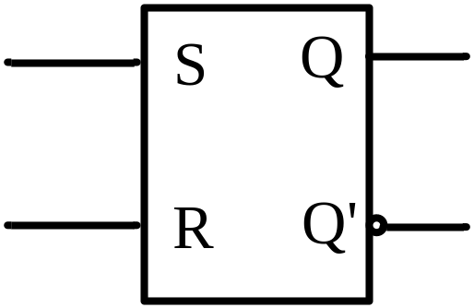
S-R Latch(SR锁存器)
00
01
11
10
RS
Q^{n}
S | R | Q^{n} | Q^{n+1} | Comments
0 | 0 | 0 | 0 | Remain
 |  | 1 | 1
0 | 1 | 0 | 0 | Reset (置0)
 |  | 1
1 | 0 | 0 | 1 | Set (置1)
 |  | 1
1 | 1 | 0 | Invalid
 |  | 1
0
0
1
d
0
1
1
1
d
0
Q^{n+1}=S+R’Q^{n}
SR=0 (约束)

Slide 12
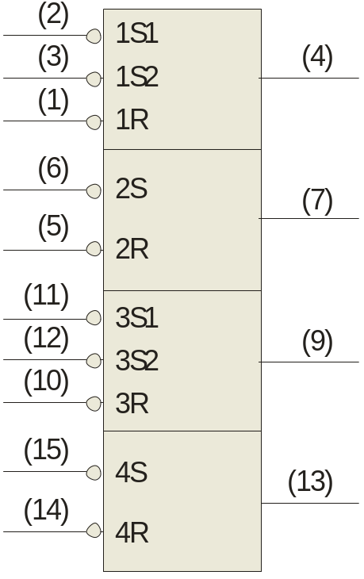
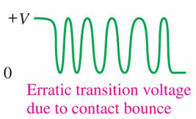
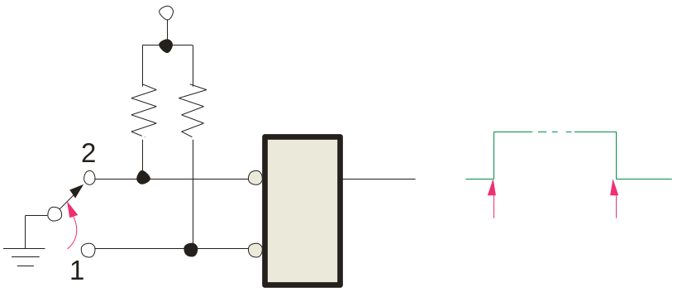
Summary
SR Latch
The active-LOW S-R latch is available as the 74LS279A IC.
It features four internal latches with two having two S inputs. To SET any of the latches, the S line is pulsed low. It is available in several packages.
1Q
S-R latches are frequently used for switch debounce circuits as shown:
2Q
V_{CC}
3Q
S
Q
4Q
S
R
R
Position 1 to 2
Position 2 to 1
74LS279A
Notes:
图示时一个SR锁存器作为触点抖动消除器的示例。
开关闭合时，可能会发生几次物理振动或抖动，产生电压尖脉冲。
通过锁存器以后，S’起效，使得锁存器置位，后续抖动时，锁存器处于保持状态。故抖动消除。

Slide 13
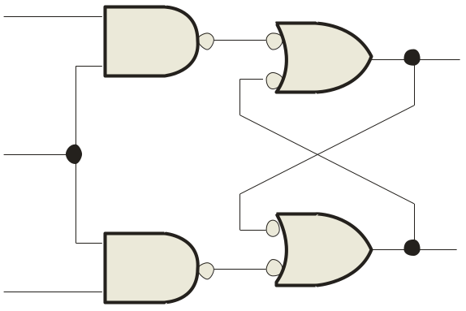
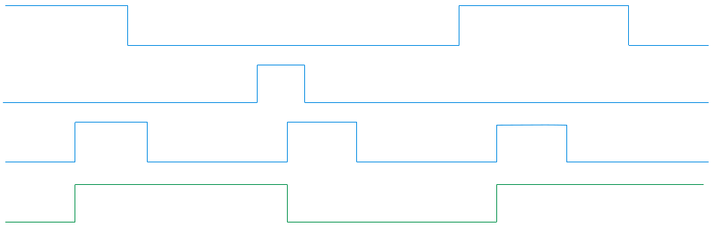

Summary
Gated S-R Latch（门控S-R锁存器）
A gated latch is a variation on the basic latch.
The gated latch has an additional input, called enable (EN) that must be HIGH in order for the latch to respond to the S and R inputs.
S
Q
EN
Example
Show the Q output with relation to the input signals. Assume Q starts LOW.
Q
R
Solution
Keep in mind that S and R are only active when EN is HIGH.
S
R
EN
Q
Notes:
门控锁存器，也即之前所说，电平触发方式的锁存器。
EN：使能信号。图中使能信号为高有效。

Slide 14
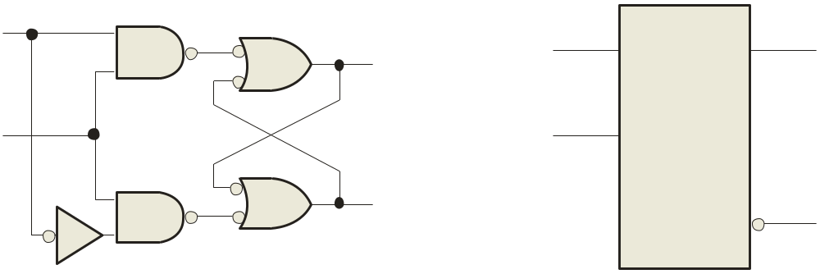
Summary
D Latch（D锁存器）
The D latch is an variation of the S-R latch but combines the S and R inputs into a single D input as shown:
D
D
Q
Q
EN
EN
Q
Q
A simple rule for the D latch is:
Q follows D when the Enable is active.
Notes:
根据SR锁存器的特性，显然能推出D锁存器的特性
D锁存器的特点：让SR触发器不会出现不确定状态，，确保S和R永远不会同时为1。

Slide 15
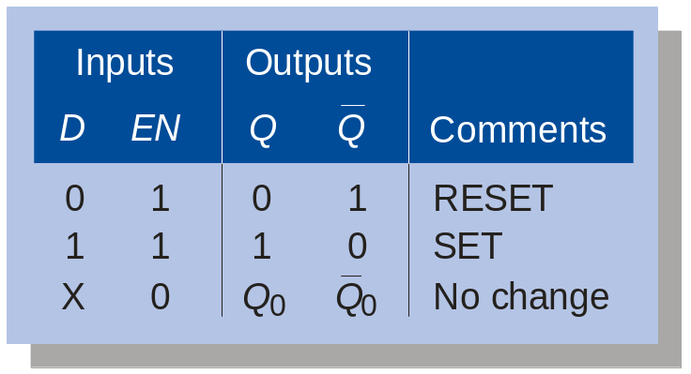
Summary
D Latch（D锁存器）
The truth table for the D latch summarizes its operation. If EN is LOW, then there is no change in the output and it is latched.
Q_{n+1}=S+R’Q_{n}=D+D’’Q_{n}=D

Slide 16
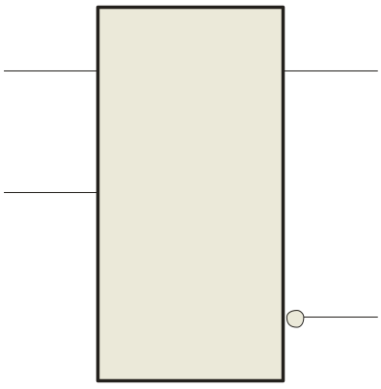

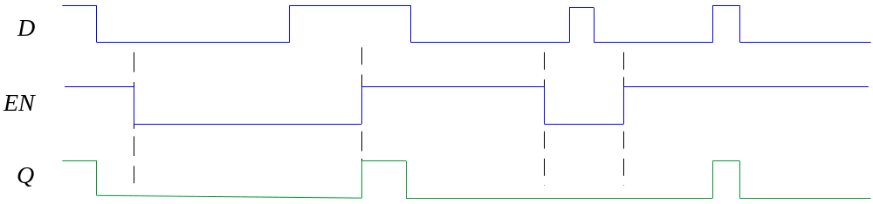
Summary
D Latch
Q
D
Example
EN
Determine the Q output for the D latch, given the inputs shown.
Q
Notice that the Enable is not active during these times, so the output is latched.

Slide 17
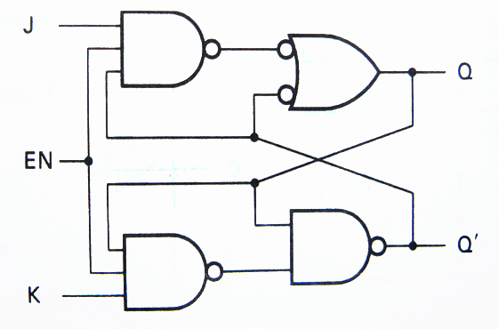
J-K Latch（J-K锁存器）
S’
EN=1：
  R’=(KQ^{n})’
  S’=(JQ^{n}’)’
R’
Q^{n+1} = S+R’Q^{n} = JQ^{n}’+(KQ^{n})’ Q^{n}
= JQ^{n}’+K’Q^{n}
S’+R’ = (JQ^{n}’)’ + (KQ^{n})’
= J+Q^{n}+K’+Q^{n}’ = 1

Slide 18
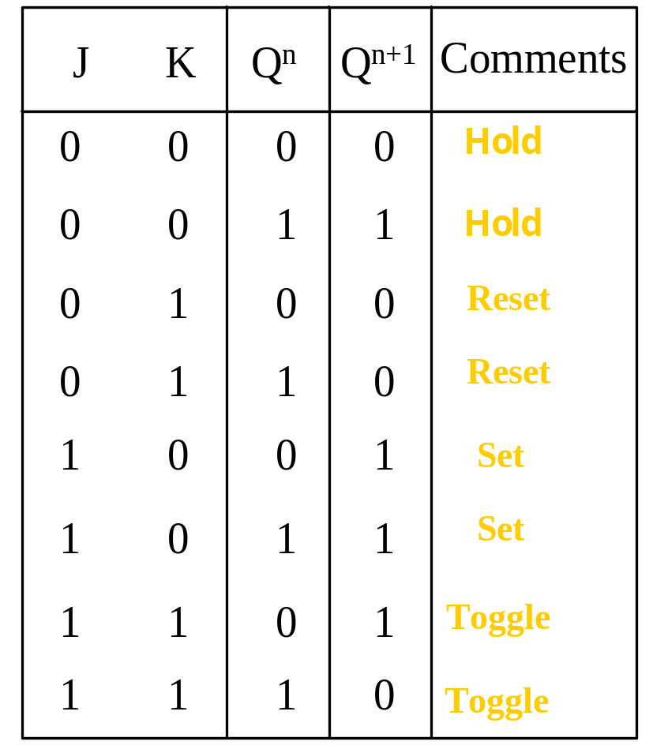
J-K Latch（J-K锁存器）
Q^{n+1} = JQ^{n}’+K’ Q^{n}
When both J and K = 1, the output changes states (toggles, 翻转).
Notes:
在RS锁存器中的不确定输入情况，在J-K选通锁存器中会导致电路状态翻转Q^{n+1}=Q^{n}’
Toggle：翻转。中文书中翻译为切换，建议翻译为“翻转”

Slide 19
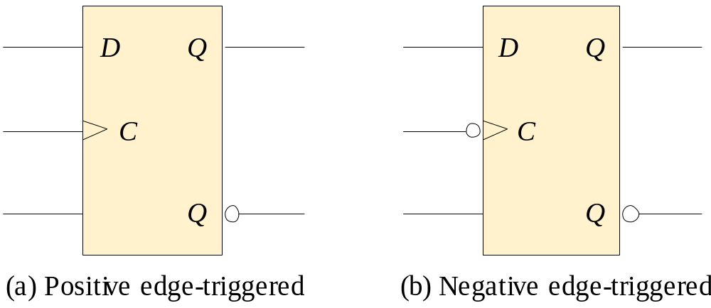
Summary
Flip-flops (触发器)
A flip-flop differs from a latch in the manner it changes states. A flip-flop is a clocked device, in which only the clock edge determines when a new bit is entered.
The active edge can be positive or negative.
Dynamic input indicator
动态输入指示器
Notes:
边沿触发器，只有在时钟的正边沿或者负边沿，也即时钟的转换瞬间才对输入做出响应。

Slide 20
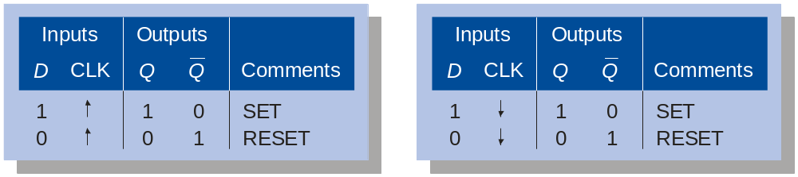
Summary
Flip-flops
The truth table for a positive-edge triggered D flip-flop shows an up arrow to remind you that it is sensitive to its D input only on the rising edge of the clock; otherwise it is latched. The truth table for a negative-edge triggered D flip-flop is identical except for the direction of the arrow.
(a) Positive-edge triggered (b) Negative-edge triggered
Notes:
本课程实际使用中，不要求在真值表中对所有触发器都列出时钟信号

Slide 21
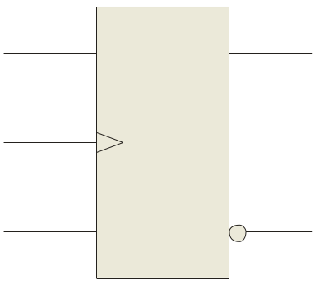
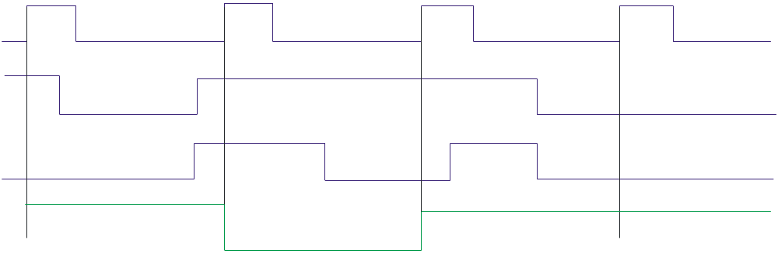
Summary
Flip-flops
Q
J
Example
Determine the Q output for the J-K flip-flop, given the inputs shown.
CLK
K
Q
Notice that the outputs change on the leading edge of the clock.
Solution
Set
Toggle
Set
Latch
CLK
J
K
Q

Slide 22
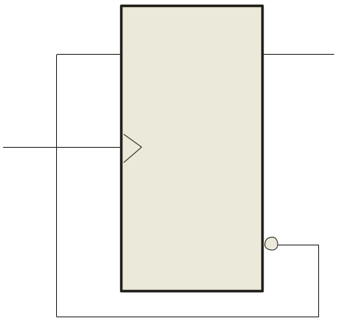
Summary
Flip-flops
A D-flip-flop does not have a toggle mode like the J-K flip-flop, but you can hardwire a toggle mode by connecting Q back to D as shown. This is useful in some counters as you will see in Chapter 8.
D
Q
For example, if Q is LOW, Q is HIGH and the flip-flop will toggle on the next clock edge. Because the flip-flop only changes on the active edge, the output will only change once for each clock pulse.
CLK
CLK
Q
D flip-flop hardwired for a toggle mode
Notes:
用D触发器实现翻转的例子。

Slide 23
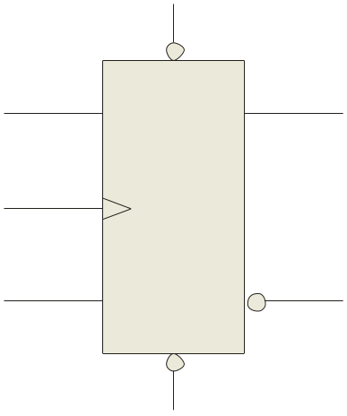
Summary
Flip-flops
Synchronous(同步的) inputs are transferred in the triggering edge of the clock (for example the D or J-K inputs). Most flip-flops have other inputs that are asynchronous(异步的), meaning they affect the output independent of the clock.
PRE
Two such inputs are normally labeled preset (PRE) and clear (CLR). These inputs are usually active LOW. A J-K flip flop with active LOW preset and CLR is shown.
Q
J
CLK
K
Q
CLR
Notes:
PRE：置1
CLR：清0

Slide 24
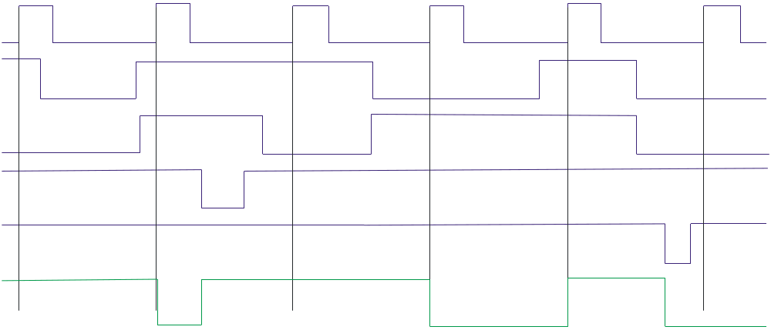
Summary
PRE
Flip-flops
Flip-flops
Q
J
Example
CLK
Determine the Q output for the J-K flip-flop, given the inputs shown.
K
Q
Solution
CLR
Set
Toggle
Set
Reset
Toggle
Latch
CLK
J
K
Set
PRE
Reset
CLR
Q

Slide 25
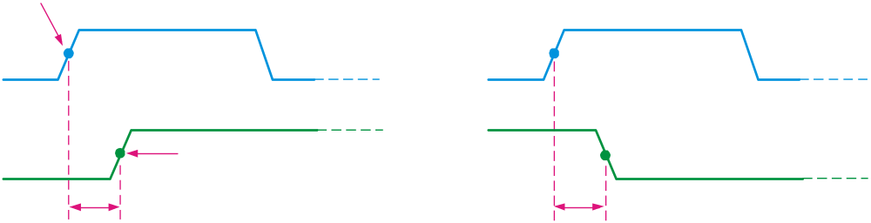
Summary
7.3 Flip-flop Characteristics (触发器特性)
Propagation delay time(传输延迟时间) is specified for the rising and falling outputs. It is measured between the 50% level of the clock to the 50% level of the output transition.
50% point on triggering edge
CLK
CLK
50% point
Q
50% point on LOW-to-HIGH transition of Q
Q
50% point on HIGH-to- LOW transition of Q
t_{PLH}
t_{PHL}
The typical propagation delay time for the 74AHC family (CMOS) is 4 ns. Even faster logic is available for specialized applications.
Notes:
传输延迟时间是施加输入信号、导致输出发送变化所需要的时间间隔。
入图所示为：
t_{PLH}：从时钟脉冲的触发边沿到输出的低电平到高电平变换之间所测得的时间。
t_{PHL}：从时钟脉冲的触发边沿到输出的高电平到低电平变换之间所测得的时间。

Slide 26
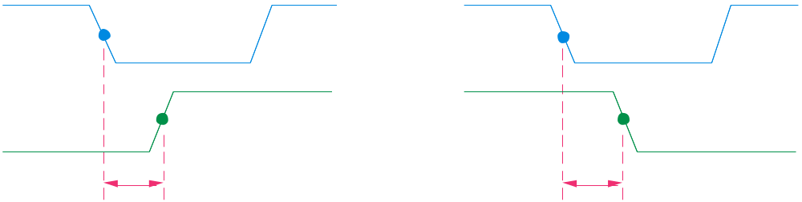
Summary
Flip-flop Characteristics
Another propagation delay time specification is the time required for an asynchronous input to cause a change in the output. Again it is measured from the 50% levels. The 74AHC family has specified delay times under 5 ns.
PRE
50% point
CLR
50% point
Q
50% point
Q
50% point
t_{PLH}
t_{PHL}
Notes:
t_{PLH}：从预置位输入的前沿到输出的低电平到高电平变换之间所测得的时间。
t_{PHL}：从预置位输入的前沿到输出的高电平到低电平变换之间所测得的时间。

Slide 27
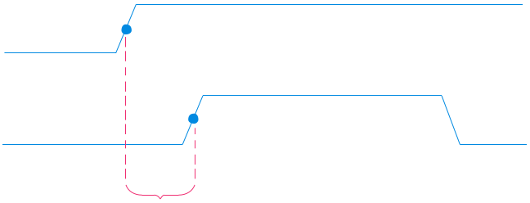
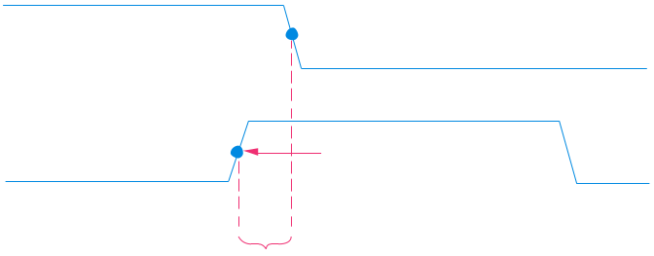
Summary
Flip-flop Characteristics
Set-up time(建立时间) and hold time(保持时间) are times required before and after the clock transition that data must be present to be reliably clocked into the flip-flop.
Setup time is the minimum time for the data to be present before the clock.
D
CLK
Set-up time, t_{s}
Hold time is the minimum time for the data to remain after the clock.
D
CLK
Hold time, t_{H}
Notes:
建立时间：输入先于时钟脉冲触发边沿到达所需要的最小时间间隔
保持时间：在时钟脉冲触发边沿到达之后，输入上的逻辑电平需要保持的最小时间间隔。

Slide 28
Summary
Flip-flop Characteristics
Other specifications include maximum clock frequency(最大时钟频率), minimum pulse widths(最小脉冲宽度) for various inputs, and power dissipation(功耗). The power dissipation is the product of the supply voltage and the average current required.
A useful comparison between logic families is the speed-power product which uses two of the specifications discussed: the average propagation delay and the average power dissipation. The unit is energy.

Slide 29
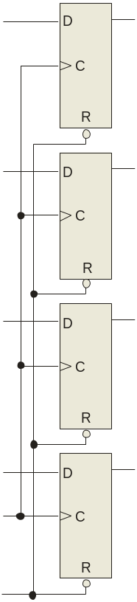
Summary
7.4 Flip-flop Applications- Parallel Data Storage
Output lines
Principal flip-flop applications are for temporary data storage, as frequency dividers, and in counters (which are covered in detail in Chapter 8).
Q₀
Q₁
Typically, for data storage applications, a group of flip-flops are connected to parallel data lines and clocked together. Data is stored until the next clock pulse.
Q₂
Parallel data input lines
Q₃
Clock
Clear

Slide 30
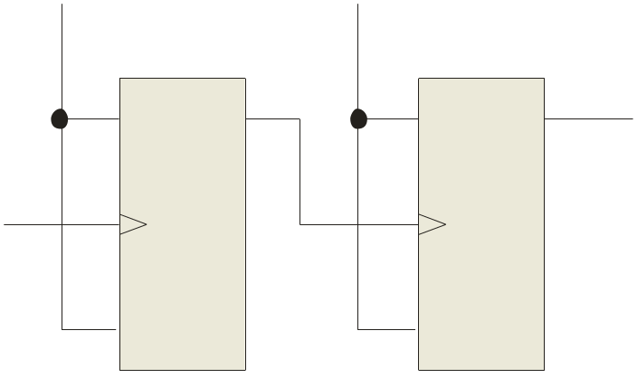
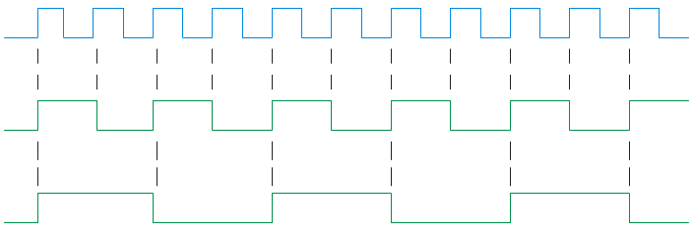
Summary
Flip-flop Applications- Frequency Division
For frequency division, it is simple to use a flip-flop in the toggle mode or to chain a series of toggle flip flops to continue to divide by two.
HIGH
HIGH
One flip-flop will divide f_{in} by 2, two flip-flops will divide f_{in} by 4 (and so on). A side benefit of frequency division is that the output has an exact 50% duty cycle.
J
Q_{A}
J
Q_{B}
f_{out}
f_{in}
CLK
CLK
K
K
f_{in}
Waveforms:
f_{out}

Slide 31
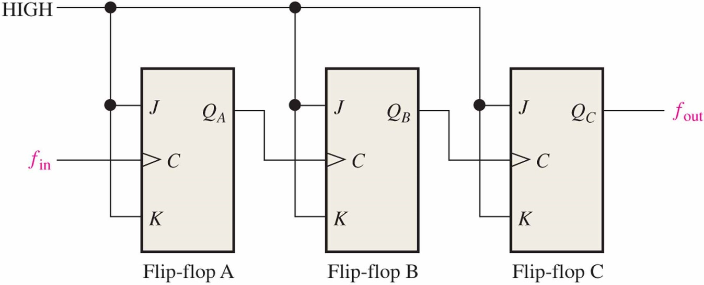
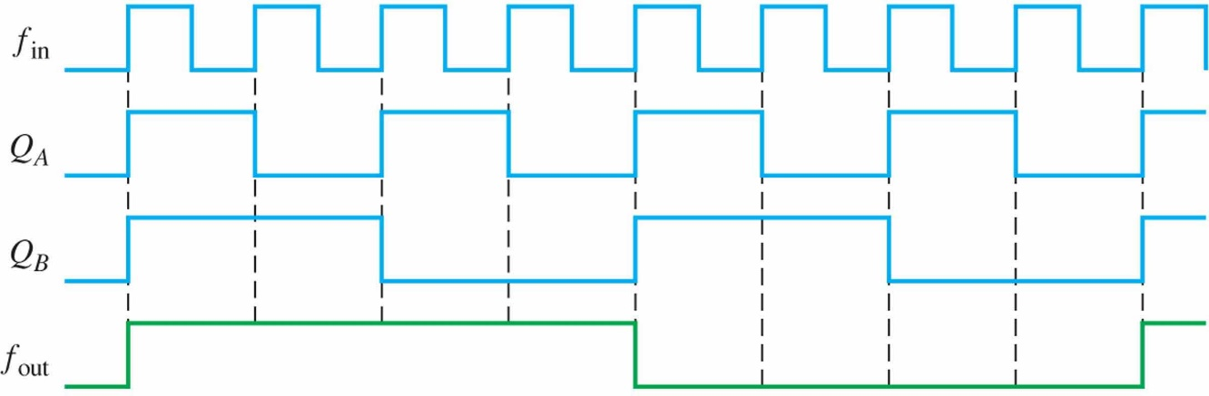
Figure 7.39
EXAMPLE 7–9
Develop the ƒ_{out} waveform for the circuit in Figure 7–39 when an 8 kHz square wave input is applied to the clock input of flip-flop A.
Solution
The three flip-flops are connected to divide the input frequency by eight (2³ = 8) and
the Q_{C} ( f_{out}) waveform is shown in Figure 7–40. Since these are positive edge-riggered flip-flops, the outputs change on the positive-going clock edge. There is one output
pulse for every eight input pulses, so the output frequency is 1 kHz. Waveforms of Q_{A}
and Q_{B} are also shown.
Figure 7.40
Related Problem
How many flip-flops are required to divide a frequency by thirty-two?

Slide 32
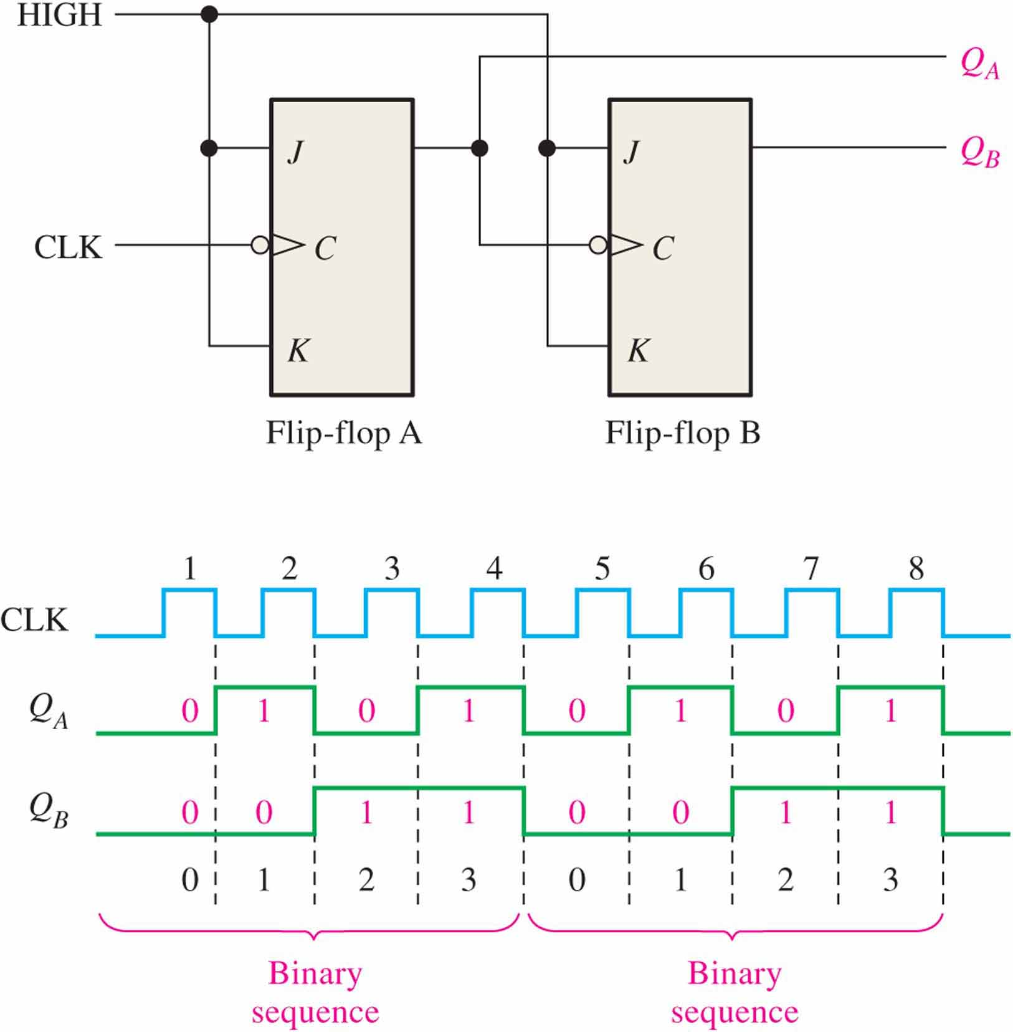
Figure 7.41
Figure 7.41 Flip-flops used to generate a binary count sequence. Two repetitions (00, 01, 10, 11) are shown.
Flip-flop A toggles on the negative-going transition of each clock pulse. The Q output of flip-flop A clocks flip-flop B, so each time Q_{A} makes a HIGH-to-LOW transition, flip-flop B toggles. The resulting Q_{A} and Q_{B} waveforms are shown in the figure.

Slide 33
Selected Key Terms
Latch
Bistable
Clock
D flip-flop
J-K flip-flop
A bistable digital circuit used for storing a bit.
Having two stable states. Latches and flip-flops are bistable multivibrators.
A triggering input of a flip-flop.
A type of bistable multivibrator in which the output assumes the state of the D input on the triggering edge of a clock pulse.
A type of flip-flop that can operate in the SET, RESET, no-change, and toggle modes.

Slide 34
Homework
判断题、自测题：(自愿完成)
7.1节：2、4、7 （SR,D）
7.2节：8、10、14 （JK）
7.3节：21
7.4节：26

Slide 35

Quiz
b
1. The output of a D latch will not change if
a. the output is LOW
b. Enable is not active
c. D is LOW
d. all of the above
© 2008 Pearson Education

Slide 36
Quiz
d
2. The D flip-flop shown will
a. set on the next clock pulse
b. reset on the next clock pulse
c. latch on the next clock pulse
d. toggle on the next clock pulse
D
Q
CLK
CLK
Q
© 2008 Pearson Education

Slide 37
Quiz
b
3. For the J-K flip-flop shown, the number of inputs that are asynchronous is
a. 1
b. 2
c. 3
d. 4
PRE
Q
J
CLK
K
Q
CLR
© 2008 Pearson Education

Slide 38
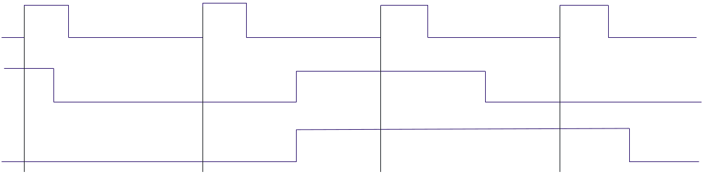
Quiz
c
4. Assume the output is initially HIGH on a leading edge triggered J-K flip flop. For the inputs shown, the output will go from HIGH to LOW on which clock pulse?
a. 1
b. 2
c. 3
d. 4
CLK
J
K
1 2 3 4
© 2008 Pearson Education

Slide 39
Quiz
Answers:
1. b
2. d
3. b
4. c

