Slide 1

Digital Fundamentals
Tenth Edition
Floyd
Chapter 9
© 2008 Pearson Education

Slide 2
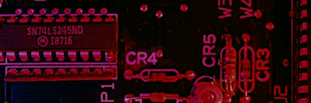
Summary
Registers
A n-bit register is a set of n flip-flops that is capable of storing n bits of binary information.
With added combinational gates, the register can perform data-processing tasks.
A counter is a register that goes through a predetermined sequence of states upon the application of clock pulses.
Notes:
一个n位寄存器由n个触发器构成，能够存储n位二进制信息。
与组合逻辑门相结合后，寄存器可完成数据处理任务；
计数器也是一种寄存器，它根据预定义的状态序列完成计数

Slide 3
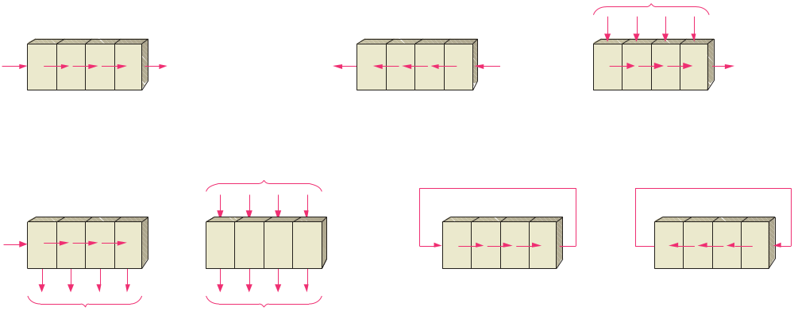
Summary
Basic Shift Register Operations(基本移位寄存器操作)
A shift register is an arrangement of flip-flops with important applications in storage and movement of data. Some basic data movements are illustrated here.
Data in
Data in
Data out
Data out
Data in
Data out
Serial in/shift right/serial out
Serial in/shift left/serial out
Parallel in/serial out
Data in
Data in
Data out
Data out
Serial in/parallel out
Parallel in/parallel out
Rotate right
Rotate left
Notes:
寄存器数据输入与输出类型：串入串出/串入并出/并入串出/并入并出
串行输入：每次只有一位数据送入最高/最低位触发器中。
串行输出：数据只从单一的一个触发器中获得，每次只能提取一位
并行输入：所有触发器应同时起作用（置位或复位）
并行输出：所以触发器的输出Q都应可访问。
……

Slide 4

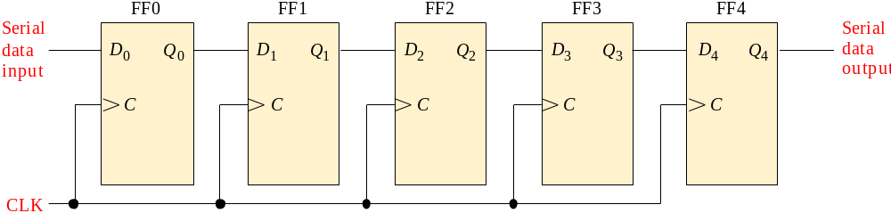

Summary
Serial-in/Serial out Shift Register
(串行输入/串行输出移位寄存器)
Shift registers are available in IC form or can be constructed from discrete flip-flops as is shown here with a five-bit serial-in serial-out register.
Each clock pulse will move an input bit to the next flip-flop. For example, a 1 is shown as it moves across.
1
1
1
1
1
1
CLK
CLK
CLK
CLK
CLK
Notes:
在每个脉冲作用下，将存储器所存储的各位数据，向左或向右移动一位。
串行输出从寄存器末端的触发器中获得。

Slide 5
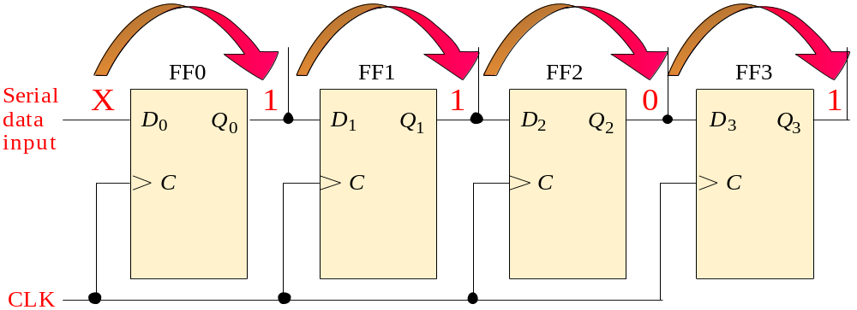
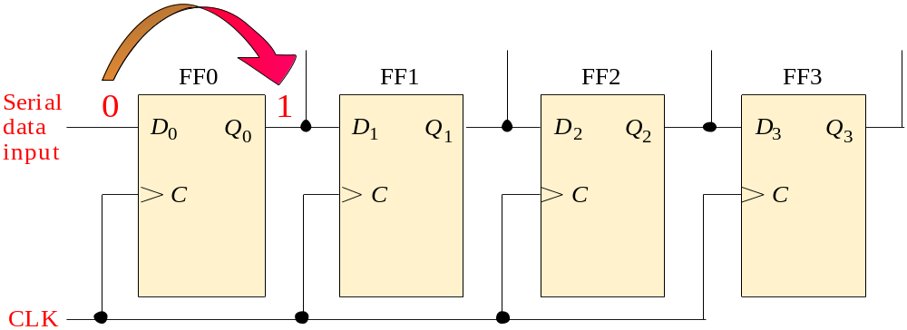
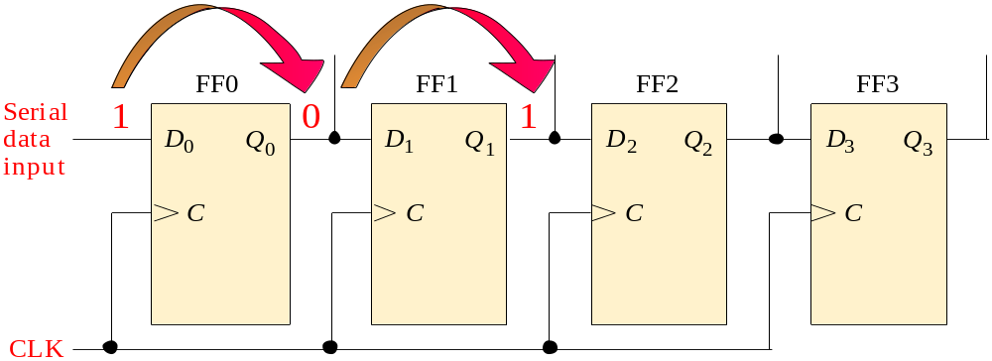
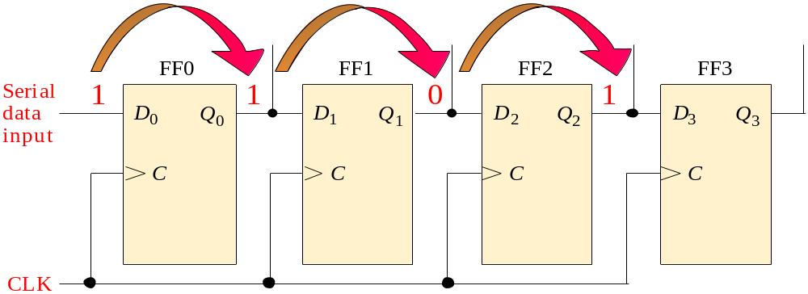
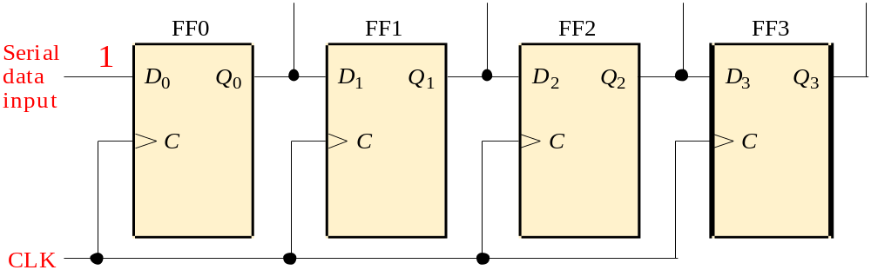
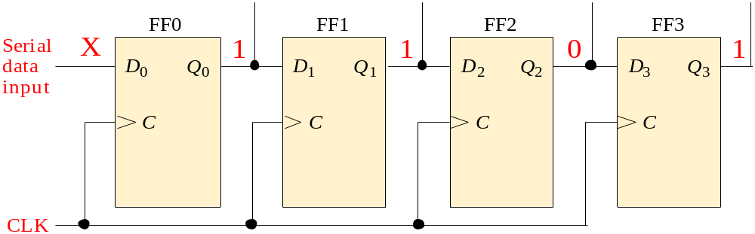
Summary
A Basic Application
An application of shift registers is conversion of serial data to parallel form.
For example, assume the binary number 1011 is loaded sequentially, one bit at each clock pulse.
After 4 clock pulses, the data is available at the parallel output.
CLK
CLK
CLK
CLK
Notes:
串行输入，然后同时读所有触发器的输出，则得到了一个并行输出。

Slide 6
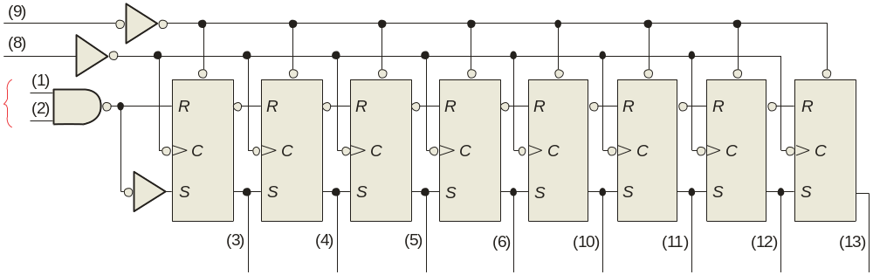
Summary
The 74HC164A Shift Register*
The 74HC164A is a CMOS 8-bit serial in/parallel out shift register. V_{CC} can be from +2.0 V to +6.0 V.
CLR
CLK
Serial inputs
A
B
Q₀
Q₁
Q₂
Q₃
Q₄
Q₅
Q₆
Q₇
One of the two serial data inputs may be used as an active HIGH enable to gate the other input. If no enable is needed, the other serial input can be connected to V_{CC}. The 74HC164A has an active LOW asynchronous clear. Data is entered on the leading-edge of the clock.

Slide 7
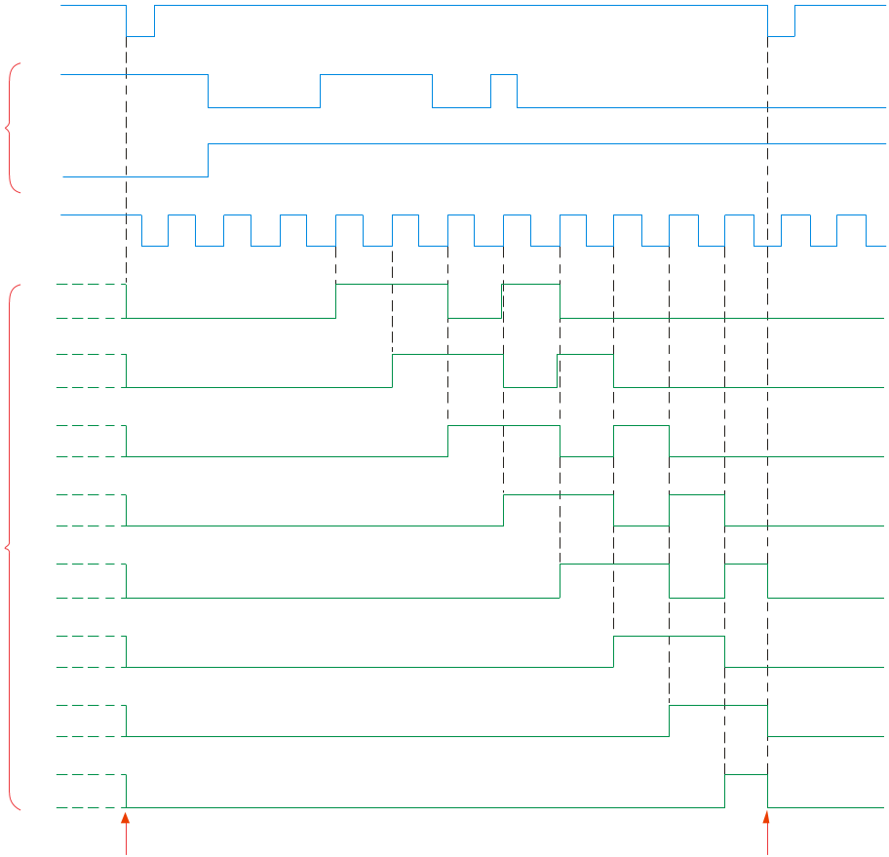
Summary
Waveforms for the 74HC164A*
Sample waveforms for the 74HC164A are shown. Notice that B acts as an active HIGH enable for the data on A as discussed.
CLR
A
Serial inputs
B
CLK
Q₀
Q₁
As with CMOS devices, unused inputs should always be connected to a logic level; unused outputs should be left open.
Q₂
Q₃
Outputs
Q₄
Q₅
Q₆
Q₇
Clear
Clear

Slide 8
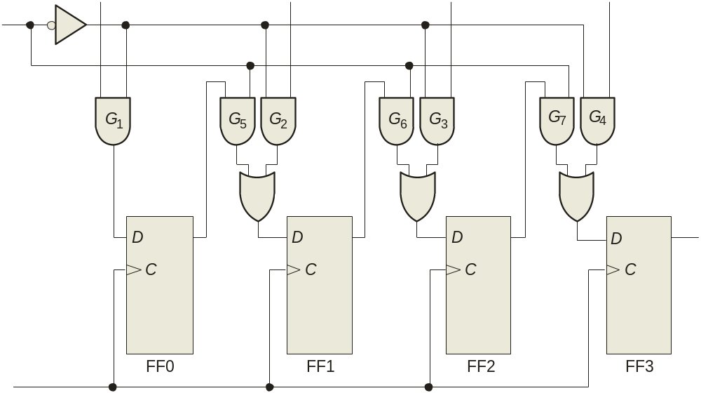
Summary
Parallel in/Serial out Shift Register(并入串出寄存器)
Shift registers can be used to convert parallel data to serial form. A logic diagram for this type of register is shown:
D₀
D₁
D₂
D₃
SHIFT/LOAD
Serial data out
Q₀
Q₁
Q₂
Q₃
CLK

Slide 9
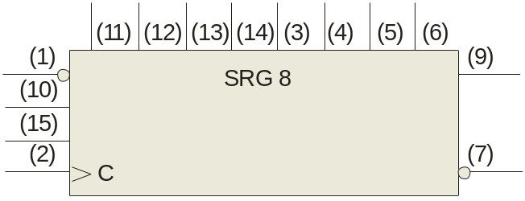
Summary
The 74HC165 Shift Register*
The 74HC165 is a CMOS 8-bit parallel in/serial out shift register. The logic symbol is shown:
D₀
D₁
D₂
D₃
D₄
D₅
D₆
D₇
SH/LD
Q₇
SER
CLK INH
CLK
Q₇
The clock (CLK) and clock inhibit (CLK INH) lines are connected to a common OR gate, so either of these inputs can be used as an active-LOW clock enable with the other as the clock input. Data is loaded asynchronously when SH/LD is LOW and moved through the register synchronously when SH/LD is HIGH and a rising clock pulse occurs.

Slide 10
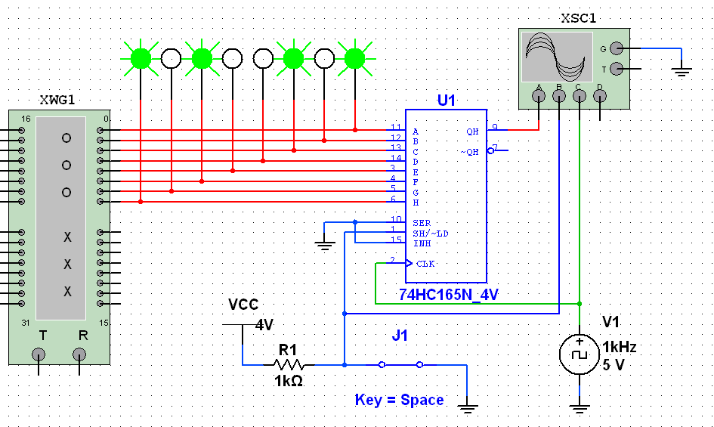
Summary
The 74HC165 Shift Register*
A Multisim simulation of the 74165A is shown. The word generator is used as a source for the pattern shown in the green probes.
MSB
Q₇ is labeled Q_{H} in Multisim
Pattern is loaded when J1 is LOW

Slide 11
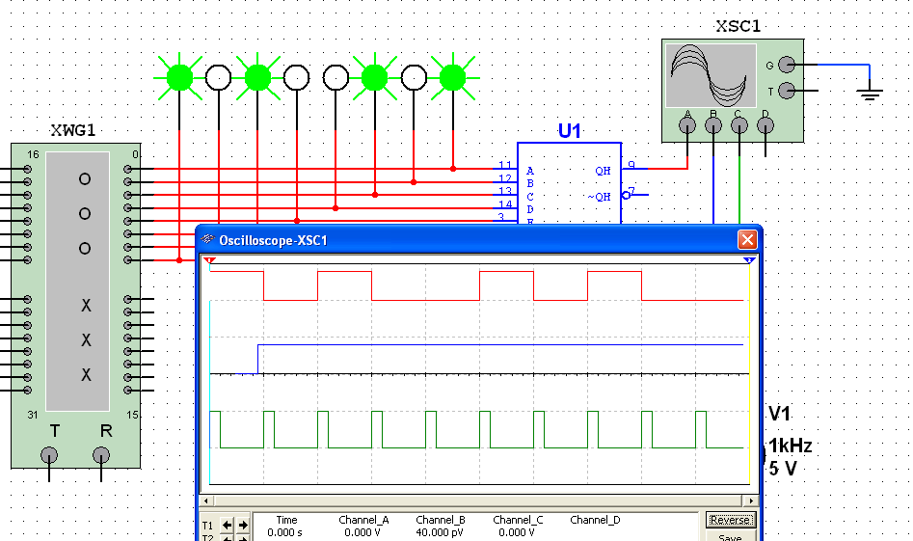
Summary
The 74HC165 Shift Register*
Here the scope is opened and you can observe the pattern. The MSB is HIGH and is on the Q₇ output as soon as LOAD is LOW.
MSB
Q₇
Load
Clk

Slide 12
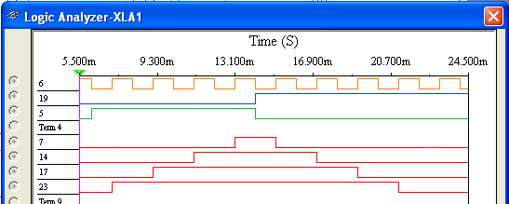
Summary
Bidirectional Shift Register*
Bidirectional shift registers can shift the data in either direction using a RIGHT/LEFT input.
The logic analyzer simulation shows a bidirectional shift register such as the one shown in Figure 9-19 of the text. Notice the HIGH level from the Serial data in is shifted at first from Q₃ toward Q₀.
CLK
RIGHT/LEFT
Shift left
Shift right
Serial data in
Q₀
Q₁
Q₂
Q₃

Slide 13
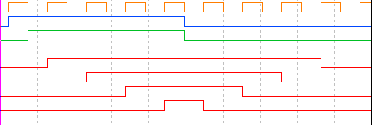

Summary
Bidirectional Shift Register*
Question
How will the pattern change if the RIGHT/LEFT control signal is inverted?
Answer
See display
CLK
RIGHT/LEFT
Shift left
Shift right
Shift right
Shift left
Serial data in
Q₀
Q₁
Q₂
Q₃

Slide 14
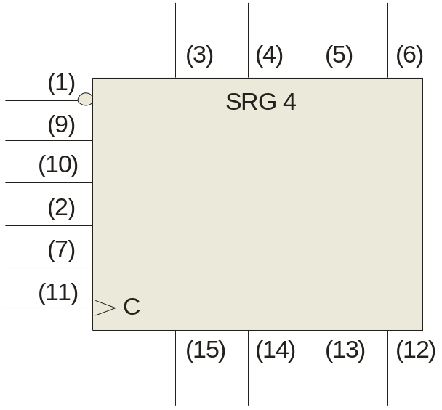
Summary
Universal Shift Register*
A universal shift register has both serial and parallel input and output capability. The 74HC194 is an example of a 4-bit bidirectional universal shift register.
D₀
D₁
D₂
D₃
CLR
S₀
S₁
SR SER
SL SER
CLK
Sample waveforms are on the following slide…
Q₀
Q₁
Q₂
Q₃

Slide 15
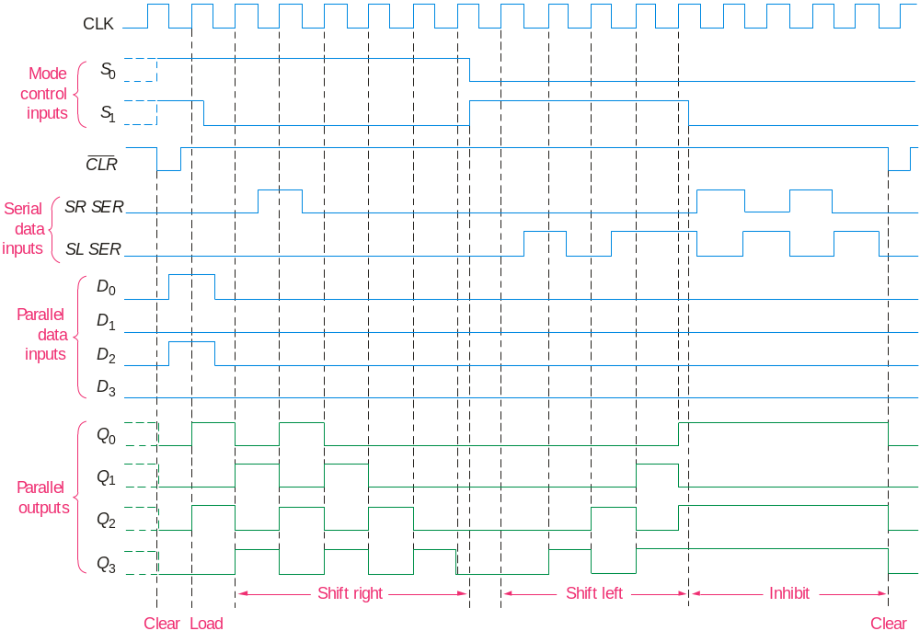
Summary
Universal Shift Register*

Slide 16
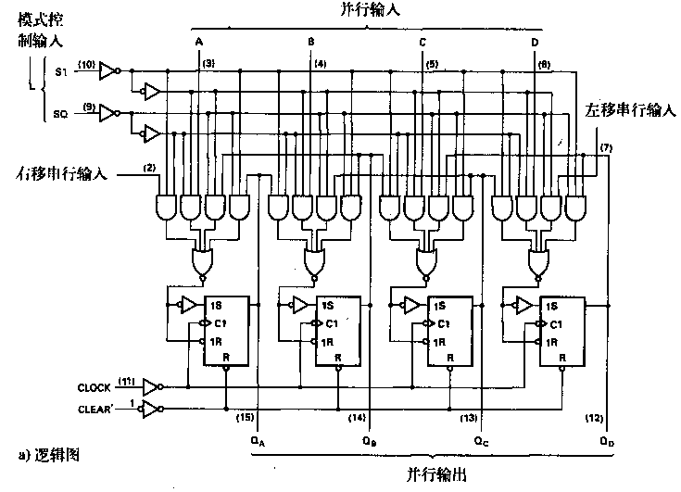
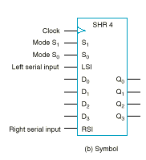
通用移位寄存器(SN74XX194)
S₁S₀ | Action
00 | Nothing
01 | Shift down
10 | Shift up
11 | Parallel load

Slide 17
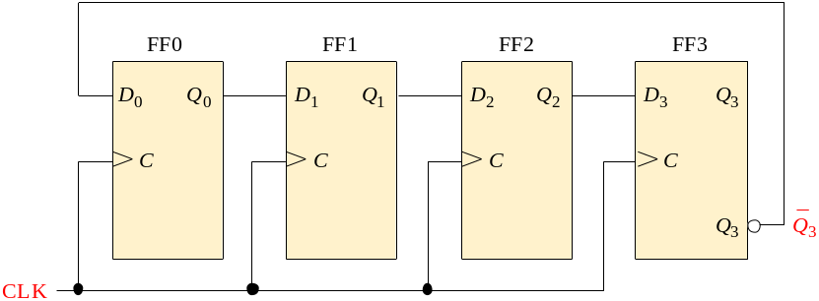
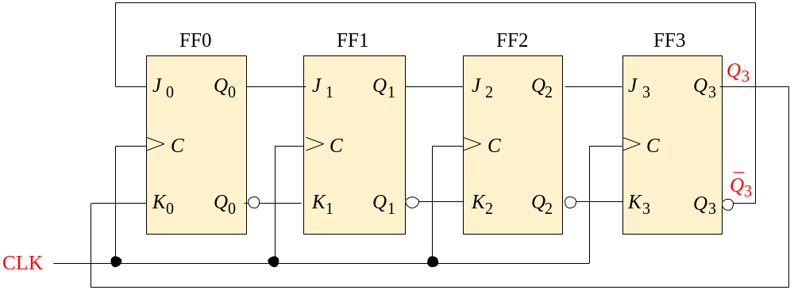
Summary
Shift Register Counters
Shift registers can form useful counters by recirculating a pattern of 0’s and 1’s. Two important shift register counters are the Johnson counter and the ring counter.
The Johnson counter can be made with a series of D flip-flops
… or with a series of J-K flip flops. Here Q₃ and Q₃ are fed back to the J and K inputs with a “twist”.
Notes:
Johnson计数器，也叫扭环计数器，同步时钟同时提供给所有触发器。

Slide 18
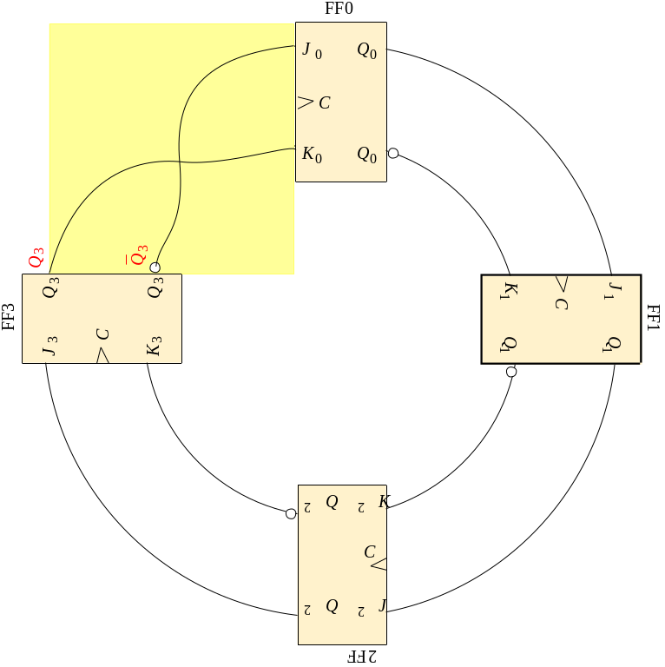
Summary
Johnson Counter
Redrawing the same Johnson counter (without the clock shown) illustrates why it is sometimes called as a “twisted-ring” counter.
“twist”

Slide 19
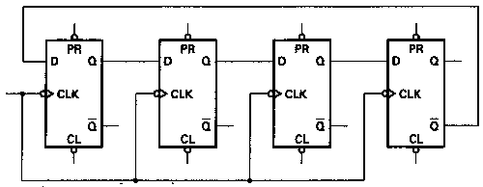
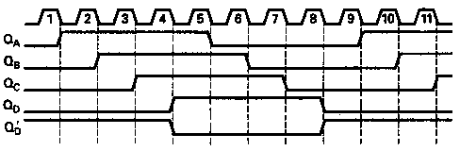
Summary
Johnson Counter
The Johnson counter is useful when you need a sequence that changes by only one bit at a time but it has a limited number of states (2n, where n = number of stages).
The first five counts for a 4-bit Johnson counter that is initially cleared are: CLK Q_{A} Q_{B} Q_{C} Q_{D}
0
1
2
3
4
5
6
7
0 0 0 0
1 0 0 0
1 1 0 0
1 1 1 0
1 1 1 1
0 1 1 1
0 0 1 1
0 0 0 1
Question
What are the remaining 3 states?
Notes:
注意，是2n不是2^{n}
The Johnson counter is useful when you need a sequence that changes by only one bit at a time but it has a limited number of states (2n, where n = number of stages).
可以看出，JOHNSON计数器的特点是，每个触发器的输出比前一个输出延迟一个时钟脉冲。且输出频率都是输入频率的1/2N

Slide 20
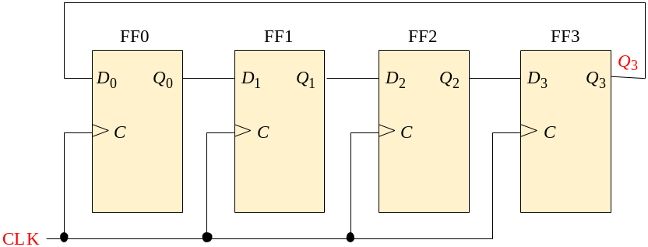
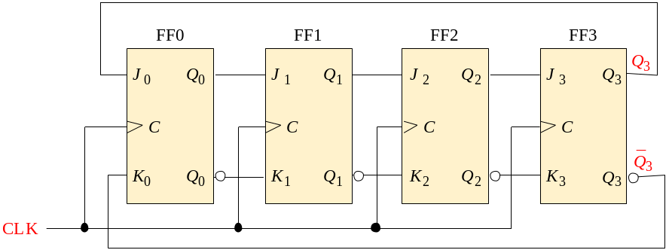
Summary
Ring Counter(循环计数器，或环形计数器)
The ring counter can also be implemented with either D flip-flops or J-K flip-flops.
Here is a 4-bit ring counter constructed from a series of D flip-flops. Notice the feedback.
Like the Johnson counter, it can also be implemented with J-K flip flops.
Notes:
循环计数器(Ring Counter)
可通过CLR和PRE预设任何输入位的模式，预先载入的模式每N个时钟脉冲重复一次

Slide 21
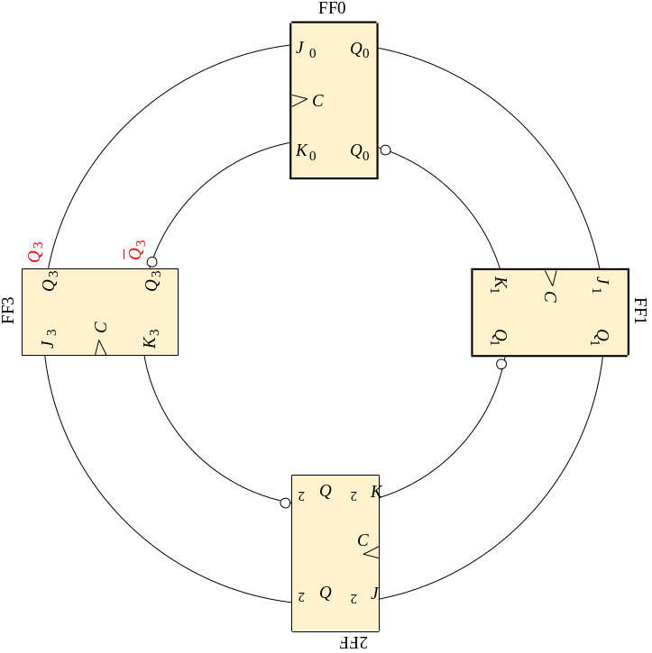
Summary
Ring Counter
Redrawing the Ring counter (without the clock shown) shows why it is a “ring”.
The disadvantage to this counter is that it must be preloaded with the desired pattern (usually a single 0 or 1) and it has even fewer states than a Johnson counter (n, where n = number of flip-flops.

Slide 22
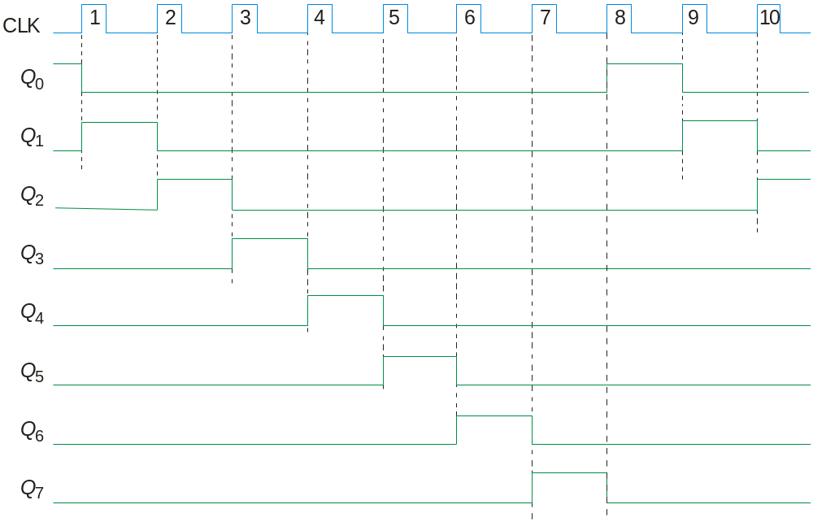
Summary
Ring Counter
A common pattern for a ring counter is to load it with a single 1 or a single 0. The waveforms shown here are for an 8-bit ring counter with a single 1.

Slide 23
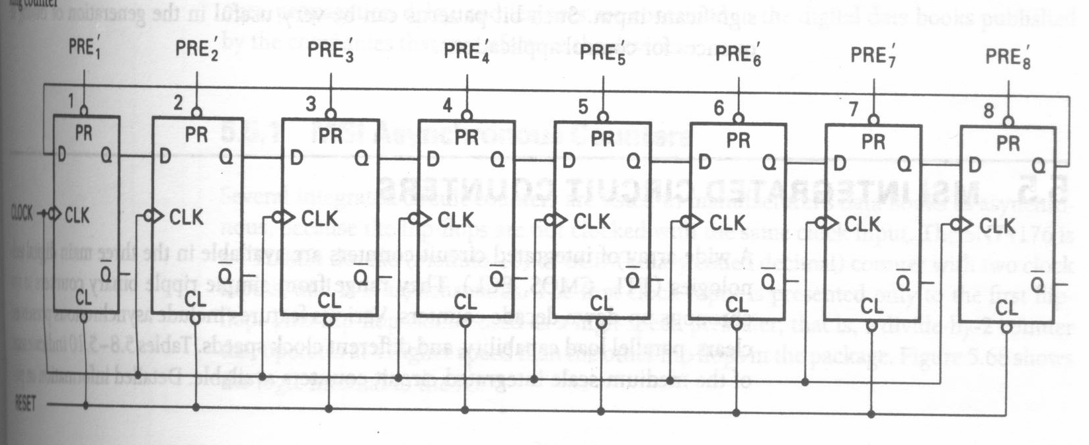
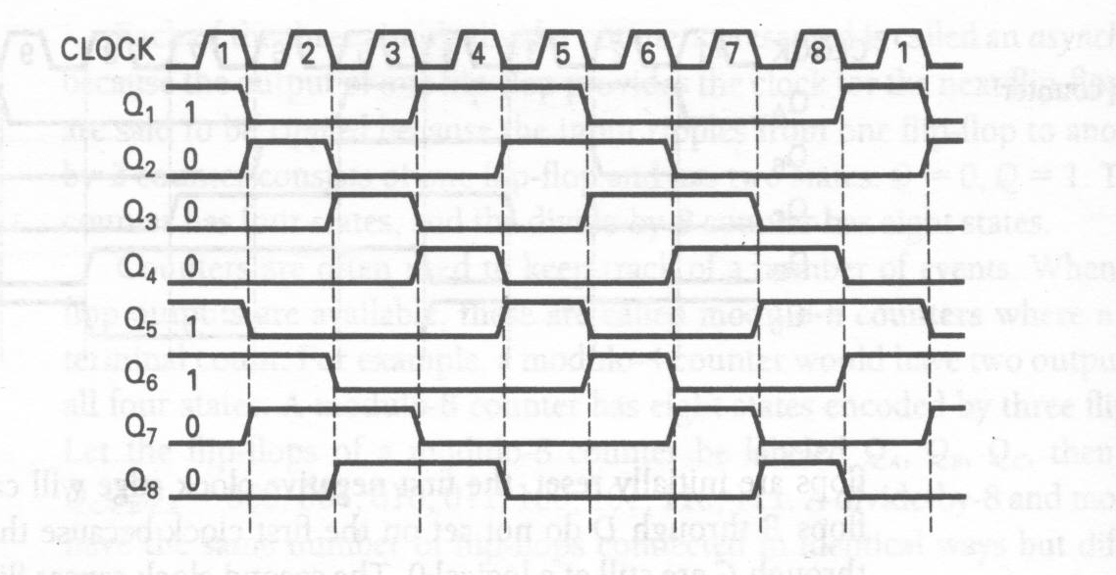
Notes:
预先载入的模式每8个时钟脉冲重复一次

Slide 24
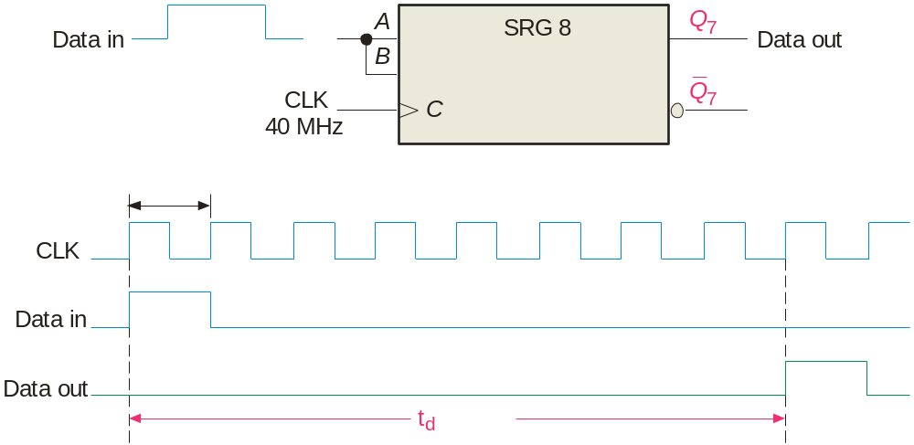

Summary
Shift Register Applications*
Shift registers can be used to delay a digital signal by a predetermined amount.
Example
An 8-bit serial in/serial out shift register has a 40 MHz clock. What is the total delay through the register?
Solution
The delay for each clock is 1/40 MHz = 25 ns
25 ns
The total delay is 8 x 25 ns = 200 ns
= 200 ns

Slide 25
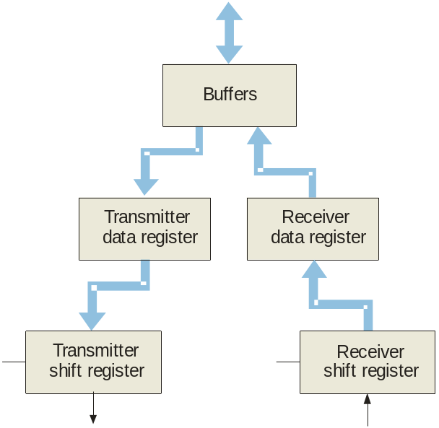
Summary
Shift Register Applications*
Data bus
A UART (Universal Asynchronous Receiver Transmitter) is a serial-to-parallel converter and a parallel to serial converter.
UARTs are commonly used in small systems where one device must communicate with another. Parallel data is converted to asynchronous serial form and transmitted. The serial data format is:
CLK
CLK
Serial data out
Serial data in
Start
Bit (0)
Stop Bits (1)

Slide 26
Summary
Keyboard Encoder*
The keyboard encoder is an example of where a ring counter is used in a small system to encode a key press.
Two 74HC195 shift registers are connected as an 8-bit ring counter preloaded with a single 0. As the 0 circulate in the ring counter, it “scans” the keyboard looking for any row that has a key closure. When one is found, a corresponding column line is connected to that row line. The combination of the unique column and row lines identifies the key. The schematic is shown on the following slide…

Slide 27
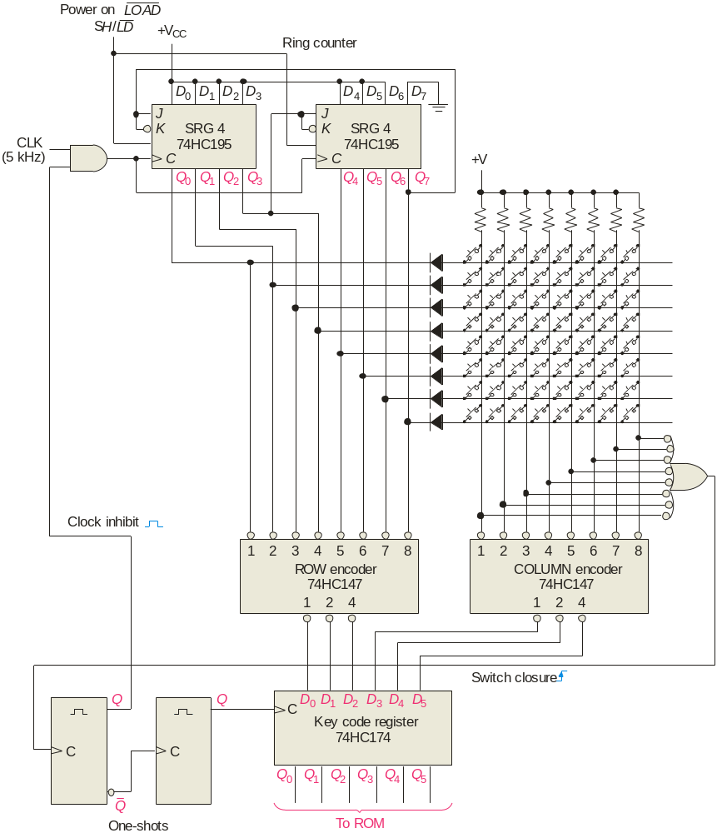
© 2008 Pearson Education

Slide 28
Key Terms
Register
Stage
Shift
Load
Bidirectional
One or more flip-flops used to store and shift data.
One storage element in a register.
To move binary data from stage to stage within a shift register or other storage device or to move binary data into or out of the device.
To enter data in a shift register.
Having two directions. In a bidirectional shift register, the stored data can be shifted right or left.

Slide 29
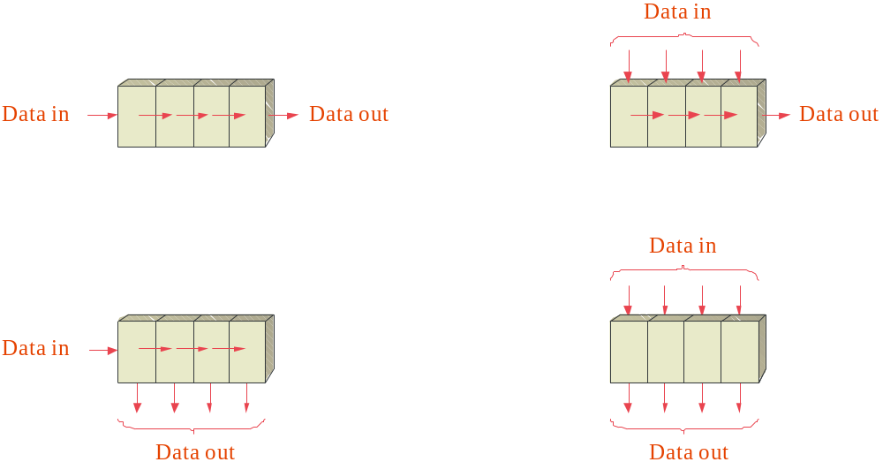

Quiz
1. The shift register that would be used to delay serial data by
4 clock periods is
a. c.
b. d.
© 2008 Pearson Education

Slide 30
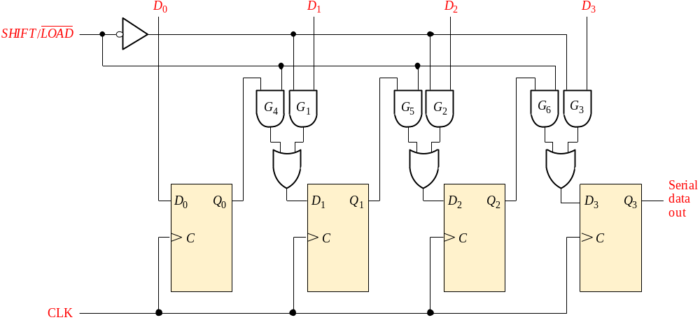
Quiz
2. The circuit shown is a
a. serial-in/serial-out shift register
b. serial-in/parallel-out shift register
c. parallel-in/serial-out shift register
d. parallel-in/parallel-out shift register
© 2008 Pearson Education

Slide 31
Quiz
3. If the SHIFT/LOAD line is HIGH, data
a. is loaded from D₀, D₁, D₂ and D₃ immediately
b. is loaded from D₀, D₁, D₂ and D₃ on the next CLK
c. shifted from left to right on the next CLK
d. shifted from right to left on the next CLK
© 2008 Pearson Education

Slide 32
Quiz
4. A 4-bit parallel-in/parallel-out shift register will store data for
a. 1 clock period
b. 2 clock periods
c. 3 clock periods
d. 4 clock periods
© 2008 Pearson Education

Slide 33
Quiz
5. The 74HC164 (shown) has two serial inputs. If data is placed on the A input, the B input
a. could serve as an active LOW enable
b. could serve as an active HIGH enable
c. should be connected to ground
d. should be left open
CLR
CLK
Serial inputs
A
B
Q₀
Q₁
Q₂
Q₃
Q₄
Q₅
Q₆
Q₇
© 2008 Pearson Education

Slide 34
Quiz
6. An advantage of a ring counter over a Johnson counter is that the ring counter
a. has more possible states for a given number of flip-flops
b. is cleared after each cycle
c. allows only one bit to change at a time
d. is self-decoding

Slide 35
Quiz
7. A possible sequence for a 4-bit ring counter is
a. … 1111, 1110, 1101 …
b. … 0000, 0001, 0010 …
c. … 0001, 0011, 0111 …
d. … 1000, 0100, 0010 …

Slide 36
Quiz
8. The circuit shown is a
a. serial-in/parallel-out shift register
b. serial-in/serial-out shift register
c. ring counter
d. Johnson counter

Slide 37
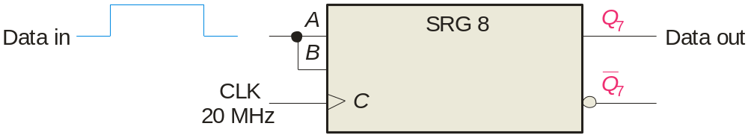
Quiz
9. Assume serial data is applied to the 8-bit shift register
shown. The clock frequency is 20 MHz. The first data bit
will show up at the output in
a. 50 ns
b. 200 ns
c. 400 ns
d. 800 ns
© 2008 Pearson Education

Slide 38
Quiz
10. For transmission, data from a UART is sent in
a. asynchronous serial form
b. synchronous parallel form
c. can be either of the above
d. none of the above
© 2008 Pearson Education

Slide 39
Quiz
Answers:
1. a
2. c
3. c
4. a
5. b
6. d
7. d
8. d
9. c
10. a

