Slide 1
COMBINATIONAL LOGIC 组合逻辑

Slide 2
DEFINITION OF COMBINATIONAL LOGIC
Logic circuits without feedback from output to the input, constructed from a functionally complete gate set, are said to be combinational.
·
Combinational Logic Functions
·
Inputs
·
·
Outputs
·
·
Notes:
如果逻辑电路中没有从输出到输入的反馈，完全由门电路构成，就称为组合逻辑电路。
不含记忆元件、不能存储信息。
Y=F(X)

Slide 3
General logic design sequence
Problem
Statement
问题陈述
Truth Table
Construction
构造真值表
Switching Equations
Written
写开关方程
Logic Circuit
Built
构造逻辑电路
Logic Diagram
Drawn
画逻辑图
Equations(s)
Simplified
方程化简

Slide 4
PROBLEM STATEMENTS TO TRUTH TABLES

Slide 5
Example 1: Conveyor system
An electric motor powering a conveyor used to move material is to be turned on when one of two operators is in position, if material is present to be moved and if the protective interlock switch is not open.
Input and output variables are to be expressed in binary; that is, if operator 1 is in position then the associated variable is a logical 1. The motor is running (on) if its output control variable is a 1, and the motor is off if the variable is a 0.
Notes:
一个电动马达传送原料的传输装置。如果有原料要传送，且保护联合开关没有打开，两个操作人员之一在位时可被启动

Slide 6
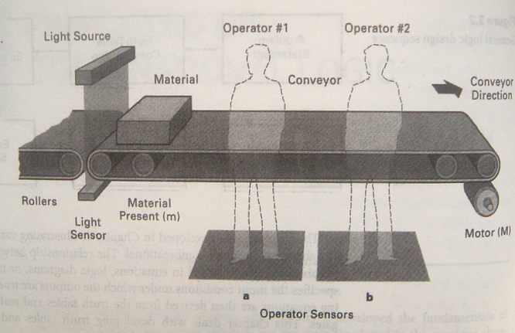
Example 1: Conveyor system

Slide 7
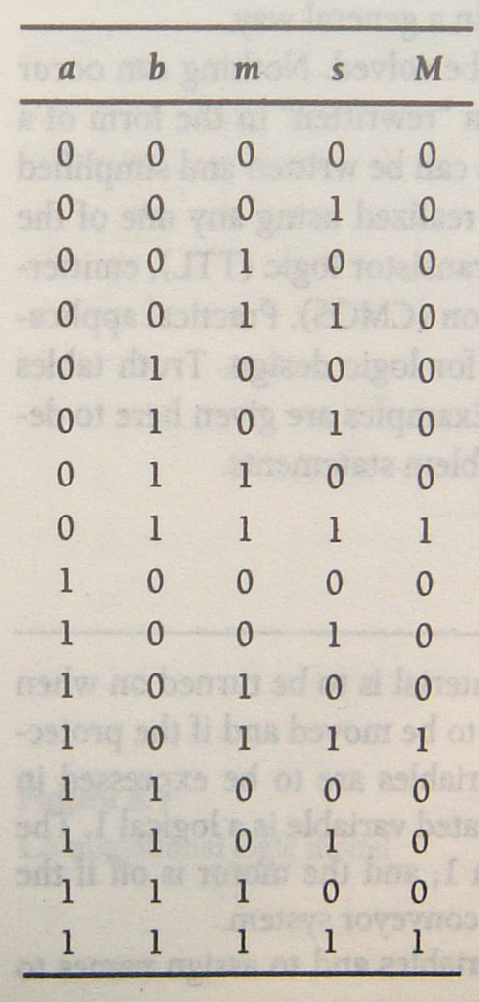
Example 1: Conveyor system
Identify the input and output variables and to assign names to them.
a, operator 1 is in position
b, operator 2 is in position
s, means the interlock switch is closed
m, means material is present.
M, the signal to turn the motor on and off.
M=a’bms+ab’ms+abms

Slide 8
Example 2: Conveyor system
Define Priority: M₁ > M₂ > M₃
Notes:
M₁~M₄分别表示4个传送带的马达，可分别控制开启、关闭
S1~S3是输入传送带的产品检测传感器
显然：

Slide 9
Example 2: Conveyor system
S₃ | S₂ | S₁ | M₄ | M₃ | M₂ | M₁
0 | 0 | 0 | 0 | 0 | 0 | 0
0 | 0 | 1 | 1 | 0 | 0 | 1
0 | 1 | 0 | 1 | 0 | 1 | 0
0 | 1 | 1 | 1 | 0 | 0 | 1
1 | 0 | 0 | 1 | 1 | 0 | 0
1 | 0 | 1 | 1 | 0 | 0 | 1
1 | 1 | 0 | 1 | 0 | 1 | 0
1 | 1 | 1 | 1 | 0 | 0 | 1

Slide 10
Summary
The process of converting a verbal problem statement into a truth table
Determine the input variables and output variables that are involved
Assign mnemonic(记忆的) or letter or number symbols to each variable
determine the size of the truth table; how many input combinations exist:
2^{x}=y x=number of input variables, y=number of combinations.
Construct a truth table containing all of the input variable combinations
By careful reading of the problem statement determine the combinations of inputs that cause a given output to be true
Notes:
书面问题描述转化成真值表的过程：
1. 确定所包含的输入、输出变量
2. 为每个变量分配助记符或字母或标识
3. 确定真值表的大小，看看有多少个输入组合
2^{x}=y：x=输入变量数，y=组合数
4. 构造一个包含所有输入变量组合的真值表
5. 仔细研究问题描述，确定使给定输出为真的输入组合

Slide 11
HOMEWORK
An automobile system is to be designed that will sound an alarm under certain conditions. The alarm is to sound if the seat belt is not fastened and the engine is running, or if the lights are left on when the key is not in the ignition, or if the key is in the ignition, the engine is not running and the driver’s door is open. Determine the number of inputs and outputs, assign names to variables, and construct a truth table that describes the system.

