Slide 1

Damaged Ticket
1/26
Yann Martin D’Escrienne

Slide 2
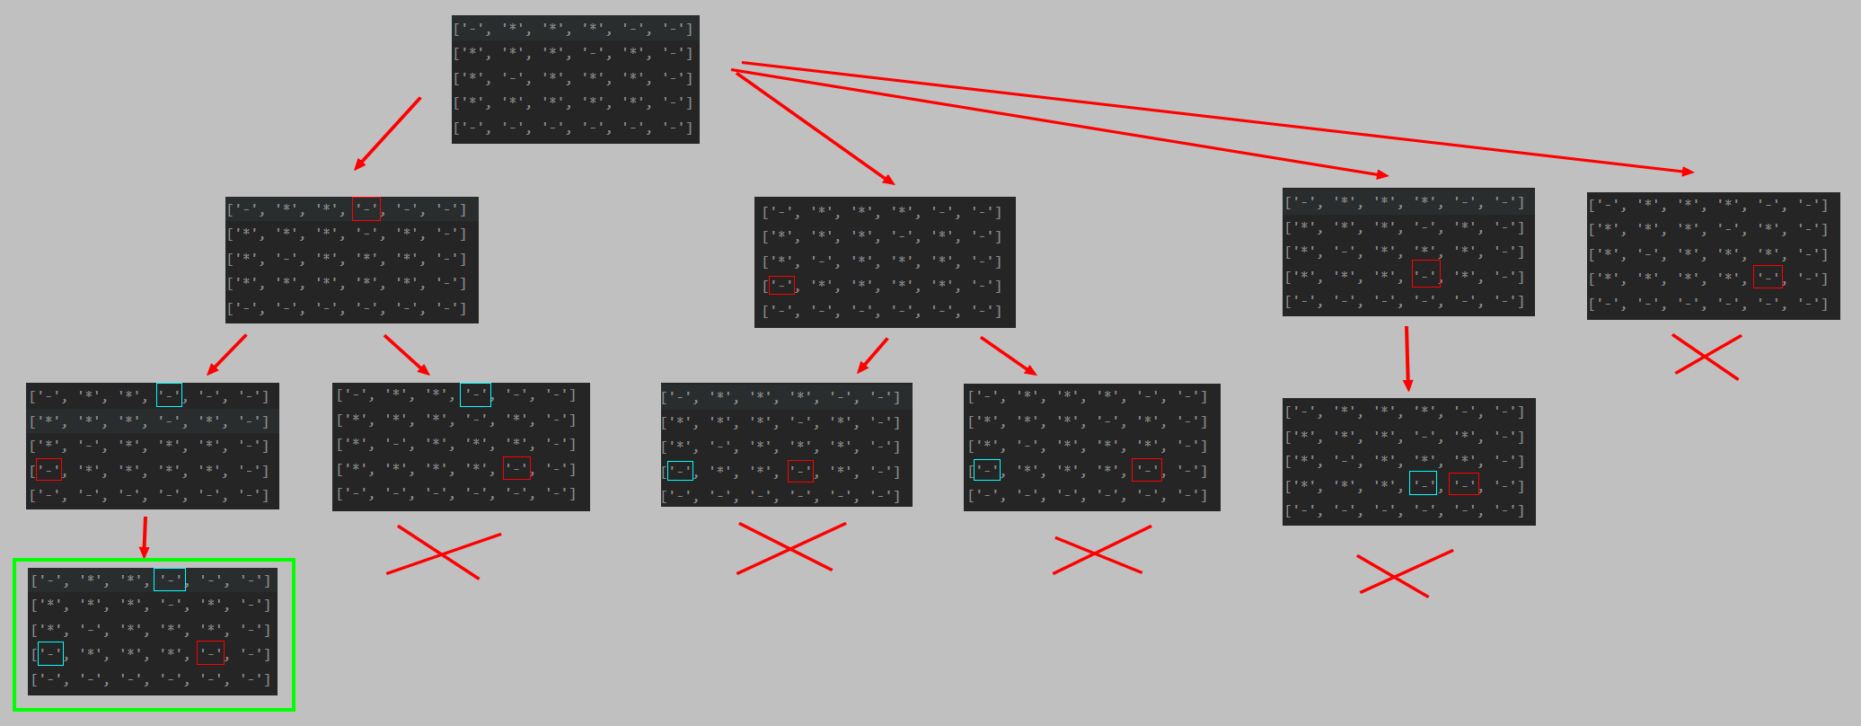
2/26
OVERALL FUNCTIONING OF THE BASE ALGORITHM
- The algorithm considers all possibilities and counts the total number of solutions found.
- If more than one solution is found, it cannot be reconstructed in a unique way: we return “NO.”

Slide 3
EXAMPLE #1
3/26
Execution of the algorithm with the input:
5 6
- * * * - *
* * * - * *
* - * * * *
* * * * * *
* * * * * *
4 2 2 3 6
3 2 1 3 3 5
Which should result in:
- * * - - -
* * * - * -
* - * * * -
- * * * - -
- - - - - -

Slide 4
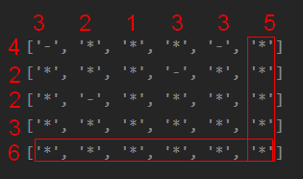
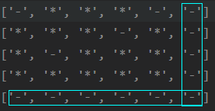
TREATMENT OF TRIVIAL CASES
4/26

Slide 5
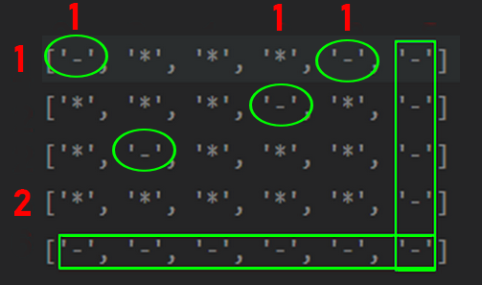
reduce counter of “-” with existing
4/26

Slide 6

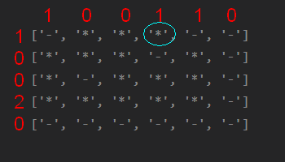
LIST OF POSSIBILITIES
5/26

Slide 7

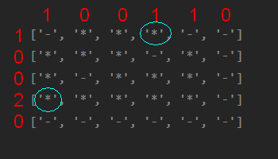
LIST OF POSSIBILITIES
6/26

Slide 8

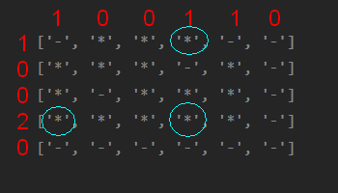
LISTE DES POSSIBILITES
7/26

Slide 9

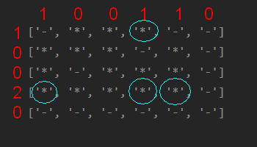
LIST OF POSSIBILITIES
8/26

Slide 10


PATH OF POSSIBILITIES:
9/26
If there are as many possibilities as missing “-” in a row or column: Replace
If a possibility is no longer possible: Remove
If no simplification is possible: Return “NO”

Slide 11
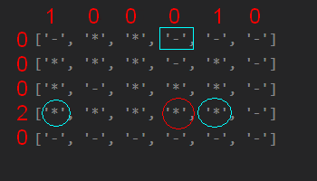

PATH OF POSSIBILITIES:
10/26
If there are as many possibilities as missing “-” in a row or column: Replace
If a possibility is no longer possible: Remove
If no simplification is possible: Return “NO”

Slide 12
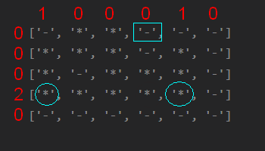

PATH OF POSSIBILITIES:
11/26
If there are as many possibilities as missing “-” in a row or column: Replace
If a possibility is no longer possible: Remove
If no simplification is possible: Return “NO”

Slide 13
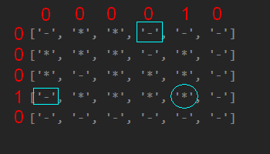

PATH OF POSSIBILITIES:
12/26
If there are as many possibilities as missing “-” in a row or column: Replace
If a possibility is no longer possible: Remove
If no simplification is possible: Return “NO”

Slide 14
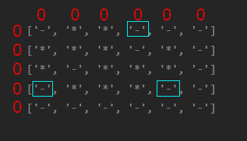

PATH OF POSSIBILITIES:
13/26
If there are as many possibilities as missing “-” in a row or column: Replace
If a possibility is no longer possible: Remove
If no simplification is possible: Return “NO”

Slide 15

PATH OF POSSIBILITIES:
14/26
If there are as many possibilities as missing “-” in a row or column: Replace
If a possibility is no longer possible: Remove
If no simplification is possible: Return “NO”

Slide 16
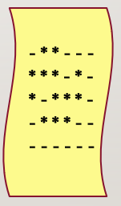
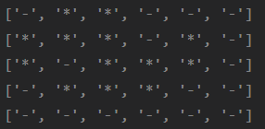
Comparison with expectations
15/26

Slide 17
Comparison with expectations
16/26

Slide 18
EXAMPLE #2
17/26
Execution of the algorithm with the input:
4 2
**
**
**
**
1 0 0 1
1 1
Which should result in:
NO

Slide 19
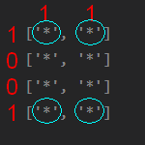

PATH OF POSSIBILITIES:
18/26
If there are as many possibilities as missing “-” in a row or column: Replace
If a possibility is no longer possible: Remove
If no simplification is possible: Return “NO”

Slide 20

PATH OF POSSIBILITIES:
19/26
If there are as many possibilities as missing “-” in a row or column: Replace
If a possibility is no longer possible: Remove
If no simplification is possible: Return “NO”

Slide 21

PATH OF POSSIBILITIES:
20/26
If there are as many possibilities as missing “-” in a row or column: Replace
If a possibility is no longer possible: Remove
If no simplification is possible: Return “NO”

Slide 22

PATH OF POSSIBILITIES:
21/26
If there are as many possibilities as missing “-” in a row or column: Replace
If a possibility is no longer possible: Remove
If no simplification is possible: Return “NO”

Slide 23

PATH OF POSSIBILITIES:
22/26
If there are as many possibilities as missing “-” in a row or column: Replace
If a possibility is no longer possible: Remove
If no simplification is possible: Return “NO”

Slide 24

COMPARISON WITH THE BASIC ALGORITHM
23/26
My algorithm:
Basic algorithm:
=> No real difference in execution time between the two algorithms

Slide 25


COMPARISON WITH THE BASIC ALGORITHM
25/26
My algorithm is easier to understand (recursion is always complex).
And is more effective in cases with numerous possibilities.

Slide 26

THANK YOU FOR YOUR ATTENTION
26/26

