Slide 1
READMEs for Open Projects

Slide 2





Slide 3
What we’ll do
Learn to communicate about your project effectively
Do exercises & look at examples
Create or Revise your README
Notes:
GOAL We're going to talk about defining and communicating your open project in a way that engages lots of contributors. I'll walk you through some short exercises on doing this, and you'll have time after the talk to create a really effective readme file, or revise your readme to be more effective.

Slide 4

Why do READMEs matter?
Notes:
The readme is a very important document, your secret weapon in opening your project! This is the first thing anyone sees when theycome to the project.

Slide 5
In your README, show:
what you're doing, for who, and why
what makes your project special and exciting
how to get started
where to find key resources
Notes:
so, what should your readme file do for this DIVERSE audience?
this is your chance to hook potential contributors and users! show the value of your project.

Slide 6
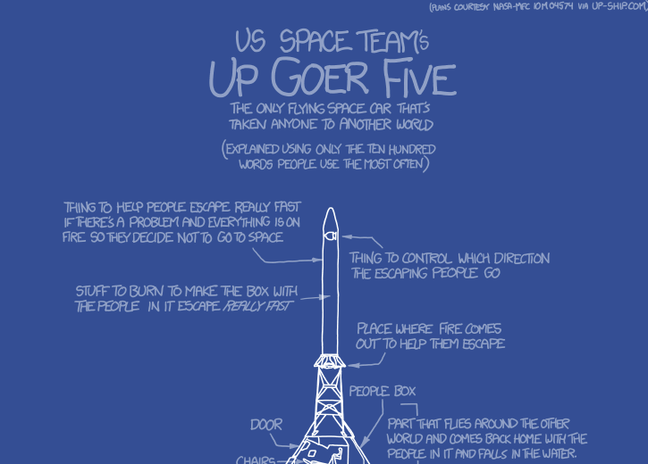
HOW can we communicate better?
Image from xkcd, editor at http://splasho.com/upgoer5/
Notes:
Finding ways to communicate so clearly about what you're doing so that anyone can engage is key, and it's a challenge if your topic is technical. Often, without intending to do so, we use language that can be confusing and unwelcoming to those outside our field. So let's try a little experiment. Let's try communicating using only the ten hundred most commonly used words in the english language, which will keep us from using jargon. Here's an example. The XKCD up-goer five rocket ship graphic. An attempt to explain a rocket using those 10 hundred words. There is also a handy text editor, which we are going to use quickly together...

Slide 7
Let’s try this together.
“Data Reuse”
Notes:
Link to editor in underlined text

Slide 8
Good README Examples
Purple Booth’s README Template
Standard README - style specification
PaperBadger - project README
Thoughtbot’s Blog on How to Write a Good README
Matias Singer’s curated List of Awesome READMES

Slide 9

Thank you!

