Slide 1
Analyzing software architecture for security threats
Riccardo Scandariato
Institute of Software Security, TUHH, Germany
ric***do . scanda***to @ tuhh.de
IIW Praktikum

Slide 2


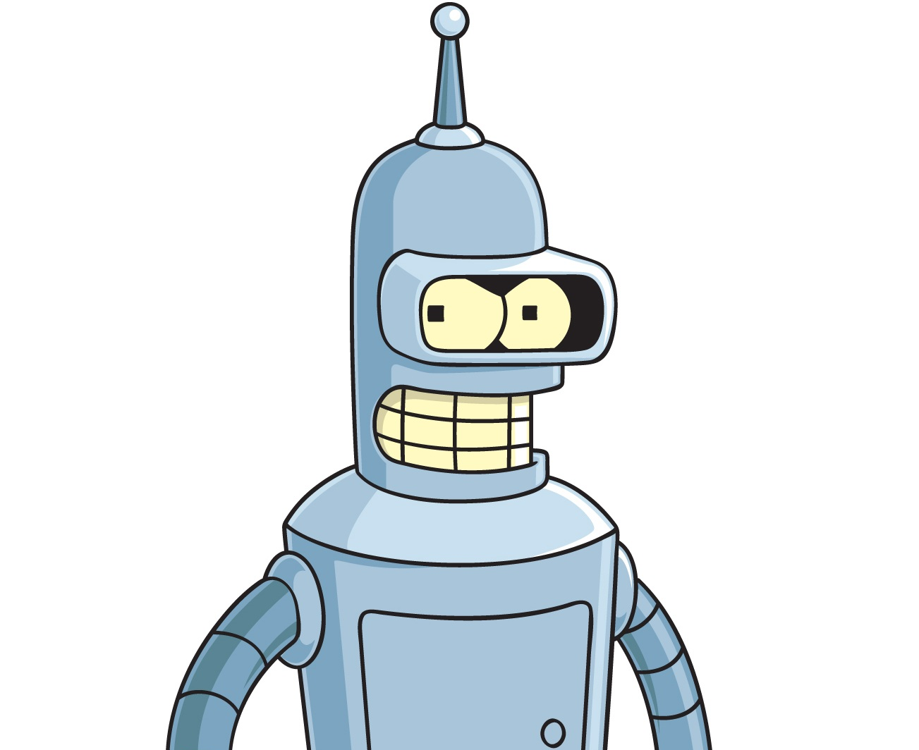
What is architectural threat analysis?
Systematic exploration of system architecture to identify and mitigate potential security risks
Security experts, domain experts
Architectural documentation
REPORT
Automated tools
List of prioritized threats (or security requirements)
+ mitigations

Slide 3
DFD
Riccardo Scandariato

Slide 4
Data Flow Diagrams (DFDs)
A DFD is a graphical representation of how data enters, traverses and leaves a system
Shows all data sources and destinations
Shows all relevant steps data goes through
Notes:
DFDs should be completed before the threat modelling meeting. The PM and the dev should work together to get it into good shape and distribute it to the team in advance of the meeting.
Data flows across trust boundaries are where the bad stuff gets in and causes the really nasty bugs (elevation of privilege, denial of service, etc.) and where the good stuff leaks out (information disclosure / privacy). Flows across other kinds of boundaries (eg machine boundaries) are also interesting if the communication channel is not secure
Once inside the trusted system, look for defence-in-depth measures (sanity checking, verification, auditing, etc) to help reduce the impact of bugs in other parts of the system

Slide 5
DFD – Example
Process
Payroll#
1. Person
2.
No. and sub-no.
Display
What’s done
Personnel info
External entity
Personnel info
(read)
Data flow
3. Personnel details
Data store D digital storage
T transient digital

Slide 6
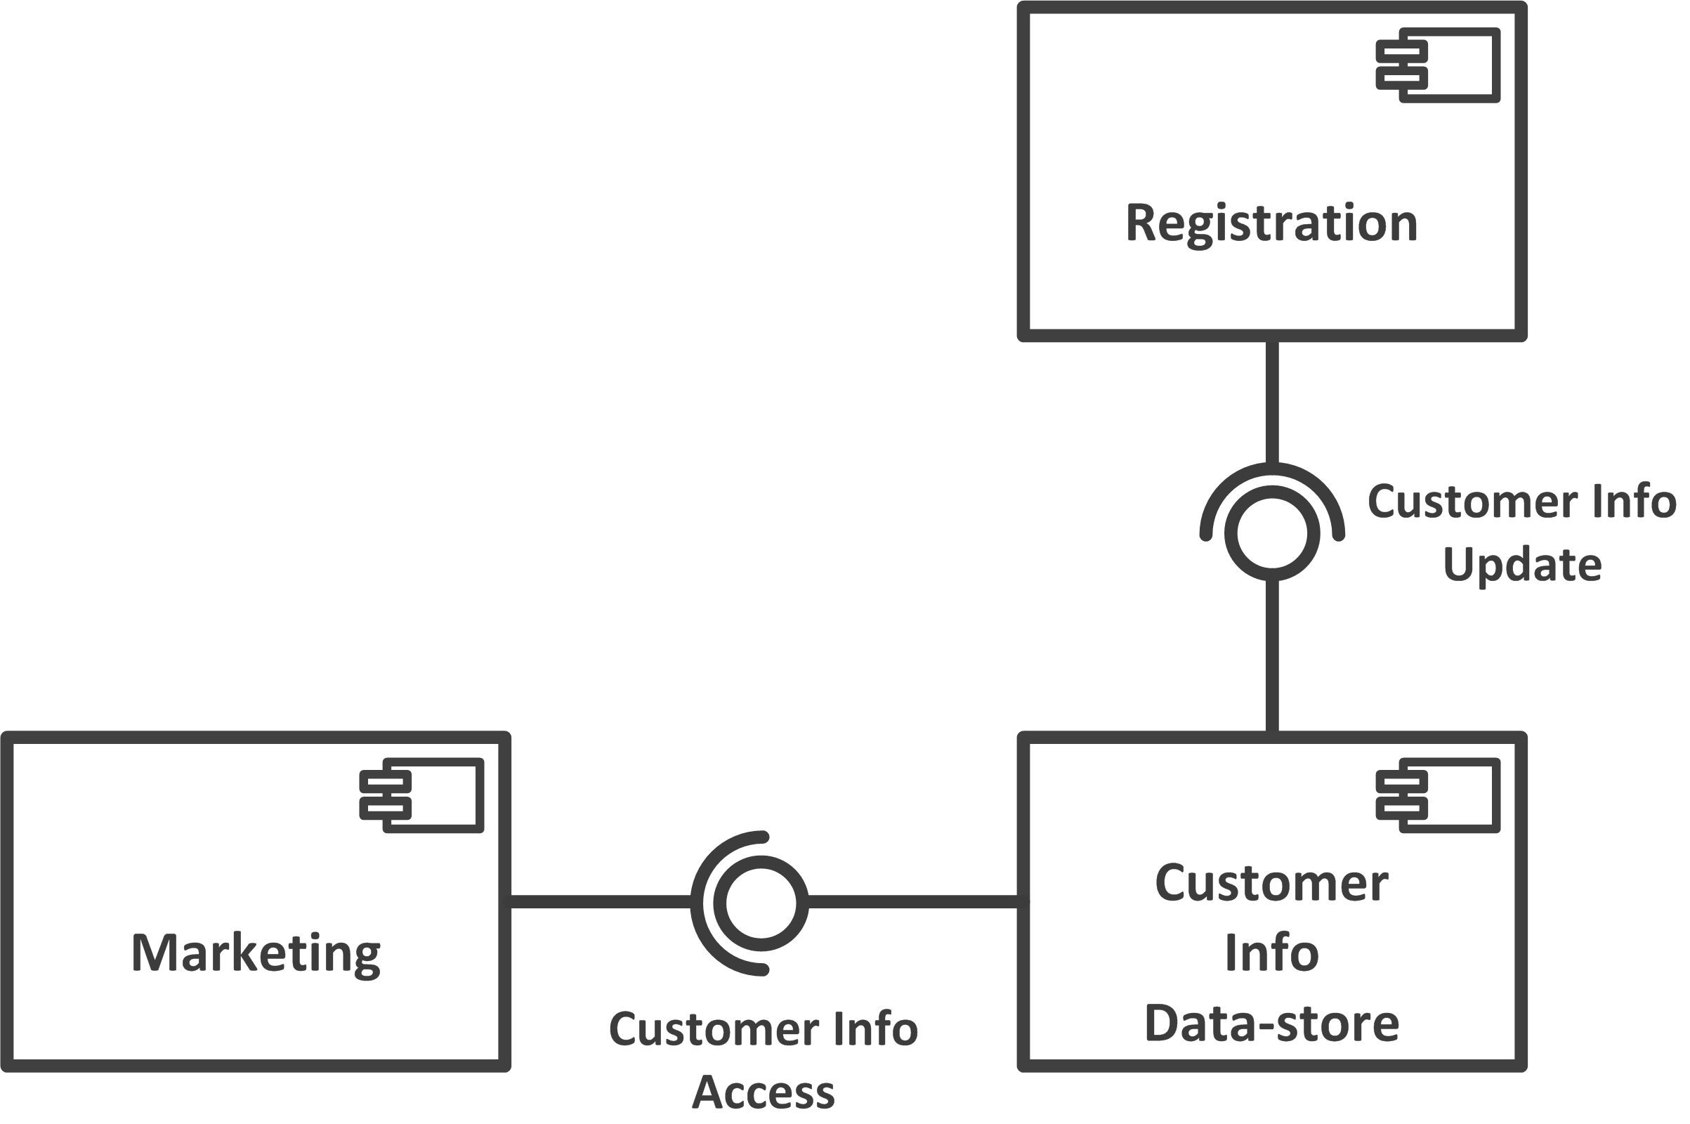
Another example
New customers
Register
My system
3rd party system

Slide 7
Another example
External Entity
Customer
Process
External Entity
Registration
Marketing
Process
Info provisioning
Customer Info
Data Store

Slide 8
DFD Elements
Process
A process is a unit of work that operates on the data
Data flow
A data flow is a named flow of data through a system of processes
Data store
A data store is a logical repository of data
External entity
An external agent is a source or destination of data

Slide 9
How to build DFD (heuristics)
Start drawing the external entities
E.g., from context diagram
Map nodes in the deployment diagram to processes or data stores
If node contains both data and logic: split into process(es) + data store(s)
If node contains multiple databases: consider splitting into multiple data stores

Slide 10
How to build DFD (heuristics)
Derive data flows from interfaces, links, connectors
Use main component diagram and decompositions to refine the DFD (if necessary!)
Ignore the inner workings
Security-relevant processes need to be shown
Add trust boundaries (each boundary box should have a label inside it)

Slide 11
Well-formed DFD
Data flows are NOT ALLOWED between
External entity ⬅➔ Data store
Data store ⬅➔ Data store
Show the process that moves the data
All processes must have at least one entry data flow and one exit data flow

Slide 12
STRIDE
Riccardo Scandariato

Slide 13
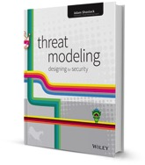
STRIDE
Security threat assessment
Spoofing is pretending to be something or someone you’re not.
Tampering is modifying something you’re not supposed to modify. It can include packets on the wire (or wireless), bits on disk, or the bits in memory
Repudiation is claiming you didn’t do something (regardless of whether you did or not)
Denial of Service are attacks designed to prevent a system from providing service, including by crashing it, making it unusably slow, or filling all its storage
Information Disclosure is about exposing information to people who are not authorized to see it
Elevation of Privilege is when a program or user is technically able to do things that they’re not supposed to do
A. Shostack, Threat Modeling : Designing for Security, Wiley 2014

Slide 14
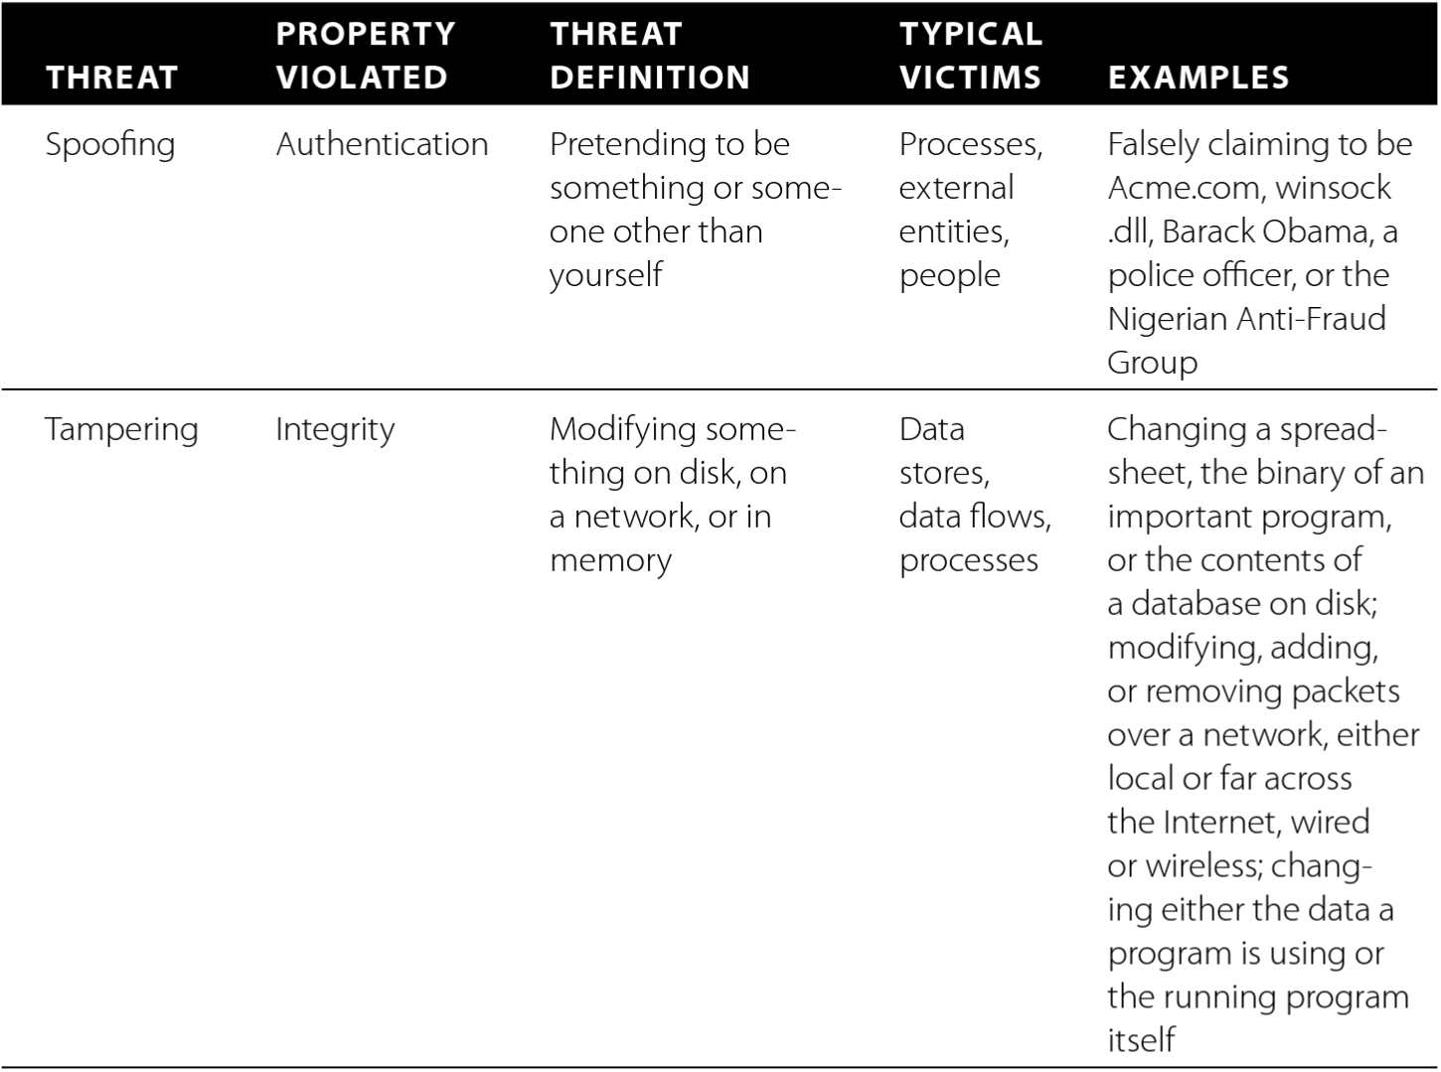
Threat categories: Spoofing
Possible because
Lack of (or weak) authentication:
Sender of a message (signature)
Identity of other party (certificate)
Identity of user (credentials)
…

Slide 15
Threat categories: Tampering
Possible because
Lack of (or weak) integrity mechanisms:
Communication (crypto hash)
Data (crypto hash)
…

Slide 16
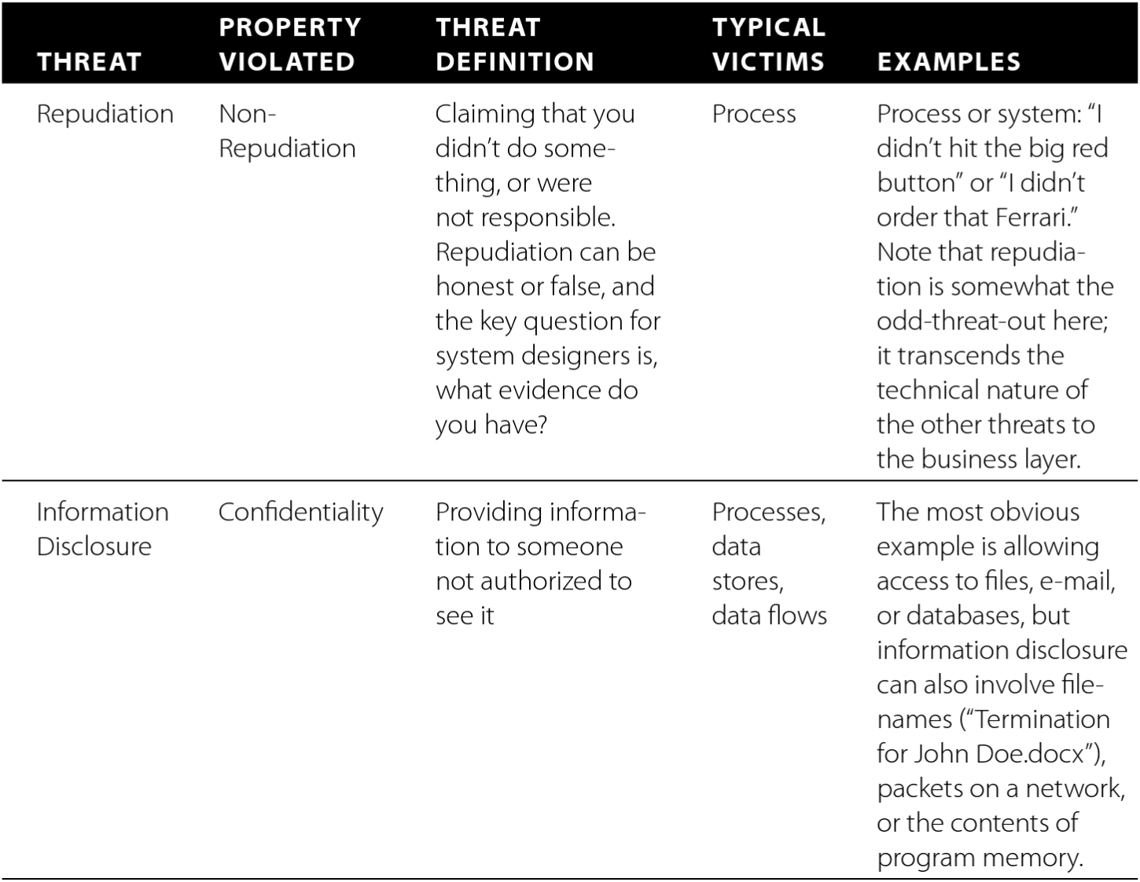
Threat categories: Repudiation
Possible because
Lack of (or weak)
non-repudiation mechanisms:
Audit trails
Signed requests
Trusted third party
…

Slide 17
Threat categories: Info disclosure
Possible because
Lack of (or weak)
confidentiality mechanisms:
Communication (encryption)
Storage (encryption)
Access control
…

Slide 18
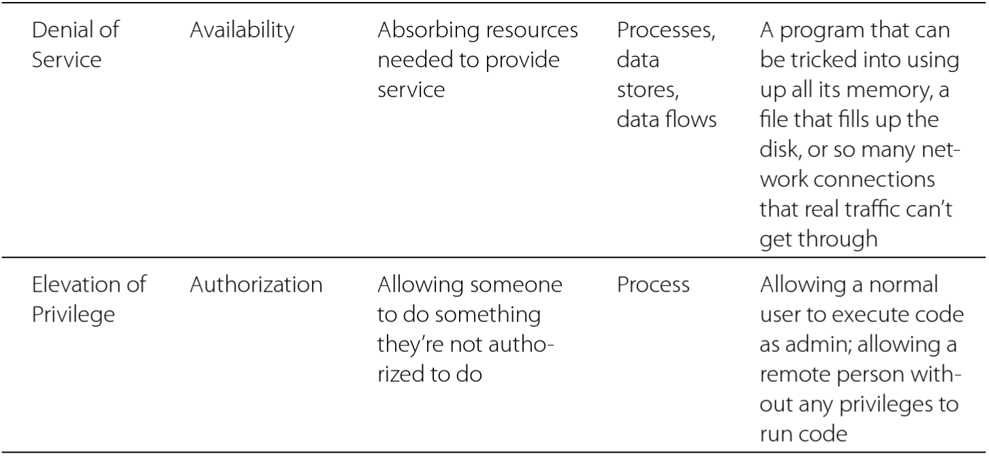
Threat categories: Denial of service
Possible because
Lack of availability mechanisms:
Load balancing/replication
Lock-down
…

Slide 19
Threat categories: Elevation of privilege
Possible because
Lack of authorization and input validation

Slide 20
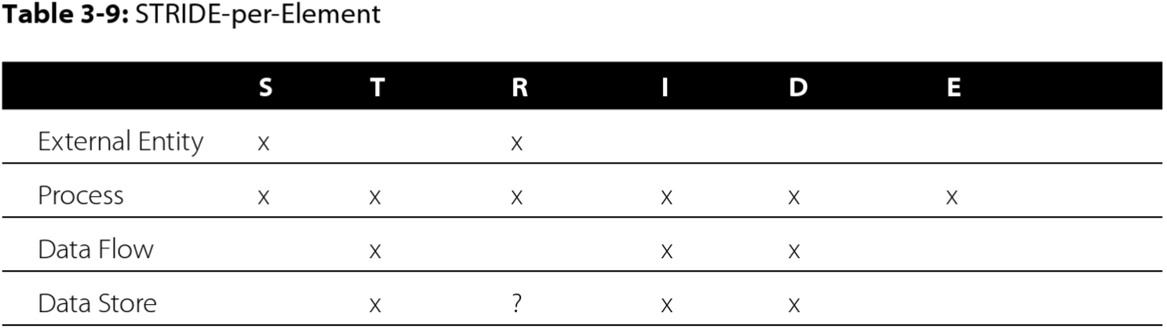
DFD elements to threat categories
Only a subset of threat categories are relevant
Not “everything” can go wrong (unless it’s a process)

Slide 21
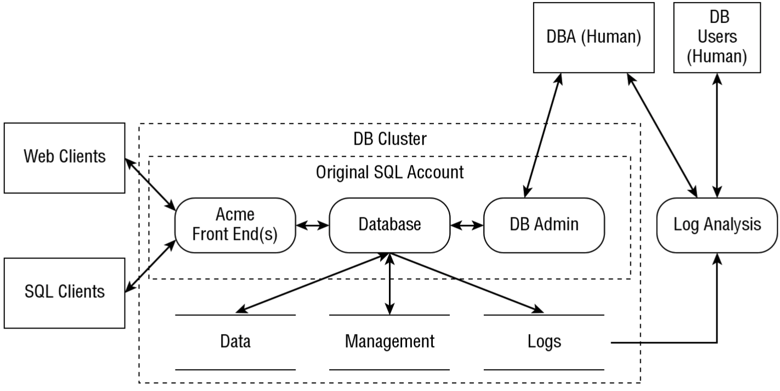

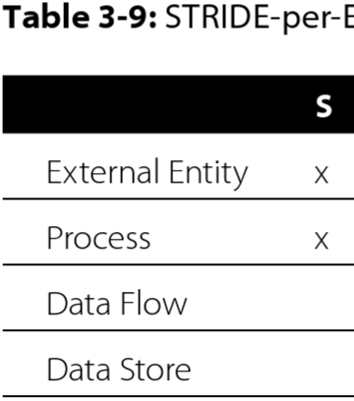





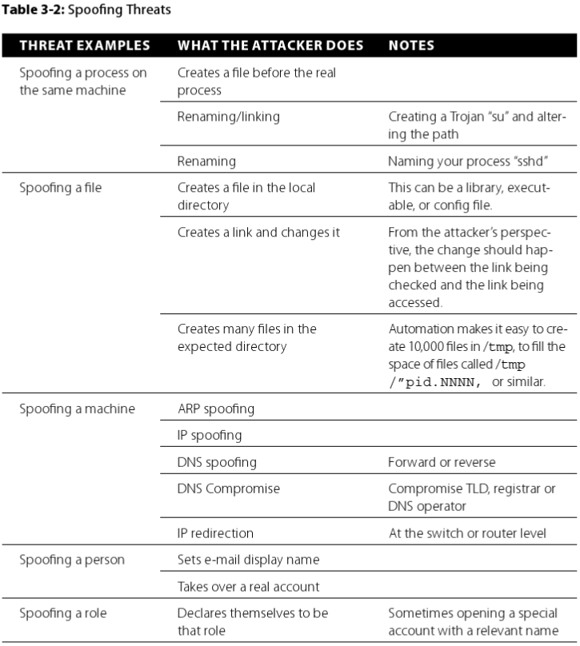
STRIDE in action
2
1
Model-based
3
Knowledge-based
(Tables 3.2 – 3.7)

Slide 22
KNOWLEDGE BASE OF Threat examples

Slide 23
Spoofing threats
Book, Ch 3
Possible because
Lack of (or weak) authentication:
Sender of a message (signature)
Identity of other party (certificate)
Identity of user (credentials)
…

Slide 24
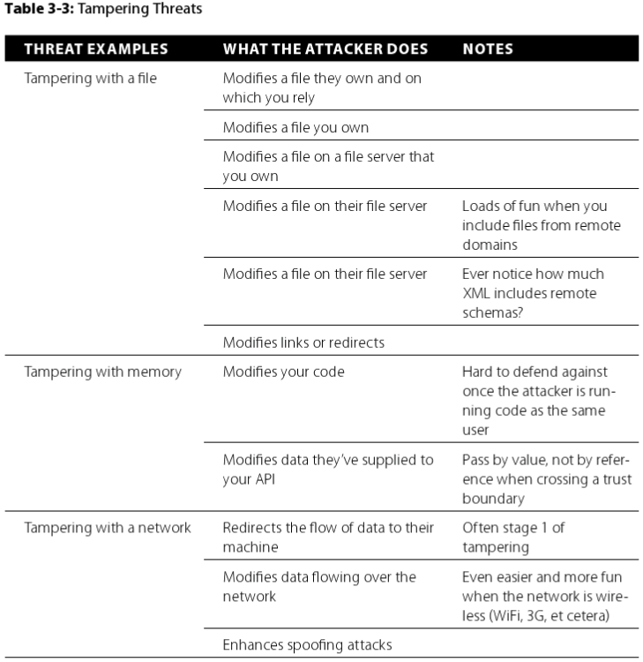
Tampering threats
Book, Ch 3
Possible because
Lack of (or weak) integrity mechanisms:
Communication (crypto hash)
Data (crypto hash)
…

Slide 25
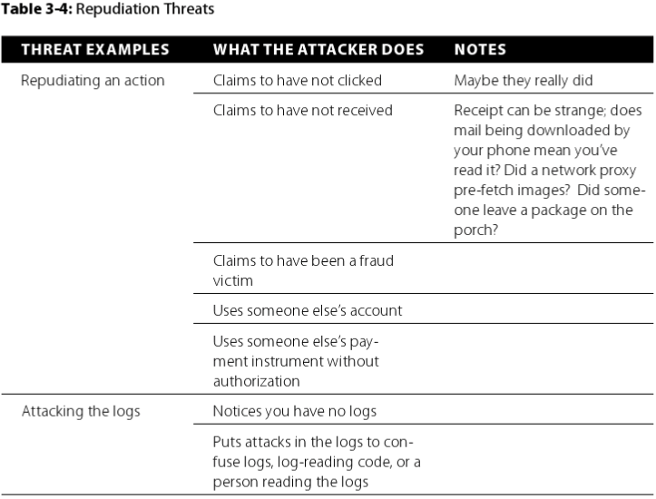
Repudiation threats
Book, Ch 3
Possible because
Lack of non-repudiation mechanisms:
Audit trails
Signed requests
Trusted third party
…

Slide 26
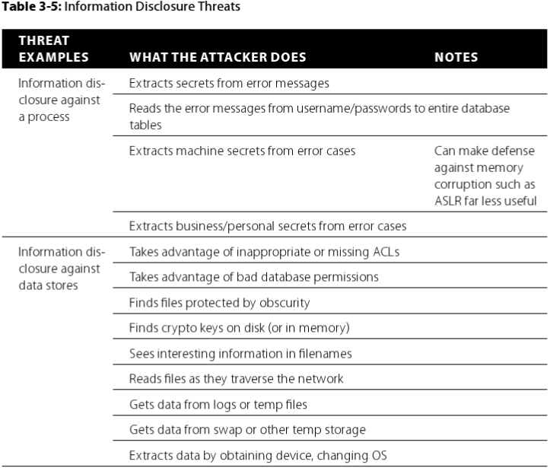
Information Disclosure threats
Book, Ch 3
Possible because
Lack of (or weak) confidentiality mechanisms:
Communication (encryption)
Storage (encryption)
Access control
…

Slide 27
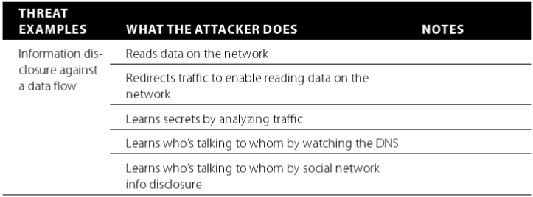
Information Disclosure threats (cont’d)
Book, Ch 3

Slide 28
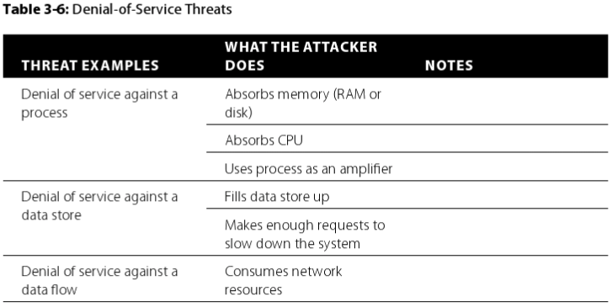
Denial-of-Service threats
Book, Ch 3
Possible because
Lack of availability mechanisms:
Load balancing/replication
Lock-down
…

Slide 29
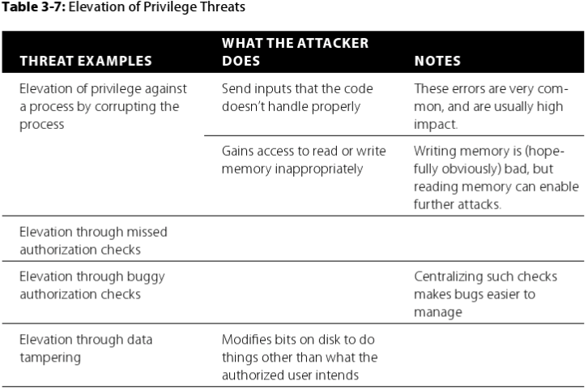
Elevation of Privilege threats
Book, Ch 3
Possible because
Lack of authorization and input validation

