Slide 1
Tips for “good” user stories
Riccardo Scandariato
Institute of Software Security, TUHH, Germany
scanda***to @ tuhh.de
IIW Praktikum

Slide 2
Good user story: INVEST Criteria
I | Independent | User stories should not overlap and they should be formulated so they can be implemented in any order.
N | Negotiable | A user story should be an invitation for a conversation. It can be changed, augmented, and redacted; of course, always in dialog with the Product Owner!
V | Valuable | Each user story should deliver value, either to the Product Owner or to Scrum Team.
E | Estimable | It must be possible to assign effort to each user story. A story that can not be estimated is not complete!
S | Small | A user story must be a manageable task. If its completion takes longer than 3 or 4 days, it must be broken down!
T | Testable | There must be clear, testable criteria to define when the story is done in the eyes of the Product Owner and the Scrum Team.
http://xp123.com/articles/invest-in-good-stories-and-smart-tasks/

Slide 3
User stories Too big
DON’T “User Story 1: As a user I want a system to search for toys that satisfy my criteria”
This is your whole concept…
Epics are broken down into stories

Slide 4
Use stories Fuzzy, not specific enough
As a user I want to search for a product
How? By name? By barcode?
As a user I want to filter my search results
According to what attributes? (Acceptance criteria!)

Slide 5
Use stories Fuzzy, not specific enough
As a user I want to edit some information
Edit own entries vs edit all (Acceptance criteria!)
As a user I want the possibility to order by price
Order what?
The results of a search as described in another story? (Reference in the acceptance criteria!)

Slide 6
Use stories Structure vs behavior
DON’T: Describing the structure of a page, instead of a provided feature
As Owner, I want to have a page where I can see all my points of interest and I can update my account settings
Also, note that there are many stories here

Slide 7
User stories Overlaps and duplications
Three stories covering the same feature
Typically the 2nd and the 3rd are acceptance criteria for the 1st
DON’T
As a user I want to describe my business
As a user I want to add the contact info and opening hours for my business
As a user I want to add a picture of my business

Slide 8
User stories Missing
Typical examples
Registration or account creation
Log in (e.g. to be referenced in the acceptance criteria of “Add” and “Update” stories)
Only one side of the coin
As a user I want to add ratings to the items
But how are user ratings used?
To compute the overall rating for the item?
To filter my results? …

Slide 9
Use stories Unattainable, unfeasible
User get rewards for their reviews
How? From whom?
User location from smartphone will be used to find nearest place of interest
But can you do it for real? Or just for show?
Login via FB credentials
In an application without networking…

Slide 10
User stories Non stories
DON’T “I want a login to a privileged page where I can perform actions other users cannot perform”
Go and implement that! ;)
DON’T “The system should be usable and easy to understand”
Pipe dream ;)

Slide 11
User stories Specification vs “Book of dreams”
Too many features that are non-core
Chat, Notifications, Password recovery, Tracking of past searches, …
Got ideas about extra features you are not so sure you’ll manage?
OK, put at the end and clearly mark it as such (e.g., appendix)

Slide 12
From threats to security requirements (as security stories)

Slide 13
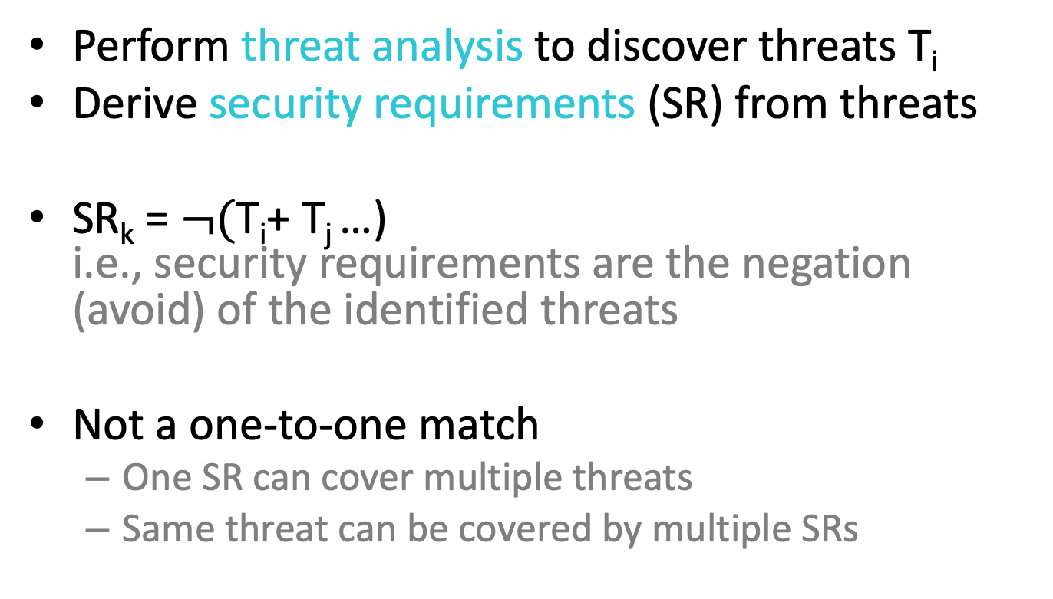
Approach
Perform threat analysis to discover threats T_{i}
Derive security requirements (SR) from threats
SR_{k} = $¬($T_{i}+ T_{j} …) i.e., security requirements are the negation (avoid) of the identified threats
Not a one-to-one match
One SR can cover multiple threats
Same threat can be covered by multiple SRs

Slide 14
Approach (cont’d)
Use catalog of security user stories for inspiration
Have you forgot something?
See catalog fomr SafeCode (on gitlab)
Focus on Section (2a) “Security-focused stories”
36 examples

Slide 15
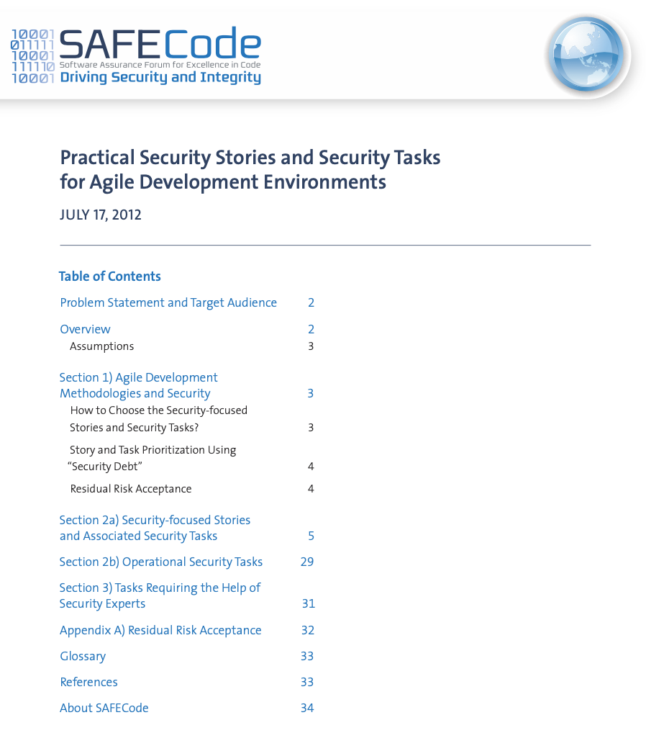
Catalog of Template Security Stories
Security stories:
Security requirements written as user stories
Focus on section (2a)

Slide 16
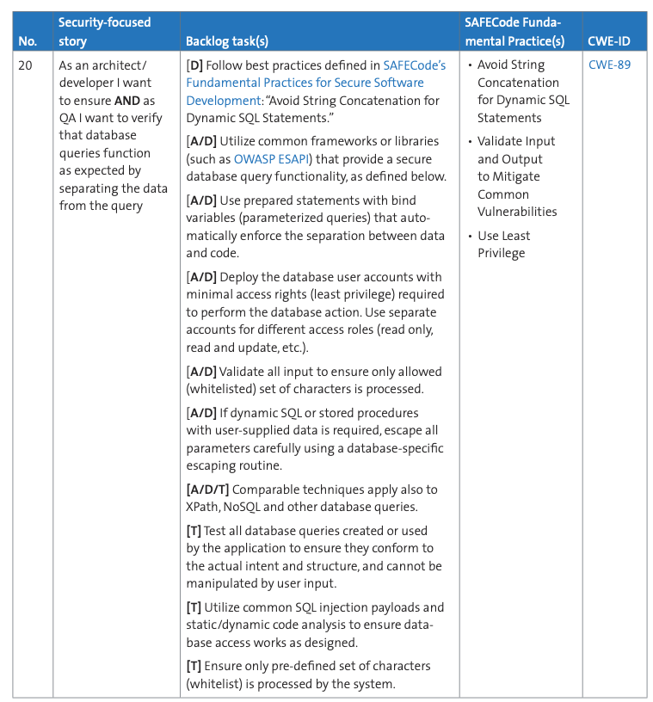
Example
Just examples… to be used for inspiration (not for copy & paste)

