Slide 1

Constructing the Dicke States on a Quantum Computer
Yannick Bergs
Technical University Munich
TUM School of Computation, Information and Technology
Quantum Computing, Christian B. Mendl
Munich, 13. Dezember 2024

Slide 2
Contents
Quantum Many Body Physics
Lattice Models &
Matrix Product State
Dicke States &
Preparation Circuit
Concrete Examples
Primitive Decomposition

Slide 3
Quantum Many Body Physics

Slide 4
Quantum Many Body Physics
What is Quantum Many Body Physics?

Slide 5
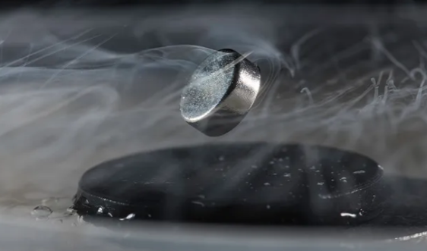
Quantum Many Body Physics
Describe emerging macroscopic features of Quantum Systems ^{[1]}
Floating Superconductor ^{[2]}

Slide 6

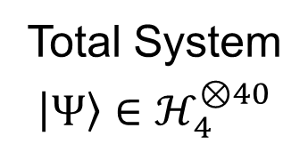

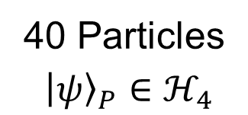




Quantum Many Body Physics
Main Problem: Computational Infeazability ← Large Statevectors
40 Particles
$${\left|ψ\right\rangle }_{P}∈ℋ_{4}$$
Total System
$$\left|Ψ\right\rangle ∈ℋ_{4}^{⊗40}$$
$${\left|3\right\rangle }_{P}$$
…
$${\left|2\right\rangle }_{P}$$
…
$${\left|1\right\rangle }_{P}$$
…
$${\left|0\right\rangle }_{P}$$
$$\dim_{ℂ}{{\left|ψ\right\rangle }_{P}=4}$$
$$\dim_{ℂ}\left|Ψ\right\rangle =4^{40}=2^{80}$$

Slide 7


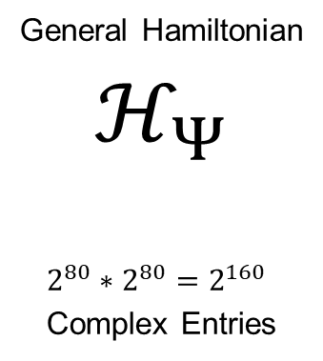

Quantum Many Body Physics
For Comparison:
General Hamiltonian
$$ℋ_{Ψ}$$
$2^{80}∗2^{80}=2^{160}$
Complex Entries
=
$2^{160}$ Atoms on Earth

Slide 8
Lattice Models & Matrix Product States

Slide 9
















Lattice Model
→ Widely Used throughout QM (e.g. Ising Models ^{[3]})
$${\left|ψ\right\rangle }_{1,1}$$
$${\left|ψ\right\rangle }_{1,2}$$
$${\left|ψ\right\rangle }_{1,3}$$
$${\left|ψ\right\rangle }_{1,4}$$
…
$${\left|ψ\right\rangle }_{1}$$
$${\left|ψ\right\rangle }_{2}$$
$${\left|ψ\right\rangle }_{3}$$
$${\left|ψ\right\rangle }_{4}$$
$${\left|ψ\right\rangle }_{2,1}$$
$${\left|ψ\right\rangle }_{2,2}$$
$${\left|ψ\right\rangle }_{2,3}$$
$${\left|ψ\right\rangle }_{2,4}$$
…
…
$${\left|ψ\right\rangle }_{3,1}$$
$${\left|ψ\right\rangle }_{3,2}$$
$${\left|ψ\right\rangle }_{3,3}$$
$${\left|ψ\right\rangle }_{3,4}$$
sites
…
…
…
…
…
Introduces locality

Slide 10
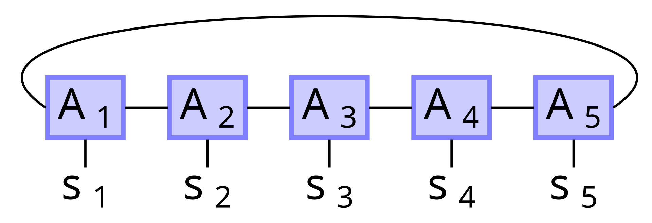


Lattice Model
Mathematical Representation of $|Ψ⟩$?
→ Matrix Product State (MPS) ^{[7]}
$$⟨L|$$
$$|R⟩$$
Image Credits ^{[4]}

Slide 11

Matrix Product State
Calculate Coefficients:
$$\left|Ψ\right\rangle =…+α|10100⟩ +…$$
$$α$$
$$=$$
$$⟨L|$$
$$|R⟩$$
0
0
1
0
1
$$|10100⟩$$
Image Credits ^{[4]}

Slide 12
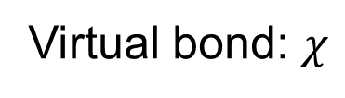
Matrix Product State
This is a Tensor Network ^{[7]}:
Contraction
Tensor
Virtual bond: $χ$
Image Credits ^{[4]}

Slide 13

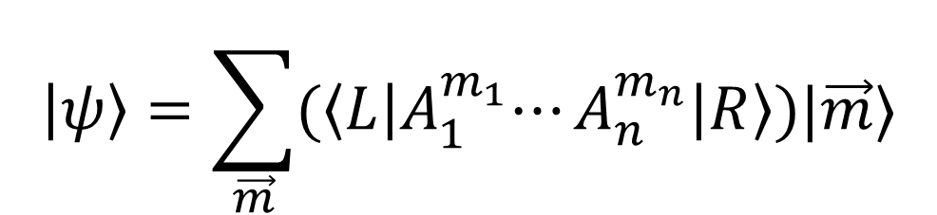
Matrix Product State
What happens mathematically?
$$\left|ψ\right\rangle =\sum_{\vec{m}}{{(\left\langle L\right|A}_{1}^{m_{1}}⋯A_{n}^{m_{n}}\left|R\right\rangle )|\vec{m}⟩}$$
For Qubits: $\vec{m}$ binary string with $n$ digits ^{[5]}

Slide 14

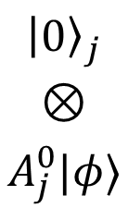











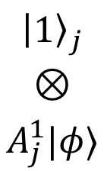
Matrix Product State
Quantum Circuit for $\left|Ψ\right\rangle$:
Action of $U_{j}:$
$$|0⟩$$
…
…
$$U_{n}$$
$$|Ψ⟩$$
$${\left|0\right\rangle }_{j}$$
$$⊗$$
$$|φ⟩$$
$${\left|0\right\rangle }_{j}$$
$$⊗$$
$$A_{j}^{0}|φ⟩$$
$${\left|1\right\rangle }_{j}$$
$$⊗$$
$$A_{j}^{1}|φ⟩$$
$$U_{1}$$
$$↦$$
…
$$+$$
$$|0⟩$$
$$|R⟩$$
$$|L⟩$$
See ^{[5]}

Slide 15
Dicke States & Preparation Circuit

Slide 16
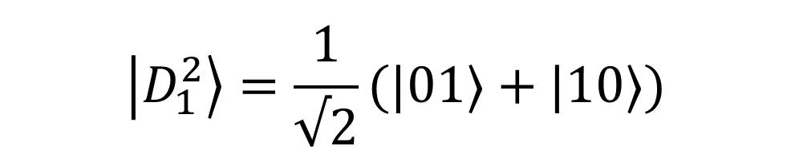


Dicke States
Superposition of States with equal Hamming Weight.
$$\left|D_{0}^{2}\right\rangle =|00⟩$$
$$\left|D_{1}^{2}\right\rangle =\frac{1}{√2}(|01⟩+|10⟩)$$
$$\left|D_{2}^{2}\right\rangle =|11⟩$$

Slide 17
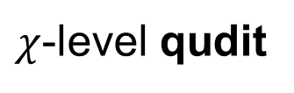
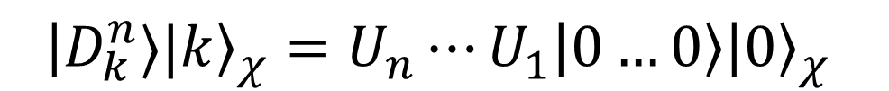
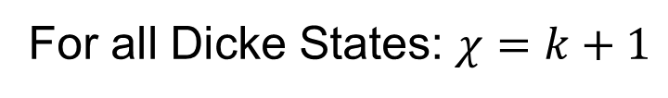
Dicke States
Have Representation as MPS.
$${\left|D_{k}^{n}⟩|k\right\rangle }_{χ}=U_{n}⋯U_{1}\left|0…0\right\rangle {\left|0\right\rangle }_{χ}$$
$χ$-level qudit
For all Dicke States: $χ=k+1$

Slide 18








Preparation Circuit
Can decompose the $U_{j}$:
$${\left|0\right\rangle }_{j}$$
$${\left|0\right\rangle }_{j}$$
…
$$U_{j}$$
$$=$$
$$I_{0}^{(j)}$$
$$I_{k}^{(j)}$$
$$|φ⟩$$
$$|φ⟩$$
…

Slide 19
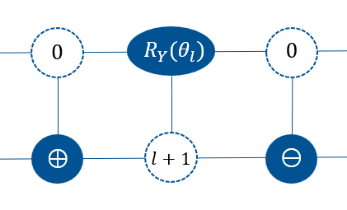


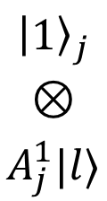

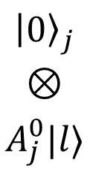



Preparation Circuit
Quantum Circuit for $I_{l}^{\left(j\right)}$:
Action of $I_{l}^{\left(j\right)} :$
$${\left|0\right\rangle }_{j}$$
$$⊗$$
$$|l⟩$$
$${\left|0\right\rangle }_{j}$$
$$⊗$$
$$A_{j}^{0}|l⟩$$
$${\left|1\right\rangle }_{j}$$
$$⊗$$
$$A_{j}^{1}|l⟩$$
$$↦$$
$$+$$
Implements $U_{j}$ for $|φ⟩$= $|l⟩$
See ^{[5]}

Slide 20

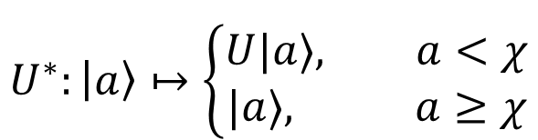
Preparation Circuit
$χ$-level Qudit needs to be emulated.
States:
$${t=max(1, ⌈log}_{2}{χ}⌉)$$
$$U^{∗}:\left|a\right\rangle ↦\left\{\begin{aligned}U|a⟩, a<χ \\ &|a⟩, a≥χ\end{aligned}\right.$$
Gates:
Yannick Bergs (TUM) | Bachelor-Student Informatik | Seminar: Advanced Concepts of Quantum Computing

Slide 21
Concrete Examples

Slide 22
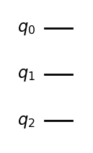

Concrete Example: $|D_{0}^{2}⟩$
$${\left|0\right\rangle }_{a}{\left|0\right\rangle }_{1}{\left|0\right\rangle }_{0}={\left|0\right\rangle }_{a}|D_{0}^{2}⟩$$
Yannick Bergs (TUM) | Bachelor-Student Informatik | Seminar: Advanced Concepts of Quantum Computing

Slide 23
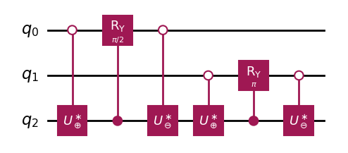





Concrete Example: $|D_{1}^{2}⟩$
$$2^{−1/2}{\left|1\right\rangle }_{a}({\left|1\right\rangle }_{1}{\left|0\right\rangle }_{0}+{{\left|0\right\rangle }_{1}\left|1\right\rangle }_{0})$$
$$2^{−1/2}{(\left|0\right\rangle }_{a}{\left|0\right\rangle }_{1}{\left|0\right\rangle }_{0}+{{\left|1 \right\rangle }_{a}{\left|0\right\rangle }_{1}\left|1\right\rangle }_{0})$$
$$={\left|1\right\rangle }_{a}|D_{1}^{2}⟩$$
$$2^{−1/2}{\left|1\right\rangle }_{a}{\left|0\right\rangle }_{1}{(\left|0\right\rangle }_{0}+{\left|1\right\rangle }_{0})$$
$$2^{−1/2}{(\left|1\right\rangle }_{a}{\left|1\right\rangle }_{1}{\left|0\right\rangle }_{0}+{{\left|0\right\rangle }_{a}{\left|0\right\rangle }_{1}\left|1\right\rangle }_{0})$$
Yannick Bergs (TUM) | Bachelor-Student Informatik | Seminar: Advanced Concepts of Quantum Computing

Slide 24
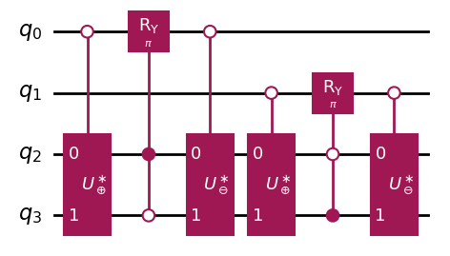


Concrete Example: $|D_{2}^{2}⟩$
$${\left|1\right\rangle }_{a}{\left|0\right\rangle }_{1}{\left|1\right\rangle }_{0}$$
$${\left|2\right\rangle }_{a}{\left|1\right\rangle }_{1}{\left|1\right\rangle }_{0}={\left|k\right\rangle }_{a}|D_{2}^{2}⟩$$
Yannick Bergs (TUM) | Bachelor-Student Informatik | Seminar: Advanced Concepts of Quantum Computing

Slide 25
Primitive Decomposition

Slide 26
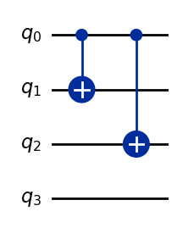



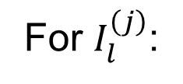


Decomposition: $c⊕, c⊖$
For $I_{l}^{\left(j\right)}$:
$${cτ}_{3,1}$$
$$c⊕$$
$${cτ}_{l,l+1 \text{mod} χ}$$
$$c⊖$$
$${cτ}_{l,l+1 \text{mod} χ}$$
Bit mismatch

Slide 27
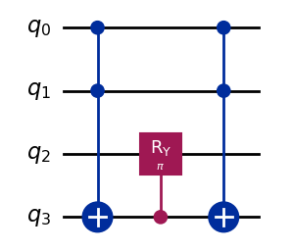
Decomposition: $c^{n}R_{Y}(θ)$
Ancilla

Slide 28
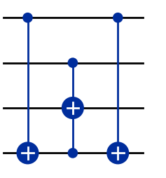


Decomposition: $c^{n}X$
Using Construction from ^{[6]}:
$$\overline{c^{n}}$$
Borrow Ancillas + Toffoli
$$\underline{c^{n}}$$
Target
Ancilla

Slide 29
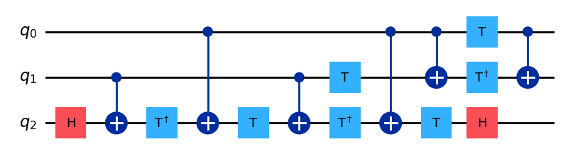
Decomposition: Toffoli
See e.g. ^{[6]}

Slide 30
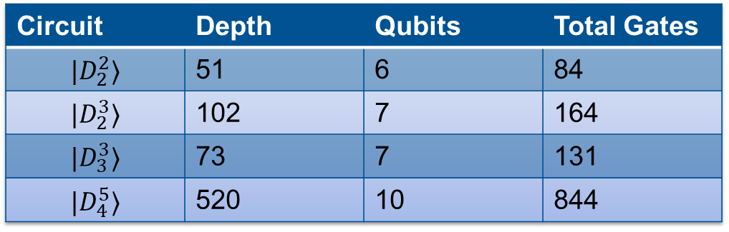

Decomposition: Results
$$ℊ=\{X,H,T,T^{†},cX,cR_{Y}(θ)\}$$
Circuit | Depth | Qubits | Total Gates
$$|D_{2}^{2}⟩$$ | 51 | 6 | 84
$$|D_{2}^{3}⟩$$ | 102 | 7 | 164
$$|D_{3}^{3}⟩$$ | 73 | 7 | 131
$$|D_{4}^{5}⟩$$ | 520 | 10 | 844

Slide 31
Thank you, Any questions left?

Slide 32
References
Max-Plank-Institute of QPO, Website (link)
J. Adam Fenster, University of Rochester
Ernst Ising, Beitrag zur Theorie des Ferromagnetismus, Springer Nature, 1925
Wikipedia, Matrix Product States, SVG-Bild (link)
D. Raveh, R. I. Nepomechie, Dicke states as matrix product states, arXiv, 2024
S. Herbert, J. Sorci, Y. Tang, Almost-Optimal Computational Basis State Transpositions, arXiv, 2023
S. Ran, E. Tirrito, C. Peng, X. Chen, L. Tagliacozzo, G. Su, M. Lewenstein, Tensor Network Contractions, Springer Nature, 2020
Yannick Bergs (TUM) | Bachelor-Student Informatik | Seminar: Advanced Concepts of Quantum Computing

