Slide 1

Constructing the Dicke States on a Quantum Computer
Yannick Bergs
Technische Universität München
TUM School of Computation, Information and Technology
Lehrstuhl für Quanten-Computing
München, 13. Dezember 2024

Slide 2
Introduction to Quantum Many Body Physics

Slide 3

Quantum Many Body Physics: Motivation
Models systems with multiple particles that exhibit quantum nature.
Machinery of Quantum Mechanics often only used in microscopic environments
BUT: Composite Systems can give rise to macroscopic properties unexplained by classical material physics ^{[1]}:
Superconductivity
Thermalization
…
Floating Superconductor ^{[2]}

Slide 4

Quantum Many Body Physics: Motivation
Modeling macroscopic structures is computationally infeazible (for classical machines).
Example:
40 particles with 4 excitation levels and no further restrictions
In general the time evolution operator $e^{−iHt}$ has $4^{{40}^{2}}=2^{160}$ complex entries.
For comparison: Earth has approx. $2^{160}$ atoms.

Slide 5
Quantum Many Body Physics: Motivation
Modeling macroscopic structures is computationally infeazible (for classical machines).
Solution:
Study toy models that have symmetries reducing the number of free components.
Concrete example:
Restricted entanglement, i.e. there has to be a basis in which two subsystems have low entanglement entropy
More on that later…

Slide 6
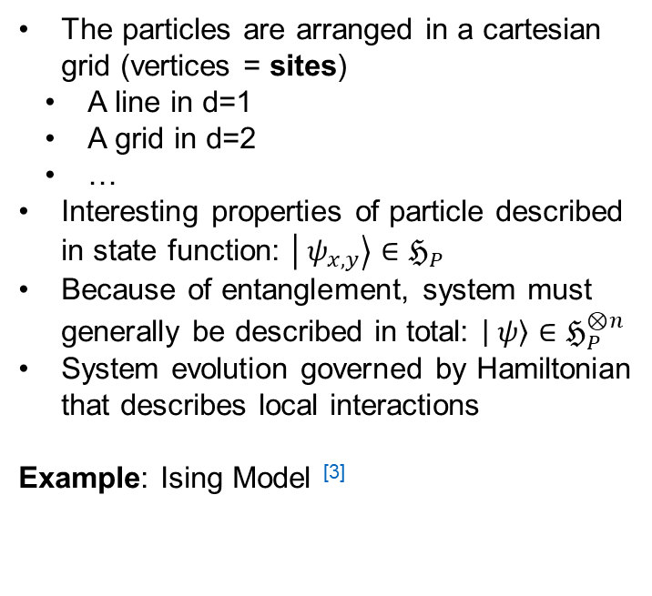
Quantum Many Body Physics: Lattice Model
A common simplification of real materials are Lattice Models.
The particles are arranged in a cartesian grid (vertices = sites)
A line in d=1
A grid in d=2
…
Interesting properties of particle described in state function: $\left| ψ_{x, y}\right\rangle ∈ℌ_{P}$
Because of entanglement, system must generally be described in total: $\left| ψ\right\rangle ∈ℌ_{P}^{⊗n}$
System evolution governed by Hamiltonian that describes local interactions
Example: Ising Model ^{[3]}

Slide 7
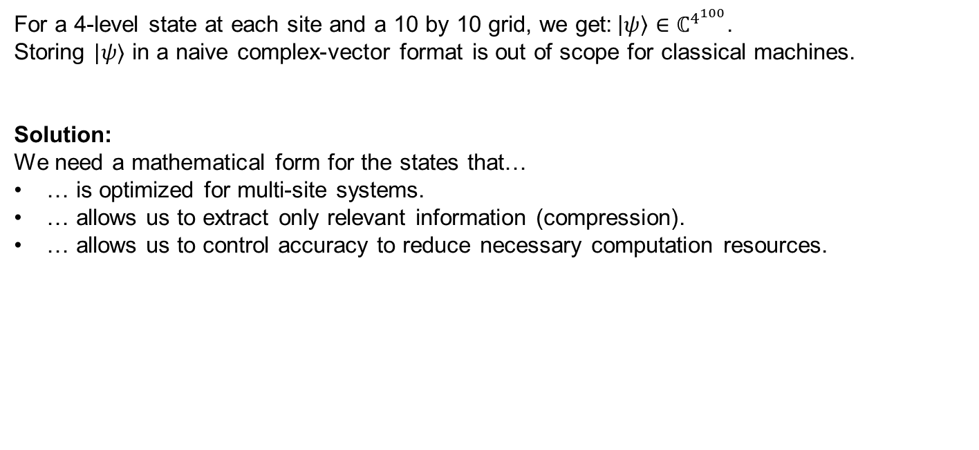
Quantum Many Body Physics: Lattice Model
Caviat:
Just using this model does not grant computational benefits.
For a 4-level state at each site and a 10 by 10 grid, we get:$\left|ψ\right\rangle ∈ℂ^{4^{100}}$.
Storing $|ψ⟩$ in a naive complex-vector format is out of scope for classical machines.
Solution:
We need a mathematical form for the states that…
… is optimized for multi-site systems.
… allows us to extract only relevant information (compression).
… allows us to control accuracy to reduce necessary computation resources.

Slide 8
Tensor Networks and Matrix Product States

Slide 9
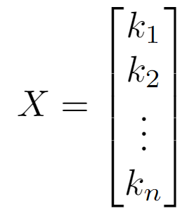
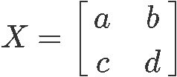

Tensor Networks: Fundamentals
The mathematical framework for optimized state-vector representations are Tensor Networks.
Key question: What are tensors?
From a computer-scientist perspective:
Tensors are N-dimensional arrays that support a mathematical operation called contraction.
They are characterized by their degree, i.e. the number of indices and the dimension of each index.
$$X=i$$
Tensor of degree 0
(3)-Tensor
(2,2)-Tensor

Slide 10

Tensor Networks: Fundamentals
Tensors are visualized with legs for each index which can be labeled for clarity.
When legs of tensors are connected a contraction is applied to get the complete tensor.
A tensor $A_{i, j, k}$ of degree 3 is visualized with three open legs (left).
A composite tensor $X_{a, b, j, k}=\sum_{s}{Y_{a, b, s}}Z_{s, j, k}$ is visualized with a connected leg (right).
X
i
a
k
A
s
k
j
Y
Z
b
j

Slide 11
Tensor Networks: Fundamentals
Tensors can be reshaped by merging or splitting indices.
Commonly tensors are matricized or vectorized to make use of LA tools.
Example:
A contraction along two legs is calculated as a matrix-vector multiplication:
mat(A)
vec(B)
i
i
A
i*j
B
k
j
j

Slide 12
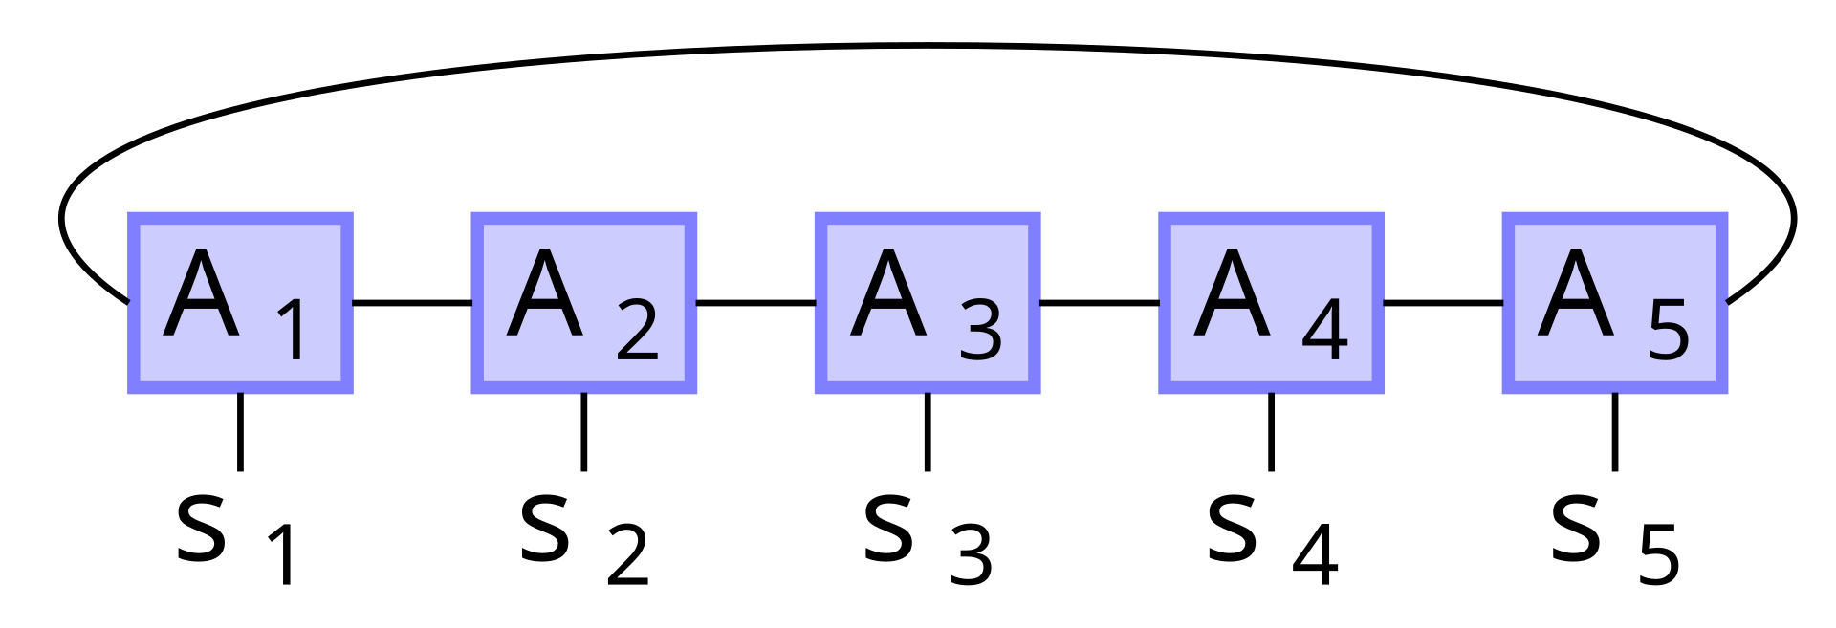


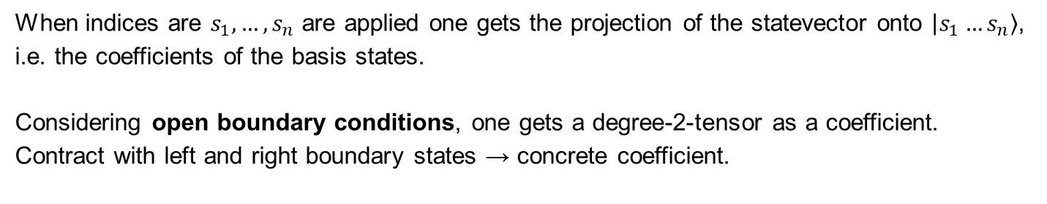
Tensor Networks: Matrix Product States (MPS)
Representation of quantum states with $n$ sites that have $d_{j}$ excitation levels.
The statevector index is split into site-local indices.
When indices are $s_{1}, …, s_{n}$ are applied one gets the projection of the statevector onto $\left|s_{1}…s_{n}\right\rangle$, i.e. the coefficients of the basis states.
Considering open boundary conditions, one gets a degree-2-tensor as a coefficient.
Contract with left and right boundary states → concrete coefficient.
$$⟨L|$$
$$|R⟩$$
Image Credits ^{[4]}

Slide 13
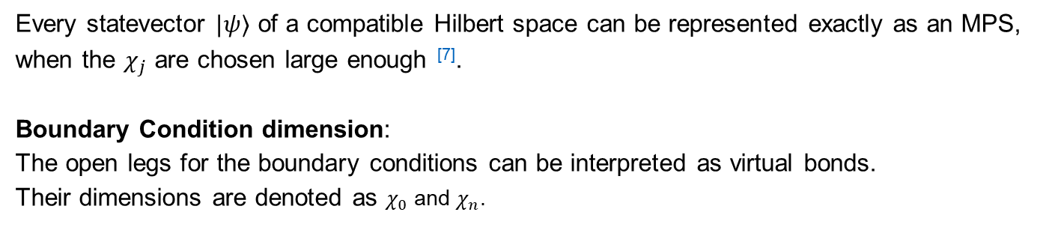
Tensor Networks: Matrix Product States (MPS)
The spatial complexity of a MPS can be controlled using the virtual bond dimensions $χ_{j}$.
Every statevector $|ψ⟩$ of a compatible Hilbert space can be represented exactly as an MPS, when the $χ_{j}$ are chosen large enough ^{[7]}.
Boundary Condition dimension:
The open legs for the boundary conditions can be interpreted as virtual bonds.
Their dimensions are denoted as $χ_{0}$ and $χ_{n}$.
$$⟨L|$$
$$|R⟩$$
Image Credits ^{[4]}

Slide 14
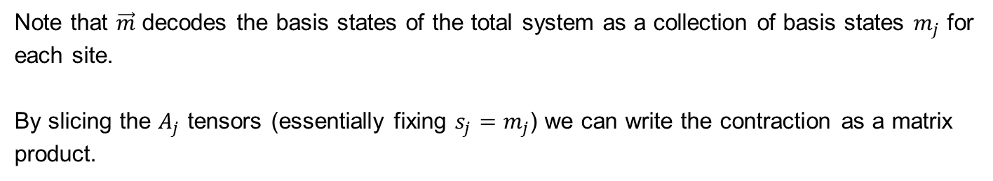
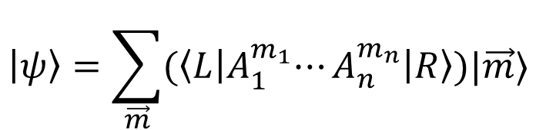
Tensor Networks: Matrix Product States (MPS)
Using slices of the degree-3-tensors one can write the MPS in symbolic form ^{[5]}.
$$\left|ψ\right\rangle =\sum_{\vec{m}}{{(\left\langle L\right|A}_{1}^{m_{1}}⋯A_{n}^{m_{n}}\left|R\right\rangle )|\vec{m}⟩}$$
Note that $\vec{m}$ decodes the basis states of the total system as a collection of basis states $m_{j}$ for each site.
By slicing the $A_{j}$ tensors (essentially fixing $s_{j}=m_{j}$) we can write the contraction as a matrix product.

Slide 15
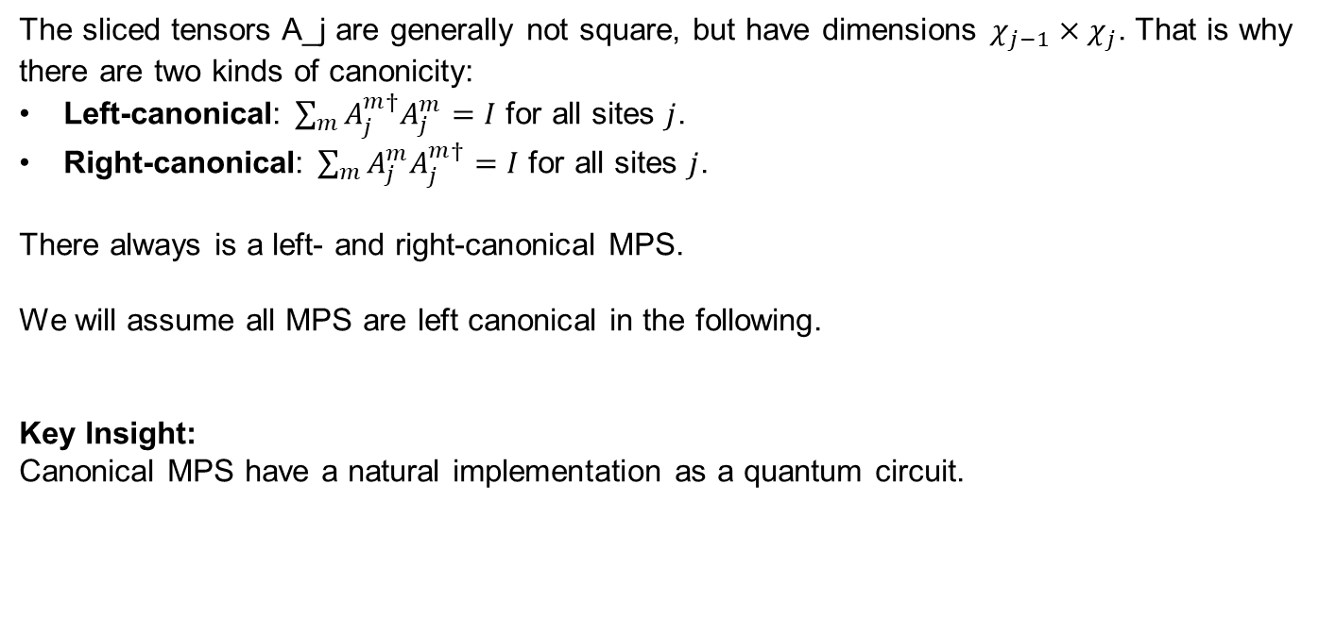
Tensor Networks: Canonical MPS
A form of tensor networks that leads to many computational simplifications.
The sliced tensors A_j are generally not square, but have dimensions $χ_{j−1}×χ_{j}$. That is why there are two kinds of canonicity:
Left-canonical: $\sum_{m}{A_{j}^{m†}A_{j}^{m}=I}$ for all sites $j$.
Right-canonical: $\sum_{m}{A_{j}^{m}A_{j}^{m†}=I}$ for all sites $j$.
There always is a left- and right-canonical MPS.
We will assume all MPS are left canonical in the following.
Key Insight:
Canonical MPS have a natural implementation as a quantum circuit.

Slide 16
Quantum Circuit for (almost) Canonical MPS

Slide 17






Quantum Circuit: Qudits
Generalization of Qubits to physical systems with $d$ computational basis states.
Each site of the MPS can be modelled as a system qudit with $d_{j}=\dim{s_{j}}$:
$q_{1}$: $d_{1}$-level qudit
$q_{2}$: $d_{2}$-level qudit
$q_{3}$: $d_{3}$-level qudit
$q_{4}$: $d_{4}$-level qudit
$q_{5}$: $d_{5}$-level qudit
Image Credits ^{[4]}
Yannick Bergs (TUM) | Bachelor-Student Informatik | Seminar: Advanced Concepts of Quantum Computing

Slide 18






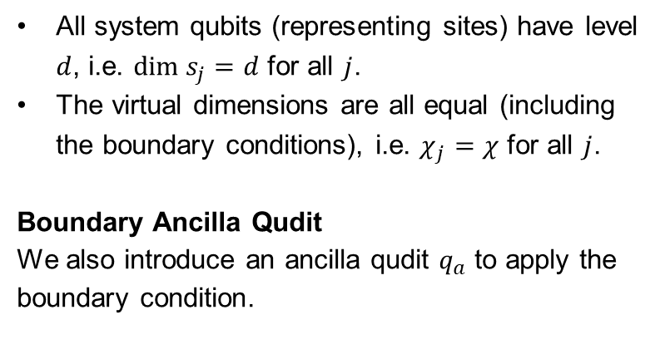
Quantum Circuit: Simplifying Assumptions
For our final purpose (implementing Dicke States) we can simplify our MPS model.
All system qubits (representing sites) have level $d$, i.e. $dim s_{j}=d$ for all $j$.
The virtual dimensions are all equal (including the boundary conditions), i.e. $χ_{j}=χ$ for all $j$.
Boundary Ancilla Qudit
We also introduce an ancilla qudit $q_{a}$ to apply the boundary condition.
$q_{1}$: $d_{1}$-level qudit
$q_{2}$: $d_{2}$-level qudit
$q_{3}$: $d_{3}$-level qudit
$q_{4}$: $d_{4}$-level qudit
$q_{5}$: $d_{5}$-level qudit
$q_{a}$: $χ$-level qudit
Image Credits ^{[4]}
Yannick Bergs (TUM) | Bachelor-Student Informatik | Seminar: Advanced Concepts of Quantum Computing

Slide 19
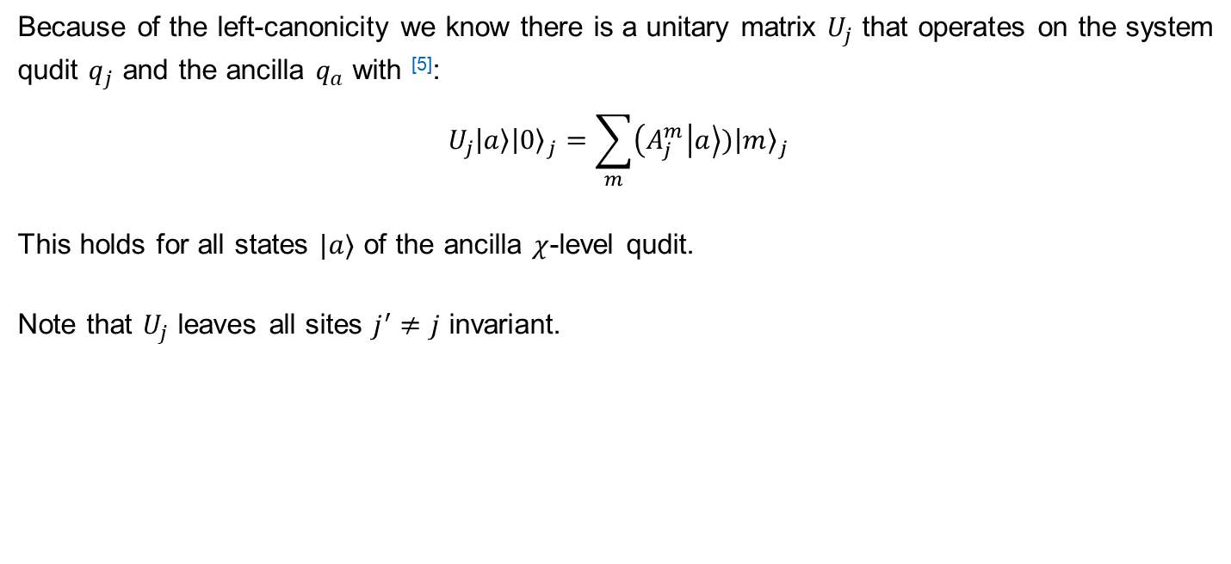
Quantum Circuit: Unitary representation of $A_{j}$
The action of each of the site-specific tensor can be represented as a unitary quantum gate form.
Because of the left-canonicity we know there is a unitary matrix $U_{j}$ that operates on the system qudit $q_{j}$ and the ancilla $q_{a}$ with ^{[5]}:
$$U_{j}\left|a\right\rangle {\left|0\right\rangle }_{j}=\sum_{m}{\left(A_{j}^{m} | a\right\rangle ){\left|m\right\rangle }_{j}}$$
This holds for all states $|a⟩$ of the ancilla $χ$-level qudit.
Note that $U_{j}$ leaves all sites $j^{′}≠j$ invariant.
Yannick Bergs (TUM) | Bachelor-Student Informatik | Seminar: Advanced Concepts of Quantum Computing

Slide 20
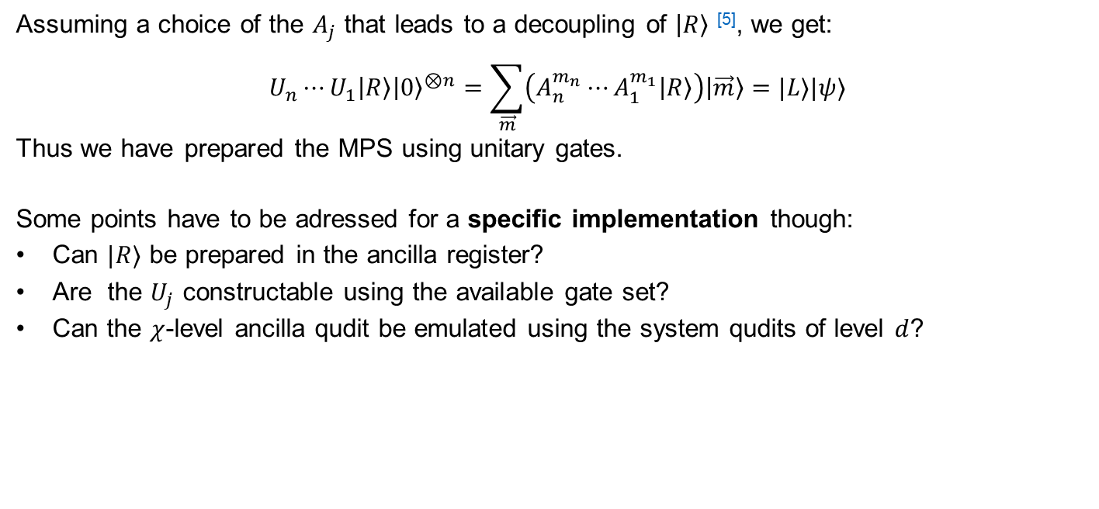
Quantum Circuit: Preparation of $|ψ⟩$
Chaining the unitaries leads to a preparation circuit for the MPS $|ψ⟩$.
Assuming a choice of the $A_{j}$ that leads to a decoupling of $\left|R\right\rangle$ ^{[5]}, we get:
$$U_{n}⋯U_{1}\left|R\right\rangle {\left|0\right\rangle }^{⊗n}=\sum_{\vec{m}}{\left(A_{n}^{m_{n}}⋯A_{1}^{m_{1}}\left|R\right\rangle \right)\left|\vec{m}\right\rangle }=|L⟩|ψ⟩$$
Thus we have prepared the MPS using unitary gates.
Some points have to be adressed for a specific implementation though:
Can $|R⟩$ be prepared in the ancilla register?
Are the $U_{j}$ constructable using the available gate set?
Can the $χ$-level ancilla qudit be emulated using the system qudits of level $d$?
Yannick Bergs (TUM) | Bachelor-Student Informatik | Seminar: Advanced Concepts of Quantum Computing

Slide 21

Quantum Circuit: Almost Canonical MPS
The requirement for the MPS of $|ψ⟩$ to be left-canonical is more strict then necessary.
It is enough to have any MPS where the $U_{j}$ are unitary and perform the mapping described earlier.
The following construction for the Dicke State MPS will only be „almost canonical“.
Yannick Bergs (TUM) | Bachelor-Student Informatik | Seminar: Advanced Concepts of Quantum Computing

Slide 22
Quantum Circuit for Dicke State Preparation

Slide 23
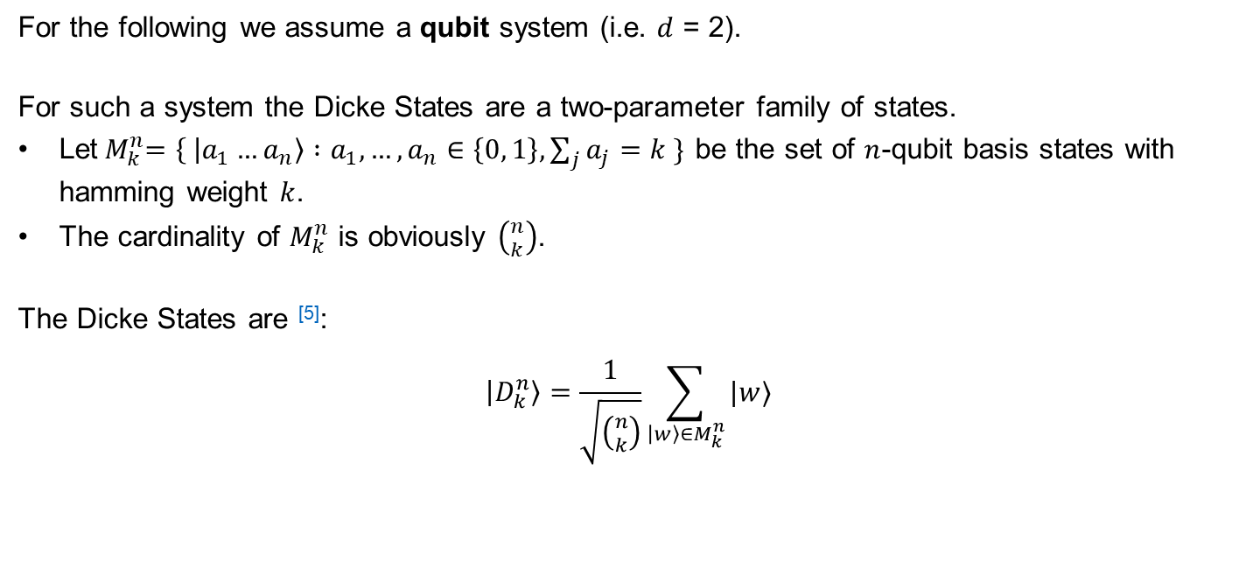
Dicke States: Definition
The Dicke states are equal superposition states of basis states with equal hamming weight.
For the following we assume a qubit system (i.e. $d$ = 2).
For such a system the Dicke States are a two-parameter family of states.
Let${ M}_{k}^{n}=\left\{ | a_{1}…a_{n}\right\rangle :a_{1}, …,a_{n}∈\left\{0, 1\right\}, \sum_{j}{a_{j}}=k \}$ be the set of $n$-qubit basis states with hamming weight $k$.
The cardinality of $M_{k}^{n}$ is obviously $\left({n \atop k}\right)$.
The Dicke States are ^{[5]}:
$$\left|D_{k}^{n}\right\rangle =\frac{1}{\sqrt{\left({n \atop k}\right)}}\sum_{\left|w\right\rangle ∈M_{k}^{n}}{|w⟩}$$
Yannick Bergs (TUM) | Bachelor-Student Informatik | Seminar: Advanced Concepts of Quantum Computing

Slide 24
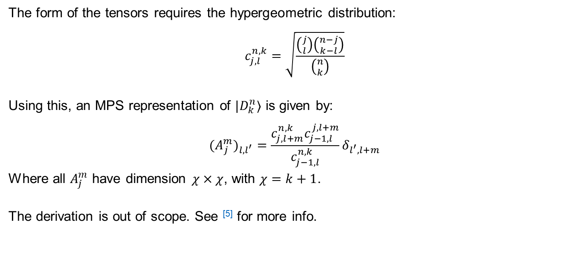
Dicke States: MPS Representation
There exists an „almost canonical“ MPS representation of Dicke States.
The form of the tensors requires the hypergeometric distribution:
$$c_{j,l}^{n,k}=\sqrt{\frac{\left({j \atop l}\right)\left({n−j \atop k−l}\right)}{\left({n \atop k}\right)}}$$
Using this, an MPS representation of $|D_{k}^{n}⟩$ is given by:
$${{(A}_{j}^{m})}_{l, l^{′}}={\frac{c_{j, l+m}^{n,k}c_{j−1, l}^{j,l+m}}{c_{j−1,l}^{n,k}}δ}_{l^{′}, l+m}$$
Where all $A_{j}^{m}$ have dimension $χ×χ$, with $χ=k+1$.
The derivation is out of scope. See ^{[5]} for more info.
Yannick Bergs (TUM) | Bachelor-Student Informatik | Seminar: Advanced Concepts of Quantum Computing

Slide 25

Dicke States: $U_{j}$-Operators
The almost-canonicity allows us to create unitary gates to implement the Dicke States, as described for general canonical MPS.
We need operators $U_{j}$ that fulfill the mapping:
$$U_{j}\left|a\right\rangle {\left|0\right\rangle }_{j}=\sum_{m}{\left(A_{j}^{m} | a\right\rangle ){\left|m\right\rangle }_{j}}$$
Ansatz:
Build $U_{j}$ from simpler operators:
$$U_{j}=\prod_{l=k}^{l=0}{I_{l}^{(j)}}$$
Yannick Bergs (TUM) | Bachelor-Student Informatik | Seminar: Advanced Concepts of Quantum Computing

Slide 26









Dicke States: $I_{l}^{(j)}$-Operators
Perform the mapping for $\left|a\right\rangle =|l⟩$ and leave other states invariant using a conditional $y$-rotation on the site qubit $q_{j}$.
The circuit for the operator rotates by an angle $θ$ with ^{[5]}:
$$θ_{l}=2\arccos{γ_{l, 0}^{j}}, γ_{l, 0}^{j}=\left\{\begin{aligned}\sqrt{1+ \frac{l−k}{n−j+1}}, \text{if} k−l≤n−j+1 \\ &0, \text{else}\end{aligned}\right.$$
$$q_{j}$$
$$0$$
$$R_{Y}(θ_{l})$$
$$0$$
$$q_{a}$$
$$⊕$$
$$l+1$$
$$⊖$$
Yannick Bergs (TUM) | Bachelor-Student Informatik | Seminar: Advanced Concepts of Quantum Computing

Slide 27

Dicke States: $I_{l}^{(j)}$-Operators
The partial operators perform conditional $y$-rotations on each site qubit.
The $⊕$ and $⊖$ operate on the auxiliary qudit and map:
$$⊕:\left|a\right\rangle ↦|a+1 \text{mod} χ⟩$$
$$⊖:\left|a\right\rangle ↦|a−1 \text{mod} χ⟩$$
$$q_{j}$$
$$0$$
$$R_{Y}(θ_{l})$$
$$0$$
$$q_{a}$$
$$⊕$$
$$l+1$$
$$⊖$$
Yannick Bergs (TUM) | Bachelor-Student Informatik | Seminar: Advanced Concepts of Quantum Computing

Slide 28

Dicke States: Restricted $U_{j}$-Operators
The product construction of $U_{j}$ can thus be restricted to only relevant terms.
Observation:
Many $I_{l}^{(j)}$-operators simplify to the identity or cancel out.
Keeping only relevant terms, the restricted form of $U_{j}$ becomes ^{[5]}:
$$U_{j}=\prod_{l=\min{(j−1, k−1)}}^{l=\max{(0, j−n+k−1)}}{I_{l}}$$
Yannick Bergs (TUM) | Bachelor-Student Informatik | Seminar: Advanced Concepts of Quantum Computing

Slide 29
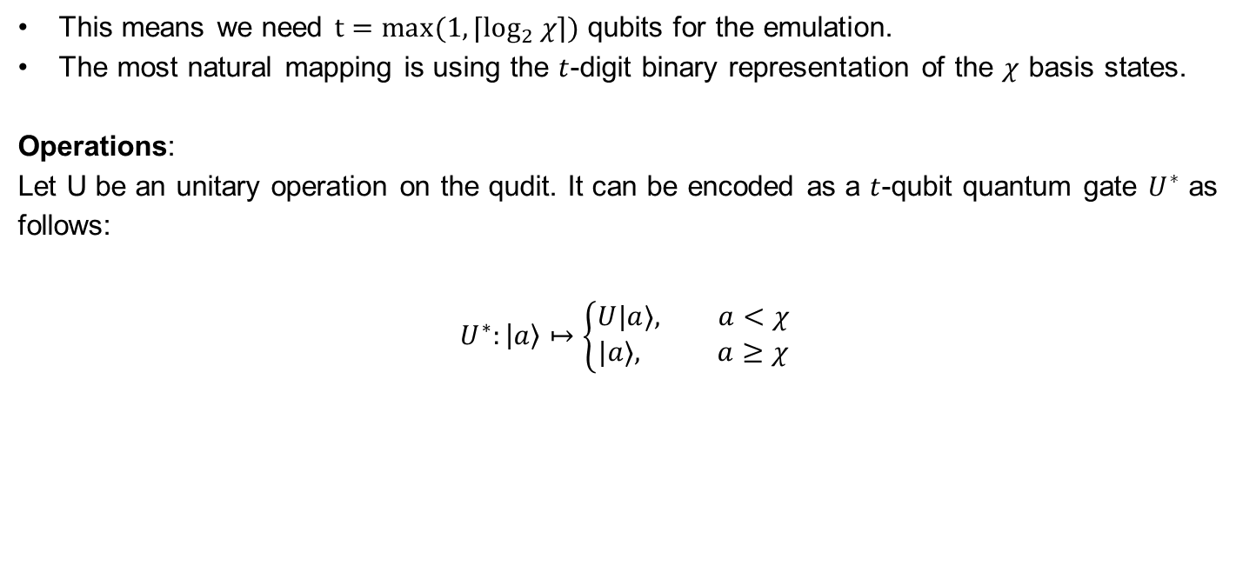
Dicke States: Emulating the $χ$-level Qudit
A qubit register can be used to emulate a $χ$-level qudit, if we can identify $χ$ distinct basis states.
This means we need ${t=max(1, ⌈log}_{2}{χ}⌉)$ qubits for the emulation.
The most natural mapping is using the $t$-digit binary representation of the $χ$ basis states.
Operations:
Let U be an unitary operation on the qudit. It can be encoded as a $t$-qubit quantum gate $U^{∗}$ as follows:
$$U^{∗}:\left|a\right\rangle ↦\left\{\begin{aligned}U|a⟩, a<χ \\ &|a⟩, a≥χ\end{aligned}\right.$$
Yannick Bergs (TUM) | Bachelor-Student Informatik | Seminar: Advanced Concepts of Quantum Computing

Slide 30

Dicke States: Circuit Complexity
We assume $⊕$, $⊖$, $c^{n}R_{Y}$ operations are supported natively by our quantum computer for now.
Circuit Depth:
Considering the restricted construction of the $U_{j}$:
$$n_{\text{layers}}=3k\left(n+1−k\right)$$
Qubit Count:
Including the emulated qudit:
$$n_{\text{qubits}}=n+\max{(1, \left\lceil \log_{2}{k+1}\right\rceil )}$$
Yannick Bergs (TUM) | Bachelor-Student Informatik | Seminar: Advanced Concepts of Quantum Computing

Slide 31
Concrete Examples for $n=2$

Slide 32
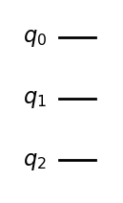

Concrete Example: $|D_{0}^{2}⟩$
$${\left|0\right\rangle }_{a}{\left|0\right\rangle }_{1}{\left|0\right\rangle }_{0}={\left|0\right\rangle }_{a}|D_{0}^{2}⟩$$
Yannick Bergs (TUM) | Bachelor-Student Informatik | Seminar: Advanced Concepts of Quantum Computing

Slide 33
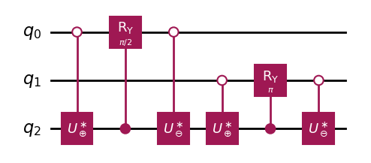





Concrete Example: $|D_{1}^{2}⟩$
$$2^{−1/2}{\left|1\right\rangle }_{a}({\left|1\right\rangle }_{1}{\left|0\right\rangle }_{0}+{{\left|0\right\rangle }_{1}\left|1\right\rangle }_{0})$$
$$2^{−1/2}{(\left|0\right\rangle }_{a}{\left|0\right\rangle }_{1}{\left|0\right\rangle }_{0}+{{\left|1 \right\rangle }_{a}{\left|0\right\rangle }_{1}\left|1\right\rangle }_{0})$$
$$={\left|1\right\rangle }_{a}|D_{1}^{2}⟩$$
$$2^{−1/2}{\left|1\right\rangle }_{a}{\left|0\right\rangle }_{1}{(\left|0\right\rangle }_{0}+{\left|1\right\rangle }_{0})$$
$$2^{−1/2}{(\left|1\right\rangle }_{a}{\left|1\right\rangle }_{1}{\left|0\right\rangle }_{0}+{{\left|0\right\rangle }_{a}{\left|0\right\rangle }_{1}\left|1\right\rangle }_{0})$$
Yannick Bergs (TUM) | Bachelor-Student Informatik | Seminar: Advanced Concepts of Quantum Computing

Slide 34
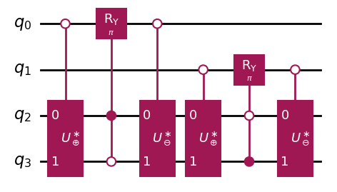


Concrete Example: $|D_{2}^{2}⟩$
$${\left|1\right\rangle }_{a}{\left|0\right\rangle }_{1}{\left|1\right\rangle }_{0}$$
$${\left|2\right\rangle }_{a}{\left|1\right\rangle }_{1}{\left|1\right\rangle }_{0}={\left|k\right\rangle }_{a}|D_{2}^{2}⟩$$
Yannick Bergs (TUM) | Bachelor-Student Informatik | Seminar: Advanced Concepts of Quantum Computing

Slide 35
Decomposition into Primitive Gates

Slide 36
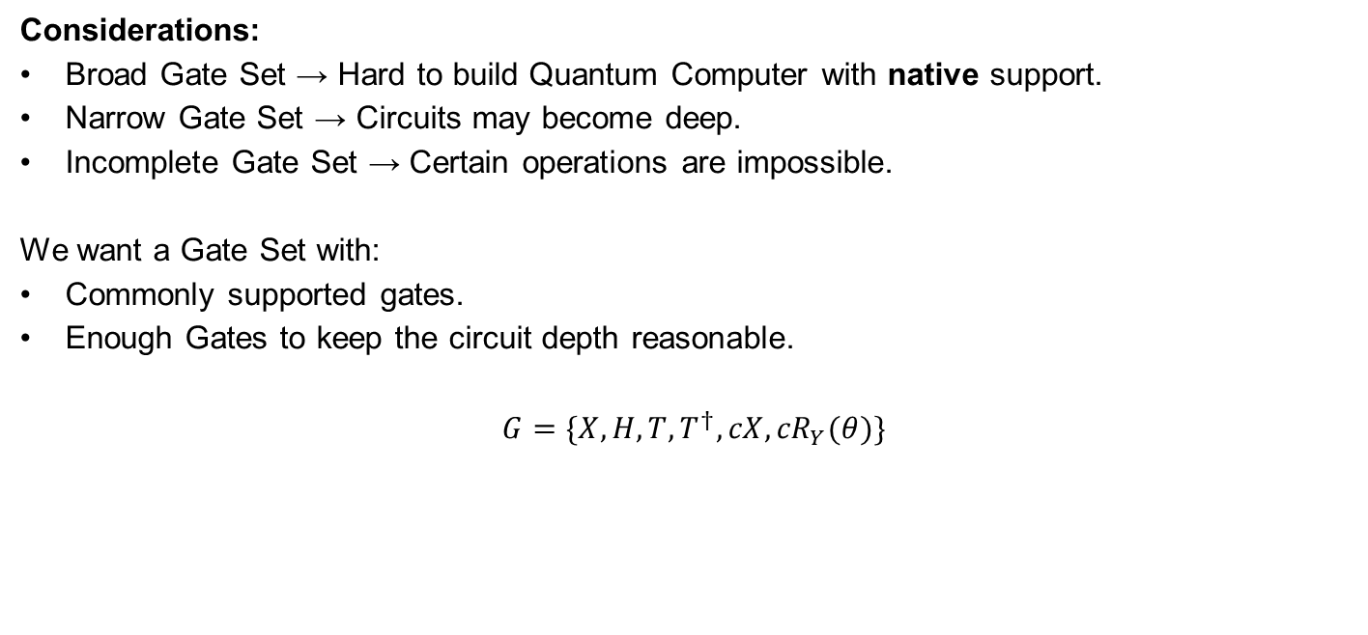
Decomposition: Primitive Gate Set
The primitive gate set contains operations that are expected to be implemented in the physical system.
Considerations:
Broad Gate Set → Hard to build Quantum Computer with native support.
Narrow Gate Set → Circuits may become deep.
Incomplete Gate Set → Certain operations are impossible.
We want a Gate Set with:
Commonly supported gates.
Enough Gates to keep the circuit depth reasonable.
$$G=\{X, H,T,T^{†},{cX,cR}_{Y}(θ)\}$$
Yannick Bergs (TUM) | Bachelor-Student Informatik | Seminar: Advanced Concepts of Quantum Computing

Slide 37

Decomposition: Procedure
Reduce the entire circuit to primitive gates.
Ripple Down:
Decompose circuit from most abstract to most concrete.
All encountered gates are decomposed.
Decompositions are potentially further simplified.
We start with the $I_{l}^{(j)}$-Operators.
Yannick Bergs (TUM) | Bachelor-Student Informatik | Seminar: Advanced Concepts of Quantum Computing

Slide 38









Decomposition: $I_{l}^{(j)}$-Operator
Non-Primitive Gates:
$c⊕$ and $c⊖$
$c^{n}R_{Y}(θ)$
Note that we have a $cR_{Y}\left(θ\right)$ gate in the primitive gate set, but need a multi-controlled version.
The increment/decrement operators also require further investigation.
$$q_{j}$$
$$0$$
$$R_{Y}(θ_{l})$$
$$0$$
$$q_{a}$$
$$⊕$$
$$l+1$$
$$⊖$$
Yannick Bergs (TUM) | Bachelor-Student Informatik | Seminar: Advanced Concepts of Quantum Computing

Slide 39
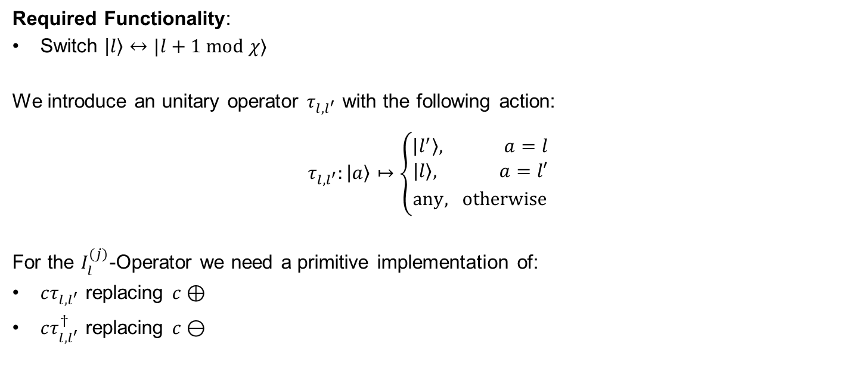
Decomposition: $I_{l}^{(j)}$-Operator, Simplification
The $⊕$ and $⊖$ provide a lot of unused functionality that makes them complex. These can be simplified.
Required Functionality:
Switch $\left|l\right\rangle ↔|l+1 \text{mod} χ⟩$
We introduce an unitary operator $τ_{l,l^{′}}$ with the following action:
$$τ_{l,l^{′}}:\left|a\right\rangle ↦\left\{\begin{aligned}\left|l^{′}\right\rangle , a=l \\ &{\left|l\right\rangle , a=l′ \atop \text{any}, \text{otherwise}}\end{aligned}\right.$$
For the $I_{l}^{(j)}$-Operator we need a primitive implementation of:
$cτ_{l,l^{′}}$ replacing $c⊕$
$cτ_{l,l^{′}}^{†}$ replacing $c⊖$
Yannick Bergs (TUM) | Bachelor-Student Informatik | Seminar: Advanced Concepts of Quantum Computing

Slide 40
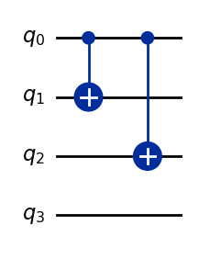

Decomposition: $cτ_{l,l^{′}}$-Operator
The $τ_{l,l^{′}}$-Operator can be implemented by introducing $X$-gates at all mismatching positions of $l$ and $l′$ in binary form.
For the controlled version, we replace $X$-gates with $cX$-gates controlled by the control qubit.
Example:
An example for:
$l=3=011$
$l^{′}=0=000$
This gate is also its own inverse.
Yannick Bergs (TUM) | Bachelor-Student Informatik | Seminar: Advanced Concepts of Quantum Computing

Slide 41


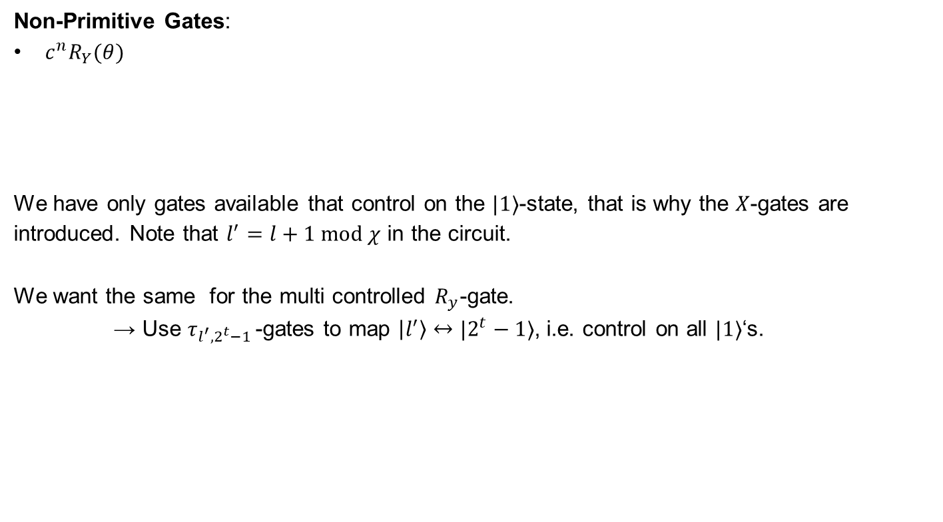





Decomposition: $I_{l}^{(j)}$-Operator, Current State
Non-Primitive Gates:
$c^{n}R_{Y}(θ)$
We have only gates available that control on the $|1⟩$-state, that is why the $X$-gates are introduced. Note that $l^{′}=l+1 \text{mod} χ$ in the circuit.
We want the same for the multi controlled $R_{y}$-gate.
→ Use $τ_{l^{′},2^{t}−1 }$-gates to map $\left|l^{′}\right\rangle ↔|2^{t}−1⟩$, i.e. control on all $|1⟩$‘s.
$$q_{j}$$
$$X$$
$$X$$
$$R_{Y}(θ_{l})$$
$$X$$
$$X$$
$$q_{a}$$
$$τ_{l,l^{′}}$$
$$l+1$$
$$τ_{l,l^{′}}$$
$$X$$
Yannick Bergs (TUM) | Bachelor-Student Informatik | Seminar: Advanced Concepts of Quantum Computing

Slide 42



Decomposition: $I_{l}^{(j)}$-Operator, Current State
Non-Primitive Gates:
$c^{n}R_{Y}(θ)$
The $R_{y}$-gate is now controlled on all $|1⟩$‘s. Note that ${η=2}^{t}−1$.
All that is left is to actually implement the $c^{n}R_{Y}(θ)$-gate using primitives.
$$q_{j}$$
$$X$$
$$X$$
$$R_{Y}(θ_{l})$$
$$X$$
$$X$$
$$q_{a}$$
$$τ_{l,l^{′}}$$
$$τ_{l^{′},η }$$
$$τ_{l^{′},η }$$
$$τ_{l,l^{′}}$$
$$X$$
Yannick Bergs (TUM) | Bachelor-Student Informatik | Seminar: Advanced Concepts of Quantum Computing

Slide 43
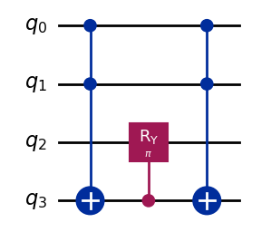

Decomposition: $c^{n}R_{Y}(θ)$-Operator
To keep the implementation of this operator simple, we introduce a clean ancilla qubit.
We store the result of the condition in the ancilla qubit, and then use a $cR_{Y}(θ)$-gate.
Example:
An example for:
$n=2$
$θ=π$
$q_{3}$ being the ancilla qubit.
Non-Primitive Gates:
$c^{n}X$
Yannick Bergs (TUM) | Bachelor-Student Informatik | Seminar: Advanced Concepts of Quantum Computing

Slide 44
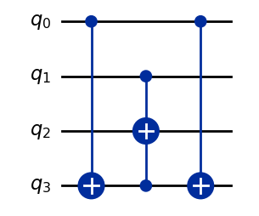
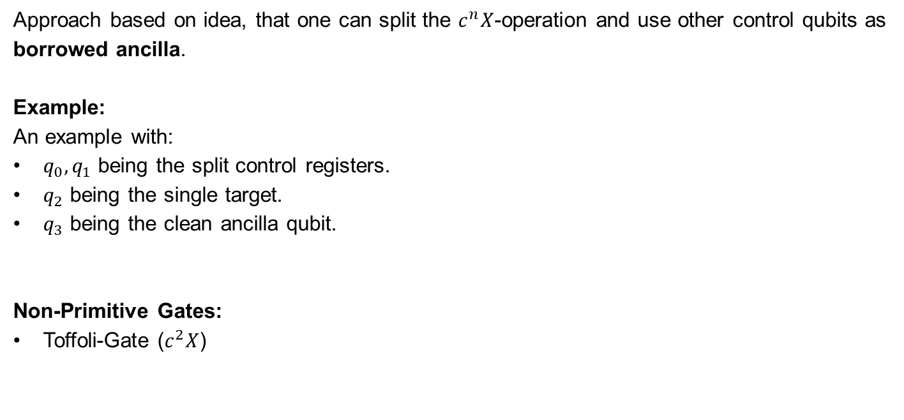
Decomposition: $c^{n}X$-Operator
Following the approach from ^{[6]} we can construct a $c^{n}X$-gate using one clean ancilla and Toffoli gates.
Approach based on idea, that one can split the $c^{n}X$-operation and use other control qubits as borrowed ancilla.
Example:
An example with:
$q_{0},q_{1}$ being the split control registers.
$q_{2}$ being the single target.
$q_{3}$ being the clean ancilla qubit.
Non-Primitive Gates:
Toffoli-Gate ($c^{2}X$)
Yannick Bergs (TUM) | Bachelor-Student Informatik | Seminar: Advanced Concepts of Quantum Computing

Slide 45
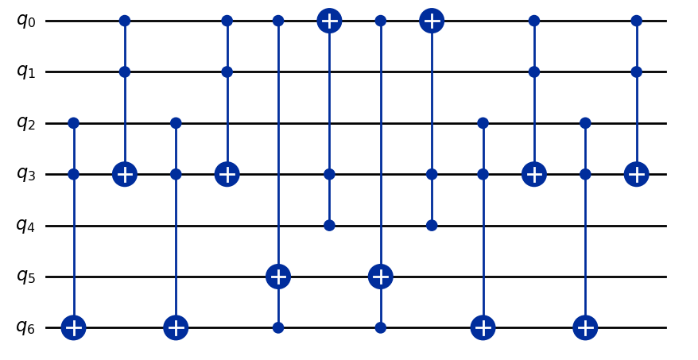



Decomposition: $c^{5}X$ Example
$$c^{5}$$
$$q_{\text{target}}$$
$$q_{\text{ancilla}}$$
Yannick Bergs (TUM) | Bachelor-Student Informatik | Seminar: Advanced Concepts of Quantum Computing

Slide 46
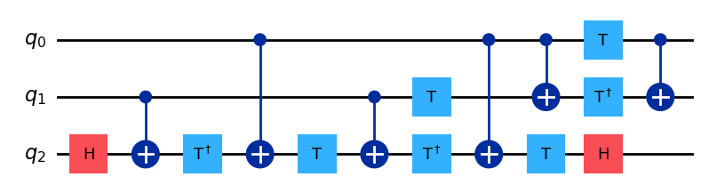
Decomposition: Toffoli-Gate
The Toffoli gate has a well-known decomposition only containing primitive gates.
Yannick Bergs (TUM) | Bachelor-Student Informatik | Seminar: Advanced Concepts of Quantum Computing

Slide 47
Decomposition: Results
We are able to completely decompose the circuit into our Primitive Gate Set, generally requiring 2 ancilla qubits.
We of course pay with circuit depth:
Dicke State | Abstract Layers | Primitive Layers
Yannick Bergs (TUM) | Bachelor-Student Informatik | Seminar: Advanced Concepts of Quantum Computing

Slide 48
Thank you, Any questions left?

Slide 49
References
Max-Plank-Institute of QPO, Website (link)
J. Adam Fenster, University of Rochester
Ernst Ising, Beitrag zur Theorie des Ferromagnetismus, Springer Nature, 1925
Wikipedia, Matrix Product States, SVG-Bild (link)
D. Raveh, R. I. Nepomechie, Dicke states as matrix product states, arXiv, 2024
S. Herbert, J. Sorci, Y. Tang, Almost-Optimal Computational Basis State Transpositions, arXiv, 2023
S. Ran, E. Tirrito, C. Peng, X. Chen, L. Tagliacozzo, G. Su, M. Lewenstein, Tensor Network Contractions, Springer Nature, 2020
Yannick Bergs (TUM) | Bachelor-Student Informatik | Seminar: Advanced Concepts of Quantum Computing

