Slide 1
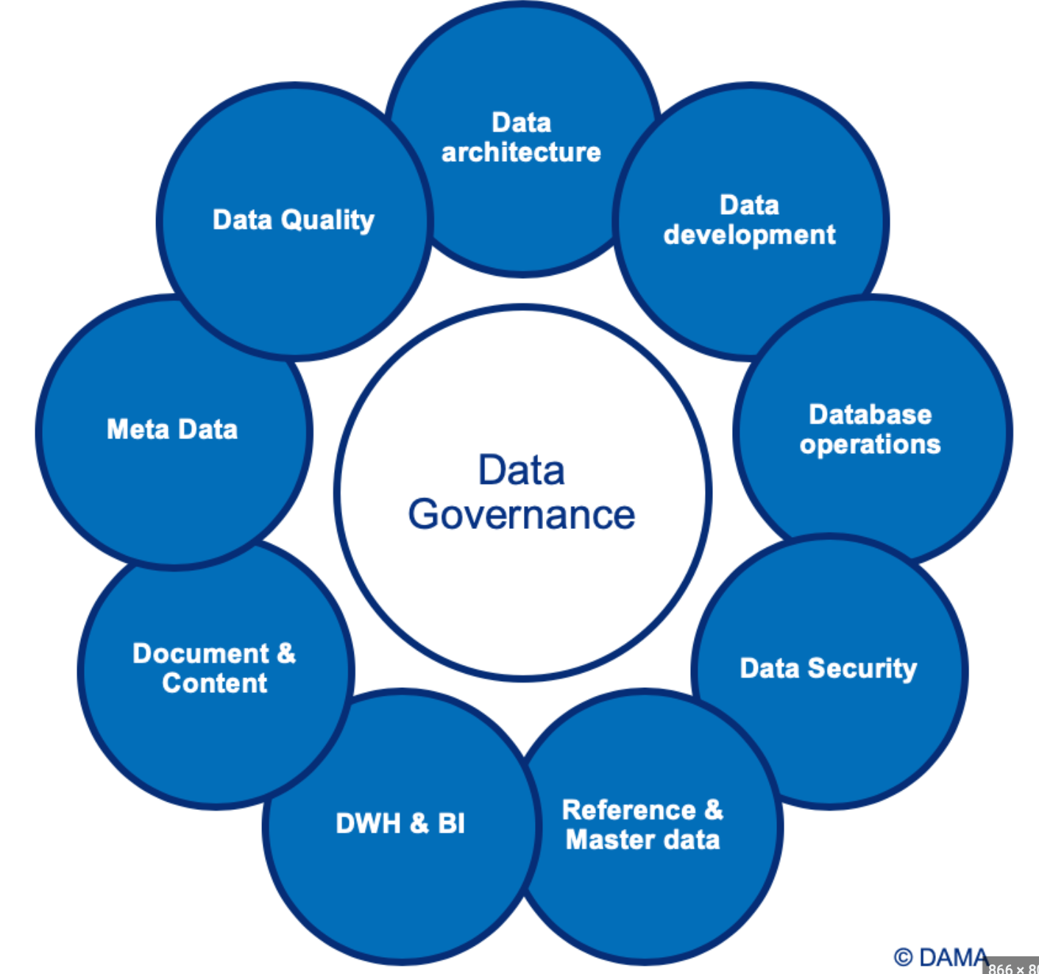
Data Governance
What is it and why is it important?
Data Governance is the process by which data is managed and monitored in an organization. It ensures that data is accurate, secure, and used properly.
Data Governance is important because it can help organizations achieve compliance, protect data integrity, and ensure data is used responsibly.

