Slide 1
Maven-bluemartini
Yannick Robin

Slide 2


What is maven-bluemartini?
maven-bluemartini is Maven archetypes for Blue Martini projects
Open source project on http://code.google.com/p/maven-bluemartini
Tested and documented with BM 10.1

Slide 3
Agenda
Why this project?
Why Maven?
Why Eclipse WTP?
What customizations have been done?
Demo
What are the next steps?

Slide 4
maven-bluemartini goals 1/3
Keep same project structure for all customers (easier for professional services and support to debug)
Respect industry standards (new developer productive in Day One)
Setup a fresh Blue Martini project in 15 minutes
Keep EAR build standard and as simple as possible (No BM installation, no BM scripts)
Integrate out-of-the-box BM projects with Continuous integration software stack (e.g.: Hudson, Sonar, Selenium...)

Slide 5
maven-bluemartini goals 2/3
Develop in Java EE mode
No BM installation required
Run and Deploy the application inside Eclipse
Increase development productivity:
No deployment for configuration and JSP file changes
No deployment for simple java code changes (Hot Code Replacement)
No restart when we can deploy (Hot Deploy)
Debugging mode

Slide 6
maven-bluemartini goals 3/3
In development mode, keep application dependencies as minimal as possible:
Remove EAC dependency
Remove JMS dependency
Remove WebSphere Network Deployment dependency

Slide 7
How did we achieve these goals?
Using Maven
Maven archetype for Blue Martini
BM configuration files customizations
BM Java code customizations
Running in deployed mode and using Eclipse WTP

Slide 8
Maven

Slide 9
What is Maven?
Convention over configuration
A standard XML file (POM) to describe what is custom in your project. E.g.:
Name
Version
SCM url
...
Advantage: respect conventions so easy to understand by developers and plugins
A nice way to manage, store and versioned dependencies (JAR’s)

Slide 10
Multitude of goals by default
mvn clean: Clean up after the build
mvn compiler: Compiles Java source
mvn test: Run unit tests
mvn ear: Generate an EAR from the current project
mvn deploy: Deploy the built artifact to the remote repository
mvn javadoc: Generate Javadoc for the project
mvn scm: Generate a SCM for the current project
mvn eclipse: Generate an Eclipse project file for the current project
…

Slide 11
Maven and releasing
Tag in svn and update POM with new version
Run
Create the artifact using the tag
Run
mvn release:prepare
mvn release:perform

Slide 12
Create a software factory
Maven is a plugin framework and integrate easily with:
Continuous Integration Systems
Code quality tools
Web test automation platforms
...

Slide 13
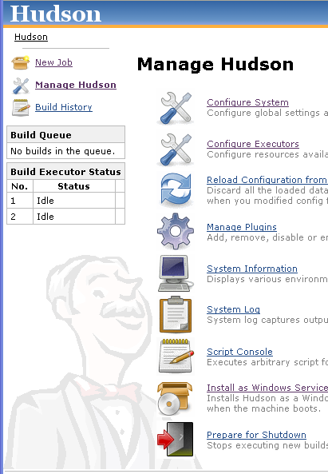
Continuous Integration System Hudson
Continuous Integration System
Nightly build
Start/Stop production servers
Deploy to production
Hudson ”speaks” Maven
Create New job and indicate the SCM URL that contains the POM file

Slide 14
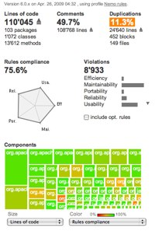
Code quality tool - Sonar
Generate code quality reports:
PMD (Code analysis)
Cobertura (Code coverage)
...
Run
mvn sonar:sonar

Slide 15

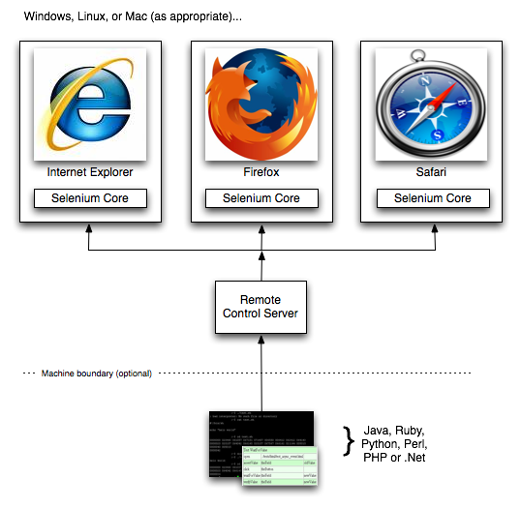
Web test automation platform Selenium Server
Easy to integrate acceptance tests to JUnit
Add to the POM file:
<dependencies> <dependency> <groupId>org.seleniumhq.selenium</groupId> <artifactId>selenium</artifactId> <version>2.0a7</version> <type>jar</type> <scope>compile</scope> </dependency> </dependencies>
mvn test
Run

Slide 16
Eclipse WTP

Slide 17

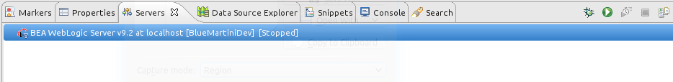
Eclipse WTP
Web Tools Platform (WTP) is an Eclipse extension
Run WebLogic inside Eclipse
Deploy/Start/Stop from Eclipse interface
Support Debug mode with breackpoints
Support Hot Code Replacement (HCR)
Support Hot Deploy (publish)
Support auto-completion inside JSP and JSP navigation
M2Eclipse is an Eclipse plugin to do the bridge between Maven and Eclipse WTP

Slide 18
Maven archetypeS

Slide 19
Maven archetypes
Web application
Repository: http://maven-bluemartini.googlecode.com/svn/repository/
GroupId: com.bluemartini.archetypes
ArtifactId: bms-archetype-ear
Version:1.0.0
Modules: EAR, WAR, EJB, Utility
Batch job
Repository: http://maven-bluemartini.googlecode.com/svn/repository/
GroupId: com.bluemartini.archetypes
ArtifactId: bms-archetype-batch
Version:1.0.0
Modules: Batch

Slide 20
Configuration files
Fix to read DNA configuration files as resources in jar archives
"module_paths" DNA {
"core" StringArray [
"!META-INF/bluemartini/core/bmcommon",
"!META-INF/bluemartini/core/appcommon",
…
Stored as Maven dependency
.m2\repository\com\bluemartini\core\martini-config\10.1.1.0\martini-config-10.1.1.0.jar
Advantages:
Versioning
Central repository management
Simplify deployment & upgrade

Slide 21
martini-patch.jar
Multiple fixes for maven-bluemartini project:
Use local EAC
Read DNA configuration files from JAR's
Add maxAbortAttempt (default is 5) for JMS connection
Load security files in deployed mode
Fix restart error when the application is redeployed
GlassFish support
JBoss support
Configure JNDI in appconfig.dna
Remove WebSphere ND dependency

Slide 22
martini-patch.jar
AspectJ for BM Java code customizations
Customizations easy to identify
Can be ported without modification
Could be the standard for custom code
public aspect BMStartupAspect {
String around(String name, String config, HashMap args)
: execution(public String BMStartup.startup(String, String, HashMap))
&& args(name, config, args)
{
System.out.println("*** martini-patch loaded ***");
BMStartup.isStarted_ = false;
return proceed(name, config, args);
}
}
Example

Slide 23
Setup

Slide 24
maven-bluemartini setup
Add BM libraries and configuration files to your Maven repository
Run
Create project modules using maven-bluemartini archetype
Run
-B
-DarchetypeRepository=http://maven-bluemartini.googlecode.com/svn/repository/
-DarchetypeGroupId=com.bluemartini.archetypes
-DarchetypeArtifactId=bms-archetype-ear
-DarchetypeVersion=1.0.0
-DgroupId=com.example
-DartifactId=myWebsite
-Dversion=1.0.0-SNAPSHOT
Build EAR
Run
mvn install-file
mvn archetype:generate
mvn install
Notes:
mvn archetype:generate -B -DarchetypeRepository=http://maven-bluemartini.googlecode.com/svn/repository/ -DarchetypeGroupId=com.bluemartini.archetypes -DarchetypeArtifactId=bms-archetype-ear -DarchetypeVersion=1.0.0 -DgroupId=com.example -DartifactId=myWebsite -Dversion=1.0.0-SNAPSHOT

Slide 25
Demo...

Slide 26
Todo list
Archetypes for specific BM web applications:
Reference Implementation
Contact Center
RemoteDesktop
Clienteling
BM 10.2 support

