Slide 1

Solving Pong with DeepProblog
NeuroSymbolic AI
New DeepProblog Application

Slide 2
Content
Motivation
Experiments
Discussion
Questions

Slide 3

Motivation
This Photo by Unknown author is licensed under CC BY-NC-ND.
Modelling of Complex Systems
ProB : create models of increasing complexity
How can we use DeepProblog to minimize the effort needed to adapt an agent to a harder version of the same problem?
Pong​
Because games are fun...​
Pong is a simple game
Difficulty increase comes from agent and ball speed variations

Slide 4

Experiments
DeepProblog vs PyTorch
Increasing agent complexity
Robustness to noise

Slide 5
DeepProblog vs PyTorch
Goal
Measurements
Multiple dataset sizes
Compare effectiveness and
Training Loss over iterations
Testing Accuracy over iterations
data efficiency of each method

Slide 6
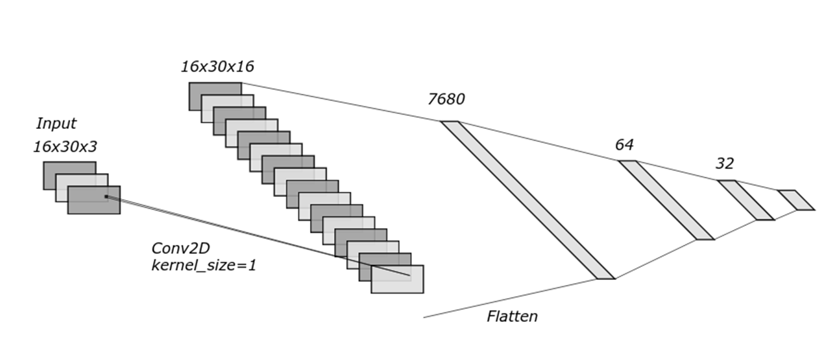
DeepProblog vs PyTorch
Model comparison
PyTorch CNN
frame => action
16x30x3 => down, up, noop
DeepProblog
frame => ball y-position
16x30x3 => 0,1,…,14,15
3
16

Slide 7
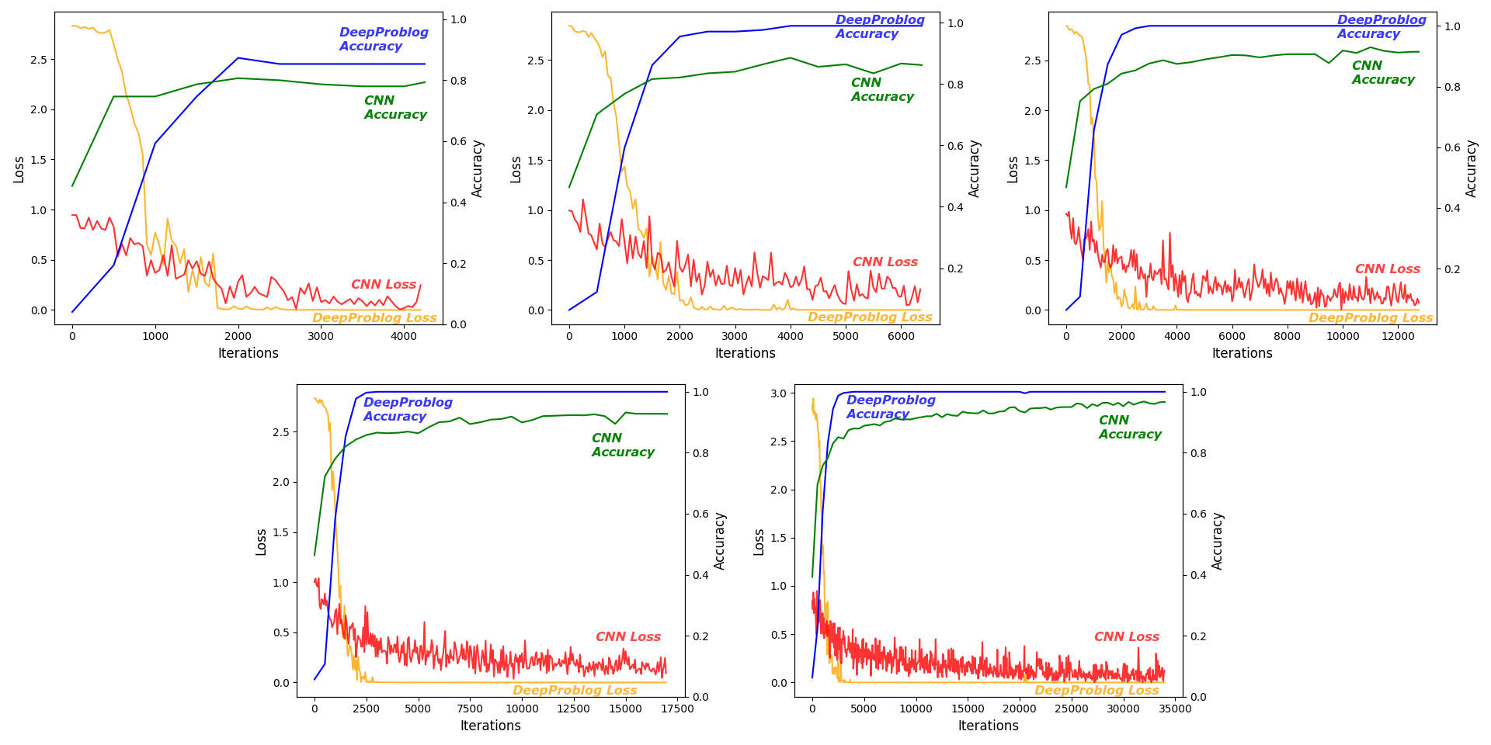
DeepProblog vs PyTorch
1000 images
2500 images
5000 images
10.000 images
25.000 images

Slide 8
Increasing Agent Complexity
Goal
Measurements
Win rate against random agent
Creating a more complex agent
@ varying ball and player speed
for harder game variations

Slide 9
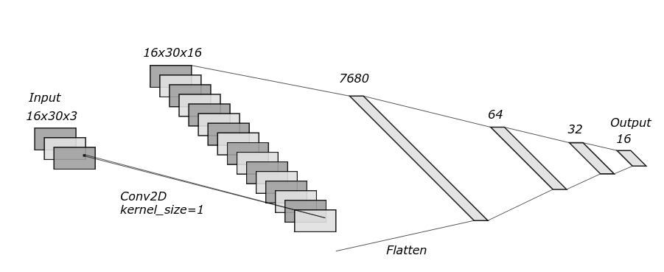
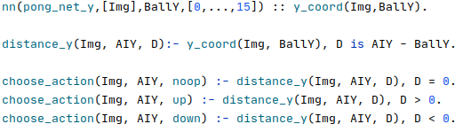
Agent v1
Follow ball y-position
Perception: CNN
Decision: FOL

Slide 10
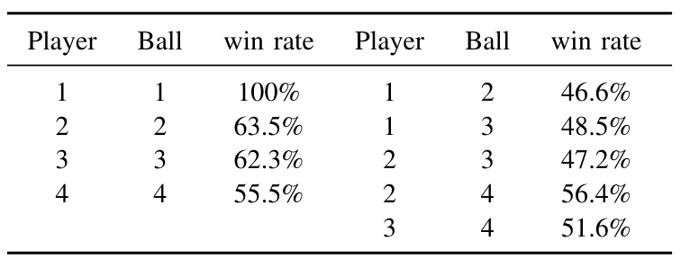
Agent v1
Player = Ball = 1
100% winrate
Fails at higher speeds

Slide 11
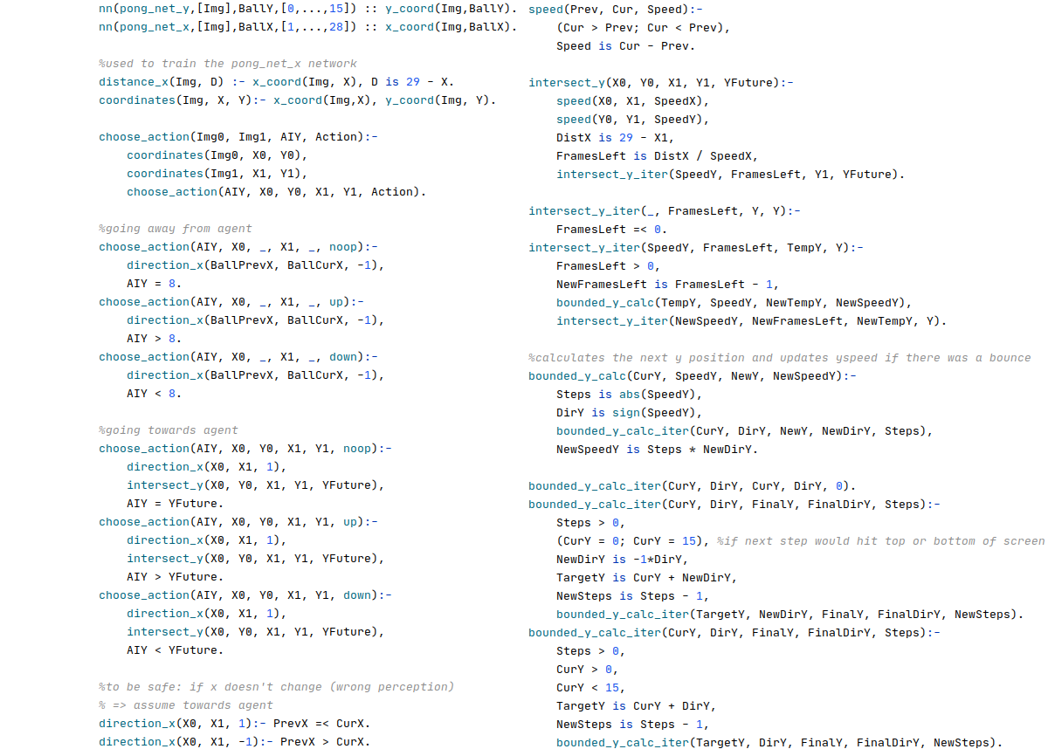
Agent v2
Predict ball y-position
Perception + x-pos
Decision: simulation

Slide 12
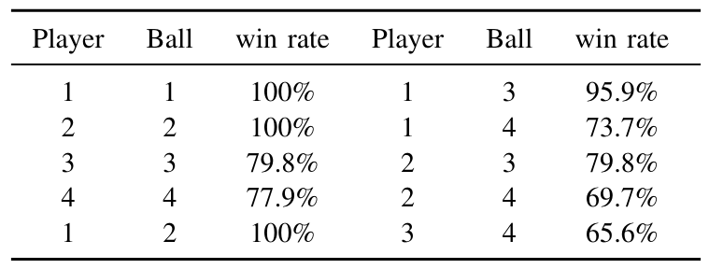
Agent v2
Better performance at higher speeds
Logic errors in speed calculation @ bounces

Slide 13
Noise Robustness
Goal
Particle effects ≈ noise
Measurements
Win rate against random agent
How much is too much?
@ varying noise levels

Slide 14
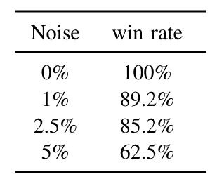
Noise Robustness
Agent v2
Player Speed = 1
Ball Speed = 2

Slide 15
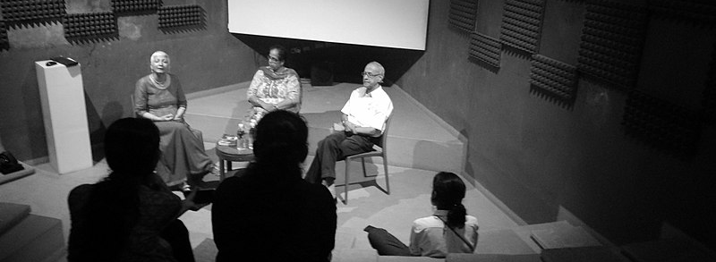
Discussion
Is DeepProblog data efficient and effective?
Is DeepProblog useful to model levels of complexity?

Slide 16
Is DeepProblog data efficient and effective?
+ Less data is needed
+ Higher accuracy is reached
+ Accuracy is reached in less iterations
+ More intuitive outputs
- Training iterations are slower
- Comparison isn’t entirely fair

Slide 17
Is DeepProblog useful to model levels of complexity?
Increasing perception complexity
+ Know what each network does
+ Reusable building blocks
+ Easy training FOL feedback clauses
Increasing decision making complexity
+ Understandable AI
± Feature Engineering
- Prone to Human Error (edge cases)
Notes:
Easy training FOL feedback clauses: you don't actually even need to use the feedback clauses in the final agent version. So you can change the agent decision making logic without changing the training and testing dataset query files.

Slide 18
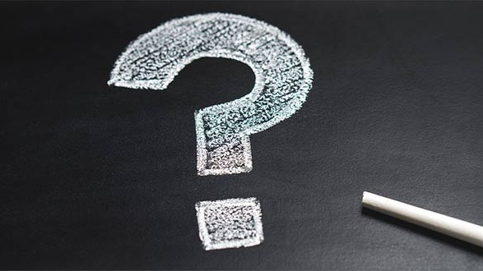
Questions

