Slide 1

SBA Loans Approval Analysis & Prediction
Team 13
INFO 6105
Yanqi Ma NUID: 002774114
You Li NUID: 002824033
2024.4.16

Slide 2




Introduction
SBA is a federal government agency aimed at supporting the growth and development of small businesses in the United States. Loan guarantees is one of their services.
The objective of this project is to classify SBA-approved loans into “will be Paid in Full” and “will be Charged-Off” categories through machine learning, and to predict the risks associated with issuing these loans, aiming to provide banks with a more precise framework for risk assessment to optimize the loan approval process and enhance the overall efficiency of the small business credit market.

Slide 3
Methodology
Feature Engineering
Model Evaluation
Data cleaning
EDA
Model Selection
Removing duplicates
Handling missing values
Converting data types
Address outliers
Random Forest
Logistic Regression
Support Vector Machines

Slide 4
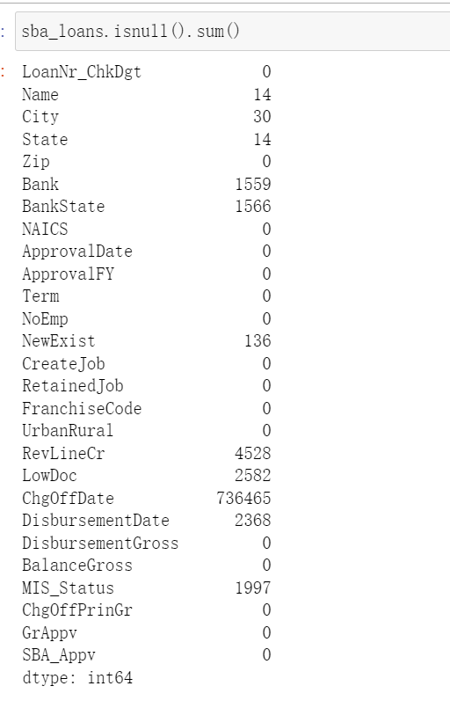
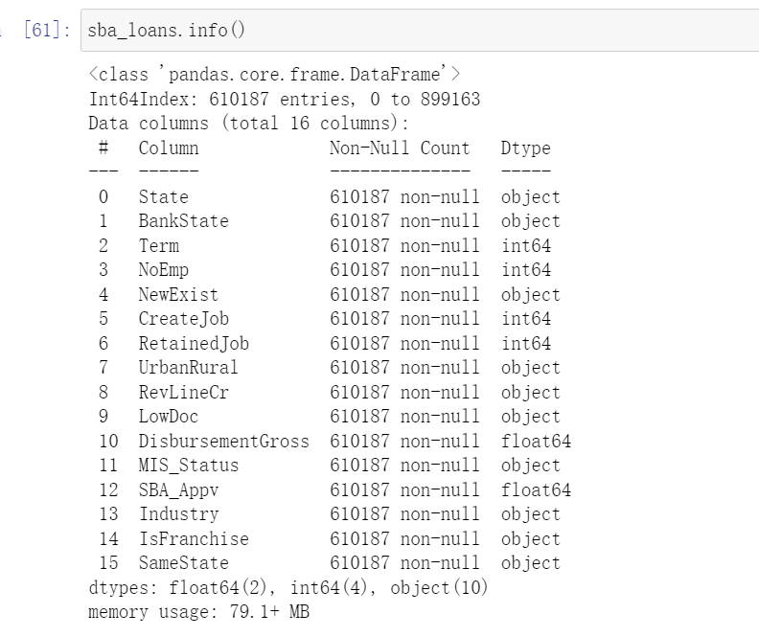
Results and Analysis -- Data cleaning
BEFORE
AFTER
Shape (899,164, 27)
With null values
Shape (610,187, 16)
Without null values

Slide 5

Results and Analysis -- EDA
Does the higher the SBA guarantee mean the company has better credit and is more likely to repay the loan in full?
Will more disbursement amount create more jobs?
How are companies applying for SBA loans geographically distributed, and what does that mean?
How does the term of the loan affect whether the company pays it back?
Will whether the location of the borrowing company and the bank be consistent will affect whether the company will repay the loan in the end? How to explain?
Does the greater a company's ability to create new jobs, the greater the likelihood of repayment?
Is there any correlation between whether a company has a franchise business code and whether it will repay the loan? If so, what advice can this correlation provide banks when approving loans?
······

Slide 6
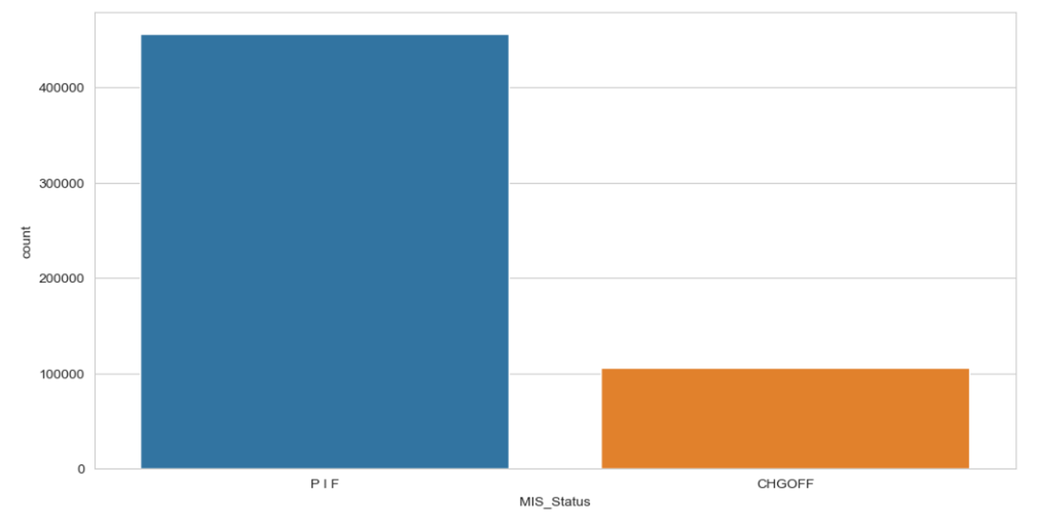
Results and Analysis -- EDA
Univariate Analysis
The total amount of Paid-In-Full data was much larger than the amount of Charged-Off data, making the distribution of data very imbalanced. This imbalance could potentially lead to a model that demonstrates strong predictive accuracy for companies that Paid-In-Full.
The distribution of our label “Mis_Status”

Slide 7
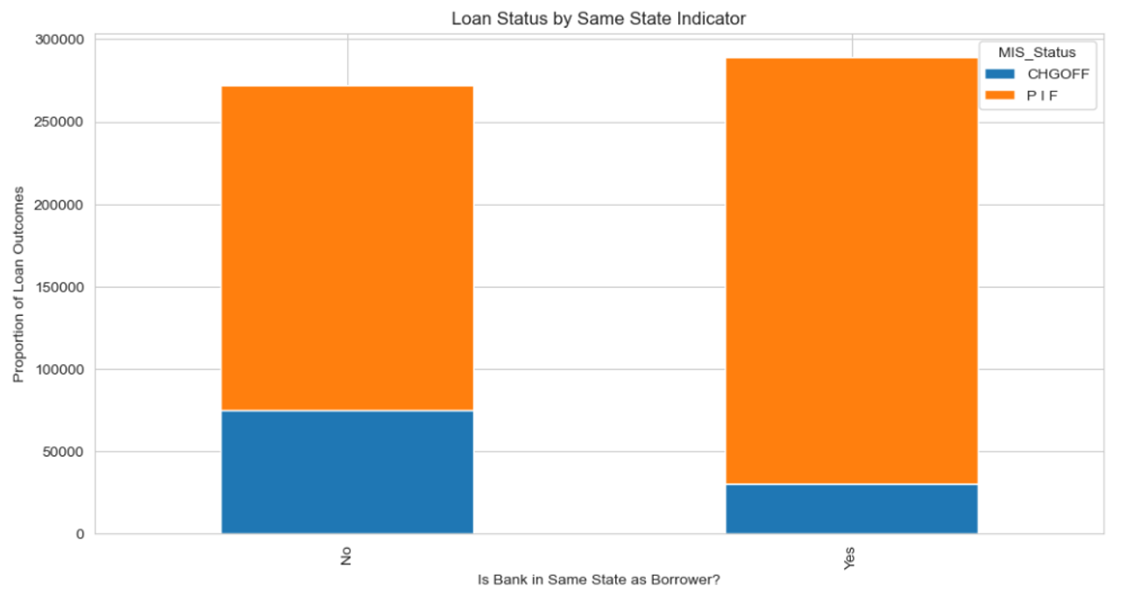
Results and Analysis -- EDA
Bivariate Analysis
The bank and the borrower company are in different states, there tends to be a higher proportion of unpaid loans. This effectively answers another question we had at the beginning of our EDA. Based on this result, we have reason to believe that SBA-approved loans where the bank and borrower company are in the same location are more conducive to reducing the risk of bad debt.
Loan Station by Same State Indicator

Slide 8
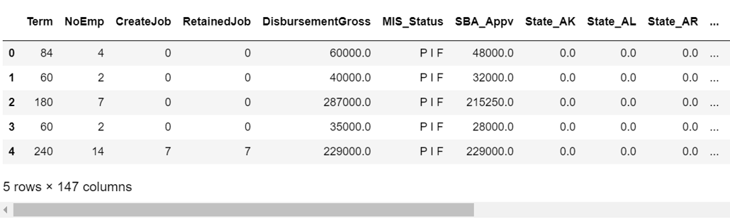
Results and Analysis -- Modeling
Processing the Modeling
We initiate the model preprocessing stage by applying one-hot encoding to transform categorical features into a numerical format amenable to algorithmic processing.
Dataset is divided into training and testing sets to facilitate model validation and to ensure that our model can generalize well to unseen data. 80% of the data reserved for training and 20% for testing.
Apply One-Hot Encoding to Features
Separate Feature Matrix & Target Variable
Split Training & Testing Data
Label Transformation with LabelEncoder
Ready for Model Training

Slide 9
Results and Analysis -- Modeling
(2) Feature Selection
Optimal Feature Selection for Models:
Utilized SelectKBest with chi2 for targeted feature reduction.
Systematic 'k' Evaluation:
Assessed a range of 'k' values for feature inclusion.
Cross-Validation Results:
Determined best 'k' based on recall score optimization.
Best 'k' Values Determined:
SVM: Model performance peaks at 'k' = 15.
Logistic Regression: Optimal performance at 'k' = 10.

Slide 10
Results and Analysis -- Modeling
(3) Feature Standardization
Necessity of Feature Standardization:
- Importance of scale consistency for SVM and Logistic Regression.
- The challenge of uneven feature scales in the dataset.
Implementation of StandardScaler:
- Applied StandardScaler to adjust feature distribution.
- Transformed features to have mean of 0 and standard deviation of 1.
Benefits of Scaling:
- Prevents features with larger scales from dominating the model.
- Facilitates a more stable and faster convergence during training.
Equalized Influence of Features:
- Ensures each feature contributes equally to the model’s predictions.
- Critical for maintaining the integrity of the model's performance.

Slide 11
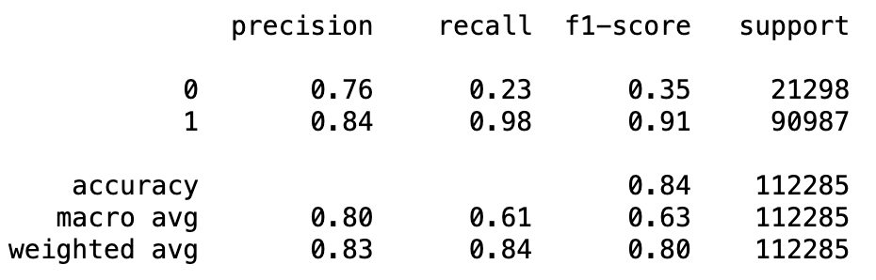
Results and Analysis -- Modeling
(4) SVM: Addressing Class Imbalance
Impact of Class Imbalance:
Initial analysis indicated a skewed distribution of classes, which could lead to a biased model that favors the majority class.
Disparity Between Precision and Recall:
The model exhibited a high precision for the majority class but a significantly lower recall for the minority class.

Slide 12
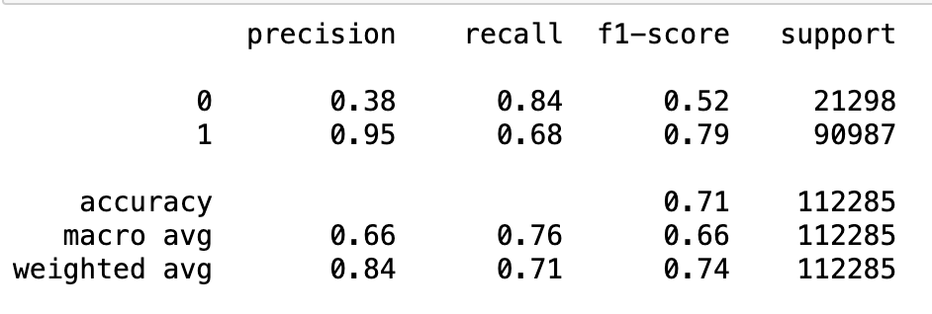
Results and Analysis -- Modeling
(5) SVM: Addressing Class Imbalance
Class Weight Adjustment:
Set class_weight='balanced' in the SVM algorithm to give more weight to the minority class during model training.
Model Retraining and Evaluation:
After adjustment, retrained the model and focused on improving recall for the minority class without compromising overall accuracy too much.

Slide 13
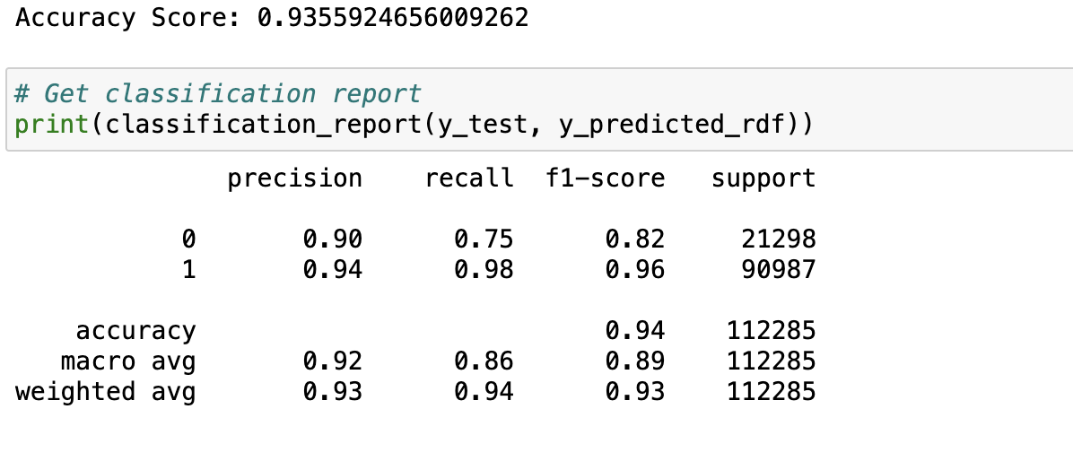
Results and Analysis -- Modeling
(6) Random Forest：Initial Training
Apply RandomForestClassifier with class_weight='balanced' to address dataset imbalance.
Achieved an accuracy score of 93.55% on test data.
Precision and recall for 'Loan Status Charged Off' (class 0) were 0.90 and 0.75, respectively.
Precision and recall for 'Paid in Full' (class 1) were 0.94 and 0.98, respectively.
Need to improve recall for 'Loan Status Charged Off'.

Slide 14
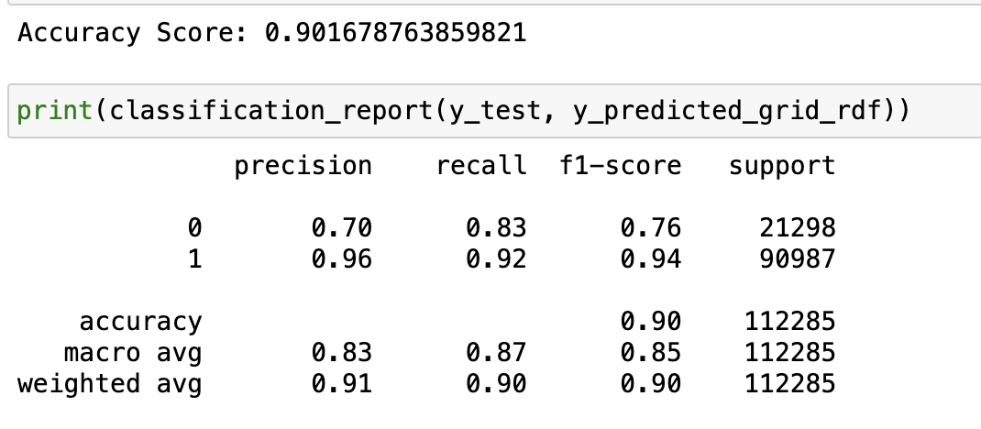
Results and Analysis -- Modeling
(7) Random Forest：Hyperparameter Tuning
Conducted Grid Search CV focusing on 'n_estimators' and 'max_depth'.
Determined optimal hyperparameters: max_depth=20, n_estimators=100.
Retrained Random Forests Model with tuned parameters.
Improved recall for 'Loan Status Charged Off' to 0.83.
Overall accuracy slightly decreased to 90.17% but with a significant gain in detecting 'charge off' cases.

Slide 15
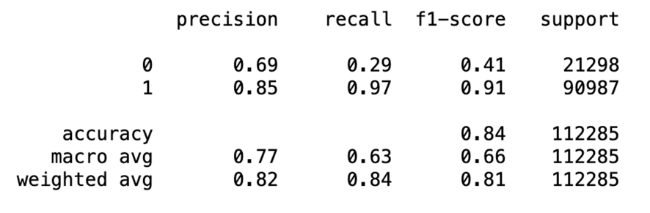


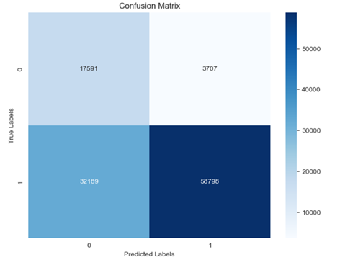
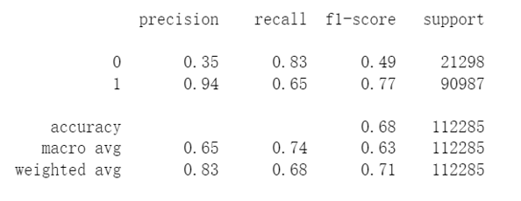

Results and Analysis -- Modeling
(8) Logistic Regression: Initial training
The resulting model exhibits an accuracy of 84%, which seemingly indicates good performance. However, we observed a significant imbalance in the prediction of positive and negative classes.

Slide 16
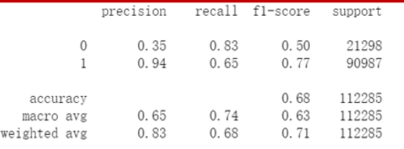

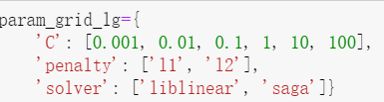
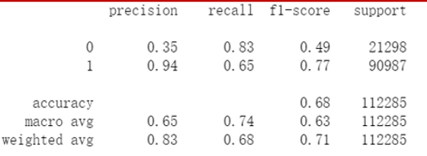





Results and Analysis -- Modeling
(9) Logistic Regression: Hyperparameter Tuning

Slide 17
Conclusion
The Random Forest model gives the better performance
Shortcomings:
The significant imbalance of the label in our dataset has resulted in unbalanced predictions from the
model.
Further analysis:
- readjust thresholds to pay more attention to minority class in the future;
- improve feature selection again;
- expand the hyperparameter grid to further tune the model.
- evaluate the influence of size of training dataset and model complexity on our model performance by
plotting a learning curve and validation
curve.
Suggestions for SBA:
We obtained a well-performing random forest model to classify loans, helping banks to improve the
correct identification of loans that will not be repaid and reduce the bank's financial risk.

Slide 18
Thank you for listening!
You Li
Yanqi Ma
2024.4.16

