Slide 1
DST group project Test
Group 1
2020.05.14

Slide 2
Unit test
Code level
test the methods
Functional test
Usability test
Interface test
Compatibility test
Performance test
Security test
System function test
test the functions of the web application

Slide 3

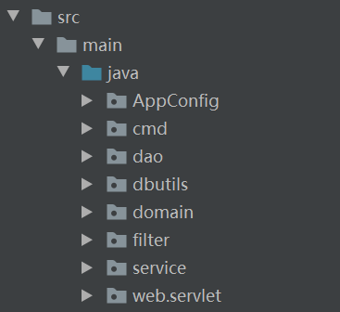
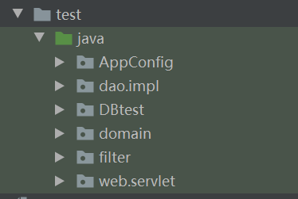
Unit test (lower level)
Tools:
Junit 4: test cases/ test suites
Easy mock

Slide 4
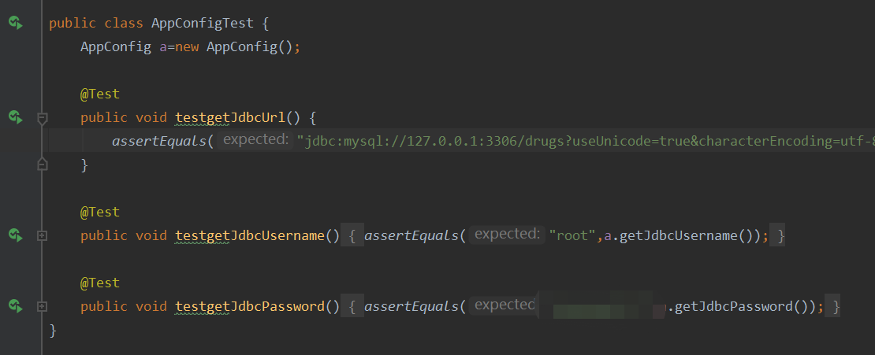
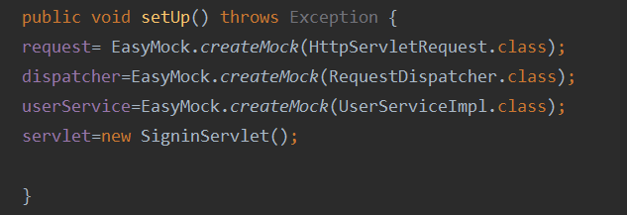
Unit test (lower level)
Try to test the functions in the classes.
Using assert***()
In the test for filter and servlet, using easy mock to create mock, which can help creating an isolate testing environment.

Slide 5
System function test
Blackbox testing.
Focus on the usability of the web application.
Test cases to cover all functionality of the system.
Steps:
Functional test
Usability test
Interface test
Compatibility test
Performance test
Security test

Slide 6
System function test
Feed input and examine the output
Happens in the code
For example:
Input a query for the database and test the correctness of the return values.
Functional test
Usability test
Interface test
Compatibility test
Performance test
Security test
servlet
dao
Appconfig
cmd
service
domain
DBUtils

Slide 7
System function test
Functional test
Usability test
Interface test
Compatibility test
Performance test
Security test
Design test strategies to ensure that all the functionality of the application can be validated.
Cannot recruit test participants
But we have our group members!

Slide 8
System function test
Functional test
Usability test
Interface test
Compatibility test
Performance test
Security test
Communication processes work well
Error messages will be displayed.

Slide 9
System function test
Functional test
Usability test
Interface test
Compatibility test
Performance test
Security test
Browser compatibility:
Microsoft edge, chrome …
Operating system compatibility:
Windows, macOS
Mobile compatibility:
Five computers of our group members!

Slide 10
System function test
Functional test
Usability test
Interface test
Compatibility test
Performance test
Security test
Conditions:
Different internet speed.
Different loads (input files)

Slide 11
System function test
Functional test
Usability test
Interface test
Compatibility test
Performance test
Security test
Security requirement is not very high.
Authentication for the displaying page of drug-related information.

Slide 12
Limitations
Unit tests did not cover the whole logic of the application because tests did not carry out following each step of development and the knowledge about unit test is limited.

Slide 13
DST group project Test
Group 1
2020.05.14

