Slide 1
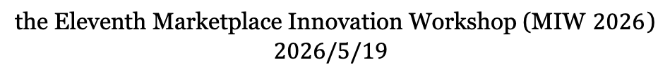
On the Coordination of Value-Maximizing Bidders
Yanru Guan
Peking University
Jiahao Zhang
Carnegie Mellon University
Zhe Feng
Google DeepMind
Tao Lin
Microsoft & CUHK-Shenzhen
the Eleventh Marketplace Innovation Workshop (MIW $2026$)
$$2026/5/19$$

Slide 2
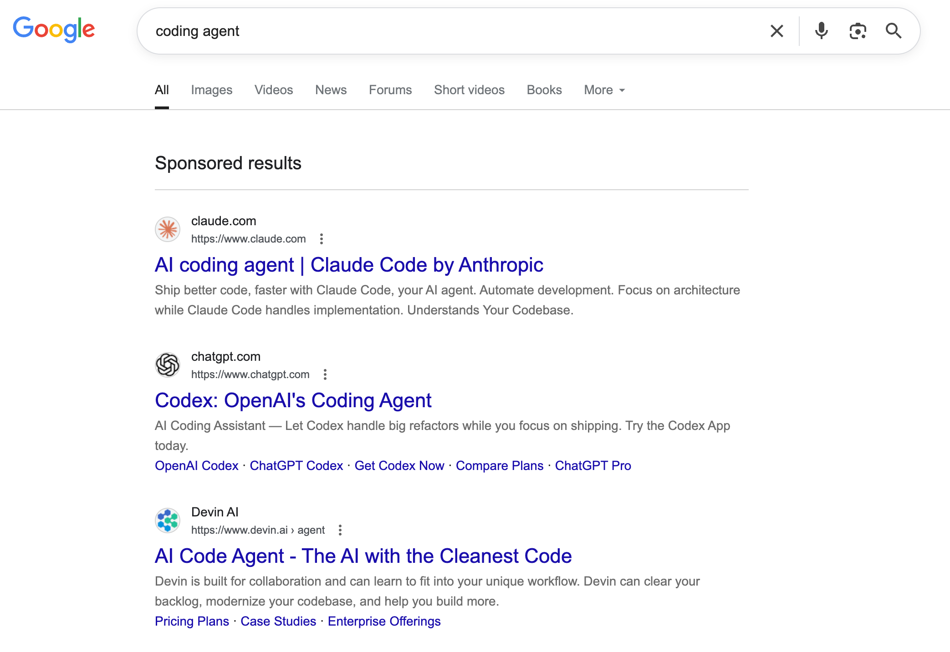
Online Ad Campaign
Sponsored results are auction winners

Slide 3
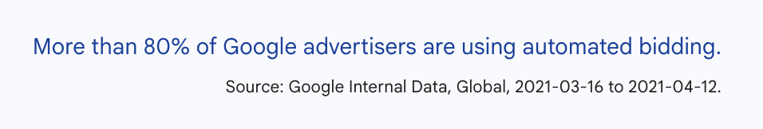
Online Ad Campaign
Auto-bidding:
The advertiser submits the goal and constraints
The delegated bidding agent runs an algorithm 𝐴 for the advertiser
How to bid over repeated auctions?

Slide 4
Online Ad Campaign
Auto-bidding:
The advertiser submits the goal and constraints
The delegated bidding agent runs an algorithm 𝐴 for the advertiser
How to bid over repeated auctions?
Independent
Coordination
existing work
?

Slide 5
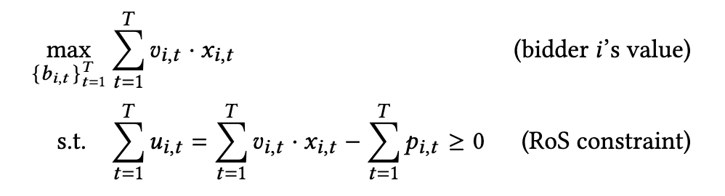
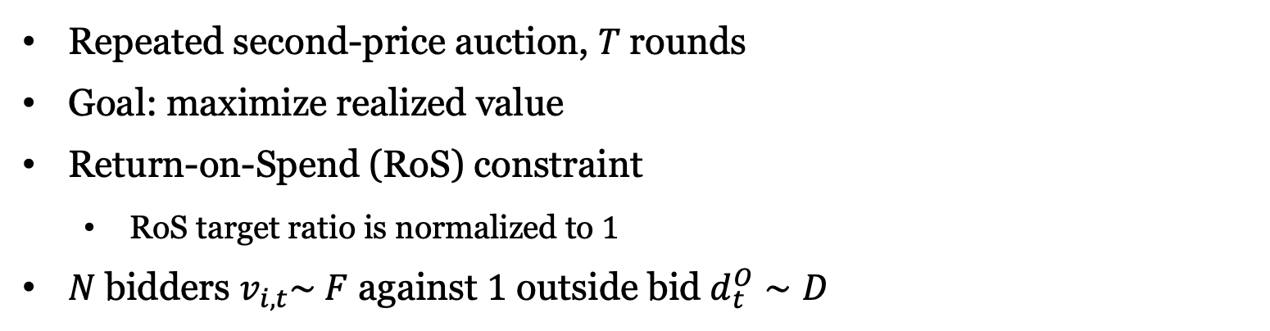
Model
Repeated second-price auction, $T$rounds
Goal: maximize realized value
Return-on-Spend (RoS) constraint
RoS target ratio is normalized to $1$
$N$bidders $v_{i,t}\sim F$ against $1$ outside bid $d_{t}^{O}∼D$

Slide 6
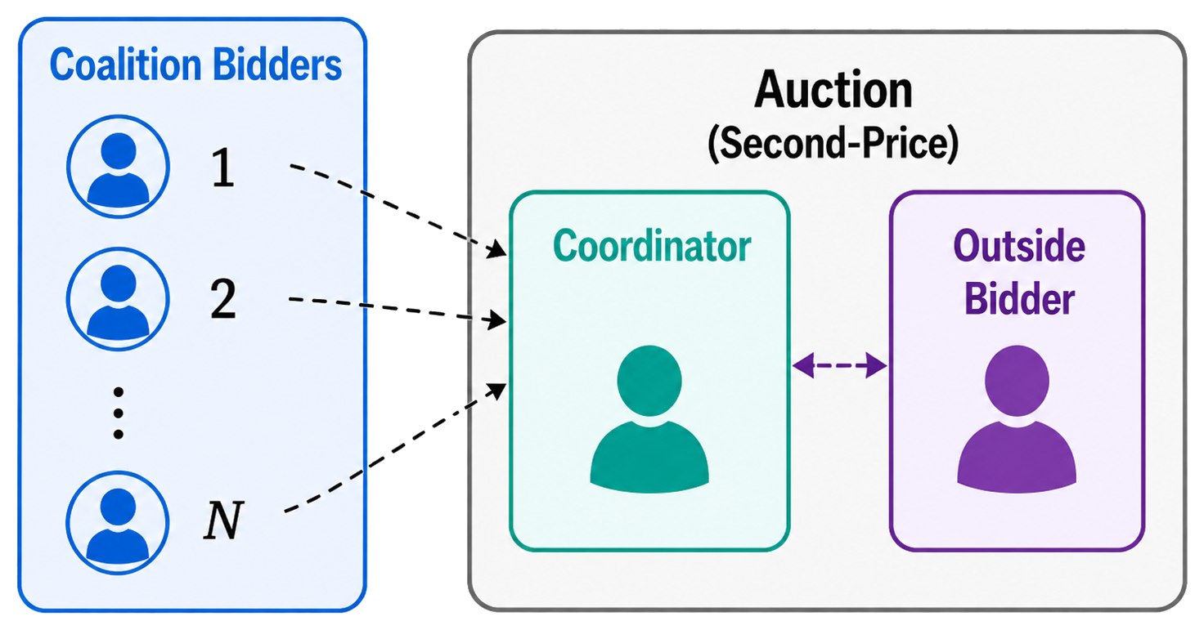
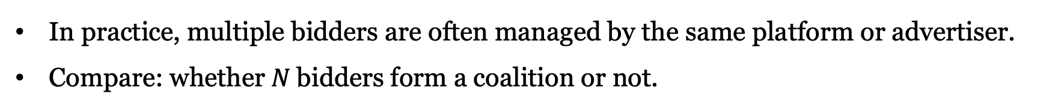

Auto-bidder Coordination
In practice, multiple bidders are often managed by the same platform or advertiser.
Compare: whether $N$bidders form a coalition or not.
Independent
Coordination
Each bidder runs a mirror-descent algo $[1]$
Overbid $b_{i,t}=\left(1+1/λ_{i,t}\right)v_{i,t}$
Observe utility $g_{i,t}=v_{i,t}x_{i,t}−p_{i,t}$
Update: $λ_{i,t+1}=λ_{i,t}e^{−αg_{i,t}}$
Can be generalized to a class of mirror-descent algo
[1] Zhe Feng, Swati Padmanabhan, and Di Wang. 2023. Online Bidding Algorithms for Return-on-Spend Constrained Advertisers. The ACM Web Conference 2023.

Slide 7
Main Results: Simple Coordination Helps
Rule: in each round, only the coalition bidder with highest value bids.
Better RoS Compliance:
Higher Coalition Value:
Value Asymptotic optimality:
Exact condition* for every bidder’s expected utility to improve
Coordination improves total value asymptotically for any mirror-descent algo
Under the same condition*, asymptotically no better coordination mechanism
* Condition: The top two coalition values are competitive against the outside bid: $Δ=E\left[{\left(v_{\left(N−1\right)}−d^{O}\right)}^{+}−{\left(d^{O}−v_{\left(N\right)}\right)}^{+}\right]≥ 0$

Slide 8
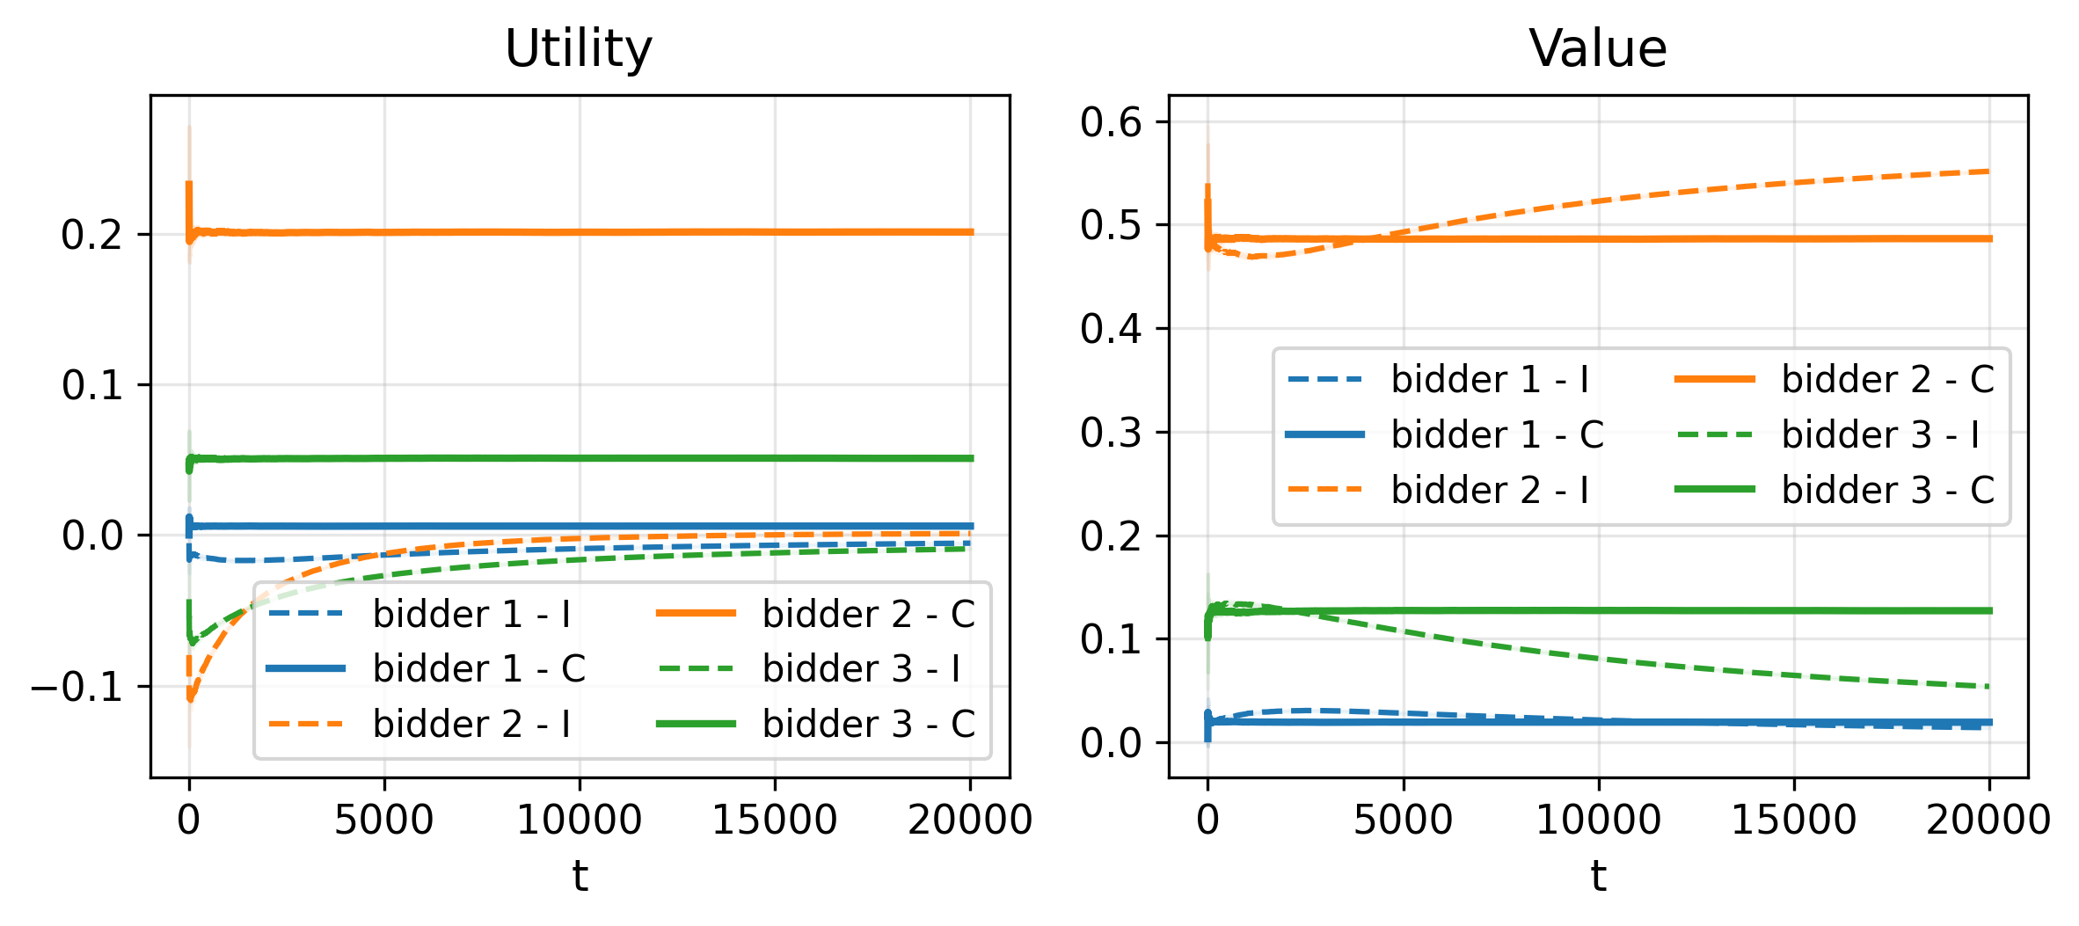
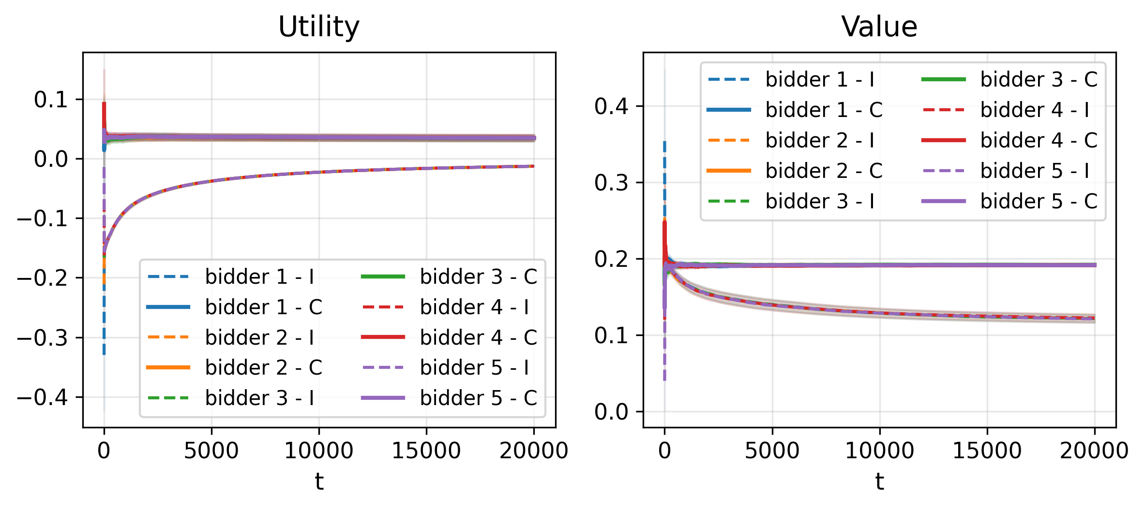
Experiments
Fig 1. Non-i.i.d. Synthetic Data
Fig 2. iPinYou Dataset
Coordination improves coalition-level utility/value across synthetic and real-data experiments.

Slide 9
Questions?
Yanru Guan
piscesguan@stu.pku.edu.cn

