Slide 1
Chronic Pain Pharmacy Services
(OTCQB: APHY)
Investor Presentation
October 2013

Slide 2
Disclaimer
Safe Harbor Statement
This document and other written or oral statements made from time to time may contain forward-looking statement s covered by the Private Securities Litigation Reform Act of 1995. Statements that are not historical in nature and which may be identified by the use of words like “expects,” “assumes,” “projects,” ”anticipates,” “estimates,” “we believe,” “target,” “could be,” and other words of similar meaning, are forward-looking statements. Theses statements are based on managements’ expectations and assumptions and are subject to risks and uncertainties that may cause actual results by the forward-looking statements include: lack of sufficient financing for opening new pharmacies, government regulation and controls, and inability to manage growth. Additional information concerning factors that could cause actual results to differ materially from those projected is contained in the Company’s filing with the Securities and Exchange Commission. The Company undertakes no obligation to revise or update forward-looking statements as a result of new information since these statements may no longer be accurate or timely.
Use of Material Contained Herein
This presentation and the information contained herein are confidential. By your receipt of a copy of this presentation (or your attendance in person), in order to comply with Regulation FD, you agree to hold in strict confidence the existence and contents of this presentation, including without limitation the potential offering. This document is intended for informational purposes to obtain indications of interest only and is not intended, no should it be construed, as a recommendation, investment advice, an offer to sell or buy, as solicitation, or an endorsement by Assured Pharmacy or any of their employees or agents.

Slide 3
Executive Summary
Assured Pharmacy, Inc. (APHY), a growing provider of pharmacy services to patients and physicians in the treatment of chronic pain. Through its network of pharmacies, the Company predominantly dispenses highly regulated pain medications to sufferers of chronic pain, while stringently adhering to federal and state reporting requirements for both patients and physicians.
Operates 2 stores
First store opened in 2003
Serving ~4000 patients per month
Employees: 35
As of October 1, 2013 Key Financials
Ticker | OTCQB: APHY
Stock Price | $0.40
Average Vol (3m) | 7,000
Shares Outstanding | 6.0 M
Full Diluted Shares | 17.8 M
2012 Revenue | $14.1M
APHY carries an inventory of medications that:
Specifically suited to treat chronic pain patients - Class II narcotics
Have complex interactions with other medications
Generally more expensive
Difficult to manage
Highly regulated and dangerous

Slide 4
Investment Highlights
Profitable Business Model
Low start-up costs:~ $350K
Achieve profitability at only 75 scripts/day with operating capacity to 300 scripts/day
Long term recurring patient revenue stream
Minimal sensitivity to economic cycles
Proven model through 4 locations with infrastructure to support 25 locations in 5 years
Large Underserved Market
Prescription pain medication is a $30 billion/year market in US
Minimal direct competition throughout US
75 million Americans with chronic pain and growing
Proven Management with Aligned Interests with Shareholders
Strong infrastructure with scalable core management systems and processes
Management team has over 50 years of combined pharmacy/healthcare industry related experience
Management and directors personally invested over $1M alongside investors

Slide 5
Business Overview
Our specialty pharmacy services specialize in complex therapy pain management and medication support services for sufferers of chronic pain and other complex health conditions. Products includes:
Oxycontin
Fentanyl
Morphine Sulfate
Oxycodone
Opana
Hydrocodone
Comprehensive support, dispensing & distribution, patient care management, data reporting
Partnering with patients, physicians, healthcare payers and pharmaceutical manufacturers
Prescription medications are dispensed at two current locations:
Kansas City, KS
Seattle, WA

Slide 6
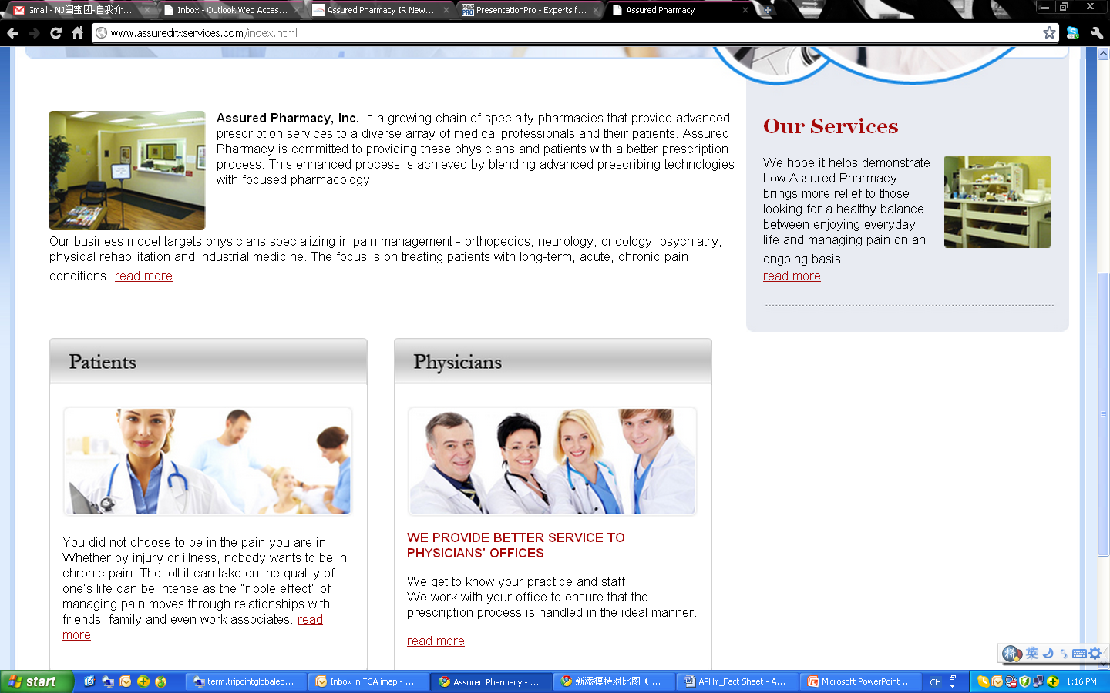
Pain — the Nation’s #1 Disability
More than 75 million Americans suffer from debilitating chronic pain
2/3 suffering for more than 5 years and experiencing pain almost 6 days a week*
Causes more disability than cancer and heart disease combined
$30B/year is spent on prescription pain medications in the US
Accounts for approximately 75% of all physician visits
Prescription pain medication is the first line of action for treatment and management
Sufferers are often misunderstood and alienated since it is the “invisible” disease
Many “traditional” retail pharmacies, because of their staffing and risk models, typically are not able to provide suffers of acute and chronic pain with the full prescribed quantity of medication on a consistent basis
*Harris Interactive/National Pain Foundation

Slide 7
Market Needs for Specialized Pain Pharmacies
Choose not to service chronic pain patients
1. To avoid bearing personal liability
2. Chronic pain medications are targeted for theft
3. Complex and intense scrutiny by the Drug Enforcement Administration (“DEA”) of record keeping & audit trail
4. Key pain medicines are typically not adequately stocked – too burdensome
Increasingly looking for a safer alternative to retail pharmacies. Inconvenienced by current pharmacy options
Increasingly pressuring physicians and wholesalers to ensure prescriptions are being dispensed with appropriate oversight/controls
Pharmacists
Physicians
Regulators

Slide 8
Assured Pharmacy Approach
Value Proposition to Patients
A relationship pharmacy - Assured Pharmacy gets to know patients
Convenience through daily pickup of prescriptions direct from physician offices
Multiple delivery options available in addition to patient pick up
Fill customers’ prescriptions from existing inventories and avoid the wait time required in a traditional pharmacy
Privacy, closed door pharmacies with low foot traffic
Complete fulfillments on paid prescriptions and accepts most insurance plans
Value Proposition to Physicians
Full service, highly secure alternative to traditional pharmacies
Daily pickup of prescriptions by Assured representatives
Convenient, cost effective and minimizes risk of counterfeit prescriptions
Reduced time
Consuming calls from chain pharmacies confirming prescriptions
Government compliance and risk mitigation
Increased controls due to specialization and pharmacy model design
Customized patient, DEA and drug reports

Slide 9
Pharmacy Expansion Strategy
Expand to new cities in a very prudent method
Evaluate physician demand in targeted expansion cities before any commitment
Limits the downside risk
It’s All About the Network of Relationships
Next:
Denver, CO
Boston, MA
Patients
Physicians
Assured Pharmacy
Future:
Nashville, TN
Omaha, NE
Phoenix, AZ
Raleigh, NC

Slide 10
Customer Acquisition Strategy
Target physicians who have the relationships with the chronic pain sufferer patients
Provides visibility and predictable revenue
Limits the downside risk
Patients
Physicians
Assured Pharmacy

Slide 11
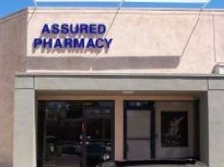
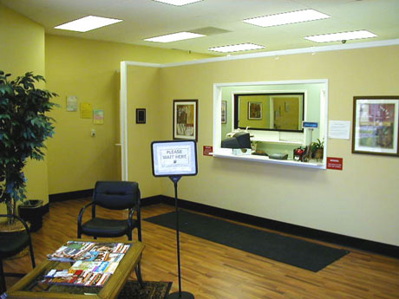
Pharmacy Business Model
Pharmacy concept
Closed door pharmacy
Walk in prescriptions are limited
800 – 1,500 sq. Ft. medical office space in secondary & tertiary locations
Pharmacy layout designed with physician office “look & feel”
First rate security measures
Video, motion, and lock storage systems
Staffing: one pharmacist, up to 3 support personal, 2 sales representatives
Geographical coverage area: (~150 mile radius)
Pharmacy revenue model projected at ~ $9.0 million at full capacity (300 scripts/day)

Slide 12
Pharmacy Economics
Low start-up costs: ~$350K
Proven business model
Achieve pharmacy level profitability at only 75 scripts/day
Rapid ROI: model built for 300 scripts/day
Long term recurring patient revenue stream
Minimal sensitivity to overall economic cycles
Model is proven through 2 store locations and replicable throughout the US
Item | Amount
Physical location | $50 - 75K
Initial inventory | $50 – 75k
Furniture, equipment, and software | $30 - 40k
Working capital (6-9 months) | $150k
Target patient has chronic pain or other complex health conditions that require multiple prescriptions each month for the rest of their life

Slide 13
Key Performance Indicators
For the Year Ending | December 31, 2012
# of new patients | 6,542
Average new patients per day | 26
# of patients serviced | 48,177
Business Days | 255
# of scripts | 121,392
# of scripts per day | 476
Average revenue per script | $117
Average revenue per patient | $291

Slide 14
Pharmacy Financial Model
Scripts Per Day | 75 | 100 | 150 | 200 | 250 | 300
Monthly Scripts* | 1,594 | 2,125 | 3,188 | 4,250 | 5,313 | 6,375
Revenue Per Script | $125 | $125 | $125 | $125 | $125 | $125
Monthly Per Pharmacy
Revenue | $199,219 | $265,625 | $398,438 | $531,250 | $664,063 | $796,875
Gross Profit | 46,816 | 62,422 | 93,633 | 124,844 | 156,055 | 187,266
Operating Expenses | 42,209 | 47,318 | 56,143 | 63,175 | 71,705 | 84,707
EBITDA | 4,607 | 15,104 | 37,490 | 61,669 | 84,350 | 102,559
Annual Per Pharmacy
Revenue | $2,390,625 | $3,187,500 | $4,781,250 | $6,375,000 | $7,968,750 | $9,562,500
Gross Profit | 561,797 | 749,063 | 1,123,594 | 1,498,125 | 1,872,656 | 2,247,188
EBITDA | 55,289 | 181,247 | 449,878 | 740,025 | 1,012,196 | 1,230,704
Gross Margin | 23.5% | 23.5% | 23.5% | 23.5% | 23.5% | 23.5%
Estimated EBITDA Margin** | 2.3% | 5.7% | 9.4% | 11.6% | 12.7% | 12.9%
*Assumes 21.25 average days in month **Based on projections of single unit economics using Seattle pharmacy as baseline

Slide 15
Kansas City, KS
Proven & Ready to Replicate
Opened January 2012
$1.75 million revenue in first year of operations
Cash flow positive in 6th month
Cash flow positive ever since

Slide 16
Short Term Growth Plan
Grow organically in existing markets by servicing new customers
The industry has underlying market growth potential attributable to both an increase in drug utilization as well as the general aging population of the United States
For 2013
Negotiate new trade terms: improve inventory, pricing, costs and turn
Streamline operations in order to target profitability in 1st half 2014
Continue to expand and refine industry leading compliance program
For 2014
Reach profitability at Kansas City, KS & Seattle, WA locations
Open two new pharmacies in Boston, MA and Denver, CO
Identify three to five additional pharmacy locations for 2015 opening
Beyond 2013
Consider future locations in major metropolitan areas in Arizona, Minnesota, Missouri, Tennessee, North Carolina and Texas
Expand national footprint: 25+ pharmacies in 5 years

Slide 17
Financials
Fiscal year ended Dec 31, in Millions of USD
 | 2010A | 2011A | 2012A
Revenue | $16.3 | $16.4 | $14.1
Gross Profit | 3.1 | 3.2 | 3.1
Gross Margin | 19.0% | 19.5% | 21.7%
Operating Loss** | -2.0 | -2.8 | -2.7
Net Loss** | -3.0 | -3.3 | -4.3
**Includes stock based compensation of $550k, $783k and $838k for years ending December 31, 2010, 2011 and 2012 respectively

Slide 18
Annual Rollout - Three Year Projections
 |  |  |  | Year 1 |  | Year 2 |  | Year 3
# of New Pharmacy Openings |  |  |  | 2 |  | 4 |  | 3
# of Pharmacies End of Period |  |  |  | 6 |  | 10 |  | 13
($000)
Revenue |  |  |  | $ 23,404 |  | $ 42,549 |  | $ 77,282
Gross Profit |  |  |  | 5,490 |  | 10,020 |  | 18,306
Gross Margin |  |  |  | 23.5% |  | 23.6% |  | 23.7%
EBITDA - Pharmacy Level Contribution |  |  |  | 2,092 |  | 3,968 |  | 9,048
EBITDA Margin - Pharmacy Level |  |  |  | 8.9% |  | 9.3% |  | 11.7%
Corporate & Shared Service expenses |  |  |  | 1,334 |  | 1,434 |  | 1,537
 | % of Revenue - Corporate expenses |  |  | 5.7% |  | 3.4% |  | 2.0%
 | EBITDA** |  |  | 758 |  | 2,535 |  | 7,511
 | EBITDA Margin |  |  | 3.2% |  | 6.0% |  | 9.7%
Net Income Before Tax** |  |  |  | $ 15 |  | $ 2,350 |  | $ 7,374
**Excludes stock based compensation

Slide 19
Management
Robert DelVecchio – CEO
CEO since February 2005, Appointed to the Board of Directors in March 2005
Previously CEO and President of Brockington Securities, Inc., a FINRA Member Firm
Mike Schneidereit – COO
15+ year career in IT, Operations & Finance in Pharmacy, Healthcare & Real Estate including Cigna Healthcare and Siemens
Formerly, Director of Specialty Pharmacy and Information Technology of SureHealth
Brett Cormier , CPA– CFO
19+ year career in Accounting & Finance in Pharmacy, Healthcare, Real Estate and Franchising including Monarch Dental and Pharmerica
Formerly, CFO & Treasurer of Sleep Holdings, Inc.,
Michael Mapes – CCO
30+ year career with U.S. Drug Enforcement Administration primarily in the enforcement and prevention of pharmaceutical diversion
Formerly, Section Chief, Washington D.C., U.S. DEA

Slide 20

Chronic Pain Pharmacy Services
Contacts
Robert DelVecchio
CEO
949-302-0934
delvecchio@assuredrxservices.com
Stephen Hart
Corporate Strategy & Development
917-658-7878
hart@haydenir.com

