Slide 1
Corporate Finance for Long-Term Value
Chapter 18: Mergers and acquisitions

Slide 2
Chapter 18: Mergers and acquisitions
Part 5: Corporate financial policies

Slide 3
The BIG Picture
M&As are very large investments in which a company takes over another company
Discussion
Value creation is more likely if there are synergies between the companies involved
There are many dubious motives for M&As
Financial sanity of M&A activity can be assessed with the NPV method
Large numbers and big stakes in M&A make behavioural issues more problematic
If not properly understood and considered, E and S issues can reduce the company’s financial value
An integrated perspective on M&A valuation is needed -> integrated value method

Slide 4
Mergers and acquisitions
In a takeover or acquisition, one company buys another company and it is typically quite clear who is the buyer and who is the seller
In a merger, it is supposed that companies of roughly equal size together decide to continue as one company, without a clear buyer or seller
Sometimes a deal may be called a merger for political reasons, whereas it is quite clear who is the senior party and who the junior
The buyer is called the bidder during the bidding process and called the acquirer if the deal happens
The company that is sold, is called the target during bidding and becomes the acquired company once the deal is done

Slide 5
Bidding process
A bidding process takes months and is preceded by screening activities aimed at identifying the most suitable targets and doing initial valuations
Due diligence is carried out in which the bidder scrutinises the target’s accounts under strict non-disclosure agreements
Bids can be friendly (with consent of target management) or hostile (lacking consent)
A deal can be stopped by regulators if it is deemed to be anti-competitive or contrary to national interests
Example: in August 2020, the UK government blocked the takeover of electronic design company Pulsic by a Hong Kong rival over national security concern

Slide 6
M&A types
The market’s assessment of a potential M&A transaction is expressed in the stock price reactions of the target and the bidder, which reflects:
The value creation for shareholders
The likelihood that the transaction will happen
M&As can be classified in terms of business activity:
Horizontal – same line of business
Vertical – different parts of the same value chain
Conglomerate – unrelated business

Slide 7
Motives for M&A
M&A deals can be done for several reasons, some deemed more valid than others
The search for synergies is typically deemed a valid reason
Cheap funding and increased earnings per share (EPS) are seen as poor reasons
Synergies mean that the cooperation of two organisations provides better results than the sum of their parts
There are several sources of synergies:
Economies of scale: as production volumes go up, costs tend to fall
Economies of scope: combining similar products could lead to spill-over effects
Vertical integration: acquiring other parts of the value chain can improve streamlining
Industry consolidation: reducing competition means a larger part of consumer surplus is taken
Transition: acquiring companies with advanced E and/or S capabilities can accelerate transition

Slide 8
Poor reasons for M&A deals
Poor reasons for M&A deals can be behaviourally driven:
Escalation of commitment: if much time and efforts has already been invested, it often becomes difficult to stop a process
When operating in the domain of losses: negative results may lead to overvaluation of takeovers
Overoptimistic managers: overconfident CEOs overestimate their ability to generate returns, thereby overpaying for target companies and undertaking value-destroying mergers
Serial acquisition: some companies are serial acquirers and acquire multiple companies per year, with performance declining deal by deal

Slide 9
M&A advisory
During an M&A process, both the bidder (acquirer) and the seller (target) hire advisory partners, also known as buy-side and sell-side mandates
Typically, an investment bank acts as the primary contact person for the sellers and bidders throughout the entire process
Each selling or bidding company hires its own investment bank advisor
Various specialists are hired to conduct a due diligence of the target
Financial experts normalise and evaluate the target’s earnings and financial statement
Operational specialists evaluate the different value drivers of the target
Lawyers review critical company contracts and prepare non-disclosure agreements and purchase agreement

Slide 10
M&A waves
M&A activity comes in waves and are linked to the state of the economy
During an upswing, M&A activity increases
During a downturn, M&A activity declines

Slide 11
M&A valuation
Koller, Goedhart and Wessels (2020) define the M&A value creation as follows:
Manager’s assessment (does not need to equal market value)
The measures that acquirer intends to take
(i.e. cost-cutting, using new market channels)
Price paid by acquirer on top of market value of target (driven by expectations and behaviour)

Slide 12
M&A valuation example
Value component | Value, $ millions at 20% takeover premium | Value, $ millions at 30% takeover premium
Standalone intrinsic value of the target | 650 | 650
+ Value of performance improvements | 97.5 | 97.5
= Value received (1) | 747.5 | 747.5
Market value of the target | 585 | 585
+ Acquisition premium | 117 | 175.5
= Price paid (2) | 702 | 760.5
Value created for acquirer (1) - (2) | 45.5 | -13
Synergies are estimated at 15% of intrinsic value
10% undervaluation of company’s intrinsic value
Seller demands 20% premium (left) or 30% premium (right) on top of target’s market value
Value is created for acquirer with 20% premium
Value is destroyed for acquirer with 30% premium

Slide 13
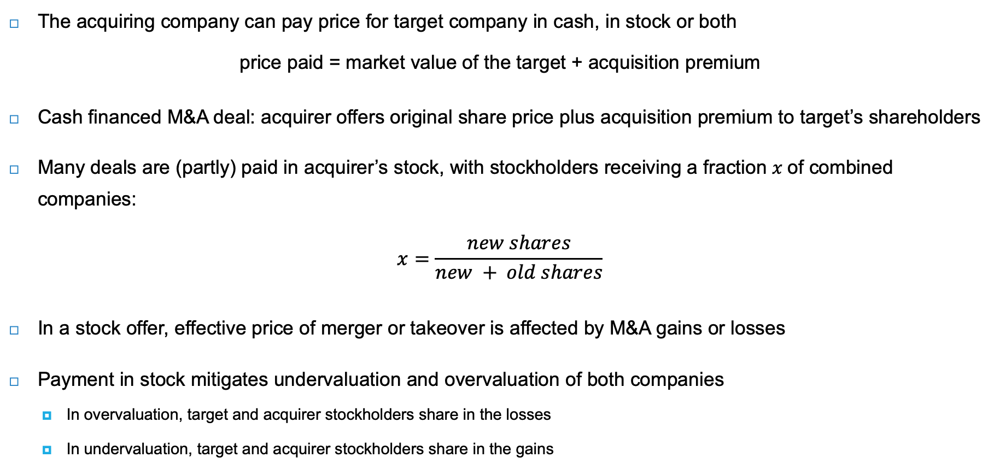
Financing M&A deals
The acquiring company can pay price for target company in cash, in stock or both
price paid = market value of the target + acquisition premium
Cash financed M&A deal: acquirer offers original share price plus acquisition premium to target’s shareholders
Many deals are (partly) paid in acquirer’s stock, with stockholders receiving a fraction $x$of combined companies:
$$x=\frac{new shares}{new + old shares}$$
In a stock offer, effective price of merger or takeover is affected by M&A gains or losses
Payment in stock mitigates undervaluation and overvaluation of both companies
In overvaluation, target and acquirer stockholders share in the losses
In undervaluation, target and acquirer stockholders share in the gains

Slide 14
Behavioural issues in M&A valuation
Behavioural issues can be internal or external errors
Internal errors: managers overvalue their own company, the target or the synergies
Before companies make their bid, they can overestimate synergies or underestimate risks
In a bidding context, management can succumb to the winner’s curse: winning by overpaying
External errors: the market overvalues the target or the bidder
Shleifer and Vishny (2003) assume that acquirers are overvalued and the motive of acquisitions is to preserve some overvaluation for long-runs shareholders
Market-level mispricing proxies and merger volume are positively correlated

Slide 15
Hedge fund activism
Activist hedge funds specialise in hostile M&A activity, and have a highly concentrated portfolio of holdings in companies that they want to shake up
Boyson, Gantchev and Shivdasani (2017) find that shareholder value creation from hedge fund activism occurs primarily by influencing takeover outcomes for targeted firms
Even failed bids lead to improvements in operating performance, financial policy, and positive long-term abnormal returns at targets of activism, which suggests that activism enhances value
Brav, Jiang, Ma and Tian (2018) find that companies targeted by activists improve their innovation efficiency over the five-year period following hedge fund intervention

Slide 16
E and S effects on M&A before valuation
Managers can see E and S issues as drivers of risks and opportunities in their product markets
Risks: certain assets can be considered too risky operationally or to be bringing reputation risks
Opportunities: driving strategic preferences (i.e. sustainability skills, renewable energy assets)
Companies can become targets because of their sustainability skills
Companies with higher CSR scores are more likely to be acquisition targets
High CSR acquirers take less time to complete and are less likely to fail than mergers by low CSR acquirers
Stronger CSR profile of the bidder means higher probability of closing the deal
High carbon emitting acquirers are more likely to buy firms in countries with low GDP

Slide 17
E and S effects on M&A valuation
E and S can affect the value drivers and hence the attractiveness of M&A deals
Also important to do E and S due diligence (see Monsanto take-over below)
Research finds a positive link between targets’ overall CSR (and environmental) performance and acquisition premiums
High CSR acquirers realise higher merger announcement returns, compared with low CSR acquirers
E and S can also have impact on post-deal performance:
Compared with low CSR acquirers, high CSR acquirers realise larger increases in post-merger long-term operating performance

Slide 18
Monsanto takeover
The underestimation of E and S effects can be extremely costly ← importance of E and S due diligence
Bayer, the German pharma and biotechnology company, announced the takeover of the agrichemical company Monsanto in 2016
The final cash offer amounted to $63 billion
Soon after finishing the deal, the first lawsuits on Monsanto’s Roundup weed killer started, internalising the negative health issues
A chemical ingredient of Roundup is glyphosate, which was shown by a 2015 WHO report to cause cancer in animals as well as damaging effects on human cells
Monsanto has settled over 100,000 Roundup lawsuits worth over $10 billion; over 30,000 lawsuits are still pending
Bayer cut its dividend to zero in 2021 after litigation on health issues hit 2020 cash flows and profits

Slide 19
E and S driven M&A activism
The past years have seen the emergence of sustainability-driven activism by hedge funds
Jana Partners pressured Apple to address the potential negative effects of iPhone use on children
Trian Partners has pushed companies to promote workplace diversity, adopt supplier codes of conduct, and reduce emissions and waste
Some hedge funds went further, and put companies under pressure to do E and S driven M&A deals
Bluebell asked Glencore to separate its coal mines
Third Point called for a breakup of Shell
DesJardine and Durand (2020) found that hedge fund activism between 2000-2016 yielded benefits that were:
Shareholder-centric and short-lived
With immediate increases in market value and profitability
Coming at a mid- to long-term cost to other stakeholders
Captured by decreases in operating cash flow, investment spending, and social performance

Slide 20
E and S valuation of M&A
Market power is becoming an important source of value, reducing consumer surplus
Incumbent firms may acquire innovative targets solely to discontinue the target’s innovation projects and pre-empt future competition (called “killer acquisitions”)
Acquired drug projects are less likely to be developed when they overlap with the acquirer’s existing product portfolio
To determine the E and S valuation effects of M&A, one needs to calculate:
The pre-deal EV and SV of the target and the bidder
EV and SV of the resulting combination

Slide 21
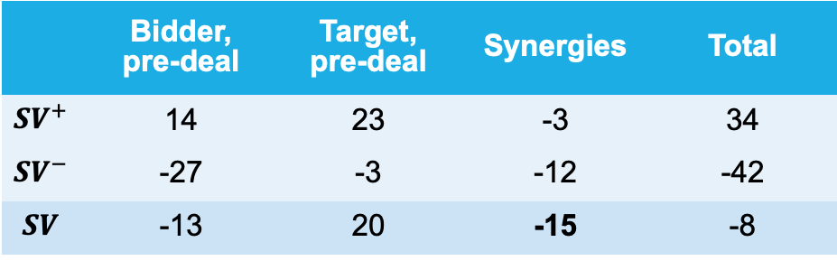
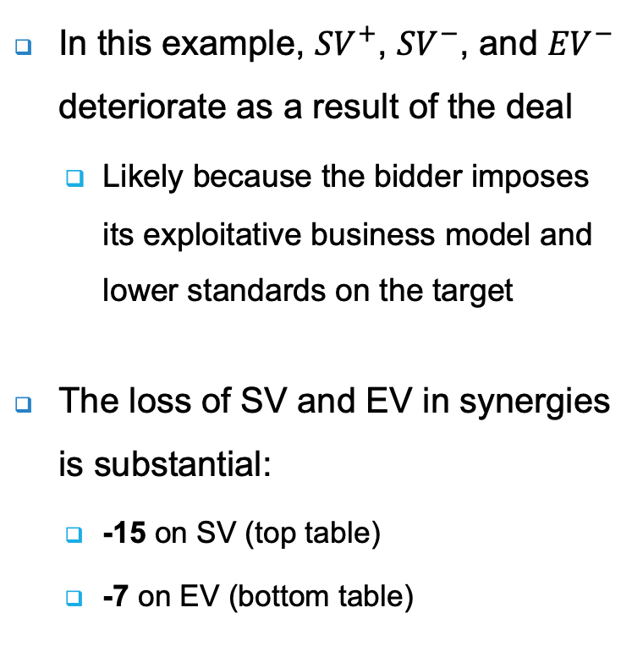
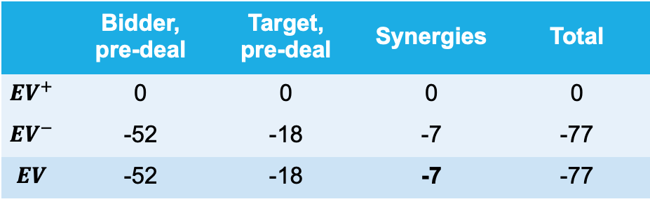
E and S valuation of M&A
In this example, ${SV}^{+}$, ${SV}^{−}$, and ${EV}^{−}$ deteriorate as a result of the deal
Likely because the bidder imposes its exploitative business model and lower standards on the target
The loss of SV and EV in synergies is substantial:
-15 on SV (top table)
-7 on EV (bottom table)
SV valuation in M&A
 | Bidder, pre-deal | Target, pre-deal | Synergies | Total
$${SV}^{+}$$ | 14 | 23 | -3 | 34
$${SV}^{−}$$ | -27 | -3 | -12 | -42
$$SV$$ | -13 | 20 | -15 | -8
EV valuation in M&A
 | Bidder, pre-deal | Target, pre-deal | Synergies | Total
$${EV}^{+}$$ | 0 | 0 | 0 | 0
$${EV}^{−}$$ | -52 | -18 | -7 | -77
$$EV$$ | -52 | -18 | -7 | -77

Slide 22
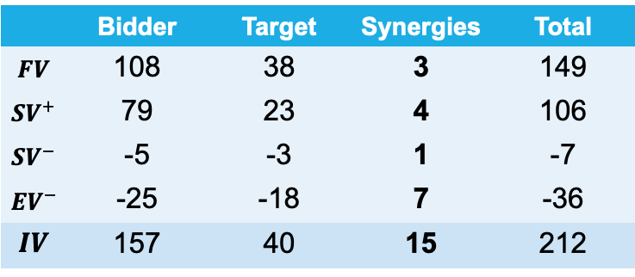
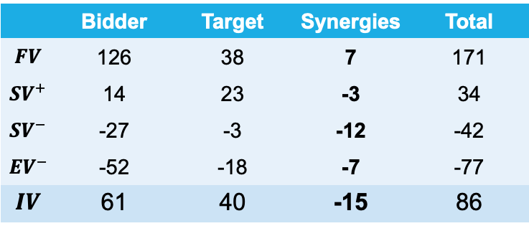
Integrated M&A valuation
Top table shows the IV for a low-quality bidder
The financial synergies (7) are offset by the negative social (-15) and environmental (-7) synergies, resulting in overall negative synergies (-15)
Bottom table shows the IV for a high-quality bidder
Financial synergies are lower (3), but the high E&S quality bidder also realises positive social (5) and environmental (7) synergies
The high-quality bidder manages to improve the overall value creation profile of the combined company by 15
 | Bidder | Target | Synergies | Total
$$FV$$ | 126 | 38 | 7 | 171
$${SV}^{+}$$ | 14 | 23 | -3 | 34
$${SV}^{−}$$ | -27 | -3 | -12 | -42
$${EV}^{−}$$ | -52 | -18 | -7 | -77
$$IV$$ | 61 | 40 | -15 | 86
 | Bidder | Target | Synergies | Total
$$FV$$ | 108 | 38 | 3 | 149
$${SV}^{+}$$ | 79 | 23 | 4 | 106
$${SV}^{−}$$ | -5 | -3 | 1 | -7
$${EV}^{−}$$ | -25 | -18 | 7 | -36
$$IV$$ | 157 | 40 | 15 | 212

Slide 23
Kraft Heinz – Unilever case
Kraft Heinz attempted a takeover of Unilever in 2017
Kraft Heinz’s strategy was to maximise shareholder value, measured by EPS (earnings per share)
Using EPS multiples, Kraft Heinz estimated the financial value of the synergies to be €46 billion (left column)
An IPV analysis of the synergies based on a DCF model showed a value destruction of €63 billion (right column)
Conclusion: the estimated synergies depend very much on how the valuation analysis is conducted
Two main reasons for the differences:
IPV analysis includes not just financial value but all three value dimensions
Financial analysis was based on EPS maximisation strategy (achieving sales growth while cutting costs) while IPV analysis was based on DCF valuation (long-term fundamental value)
Financial analysis based on EPS |  | IPV analysis based on DCF
Value | Synergies | Value | Synergies
FV | 46 | FV | -11
 |  | SV | -38
 |  | EV | -13
FV | 46 | IPV | -63

Slide 24
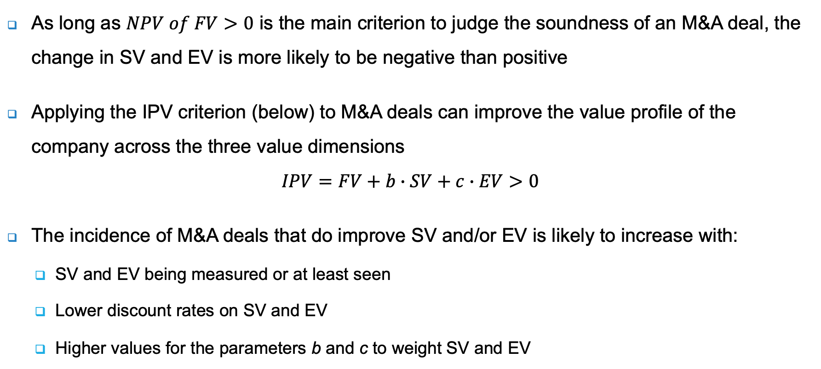
IPV criterion
As long as $NPV of FV>0$ is the main criterion to judge the soundness of an M&A deal, the change in SV and EV is more likely to be negative than positive
Applying the IPV criterion (below) to M&A deals can improve the value profile of the company across the three value dimensions
$$IPV=FV+b∙SV+c∙EV>0$$
The incidence of M&A deals that do improve SV and/or EV is likely to increase with:
SV and EV being measured or at least seen
Lower discount rates on SV and EV
Higher values for the parameters b and c to weight SV and EV

Slide 25
Integrated takeover test
The aftermath of the aborted takeover of Unilever by Kraft Heinz generated a debate on the ‘protection’ of companies steering on integrated value
Without protection, financial considerations (F) would always dominate social and environmental considerations (S+E)
De Adelhart Toorop, De Groot Ruiz and Schoenmaker (2017) propose a integrated value test for takeovers:
It is the responsibility of the management of both the acquiring and target company to conduct this test to obtain the integrated value of the joint companies
An independent advisor would give a fairness opinion on the outcome of the integrated takeover test

Slide 26
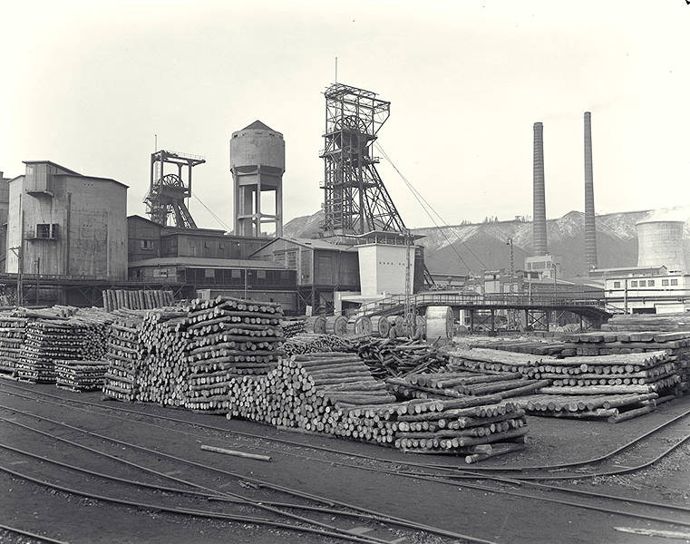
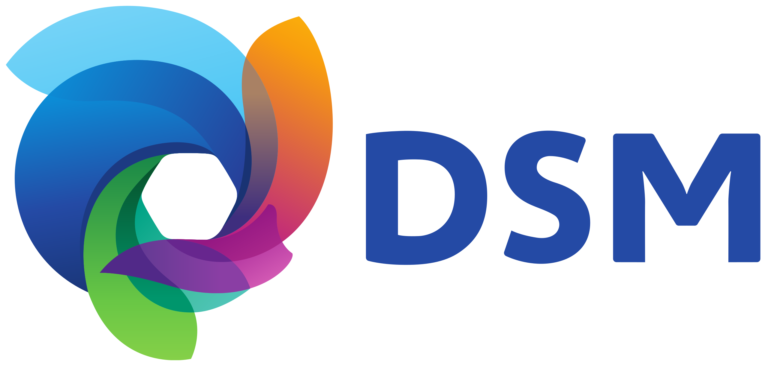
DSM’s transition through M&As
When the coal mines were closed in the 1970s, the Dutch government helped the transformation of DSM (Dutch State Mines) into a base chemicals company
Since the 1990s, DSM has transformed itself again, becoming a global science-based company for nutrition and health through a string of M&A deals
The DSM – Firmenich merger combines the health and nutrition divisions of DSM and the taste and perfume divisions of Firmenich
This merger completed the transition of DSM into a global leader in nutrition, beauty and wellbeing

Slide 27
Integrated view on M&A activism
M&A activism is typically justified by claims of value creation, but the key question is whether that value creation benefits all stakeholders (FV, SV and EV all rise)
It would be helpful if this distinction would already be made by managers, analysts, regulators, and reporters
Value creation
Value extraction
Improving FV, SV, and/or EV without hurting the other
Taking a share of value at the expense of FV, SV, and/or EV

Slide 28
Conclusions
M&A are very large investments in which a company absorbs another company, which can dramatically change the profile of a company’s assets
Value creation is often more likely if there are synergies between the companies involved
Large numbers and big stakes in M&A make behavioural issues more problematic
If not properly understood and considered, E and S issues can reduce the company’s financial value (illustrated by Bayer’s acquisition of Monsanto)
An integrated perspective on M&A valuation is needed
For large M&A deals, an integrated value test should be required

