Slide 1
Case Study: LVMH-Tiffany
With Professor Julian Zlatev (HBS) and Raseem Farook (HBS ’21)
Also drawing from: Guhan Subramanian & Caley Petrucci (HLS ’20), Deals in the Time of Pandemic, Columbia Law Review (forthcoming June 2021)
Guhan Subramanian (JD/MBA ’98), Joseph Flom Professor of Law & Business, Harvard Law School Douglas Weaver Professor of Business Law, Harvard Business School Faculty Chair, Harvard Law School Program on Negotiation (www.pon.harvard.edu)

Slide 2

M&A Sequencing
Q: Is COVID-19 a Material Adverse Effect that allows the buyer to walk away?
Planning
Negotiation
Processing
Sign
and announce
Shareholder meeting(s)
Close;
Transfer title
Pre-Signing Phase
Post-Signing Phase

Slide 3
The General Structure of MAE’s
General Rule: Buyer can generally walk if the target experiences a Material Adverse Effect between signing and closing.
Akorn v. Fresenius (2018): “the occurrence of unknown events that substantially threaten the overall earnings potential of the target in a durationally-significant manner.”
“Material Adverse Effect” means any state of facts, circumstance, condition, event, change, development, occurrence, result or effect . . . that has a material adverse effect on the financial condition, business, assets, or results of operations of the Business,
Except that the following things shall not be MAEs: [long list of “carveouts”]
Except that in the case of [certain carveouts], they become MAEs again if “the Business is materially and disproportionately adversely affected thereby as compared to similarly situated businesses in the industry of the Business.”
MAE Clause
MAE Exceptions (or Carveouts)
Disproportionality Carvebacks

Slide 4
The Growth of the MAE Clause (2005-2020)
From: Guhan Subramanian & Caley Petrucci, Deals in the Time of Pandemic, Columbia Law Review (forthcoming June 2021)

Slide 5
The General Structure of OCCs
[T]he Company shall, and shall cause each of its Subsidiaries to,
(A) conduct its business in all material respects in the ordinary course of business consistent with past practice and
(B) use commercially reasonable efforts to preserve intact its current business organization, assets, technology and franchises, keep available the services of the employees of the Company and its Subsidiaries, maintain in effect all of its material Permits, and maintain relationships with its significant customers, suppliers and distributors, and other Persons with which it has significant business relations.
[+ typically many negative covenants]
General Affirmative OCC
Specific Affirmative OCC

Slide 6
The Overlooked Implications of the OCC
Matt Levine, Bloomberg News (April 2020): “I assert that there are zero businesses in the United States right now that are running ‘in the ordinary course consistent with past practice.’”
Rob Kindler, Vice Chairman and Global Head of M&A, Morgan Stanley (June 2020): “Lawyers should have examined every . . . other provision in the merger agreement that could be implicated by the MAC. They . . . caught just half the problem. A pandemic is not a MAC but everything that flows from it is going to breach your covenants? I just can’t fathom how this happened.”
Prominent M&A Attorney (Sept. 2020): “If you had told me in 2019 that there was going to be a global pandemic, and asked me what clauses in the merger agreement were going to be implicated, I wouldn’t have picked the ordinary course covenant.”

Slide 7
Case Study: LVMH-Tiffany
October 2019: LVMH opens new plant to make Louis Vuitton handbags in Texas.
November 24, 2019: LVMH announces deal to acquire Tiffany for $135 per share in cash, or $16.2 billion in total value.
June 9, 2020: Tiffany reports a 44% drop in sales for the first quarter of 2020 due to COVID store closures.
August 31, 2020: LVMH receives a letter from the French Minister of Foreign Affairs requesting LVMH to delay the closing until January 6, 2021 [outside the drop-dead date of November 24, 2020].
September 9, 2020: LVMH backs out of the deal. Tiffany’s sues in Delaware Chancery Court on the same day; trial scheduled for early January 2021.
October 28, 2020: Tiffany and LVMH agree to a new deal at $131.50 per share (2.6% price reduction), or $425 million lower value.

Slide 8
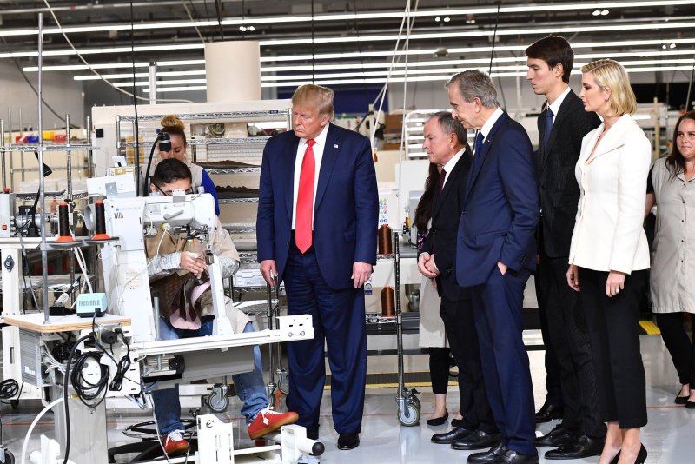
Deal Setup: LVMH Factory in Texas (Oct 2019)

Slide 9
The French Letter (August 31, 2020)
. . . [B]ecause the implementation of these tariffs may affect France’s external relations, for which my department is responsible, proposed investments by French companies in sectors that could be subject to such sanctions must be reevaluated in light of this new context.
My attention was drawn to the most important current investment, which is your Group’s pending acquisition of Tiffany.
In order to support the steps taken vis-a-vis the American government, you should defer the closing of the pending Tiffany transaction until January 6, 2021.
I am sure that you will understand the need to take part in our country’s efforts to defend its national interests.
Sincerely yours,
[Minister of Foreign Affairs]

Slide 10
Tiffany Ordinary Course Obligation
[T]he Company shall, and shall cause each of its Subsidiaries to, except as . . . consented to in writing by Parent (such consent not to be unreasonably conditioned, withheld or delayed) . . .
conduct its business in all material respects in the Ordinary Course of Business and, in connection therewith and to the extent consistent with the Ordinary Course of Business, shall use and cause each of its Subsidiaries to use their respective commercially reasonable efforts to preserve its and its Subsidiaries’ business organizations substantially intact, . . .
“Ordinary Course of Business” means, with respect to any Person, the conduct by a Person of the relevant business in the ordinary course.

Slide 11
Billionaire Arnault On The Offensive After Tiffany Pays Out $140 Million Pandemic Dividends Despite $32 Million In Losses Forbes (Sept. 15, 2020)
Billionaire Bernard Arnault’s deal to bring U.S. jewelery giant Tiffany & Co. into the LVMH family for $16 billion has been damaged by LVMH anger over the $70 million per quarter in dividends Tiffany has paid its shareholders during the pandemic . . .
. . . [T]he major bone of contention for LVMH has been the generous dividend payments Tiffany has made to shareholders since the deal was announced, especially those paid out in May and August during the pandemic, which total $140 million, an amount described by the source as “kind of bananas” and “literally burning cash.” An additional $70 million is set to be paid out in November despite a potential extended lockdown period. . . .
Tiffany & Co.—which suffered a net loss of $32.7 million during the first half of 2020, compared to a $261 million profit over the same period in 2019—told Forbes that LVMH knew about Tiffany’s dividend policy.
The November 2019 merger agreement confirmed that Tiffany would “continue to declare and pay its regular quarterly dividends in an amount not to exceed $0.58 per share and in a manner consistent with past practice.”
Tiffany has paid 131 consecutive quarterly dividends since 1988 shortly after the IPO and has never missed one, including during periods of economic downturn.

Slide 12
LVMH-Tiffany: The Act of God Carveout
"Material Adverse Effect" means any Effect that, individually or in the aggregate with all other Effects, (a) has had or would be reasonably expected to have a material adverse effect on the business, condition (financial or otherwise), properties, assets, liabilities (contingent or otherwise), business operations or results of operations of the Company and its Subsidiaries . . .
provided, however . . . no Effect arising out of or resulting from any of the following shall be deemed either alone or in combination to constitute a Material Adverse Effect: . . . (viii) any hurricane, tornado, flood, earthquake or other natural disaster . . .

Slide 13
Specific “Act of God” & Related Carveouts
✓
= Included in LVMH-Tiffany (=> LVMH bears risk)
X
= Not included (=> Tiffany bears risk)
✓
X
✓
✓
✓
X
X
X
* “Pandemic” includes carveouts for any of: pandemic, epidemic, illness, disease, influenza, quarantine, and public health.

Slide 14
The Absence of a Pandemic Carveout
LVMH: “Notably absent from this list of highly negotiated carve-outs, several of which Tiffany’s counsel expressly requested during negotiation of the Agreement, is an exclusion for public health events, much less pandemics. . . .
Among these [prior deals that included a pandemic carveout] was a contract executed on the day before the Agreement, for a prospective $6.8 billion transaction in which the buyer was represented by Tiffany’s M&A counsel—indeed, by the very same two attorneys from Sullivan & Cromwell who negotiated the Agreement on behalf of Tiffany.
Accordingly, when Tiffany’s counsel wants to carve out pandemics in a Material Adverse Effect clause, they know how to do so expressly and clearly, which has not been the case here.”
Tiffany: “Before February 2020, only a small fraction of merger agreements include an explicit pandemic carve-out. . . .”
From: LVMH’S Verified Counterclaim and Answer to Verified Complaint (Sept. 28, 2020) at ¶¶ 47-50; Tiffany & Co.’s Answer to Verified Counterclaim at 7 (Oct. 13, 2020).

Slide 15
LVMH-Tiffany: The ChEcon Carveout
"Material Adverse Effect" [does not include any] . . . Effect arising out of or resulting from . . .
(i) changes or conditions generally affecting the industries in which the Company and any of its Subsidiaries operate,
(ii) general economic or political conditions (including U.S.-China relations), commodity pricing or securities, credit, financial or other capital markets conditions, in each case in the United States or any foreign jurisdiction in which the Company or any of its Subsidiaries operate,

Slide 16
The Meaning of the ChEcon Carveout
LVMH: “[T]he Material Adverse Effect definition in the Agreement excludes only effects “arising out of or resulting from” any of the carved out events.
This means that the exclusions must be “causal” – the exclusions must have caused the Material Adverse Effect.
Here the Material Adverse Effect resulted from the Pandemic . . . and not general economic or political conditions.
For that reason, the generic carve-outs offer Tiffany no protection from harm caused by the Pandemic. . . .
From: LVMH’S Verified Counterclaim and Answer to Verified Complaint (Sept. 28, 2020) at ¶¶ 47-50

Slide 17
The Meaning of the ChEcon Carveout (cont)
Tiffany: “Every general economic or industry condition has an underlying cause, whether it be a credit crisis, an oil shortage, a stock-market crash, a terrorist attack or a pandemic.
The drafters of a merger agreement need not anticipate every conceivable cause of an industry-wide decline and specifically identify each of those causes in the MAE definition for the broad exclusions for general economic or industry conditions to have effect.
If they did, the definition of an MAE would go on for pages, and the broad exclusions would be rendered meaningless.”
From: Tiffany & Co.’s Answer to Verified Counterclaim at 7 (Oct. 13, 2020).

Slide 18
A Legal Drafting Solution
Delta/Northwest (2008): requires each of Northwest and Delta to “conduct its business in the ordinary course for the airline industry, provided if changing events or circumstances warrant otherwise, each of Northwest and Delta may conduct its business in a commercially reasonable manner in light of such events or circumstances.”
Baker Hughes/General Electric (2017): “. . . provided that strategic decisions to restructure businesses, mothball assets or reduce or increase headcount as a result of changes to market or competitive conditions if commercially reasonable will be deemed to be in the ordinary course and consistent with past practices . . . to the extent such actions are (i) consistent with actions taken in the thirty-six (36) month period prior to the date of this Agreement and (ii) consistent with actions being taken by competitors . . . .”
Or perhaps “commercially reasonable best efforts” implies the ability to take actions outside the ordinary course in extraordinary times.

Slide 19
A Potential Judicial Solution
Courts could read the ordinary course covenant to allow extraordinary actions in extraordinary times (particularly if the OC covenant does not require “consisten[cy] with past practice” and/or only requires “commercially reasonable best efforts”)
But such a reading seems contrary to the plain language of the ordinary course requirement; seems to give the target company a “get out of jail free” card in extraordinary times.
From: Guhan Subramanian & Caley Petrucci, Deals in the Time of Pandemic, Columbia Law Review (forthcoming June 2021)

Slide 20
A Business Solution
Courts should read the ordinary course covenant according to its plain words, which would then force a socially desirable negotiation between buyer and seller over an appropriate mitigation strategy:
Avoids moral hazard problem of seller playing with “house money.”
Explicitly invited by MAE clauses and Ordinary Course covenants that provide exceptions for buyer consent.
Buyer cannot act opportunistically if such consent “cannot be unreasonably withheld.” (which is true in 79% of deals)
If buyer rejects seller’s proposed mitigation plan, seller can simply categorically agree to buyer’s counter-proposal for mitigation.
From: Guhan Subramanian & Caley Petrucci, Deals in the Time of Pandemic, Columbia Law Review (forthcoming June 2021)

Slide 21
Allocation of Risk in the Post-COVID World
Material Adverse Effect and Force Majeure provisions now heavily negotiated compared to pre-COVID times.
Pandemic risk universally allocated to buyer – no serious buyer would resist taking risk stemming from a “continuation or worsening of the COVID-19 pandemic.”
“Ordinary course” obligations increasingly providing “exit ramps” or “safety valves” for responses to crisis situations.
Parties increasingly stipulating the target industry for “disproportionality” analysis (which allocates risk back to target).
From: Guhan Subramanian & Caley Petrucci, Deals in the Time of Pandemic, Columbia Law Review (forthcoming June 2021)

