Slide 1

Investor Presentation
First half – June 2018
Robin Fleming – Group Chief Executive Officer
28 August 2018

Slide 2
Disclaimer
NOT FOR PUBLICATION OR DISTRIBUTION, DIRECTLY OR INDIRECTLY
This presentation has been prepared and issued by Bank of South Pacific Limited (the “Company”), and may not be reproduced in whole or in part, nor may any of its contents be disclosed to any other person without the prior written consent of the Company.
This presentation is provided by the Company for general information purposes only, without taking into account any recipient’s personal objectives, financial situation or needs. It should not form the basis of or be relied on by the recipient in considering the merits of any particular transaction and does not purport to contain all of the information that an interested party may desire. It is not an offer to buy or sell, or a solicitation to invest in or refrain from investing in, any securities or other investment product. This presentation has not been filed, lodged, registered, reviewed or approved by any regulatory authority in any jurisdiction and recipients of this presentation should keep themselves informed of, and comply with and observe, all applicable legal and regulatory requirements. The distribution of this presentation in certain jurisdictions may be restricted by law and, accordingly, recipients of this presentation represent that they are able to receive this presentation without contravention of any unfulfilled registration requirements or other legal restrictions in the jurisdiction in which they reside or conduct business. Nothing in this presentation constitutes investment, legal, tax, accounting or other advice. The recipient should consider its own financial situation, objectives and needs, and conduct its own independent investigation and assessments of the contents of this presentation, including obtaining investment, legal, tax, accounting and other advice as it considers necessary or appropriate. Any costs incurred by recipients in making such investigations and assessments, etc. are not the responsibility of the Company or any of its advisers, directors, employees or agents.
Provision of this presentation is not a representation to any recipient or any other person that the shares or business of the Company or any of its subsidiaries will be sold. The Company may at any time negotiate with one or more interested parties and enter into a definitive agreement without prior notice to any or all interested parties. The Company also reserves the right to terminate, at any time, further participation in the investigation and proposed process by any party, to modify any of the rules or procedures set forth herein or any other procedures without prior notice or assigning any reason therefore or to terminate the process contemplated hereby. The Company reserves the right to take any action, whether in or out of the ordinary course of business, which the Company in its sole discretion deems necessary or prudent in the conduct of its business or the process contemplated by this presentation.
This presentation has been prepared on the basis of publicly available information and/or selected information and does not purport to be all-inclusive or to contain all of the information that may be relevant to the presentation. Neither the delivery or supply of this presentation (or any part thereof) nor the provision of information referred to herein or provided in connection with the evaluation of the Company by interested parties shall, under any circumstances, (a) constitute a representation or give rise to any implication, that there has been no change in the affairs, business or financial position of the Company or any of its subsidiaries, associated companies or affiliates or in the information herein since the date hereof or the date on which this presentation has been provided or delivered or (b) provide a basis of any credit or other evaluations and should not be considered as a recommendation by the Company that any recipient of the presentation or such other document or information contemplated herein should proceed with a further investigation of the Company or enter into any transaction with the Company or any person in relation to the Company. Neither the Company nor any other person are under any obligation to update or correct this presentation.
The Company and its related bodies corporate and other affiliates, and their respective officers, employees, advisors, representatives, consultants and agents (“Relevant Parties”) make no representation or warranty, expressed or implied, as to, and no reliance should be placed on, the fairness, accuracy, completeness, timeliness or reliability of the contents of this presentation or any other written or oral communication transmitted or made available to any interested party, whether as to the past or future. To the maximum extent permitted by law, none of the Relevant Parties accept any liability (including, without limitation, any liability arising from fault of negligence on the part of any of them) for any loss whatsoever arising from the use of this presentation or its contents or otherwise arising in connection with it or as a result of any omission, inadequacy or inaccuracy herein. Only those representations and warranties that are provided in a definitive agreement when, and if, it is executed, and subject to such limitations as may be provided in such agreement shall have any legal effect. This presentation may contain forward-looking statements, forecasts, estimates and projections (“Forward Statements”). No independent third party has reviewed the reasonableness of any such statements or assumptions. None of the Relevant Parties represents or warrants that such Forward Statements will be achieved or will prove to be correct. Actual future results and operations are subject to significant business, economic and competitive uncertainties and contingencies, many of which are beyond the control of the Company, and could vary materially from the Forward Statements. Similarly, no representation or warranty is made that the assumptions on which the Forward Statements are based may be reasonable. No audit, review or verification has been undertaken by an independent third party of the assumptions, data, historical results, calculations and forecasts presented. In receiving this presentation, each recipient acknowledges that it shall not deal or cause or procure any person to purchase, acquire, dispose of or deal in any securities of the Company in breach of any laws and regulations relating to insider dealing, market abuse or securities in general of Singapore and elsewhere.
The recipient acknowledges that no person is intended to act or be responsible as a fiduciary to the recipient, its management, stockholders, creditors or any other person. By accepting and providing this presentation, the recipient expressly disclaims any fiduciary relationship with any person and agrees that the recipient is responsible for making its own independent judgements with respect to any transaction and any other matters regarding this presentation.
The Company is not authorised under the Banking Act 1959 (Cth) (the "Banking Act") and is not supervised by the Australian Prudential Regulation Authority. The Company's products are not covered by the depositor protection provisions in section 13A of the Banking Act and will not be covered by the financial claims scheme under Division 2AA of the Banking Act.
2
2

Slide 3

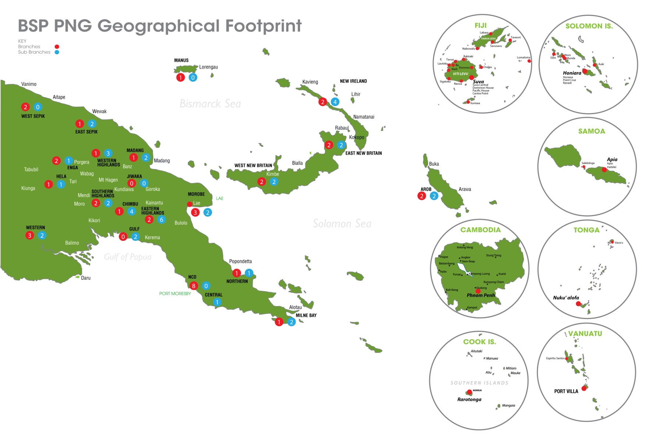
Markets where BSP operates
BSP is the leading financial services provider in the markets we operate
# 1
Loan market share in 4 x markets
# 1
Deposit market share in 4 x markets
POMSOX
Market cap of K4.67b [30 June 2018]
INVESTOR PRESENTATION Half year 2018
3

Slide 4








BSP’s growing service offering
In line with BSP’s geographical and income diversification strategy, BSP has expanded its product / service offering into both existing and new markets.
Papua New Guinea
Solomon Islands
Fiji
Samoa
Cook Islands
Vanuatu
Tonga
Cambodia
Bank
Bank
Bank
Bank
Bank
Bank
Bank
Finance
Finance
Finance
Finance
BSP’S TOP 10 SHAREHOLDERS
Rank | Name | % Held
1 | Kumul Consolidated Holdings | 18.0%
2 | Nambawan Super Ltd | 12.3%
3 | Petroleum Resources Kutubu Ltd | 9.9%
4 | National Superannuation Fund Ltd | 9.7%
5 | Credit Corporation (PNG) Ltd | 7.1%
6 | Motor Vehicles Insurance Ltd | 6.7%
7 | PNG Sustainable Development Program Ltd | 6.2%
8 | Fiji National Provident Fund Board | 4.1%
9 | Teachers Savings & Loan Society Ltd. | 3.3%
10 | Comrade Trustee Services Ltd | 3.1%
Life
Life
BSP Capital
KEY
New operations in 2017/2018
INVESTOR PRESENTATION Half year 2018
4

Slide 5

Financials
Sub - title of Presentation
Slide 1
5

Slide 6
Highlights for first half of 2018 [YTD June]
BSP continues its strong performance … despite challenging business and economic environments.
Profit (NPAT) up 12.8% YOY to
K418.3m
Cost to income ratio improves to 41.1%
Capital adequacy 22.7%
Total income up 8.0% YOY to
K1.06bn
Total assets up 5.6% YOY to
K22.9bn
Loan provisions down
4.7%
Dividend yield of
12.4%
ROE up to
30.7%
GROUP NPAT TREND [Km]
INVESTOR PRESENTATION Half year 2018
6

Slide 7
Group key ratios
Our key ratios are trending favourably … a clear picture of our corporate health.
COST TO INCOME TREND
ROE AND ROA TRENDS
PROVISION AND NPL TO LOANS
CAPITAL ADEQUACY
INVESTOR PRESENTATION Half year 2018
7

Slide 8
Group key performance indicator trends
BSP’s loans and deposits continues to grow despite competitor and economic challenges
NET LOAN TRENDS
[Km]
TOTAL ASSETS TRENDS
[Kb]
CAGR 12.3%
CAGR 7.7%
DEPOSIT TRENDS
[Kb]
DEPOSIT MIX TRENDS
[Kb]
CAGR 7.7%
INVESTOR PRESENTATION Half year 2018
8

Slide 9
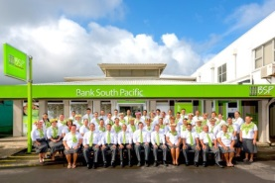
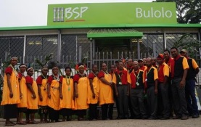
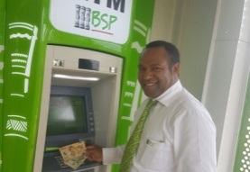
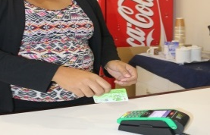
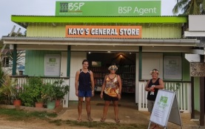
Continued investment to improve service
Our Digital Strategy continues to deliver enhanced coverage and banking services throughout the pacific region … with digital channels supported by our extensive branch network
 | Total
 | 82 | 46 | 17 | 8 | 3 | 2 | 2 | 4
 | 48 | 46 | 0 | 0 | 2 | 0 | 0 | 0
 | 524 | 316 | 115 | 30 | 21 | 11 | 19 | 12
 | 10,837 | 7,123 | 1,791 | 368 | 387 | 376 | 415 | 377
 | 577 | 371 | 43 | 76 | 35 | 9 | 23 | 20
Branches
Sub Branches
ATMs
EFTPOS
Agent
INVESTOR PRESENTATION Half year 2018
9

Slide 10







Market strength
BSP’s combined loan market share stood at 42% at 30-Jun-18, an increase of K813m in the first half of 2018. Our combined deposit share is 45%, an increase of K540m
LOANS MARKET SHARE
DEPOSIT MARKET SHARE
 | Rank
 | #1
 | #1
 | #1
 | #1
 | #2
 | #2
 | #4
 | Rank
 | #1
 | #1
 | #1
 | #1
 | #2
 | #2
 | #4
LOANS PORTFOLIO COMPOSITION
DEPOSIT PORTFOLIO COMPOSITION
INVESTOR PRESENTATION Half year 2018
10

Slide 11
Q2-2018 results
INVESTOR PRESENTATION Q2, 2018
11

Slide 12
Profit and Loss [Q2-2018]
BSP’s Q2 profit grew by 11% year on year notwithstanding a slight increase in operating expenditure
 | Total Income | Operating costs | Cost to income | NPAT
PCP | 10.1% | 8.2% | (2.4)% | 12.2%
YOY | 11.0% | 17.6% | 5.9% | 10.3%
HIGHLIGHTS
Q2 2018 Operating income is 10% higher than Q1 2018, driven by higher interest on loans [due to higher volumes], higher liquids income, and higher FX income and proceeds from aircraft loss [proceeds of K19.2m and corresponding loss booked in expenses of K13.6m, a net gain K5.6m]
Total operating cost increased by 8.2% from Q1 2018 mainly due to non-lending losses and loss on fixed assets [mentioned above]
Cost to income ratio improved to 40.6% in the quarter
BSP GROUP QUARTERLY P&L
[Km]
Key:
PQ = prior quarter
YOY = year on year
INVESTOR PRESENTATION Q2, 2018
12

Slide 13
Balance sheet [Q2-2018]
Our balance sheet continues to strengthen with increase in both loans and deposits
 | Loans and advances | Deposits | Total Assets | Total Liabilities | Net assets / SH equity
PQ | 3.3% | 0.6% | (0.1)% | 1.1% | (8.7%)
YOY | 13.1% | 4.4% | 5.9% | 5.1% | 11.7%
HIGHLIGHTS
Total loan increased by K358m in Q2 2018 [PNG +K229m, Fiji K100m, SI K16m and other OSBs and SUBs + K12m]
PNG SBU loan movements – Corporate +K258m, Retail +K48m
Total deposits increased by K113m in the quarter. [PNG +K100m, Fiji -K61m, SI +K13m, other OSBs and SUBs +K61m]
Total assets saw a slight drop from last quarter due to reduced T’bills maturity
FX translation in Q2 increased; loans –K44m and Deposits +K166m due to the Kina weakening against currencies of BSP offshore assets
BSP GROUP QUARTERLY BALANCE SHEET
[Kb]
Key:
PQ = prior quarter
YOY = year on year
INVESTOR PRESENTATION Q2, 2018
13

Slide 14
Group key ratios [Q2-2018]
All key ratios are continue with upward recent trends.
COST TO INCOME TREND
ROE [annualised]
ROA [annualised]
LOAN TO DEPOSIT RATIO
INVESTOR PRESENTATION Q2, 2018
14

Slide 15
Group key risk ratios [Q2-2018]
Our risk ratios remain stable and asset quality remains sound
CAPITAL ADEQUACY
HIGHLIGHTS
BSP’s capital adequacy ratio declined slightly to 22.7% in Q2-18, due to dividend payout … but remains well in excess of the 12% prudential requirement.
BSP’s Provisions to Loans ratio in Q2-18 improved from the previous quarter to 4.7% … due to an increase in gross loans, coupled with minimal change to provisions.
BSP’s prudent provisioning policies has ensured that the banks operating results are not adversely impacted as a result of the transition to IFRS 9. Management overlay provisions taken up in anticipation of IFRS 9 have adequately catered for the changes in required provisions under the new standard, while residual overlay provisions have been largely retained as ‘model adjustments’, to cater for factors outside the IFRS 9 model assumptions
22.7%
PROVISIONS TO LOANS
INVESTOR PRESENTATION Q2, 2018
15

Slide 16
Channels [Q2-2018]
Mobile banking is our leading [33%] channel, with branches representing only 13% of total transactions in Q2-2018 … given continued focus to reduce customers cash dependency [in-line with our digital strategy] with ongoing investment in EFTPOS, internet and mobile banking.
QUARTERLY CHANNEL TRENDS [Q2-2018]
INVESTOR PRESENTATION Q2, 2018
16

Slide 17
Share price
Dividend yield of 12.4%, based on K10.01 share price, with market capitalization of K4.67b as at end of June.
01st June 2017 to 30th June 2018
K4.67b Market Cap
Share Price K9.48
28 Apr’17
Share Price K10.01
30 June 18
INVESTOR PRESENTATION Q2, 2018
17
Notes:
PE Ratio = Price per share/EPS
EPS= Net income – dividends on preferred stock /Average outstanding shares
= 757, 003m/467,318m
= 1.62
PE = 9.5/1.62= 5.5 times
Dividend Yield = Annual Dividends/Price per share ( 2016 full 0.79+0.32 2017 interim)
= 111/10.01 * 100 = 11.1%

Slide 18
Thank You
Slide 1
Sub - title of Presentation
18

