Slide 1

Introduction to Capital IQ
WHARTON RESEARCH DATA SERVICES
April, 2020
Eunji Oh, Ph.D.

Slide 2
Agenda
1
Capital IQ Overview
2
Capital IQ Products on WRDS
3
Capital IQ products Schema

Slide 3
Capital IQ
Founded in 1999 and acquired by Standard & Poor’s in 2004
Provides financial information and workflow solutions to financial institutions
Real-time market data, back-testing, portfolio management, financial modeling, quantitative analysis
Capital IQ products on WRDS
Compustat
Capital IQ Xpressfeed via WRDS

Slide 4
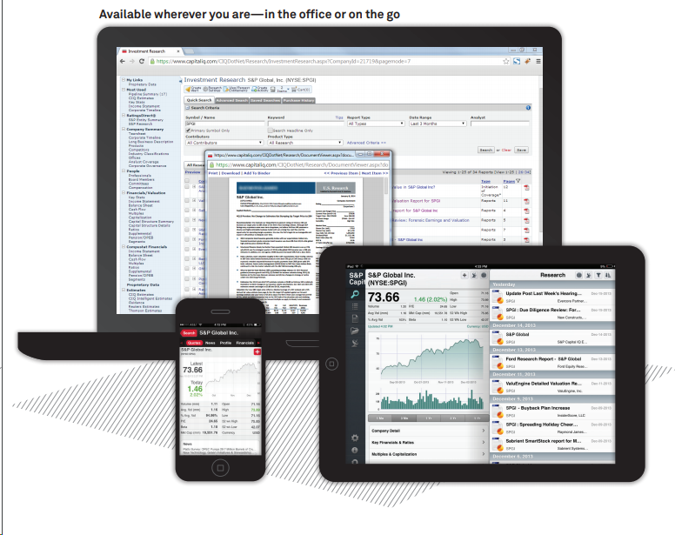

Capital IQ on WRDS
Capital IQ Web Portal
Structured Datasets
Capital Structure
Transactions
People Intelligence
Key Developments
Transcripts

Slide 5
Comparison
Capital IQ Portal
Web interface
Company-oriented interface
Real time & dynamic data
Short historical data
Data fields contain most current information
Capital IQ via WRDS
Structured data (XpressfeedTM)
Various options to access to and work with the bulk data
WRDS cloud (SAS, Stata, Python, R, Matlab, Postgresql)
Web query for direct download
All historical data is available
Quarterly updates
Each product has different update schedule (quarterly to annually)

Slide 6
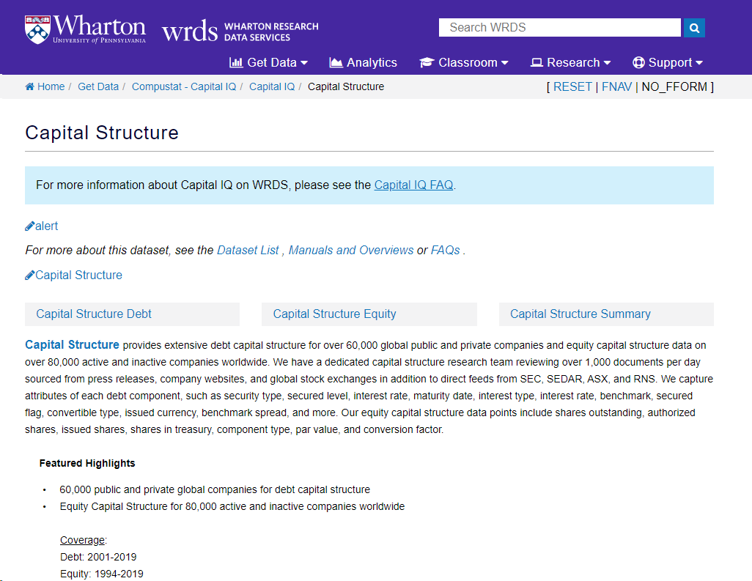
Capital IQ – Capital Structure
Capital Structure
Extensive detailed debt and equity capital structure for global public and private companies
Point-in-time database
Debt structure goes back to 2001
Equity structure goes back to early 1990s
Sources: press releases, company websites, global stock exchange, SEC, and etc.

Slide 7
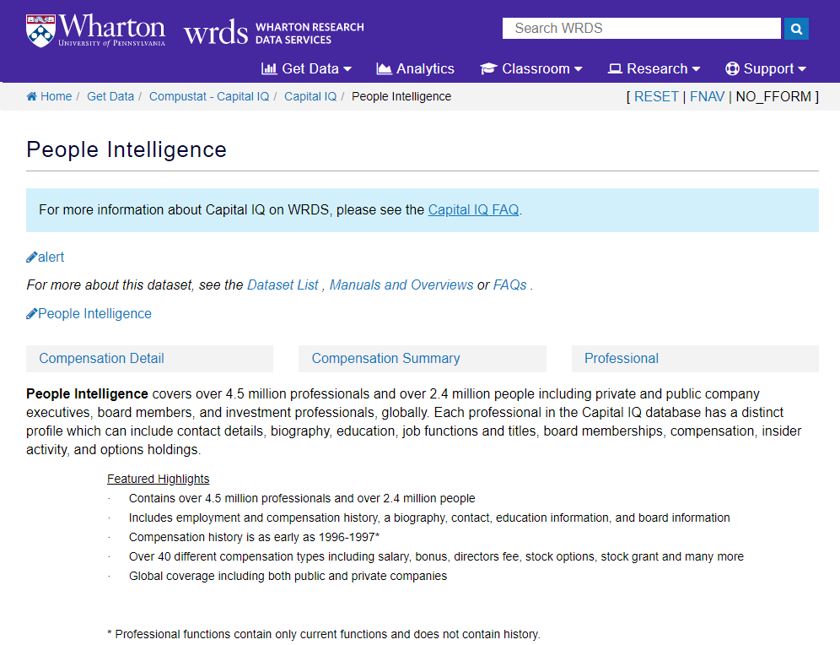
Capital IQ – People Intelligence
People Intelligence
Professional and compensation data for executive and directors of global companies
Other descriptive information included is Biographies, Specialties, Job Functions, Coverage, and Educational Relationships
Data goes back to 1992
Sources: proxies, public records, regulatory filings

Slide 8
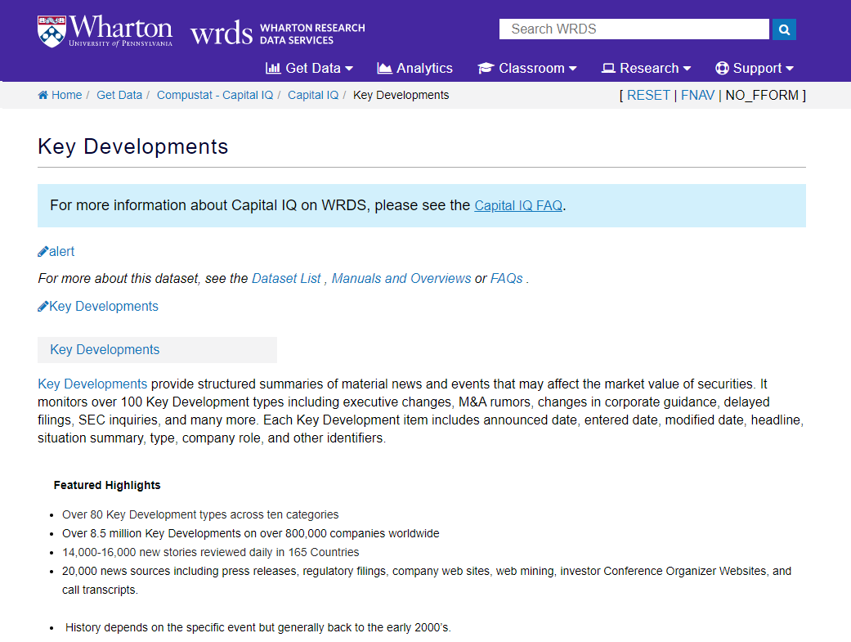
Capital IQ – Key Developments
Key Developments
Material news and events that may affect the market value of securities
165 event types with announcement date
Significant coverage starts from 2003
Sources: press releases, news wires, regulatory filings, exchanges, company web sites, web mining (significant percentage), and call transcripts (2009+)

Slide 9
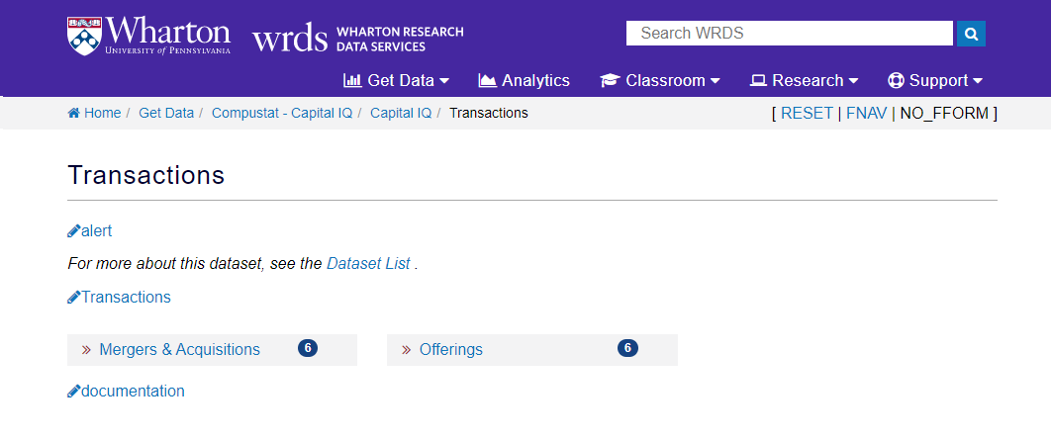
Capital IQ - Transactions
Transactions
Detailed data and analysis of corporate entity transactions
About 2 million transactions across the globe
Deals with non-corporate entities are covered, including government institutions, educational institutions, and etc.
Significant coverage starts from 1998 for US data

Slide 10
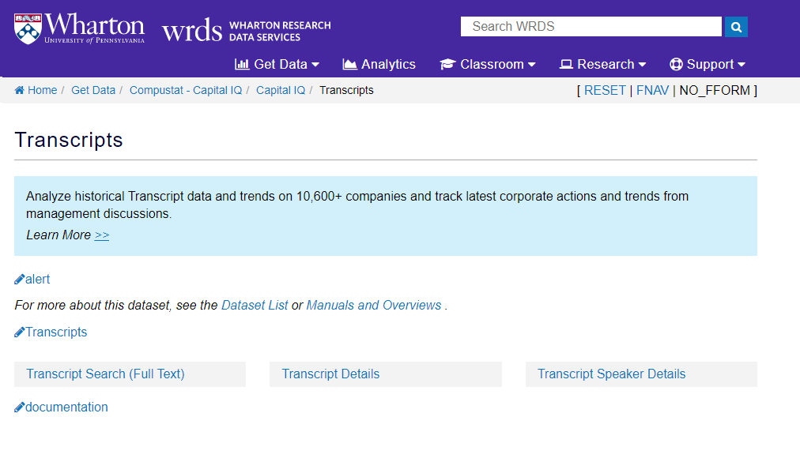
Capital IQ - Transcripts
Transcripts
Historical conference call transcripts around the world covering around 8,000 public companies
Earnings conference calls, Conference presentations, M&A calls, Shareholder calls, and etc.
Language: English
Significant coverage starts from 2008
Sources: Call recordings, Other data vendors
+
Full text data accessible on WRDS cloud

Slide 11
Use case of Capital IQ products
Example: In-depth analysis on multiple M&A events using Transcripts, Key developments, People Intelligence, Transactions
M&A Call Event
M&A Call Transcript
KeyDevId
CompanyId, Date
ProID
Executives information
Compustat
M&A Transactions Event
GVKEY-CompanyId Link
M&A Transactions Details
CompanyId, Date

Slide 12
Related videos
More detailed information will be covered in separate videos:
How to pull Capital IQ data
Capital IQ identifiers
Capital IQ Transcripts
Capital IQ Key Developments
And so on

Slide 13


