Slide 1

Raising Capital
Andrew Kelley, III
CEO, Bell Creek Partners
www.linkedin.com/in/kelleyan

Slide 2
Legal Disclaimer
Bell Creek Partners is the d.b.a. for Exfitech, LLC which is a Delaware limited liability corporation providing management consulting services to private equity firms.
The information provided herein is for informational purposes only, should not be considered legal or financial advice, and you should consult with an attorney to determine or registered investment professional should you need to raise capital.
Bell Creek Partners nor any of its principals, directors, employees or representatives is providing you any investment advice.
Bell Creek Partners assumes no responsibility or liability for any errors or omissions in this content which is provided on an “as is” basis with no guarantees of completeness, accuracy, usefulness or timeliness.
Bell Creek Partners is not an investment adviser, and is not registered with the Securities and Exchange Commission (SEC) or any state regulator and the company does not endorse or recommend the purchase or sale of any securities.
Bell Creek Partners is not a registered broker-dealer and is not regulated by the Financial Industry Regulatory Association (FINRA).
All logos, trademarks, services marks, etc are the property of their respective owners.
Private & Confidential

Slide 3
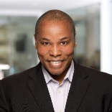










Biography: Andrew Kelley, III
Andrew Kelley is a global technology executive. He is CEO of Bell Creek Partners consulting to lower middle market private equity firms.
Previously he was with Vista Equity-backed Omnitracs as President of Haulme and VP Corporate Development. Prior to that, he worked at Dell focused mostly on venture investing including Nutanix, a successful $2B IPO. Overall he has executed $30B of combined M&A and investments mostly with UBS Investment Bank’s Technology, Media & Telecom group.
He began his professional career co-founding Virtual Ink at MIT in 1997 and that product, mimioTM, is now part of Boxlight Corporation. Andrew has an MBA from Harvard Business School, an MSME from MIT, and a BSME from North Carolina State University.
Andrew Kelley, III
CEO
www.linkedin.com/in/kelleyan

Slide 4
Raising Capital Outline
Types & Sources of Capital
Deep Dive on Venture Capital (VC)
Alternative Paths to Entrepreneurship
1
2
3
www.linkedin.com/in/kelleyan

Slide 5
Types & Sources of Capital

Slide 6











VCPE Funds Led by Blacks & Women
Good news: Firms run by Blacks and Women are on the rise
Bad news: This still represents only about 1% of all US GPs

Slide 7
Overview of Capital Sources
A balance sheet mindset helps think through capital sources
The cost of capital for these various sources may impact how much equity you ultimately give up
Capital Sources | Cost of Capital | Where to go | Pros | Cons
Cash | 0% - 3% | Friends & Family | Your counterparty already knows and trusts you Bootstrapping is good | Awkward Thanksgiving dinners if things go wrong Limited availability
Debt | 8% - 15% | Lenders | Relatively low cost of capital | Not available without ARR or EBITDA
Equity | 20% - 50% | Accelerators, Angels, VCPE firms | Potential to be transformative Multiple different sources available | Highest cost of capital May take 6 – 12 months to raise

Slide 8
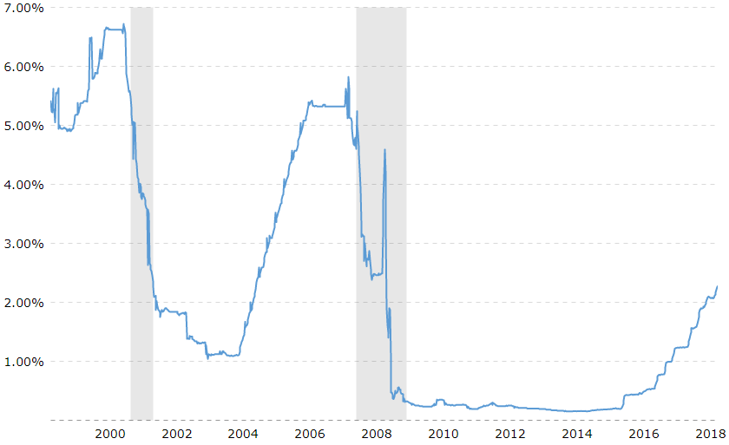
Debt Capital Sources
Even for convertible debt there has to be a promise or ARR or EBITDA
A ‘strong credit’ has good cash flow, credit metrics, and favorable dynamics
Credit cards
Convertible notes
SBA loans
Bank debt
Typical for seed rounds
Kicks can on valuation
May have cap & coupon
30-day US LIBOR
Some will lend at 1x ARR
Later stage is 3x – 6x debt/ EBITDA
Could be around LIBOR + 600 area
www.linkedin.com/in/kelleyan

Slide 9

Equity & Equity-Linked Sources
Friends & Family
Angel Investors
Accelerators
VCs
Mezzanine Lenders
Growth Equity
Private Equity
Public Equity
Increasing Raise Size
www.linkedin.com/in/kelleyan

Slide 10














Accelerators
Good networking opportunity and support typically for seed to Series B
May add a stamp of credibility if company ‘graduates’
May or may not take equity in your business

Slide 11
Angel Investors
Typically write $25K - $1M checks & so more than friends & family
High net worth individuals that you know or can get to through a friend
You will need to work your own personal network
Selected Individuals
Selected Investor Groups
1) Fabrice Grinda (245 investments)
2) Paul Buchheit (135 investments)
3) Wei Guo (129 investments)
4) Alexis Ohanian (126 investments)
5) Scott Banister (126 investments)
6) Naval Ravikant (121 investments)
7) Daniel Curran (114 investments)
8) Marc Benioff (113 investments)
9) Mark Cuban (110 investments)
10) Simon Murdoch (99 investments)
Source: Forbes
1) Lifescience Angels
2) Queen City Angels
3) Boston Harbor Angels
4) Atlanta Technology Angels
5) Tech Coast Angels
6) Band of Angels
7) Pasadena Angels
8) Upstate Carolina Angel Network
9) Launchpad Venture Group
10) Keiretsu Forum
Source: CBI nsights

Slide 12
Deep Dive on Venture Capital (VC)

Slide 13
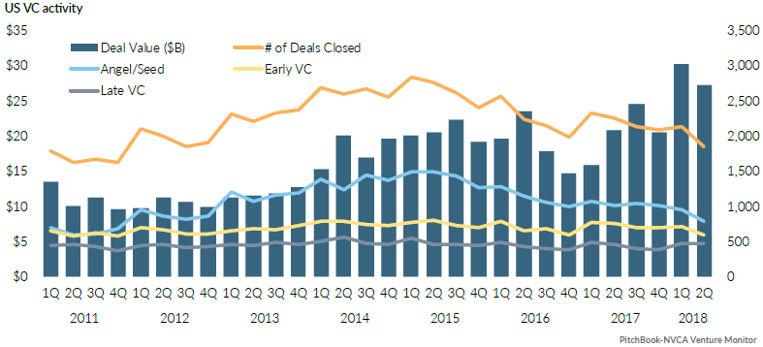
US VC Market Overview
There is a tremendous amount of VC money available
($ billions)

Slide 14
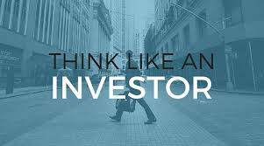
Think Like a VC
Begin with the end in mind and give yourself an opportunity to get your fair share
Know that your investor must eventually exit your investment opportunity
Ideally you’ll first find an investor who is a true partner who brings skills you lack
That will make it easier to understand their incentives to drive value for their LPs
Together, you’ll need to be on the same page regarding milestones you need to achieve
www.linkedin.com/in/kelleyan

Slide 15
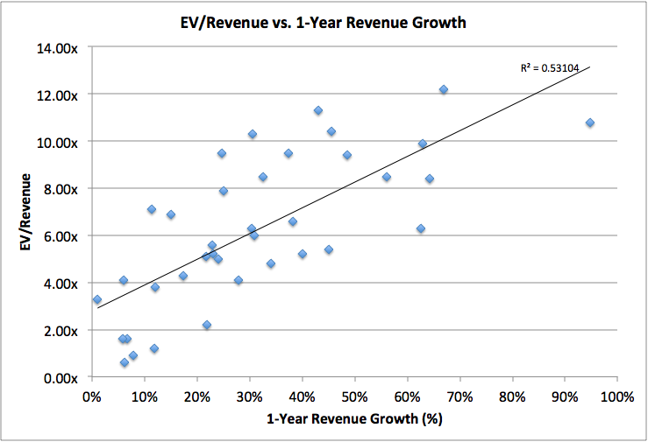
How to create value for investors
Recognize that 9 out of 10 exits are through an M&A exit vs IPO
Focus on revenue growth (vs profitability)
Know the top 25 strategic buyers for your particular business
Work with your capital sources to prepare the business for sale
Lean on your investors to field inbound M&A inquiries
Source: CapShare
www.linkedin.com/in/kelleyan

Slide 16
Investment Grading Framework
I’ve used this framework to grade potential investments
 | Key Factors | Critical Questions | Rating
1 | Experienced Team | Has the founder, CEO, or team had a successful exit before? Who is the next mission-critical hire to bolster the team and why?
2 | Market Opportunity | Is the addressable market at least $1B and growing greater than 10%? Who are the top 3 competitors?
3 | Go-to-Market & Customers | Why do customers buy and why do customers churn? Is the Sales strategy consistent with the vision for the business?
4 | Operating Plan | Is a 25% or 50% haircut to the financial plan appropriate? How much total capital is required to get to cash flow break even?
5 | Financial Return | What are the most successful exits in this particular industry vertical? Who are the most likely acquirers for the target? Can this investment potentially return 5x – 10x cash-on-cash?
www.linkedin.com/in/kelleyan

Slide 17

Venture Capital Returns Math
Generally VCs don’t build discounted cash flow models
Early stage investors need to get a 5x – 10x “cash-on-cash” return on their invested capital
Example math:
Of course, the variables the entrepreneur controls most directly above are the $ figures ….
(4x EV / ARR ) (Yr 7 $10M ARR) (25% stake)
10x Return =
$1M Seed Investment
www.linkedin.com/in/kelleyan

Slide 18

VCPE Investment Committee Process
Investment Committee or “IC” is where decisions get made
Most VCPE firms have weekly IC meetings either on Monday or Friday
At small firms it may be all the GPs
At larger firms it’s typically a subset of the senior most GPs
You should hope for a robust IC discussion about your opportunity
Approval means you get capital
www.linkedin.com/in/kelleyan

Slide 19
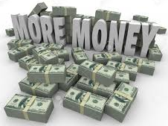
Venture Terms 101
Main terms in a venture term sheet include:
Securities: typically preferred stock vs common stock
Investment Amount: how much money is being raised
Price per share: fully diluted to 4 decimals via spreadsheet waterfall
Valuation: post-money = pre-money + Investment Amount
Liquidation preference: typically 1x … the “double dip”
Closing date: moving target but CEO should put a stake in the ground
Others: voting rights, info rights, board seats, etc
Get a lawyer even if you’ve raised capital before
www.linkedin.com/in/kelleyan

Slide 20








Selected Law Firms Good at VC
You need someone who understands share holder agreements, investor rights agreements, corporate formation docs, etc
Increasing Risk
www.linkedin.com/in/kelleyan

Slide 21

So now that you know how VCs think what’s your pitch?
www.linkedin.com/in/kelleyan

Slide 22
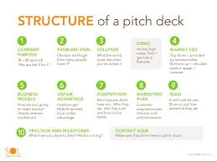
Investor Pitches 101
You get just one shot to make a 1st impression with a VC
If you don’t impress in your first meeting you may be shelved for 12 – 24 months until after you’ve raised money for others
There are many different Dos and Don’ts for pitches & here’s my top 3 “Dos”:
Do make deck professional, visually arresting, and to the point
Do must convince the investor that the market opportunity matters
Do demonstrate your traction and why you’re uniquely qualified
www.linkedin.com/in/kelleyan

Slide 23
Alternative Paths to Entrepreneurship

Slide 24

Paths to Entrepreneurship
Start a business
Buy a business
Incubate a business
Think like an entrepreneur
Increasing Risk
www.linkedin.com/in/kelleyan

Slide 25
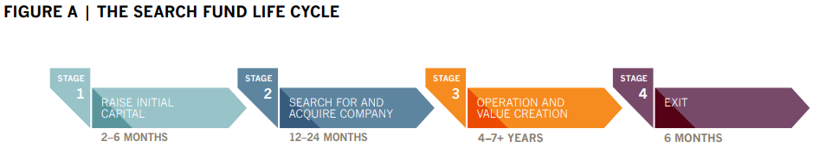






Search Funds & Independent Sponsors
Search funds allow a searcher to buy a small business to run
Typically takes 15 – 24 months to execute starting with $350K - $750K raise
Average search typically ~30 years old and may contact 300 – 500 prospects
Source: Stanford GSB
Sample Search Fund Resources

Slide 26
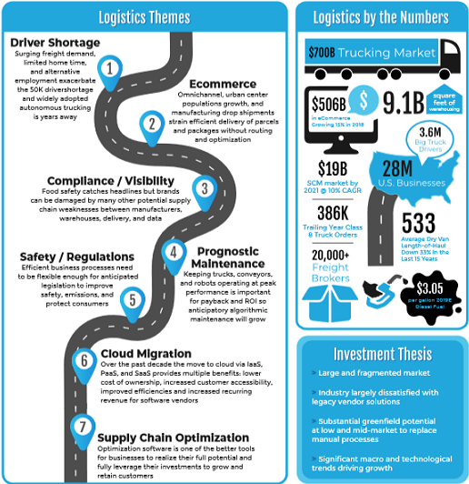
Sample Investment Thesis: Logistics
Lead with expertise and have a clear point of view
Our Approach | Guiding Parameters
Sector Focus | Logistics and Supply Chain SaaS and Software companies broadly defined No distractions
Our Value Added | Deep domain expertise Hands-on operational Partnership approach Startup & Big company experience Committed executive Committed capital
Platform Deal Size Criteria | Revenue: $15 - $50M EBITDA: $3 - $15M Employees: 50 – 150 Customers: 100+
Style | Buyout 51% - 100% control
Private & Confidential

Slide 27
Thank You!
www.linkedin.com/in/kelleyan

Slide 28



Q&A
Andrew Kelley, III
akelley@bellcreekpartners.com
linkedin.com/in/kelleyan
@akelleyiii

