Slide 1
Specialised Finance strategy presentation
23-25 May 2016

Slide 2
Introduction “We are what we repeatedly do. Excellence then is not an act, but a habit” – Aristotle
Defining the direction of Specialised Finance within FA
Formulate
Strategy
Our vision:
Distinguished empowerment corporate finance & strategy business
Chosen performance partner due to execution excellence.
Our mission:
Profit while making an impact.
Our holistic strategy encompasses all of the aforementioned strategic pillars:
This is supported by our implementation plan.
Propose
Vision and
Mission
5
1
Examine
Internal
Factors
4
Propose
Objectives
Assessed our business from the inside out:
Reviewed the organisational structure, staffing needs, culture and process requirements
Examine
External
Factors
2
Our objectives:
Our values are the bedrock of our business
We must instill them to drive competitive advantage through our people to ensure we can execute our strategic actions which drives client satisfaction to ensure we meet our financial goals
3
Examined external factors which included:
Company analysis, service offering, current positioning, competitors and clients.
Synthesised external information to devise an approach to develop into the chosen partner to our clients.

Slide 3
Specialised Finance strategy snapshot : Vision, mission and objectives
Our vision is to build the leading black owned and operated corporate finance and strategy business with a track record of exceeding our clients expectations through exceptional delivery.
Our mission is to make a profit while making an impact!
Description
Objectives
Our values are the bedrock of being a high performance business
Values
Live our values of Transformation, Innovation, Client Centricity, Performance, Inclusiveness and Integrity
We must instill them to
Drive competitive advantage through our people
Talent
Develop, attract and retain talent in a best fit organisational structure that will deliver on our mission
To ensure we can execute our
Strategic actions
Client Focus
Deliver consistent, high quality client experiences
Grow a loyal, long term client base – new and existing.
Cultivate mutually beneficial partnerships
Drive productivity and quality through process improvement and PM
Which drives
Client satisfaction
Client/ Partner objectives
Provide high quality, market competitive professional services
To ensure we meet
our
Financial Goals
Financial excellence
Maximise revenue
Minimise costs
KPI’s are defined in implementation section

Slide 4
Specialised Finance strategy snapshot : External analysis (1/4)
1
Trillian Capital Partners
Financial Advisory
A
Management Consulting
B
Asset Management
C
Securities
D
Property
Specialised Finance
Debt Capital Markets
Where we fit in
Enabler for TCP as a whole
Specialised finance is a solutions driven business positioned as an autonomous division within Financial Advisory in line with leading practice and to avoid perceived conflict of interest in the market
Our value proposition lies in:
Our risk share model = investment in our clients success
Define strategic direction and advise on capital market execution in a manner that promotes sustainable value creation.
Our clients are an invaluable part of our advisory process and as such, we work in a collaborative manner
Our expertise spans both the public and private sectors, whilst our competitive advantage lies in the public sector due to our intimate knowledge of this operating environment and our team’s successful execution track record in this space.
Our core services include:
A
Provide support on the execution of all finance related deliverables within projects
B
Act as a conduit for providing access to investment opportunities within the deal market on an arms length basis
Provide cross-selling opportunities for asset management and vice versa
C
Originate securities execution support initiatives as part of larger solutions presented by Specialised Finance
D
Provide transaction advisory services to property development projects
Structured Solutions
Mergers & Acquisitions & Divestitures
Valuations & Business Modelling
Corporate Finance Strategy

Slide 5
Specialised Finance strategy snapshot : External analysis (2/4)
2
Service offering
Specialised Finance overview
Our team of professionals devise and execute innovative and tailored financial solutions to adequately address our clients’ most challenging problems. Combining our clients' insight with our transactional expertise, we work alongside our clients on all aspects of their Capital Agenda (Raise, Invest, Optimise and Preserve)
Structured Solutions
Advise on optimal deal structure and how to effect transactions. The team provides solutions to support a range of transactions, including refinancing/securitisation.
What we do
We measure our success based on our clients’ success. So, too, our clients’ risks are our risks. This is true partnership in action.
Mergers & Acquisitions Advisory
The M&A team excels in devising and executing transactions including mergers, acquisitions, divestitures, and corporate restructurings.
Partnering for success
Our team boasts strong credentials, intimate knowledge of our clients and a proven ability to maximise value for our clients through leading insights and prudent advice.
Transparent and robust valuations to support corporate transactions.
Building an effective business model, whether it's to evaluate a transaction, a new market opportunity or for other strategic purposes, is a complex task.
Our team is well equipped to carry out the model review and model-build activities to support our clients need to make key decisions and improve their strategic outcomes.
Valuations and Business Modelling
Proven capability in executing transactions
Deep capital market expertise and networks with direct access to key decision makers allowing rapid turn around of financial solutions that are practically executable
We work with CFO’s on major investment decisions; linking corporate strategy to capital markets performance; investor communications; and ensuring that M&A, strategic due diligence reviews and other transactions are consistent with overall strategy.
In depth sector knowledge
Corporate Finance Strategy

Slide 6
Specialised Finance strategy snapshot : External analysis (3/4)
Positioning – where we are and where we want to go
3
Current market position
New
Market expansion
Diversification
We currently provide services to SOC’s within South Africa. Our efforts are focussed on winning more work within these SOC’s. However this does present a client concentration risk.
The positioning of our business compared to our competitors is relatively unknown.
We are concentrating on enhancing our core services rather than diversification at this stage.
IB’s
Target - TFA
Consulting
firms
Target market position
Niche
In the medium term, over and above enhancing our service in the public sector, we intend and are already engaging strategic partners (new channels of distributions) in the private sector to further expand our client reach.
Actively seeking to bolster our team of professionals in an attempt to bid and deliver on more projects to increase our market share by winning work from our competitors.
M&A activity is expected to peak between 2018 to 2020.
Markets
Actual - TFA
High level objectives over the five year period
Revenue growth through client and product diversification
Defined value proposition to clients
Develop sustainable relationships with external clients and strategic partners
Service excellence
Strong core is essential to our success: People, systems and processes
Existing
Market penetration
Development
Existing
Products
New
Consulting firms (“CF’s”): Big 4, McK, Bain
Investment banks: Investec, RMB, Nedbank, Macquarie advisory
Niche firms: Bravura, Transcend, Tamela, PSG Capital

Slide 7





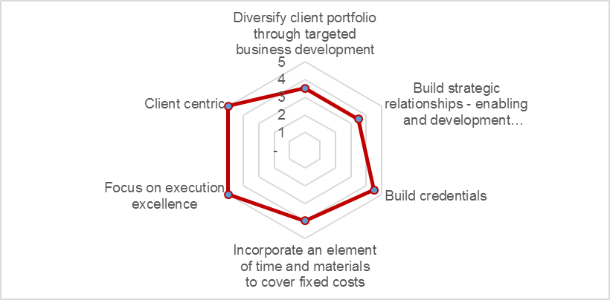
Specialised Finance strategy snapshot : External analysis (4/4)
Competitor analysis
Client analysis
4
5
Key levers
No. of projects
Expected revenue – current projects
# of projects in pipeline
CF’s
IB’s
Niche
4
20m
2
BEE rating
Credentials
BEE rating
Well qualified workforce
3
350m
3
Product quality
Pricing
Pricing
Own our niche – SF/Strat
Client concentration risk
Enjoy:
Working with not for them
Regular communication
Brand
Tap into skills across org.
Action: BD initiatives
Key
Below average
Average
Above average
Elevator pitch
6
Priorities: Critical success factors
7
We are a niche level two BB-BEE business which provides end to end financial advisory services with extensive experience advising on large public sector projects
The Specialised Finance business within Trillian Financial Advisory provides innovative, client focused corporate finance and strategy solutions.
Our clients are an invaluable part of our advisory process and as such, we believe in working in a collaborative and interactive manner
Our team members work with integrity and efficiency in order to guarantee client satisfaction.
1
2
3
4
5
Low priority
High priority

Slide 8


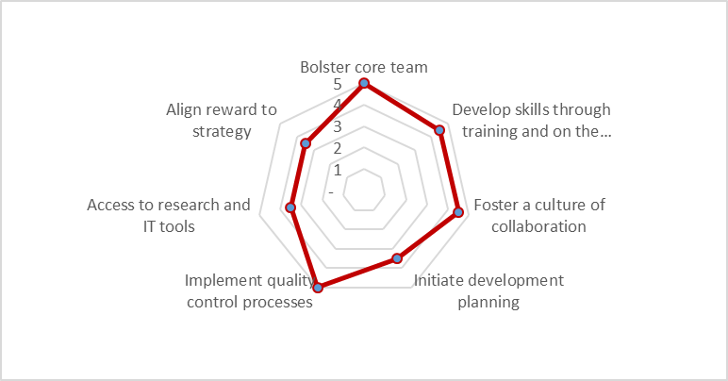
Specialised Finance strategy snapshot : Internal analysis “The secret to success is to do common things uncommonly well” - John D. Rockefeller
Analysis: Team, culture and processes
Operating framework – cross functional teamwork
1
2
Staff complement
Culture
Processes and tools
Organisational context
Clear mission from leadership
Effective teamwork
Team leader – overall accountability
Right mix of skills
Frequent communication
No. of employees
Inspiring relationships
Model audit licences
5
Trust and autonomy
Transparency
Caring
1
2
Utilisation
Think Cell licences
>100%
Inspiring day-to-day
Central repository for RFP documentation
Recruitment (next 12 months)
Scoping - clear expectations
Focus and structure through alignment and PS
Criteria for success
Set clear objectives
Communicate clearly
Leadership is essential
Team culture
Trust and mutual respect
PS culture – harness the power of collaboration
Research portal
Min 3
Quality control processes
4
3
Cost base (annual)
Inspiring outcomes
TBD - Ops
Lasting impact
Personal growth and fun
Document templates
Development: 70-20-10 learning model will be utilised
3
Priorities: Critical success factors
4
Phase 1 – Initial skills assessment and development plan template created.
Phase 2 – One on one assessments with HR
Phase 3 – Monitoring
10
Formal learning
Through training and certifications
20
Mentorship and learning from others
70
Workplace learning
Projects, Problem solving
1
2
3
4
5
Low priority
High priority

Slide 9




Specialised Finance strategy snapshot : SWOT
Strengths
Weaknesses
1
2
Network of individuals with relationships in the private and public sector
Diverse service offering and skills set
Partnering with internationally recognised investment banks and strategy consultancies
Operate in a collaborative manner internally and with clients
Lack of credentials
Lack of brand recognition
Client concentration risk with Transnet and Eskom
Lack of standardised processes – quality control on engagements, communication protocol
Lack of critical mass of skill sets
Risk of incurring losses as a result of risk share model
Opportunities
3
Threats
4
Building, maintaining and enhancing long term relationships with clients and even competitors.
Leveraging off of business units within the organisation for business development
Attract talent with Corporate Finance expertise which provides greater potential to engage a wider client base.
Service offering enhancement
Build reputation through superior delivery
Develop existing talent through internal training
A key point of building this business is through delivering on our mandates – reputational risk associated with not meeting expectations
Competition from existing M&A houses and investment banks and strategy consultancies
Inconsistent standard of service delivery across teams
Difficulty to attract talent with Corporate Finance expertise in a new environment

Slide 10

Specialised Finance strategy snapshot : Implementation The formulation of strategy may be a sprint, but the execution of strategy is a marathon.
Distribution approach
Key objectives and associated drivers
1
2
Direct
Business Partners
People are our product!
Need talent to act instinctively to promote strategy
Quality execution
Develop sustainable relationships with clients and partners
Strategy
Own the sweet spot of our market through targeted BD
Utilise business partner relationships to complement delivery on our current clients
Leverage strategic partner engagements/
assignments on other clients to build credentials and diversify revenue generation capacity
Attract and develop people
Company size
SOC’s, public companies, private companies with > 100 million rand in turnover
Operational excellence
Operational excellence = revenue growth !
Client and product diversification
Develop systems and processes to execute effectively
Industries
Government, energy, transportation, retail, financial services, real estate, healthcare
Target
CEO, CFO, Executive directors, Divisional managers
Partner of choice!
Quality solutions through execution excellence
Commercial rationale needs to be evaluated in line with current delivery workload and delivering on strategic objectives
Clients / Partners
Deal size
KPI’s
3
Actions and responsible parties
4
Robust revenue pipeline
Cost to revenue %: minimum two - three times cost base (advisory services norm)
Reduce time spent on rework – process improvement
Develop a training plan – FB/AW
Arrange sessions with each team member to understand their developmental goals and development plan – FB/SN
Develop marketing material – Team/Marketing
Implement processes to enable optimal service delivery - Team
Relationship building with strategic partners to strengthen credentials and enhance our client portfolio – FB supported by team
Build critical mass within the core Specialised finance team – FB/SN
Obtain access to a research portal – FB/Finance
Host team training sessions - Team
Operational excellence
% of HR budget spent on training: Linked to SDL
Time to find skilled hires: Use for planning
Training and development:
Performance improvement – TBD
Human capital alignment
Number of contract renewals/ new mandates won
Client Feedback:
Client experience vs ideal experience
Expectations met
Intent to use TFA again
Client satisfaction

Slide 11
Market analysis

Slide 12
Market Analysis: Consolidated spending by functional and economic classification – 16/17 Understanding the operating environment of our country and that of our target markets will allow us to isolate opportunities and execute more efficiently
Market analysis
Economic affairs and agriculture
87
Education
219
Economic infrastructure and network regulation
Basic education
95
69
Employment, labour affairs and social security funds
Post-school education and training
32
Industrial development and trade
26
Agriculture, rural development and land reform
20
Science, technology, innovation and the environment
Defence and public safety
88
Health
168
Police services
Health
52
Defence and state security
42
Law courts and prisons
Addressable spend
Compenstion of employees
Goods and Services
Capital Spending and transfers
Current tranfers and subsidies
interest payments

Slide 13
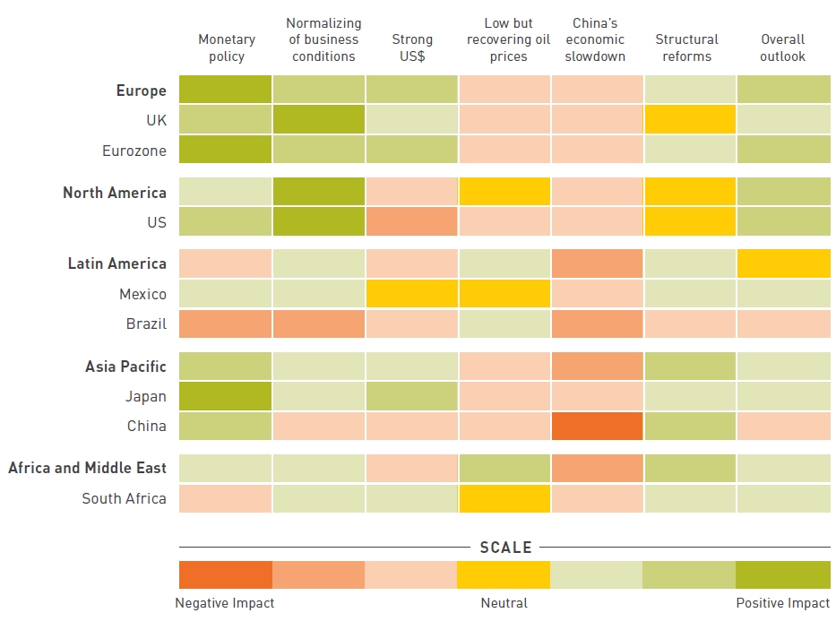
Market Analysis: M&A Activity
Impact of key macro themes by region
Key insights in target markets
More deal-making activity in Africa and the Middle East as oil prices rebound over the next few years.
The decline in oil prices has restricted available funding for M&A, but a recovery in oil prices should increase deal-making activity in the region.
Key to improving M&A activity in Africa is pushing forward economic reforms and consolidating progress already made in countries like Egypt, where the government has introduced business-friendly investment policies.
Emerging market M&A activity will capture a larger share of total deals
Rising to 21% of total transactions in 2018 through 2020, up from 18% in 2014.
Cross -border M&A activity will outpace domestic activity
The share of cross-border deals rose to 38% in 2015, up from 36% in 2014. The pace of cross-border activity will slow in 2016 but rise back to a 38% share by the end of 2017.
Source: BAKER & MCKENZIE

Slide 14
Questions?
Thank you

