Slide 1
Figure 1. Frozen IMRS scoring framework and dataset-level delivery-minus-control ΔIMRSz landscape.
(A) Overview of the IMRS scoring and transfer-evaluation workflow. Delivery-versus-control split contrasts were defined from verified metadata and raw RNA-seq count matrices. Frozen IMRS gene coefficients were derived exclusively from the five locked-anchor datasets and were not refit during validation or transfer evaluation. Target datasets were scored using dataset-internal normalization, control-referenced gene z-scores, weighted sample-level IMRS scores, and control-standardized IMRSz values. (B) Dataset/context-level mean delivery-minus-control ΔIMRSz values across evaluated contexts. Point size indicates the number of passing split contrasts, and color indicates manuscript analysis group.

Slide 2
Figure 2. Cross-anchor support and coefficient structure of the frozen IMRS model.
(A) Numbers of retained IMRS genes supported in all five locked-anchor datasets or in four of five locked-anchor datasets. Of the 287 retained genes, 178 were supported in all five anchors and 109 in four of five anchors. (B) Distribution of the missing anchor among the 109 genes supported in four of five locked anchors. Bar labels indicate the number of genes associated with each missing-anchor dataset. (C) Distribution of the frozen IMRS gene coefficients across the 287 retained weighted genes. (D) Retained genes with the largest absolute frozen IMRS coefficients.

Slide 3
Figure 3. Frozen IMRS scoring in primary acute and extended validation datasets.
(A) Contrast-level delivery-minus-control ΔIMRSz values in the primary acute-validation and extended-validation groups. Primary acute validation included 14 split contrasts, all with positive ΔIMRSz, with a mean ΔIMRSz of 10.87. Extended validation included 11 split contrasts, 9 of which had positive ΔIMRSz, with a mean ΔIMRSz of 1.36. Points represent individual split contrasts; boxes show the interquartile range, with the median indicated by the central line. (B) Nested split-contrast ΔIMRSz values for the three independent primary acute-validation datasets. Points represent individual split contrasts, horizontal lines indicate the observed split-contrast range within each dataset, and diamonds indicate dataset-level mean ΔIMRSz. Dataset-level mean ΔIMRSz values were 11.92 for GSE139529, 10.74 for GSE119119, and 8.15 for GSE279743.

Slide 4
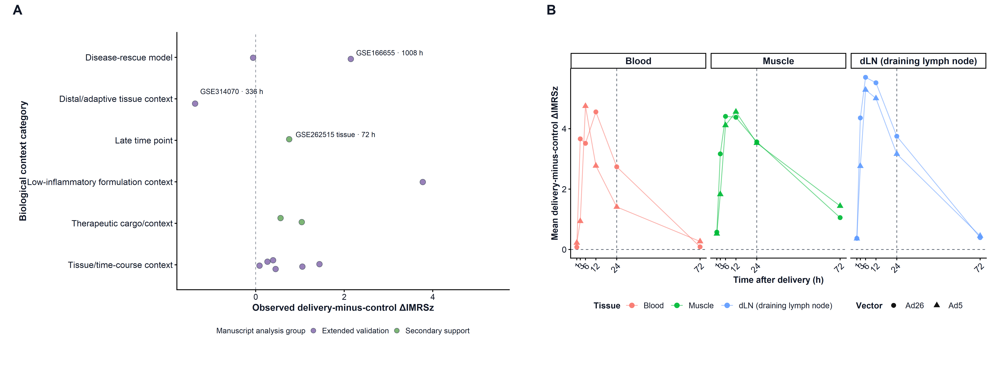
Figure 4. IMRS responses across context-shifted settings and an adenoviral-vector time course.
(A) Delivery-minus-control ΔIMRSz values for extended-validation and secondary-support contexts, grouped by biological context category. Points represent individual scored contexts and are colored by manuscript analysis group. Selected dataset/time-point labels identify representative observations. (B) Mean delivery-minus-control ΔIMRSz values across blood, muscle, and draining lymph node in the GSE264344 adenoviral-vector time course. Lines connect observations across time within vector condition, colors indicate tissue, and point shapes indicate Ad26 or Ad5. The dashed vertical line marks 24 h.

Slide 5
Figure 5. Permutation and gene-sensitivity analyses of IMRS score shifts.
(A) Observed delivery-minus-control ΔIMRSz values for the 68 scored split contrasts compared with their within-contrast label-permutation null distributions. Points indicate observed ΔIMRSz values, and vertical intervals indicate the corresponding 95% permutation-null intervals. Contrasts are ordered by observed ΔIMRSz and colored by manuscript analysis group. (B) Observed delivery-minus-control ΔIMRSz values across locked-anchor, primary acute-validation, extended-validation, and secondary-support groups. Points represent individual split contrasts, and boxplots summarize the distribution within each manuscript analysis group. (C) Leave-one-gene-out ΔIMRSz values compared with the corresponding original ΔIMRSz values across contrast-by-gene-removal analyses. The dashed diagonal line indicates equality between the original and leave-one-gene-out values. (D) Mean maximum single-gene contribution percentages across manuscript analysis groups. Points represent individual contrasts, and boxplots summarize the distribution within each group. The dashed vertical line marks the overall mean maximum single-gene contribution across contrasts; the largest observed value is annotated.

Slide 6
Figure 6. Comparator immune-signature responses across manuscript analysis groups.
(A) Delivery-minus-control score shifts for IMRS, the ISG signature, the chemokine/inflammatory signature, and the generic innate signature across locked-anchor, primary acute-validation, extended-validation, and secondary-support contrasts. Points represent individual split contrasts, and boxplots summarize the distribution within each manuscript analysis group. (B) Proportion of contrasts with positive delivery-minus-control score shifts for each signature within each manuscript analysis group. Bars indicate the percentage of contrasts with values greater than zero. Bars at 0% represent measured zero positive proportions rather than missing values.

Slide 7
Supplementary Figure S1. Detailed dataset/context IMRS summaries and biological-context composition of context-shifted contrasts.
(A) Dataset/context-level mean delivery-minus-control ΔIMRSz values across locked-anchor, primary acute-validation, extended-validation, and secondary-support groups. Points are colored by manuscript analysis group, and point size indicates the number of passing split contrasts contributing to each dataset/context summary. Group labels on the right indicate the corresponding manuscript analysis category. (B) Number of context-shifted contrasts assigned to each biological context category. Bars show the counts of contrasts classified as tissue/time-course context, therapeutic cargo/context, disease-rescue model, late time point, distal/adaptive tissue context, or low-inflammatory formulation context.

Slide 8
Supplementary Figure S2. Gene-program enrichment of retained frozen IMRS genes.
(A) GO Biological Process over-representation analysis of the 287 retained frozen IMRS genes. (B) Reactome pathway enrichment analysis of the same retained gene set. (C) MSigDB Hallmark enrichment analysis of the retained frozen IMRS genes. Dot size indicates the number of retained IMRS genes overlapping each term, and color indicates −log10(FDR).

