Slide 1
CC & MAE
Yanwei JIN (靳颜蔚)

Slide 2
100 patients (80 train + 20 test)
CC (mean)
 | 30s | 60s
ref bp — est bp | 0.8347 | 0.8275
ppg — est bp | 0.9028 | 0.8682
ori ppg — est bp | 0.0066 | 0.0078
ecg — est bp | 0.0361 | 0.0584

Slide 3
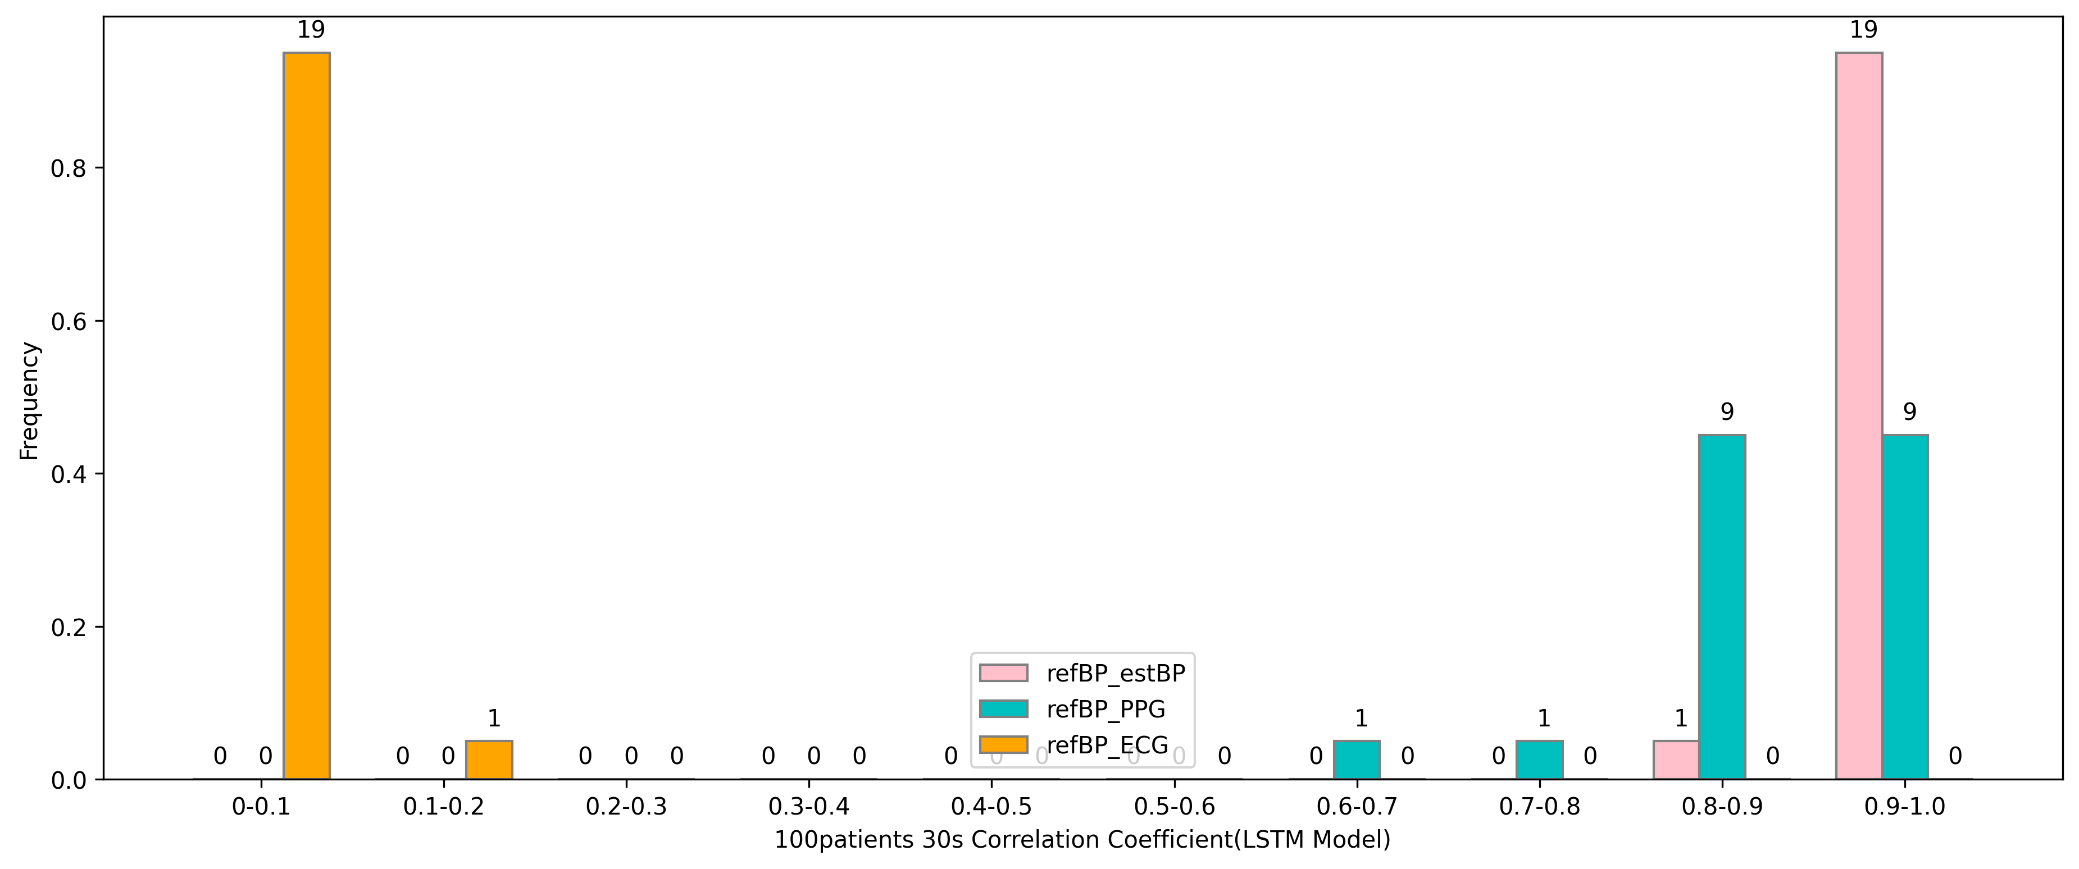
100 patients (80 train + 20 test)
ref bp — est bp: 0.9696
ppg — est bp: 0.8772
ecg — est bp: 0.0461
30s BP wave — CC(mean)
LSTM Model

Slide 4
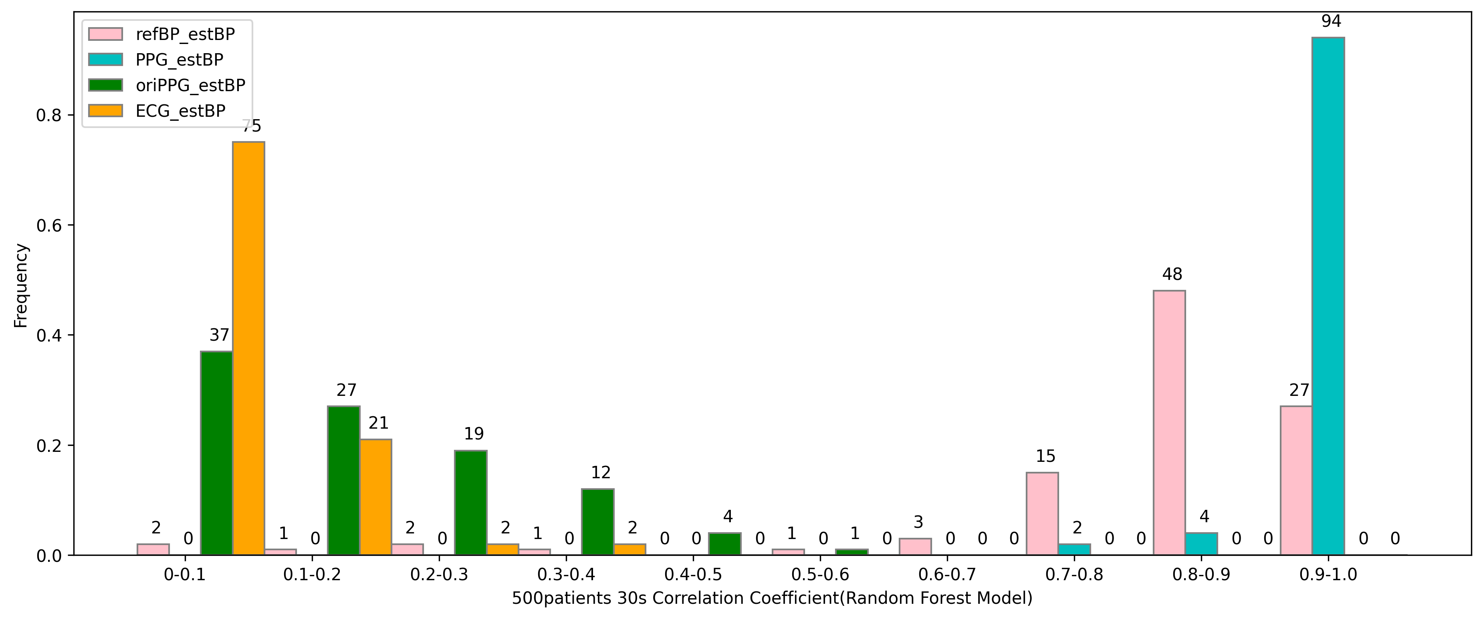
500 patients (400 train + 100 test)
ref bp — est bp: 0.8006
ppg — est bp: 0.9377
ori ppg — est bp: 0.0306
ecg — est bp: 0.0687
30s BP wave — CC(mean)
Random Forest Model

Slide 5
500 patients (400 train + 100 test) — LSTM Model
MAE
 | 10s | 30s | 60s
ref sbp -- est sbp | 5.0760 | 5.0479 | 4.9812
ref dbp -- est dbp | 2.2979 | 2.2857 | 2.3218
ref bp wave — est bp wave | 17.6773 | 17.6582 | 17.6480

Slide 6
500 patients (400 train + 100 test) — Random Forest Model
MAE
 | 30s | 60s
ref sbp — est sbp | 7.8312 | 5.3634
ref dbp — est dbp | 7.9337 | 6.7394

