Slide 1
TMC Web System - Full Functional Architecture
Layer 1: User Navigation & Pages
Home Master Data Maintenance & Upload Entry Submit Matrix Upload OTH Data Upload CRP Data View Pipeline (P00/P10/A10/SPL/TMC/RES/RPT)
Submit Matrix - Group Country CSV - Reporter List CSV - Source Matrix CSV - Size Class Flag CSV - Brand Mapping CSV - Machine Line Mapping CSV
User Flow Home -> Submit Matrix -> Upload OTH -> Upload CRP -> View Pipeline -> P00
Layer 2: Feature Actions (UI Capabilities)
Upload | Show Latest | Download Latest | Edit in Page (where enabled) | Table Filters (All) | Run Report | Show Latest Report | Run Tracking Timestamp | Status/Error Messaging
Layer 3: Processing & Rule Engine (Backend Services)
Upload Service - CSV parsing - Header normalization - Column validation - Row persistence
Matrix Resolver - Country + artificial ML matching - Brand/machine mapping
Rule Engine - Reporter flag - Deletion flag - Pri/Sec tagging - VCE/non-VCE related flags
Report Builders - CRP D1 Combined - OTH Deletion Flag - P00 3-Check - Layer snapshots
Versioning Engine - New upload run per CSV - Latest successful run - Run metadata tracking
Layer 4: Pipeline Calculations
P00 Raw Preparation -> P10 Prepared Output -> A10 Adjustment Build -> SPL Machine Line Split -> TMC Total Market Calculation -> RES Restatement -> RPT Reporting
P00 focus: SAL deletion logic, OTH reporter/deletion logic, Source Matrix validation
TMC focus: eligible row selection and case-handling workflow
Layer 5: Data Storage (Database)
upload_runs
group_country_rows
reporter_list_rows
source_matrix_rows
size_class_rows
brand_mapping_rows
machine_line_mapping_rows
Scope: current web implementation (new system), replacing legacy SAP-heavy architecture for operational documentation.

Slide 2
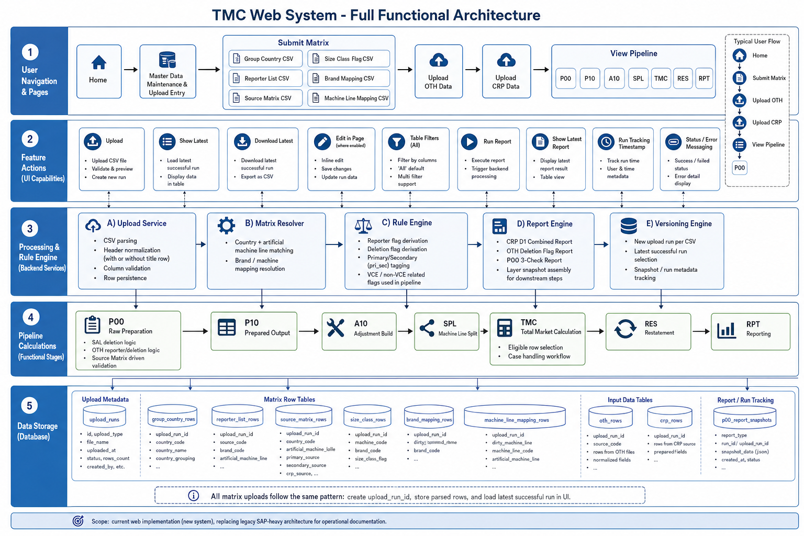
Reference Image (for comparison)

