Slide 1

UNEQUAL NIGHTS
Shining Light on Inequality
Philadelphia Lighting Equity Analysis

Slide 2
Research Question
"Why do some areas remain dark, yet residents never complain?"
Traditional maintenance relies on 311 complaints. But some communities face barriers to reporting: language, time, distrust, or lack of awareness. Satellite data reveals what complaints miss.
THE COMPLAINT GAP CONCEPT
LOW LIGHT
+
LOW 311
+
LOW INCOME
=
COMPLAINT GAP
Objectively Dark
Few Complaints
Vulnerable Areas
Underserved Areas
These communities need proactive intervention, not reactive 311 responses.
This study uses VIIRS satellite data to objectively identify dark areas, bypassing the complaint system to find underserved communities directly.

Slide 3
Data Sources
VIIRS Satellite Data
1,283
Nighttime light radiance, 2022-2024
311 Service Requests
Block Groups Analyzed
(95.9% of Philadelphia)
Street light outage complaints
ANALYSIS TOOLS
Raster: Reclassify, Raster Calculator, Focal Statistics
Zonal: Zonal Statistics, Summary Statistics
Network: Distance Accumulation, Optimal Path
Overlay: Spatial Join
Python：pandas, geopandas, scikit-learn (Random Forest), NetworkX, OSMnx
Crime Data
Incident locations for risk analysis
Census Demographics
Population, income, housing data

Slide 4
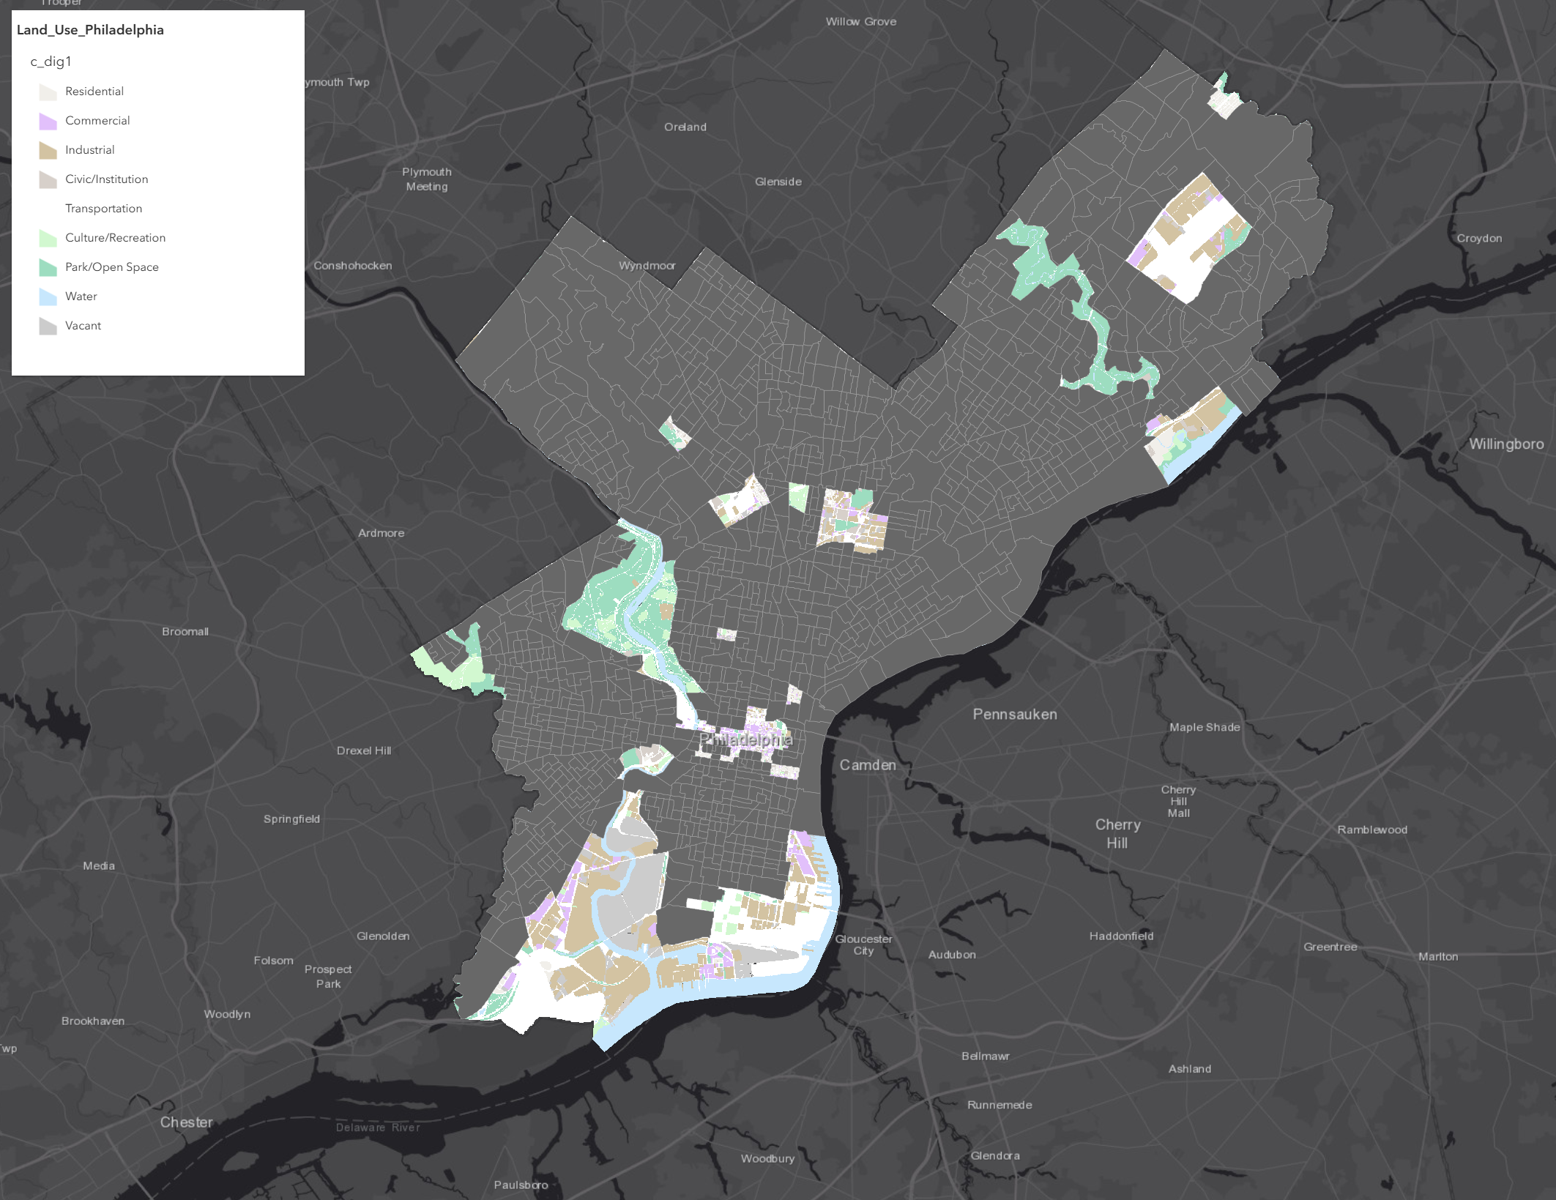
Study Area
1,283
55
Analyzed
Excluded
EXCLUDED AREAS Summary Statistics
Other Non-Residential: 20 (36.4%)
Park/Open Space: 18 (32.7%)
Industrial/Port: 7 (12.7%)
Airport: 6 (10.9%)
Institutional: 3 (5.5%)
Water/Special Area: 1 (1.8%)
Total Area: 64.34 km²
Study area selection using land use classification. 1,283 residential block groups were included for analysis. 55 non-residential blocks (airports, parks, industrial zones) were excluded due to unique lighting requirements not comparable to typical neighborhoods.

Slide 5
Methodology
VIIRS
311 Data
Crime
Census
OpenDataPhilly
▼
Reclassify
→
Cost Surface
→
Spatial Analysis
Layer 1-5
Weighted Risk
Zonal + Focal
▼
Complaint Gap
Predictive Model
Safe Paths
62 Areas
Random Forest
Network Analysis

Slide 6
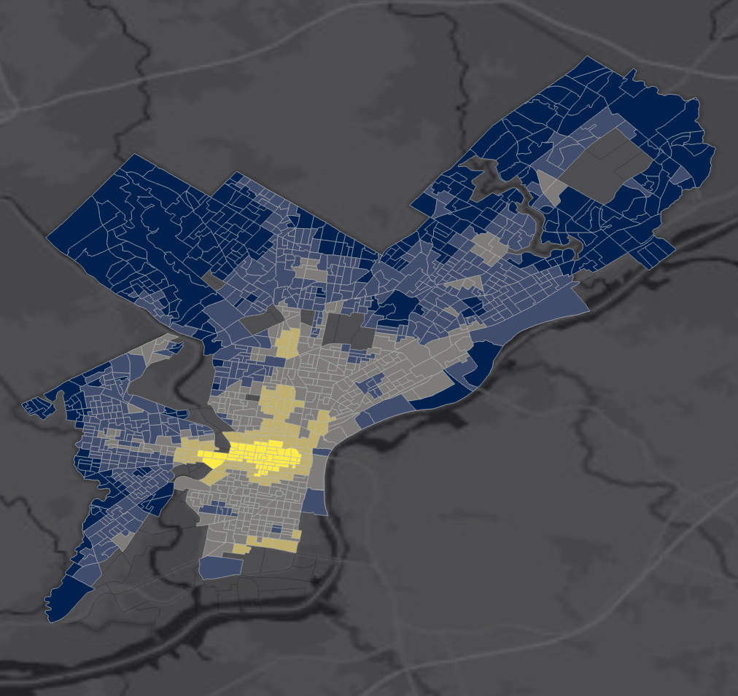
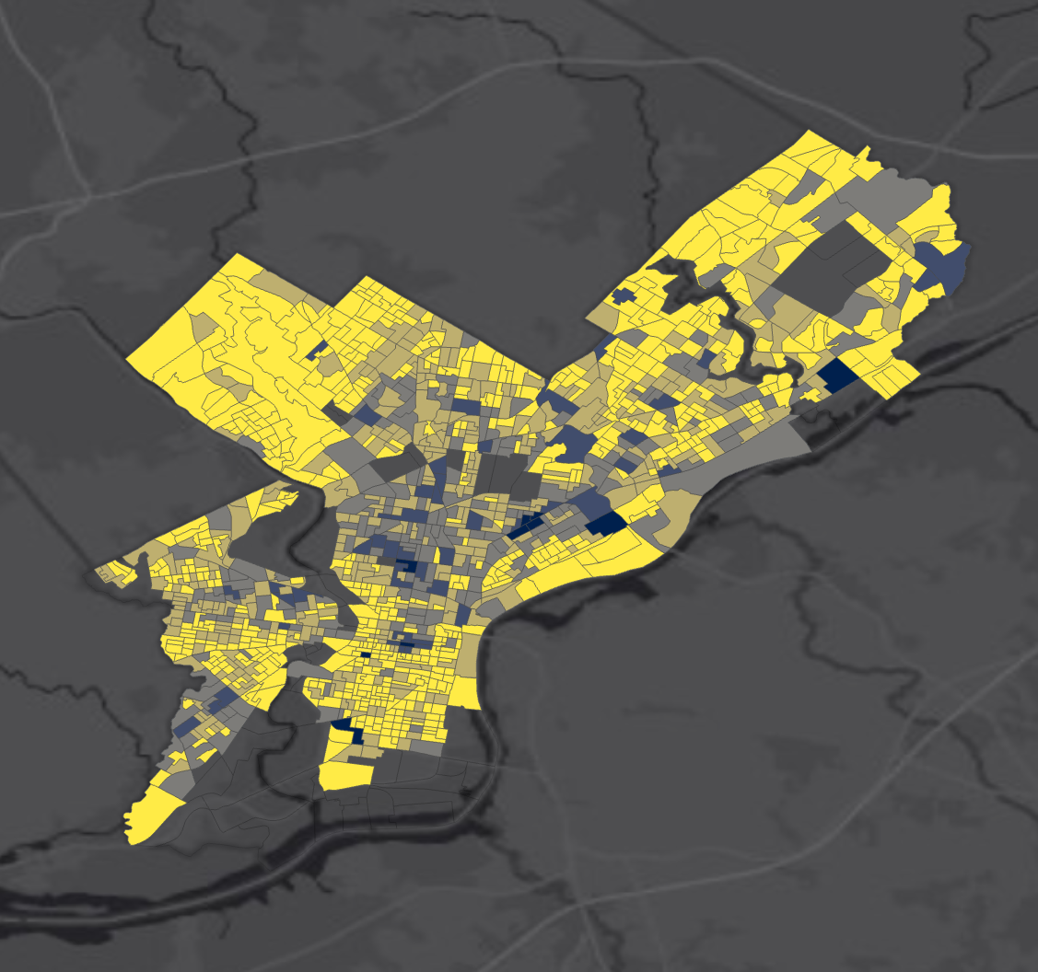
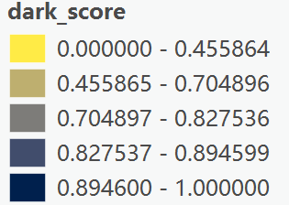
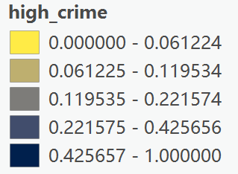
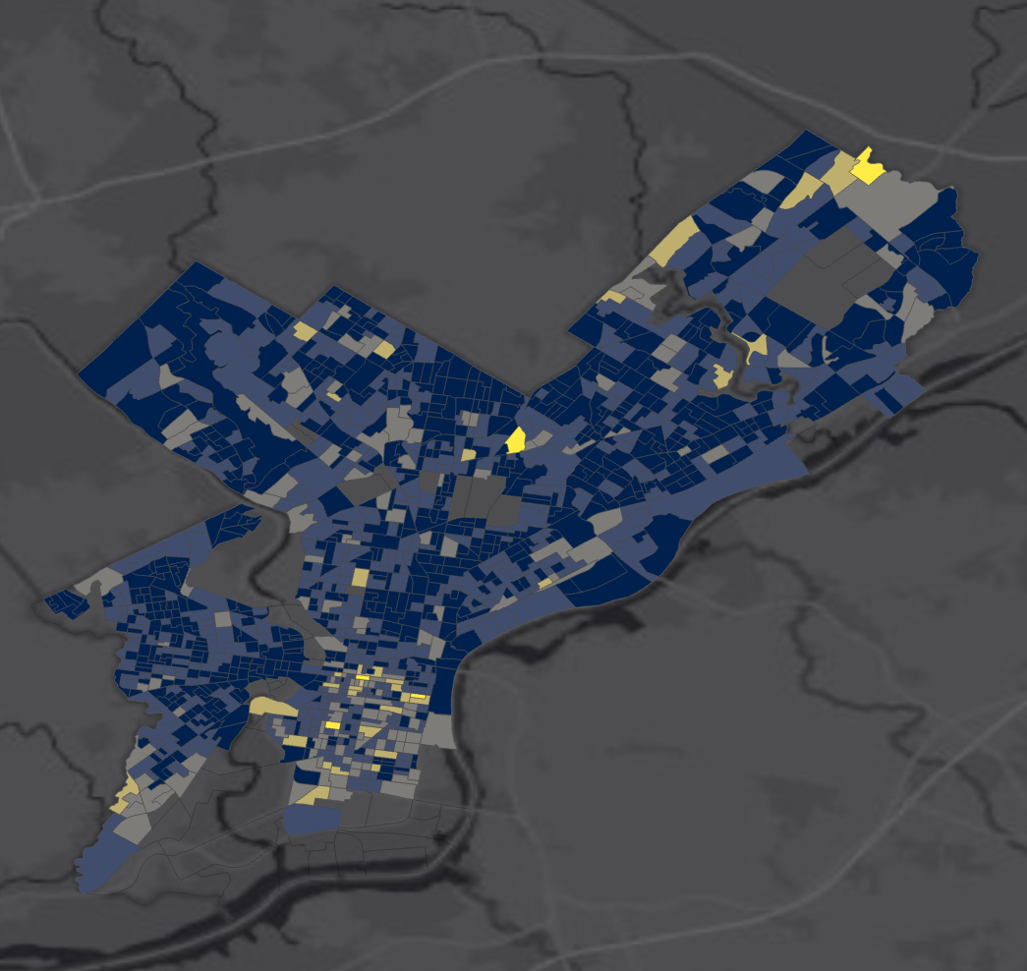
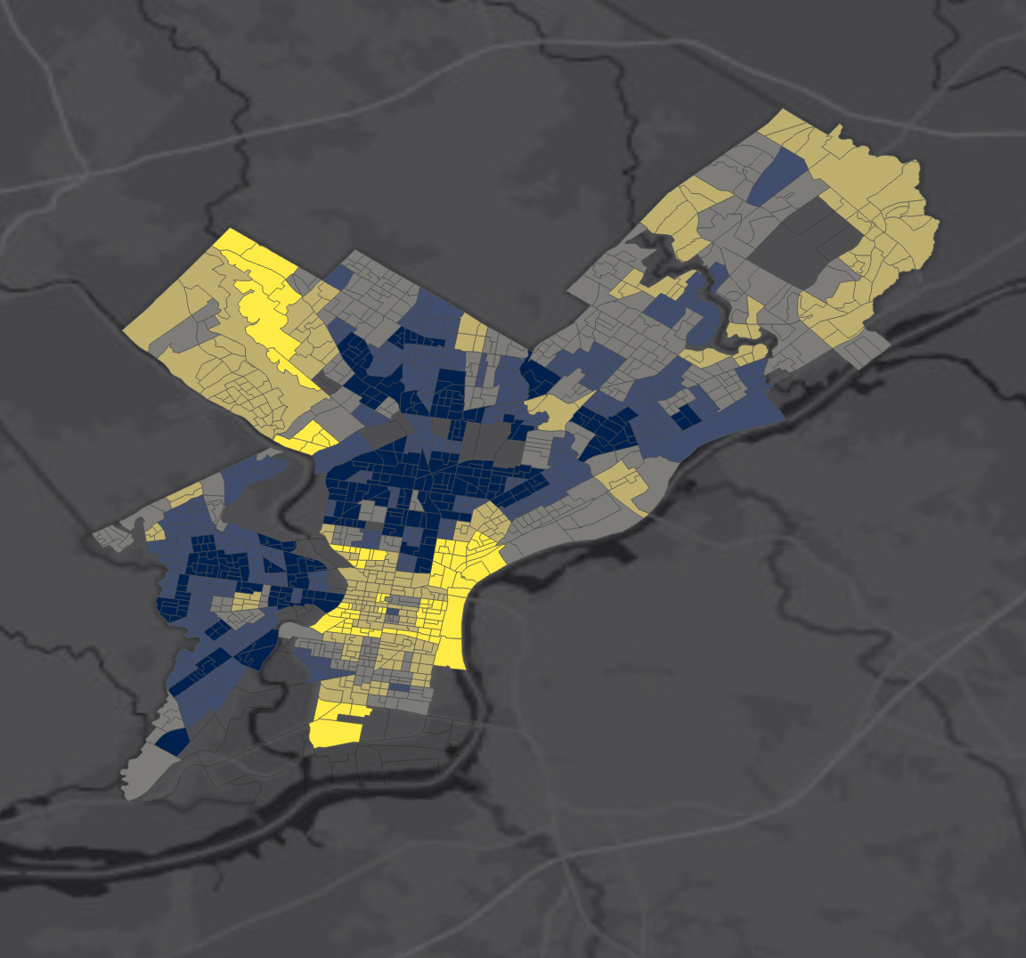
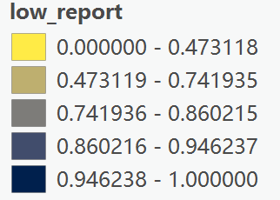
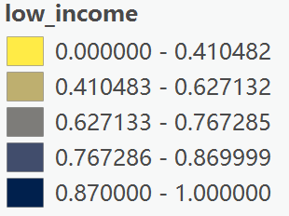
Reclassify & Cost Surface
Python: Integrated VIIRS, 311, Crime, Census data into _.shp
ArcGIS: Reclassify each variable to 1-5 scale → Raster Calculator to combine
RECLASSIFIED LAYERS
Darkness
Crime Rate
COST SURFACE FORMULA
Raster Calculator:
CostSurf_Risk =
0.30 × Darkness +
0.30 × Crime +
0.20 × Low311 +
0.20 × LowIncome
Low 311
Low Income
Weighted cost surface created using Raster Calculator. Four factors were reclassified to 1-5 scale and combined: Darkness (30%), Crime rate (30%), Low 311 complaints (20%), Low income (20%). Higher values indicate higher risk areas requiring priority attention.

Slide 7
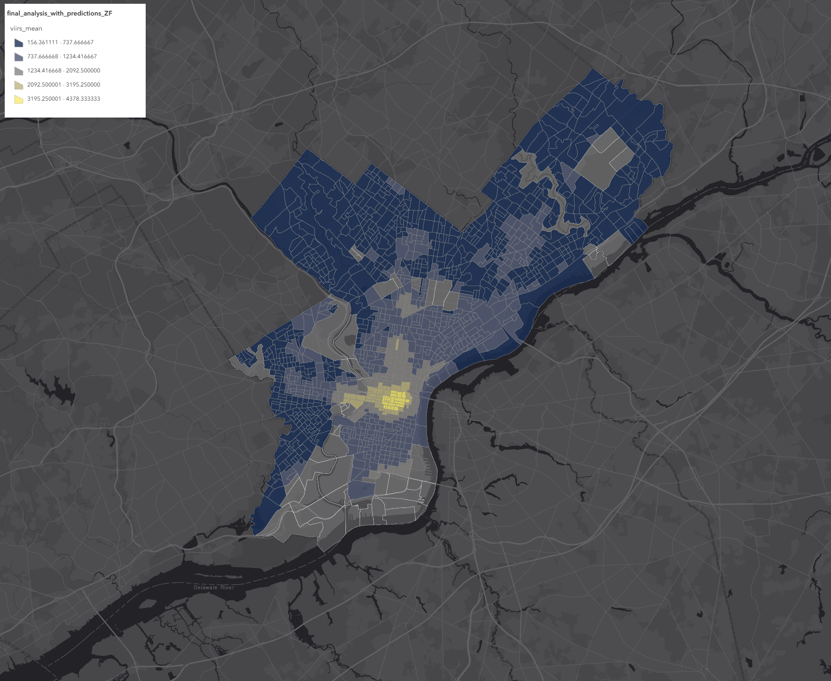
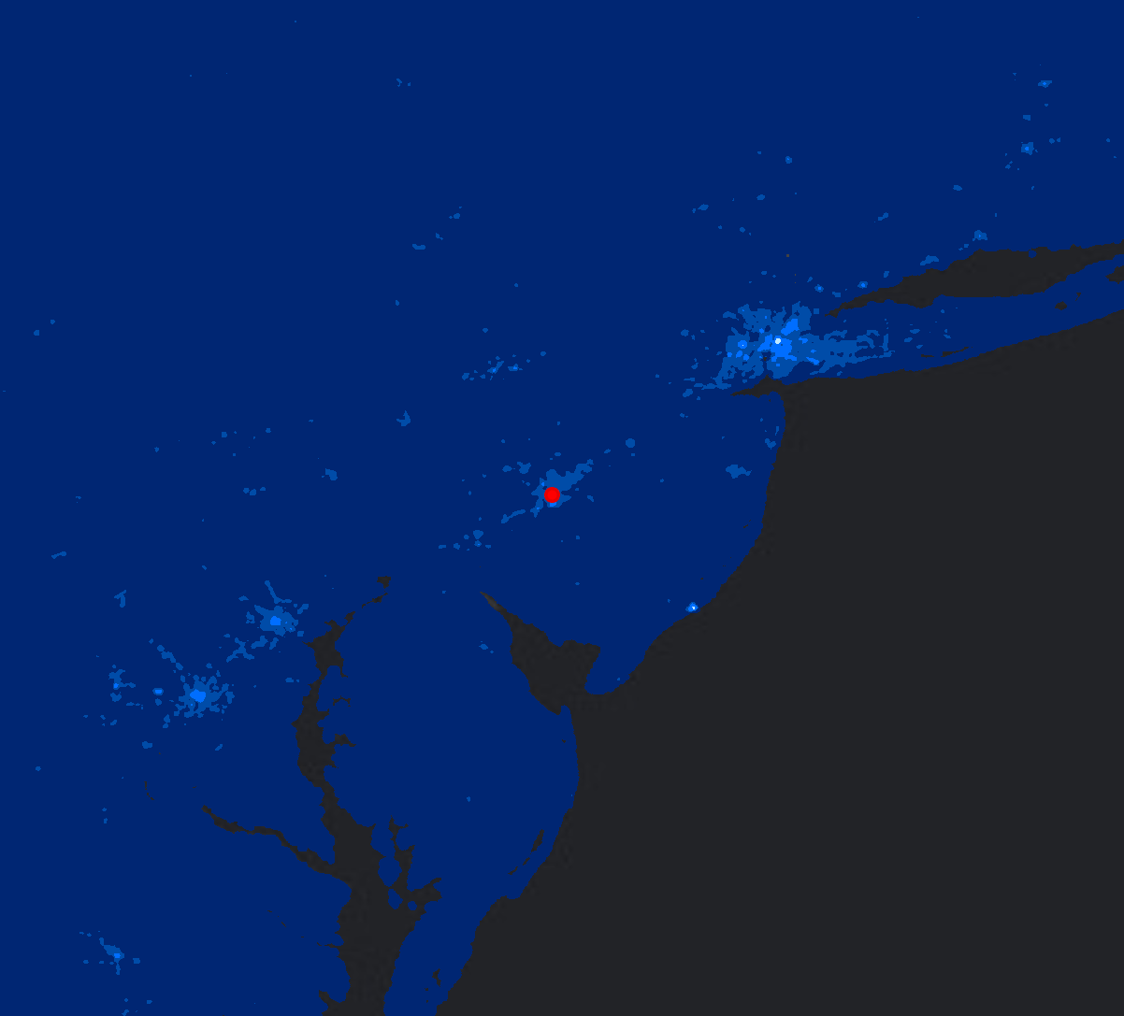
Reclassify & Cost Surface
VIIRSFocalMean
Weighted overlay combining four reclassified factors: Darkness (30%), Crime (30%), Low 311 (20%), Low income (20%). Brighter areas = higher risk scores.
Focal Statistics smoothed VIIRS radiance using circular neighborhood. Center City shows highest brightness concentration; peripheral areas significantly darker.
CostSurf_Risk (Weighted Overlay)

Slide 8
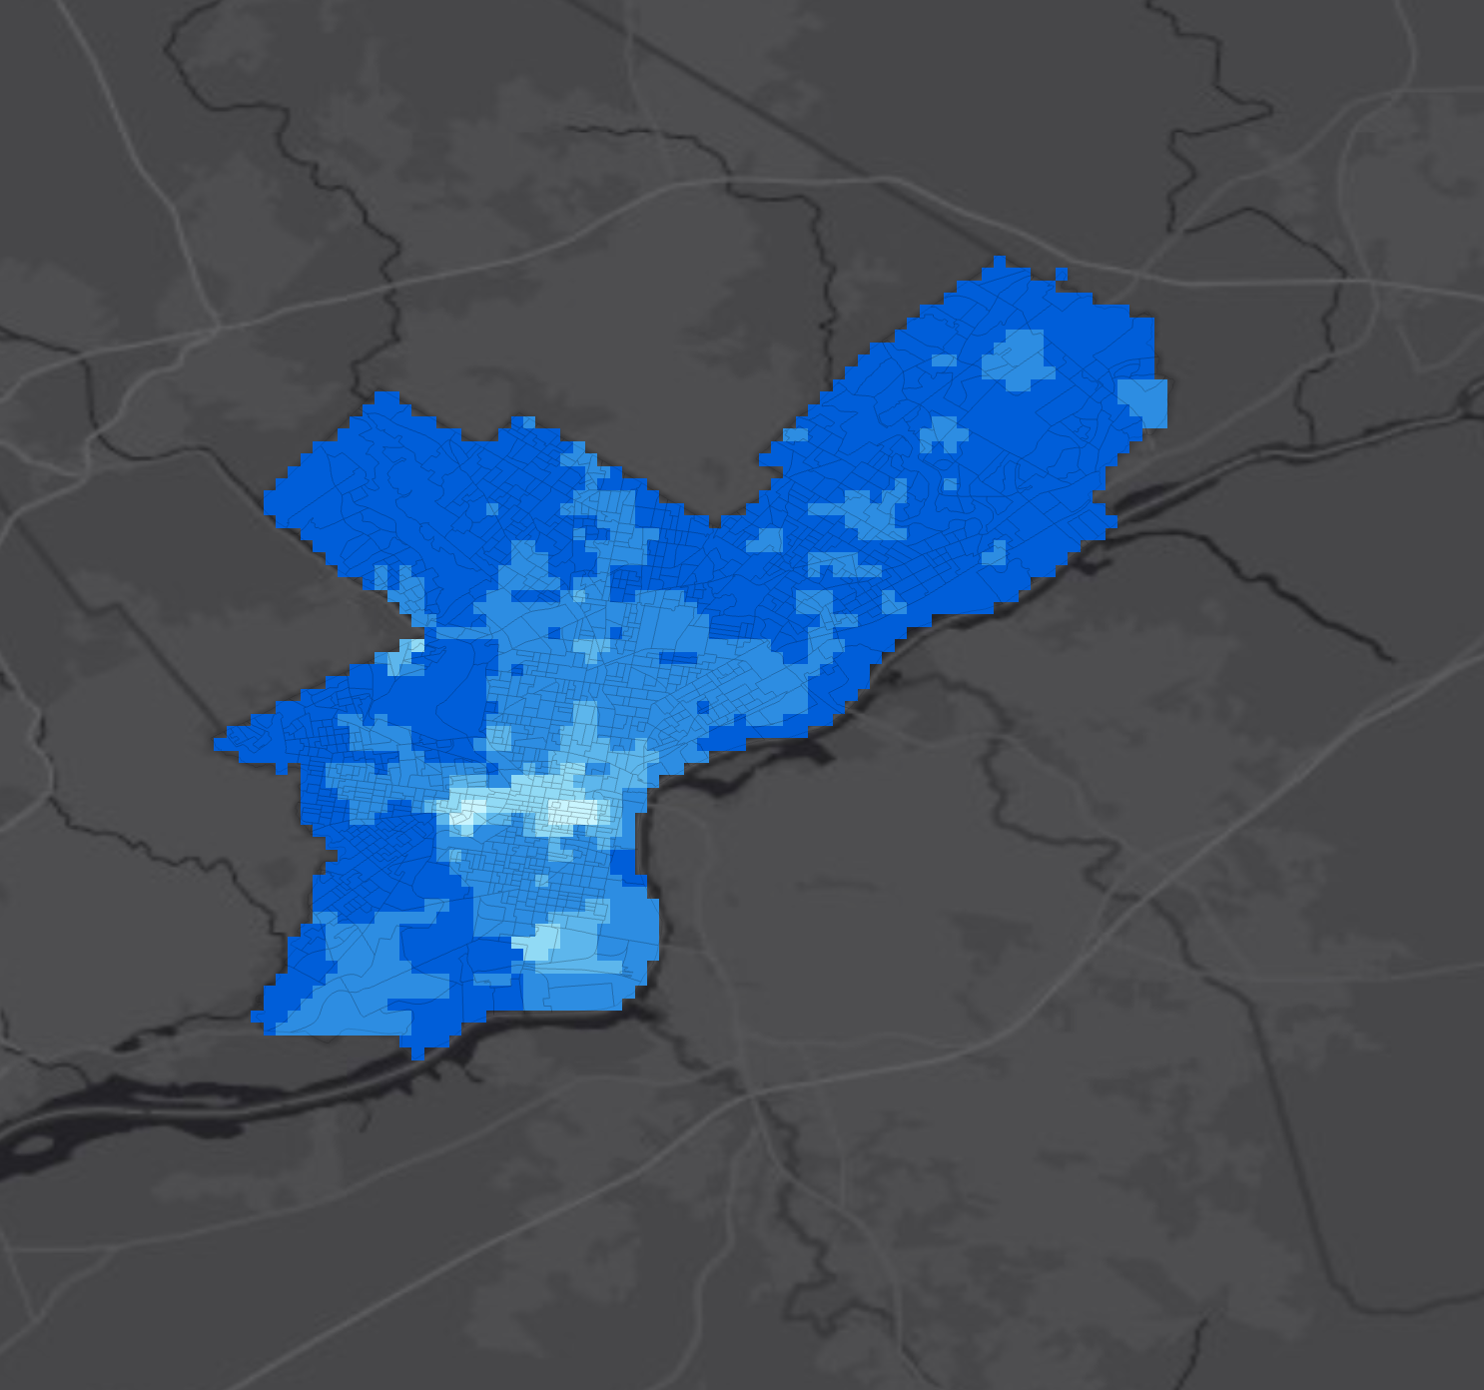
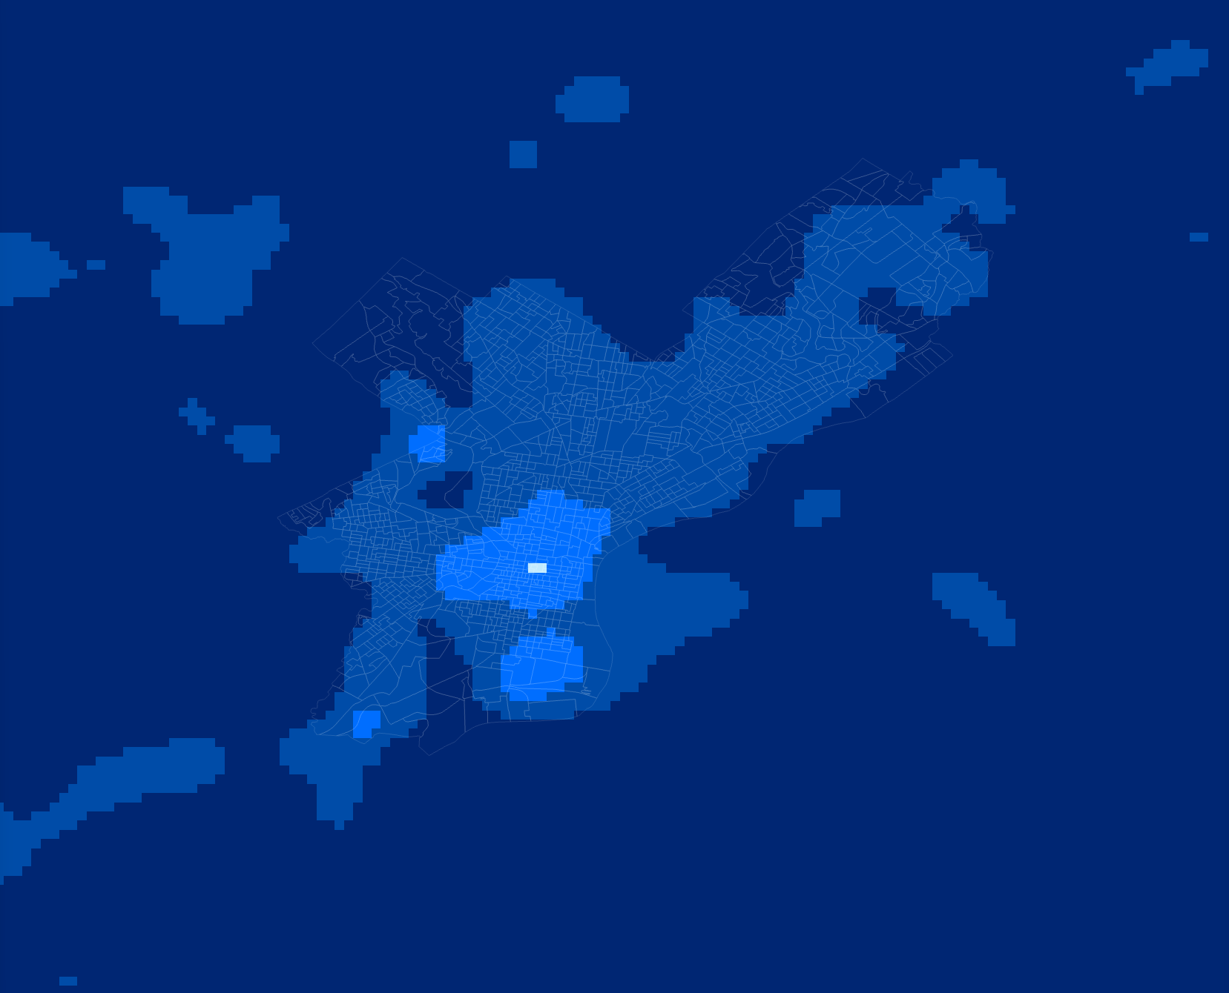
Neighborhood Analysis
Zonal_VIIRS_Mean
VIIRSFocalMean
Zonal Statistics tool calculated mean VIIRS radiance within each block group boundary. This aggregates satellite pixel values to census geography for statistical comparison.
Focal Statistics with circular neighborhood window smooths brightness values to reveal spatial patterns. Center City shows highest brightness; peripheral neighborhoods significantly darker.
Key Finding: Center City is brightest; peripheral neighborhoods show significantly lower lighting levels

Slide 9
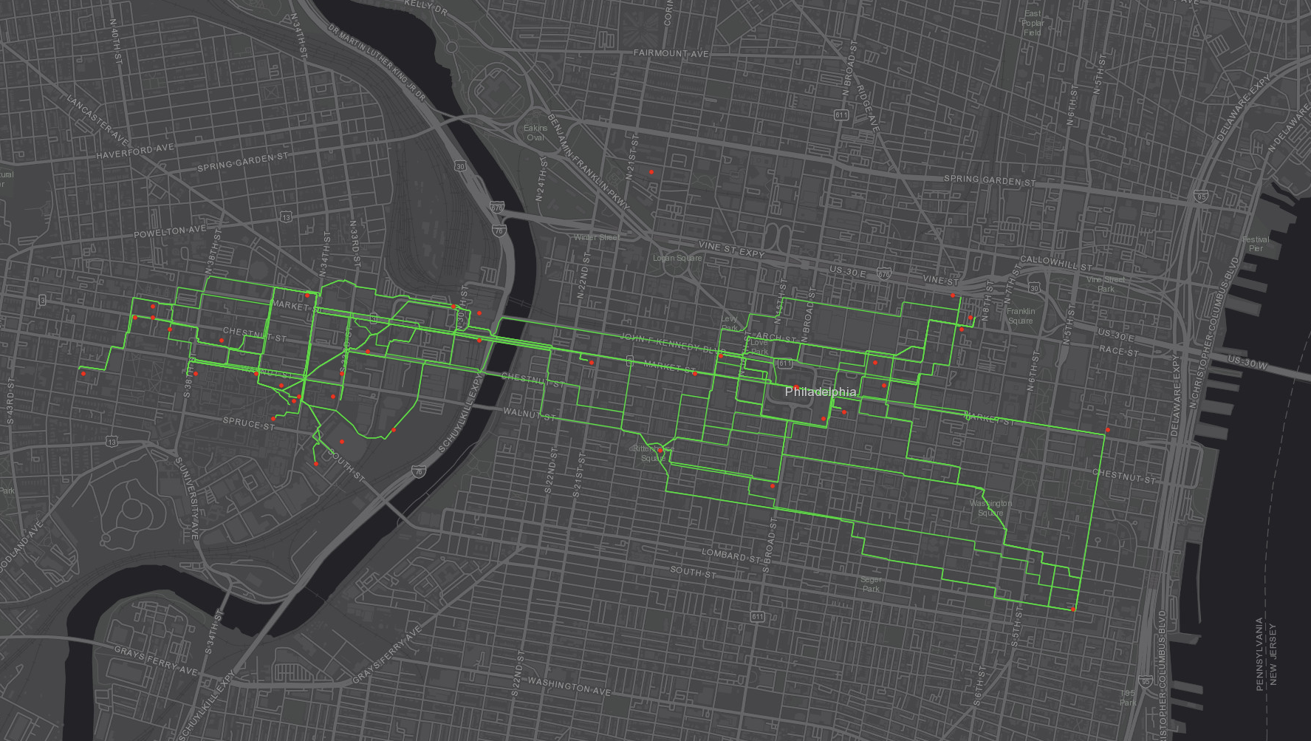
Safe Path Analysis
Finding Safer Alternatives
TRADE-OFF
+1-3% Distance
= Up to 20% Safer
ROUTE COMPARISON
52 routes analyzed between key Philadelphia locations: City Hall, Temple University, 30th Street Station, University City, Chinatown, and major transit hubs.
Methods:ArcGIS: Distance Accumulation + Optimal Path
Python: OSMnx + NetworkX for 52 street-level routes with risk-weighted edges
Distance Accumulation + Optimal Path
ArcGIS Distance Accumulation calculated cost-distance surface from City Hall. Optimal Path tool generated lowest-cost route to Temple. However, raster-based paths cut through buildings, so Python OSMnx was used for realistic street network routing with 52 origin-destination pairs.
Chinatown route shows greatest risk reduction

Slide 10
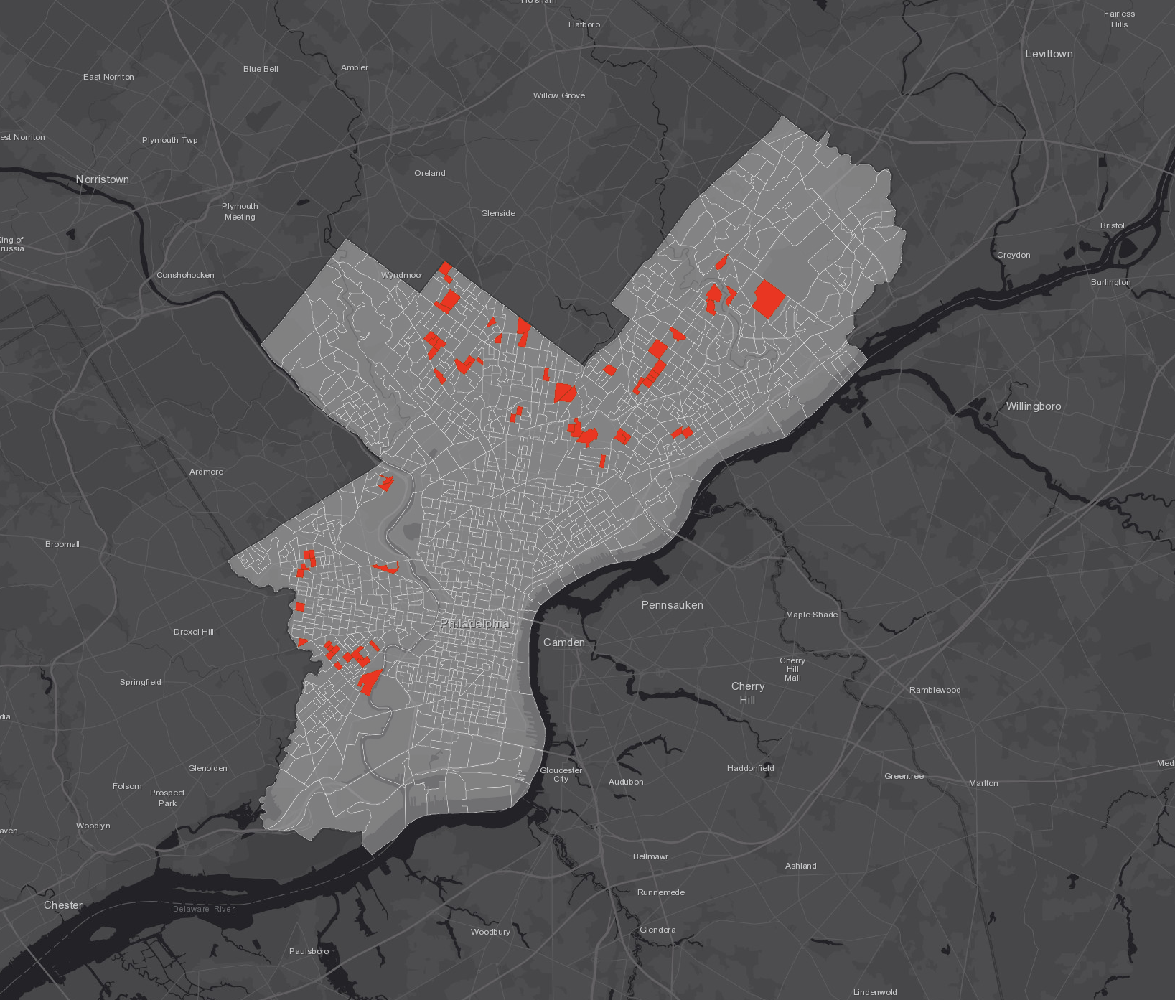

Key Finding: Complaint Gap
62
Underserved Areas Identified
GAP AREA CHARACTERISTICS
Three criteria overlap: Low brightness (VIIRS), Low complaints (311), Low income (Census). Identified with Python spatial analysis on Zonal_VIIRS_Mean output.
Gap vs Non-Gap Comparison:
Gap areas: 38% lower income, 65% darker, 76% fewer complaints than city average.
Gap Areas Non-Gap
Avg Income $42,800 $67,200
Avg VIIRS 0.31 0.89
311 Complaints/km² 2.1 8.7
complaint_gap_areas.shp
These areas need PROACTIVE intervention
62 Complaint Gap areas identified where three conditions overlap:
objectively dark (low VIIRS brightness), low 311 complaint rates,
and below-median household income. These underserved communities need proactive maintenance rather than reactive complaint-based service.
Our data shows a paradox: the darkest areas file 76% fewer complaints. These are also the lowest-income neighborhoods. This means the 311 system systematically misses the communities that need help most.

Slide 11
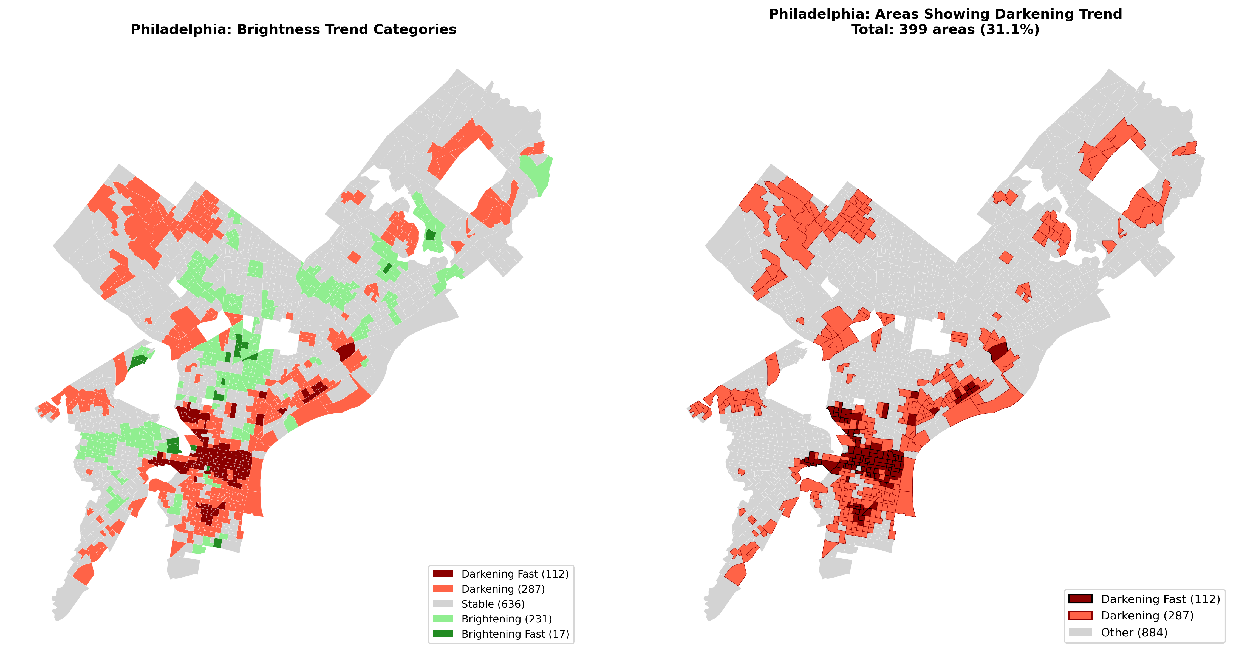
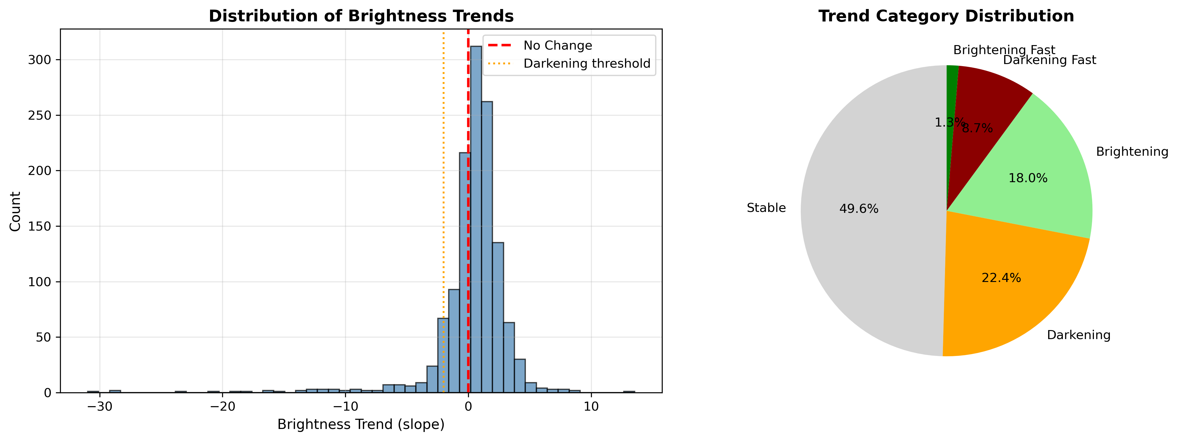
Temporal Trend Analysis
399
31.1%
Areas Showing
Darkening Trend
of Philadelphia
Darkening
TREND ANALYSIS
Linear Regression Slope
2022-2024 VIIRS Data
scipy.stats (Python)
geopandas for spatial analysis
Trend Categories
- Darkening Fast: 112 (8.7%) - Darkening: 287 (22.4%)
- Stable: 636 (49.6%) - Brightening: 248 (19.3%)
Philadelphia lighting is declining citywide
Temporal trend analysis using linear regression on VIIRS data (2022-2024) identified 399 block groups showing declining brightness. 31.1% of Philadelphia block groups are experiencing darkening trends. Priority intervention needed for areas with fastest decline.

Slide 12
Policy Recommendations
399 areas showing darkening trend.
31% of Philadelphia experiencing decline. Act before failure.
Philadelphia's 1970s streetlights are reaching end-of-life. Our 2022-2024 analysis captures peak infrastructure decline — just before the $91M LED project (Aug 2023). With research showing lighting improvements reduce crime by 21%, proactive monitoring is essential.
REACTIVE
→
PROACTIVE
Wait for complaints
Satellite-driven
Priority Areas
Satellite Monitoring
Equity Dashboard
Predictive Maintenance
Focus maintenance on the 62 Complaint Gap areas first — these communities are underserved.
Use VIIRS data to supplement 311 system — don't rely solely on complaints.
Build a monitoring dashboard tracking lighting equity across neighborhoods.
Deploy resources to 399 darkening darkening areas before they fail.

Slide 13

Conclusion
This analysis reveals systemic lighting inequality in Philadelphia. Communities that need light the most are least likely to report problems — creating a gap that perpetuates inequity.
KEY NUMBERS
62 Complaint Gap areas
399 Areas darkening (31.1%)
112 Darkening Fast
287 Darkening
LIMITATIONS
- VIIRS resolution (500m) may miss localized outages
- 311 data reflects reporting behavior, not actual conditions
- Cross-sectional analysis; causation not established
FUTURE WORK
- Integrate real-time 311 monitoring
- Field validation of Gap areas
- Expand to other cities

