Slide 1
WRF

Slide 2
Function of Each WPS Program
geogrid defines model domains and interpolates static geographical data to the grids;
ungrib extracts meteorological fields from GRIB-formatted files;
metgrid horizontally interpolates the meteorological fields extracted by ungrib to the model grids defined by geogrid.
Notes:
WRF 前处理系统（WPS）是一个由三个程序组成的模块，这三个程序的作用是为真实数据模拟准备输入场。三个程序的各自用途为：geogrid确定模式区域并把静态地形数据插值到格点；ungrib从GRIB格式的数据中提取气象要素场；metgird则是把提取出的气象要素场水平插值到由geogrid确定的 网格点上。

Slide 3
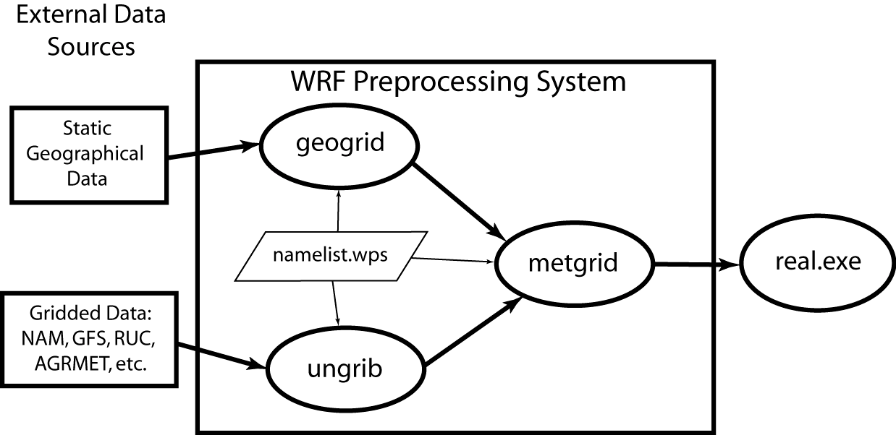
WPS(WRF Preprocessing System)

Slide 4
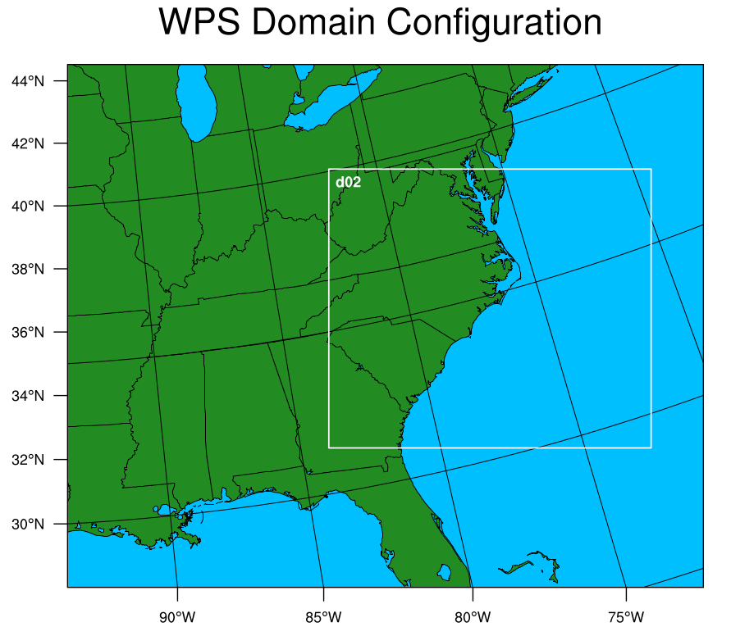
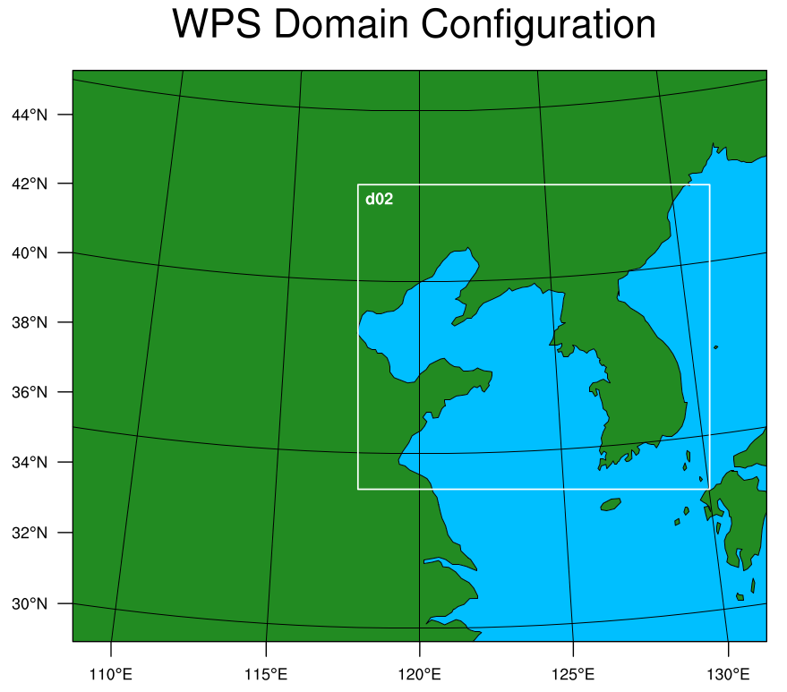
Graphics:NCL(NCAR Command Language)

Slide 5
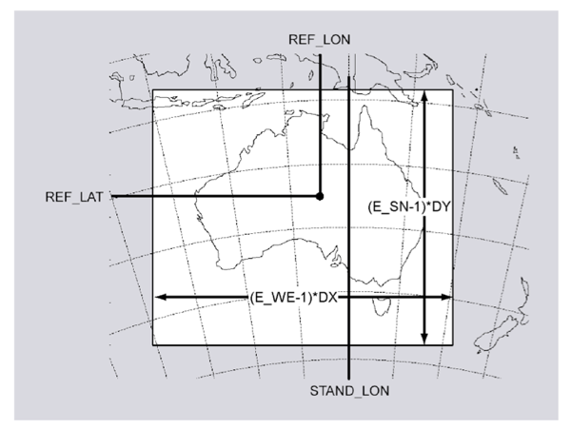

Slide 6
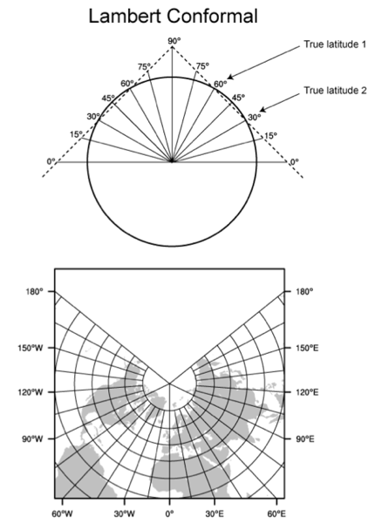

Slide 7
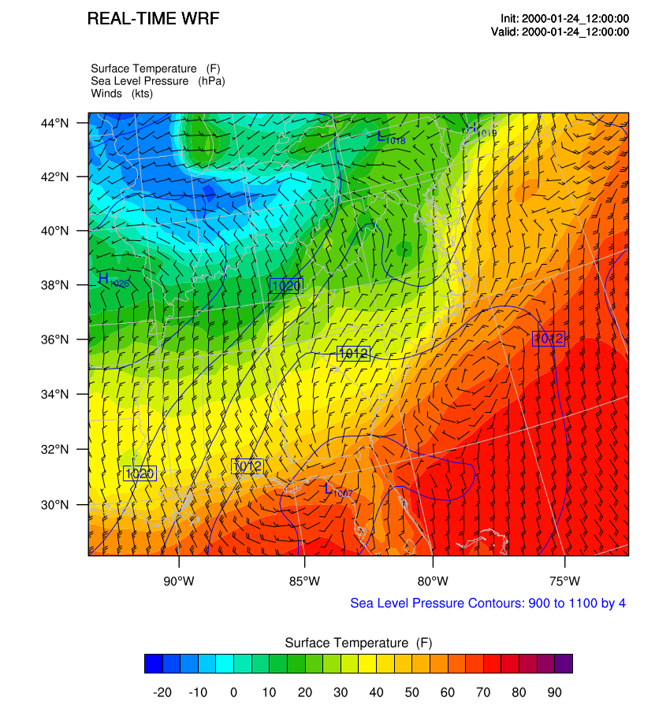

Slide 8
WRF configuration file—namelist.input
a list of runtime options for WRF to read in during its execution
As a general rule:
Multiple columns: domain dependent
Single column: value valid for all domains

Slide 9
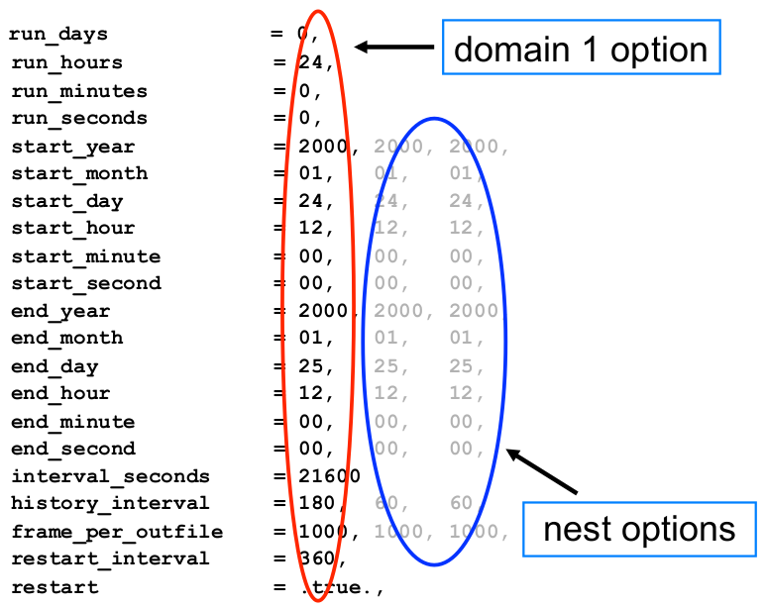

Slide 10
run_* time
Model simulation length
start_* and end_* time
start and end of simulation times
time_step, time_step_fract_num, time_step_frac_den
Time step for model integration in seconds
e_we, e_sn, e_vert
Model grid dimensions (staggered) in X, Y and Z directions
dx, dy
grid distances in meters

Slide 11
nio_tasks_per_group
the number of processors used for IO
typically 1 or 2 processors should be sufficient
tile_sz_x,tile_sz_y
number of points in tile x,y direction (openMP only)
nproc_x,nproc_y
number of processors in x for decomposition (MPI only)

Slide 12
WRF output
If you have run the model using MPI, you will have a number of rsl.out.* and rsl.error.* files
Otherwise, if you use OpenMP or serial version, the output will be printed on the screen.

Slide 13
restart run
A restart run is a continuation of a model run
wrfrst_d01_2000-01-25_00:00:00
Set restart = .true.

Slide 14
WRF crashed
"forrtl: severe (174): SIGSEGV, segmentation fault occurred"
Because stack size is not large enough to run the specific configuration
ulimit -s unlimited
to obtain more stack size

Slide 15
Benchmark
http://www2.mmm.ucar.edu/wrf/users/download/test_data.html
http://www2.mmm.ucar.edu/wrf/WG2/benchv3/

Slide 16
ncdump –h wrfout_d01_2005-08-28_00:00:00

